Slide 1
IoU, mAP

Slide 2
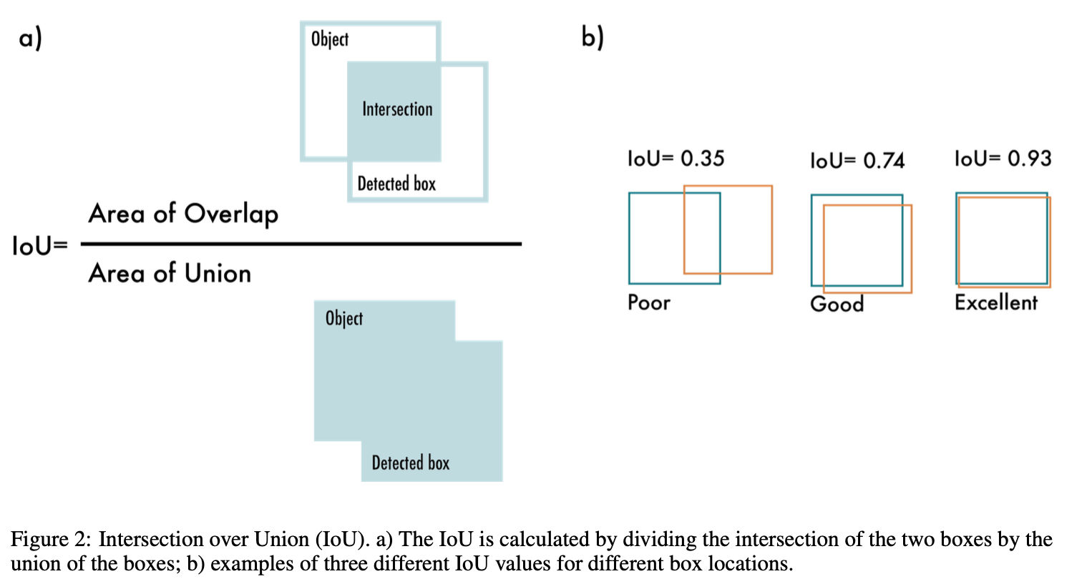
IoU
IoU (Intersection over Union) is a metric used to evaluate the accuracy of an object detection model by measuring the overlap between the predicted bounding box and the ground truth bounding box.
https://arxiv.org/abs/2304.00501

Slide 3
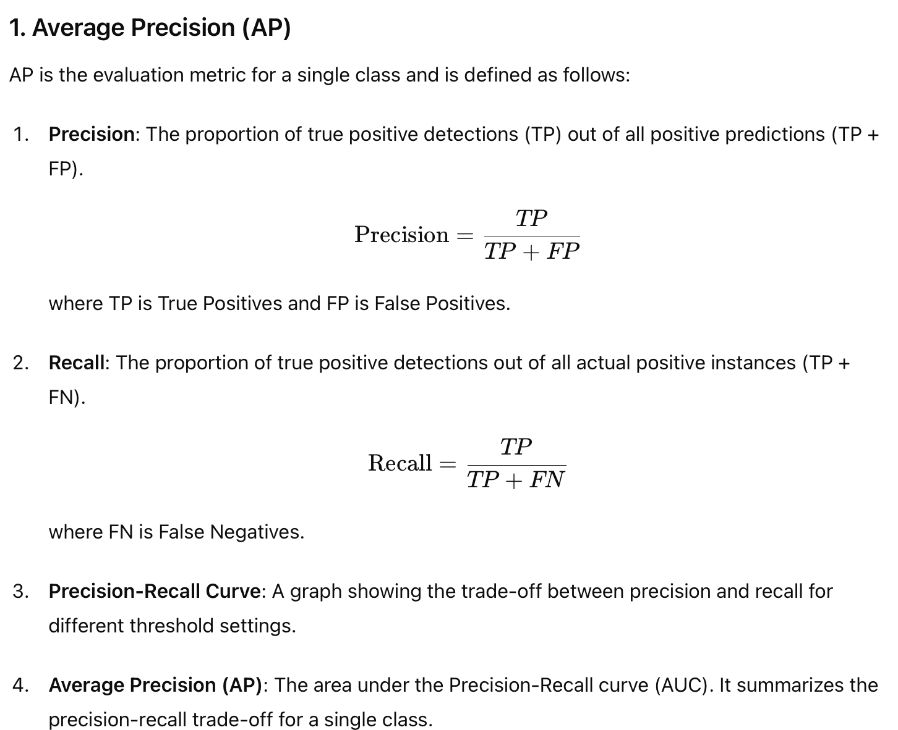
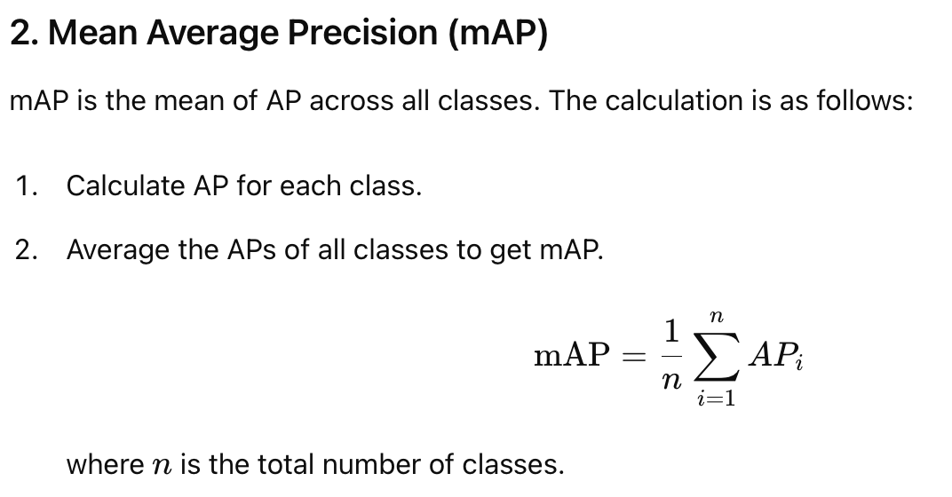
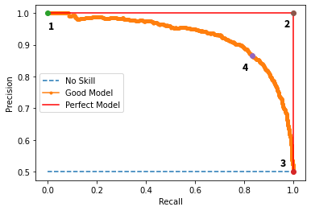
mAP
mAP (mean Average Precision) combines precision and recall to provide an overall measure of the model's accuracy.
https://analyticsindiamag.com/complete-guide-to-understanding-precision-and-recall-curves/

Slide 4
mAP@
mAP@0.5: mAP at an IoU threshold of 0.5. This means a detection is considered correct if the IoU between the predicted and ground truth boxes is greater than 0.5.
IoU >= 0.5 ➔ correct
mAP@0.5:0.95: The average mAP computed at IoU thresholds from 0.5 to 0.95, in increments of 0.05. This provides a more comprehensive evaluation of the model‘s performance.
IoU 從 0.5 到 0.95, 每 0.05 算一次AP

Slide 5
