Slide 1
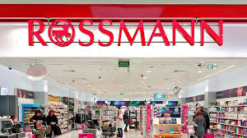
TEAM MEMBERS
Juan Bohorquez
Ethan Rosenberg
Jaime Villafuerte
Catherine Logan

Slide 2

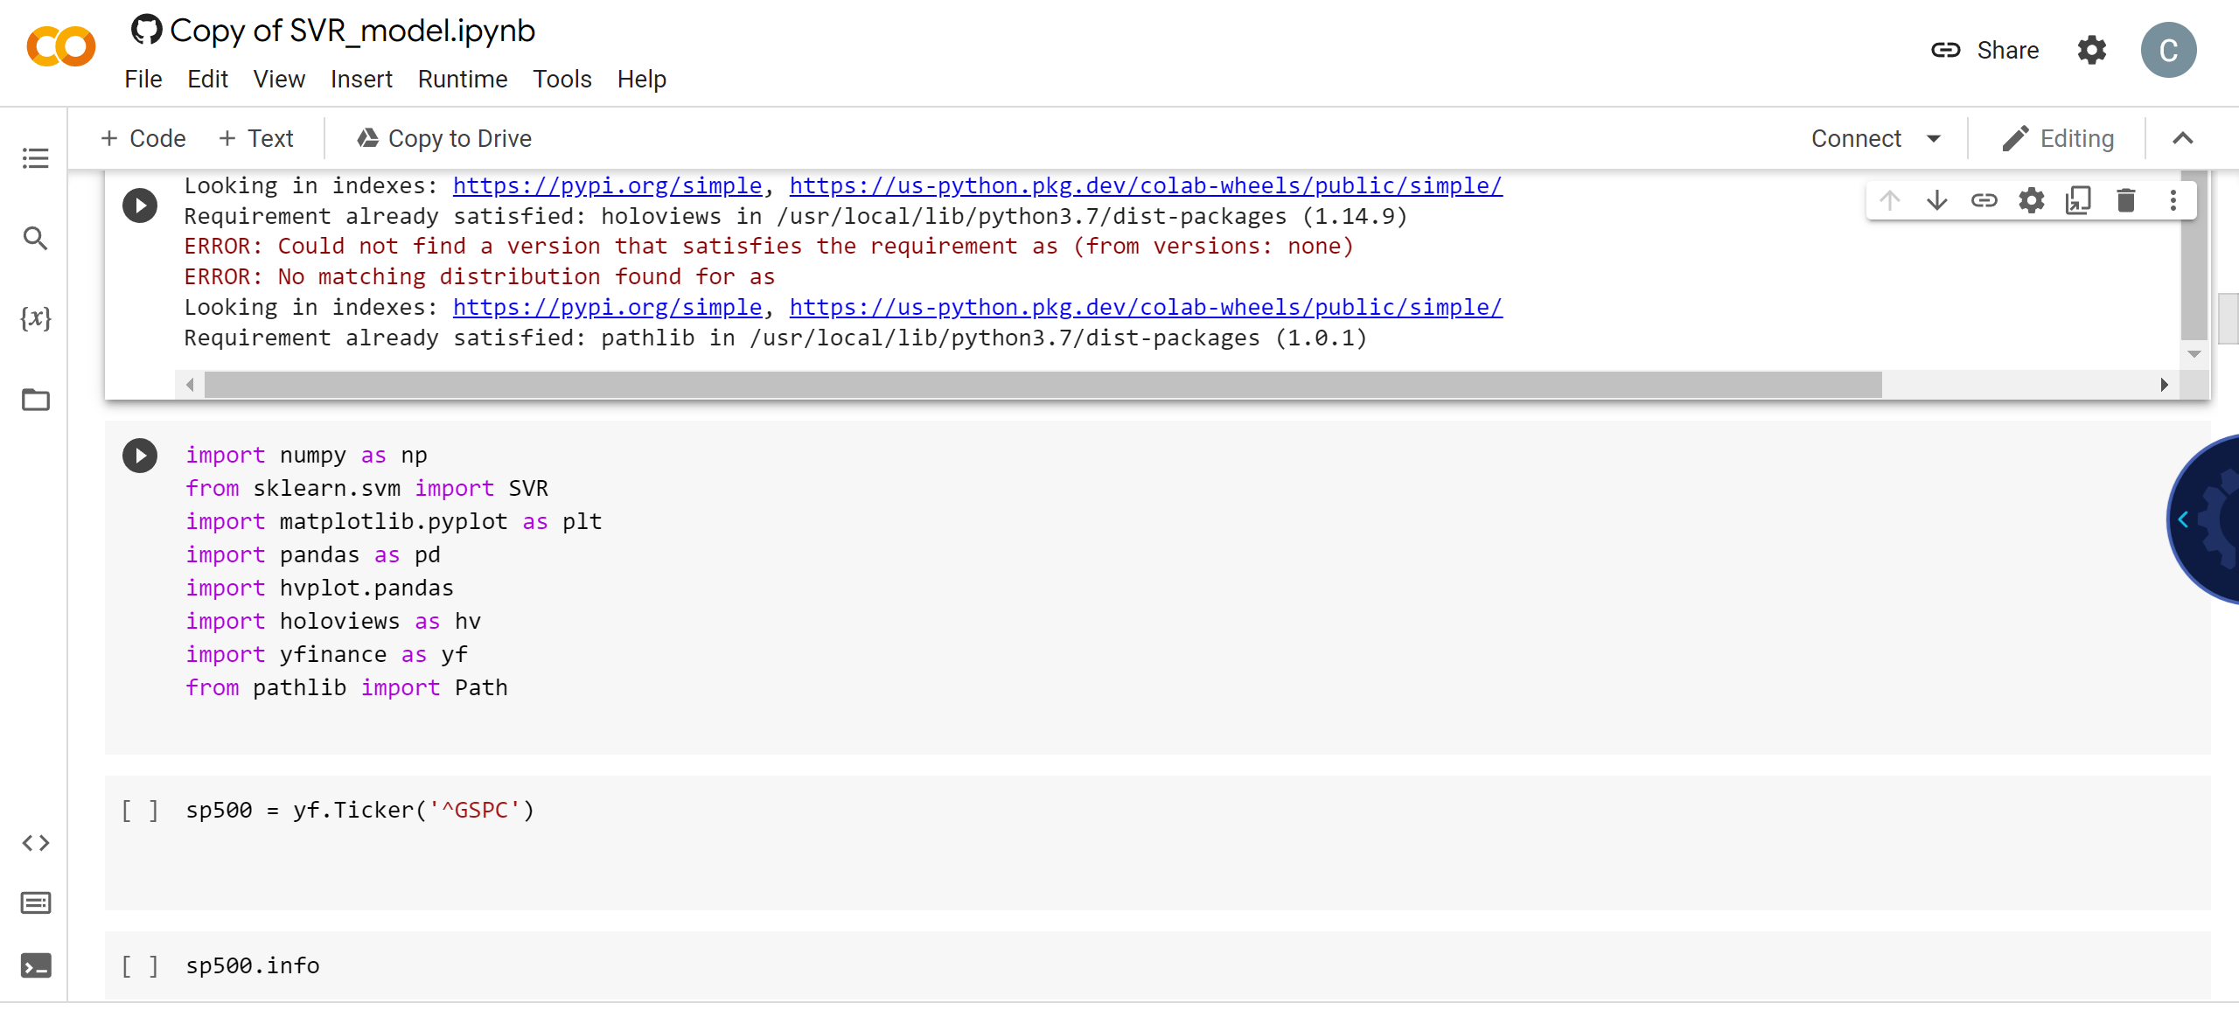
INITIAL PLAN

Slide 3
Project 2 Group 2
Rossmann operates over 3,000 drug stores in 7 European countries. Currently, Rossmann store managers are tasked with predicting their daily sales for up to six weeks in advance. Store sales are influenced by many factors, including promotions, competition, school and state holidays, seasonality, and locality. With thousands of individual managers predicting sales based on their unique circumstances, the accuracy of results can be quite varied.

Slide 4
DATA FIELD
You are provided with historical sales data for 1,115 Rossmann stores. The task is to forecast the "Sales" column for the test set. Note that some stores in the dataset were temporarily closed for refurbishment.
Files
train.csv - historical data including Sales
test.csv - historical data excluding Sales
sample_submission.csv - a sample submission file in the correct format
store.csv - supplemental information about the stores
Data fields
Most of the fields are self-explanatory. The following are descriptions for those that aren't.
Id - an Id that represents a (Store, Date) duple within the test set
Store - a unique Id for each store
Sales - the turnover for any given day (this is what you are predicting)
Customers - the number of customers on a given day
Open - an indicator for whether the store was open: 0 = closed, 1 = open

Slide 5
DATA FIELD
StateHoliday - indicates a state holiday. Normally all stores, with few exceptions, are closed on state holidays. Note that all schools are closed on public holidays and weekends. a = public holiday, b = Easter holiday, c = Christmas, 0 = None
SchoolHoliday - indicates if the (Store, Date) was affected by the closure of public schools
StoreType - differentiates between 4 different store models: a, b, c, d
Assortment - describes an assortment level: a = basic, b = extra, c = extended
CompetitionDistance - distance in meters to the nearest competitor store
CompetitionOpenSince[Month/Year] - gives the approximate year and month of the time the nearest competitor was opened
Promo - indicates whether a store is running a promo on that day
Promo2 - Promo2 is a continuing and consecutive promotion for some stores: 0 = store is not participating, 1 = store is participating
Promo2Since[Year/Week] - describes the year and calendar week when the store started participating in Promo2
PromoInterval - describes the consecutive intervals Promo2 is started, naming the months the promotion is started anew. E.g. "Feb,May,Aug,Nov" means each round starts in February, May, August, November of any given year for that store

Slide 6
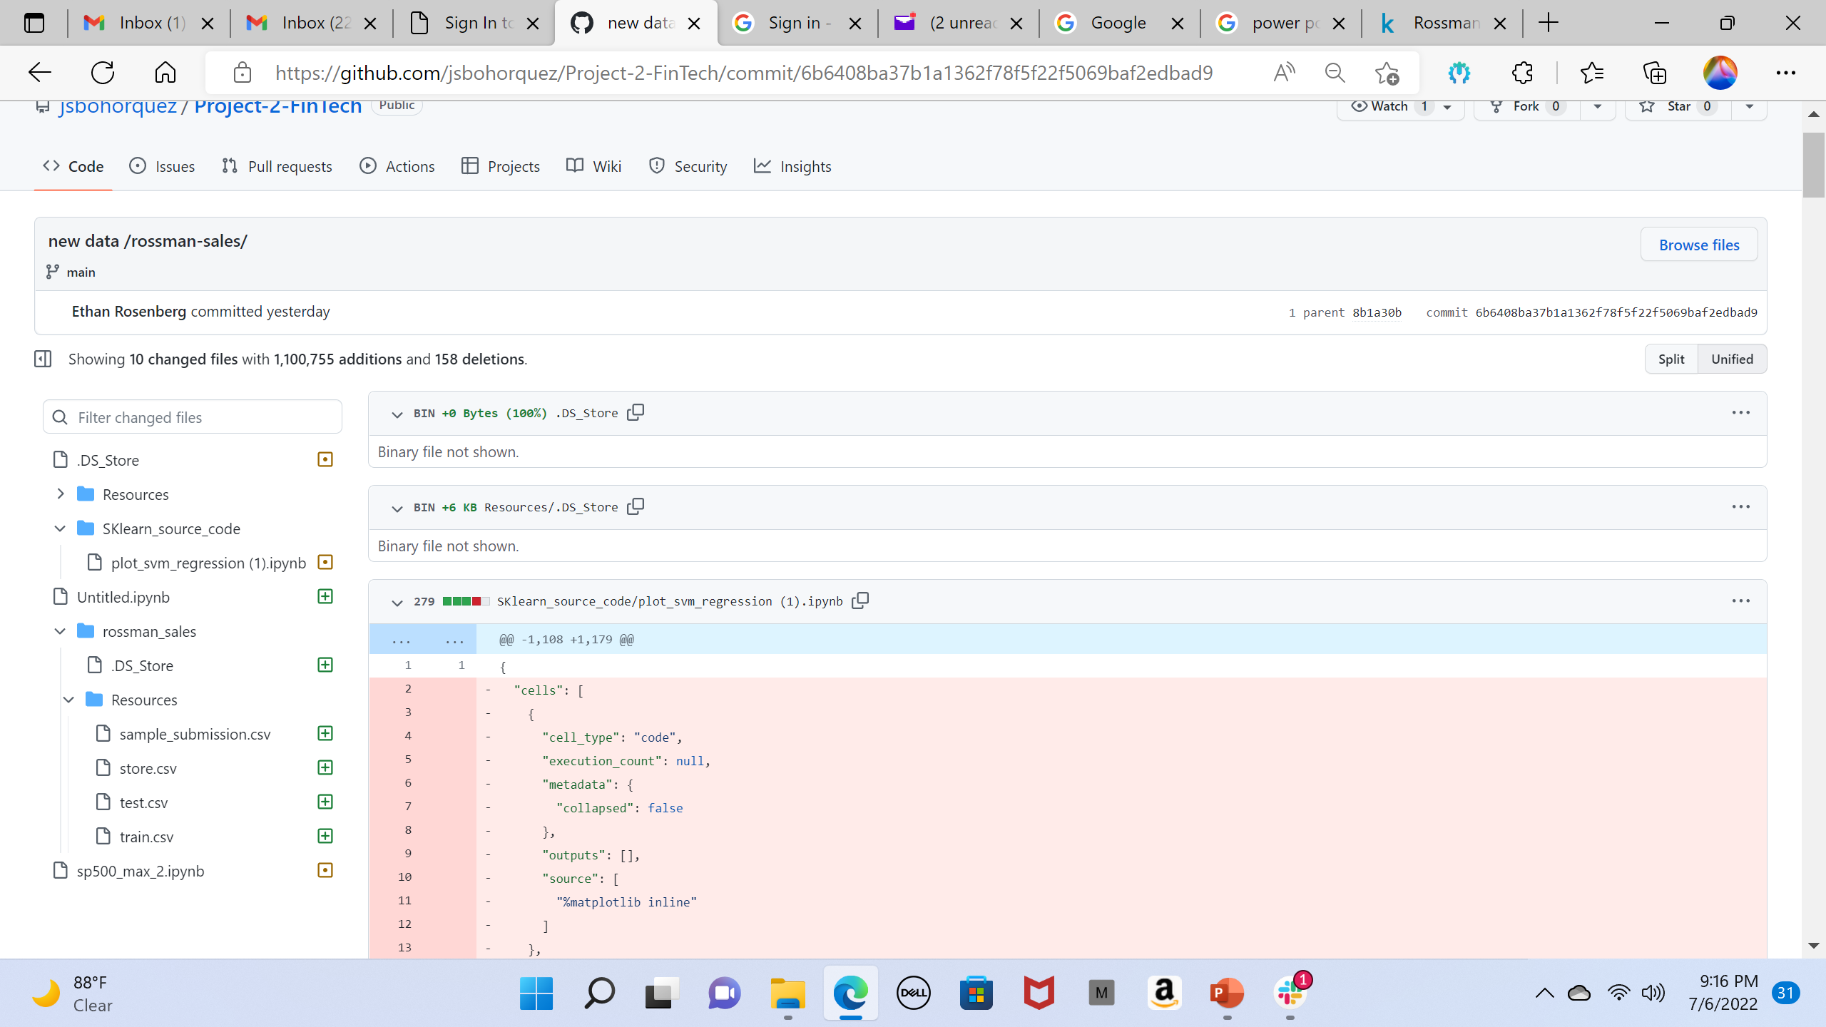
GitHub

Slide 7
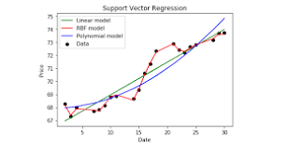
Support Vector Regression (SVR)
Support Vector Regression (SVR) using linear and non-linear kernels
Support Vector Regression is a supervised learning algorithm that is used to predict discrete values. Support Vector Regression uses the same principle as the SVMs. The basic idea behind SVR is to find the best fit line. In SVR, the best fit line is the hyperplane that has the maximum number of points.

