Slide 1
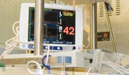
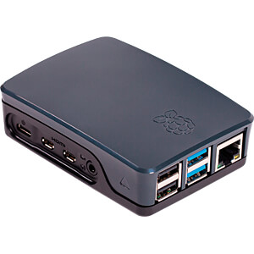

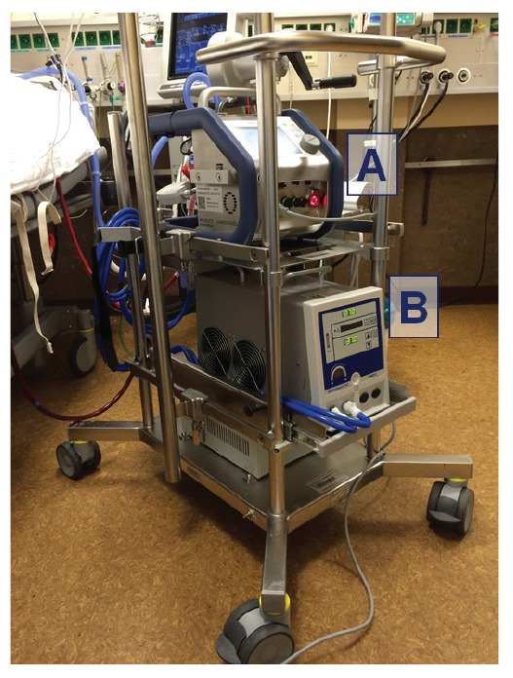

Room 1
Monitoring
Raspberry Pi + Mike
🎙
Displays (outside or in the rooms)
Smartphones
Smartphones
Room 2
Monitoring
Raspberry Pi + Mike
Streams the sounds
& sends alarms
Server
Dedicated smartphones
Smartphones
🎙
Smartphones
(a Raspberry Pi, in the corridor in front of the rooms)
Room 3
DECTs
Smartphones
Smartphones
ECMO
Raspberry Pi + Mike
Pictures: sickkids.ca, creazilla.com
🎙
FFMPEG, VLC, …
RTSP
BLE, Wifi
own network, separated from hospital network
SIP, Asterisk, Ethernet …
Goes through hospital network
github.com/ccloquet/icu-babyphone
2020-11-01

