Slide 1
Simulation of 2D Ising Model
C H Chaitanya
Angad Singh Gill

Slide 2
Ferromagnetic
Ferromagnetism is the phenomenon by which materials, such as iron, in an external magnetic field become magnetized and remain magnetized after the material is no longer in the field.

Slide 3
Paramagnetism
Paramagnetism is a form of magnetism which occurs only in the presence of an externally applied magnetic field.
However, unlike ferromagnets which are also attracted to magnetic fields, paramagnets do not retain any magnetisation in the absence of an externally applied magnetic field.
Notes:
Paramagnetic materials are attracted to magnetic fields, hence have a relative magnetic permeability greater than one (or, equivalently, a positive magnetic susceptibility).

Slide 4
Phase Transition
phase transition or phase change is the transformation of a thermodynamic system from one phase to another.
The distinguishing characteristic of a phase transition is an abrupt sudden change in one or more physical properties, in particular the heat capacity.

Slide 5
Phase Transition
An example can be the transition between the ferromagnetic and paramagnetic phases of magnetic materials at the Curie point.

Slide 6
Modern classification of phase transitions
first-order phase transitions
second-order phase transitions

Slide 7
Modern classification of phase transitions
The first-order phase transitions are those that involve a latent heat. During such a transition, a system either absorbs or releases a fixed (and typically large) amount of energy.
Notes:
Mixed-phase systems are difficult to study, because their dynamics are violent and hard to control.
However, many important phase transitions fall in this category, including the solid/liquid/gas transitions

Slide 8
Modern classification of phase transitions
The second class of phase transitions are the continuous phase transitions, also called second-order phase transitions. These have no associated latent heat.
Examples of second-order phase transitions are the ferromagnetic -paramagnetic transition.

Slide 9
Properties of phase transitions
In a system there exists a point known as the critical point, at which the phase transition becomes a second-order transition.

Slide 10
Critical exponents and universality classes
Continuous phase transitions are easier to study than first-order transitions due to the absence of latent heat, and they have been discovered to have many interesting properties.
The phenomena associated with continuous phase transitions are called critical phenomena, due to their association with critical points.

Slide 11
Critical exponents and universality classes
phase transitions can be characterized by parameters known as critical exponents.

Slide 12
Heat Capacity near Tc
The behavior of the heat capacity near a transition. We vary the temperature T of the system while keeping all the other thermodynamic variables fixed, and find that the transition occurs at some critical temperature T_{c} , When T is near T_{c} , the heat capacity C typically has a power law behaviour

Slide 13
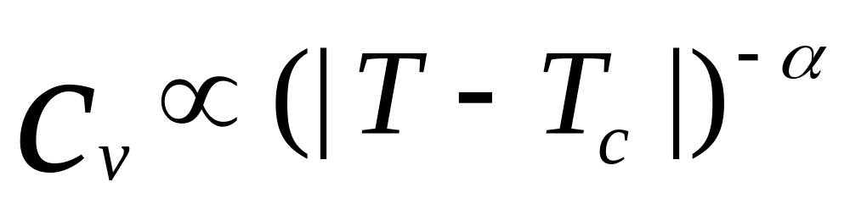

Is found equal to 0
(2D Ising model)
Notes:
Write the formuola for cv

Slide 14
Ising Model
The Ising model, named after the physicist Ernst Ising, is a mathematical model in statistical mechanics.
It can be represented on a graph where its configuration space is the set of all possible assignments of +1 or −1 to each lattice point of the graph.

Slide 15
Ising Model
The graph can exhibit periodic boundary conditions or free space boundary conditions depending on the system being modeled.
To complete the model, a function, H({Si}) must be defined, giving the difference between the energy of the "bond" associated with the edge when the spins on both ends of the bond are opposite and the energy when they are aligned.

Slide 16
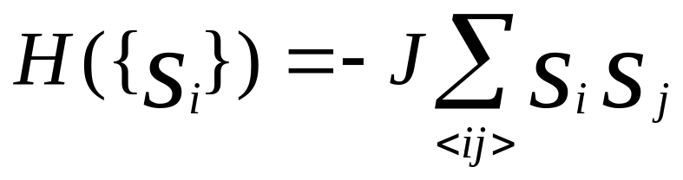
Ising energy
<i j> is nearest neighbor

Slide 17
Monte Carlo methods
Monte Carlo methods are a widely used class of computational algorithms for simulating the behavior of various physical and mathematical systems, and for other computations.
Because of the repetition of algorithms and the large number of calculations involved, Monte Carlo is a method suited to calculation using a computer, utilizing many techniques of computer simulation.

Slide 18
Monte Carlo algorithm
A Monte Carlo algorithm is often a numerical Monte Carlo method used to find solutions to mathematical problems (which may have many variables) that cannot easily be solved, for example, by integral calculus, or other numerical methods.
Notes:
To find the aprrox value of pi…
Choose 2 random numbers between 0 and 1 and if the root of the sum if the individual squares is less than 1 …..

Slide 19

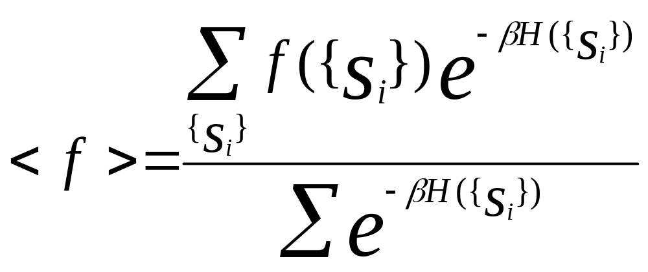
Monte Carlo algorithm
For example:
Value of
The following formula from statistical physics

Slide 20
Metropolis-Hastings algorithm
In mathematics and physics, the Metropolis-Hastings algorithm is a rejection sampling algorithm used to generate a sequence of samples from a probability distribution that is difficult to directly sample from.
Notes:
In mathematics, a Markov chain, named after Andrey Markov, is a discrete-time stochastic process with the Markov property.
A Markov chain is a series of states of a system that has the Markov property. At each time the system may have changed from the state it was in the moment before, or it may have stayed in the same state. The changes of state are called transitions.
Markov chain Monte Carlo (MCMC) methods (which include random walk Monte Carlo methods), are a class of algorithms for sampling from probability distributions based on constructing a Markov chain that has the desired distribution as its stationary distribution. The state of the chain after a large number of steps is then used as a sample from the desired distribution. The quality of the sample improves as a function of the number of steps.
A series with the Markov property is a sequence of states for which the conditional probability distribution of a state in the future can be deduced using only the current state; no additional information is given by the states the process was in, in the past. In other words, the past states carry no information about future states.
stochastic process has the Markov property if the conditional probability distribution of future states of the process, given the present state and all past states, depends only upon the present state and not on any past states, i.e. it is conditionally independent of the past states (the path of the process) given the present state. A process with the Markov property is usually called a Markov process, and may be described as Markovian.

Slide 21
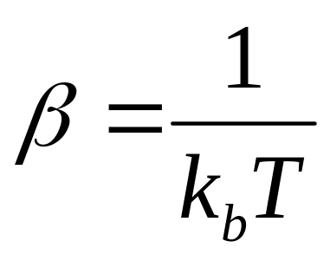
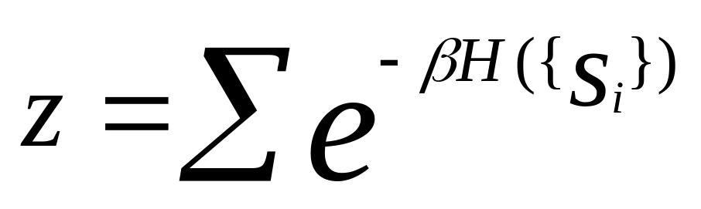
From statistical mechanics:
Where z is partition function (constant)
Notes:
In statistical mechanics, the partition function Z is an important quantity that encodes the statistical properties of a system in thermodynamic equilibrium. It is a function of temperature and other parameters, such as the volume enclosing a gas. Most of the thermodynamic variables of the system, such as the total energy, free energy, entropy, and pressure, can be expressed in terms of the partition function or its derivatives.
There are actually several different types of partition functions, each corresponding to different types of statistical ensemble (or, equivalently, different types of free energy.) The canonical partition function applies to a canonical ensemble, in which the system is allowed to exchange heat with the environment at fixed temperature, volume, and number of particles. The grand canonical partition function applies to a grand canonical ensemble, in which the system can exchange both heat and particles with the environment, at fixed temperature, volume, and chemical potential. Other types of partition functions can be defined for different circumstances.

Slide 22
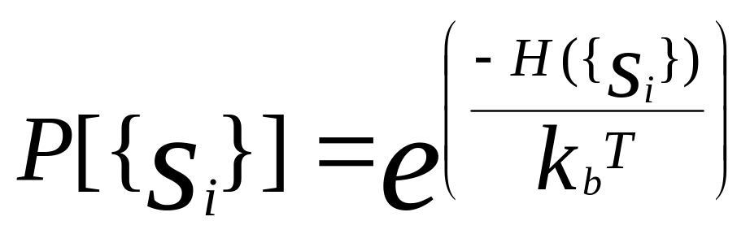
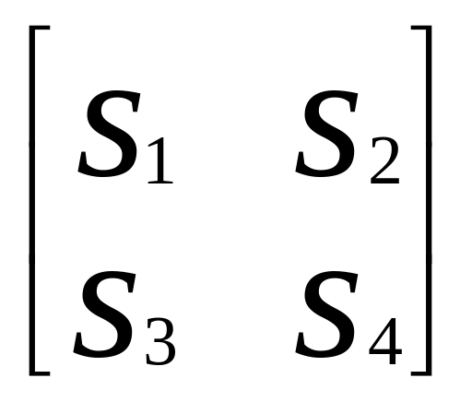
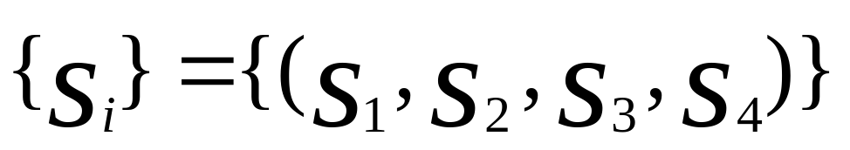
Ising energy
<i j> is nearest neighbor

Slide 23
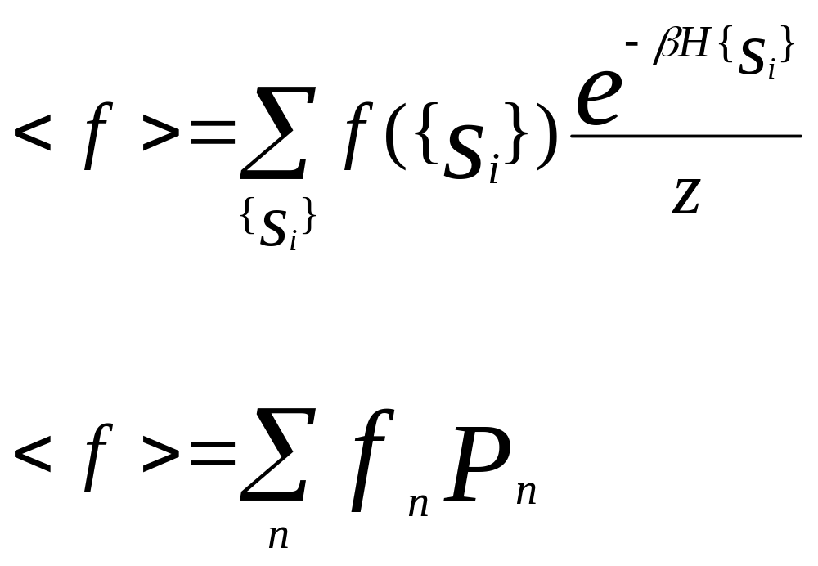
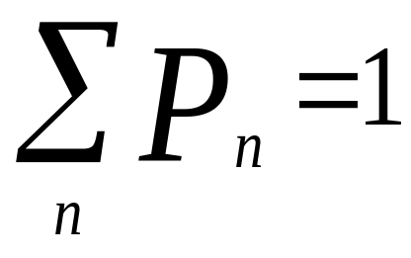
normalized

Slide 24
Plots

Slide 25
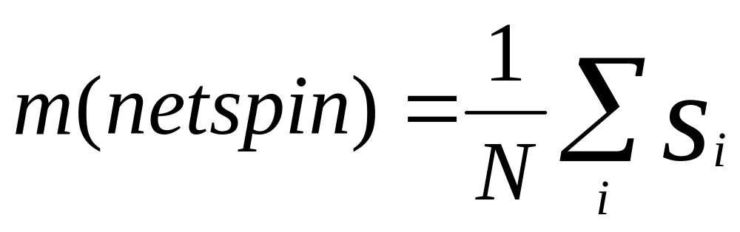
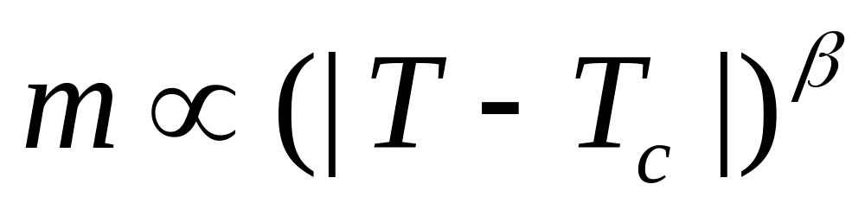
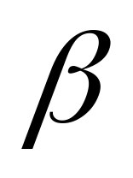
Is found to be equal to 1/8
(2D Ising model)

Slide 26
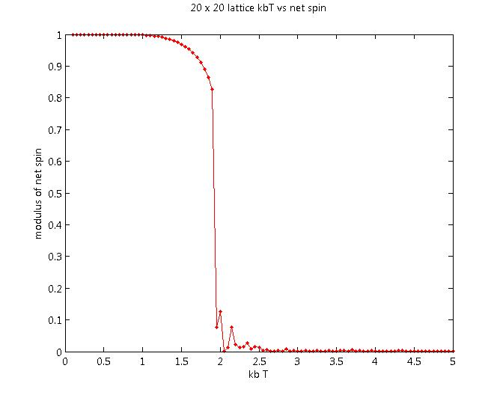

Notes:
Magnetization is defined as the amount of magnetic moment per unit volume. The origin of the magnetic moments that create the magnetization can be either microscopic electric currents corresponding to the motion of electrons in atoms, or the spin of the electrons.

Slide 27
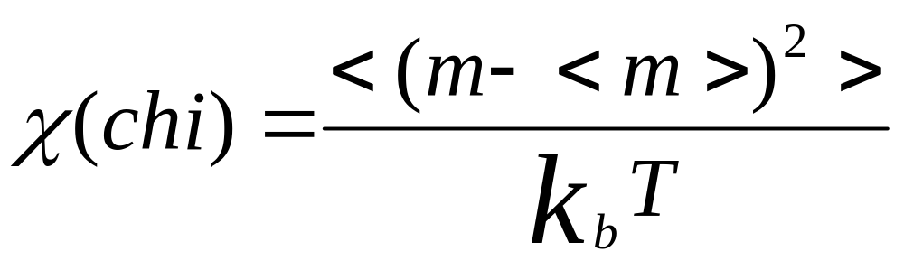
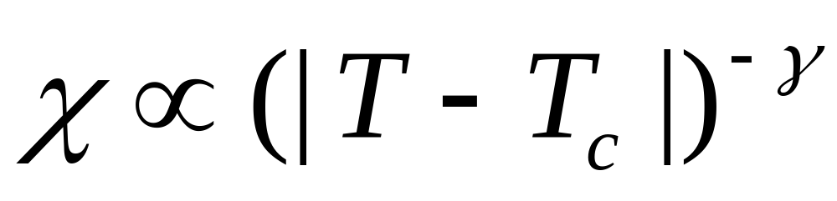

Is found equal to 7/4
(2D Ising model)
Notes:
In physics and electrical engineering, the magnetic susceptibility is the degree of magnetization of a material in response to an applied magnetic field. The dimensionless volume magnetic susceptibility, represented by the symbol (also represented in the literature by κ or Κ), is defined by the relationship
where
M is the magnetization of the material (the magnetic dipole moment per unit volume), measured in amperes per meter, and H is the applied field, also measured in amperes per meter.

Slide 28
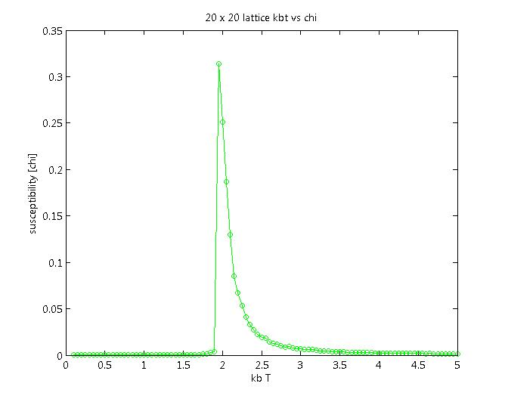

Slide 29
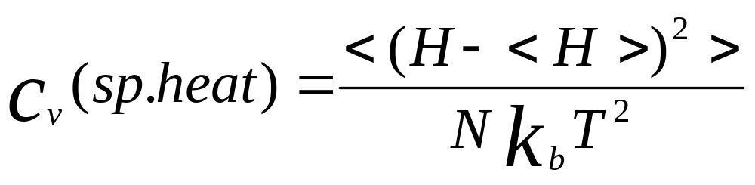
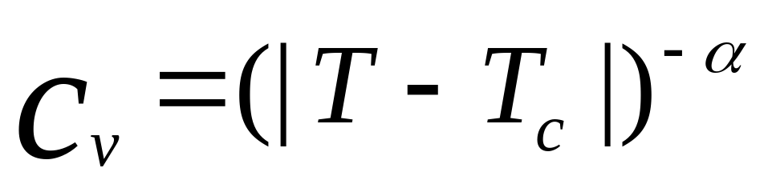
Is found equal to 0
(2D Ising model)

Slide 30
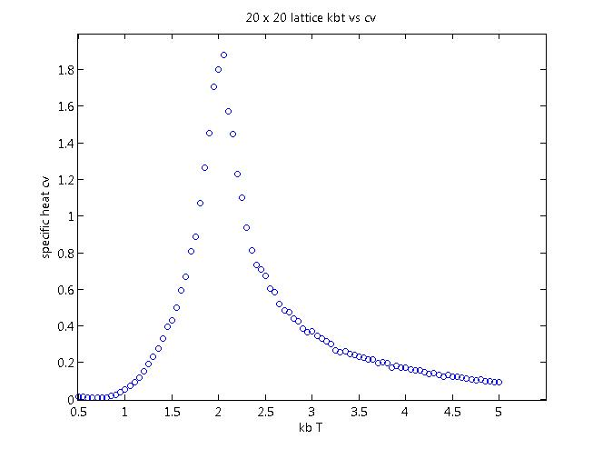

Slide 31
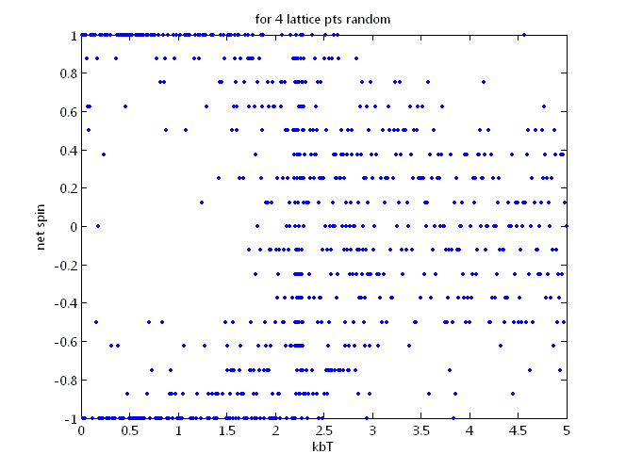
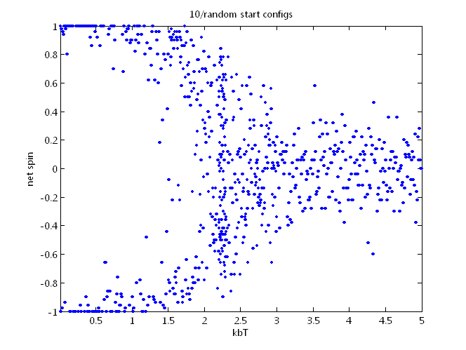
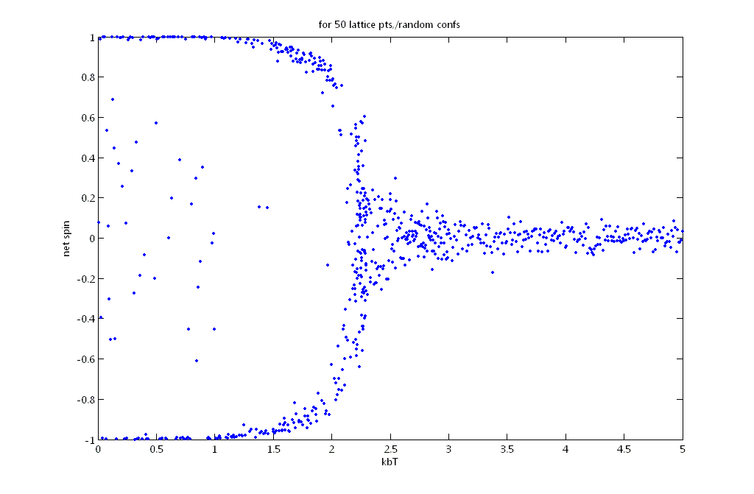

Slide 32
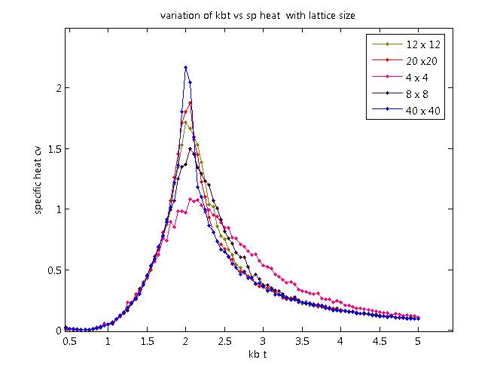

Slide 33
Metropolis Algorithm

Slide 34
Metropolis Montecarlo Algorithm
Start with a new config [n x n]
Compute the enrgy of this config [E1]
1)Do not accept the flip
2)Flip back to original config
3)Update the next flip point
Choose flip point, flip this lattice point [p,q]
no
1)Accept the flip
2)Update E1=E2
3)Update the next flip point to the next lattice point
Compute the energy after the flip [E2]
yes
Is r1 > r2
yes
no
Is E2 < E1
1)Compute r1=
exp(-∆E/(Kb T)
2)Generate a random number between 0 and1.[=r2]

Slide 35
Further
Study and Simulation of 3state potts model
[spin variable takes not 2 values but 3]
Study and simulation of x-y model.
[spin variable can now take any value in the x y plane]

Slide 36
Reference
www.en.wikipedia.org
Statistical mechanics, Kerson Huang.
chapters
14:The Ising Model
16:Critical Phenomena
Phases of Quantum chromodynamics,
JB Kogut

Slide 37
Thank you

