Slide 1
INTELLECTUAL PROPERTY OVERVIEW
KRYLO
A structural review of the system's architecture and documentation record, prepared for attorney assessment.
August 2026
Notes:
Cover slide. Introduce KRYLO and the purpose of this review: an IP overview for attorney assessment.

Slide 2
01 — BACKGROUND
Founder Background & Why This Matters
Building Complex Systems Across Technology, Enterprise, and Creative Domains
—
20+ years delivering enterprise technology programs across engineering, infrastructure, digital platforms, and AI enablement.
CORE THEME
—
Autodesk / AutoCAD Engineering — engineering, build/release, and web systems foundation.
Building systems that transform complex information into actionable understanding.
—
Royal Caribbean Group/Celebrity Global Ecommerce — enterprise infrastructure modernization and global digital initiatives.
·
Program Manager for Next Generation Embarkation (NGE).
·
Large-scale digital and operational transformation.
—
AmEx / regulated enterprise environments — large-scale delivery, governance, and operational complexity.
—
Founder-led development approach combining technical execution, product strategy, and creative direction.
—
Filed first patent at 14 — retractable, submersible garden hose.
Notes:
Establish founder credibility: 20+ years across major enterprise programs, culminating in a founder-led approach that blends technical, product, and creative work.

Slide 3
02 — ORIGIN
The Origin of KRYLO
The Foundational Observation
Before events become visible, signals already exist.
A vibration. A pattern. A relationship. A change in state.
THE QUESTION
Can we build systems that recognize these signals, understand their relationships, and preserve the path from observation to understanding?
KRYLO began with that pursuit:
Not prediction. Not persuasion. Not recommendation.
Recognition of structure before it becomes obvious.
Notes:
Play the linked video in frame. This slide sets the philosophical premise before the technical detail: KRYLO started from the idea that signals precede visible events, and the pursuit was recognition of structure, not prediction.

Slide 4
03 — EVOLUTION
KRYLO Evolution
From Information Verification to Structural Intelligence
→
→
INITIAL FOCUS
REASONING ARCHITECTURE
CURRENT FOCUS
Understanding information reliability and evidence quality.
A staged reasoning pipeline, detailed on the next slide.
Detecting relationships, structures, and patterns across complex information environments.
CI-F → CI-R → RBCS → LFOS → IB → Decision → Execution → Feedback → Calibration
KEY PRINCIPLE
KRYLO is designed to preserve evidence, trace reasoning, and reduce unsupported conclusions.
Notes:
Walk through the three development phases of KRYLO, ending with the reasoning pipeline stages and the guiding principle around evidence and traceability.

Slide 5
04 — ARCHITECTURE
Reasoning Architecture
A staged reasoning architecture where each layer performs a distinct analytical function under defined constraints.
COMPONENT
DEFINITION
ROLE IN PIPELINE
CI-F
Causal Expansion System — expands an initial knowledge claim into candidate causal structures by traversing the knowledge store and identifying evidence-backed relationships.
Produces candidate causal graphs for validation.
Causal Inference Formation Engine
CI-R
Constitutional Validation Gate — performs binary validation of candidate causal structures against three immutable constraints: edge legality, temporal legality, and evidence-anchor coverage.
Rejects invalid branches before scoring.
Causal Inference Reality Validator
RBCS
Branch Scoring Engine — scores only branches admitted by CI-R using a weighted geometric model across five independent factors: temporal advantage, divergence, cross-domain coupling, amplification, and volatility.
Produces ranked candidate branches.
Reality Branch Convergence Score
LFOS
Propagation Physics Engine — models how validated branches propagate, compound, decay, or stabilize through the graph over time.
Adds survival probability and stability metrics.
Lifecycle Forecasting & Outcome Simulation
IB
Output Qualification Gate — applies final interpretation constraints: survival threshold filtering, ranking, and output limits.
Presents results to users.
Interpretation Boundary
Notes:
Define each pipeline layer in plain technical language for the attorneys, then show the flow from signal generation to operational decision.

Slide 6
05 — FOUNDATION
Current Technical Foundation
Evidence-Based Intelligence Architecture
Implementation status: CI-F, CI-R, and RBCS are implemented and confirmed executing against live production data as of August 2026 . LFOS, IB, Decision, Execution, Feedback, and Calibration are implemented as standalone code but not yet connected to the live system — built and correct, awaiting integration.
Multi-Stage Reasoning Pipeline
AS-DIFF
—
Independent processing stages with defined contracts.
—
Canonical comparison framework for heterogeneous information.
—
Separation of evidence generation, validation, reasoning, and decision processes.
—
Resolves objects into comparable structures before analysis.
—
Tracks unresolved comparison gaps for future refinement.
Formation Detection
Governance Discipline
—
Identifies higher-order structures from underlying signals.
—
Work-order driven development.
—
Supports recognition of patterns beyond individual data points.
—
Architectural changes traceable through specifications, implementation, defects, and validation.
Notes:
Cover the four confirmed implemented capabilities that form KRYLO's technical foundation today.

Slide 7
06 — TIMELINE
From Concept to Structural Intelligence
Development & Evolution Timeline
SPARK
→
SIGNAL
→
PERCEPTION
→
STRUCTURE
→
RELATIONSHIP
→
PROPAGATION
→
CONVERGENCE
→
STRUCTURAL INTELLIGENCE
PHASE
EVOLUTION
WHAT CHANGED
0. The Spark
Jurassic Park — water-glass observation
A disturbance becomes detectable before its source becomes visible
1993
1. Concept
Absence as signal / early as-diff concept
The physical-observation insight expands into the idea that absence and change are themselves informational signals; as-diff is the first identifiable artifact of that transition
2025
2. Foundation
Truth Engine / projection-not-prediction
Establishes the epistemic model: observe and represent, not manufacture predictions
2026
3. Perception
Signals → Lenses → Perception Surface
Creates the instrument layer for observing signals through different analytical perspectives
2026
4. Structure
Ontology + RKM + Evidence + Relationships
Converts observations into structured representations
TBD
5. Relationship
Structural relationships
Connects otherwise separate observations and entities
TBD
6. Propagation
LFOS / propagation
Models how structural effects move through connected systems
TBD
7. Convergence
Multi-source confirmation
Distinguishes isolated signals from meaningful structural change
2026
8. Domain Expansion
Capital / Operating / Market / Knowledge / Time / Ownership
Demonstrates application across materially different domains
2026
9. External Reality
EIA / FRED / EDGAR / OpenAlex / USASpending / FEC
Connects the structural model to external evidence
2026
10. Structural Intelligence
KRYLO
The accumulated system becomes a structural-intelligence platform
NOW
1993 is the spark; 2025 is the beginning of KRYLO as an intentional system. Timeline dates distinguish conceptual origin from subsequent system development and implementation.
Notes:
Show how KRYLO progressed from concept to structural intelligence engine — not as an engineering changelog, but as a capability evolution. Separate what's built, validated, and next-stage; this bridges the technical story into the IP and valuation conversation.

Slide 8
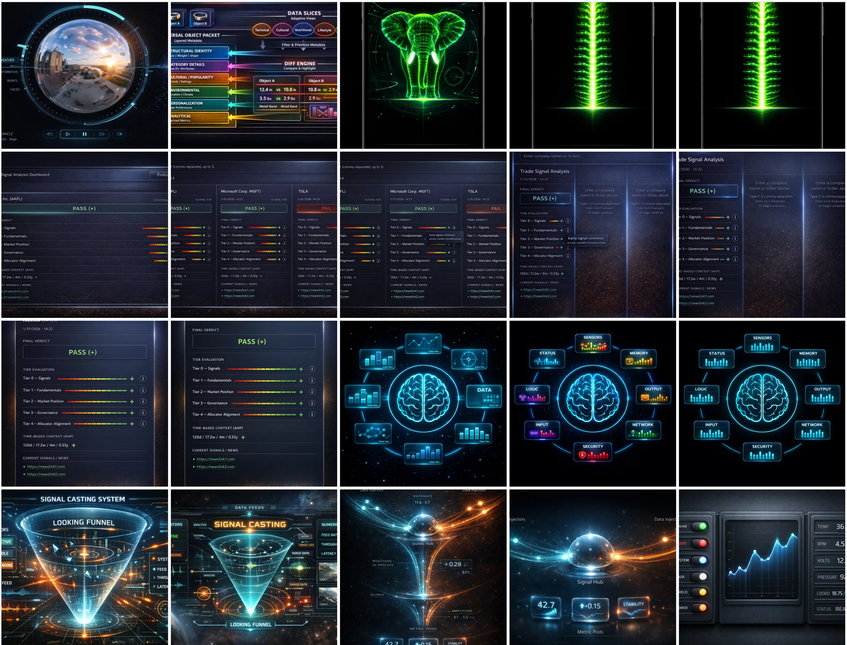
07 — PROTOTYPE LINEAGE
Prototype Lineage — From Analysis to Signal Structure
Early concepts and visual embodiments preceding the current KRYLO system
Early artifacts document multiple converging development threads: comparative/differential analysis (as-diff), signal evaluation, tiered evidence assessment, signal casting, focused perception, distributed inputs, and signal convergence.
These artifacts are presented as developmental evidence. They are not represented as the completed KRYLO architecture, and individual dates or causal relationships should not be inferred from the montage alone.
Notes:
Present the montage as developmental evidence of an evolving design vocabulary, not as the completed KRYLO architecture. Do not assign dates to individual panels or claim any panel is the first KRYLO prototype. Name as-diff explicitly as part of the analytical lineage.

Slide 9
08 — ASSESSMENT
Areas Identified for Attorney Assessment
The purpose of this review is not to assert protection, but to identify technical areas requiring professional evaluation.
1 Structural Reasoning & Traceability
2 Canonical Comparison Systems
POTENTIAL AREA OF REVIEW
POTENTIAL AREA OF REVIEW
—
Evidence-backed reasoning paths.
—
Comparison of heterogeneous entities through normalized representations.
—
Derived explanations generated from verified system state.
—
Preservation of lineage between evidence, reasoning, and resulting intelligence artifacts.
—
Resolution of relationships across different domains.
—
Handling of unresolved comparison gaps and refinement opportunities.
3 Decision Integrity Mechanisms
4 Knowledge Evolution Controls
POTENTIAL AREA OF REVIEW
POTENTIAL AREA OF REVIEW
—
Non-compensating scoring approaches.
—
Rules governing relationship admission.
—
Separation of validity qualification from downstream confidence scoring.
—
Qualification and escalation workflows.
—
Controlled evolution of structured knowledge representations.
—
Prevention of unsupported inputs being masked by stronger signals.
OBJECTIVE
Identify the appropriate protection strategy across patent, trade secret, copyright, and defensive documentation approaches.
Notes:
Frame this slide carefully: this is a starting point for attorney evaluation, not a claim of protection. Four candidate areas follow, each mapped to a potential area of review.

Slide 10
09 — RECORD
Documentation & Development Record
Engineering History and Traceability
MAINTAINED THROUGH
Every meaningful architectural change has a documented origin, rationale, implementation path, and validation record.
—
Technical design specifications
—
High/low-level architecture docs
—
Product requirement documents
—
Founder documentation
OBJECTIVE FOR IP REVIEW
Determine the strongest protection strategy across:
—
Investor materials
—
Jira / work-order history
—
Patent opportunities
—
Defect records
—
Implementation artifacts
—
Trade secrets
—
Copyrighted materials
—
Defensive documentation
Notes:
Close by establishing that KRYLO's development is thoroughly documented and traceable, and lay out the objective of the IP review: choosing among patents, trade secrets, copyright, and defensive documentation.

