Slide 1

Machine Learning
Auto Detection Fraud

Slide 2
Fraud Detection Project
Welcome to the **Fraud Detection Project**! This is a Flask-based web application designed to help you upload data, preprocess it, train a model, and make predictions for fraud detection specifically for auto insurance fraud detection using insuranceFraud.csv from kaggle. It's a beginner-friendly tool for exploring machine learning workflows.

Slide 3
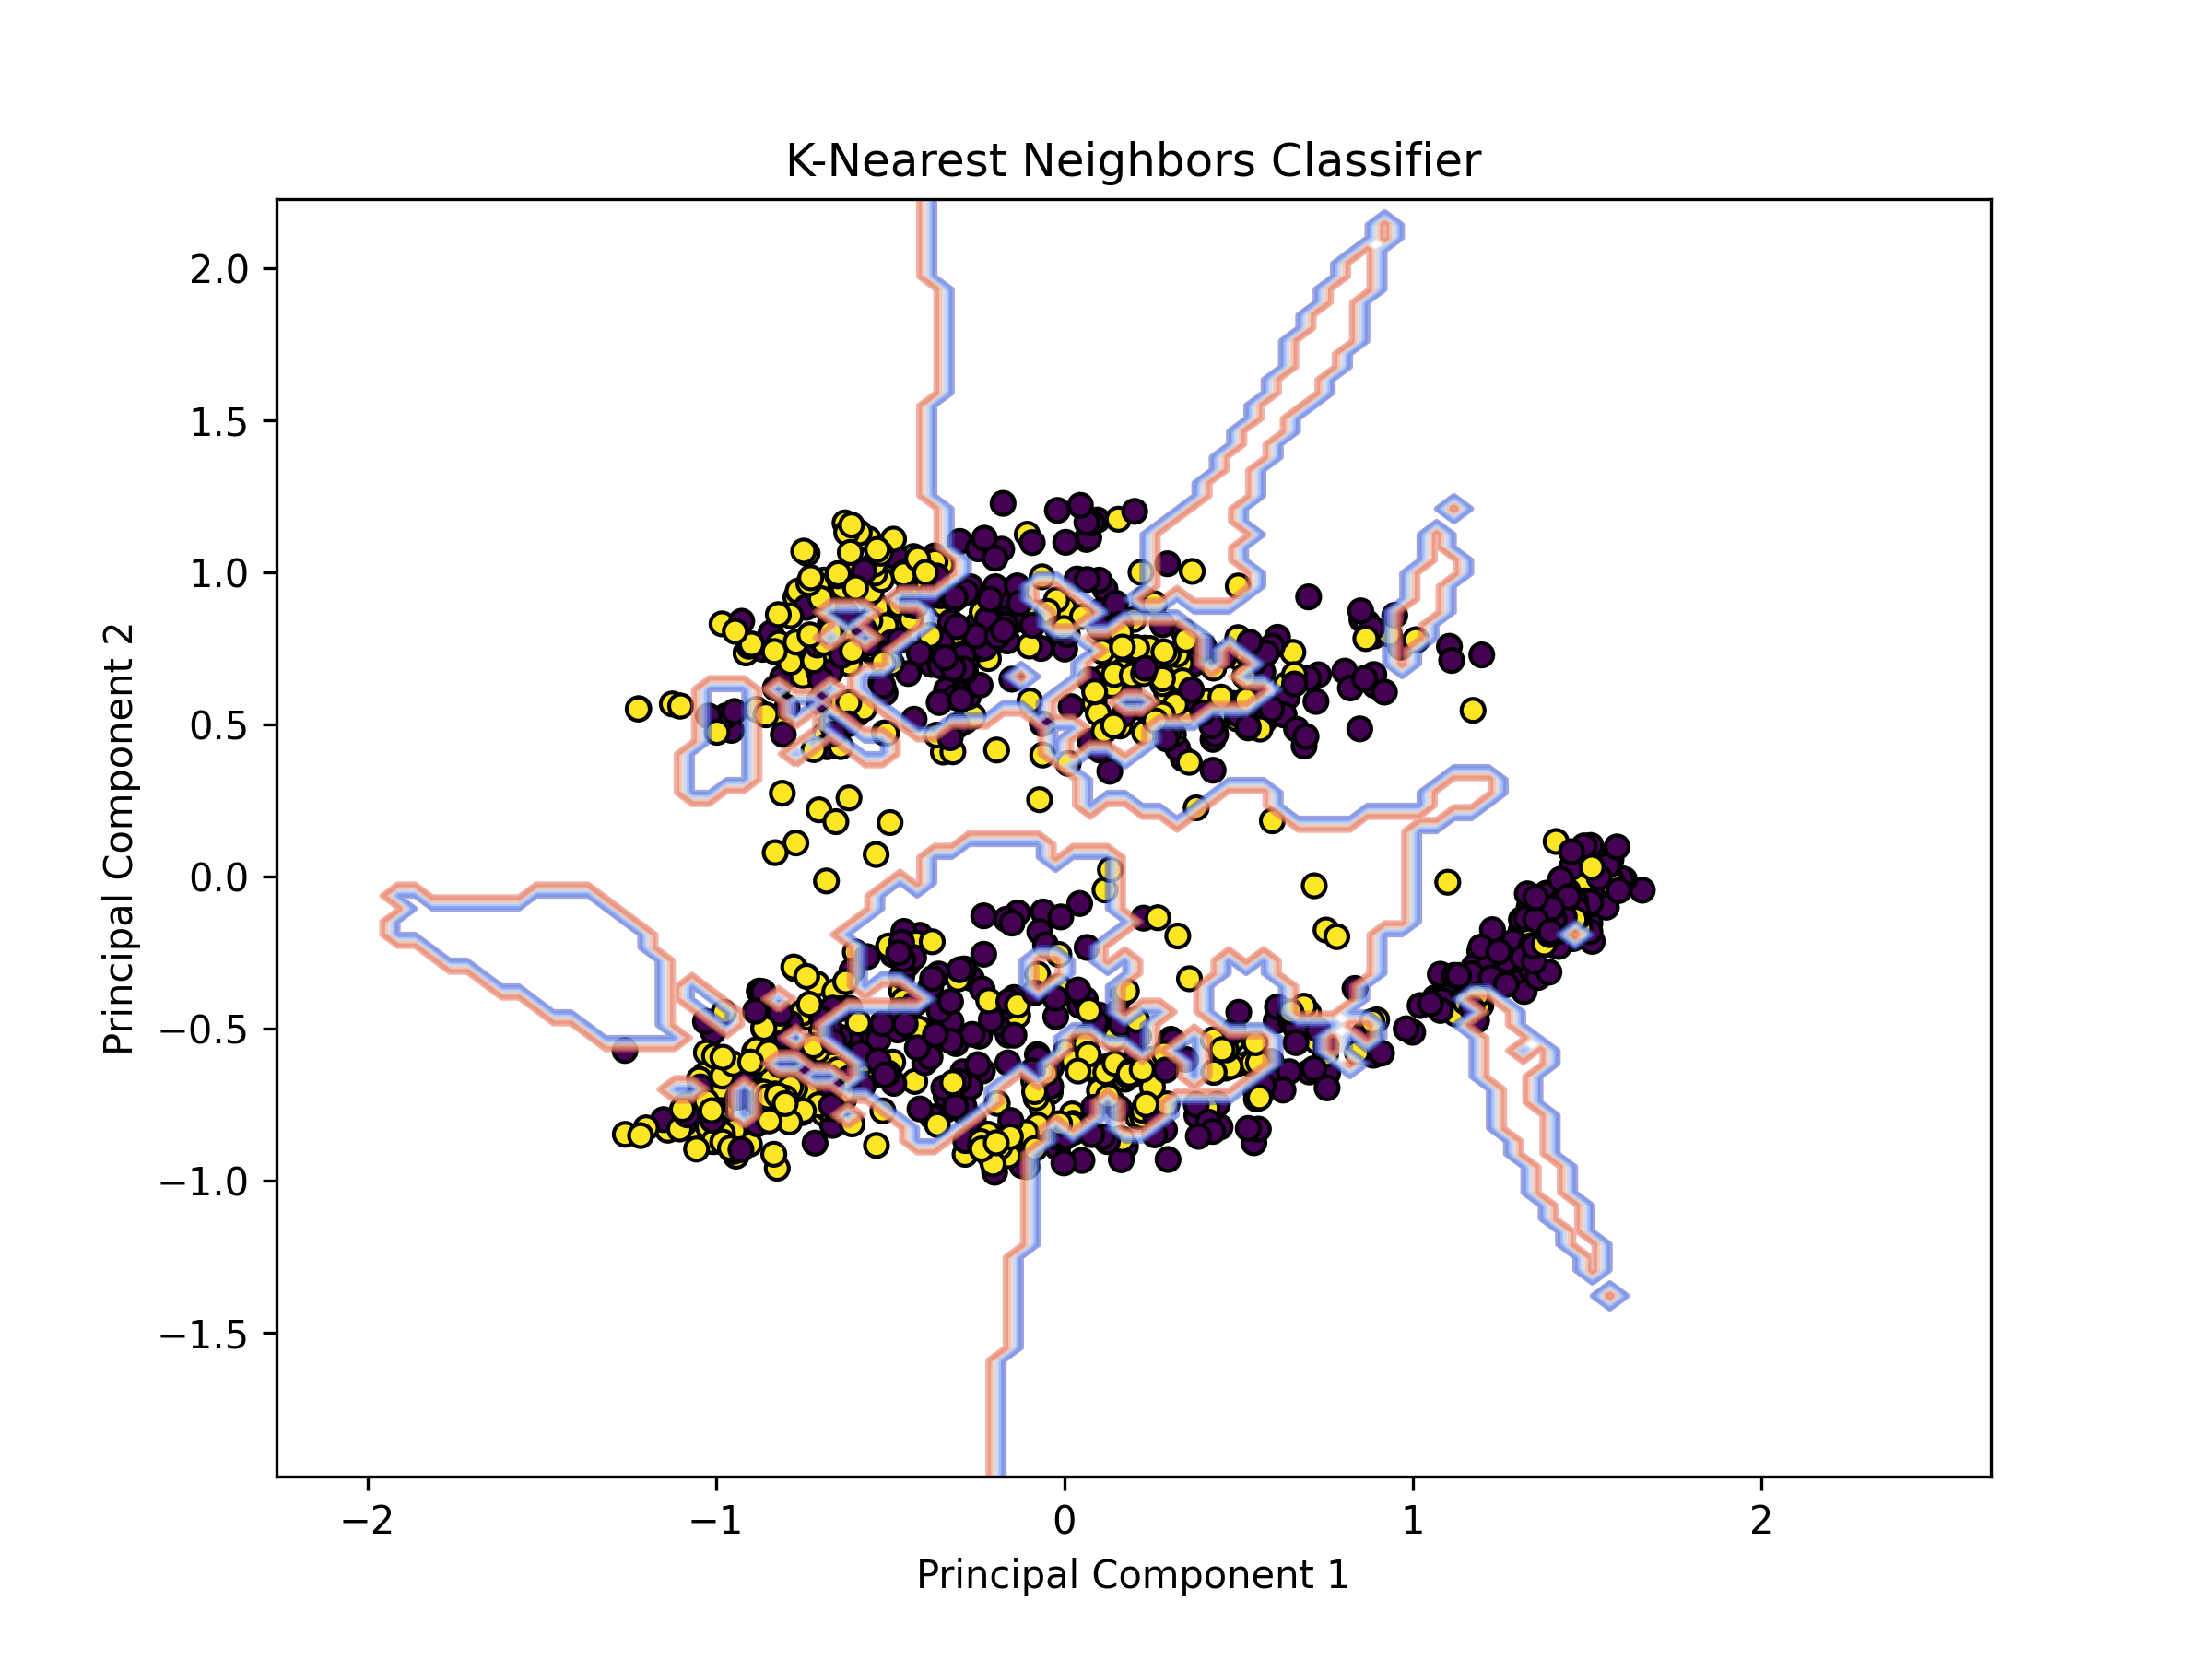
K Nearest Neighbor Classifier

Slide 4
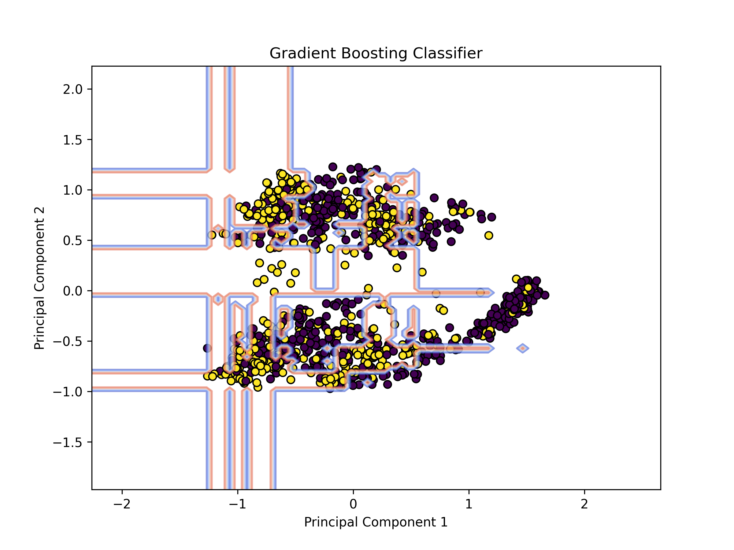
Gradient Boosting Classifier

Slide 5
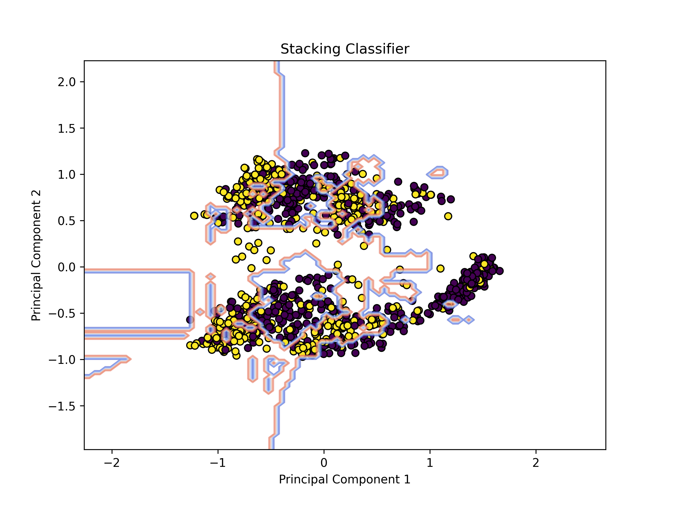
Stacking Classifier

Slide 6
Features
**Upload Raw Data**: - Upload your dataset, and the application will preprocess it for you (insurance.csv). - Preprocessing includes handling missing values and encoding categorical data.
**Train a Model**: - Use the cleaned dataset to train a machine learning model. - The target column is specifically fraud_reported as listed in config.py - The selected features are also in config.py and those can be changed accordingly.
**Make Predictions**: - Use the cleaned dataset to make predictions (e.g., fraudulent or legitimate cases). - Predictions are displayed in JSON format for easy interpretation.
**Simple Navigation**: - Initially the home page leads to the upload page. - Second page allows the user to choose the file and upload. - Once successful, the metrics and values results are shown. Features and target column are also displayed. - The user can continue to predict in which the ID and the prediction for Fraud are displayed. - Lastly, the user is able to download the report. If chosen, fradulent_prediction_report.csv is downloaded to the user's download folder.

Slide 7
Dependencies
Flask
pandas
scikit-learn
pickle
gunicorn (optional for production)

Slide 8
Workflow
Upload Data
Train Model
Make Predictions

Slide 9
Upload Data
Go to the Upload Data page by clicking Upload Data
Upload your raw dataset (e.g., insurance_fraud.csv) and click Upload.
The app will clean the data and save it in the data subfolder.
Cleaned data is called insuranceFraud_cleaned.csv

Slide 10
Train Model
Go to the Train Model page by clicking the Train the Model button.
Click Start Training to train the machine learning model.
The training process outputs metrics like accuracy, precision, recall, and F1-score as well as the value. Also in the results are macro avg as well as weighted avg of said metrics.
Features Used for Training are also listed on the page.

Slide 11
Make Predictions
Go to the Predict page by clicking the Predict button from the Training Page.
Click on Make Prediction in the subsequent page.
The app will output predictions, showing whether each row is "Fraudulent" or "Legitimate".

Slide 12
Notes
Preprocessing:
Always upload the raw dataset to clean it before training or prediction.
The raw data is cleaned and modified to include _clean to be updated as the trained model
Consistent Data:
The cleaned dataset is used for both training and prediction to avoid errors.
Error Handling:
If you encounter any issues (e.g., file not uploading or prediction errors), check the Flask terminal output for error messages.
Flexibility:
This project uses both the GradiantBoostingClassifier in combination of K nearest neighbor, but you can modify the training.py file to experiment with other models.

Slide 13
Future Improvements
Add data visualization features.
Provide downloadable results for predictions.
Include model comparison for different algorithms.

