Slide 1

Data Analysis on Vehicle Safety
James Velardi
May 10th, 2025

Slide 2
Dataset Used for This Project
This project uses data from The National Highway Traffic Safety Administration collected from 2011-2024.
The data collected is in a CSV file. URL: https://www.nhtsa.gov/nhtsa-datasets-and-apis
There is a lot of data in this CSV file, well over 10,000 rows and 100 columns, so filtering is required.
Data contains 5-star safety ratings, types of vehicles, safety features, manufacturers, frame types, and much more.

Slide 3
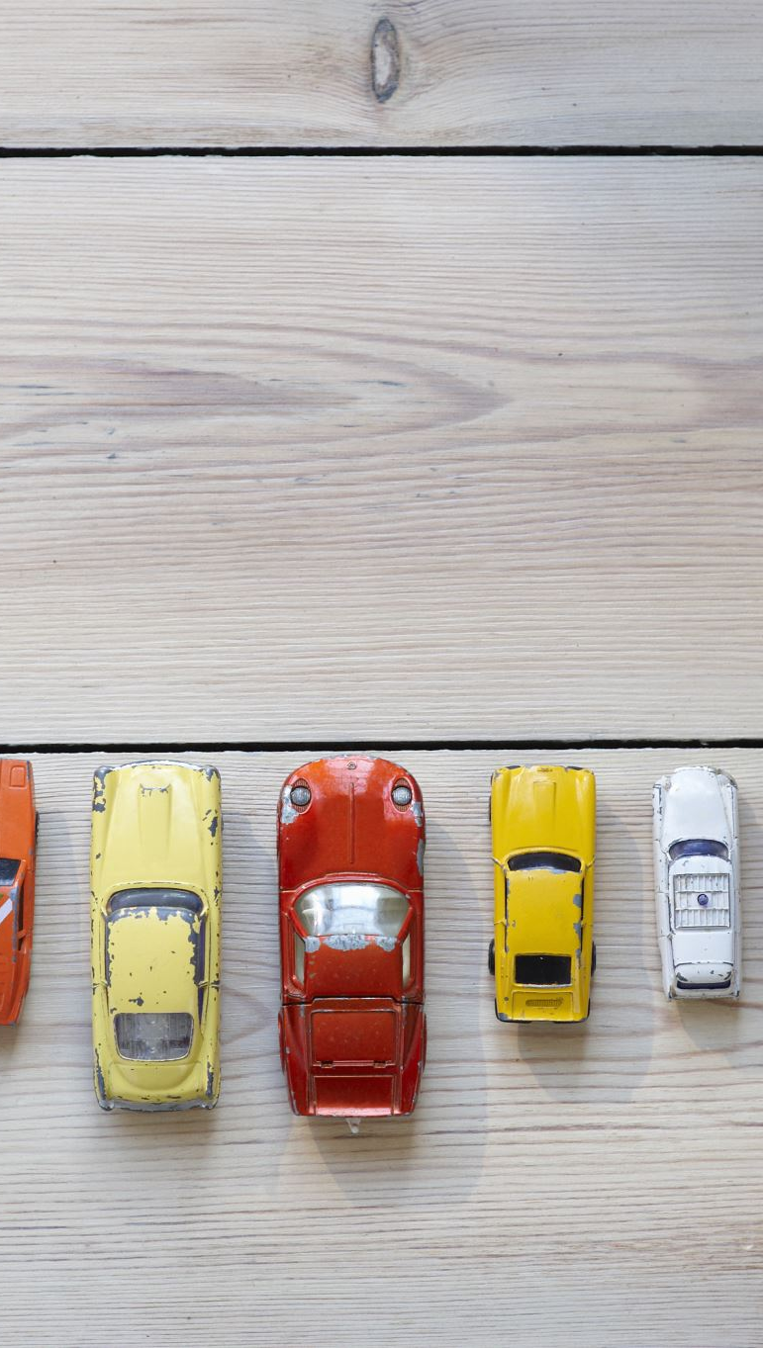
Data Science Questions Explored
Which car manufacturers overall have the highest average safety ratings?
What is the distribution of vehicle types (Passenger Car, Multi-Passenger Car (SUV, Crossover), Vans, and Trucks) and their safety ratings?
Do cars with advanced safety features (Automatic Emergency Braking, Forward Collision Warning) help improve safety ratings?
How does the safety of vehicles compare overtime? Are newer vehicles getting much safer?
What do vehicles that rank the lowest in vehicle safety have the most in common? Could it be based on body type, frame type, lack of safety features and airbags, or does it all come down to brand?

Slide 4
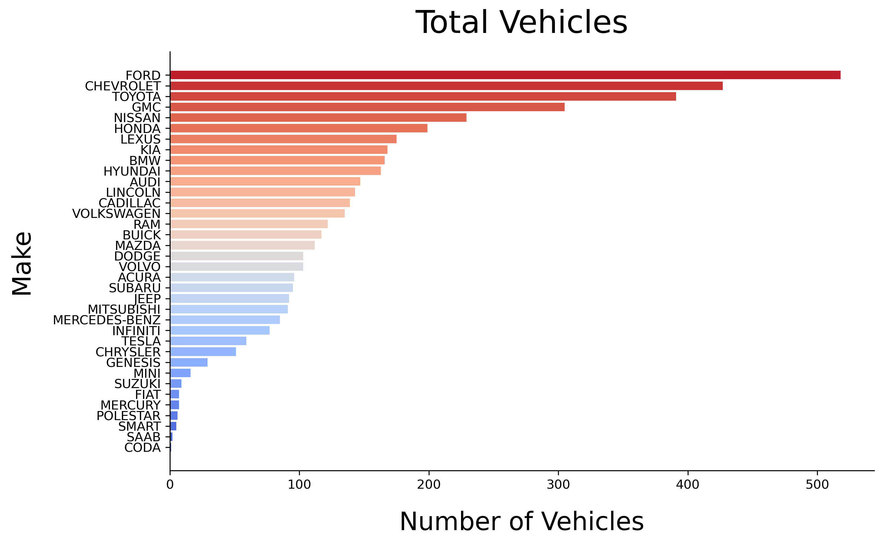
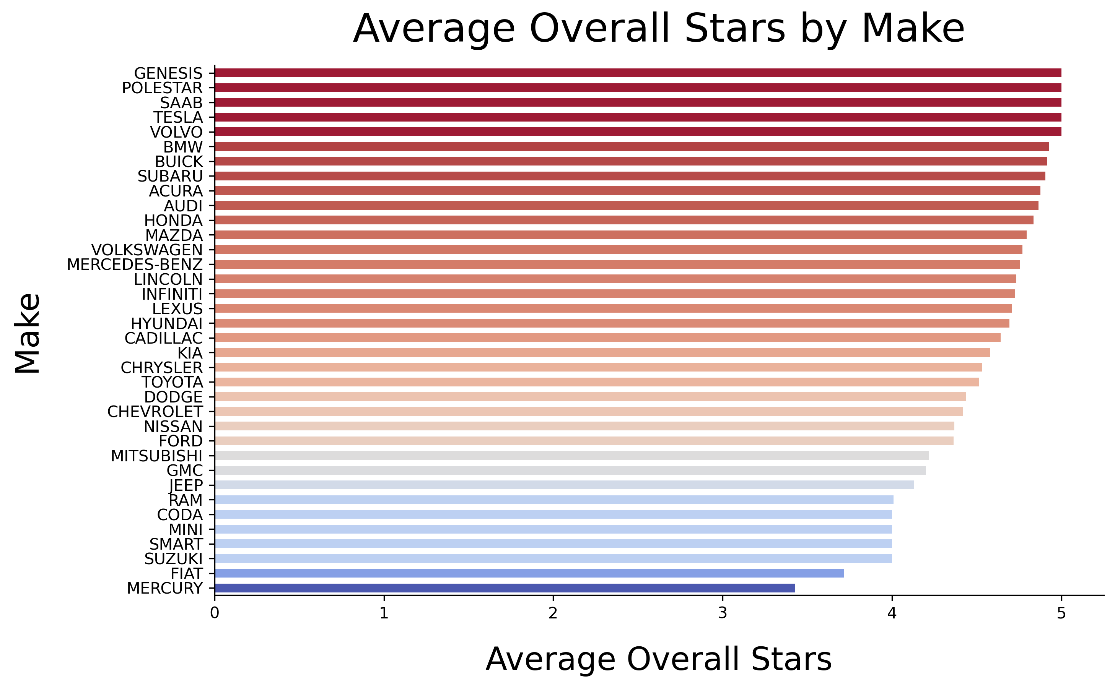
Which car manufacturers overall have the highest average safety ratings?
To answer this question accurately, I had to take the average overall safety rating and get the amount of makes in this dataset to check the reliability of the sample size.

Slide 5
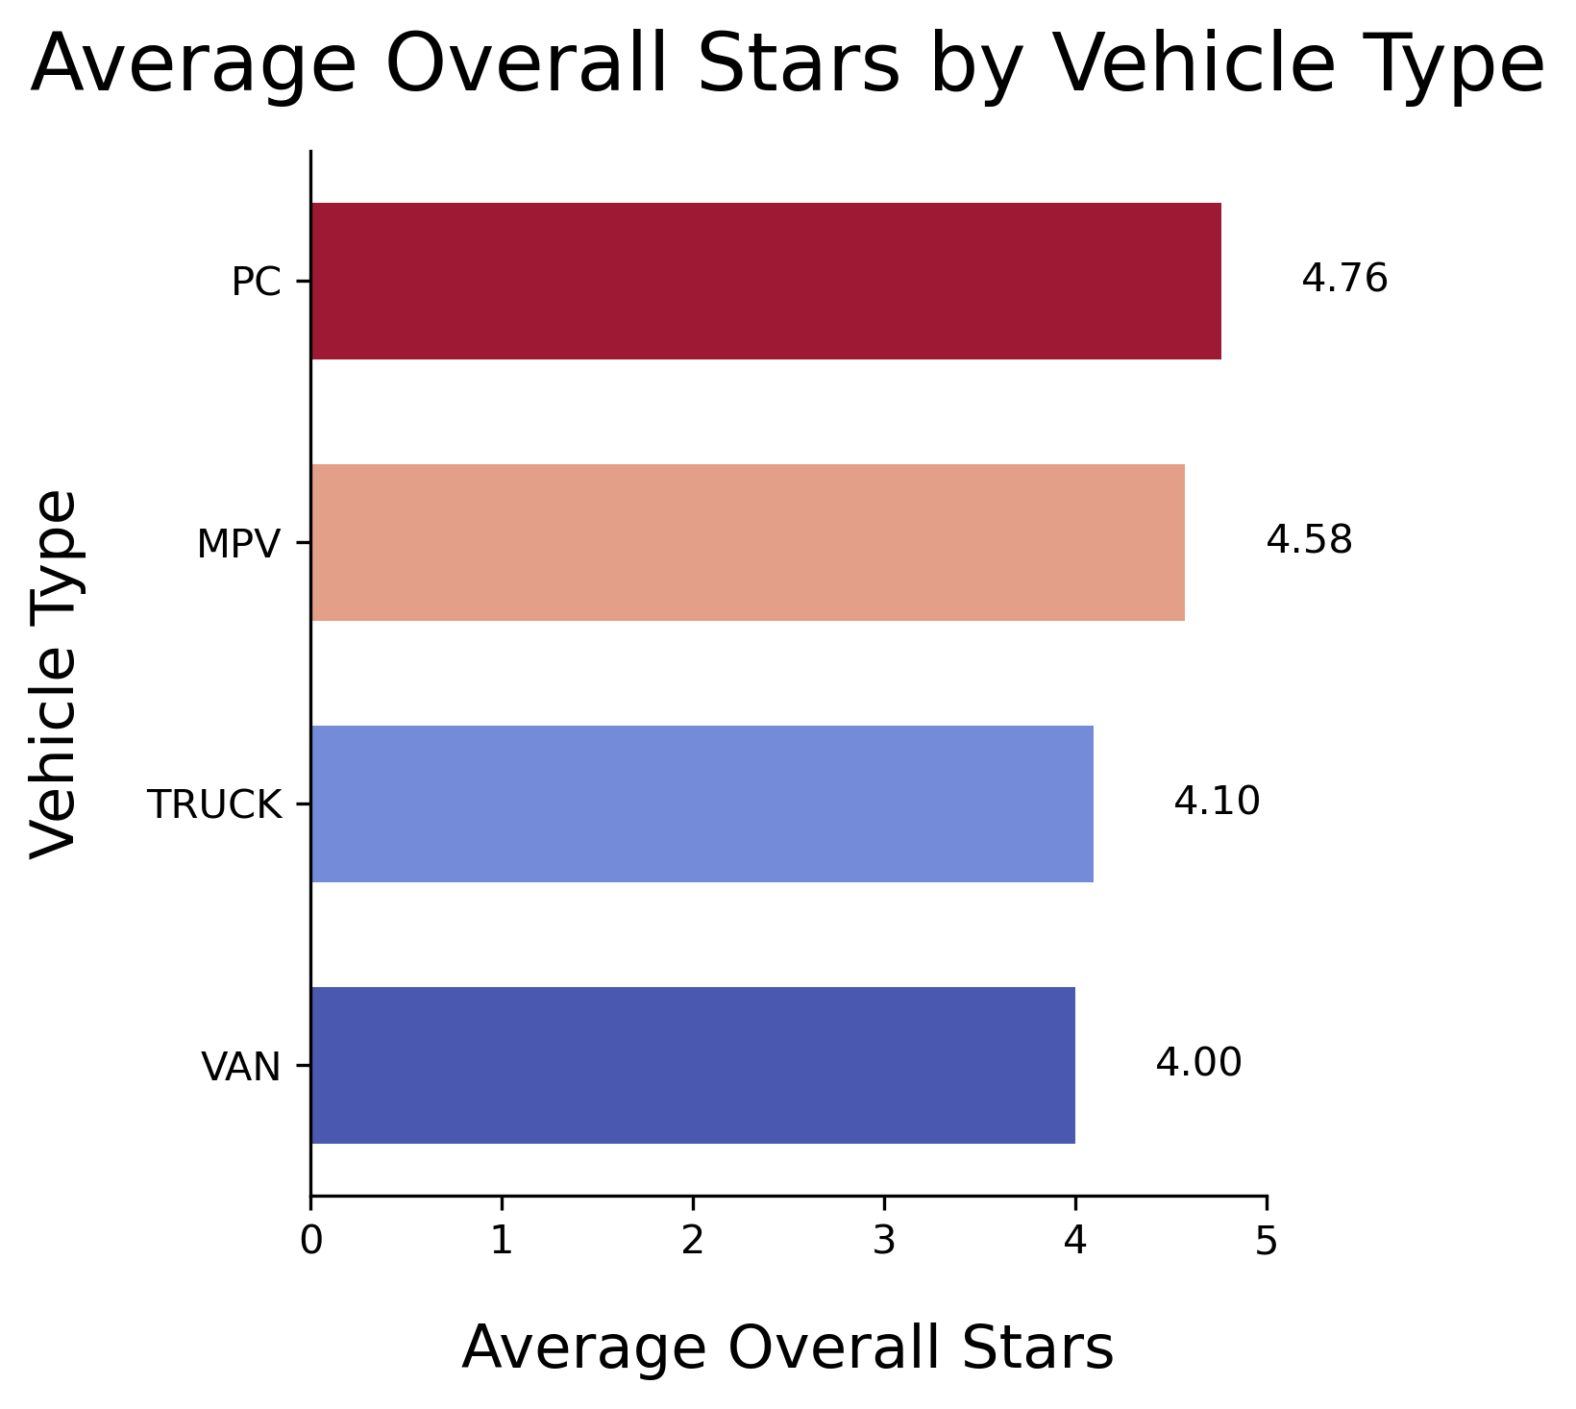
What is the distribution of vehicle types (Passenger Car, Multi-Passenger Car (SUV, Crossover), Vans, and Trucks) and their safety ratings?
- Overall, in terms of safety, passenger cars like sedans and coupes take the lead, while multi-passenger cars like SUV's come shortly behind.

Slide 6
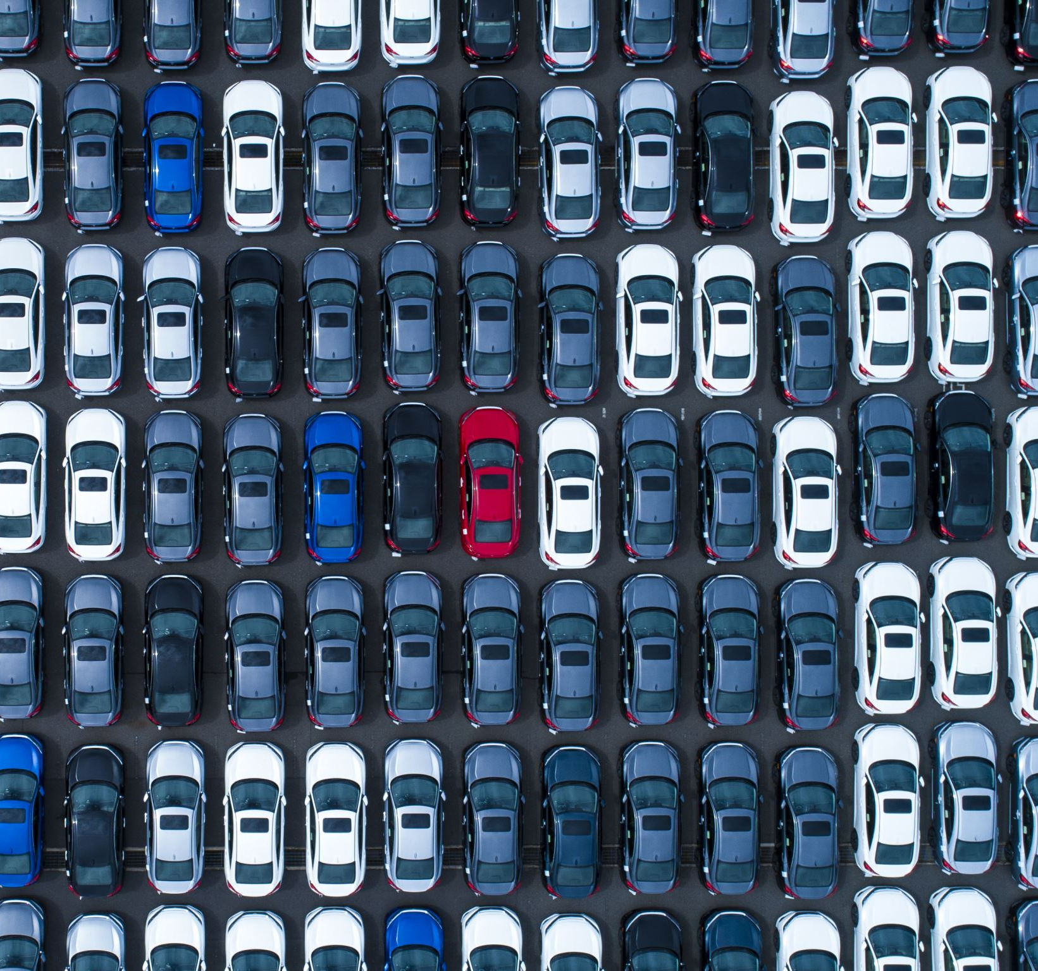
Do cars with advanced safety features (Automatic Emergency Braking, Forward Collision Warning) help improve safety ratings?

Slide 7
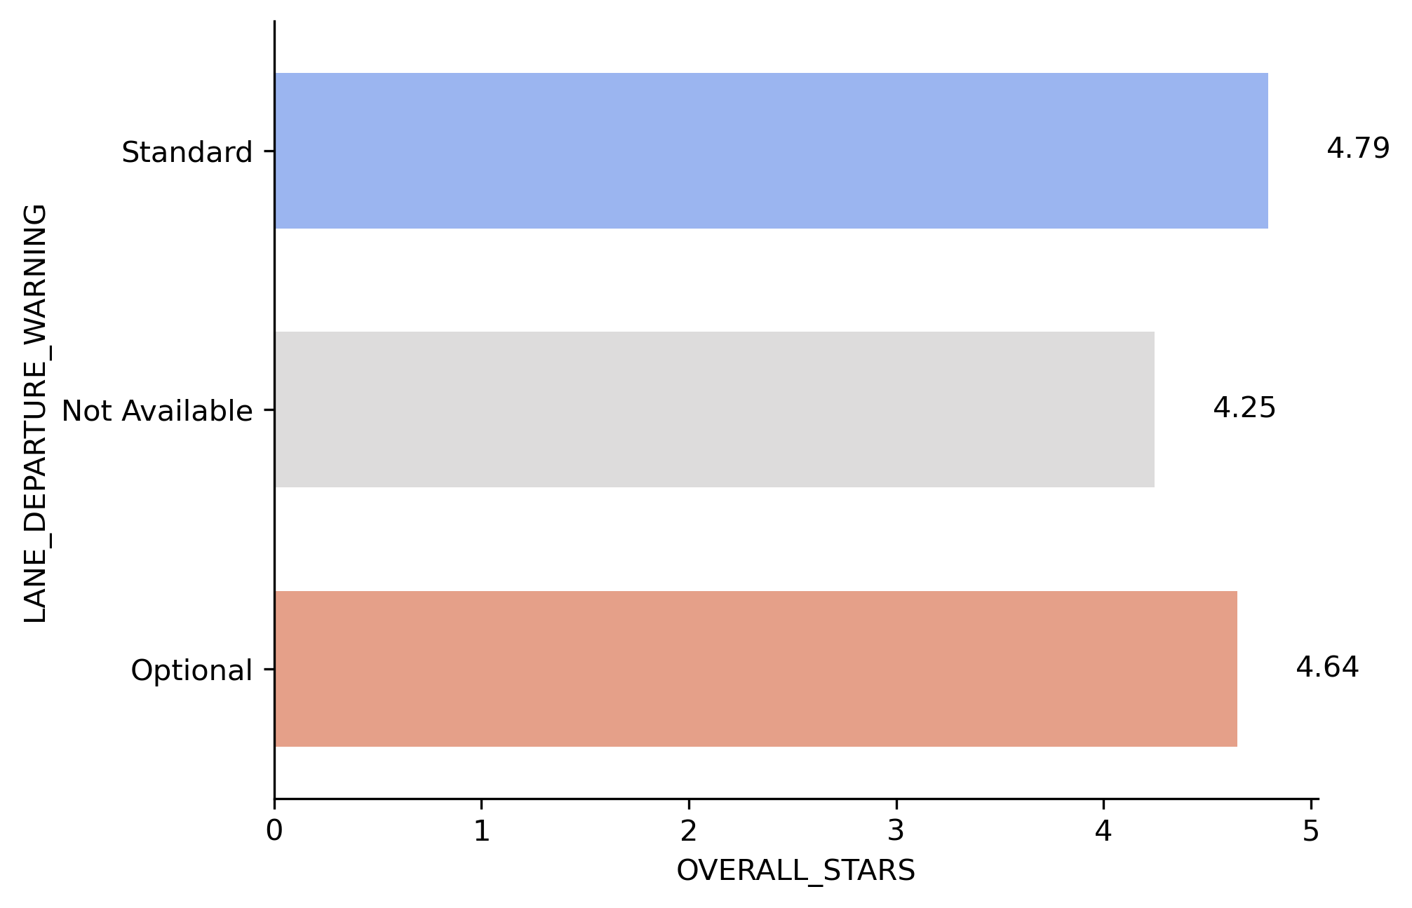
Lane Departure Warning

Slide 8
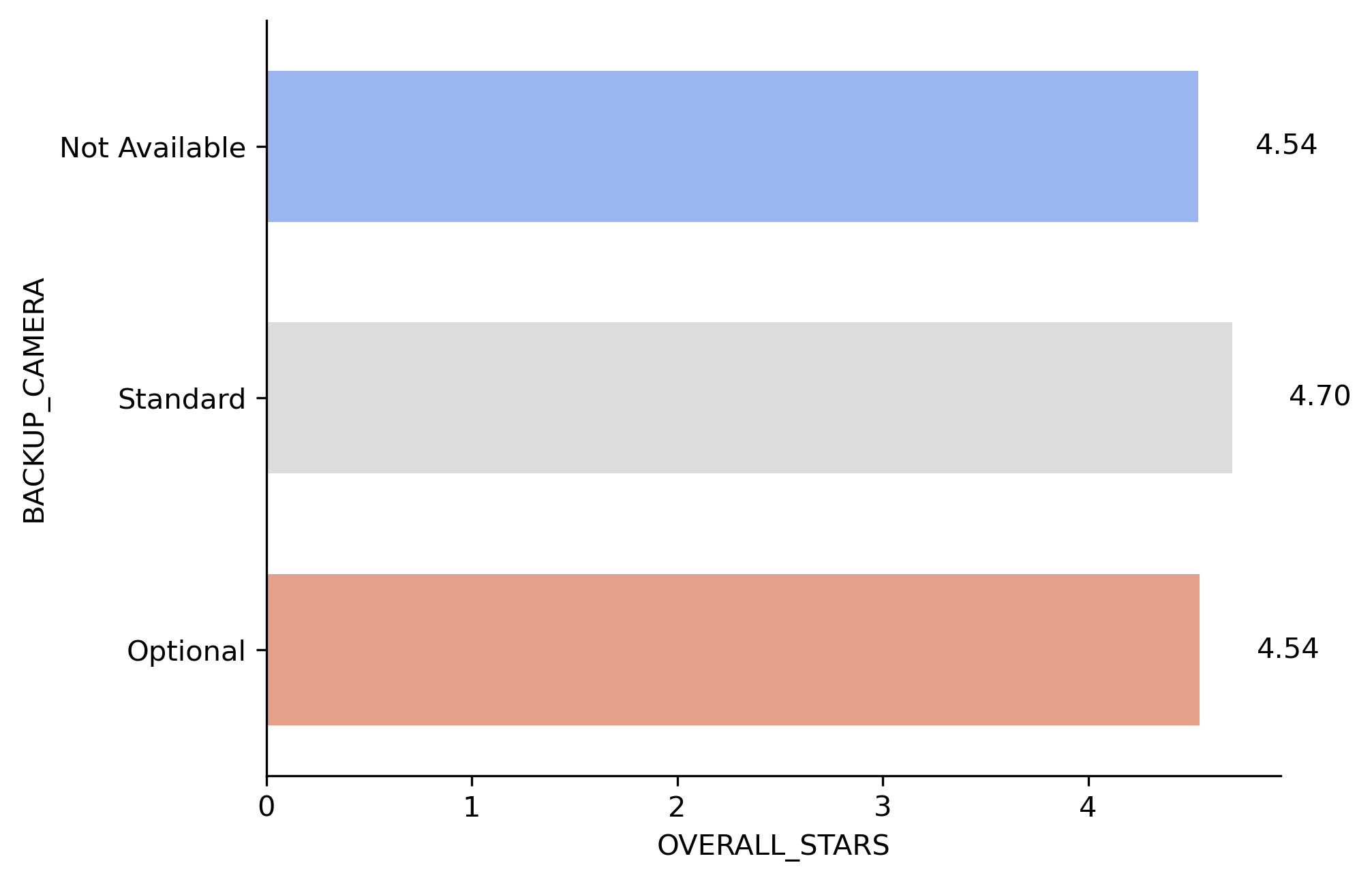
Back Up Camera

Slide 9
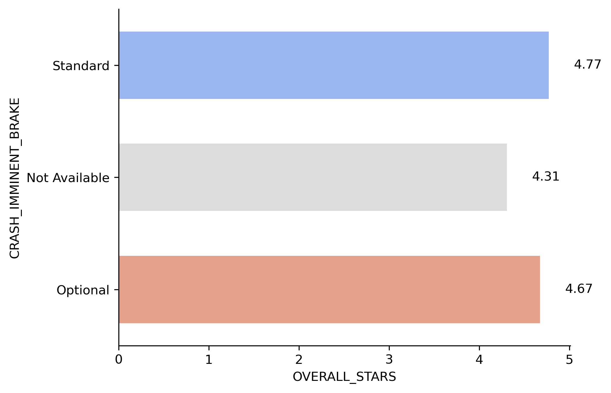
Crash Imminent Brake

Slide 10
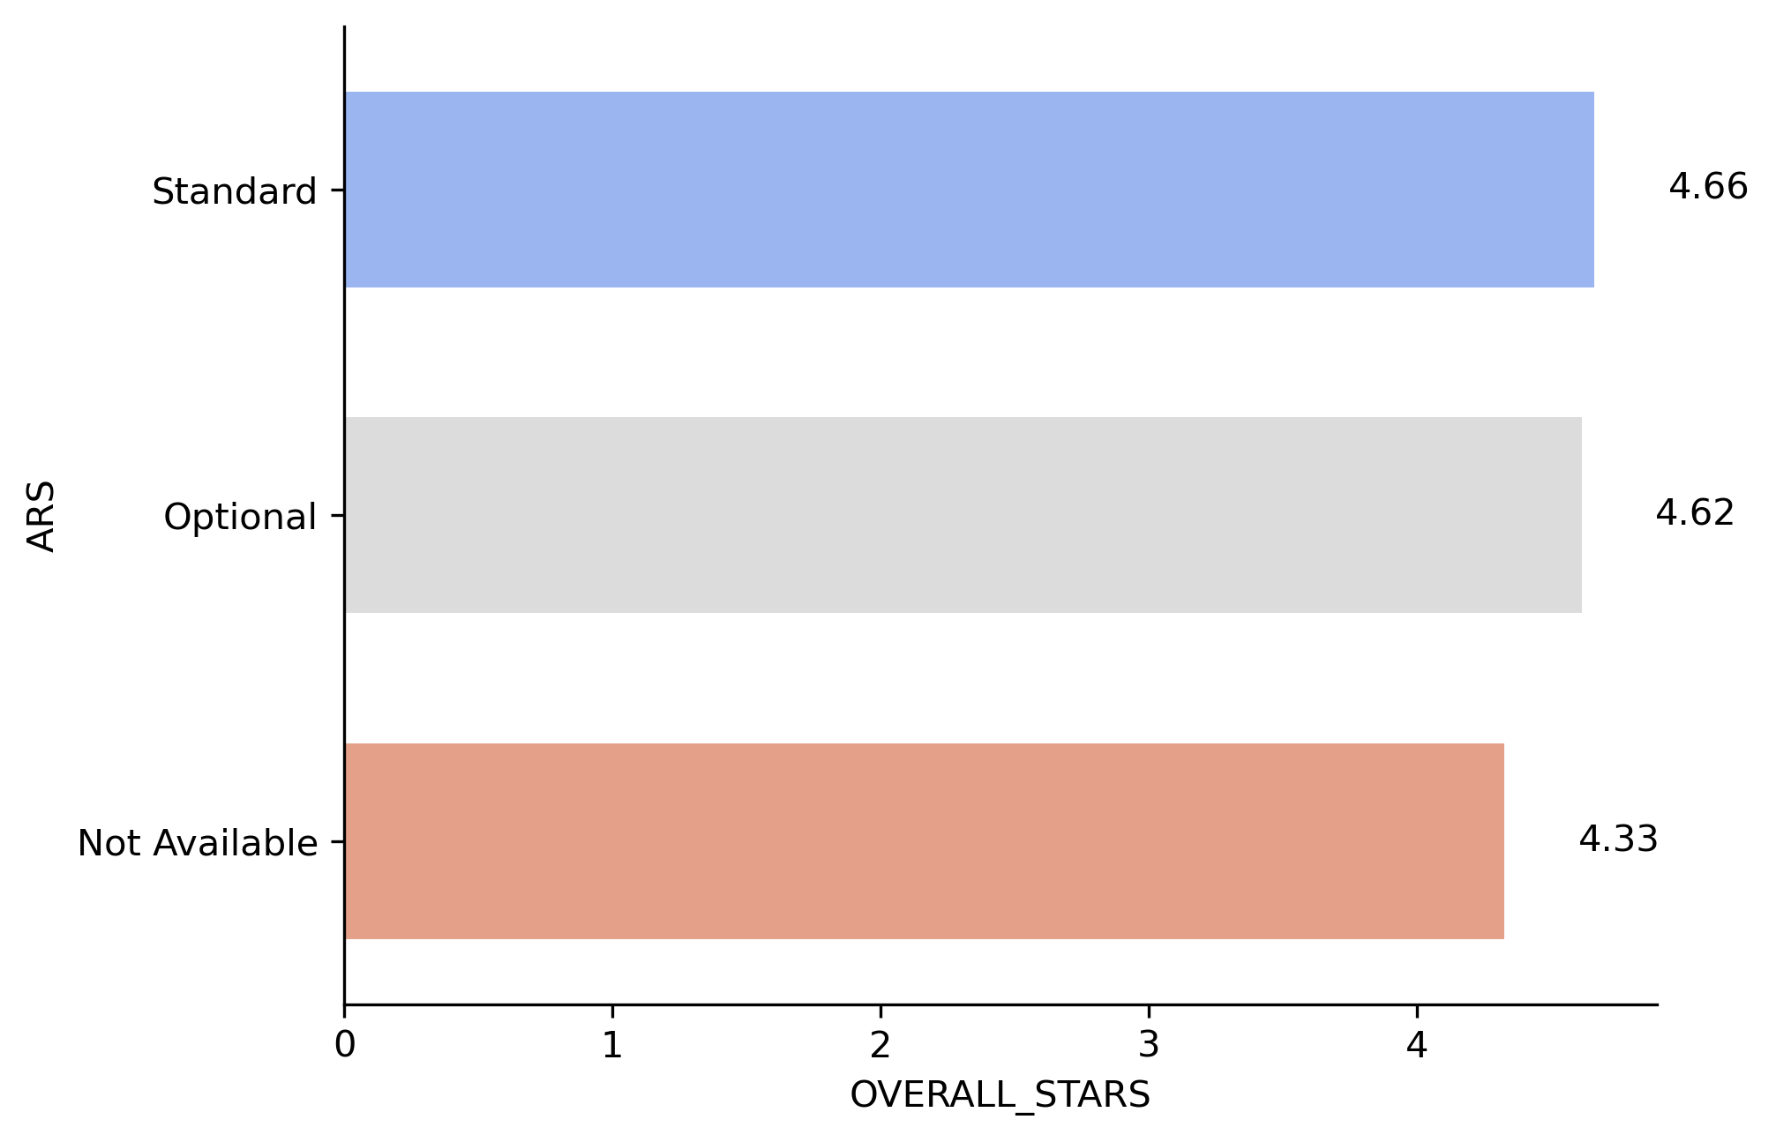
Window Auto Reverse System

Slide 11
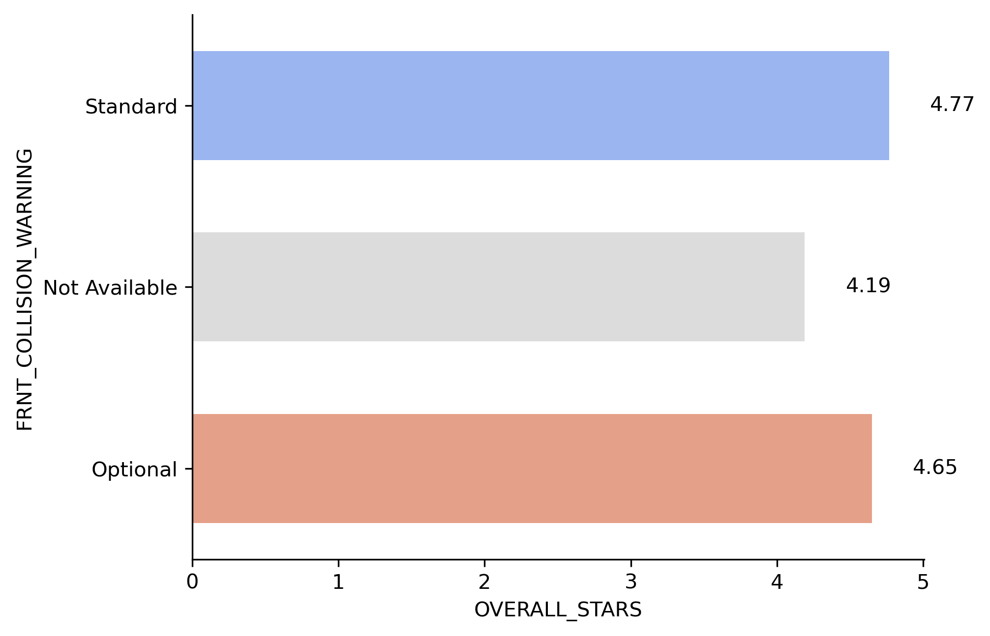
Front Collision Warning

Slide 12

Dynamic Brake Support

Slide 13
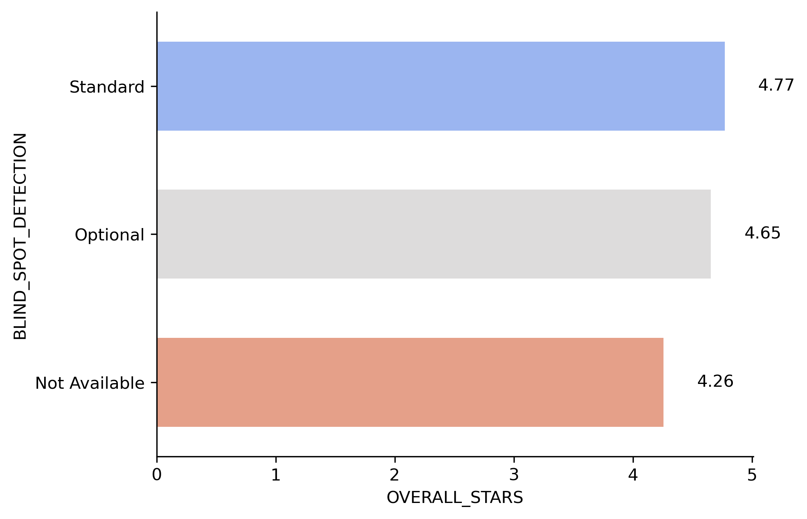
Blind Spot Detection

Slide 14
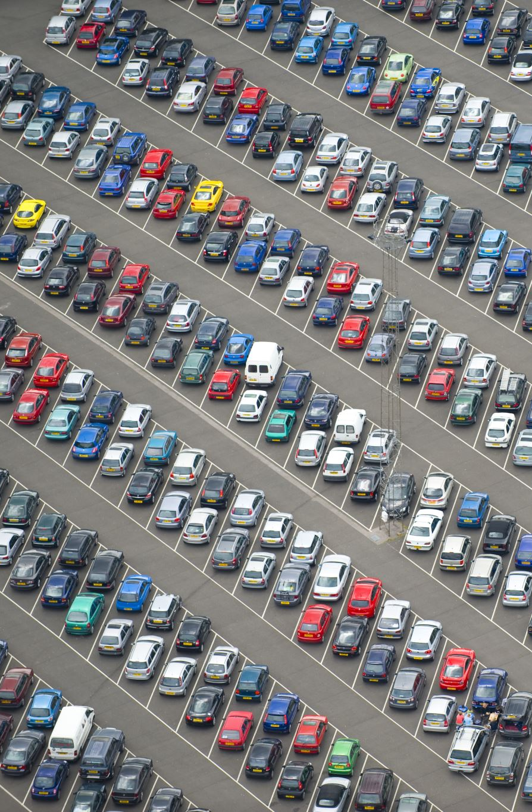
Advanced Safety Feature Findings
Advanced safety features in vehicles strongly correlate to higher safety.
Newer vehicles have these features.
Let’s investigate if newer vehicles rate higher.

Slide 15
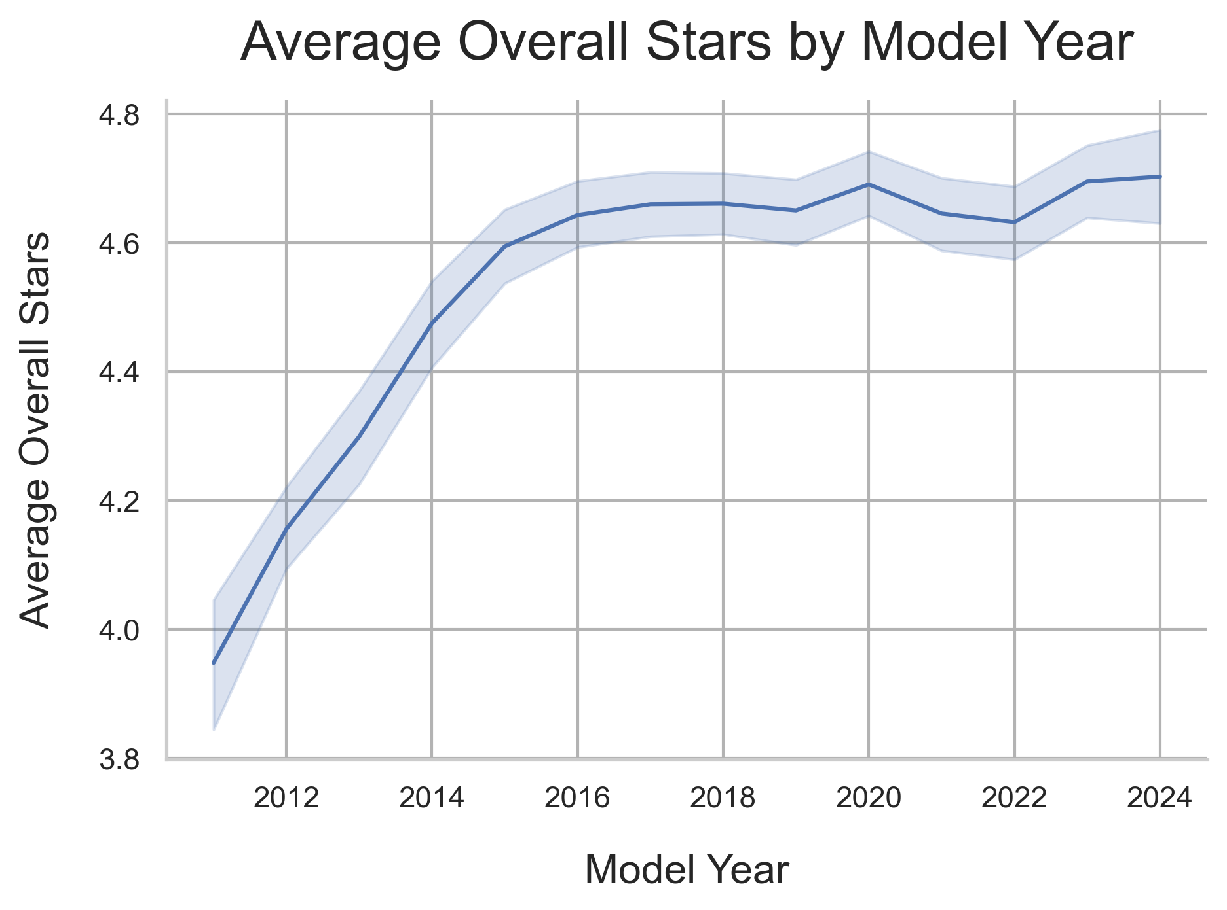
Question 4: How does the safety of vehicles compare overtime? Are newer vehicles getting much safer?
A positive trend in safety is established in new vehicles.

Slide 16
Question 5: What do vehicles that rank the lowest in vehicle safety have the most in common?
Let’s pull the data from 2-Star and 3-Star vehicles.

Slide 17
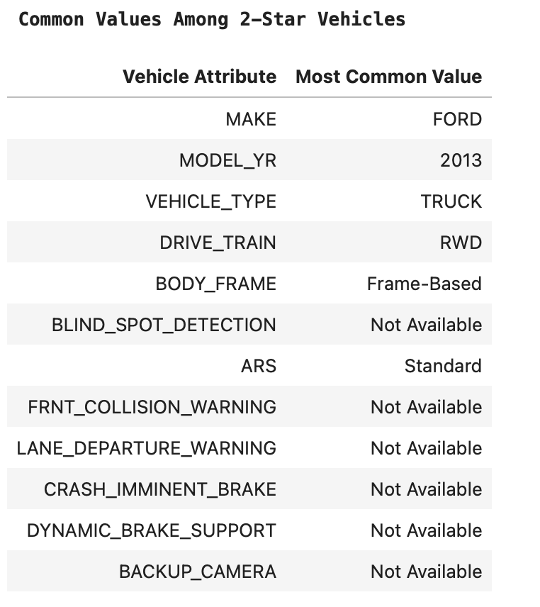
Common Values in 2-Star Rated Vehicles

Slide 18
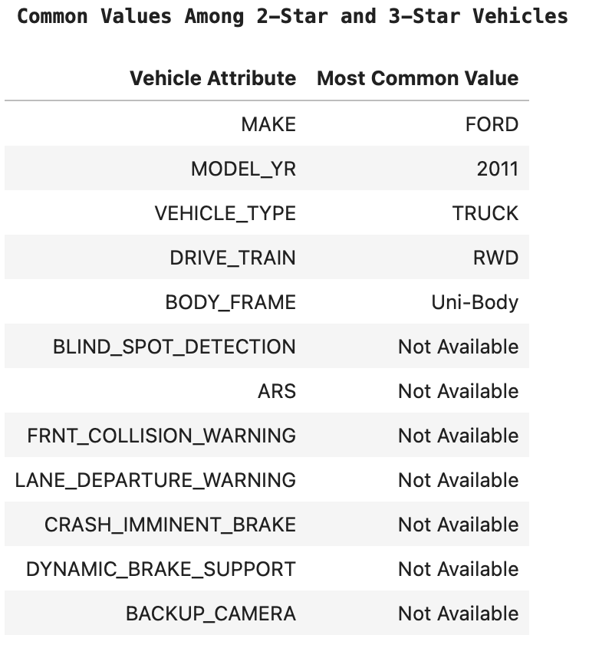
Common Values among 2-Star and 3-Star Vehicles

Slide 19
Conclusions
New Passenger Cars (Sedans, Coupes) are the safest vehicles to drive.
More safety features correlate to more safety.
Jeep and Ram with a sample size of at least 100 vehicles ranked lowest.

Slide 20
Future Questions to Explore
Would poorly rated vehicles rate higher with a bigger sample size?
Which models of each brand rate highest and lower?
I would also like more data on frame types and safety.

Slide 21
That concludes this presentation
Feel free to ask any questions!

