Slide 1
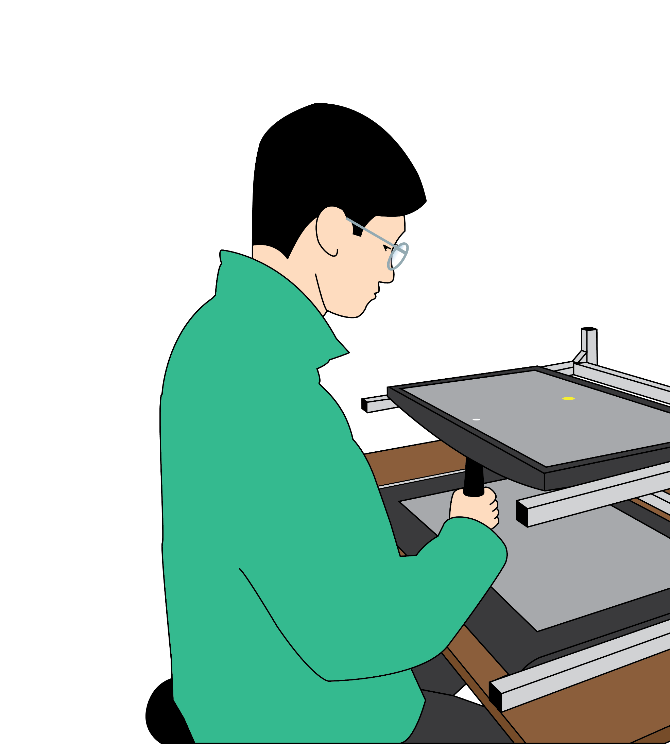
Recruiting Motor Control Study Participants!
Help us better understand how the human motor system controls reaching movements and utilizes different types of sensory feedback 🧠.
Details: Testing will involve making reaching movements over a graphics tablet in a game-like setting
Who: 1) Healthy volunteers aged 18-35 years old,
2) No known history of neurological impairment, and
3) Normal to corrected-to-normal vision
Where: Osborne Centre, Unit 2, Room 203
Duration: 1 to 3 sessions | ~1.5 hours per session
Compensation: $15 per completed session
Interested? Email us at ccm.lab@ubc.ca.
Learn more about our lab at ccmlab.org.

Slide 2
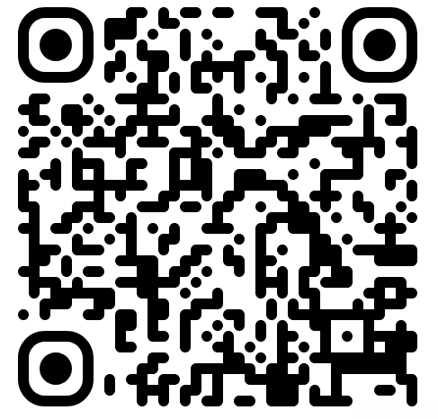
Recruiting Motor Control Study Participants!
Help us better understand how the human motor system controls reaching movements and utilizes different types of sensory feedback 🧠.
Details: Testing will involve making reaching movements over a graphics tablet in a game-like setting
Who: 1) Healthy volunteers aged 18-35 years old,
2) No known history of neurological impairment, and
3) Normal to corrected-to-normal vision
Where: Osborne Centre, Unit 2, Room 203
Duration: 1 to 3 sessions | ~1.5 hours per session
Compensation: $15 per completed session
Interested? Scan the QR code to sign up!
Learn more about our lab at ccmlab.org.

