Slide 1
DailyBudget
Minh Chung, Jason Nguyen, Chathuri Palanivelu, Chloe Pascual, Jerry Wang

Slide 2
DailyBudget Objectives
Efficient maintenance of finances
Organized allocation of budget
Easy to use on the go
Accessible to people of different backgrounds

Slide 3
Cost Estimation and Pricing
Costs
Pricing
Hardware = $2,553.20
Software = $339.17
Travel = $0
Personnel = $41,720
————————
Total Cost = $44,612.17
Free Plan = $0
Premium Plan= $5 monthly or $54 annually
Advertising = $0.5 - $12
DailyBudget

Slide 4
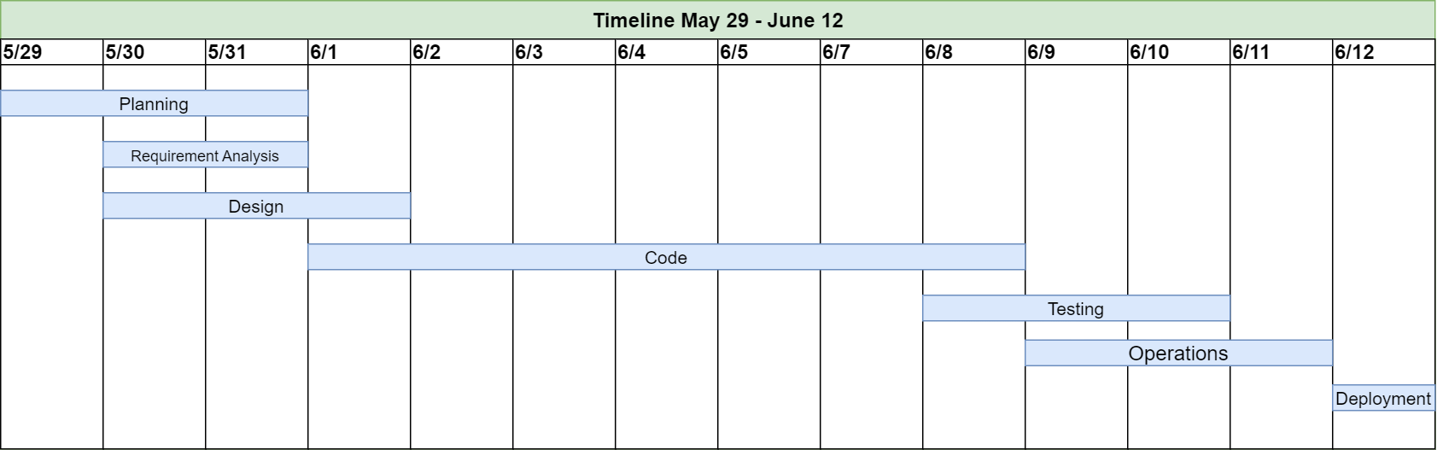
Timeline
DailyBudget

Slide 5
Requirements
Functional
User registration: The app should allow users to create an account and sign in securely.
Expense tracking: The app should allow users to track their expenses by category (e.g. groceries, rent, entertainment).
Budget planning: The app should allow users to set monthly or weekly budgets for each category.
Notifications: The app should send notifications to users when they approach or exceed their budget limits.
Goal setting: The app should allow users to set financial goals (e.g. saving for a vacation, paying off debt) and track progress towards these goals.
Reporting: The app should generate reports and visualizations of spending habits and trends.
Non-functional
Security: The app should be designed with strong security features to protect user data.
Usability: The app should be user-friendly and easy to navigate, with a clear interface and intuitive controls.
Performance: The app should be fast and responsive, with minimal lag or delay.
Availability: The app should be available for use on multiple devices and platforms (e.g. iOS, Android, web).
Reliability: The app should be reliable and stable, with minimal crashes or bugs.
Scalability: The app should be designed to handle a large number of users and a growing database of financial data.
DailyBudget

Slide 6
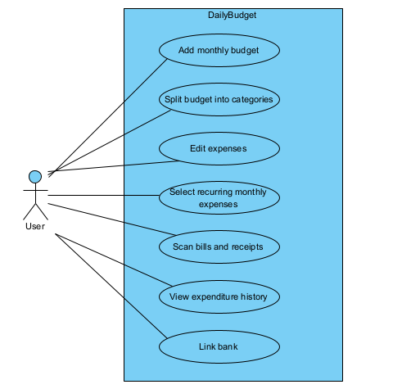
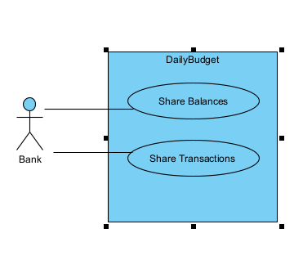
Use Case Diagrams - USER & BANK
DailyBudget

Slide 7
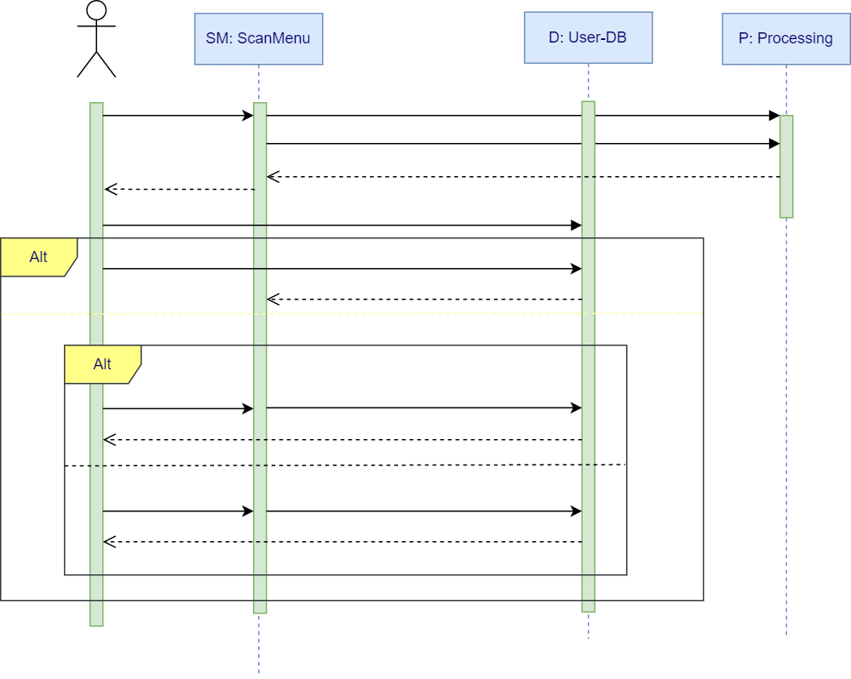
Sequence Diagram - SCAN BILLS AND RECEIPTS
DailyBudget

Slide 8
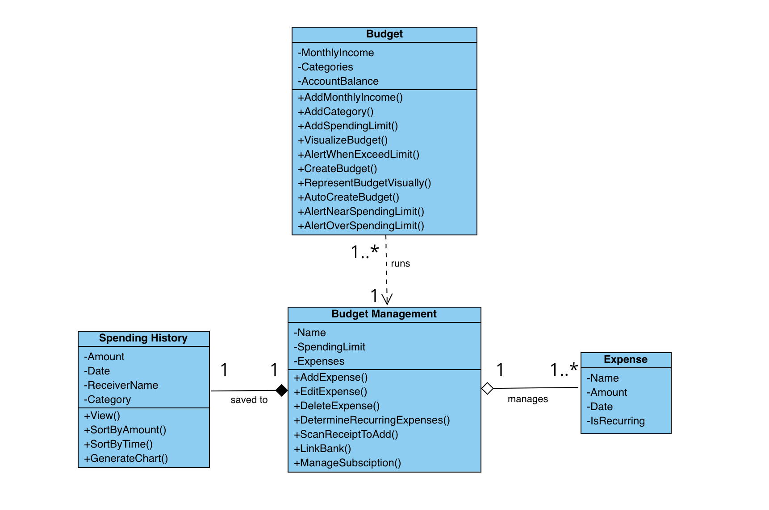
Class Diagram
DailyBudget

Slide 9
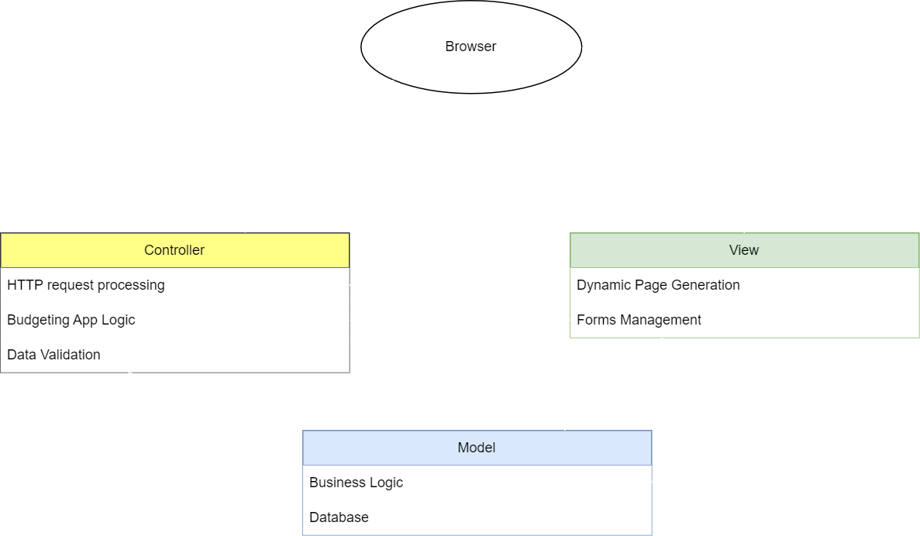
Architectural Design - MODEL VIEW CONTROLLER
DailyBudget

Slide 10
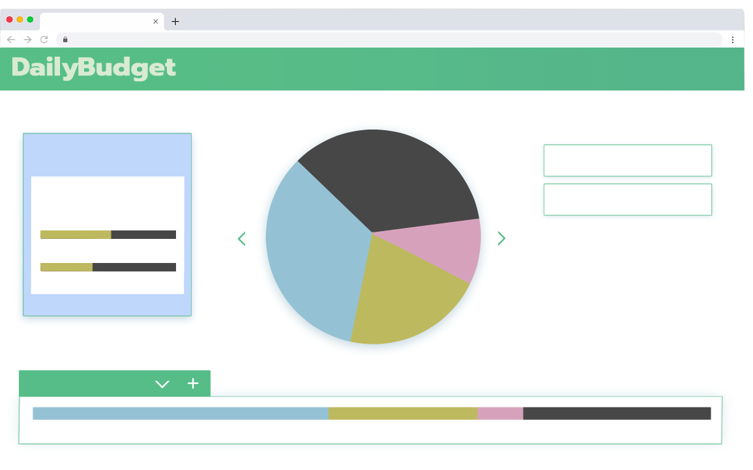
DailyBudget Sample Landing Page
Budgets
Transactions
⋮
Trends
Goals
Upload
Budgeter
NOTIFICATIONS
May 27, 2023
UPCOMING TRANSACTION:
Netflix $12 June 1, 2023
x
You’re on track.
So far, so good!
You have spent 5% less on Groceries today than around the same time a month ago.
RECENT TRANSACTION:
Chick-fil-A $14 May 27, 2023
x
April 27, 2023
May 27, 2023
View Trend History ＞
$1,480/$2,000
NECESSITIES
37%
21%
16%
26%
⬤Rent ⬤Groceries ⬤Gas ⬤Available ◯Entertainment
74% of Necessities Budget Used

Slide 11
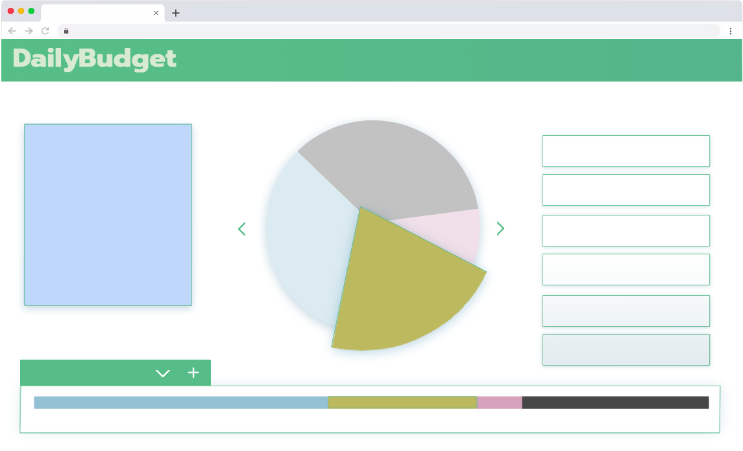
DailyBudget Sample Inspect Category
Home
⋮
Budgets
Transactions
Trends
Goals
Budgeter
Upload
GROCERIES
RECENT TRANSACTIONS
く
＞
Your monthly Groceries goal: $475 88% spent
Your spending on Groceries has been steadily decreasing since February, 2023.
As of today, you have spent 5% less on Groceries than around the same time a month ago.
Kroger $124 May 25, 2023
x Average
$421/$2,000
Groceries
Target $13 May 18, 2023
x Below Average x Unexpected
Target $169 May 17, 2023
x Above Average
Kroger $88 May 18, 2023
x Below Average
View Trend History ＞
✎ Edit Category
✎ Edit Transaction
+ Add Transaction
× Remove Transaction
NECESSITIES
37%
21%
16%
26%
⬤Rent ⬤Groceries ⬤Gas ⬤Available ◯Entertainment
74% of Necessities Budget Used

Slide 12
DailyBudget
Thank you!

