Slide 1
Integrating Systems and Theories in the SAL Hybrid Architecture
Andrew Szabados, Seth Herd, Yury Vinokurov, Christian Lebiere, Randall C. O’Reilly
eCortex, Cargnegie Mellon University, University of Colorado Boulder

Slide 2
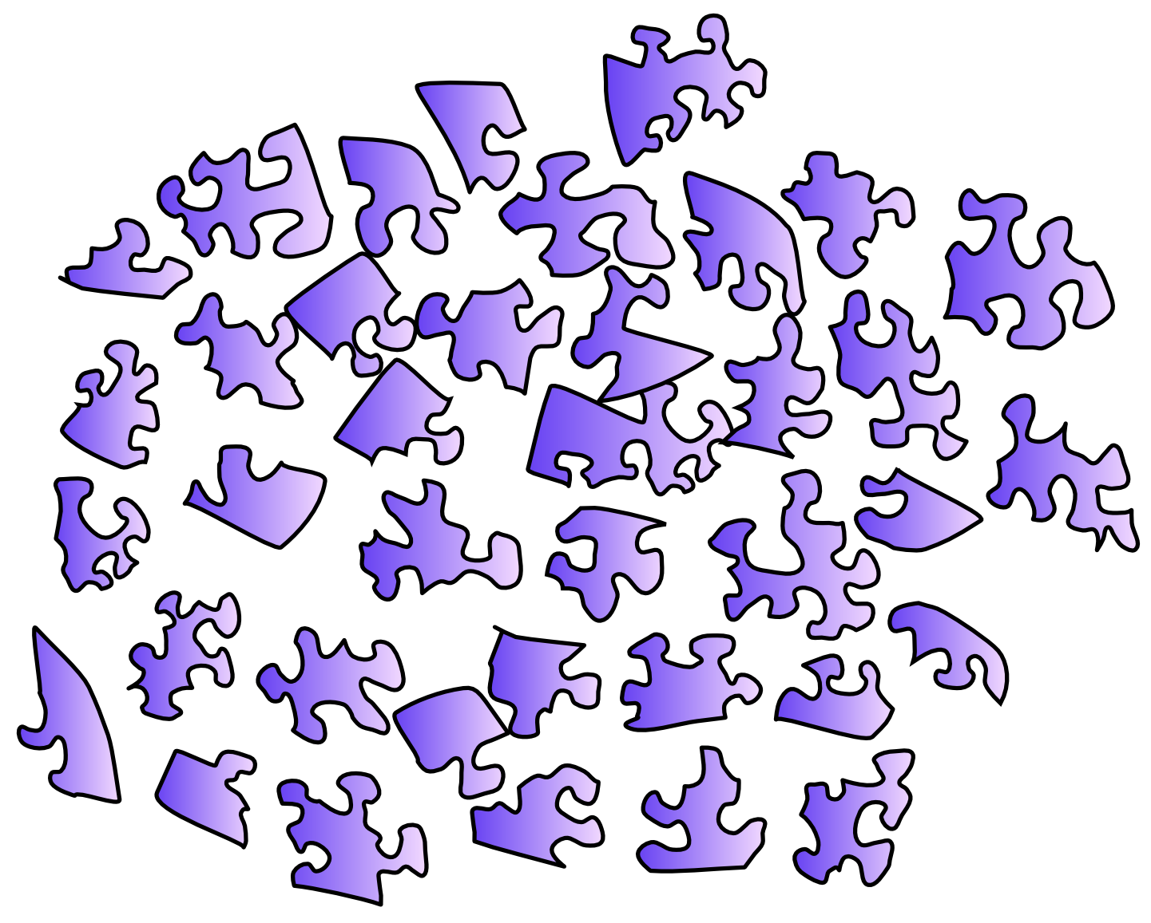
Motivating the Integrated Approach

Slide 3
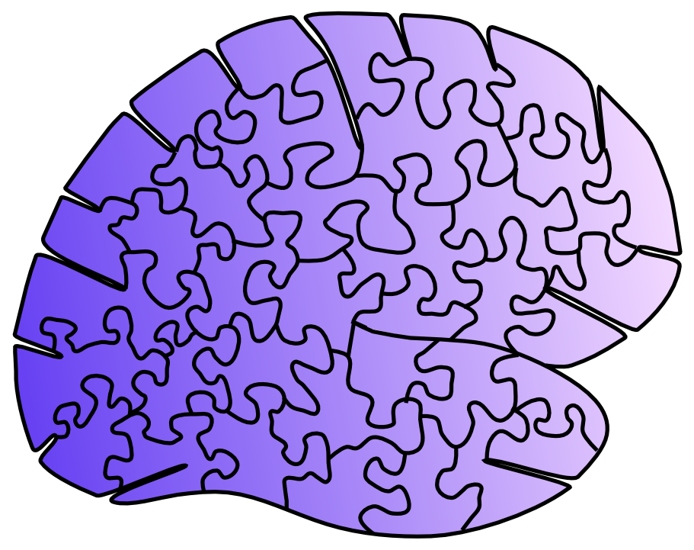
Motivating the Integrated Approach

Slide 4
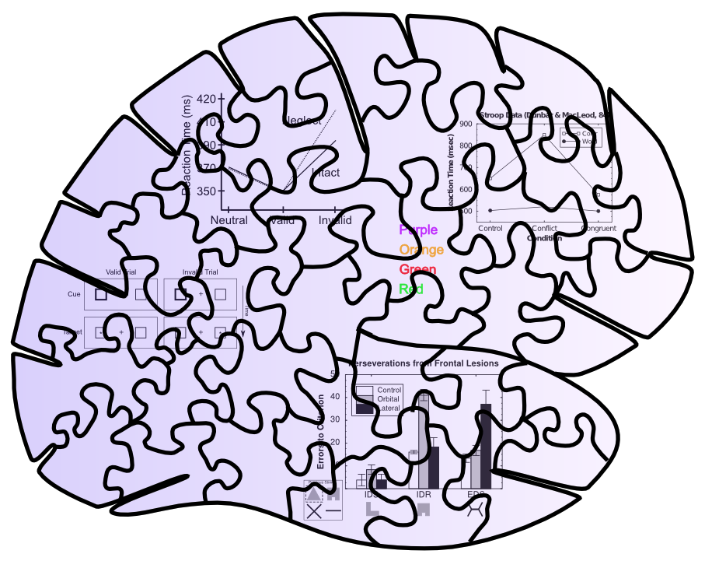
Behavioral Constraints

Slide 5
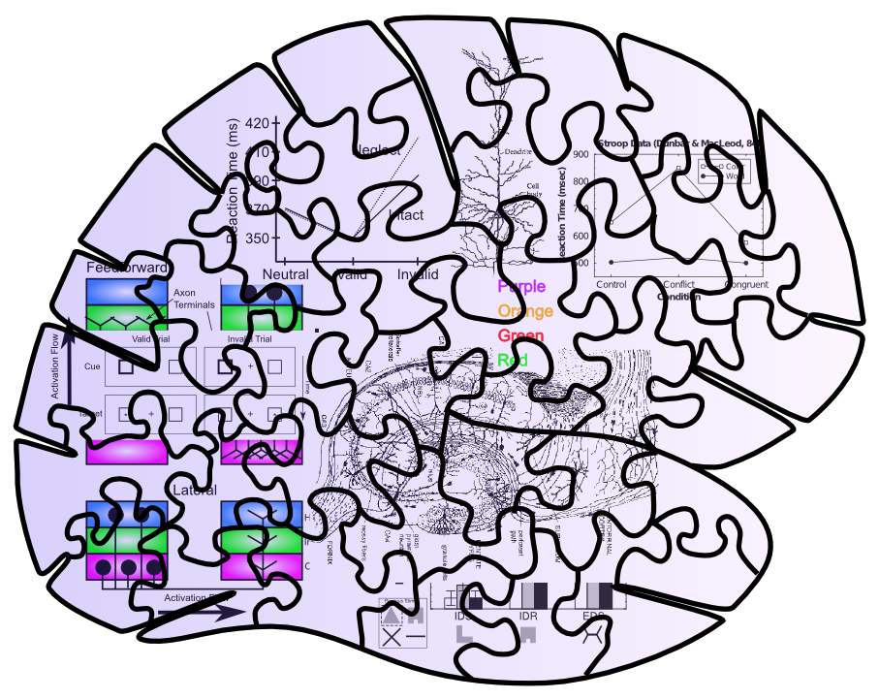
Neuro + Behavioral Constraints

Slide 6
Messy Puzzles are Easier to Solve!!

Slide 7
Newell’s argument: Satisfy more constraints in an Integrated Architecture
(Biology just as, if not more, constraining vs. other kinds of data)

Slide 8
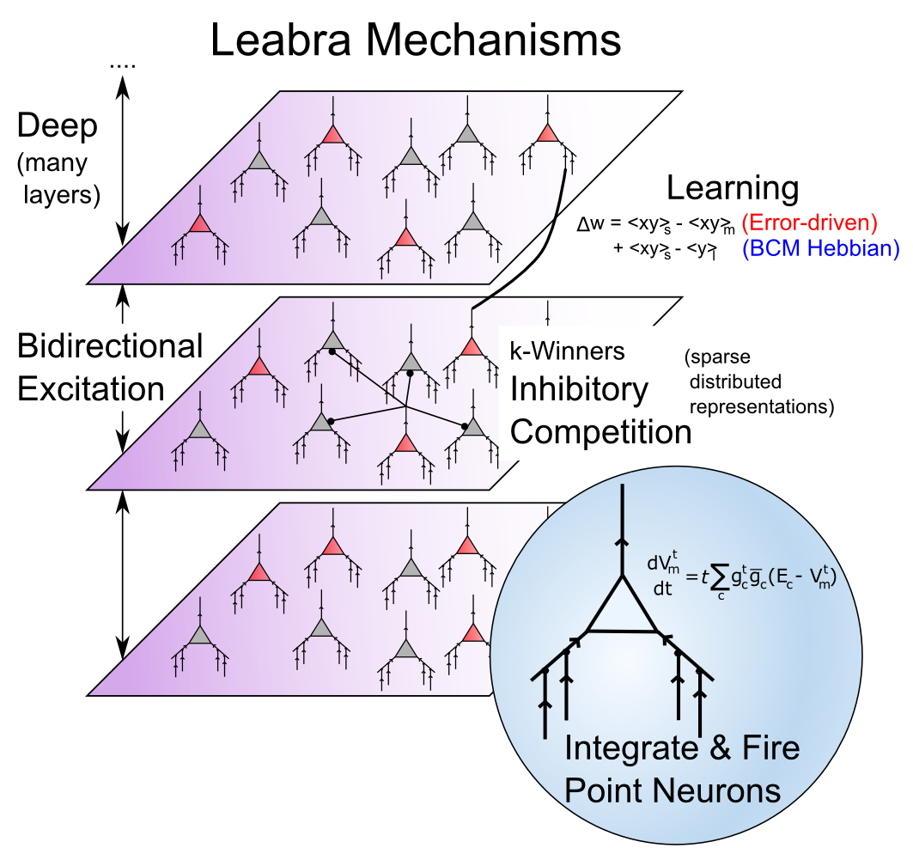
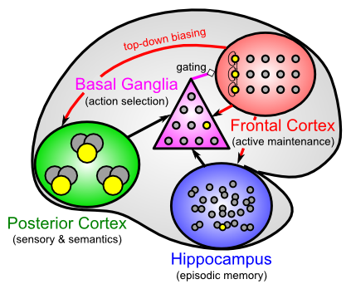
Biologically-based Cognitive Architecture
Same framework accounts for wide range of cognitive neuroscience phenomena: perception, attention, motor control and action selection, learning & memory, language, executive function…

Slide 9
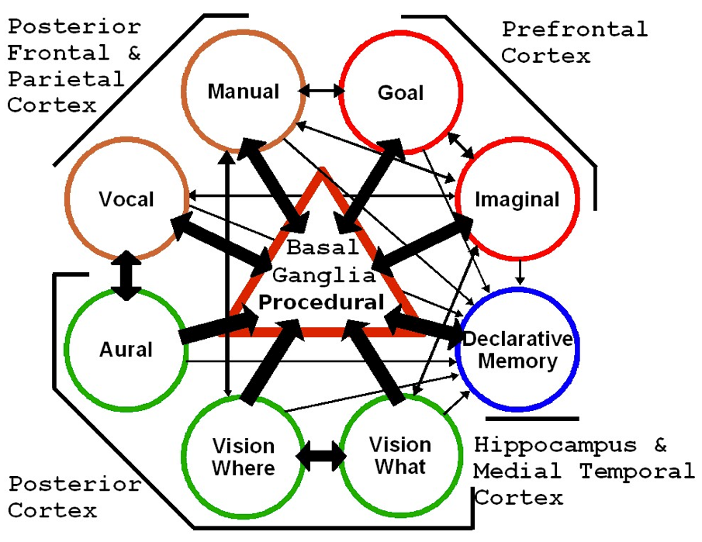
SAL: Synthesis of ACT-R & Leabra (Jilk, Lebiere, O’Reilly & Anderson, 2008)
(ACT-R now available in emergent)
Convergent architecture from very different trajectories and constraints

Slide 10
Neural Mechanisms of Adaptive Human Executive Control
Goal is to develop higher functionality, robust, adaptive, architecture, based on biology, with new advances
Key functional goals: neural mechanisms of robust cognition (error recovery at many levels):
Dynamic reconfiguration: recognizing difficulty, developing new plans with hierarchical planning
Top-down / bottom-up synergy: affordances for new solutions come from interactive perception
Pervasive learning: adapt at all levels from experience

Slide 11
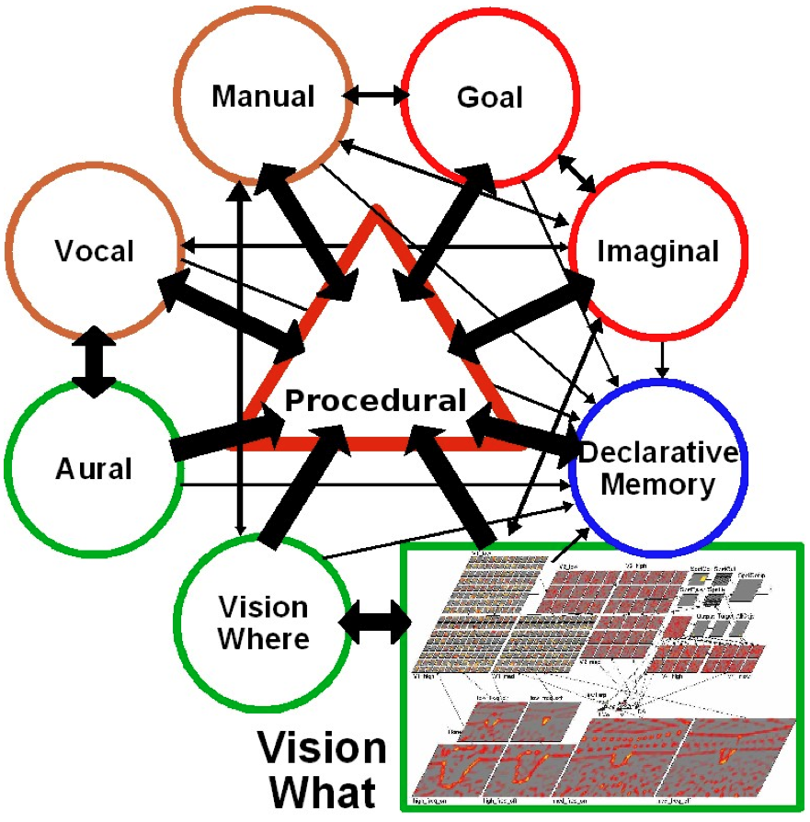
Starting Point is SAL v 0.1: Modular Replacement

Slide 12
Progressive Task Difficulty with Many Opportunities for Error
Assembly required: Lego blocks, IKEA Furniture
Perceptual errors, low-level motor errors, planning errors, instruction-following errors, etc.
Early vs. late discovery of errors: different levels of recovery required (fix last part vs. disassemble entire thing and start over)
Rich perceptual / motor affordances for planning (with dial-able difficulty)

Slide 13
Key Architectural Innovations: Expectations and Goals
Expectations: To detect errors, you have to know what outcome an action should produce.
Every ACT-R production now has explicit expectations for outcomes, results checked
New LeabraTI learning mechanism learns based on constant predictions vs. outcomes
Goals: To plan & re-plan, and learn plans from experience, every action must be in service of a goal, and system must explore in goal space first

Slide 14
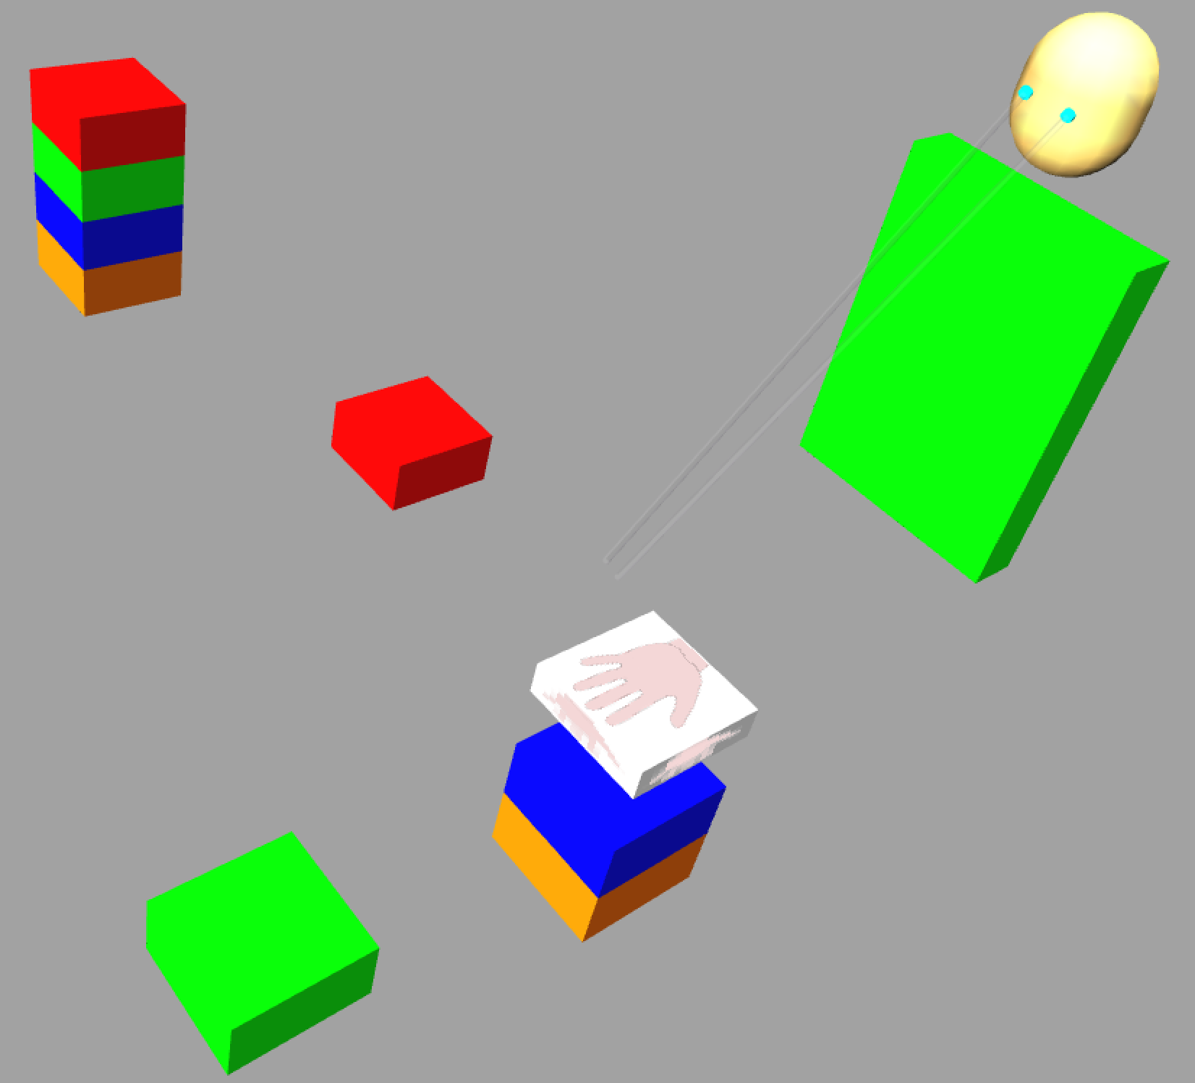
Simple Lego Assembly Task: Already Has Many Key Elements

Slide 15
Summary of Current Model
Outcomes compared with expectations to detect errors (fixation, identification, motor, etc)
ACT-R uses blended retrieval of prior experiences to decide proper strategy in face of errors: retry or start over again
Perception driven by Leabra vision model (LVis; O’Reilly et al, 2013)

Slide 16
SAL v 1.0: ACT-R Tutors Leabra
ACT-R Teacher knows overall task flow (“outer loop” control), trains Leabra network to perform task.
Leabra ultimately performs task by itself, using entirely learned, adaptive biological mechanisms.
Initial development underway, being used currently for ICArUS (IARPA) project
ACT-R implemented natively in C++ in emergent simulator to facilitate training

Slide 17
SAL v 1.0: ACT-R Informs Leabra
Leabra PFC & BG mechanisms learn procedural control through trial & error learning, based on dopamine reinforcement learning & PFC learning
ACT-R productions have far more powerful variable-binding capabilities than Leabra
Goal: Develop biologically-based systems that capture this power, while preserving adaptive learning mechanisms
Step 1: Indirection-based variable binding

Slide 18
Integration Tradeoffs
Messy puzzles are, well, messy…
Satisfying multiple constraints requires compromises – it is a balancing act (Libra / Leabra)
Purists and extremists may be disgusted
Everything in an architecture is embedded
Harder to isolate critical factors for any one result
Harder to communicate to those unfamiliar w/ arch
The good thing about standards [architectures]:… so many to choose from..

Slide 19

But Consider the Alternative…

Slide 20
Addressing the Tradeoffs
Pluralism: converging models across levels
Simple, standalone component models test elemental functionality
Integrated large-scale models at multiple levels of abstraction
Pragmatics
Steal the best ideas at all levels, without regret
Communicate the principles, clearly
Don’t overlook the value of $ to force collaboration

Slide 21
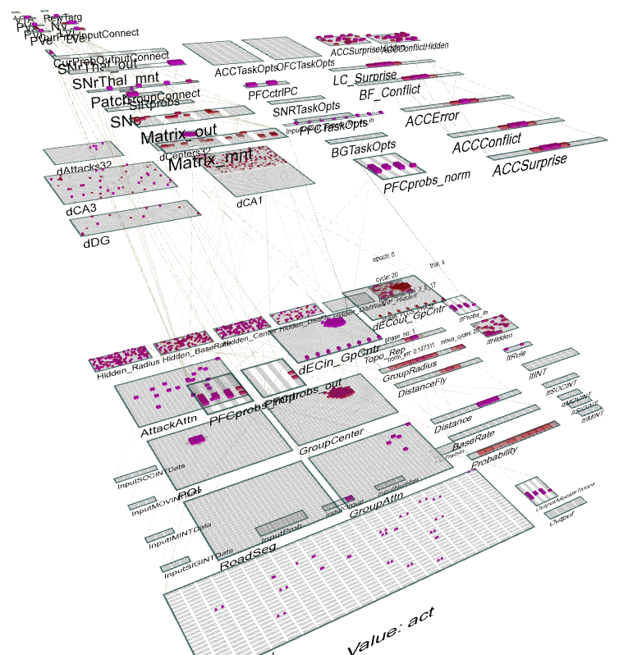
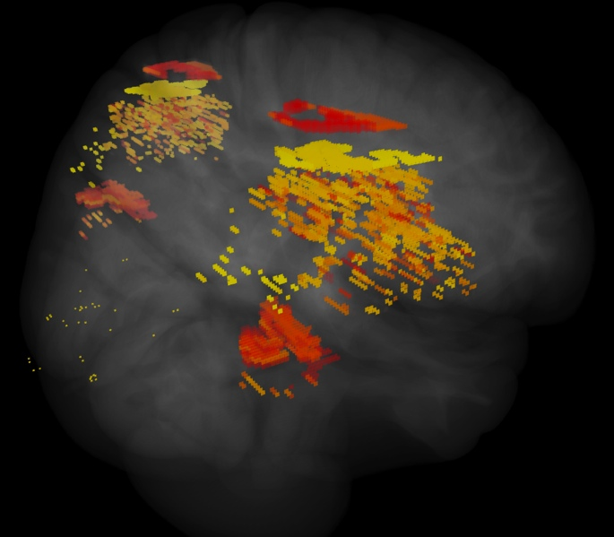
ICArUS-MINDS (IARPA) Integrated Cognitive Architecture for Understanding Sensemaking Mirroring Intelligence in a Neural Description of Sensemaking
Team: HRL (R. Bhattacharyya), CU Boulder (R. O’Reilly), CMU (C. Lebiere), UTH (H. Wang), PARC (P. Pirolli), UCI (J. Krichmar)
Goal: Build biologically-based cognitive architecture to model intelligence analyst.
Brain areas:
Posterior Cortex (IT, Parietal)
PFC/BG/DA
Hippocampus
BNS: LC, ACh

Slide 22
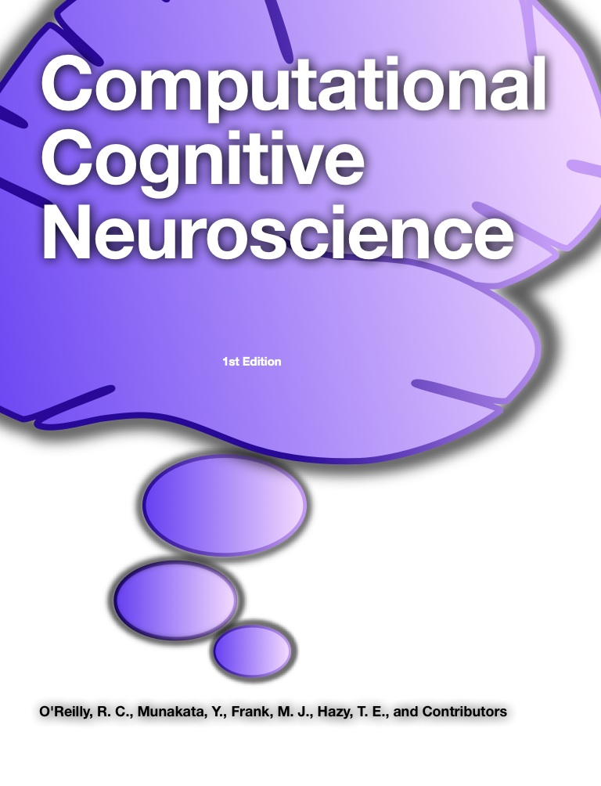
ccnbook.colorado.edu

Slide 23
Thanks To
CCN Lab
Tom Hazy
Seth Herd
Tren Huang
Dave Jilk (eCortex)
Nick Ketz
Trent Kriete
Kai Krueger
Brian Mingus
Jessica Mollick
Wolfgang Pauli
Sergio Verduzco-Flores
Dean Wyatte
Funding
ONR – Hawkins
ONR – McKenna & Bello
IARPA – Minnery
ARL RCTA
NIMH P50-MH079485

Slide 24
Discussion

