Slide 1
Balancing Biology, Computation, and Cognition in Integrative Architectures
Randall C. O’Reilly
University of Colorado Boulder

Slide 2
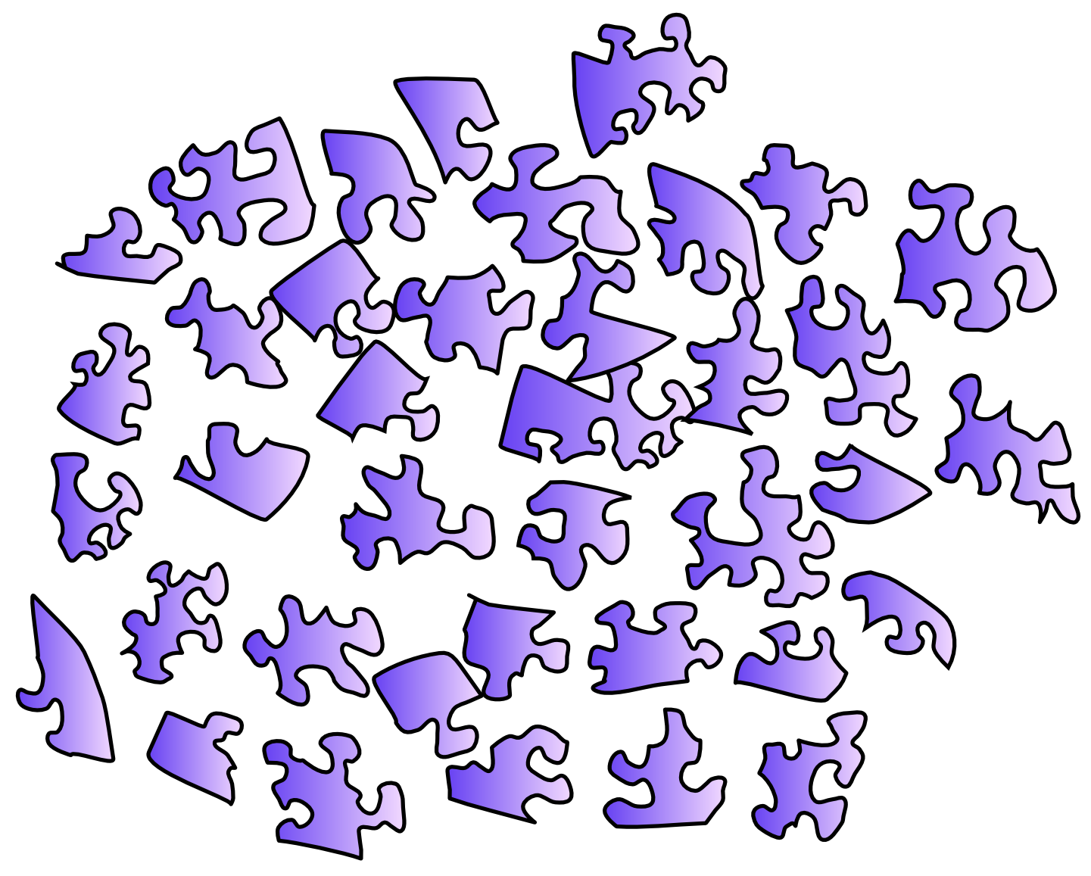
The Problem

Slide 3
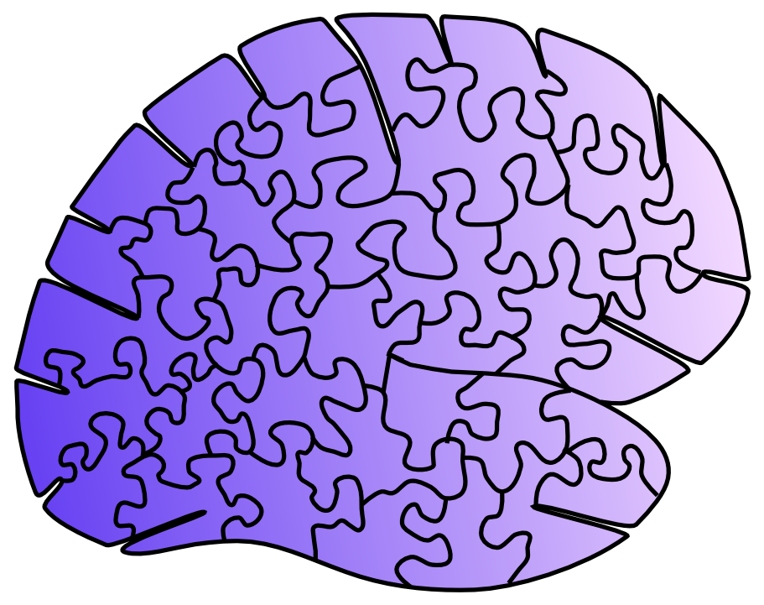
The Problem

Slide 4
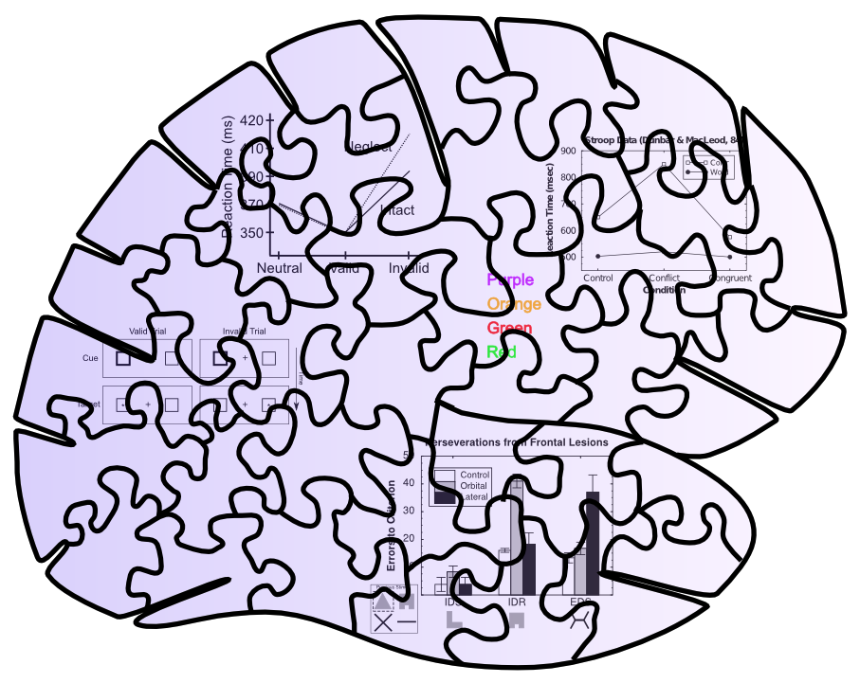
Behavioral Constraints

Slide 5
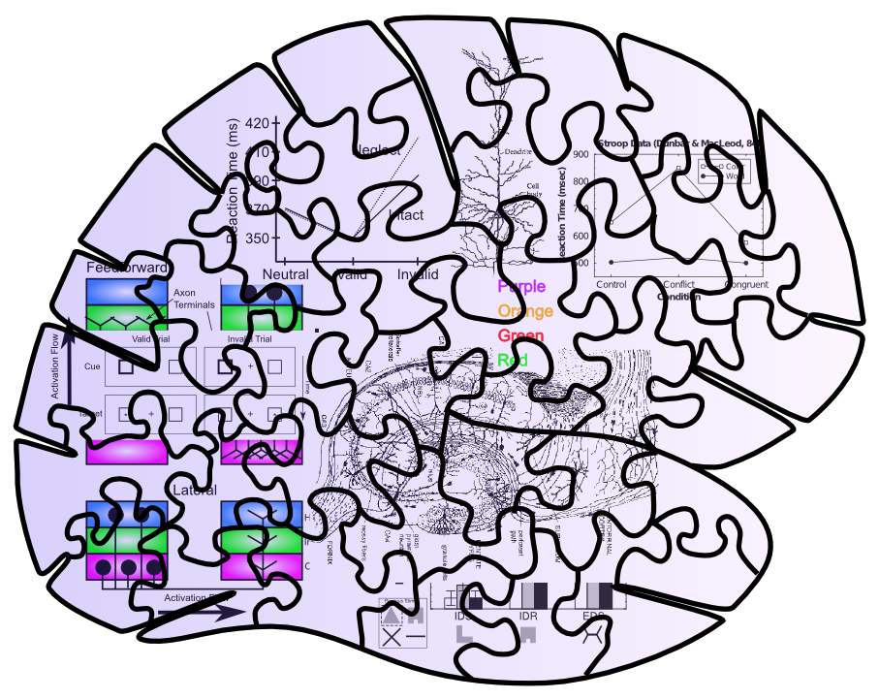
Neuro + Behavioral Constraints

Slide 6
Messy Puzzles are Easier to Solve!!

Slide 7
Newell’s argument: Satisfy more constraints in an Integrated Architecture
(Biology just as, if not more, constraining vs. other kinds of data)

Slide 8
Tradeoffs
Messy puzzles are, well, messy…
Satisfying multiple constraints requires compromises – it is a balancing act (Libra / Leabra)
Purists and extremists may be disgusted
Everything in an architecture is embedded
Harder to isolate critical factors for any one result
Harder to communicate to those unfamiliar w/ arch
The good thing about standards [architectures]:… so many to choose from..

Slide 9

But Consider the Alternative…

Slide 10
Is Extreme Simplicity Generative?
What have we learned from Bayes models?
Yes I know the Bayesian model is “optimal”
And much cleaner and more “principled”
But what fundamental constructive constraints does it really buy you??
Bayes may be too clean, too simple, too… sterile

Slide 11
Common Goals for Cognitive Architectures
The more constraints, the closer to the truth
Common small set of core principles explaining a lot of different data
Breadth is key: perception, memory, executive control..
Anti-modular modularity: everything is an interaction of many different components

Slide 12
Addressing the Tradeoffs
Pluralism: converging models across levels
Simple, standalone component models test elemental functionality
Integrated large-scale models at multiple levels of abstraction
Pragmatics
Steal the best ideas at all levels, without regret
Communicate the principles, clearly
Don’t overlook the value of $ to force collaboration

Slide 13
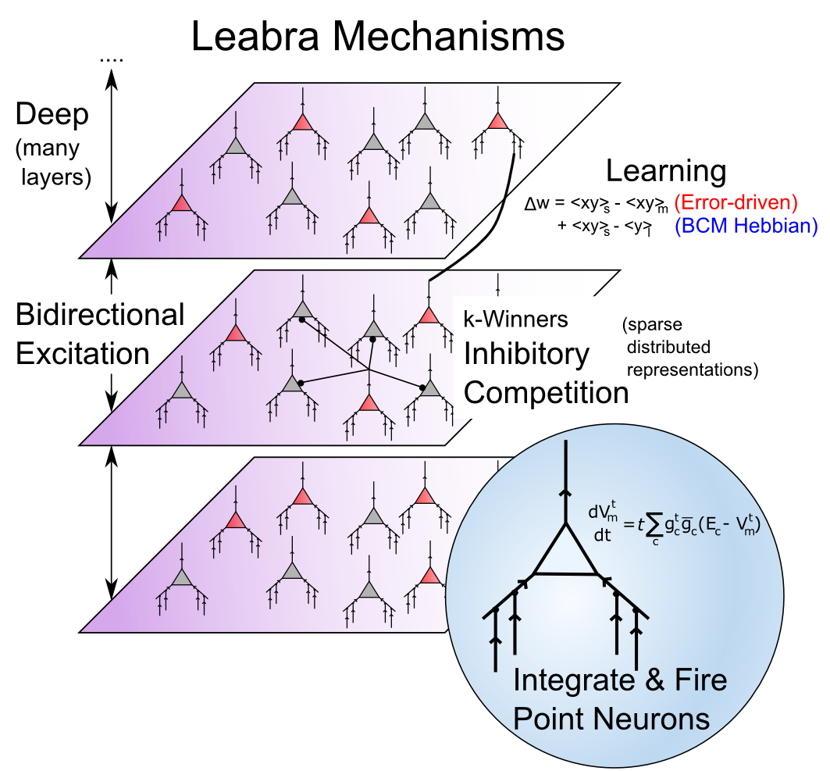
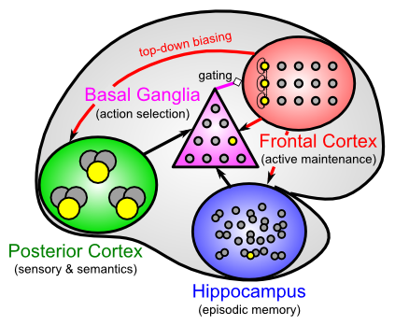
Biological Modeling Framework
Same framework accounts for wide range of cognitive neuroscience phenomena: perception, attention, motor control and action selection, learning & memory, language, executive function…

Slide 14
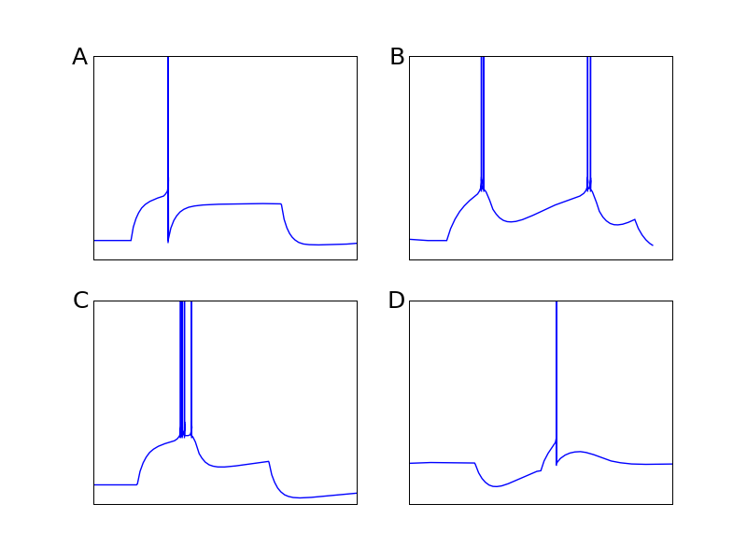
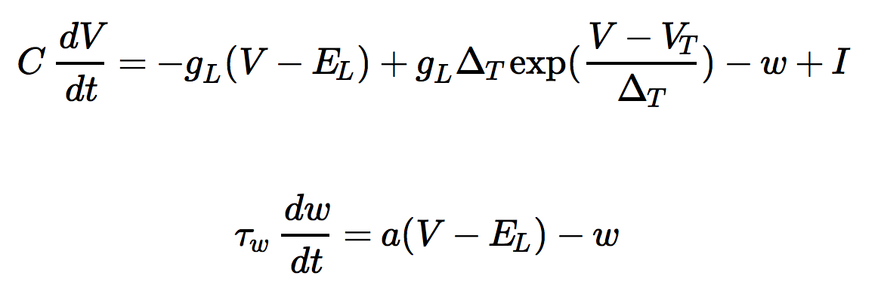
AdEx Spiking Neurons (Brette & Gerstner, 2005)
Just 2 more equations over basic integrate & fire (with Vm)
Similar overall to Izhikevich, but in more standard g(V-E) format
Has won competitions for best generalization fit to real pyramidal neuron firing

Slide 15
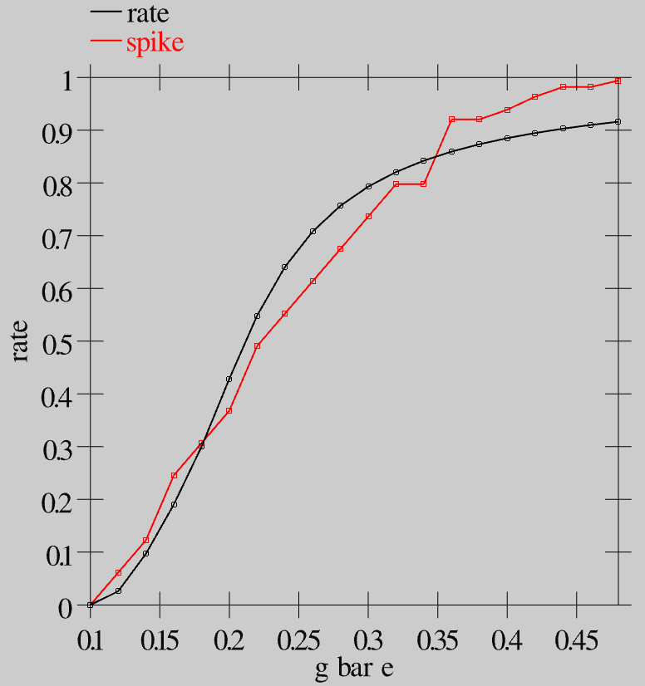
Multi-level Convergence
Fit between direct rate code & discrete spiking is very close
Mapping: 100 spikers per 1 rate code in a microcolumn
Tradeoffs:
Spiking = timing, dynamics
Rate code = efficient, large scale

Slide 16
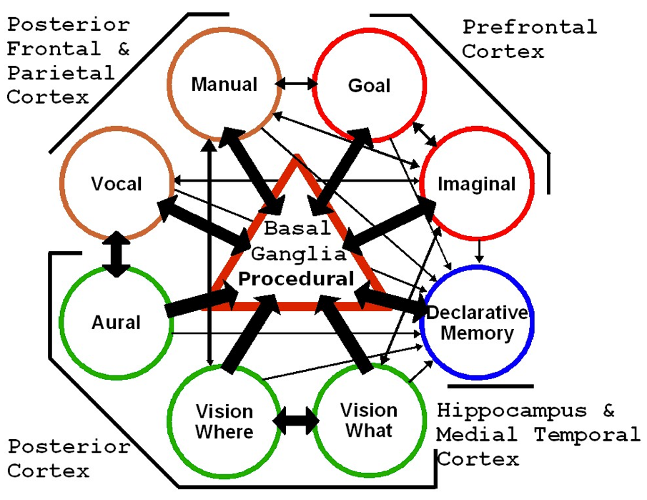
SAL: Synthesis of ACT-R & Leabra (Jilk, Lebiere, O’Reilly & Anderson, 2008)
(ACT-R now available in emergent)
Convergent architecture from very different trajectories and constraints

Slide 17
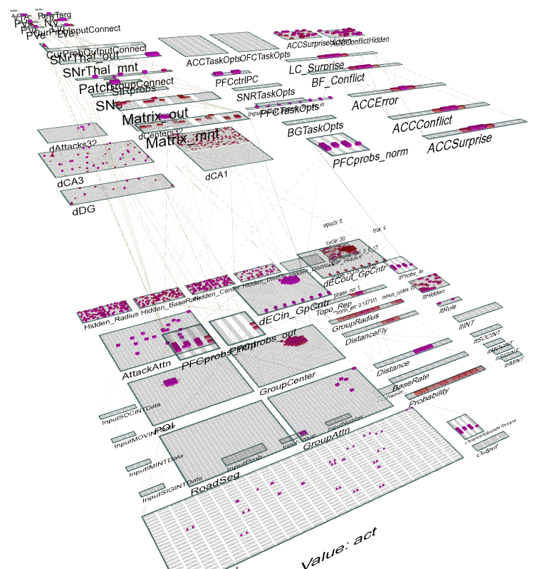
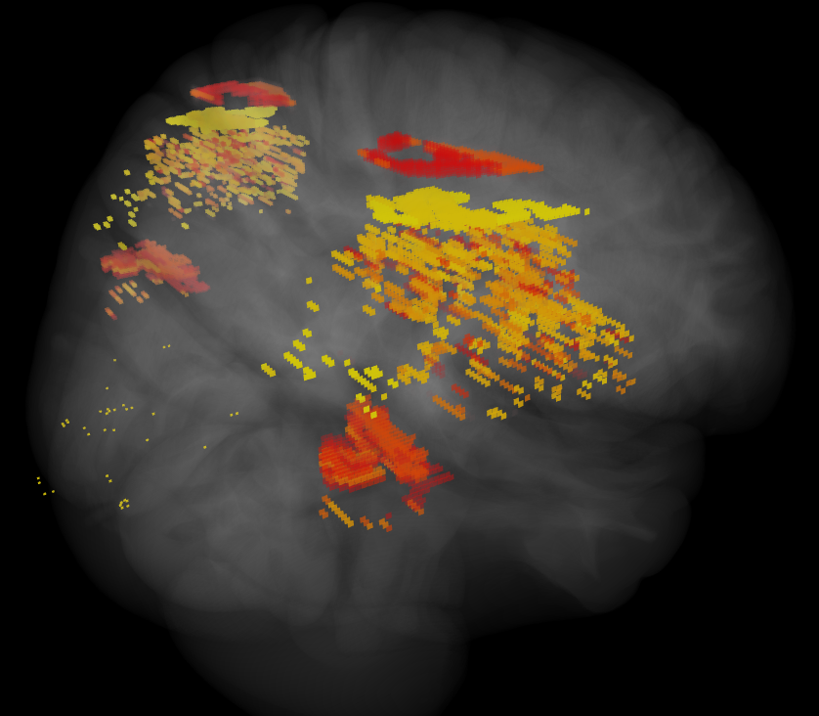
ICArUS-MINDS (IARPA) Integrated Cognitive Architecture for Understanding Sensemaking Mirroring Intelligence in a Neural Description of Sensemaking
Team: HRL (R. Bhattacharyya), CU Boulder (R. O’Reilly), CMU (C. Lebiere), UTH (H. Wang), PARC (P. Pirolli), UCI (J. Krichmar)
Goal: Build biologically-based cognitive architecture to model intelligence analyst.
Brain areas:
Posterior Cortex (IT, Parietal)
PFC/BG/DA
Hippocampus
BNS: LC, ACh

Slide 18
Convergent Pluralism
ACT-R model and Leabra model of same task
ACT-R serves as an implemented task analysis
Guides slower development and training of neural model
Latest approach: ACT-R is a Tutor (again) for Leabra neural models, which learn more slowly to perform same functionality – many opportunities to compare and contrast…

Slide 19
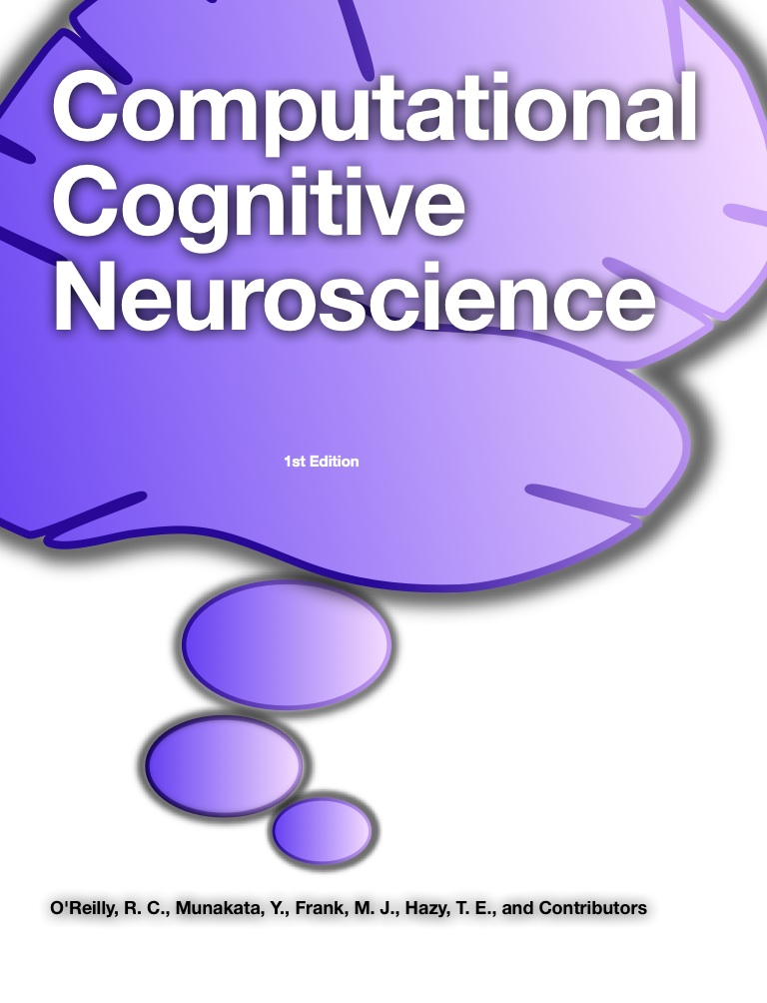
ccnbook.colorado.edu

Slide 20
Discussion

