Slide 1
Latest Leabra Dynamics
Randall O’Reilly, 2/27/12

Slide 2
Overview of Issues
Getting a decent rate-code activation function (new gelin)
Attractor dynamics and metacognitive signals
Dwt_norm and synaptic rescaling
Normalization vs. kWTA and Heeger’s model
Plans for spiking

Slide 3
Rate Code History
Old Vm-based: y = NXX1(Vm – θ)
Problem: actual spiking rate not monotonic in equilibrium Vm (without constant ahp): activations too binary.
Old ge-linear (gelin): y = NXX1(ge – geθ)
Problem: temporal dynamics not graded enough
New ge-linear (gelin): y* = NXX1(ge – geθ),
y(t) = y(t-1) + dt (y* - y(t-1)) – exponential dynamics

Slide 4
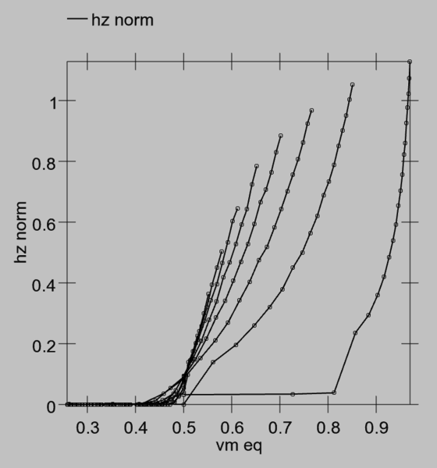
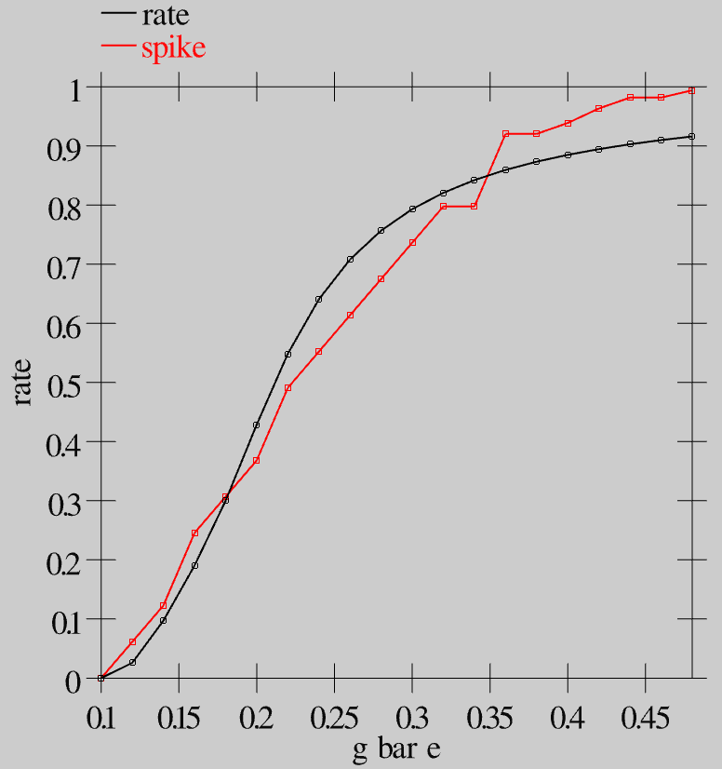
Rate Code Activations
Old Vm based - nonmonotonic
Gelin

Slide 5



Gelin Rate Code Equations
A little bit tricky because Vm doesn’t work.
Need to use excitatory conductance – threshold
XX1 equation:
ge-theta:
Tracking Vm timecourse:

Slide 6
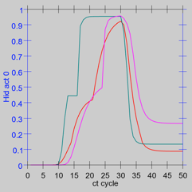
Temporal Dynamics
Violet = old vm-based
Green = old gelin
Red = new gelin
svn_sims/leabra/dev_misc/gelin_debug.proj

Slide 7
Attractor Dynamics
http://grey.colorado.edu/ccnlab/index.php/Leabra_Attractors
Dwt_norm improves d’ considerably
New gelin d’ = 2.24 – vs. like .8 or so before..
Higher gain = lower d’ (1.73) but more graded attractors..
svn_sims/leabra/spike_learn/proto_spk_flex.proj

Slide 8
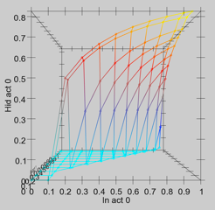
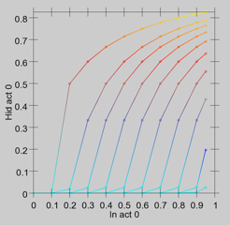
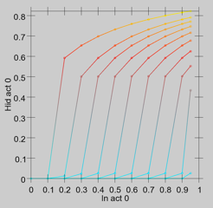
Heeger-style Normalization
svn_sims/leabra/dev_misc/gelin_debug.proj

Slide 9
Dwt_norm and ampa rescaling
Dw = dw* - \sum dw*/n – subtract average
http://www.sciencedirect.com/science/article/pii/S0896627306006830
http://www.sciencedirect.com/science/article/pii/S016622360700077X

Slide 10
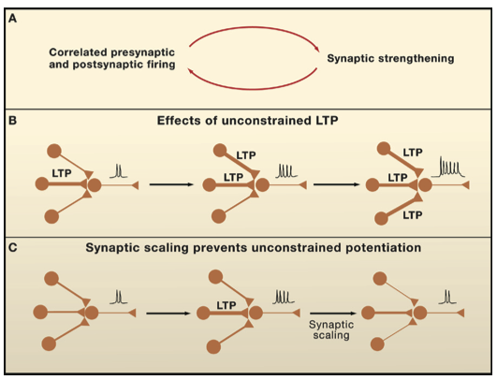
Ampa rescaling via Arc (Turrigiano review, 2008)
http://www.cell.com/abstract/S0092-8674(08)01298-1

Slide 11
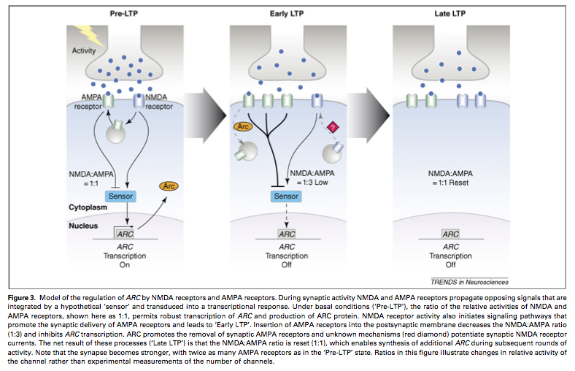
Ampa rescaling via Arc

Slide 12
Spiking issues
Avantages:
rapid first-pass signal followed by more graded
Contrast enhancement from synchrony
Issues:
Kwta doesn’t work very well (only basic I&F)
Need to mess with inhib interneurons
Can still do rate-code like learning??
Plan:
Two-tier “kinky” inhib – more robust set-point?

