Slide 1
LeabraTI: Temporal Integration

Slide 2
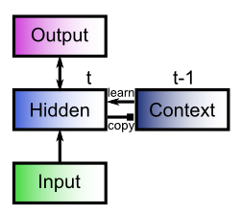
Simple Recurrent Network
Hidden learns to integrate present + past
Context holds past (t-1) as veridical Hidden copy
Solves representational problem: how else to train good context rep?
(training signals are in present, contaminates past if used for context)

Slide 3
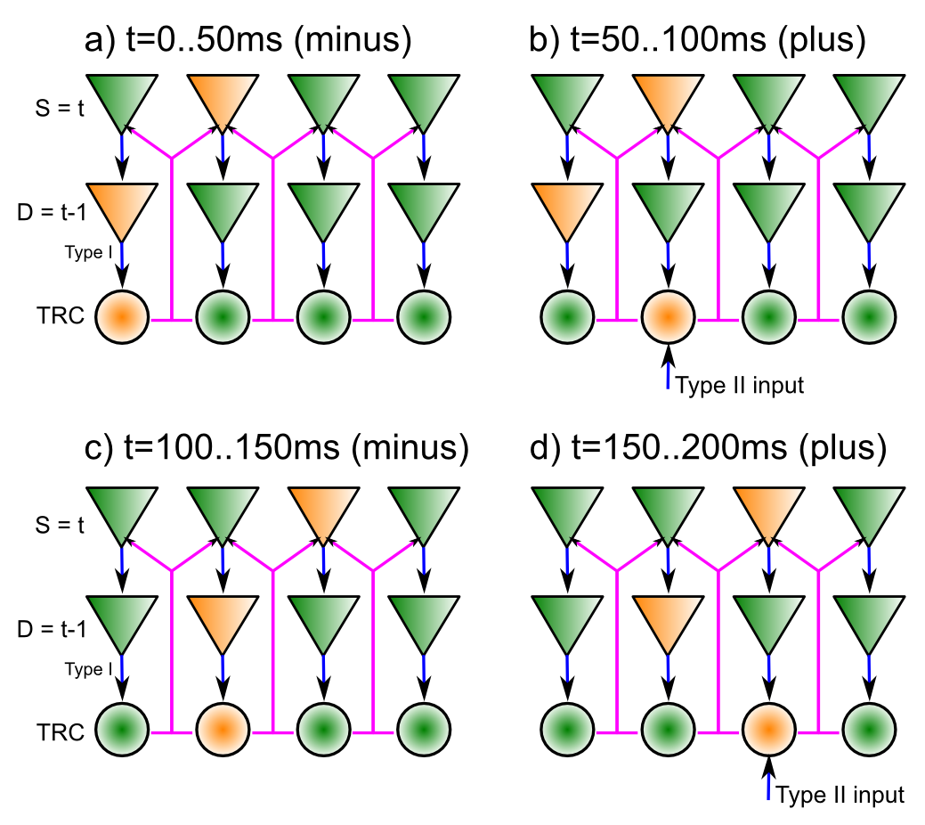
LeabraTI: SRN as fundamental cortical computational unit
Superficial = “hidden” = t
Deep = context = t-1
Isocoding microcolum = copy
Deep updates @ alpha (10hz = 100ms cortical clock)
Super updates at gamma (40+hz)
Minus phase: TRC broadcasts deep context, super makes expectation
Plus phase: TRC has driving inputs
Learning = plus – minus (XCal)
Goal: to predict / reconstruct inputs

Slide 4
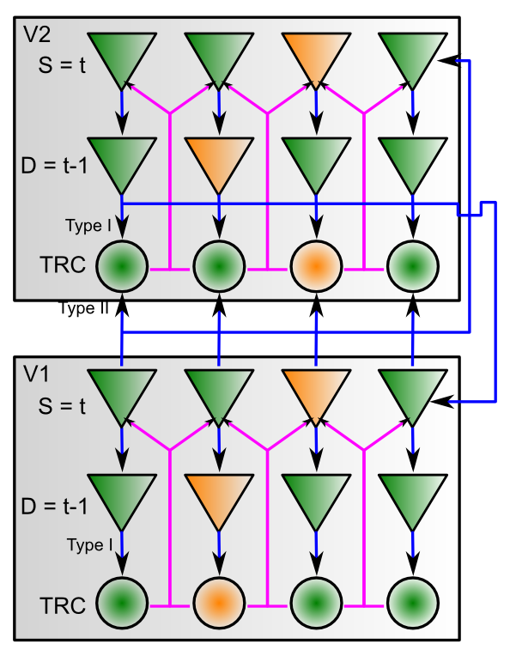
LeabraTI: Multi-layer Structure
Feedforward = super to super and TRC type II drivers
Feedback = super & deep to all
Entire network alpha phase locked for minus/plus phase coherence
V2,V3,MT,PPC all produce rich predictive encoding of visual structure (surfaces, bodies, motion, depth, occlusion, etc)
Higher layers (V4,IT,etc) do multimodal prediction (visual from auditory, etc)

Slide 5
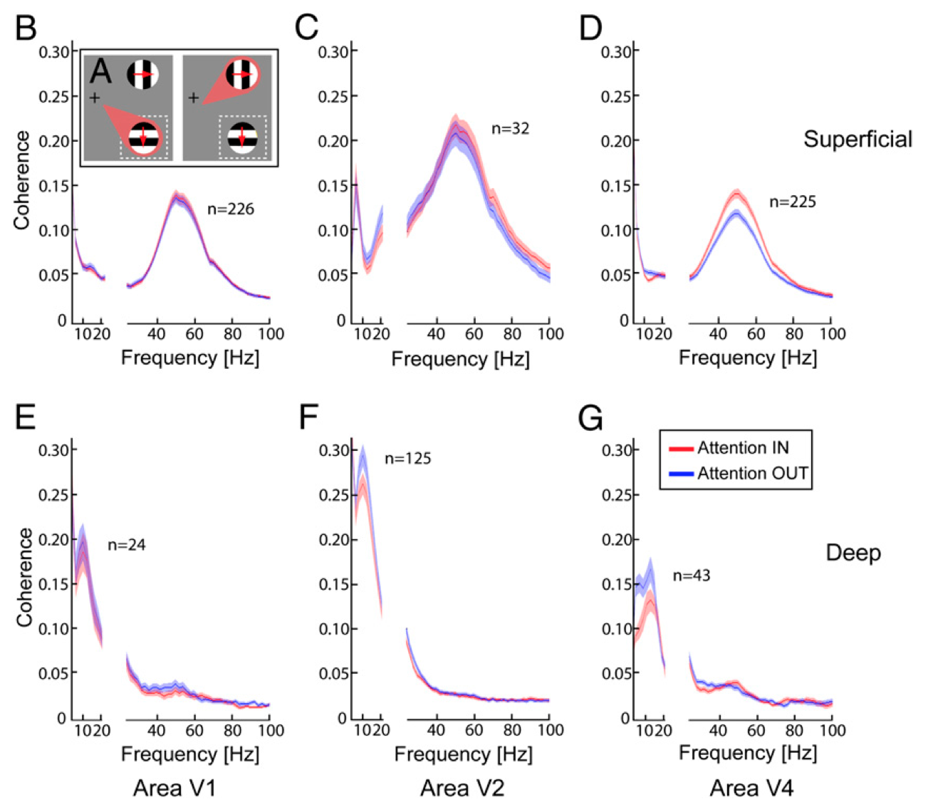
Buffalo et al, 2011 Super = gamma, Deep = alpha

Slide 6
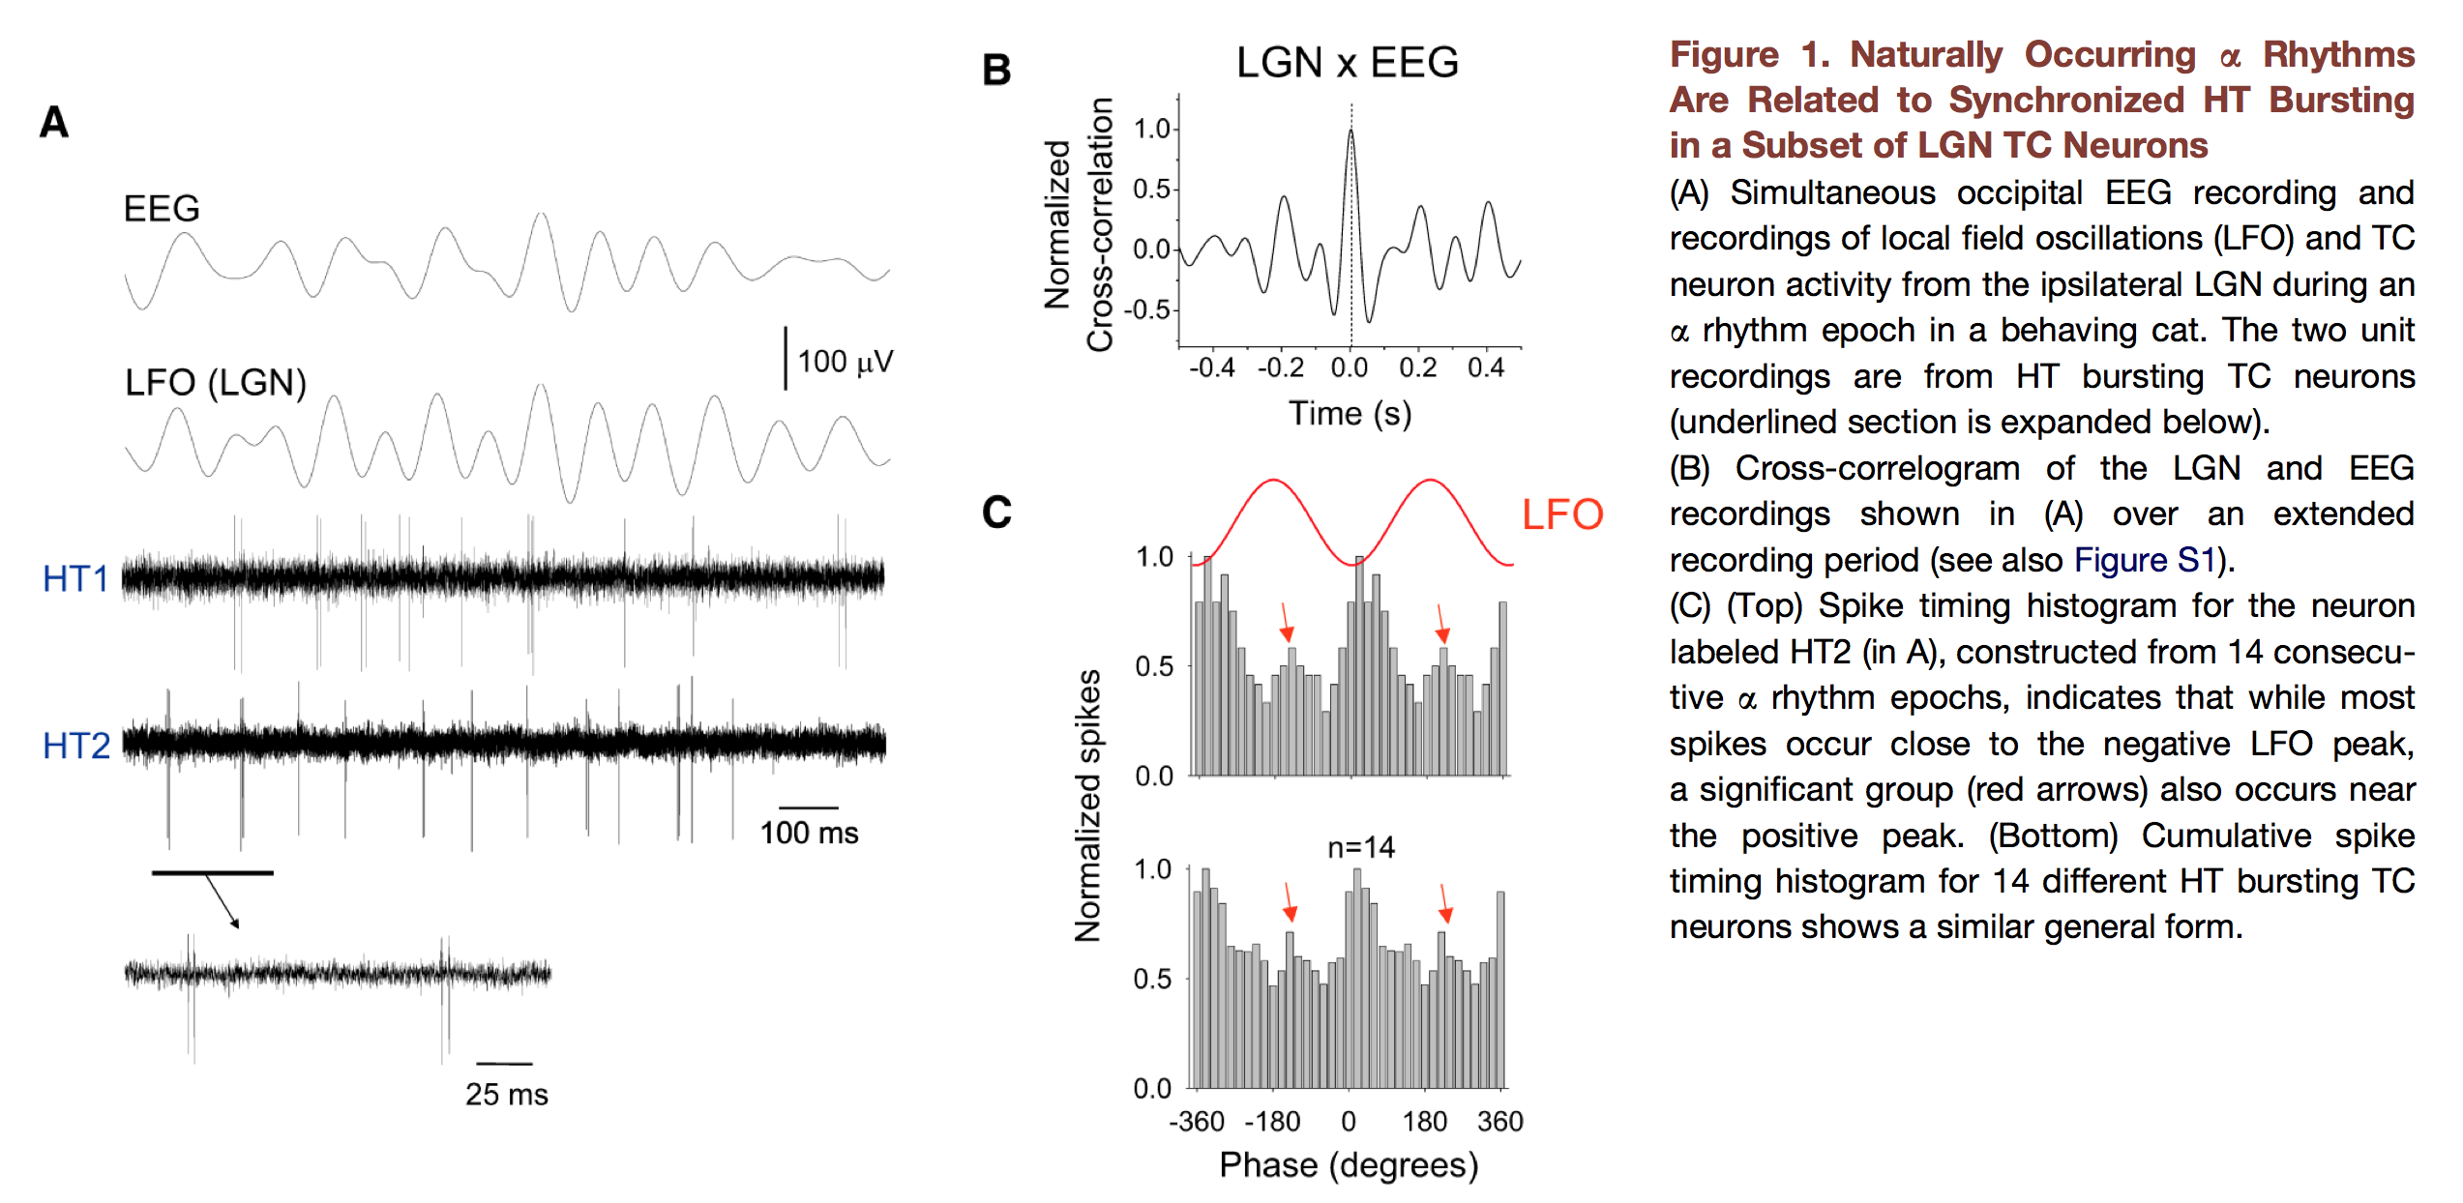
Lorincz et al (2009): LGN Alpha
Thalamic circuits drive alpha rhythms that provide clock for minus (no sensory input) and plus (strong sensory input) dynamics, within overall trial length of 100ms

Slide 7
Computational Results
LeabraTI computationally = SRN, many models
But we have unique bidirectional single-input/target layer reconstruction dynamic (no separate input / output or time straddling – only ever gets positive examples from world)
Dorsal_ti = develop V2,V3,MT,PPC reps by predicting outcomes of large number of random visual sequences – physics simulation -> vision
Brad Aisa’s auditory model: predict auditory inputs

Slide 8
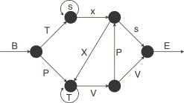
Classic example: Reber grammar
Generates strings like: BTSSXXTTTVPSE
SRN can easily learn to predict valid (not actual) next input

Slide 9
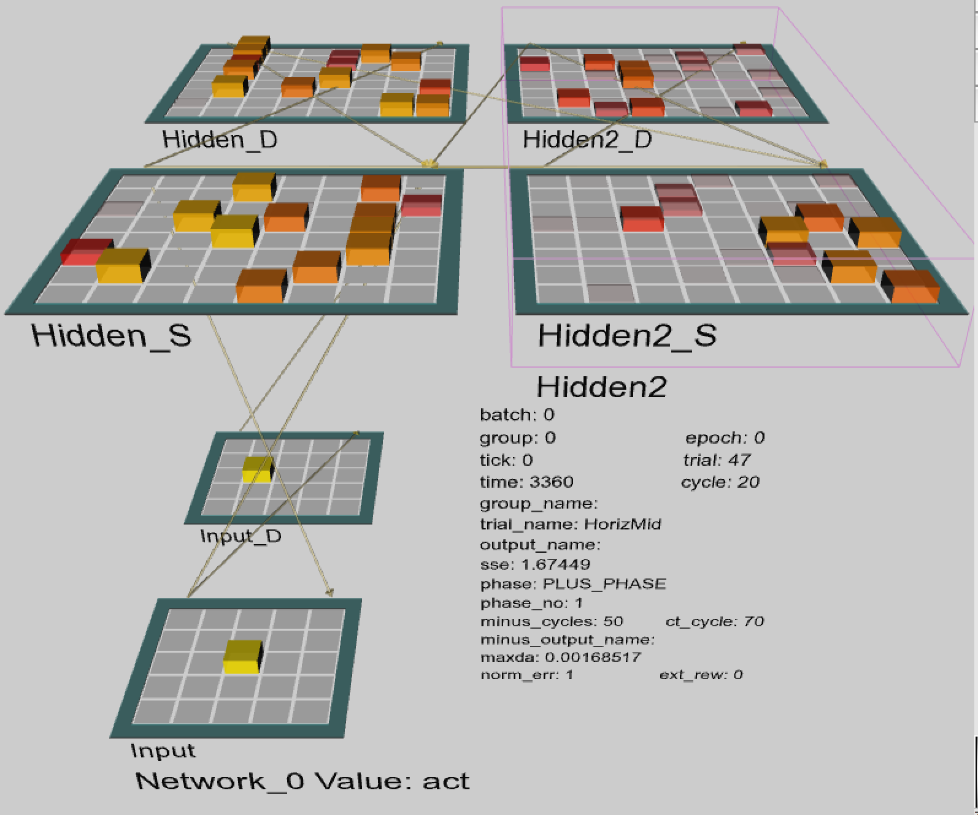

Slide 10
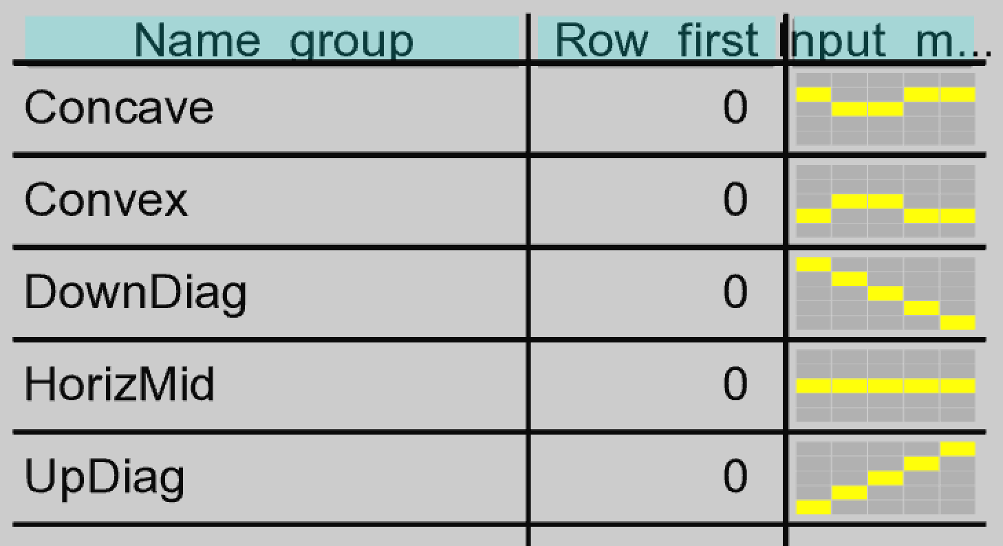

Slide 11
