Slide 1


Learning to Infer Causal Structure over Time
Randall C. O’Reilly
University of Colorado Boulder & eCortex, Inc
w/ Kai Krueger, Trent Kriete, Suhas Chellian, Rajan Bhattacharyya, Peter Pirolli

Slide 2
Beyond Pattern Recognition
Pattern recognition dominates machine learning
e.g., Deep neural networks, SVM, etc..
More complex reasoning requires encoding structured, relational representations
Analogies, events (who did what to whom), strategies, etc..
Bayesian & symbolic models dominate here
But can they learn novel structures completely de-novo like neural networks do?
Typically learn parameters on given structures

Slide 3
Learning Causal Structure
LeabraTI (Temporal Integration) neural network learns by predicting what happens next
Learns de novo causal logic from multi-agent causal events unfolding over time.
Can generalize this learned structure to novel entities, based on how they behave
Fits human data in range of causal inference tasks (“blicket” paradigm): backwards blocking, screening off, conjunctive, disjunctive, noisy..

Slide 4
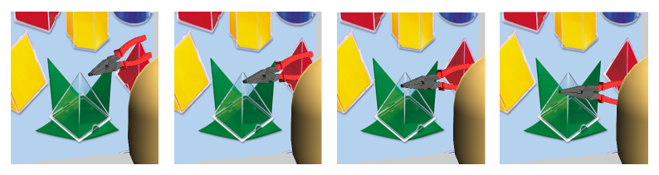
Predictive Learning
Predictive learning creates nearly infinite supply of challenging learning problems: can learn a lot about physics and visual structure
Widely exploited idea: Helmholtz, Elman, Hawkins…
Requires encoding of prior context for future prediction
LeabraTI: based on thalamocortical loops and neocortical layers

Slide 5
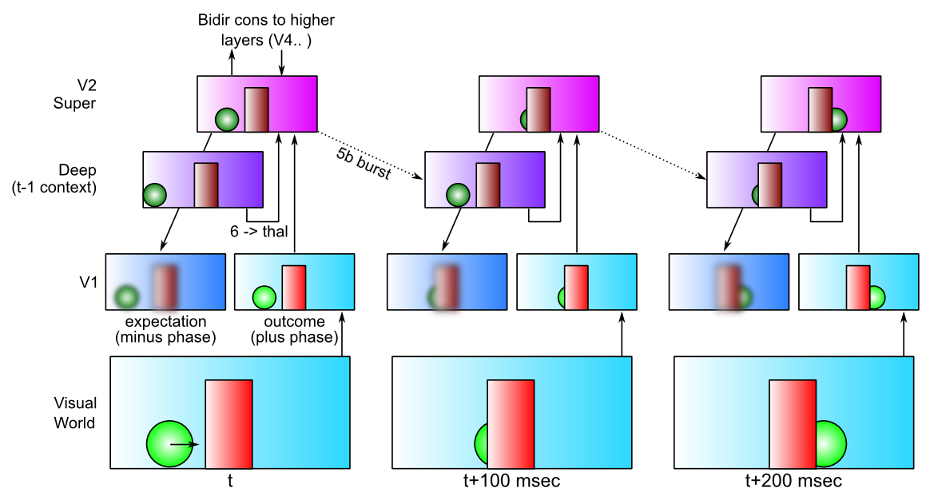
LeabraTI: Learning Through Time in the Thalamocortical Loops

Slide 6
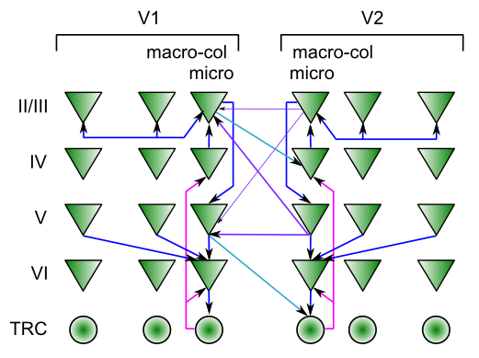

LeabraTI: Biological Details
Many testable predictions:
Perceptual discretization at alpha freq (10hz)
Deep layer alpha vs. superficial gamma
Consistent with existing data; testing predictions

Slide 7
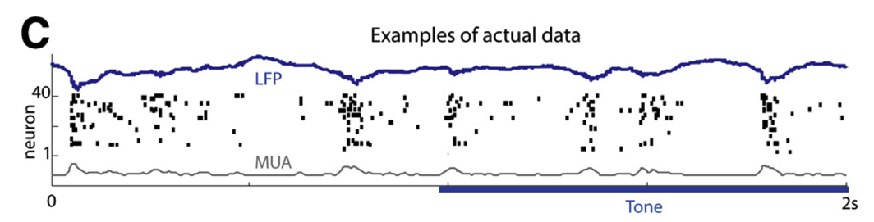
TI: Key Biological Data
Alpha freq dominant in deep layers (e.g., Buffalo et al, 2011).
Sustained auditory tones discretized into alpha “packets” (Luczak et al, 2013)
Many indications of discretization in perception (Van Rullen & Koch, 2003)
Saccades: thalamic input is blanked out, prediction generated
Blanking important for allowing a prediction to be generated over same neurons where actual input is processed.
Predictive remapping during saccades very well documented

Slide 8
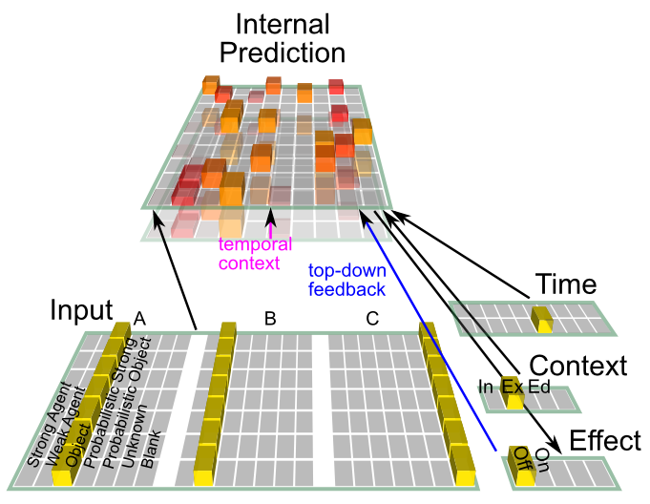
TI Model

Slide 9
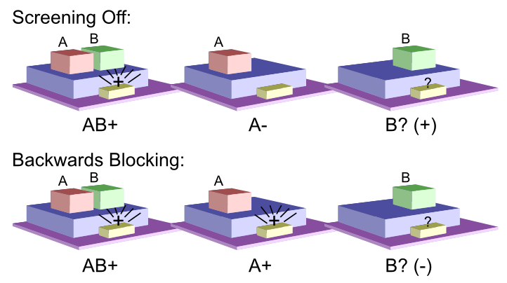
The Blicket Detector

Slide 10
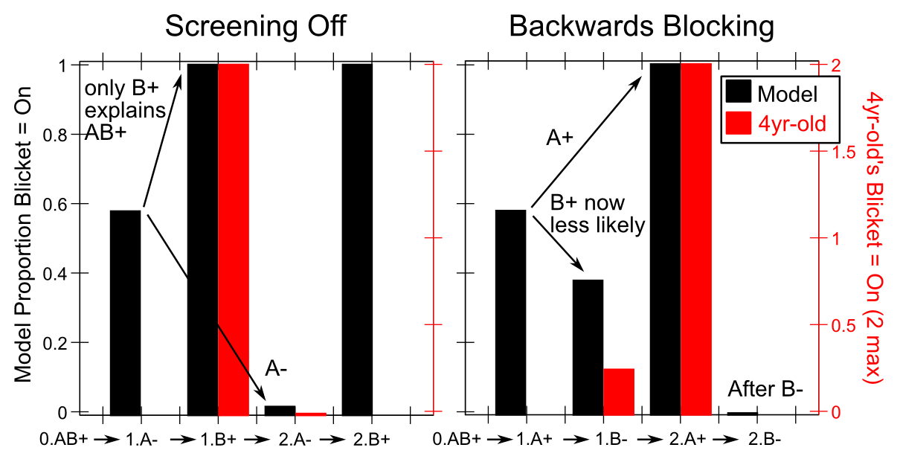
Model Results

Slide 11
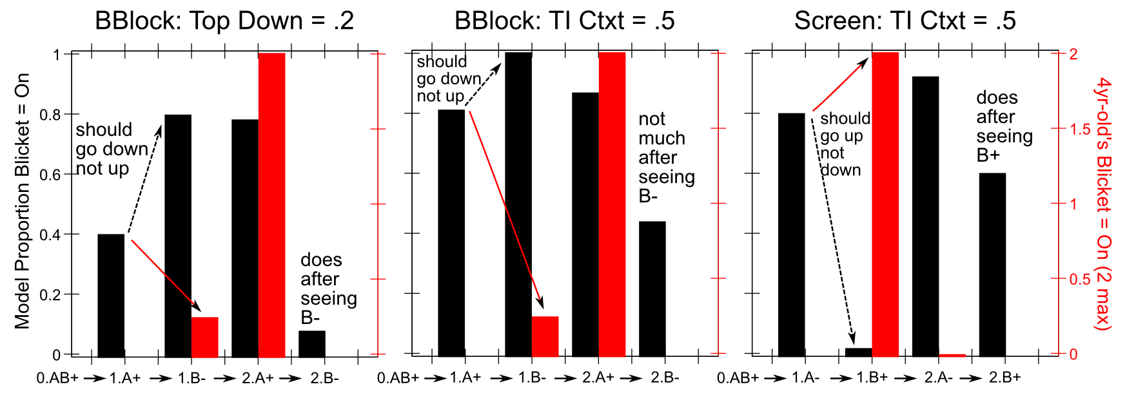
Depends on Temporal Context, Recurrent Processing

Slide 12
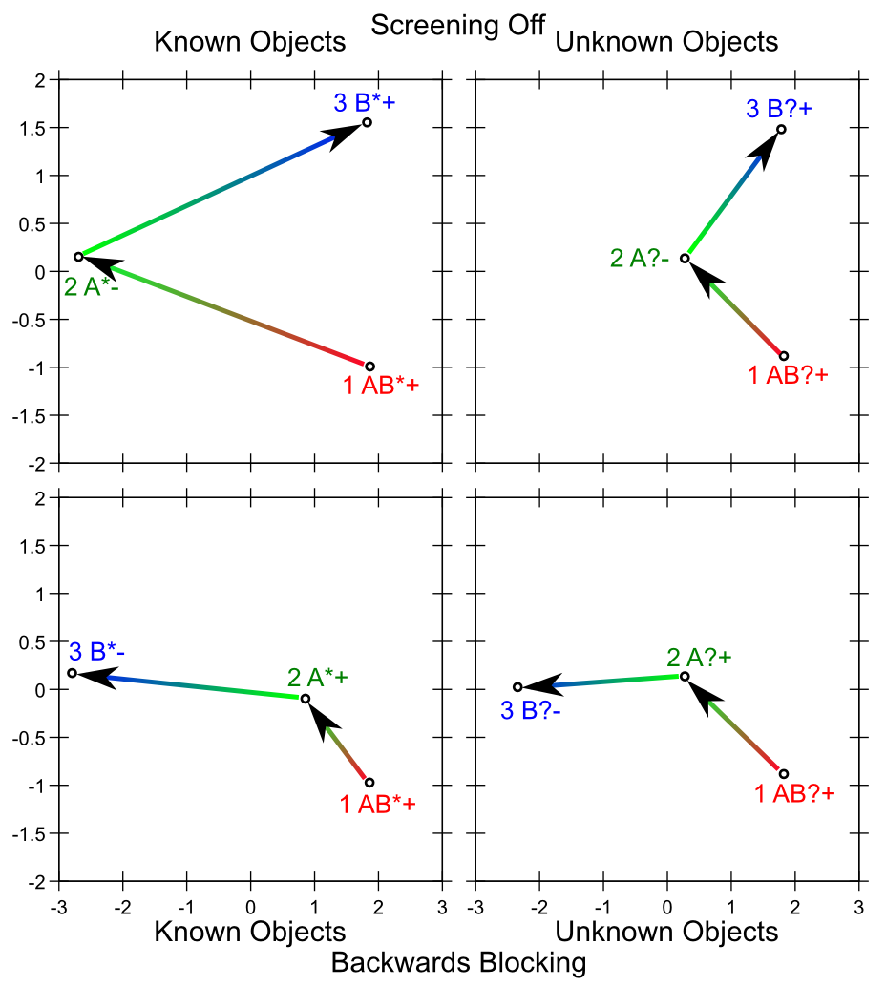
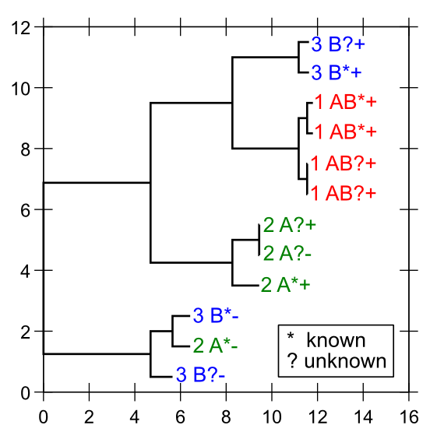
Network Dynamics over Time
PCA projection of internal representations, and cluster plot of distances between representations

Slide 13
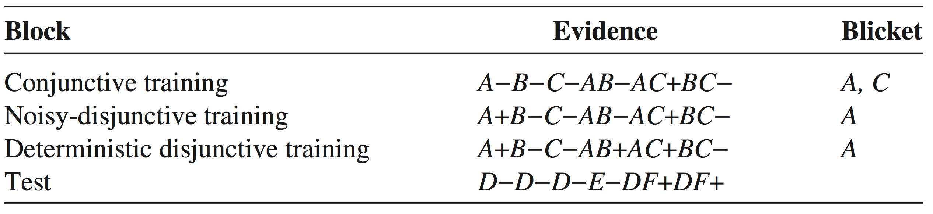
More Subtle Inferences: Conjunctive vs. Disjunctive Causes

Slide 14
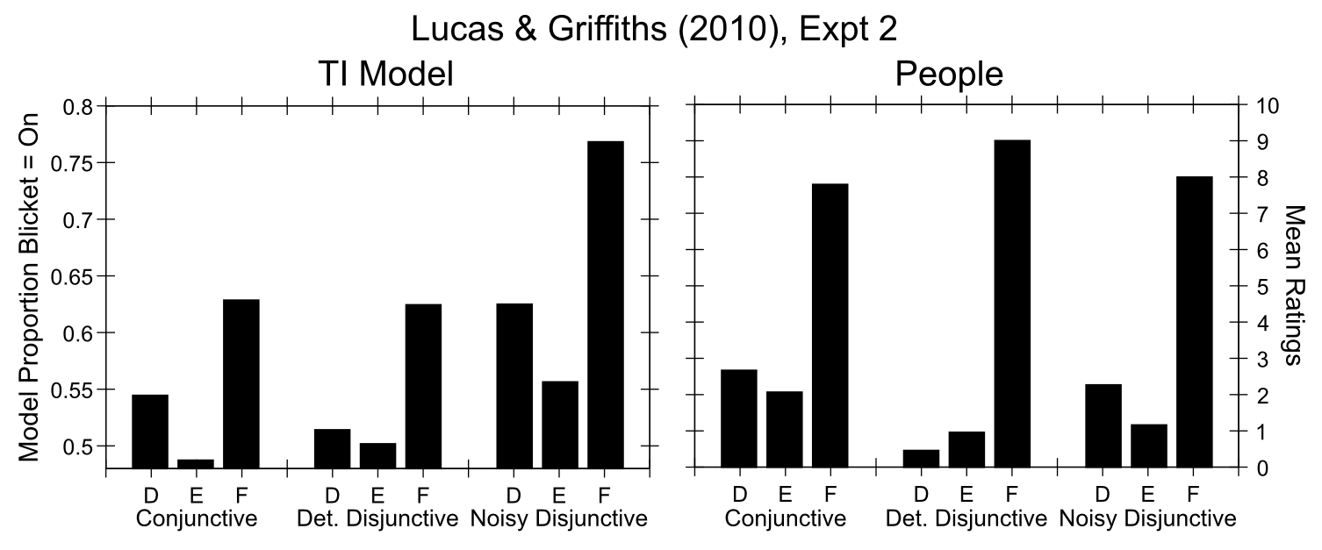
Model Reproduces Qualitative Patterns

Slide 15
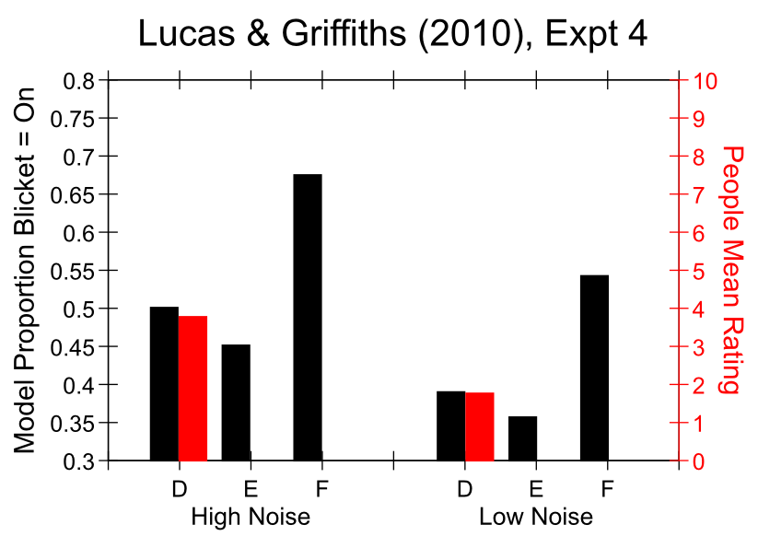
Sensitivity to Probabilities

Slide 16
Conclusions
Neural network predictive learning can learn to infer about status of unseen objects given outcomes from other objects
The neural advantage: ability to learn complex structured representations completely de-novo – contrast with Cyc, Bayesian models, etc where knowledge is engineered.
Learned structured knowledge generalizes readily to novel cases..

Slide 17
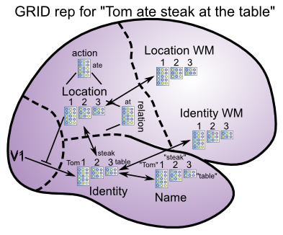
Future Work
How well does this scale?
Binding issues: “generic slots” Grounded Replicated Indexed Data (GRID) (c.f., Taatgen, Pylyshyn)
Goal-grounded representations: learn by doing..

Slide 18
Extras

Slide 19
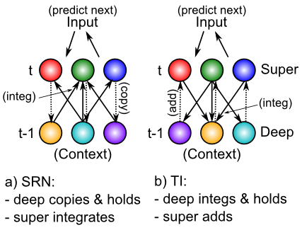
LeabraTI vs. SRN

