Slide 1

Continuous Time Leabra, eXtremization Contrastive Attractor Learning (XCAL)
Randall C. O'Reilly
University of Colorado Boulder

Slide 2
Overview
Derivation of learning rule from Urakubo et al (2008) hyper-detailed STDP model
Determining how it might do something useful..

Slide 3
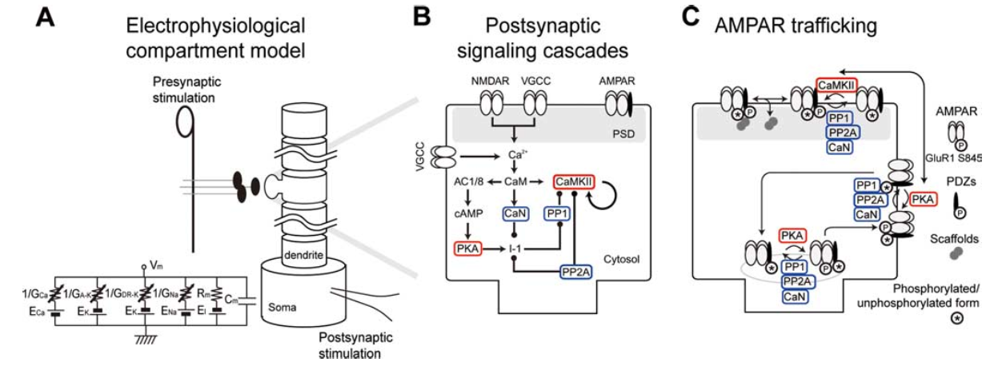
Urakubo et al, 2008 Model
Unbelievably detailed combination of 3 existing strongly-validated models:

Slide 4
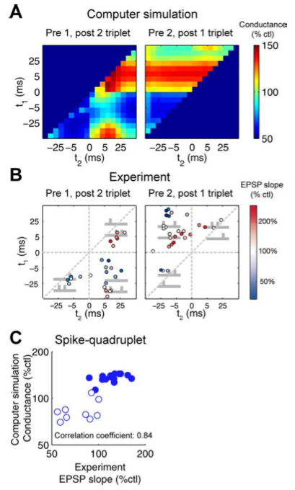
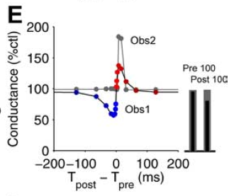
Requires “Allosteric” NMDA to Capture STDP

Slide 5
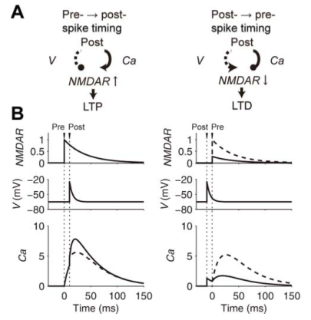
Allosteric NMDA
Basically, post-spiking inhibits subsequent Ca influx from pre-spiking!
The mediating variable (CaM) has a slow timecourse – this explains non-independence of triplet and quad data

Slide 6
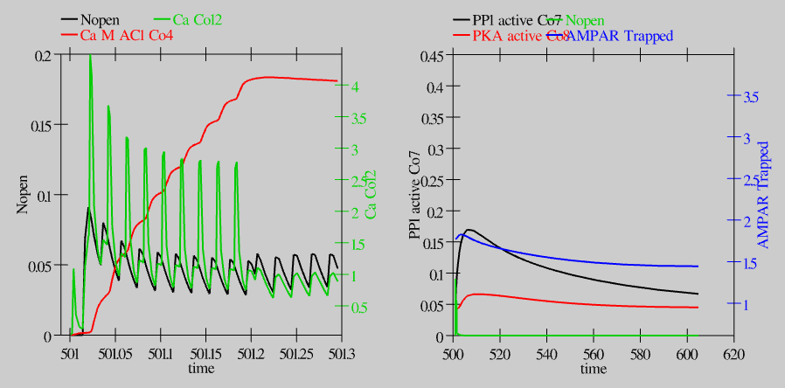
Allosteric LTD from Spike Train

Slide 7
Extraction of Learning Rule
Run full Urakubo model with sender and recv firing rates in [10-100]hz range, every 10hz, for durations from 10-1000msec, and record resulting weight change value (dWt)
Attempt to fit resulting dWt as function of these “rate code” variables, using some kind of simple function..

Slide 8
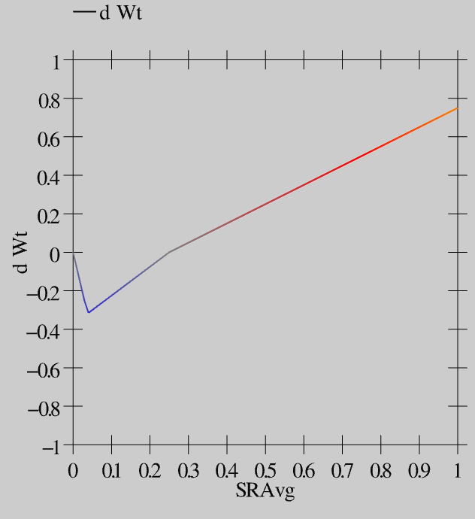
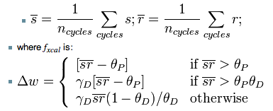
Simple Function: XCAL Fun
f(s,r,d) = f(s*r*d)!

Slide 9
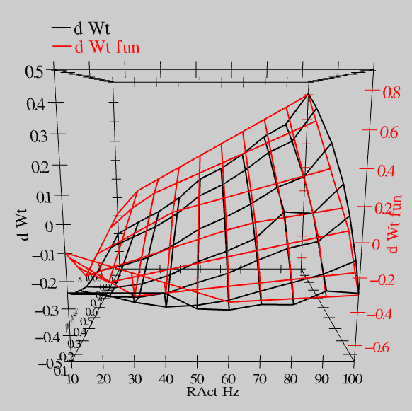
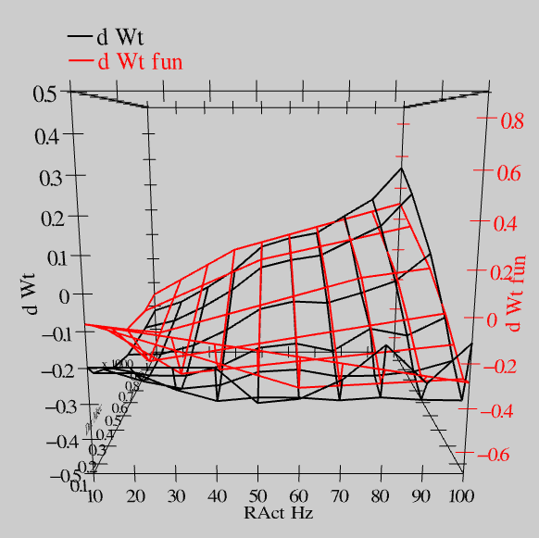
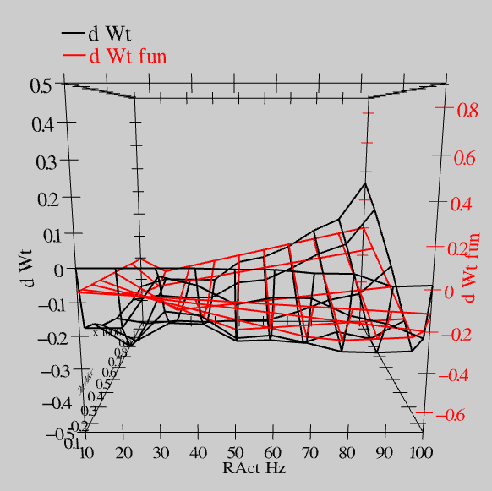
Fits data r=.894!
S = 100Hz
S = 50Hz
S = 20Hz

Slide 10
STDP??
TODO: generate lots of random spike trains and see how much variance in dwt outcome there is.
Prediction: because CaM has slow kinetics, timing simply won't matter much (it is really responsible for the timing asymmetry).
However: “first” spike may matter somewhat (is there a “first” spike in the brain??) – Thorpe data (and model) showing time to first spike is highly correlated with subsequent rate.
Note: STDP expts are diabolically designed to only be about “first” spikes w/ 1s intervals between them – very artificial.

Slide 11

BCM Rule
XCAL is basically linearized BCM curve: both are “rich get richer” (eXtreme!)
And very familiar LTP/D as f(Ca) curve
BCM has floating LTP threshold as f(avg act) – prevents hogs, keeps in game
Key new variable here is duration

Slide 12
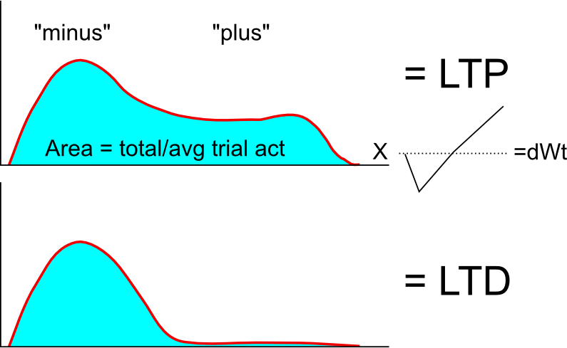
Duration = Error-Driven Learning?

Slide 13
Issues
Not full err: LTP when active in – & +
  Generally: combination of err + “hebbian”
  BCM does something much more useful in this case than simple Hebbian!
DA effects: magnify “plus” phase for learning?
  p_boost parameter in simulator: 10-15x..
What goes into Θ_{p} threshold?
  If it reflects avg act in cur trial, and learning is based on p-boosted acts, then you get:
  act_p – ravg = delta on recv unit = recv-only version of CtLeabra CAL learning!

Slide 14
What Works
BCM alone on plus phase acts (p_boost = 10k!)
  Gets ~80% correct on random assoc – much better than simple Hebbian
Recv-CAL (r_act_p * s_act_p – ravg * savg_thr)
  ~92% correct on RA (not as good as CAL)
.3 BCM + .7 Recv-CAL (self-org & err combo)
  100% w/in ~40epcs (same as CAL)
  Key to base Θ_{p} on non-p_boost acts: thr is a kind of average over ravg's across trials

Slide 15
Remaining Issues
Fully continuous, asynchronous operation:
  For any sig chunk of activation: integrate over ~1sec or so, and compute XCAL on that..
Syndep at unit level seems important for plus-phase penetration (doesn't alter attractor, just weakens it)
Should be more robust for spiking nets than precise delta-based learning (CAL, CHL) – did a lot of work and spiking works well!
  Todo: explore more detailed STDP stuff on 1st spike – advantage over rate codes??

Slide 16
Deep Thoughts
The “homeostatic” self-regulating nature of BCM could be very good for deep nets in preventing the inevitable hog unit dynamic
  Eager to try on highvis model, etc
Spiking makes it easier for net to transition between trials without decay?
  I always have this intuition, and some prelim results consistent w/ it – continuity of rate code units = stronger memory

Slide 17
Lessons Learned
BCM is much more powerful than I had previously considered – lot of other work linking STDP & BCM so we're in good company here
  Linearized version + kWTA fun may be much better than regular BCM??

