Slide 1
Mandated Reporter Training:
Identifying and Reporting
Child Abuse and Maltreatment/Neglect
NYS OFCS CUSSW
Supplemental Slides provided by E. VanBergeijk, Ph.D, MSW Dean, NYIT
Notes:
‹#›
1

Slide 2
Introduction
One of the most important roles that professional social workers have is protecting the safety and well being of children. In addition to providing much needed services, social workers also serve as mandated reporters of child abuse and neglect. As mandated reporters, social workers are legally required to report reasonable suspicions of child abuse, neglect, or maltreatment to the State Central Registry (SCR). This online course is designed to give you important information about your role as a mandated reporter and your reporting obligation.

Slide 3
By the end of this course
You will be able to
Define child abuse, neglect, and child maltreatment
Describe some of the physical and behavioral indicators of child abuse, maltreatment, and neglect
Describe under what conditions you as a mandated reporter must report child abuse, neglect, or maltreatment
Identify the steps to make a report to the State Central Registry
Describe the legal consequences to you for failing to make a report and the legal protections you are given when you do report

Slide 4

After the passage of the Child Protective Services Act of 1973, there are 3 important professional elements:
Who are the professionals involved in child protection?
Local Child Protective Services
Mandated
Reporter
State Central Register operated by the OFCS

Slide 5
Child Protective Services Act of 1973
  The passage of the Child Protective Services Act in 1973 required mandatory reporting of suspected child abuse or maltreatment by specific professionals. The list of those professionals can be found in the New York Social Services Law §413. This list changes as laws are updated.
  The CPS Act also created a 24 hour, 7 day a week central registry known in New York as the State Central Registry (SCR), to receive reports. The SCR is operated by the New York State Office for Children and Family Services (OCFS).

Slide 6
Child Protective Services Act of 1973 … continued
The CPS Act also required the creation of local Child Protective Services (CPS) to receive and investigate registered reports. In New York, local district CPS offices are staffed by human service professionals trained to investigate allegations of child abuse and maltreatment.
The laws that guide New York Child Protective Services today are Article 6, Title 6 of the Social Services Law and Article 10 of the Family Court Act.
Nationally, with the passage of the Child Abuse and Prevention and Treatment Act of 1974, all 50 states were required to pass child abuse reporting statutes, create reporting 24/7 reporting hotlines, and local CPS investigative units.

Slide 7
Who is a mandated reporter?
A mandated reporter is any person who is required by Section 413 of the Social Services Law to make a report to the SCR when:
  a) in their professional capacity, they have reasonable cause to suspect that a child before them has been abused or maltreated

Slide 8
Who is a mandated reporter?
  b) A parent, guardian, custodian, or other person legally responsible for a child comes before the mandated reporter in their professional capacity and states from personal knowledge, facts, conditions, or circumstances which, if correct would render a child abused or maltreated

Slide 9

Mandated Reporters Make the
Majority of Calls to the SCR
Reports Registered in 2007
Mandated Reporter
Non-Mandated Reporter

Slide 10
Role of the Mandated Reporter
Your role as a mandated reporter is to report suspected incidents of child abuse and maltreatment
Your report needs to be made to the SCR immediately upon the development of reasonable cause to suspect child abuse or maltreatment

Slide 11
Role of the Mandated Reporter
Whenever you are required to make a report in your professional capacity, you must do so by your title
No retaliatory personnel action is allowed

Slide 12
What is “Professional Capacity”?
Anytime a person is acting within the scope of their employment or carrying out functions as part of the duties and responsibilities of their profession

Slide 13
Professional Capacity Examples
A doctor examining a child in her practice who has a reasonable suspicion of abuse must report her concern
In contrast, the doctor who witnesses child abuse while riding her bike while off duty is not mandated to report that abuse
The mandated reporter’s legal responsibility to report suspected child abuse or maltreatment ceases when the mandated reporter stops practicing his or her profession
Of course, anyone may report any suspected abuse or maltreatment at anytime and is encouraged to do so

Slide 14

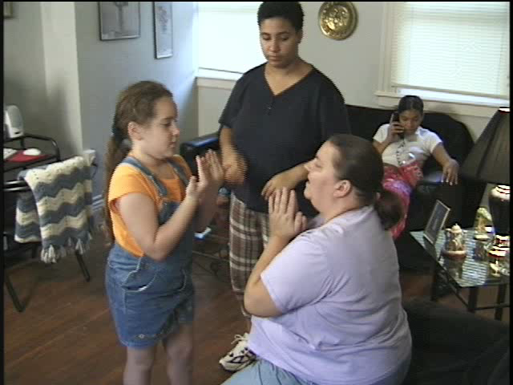
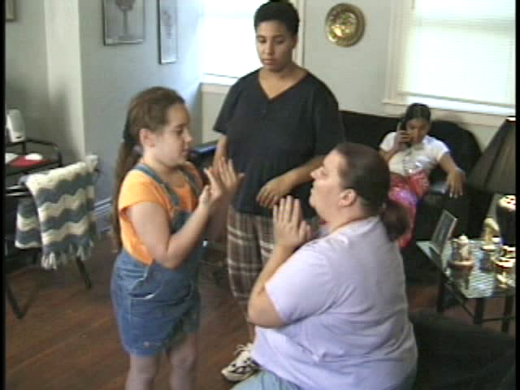
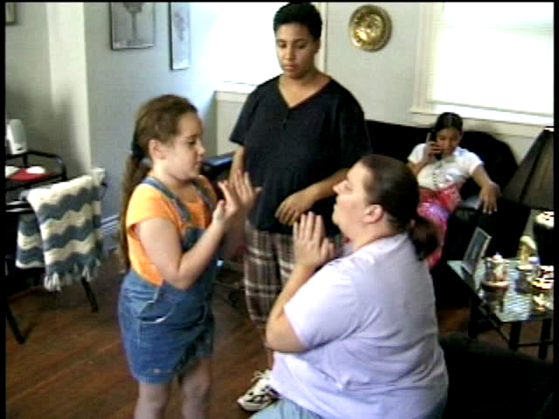

Slide 15
Philomena Video
It is important to note that the CPS system can work to support families through crisis and stressful periods in their lives
The system works with families to improve their lives and break the cycle of abuse and maltreatment. This is the purpose of the intervention.
Instead of thinking of the call to the SCR as punitive, sometimes it is the wake up call a parent needs
Whether or not you think the parents are open to intervention, you still are legally obligated to file a report to the SCR

Slide 16
If it is a requirement, then why don’t mandated reporters report suspected child abuse, neglect, or maltreatment 100% of the time?

Slide 17
A national incidence study found professionals reported only half the incidents about which they knew. The reasons for this were:
  Confusion or misunderstanding about reporting laws and procedures
  Lack of knowledge or awareness
  of warning signs/clues
In a study conducted at the University of Rochester, mandated reporters disclosed they were:
  Not clear about abuse/neglect as defined in State Law
  Often influenced by their professional beliefs, values, and experiences

Slide 18
The belief that the mandated reporter needs proof or evidence of abuse to make a report is one of the most frequently cited false beliefs about the reporting law
Many professionals fear and erroneously believe that reporting child maltreatment will destroy the therapeutic relationship
Prior negative professional experiences and negative press can affect the mandated reporter’s willingness to report

Slide 19
There are Legal Penalties for Mandated Reporters for Failing to Report
  Mandated reporters are subject to serious consequences for failure to report
  A mandated reporter who fails to report can be found guilty of a Class A misdemeanor. A Class A misdemeanor can result in penalty of up to a year in jail, a fine of up to $1,000.00, or both
  Additionally, failing to report may result in a lawsuit in civil court for monetary damages for any harm caused by the mandated reporter’s failure to make the report to the SCR, including wrongful death
Notes:
‹#›
26

Slide 20
Mandated reporters MUST call the SCR to ensure immunity and to be protected from criminal and civil liability. If the mandated reporter calls the local county department of social services office or law enforcement official, then that mandated reporter HAS NOT fulfilled their legal duty to report to the SCR.
Notes:
‹#›
23

Slide 21
Important: Mandated Reporter Records
Section 415 of the Social Service Law requires mandated reporters to provide records regarding a mandated report necessary for a CPS investigation, irrespective of HIPAA proscriptions or any other privilege.
Notes:
‹#›
31

Slide 22
Mandated Reporter Records
The amendment to SSL §415 only applies to the records of the mandated reporter who made the report
The purpose of the inclusion of these records is to support a full investigation of allegations of child abuse or maltreatment
The mandated reporter to whom the request is directed makes the determination of what information is essential
Written reports from mandated reporters shall be admissible in evidence in any proceedings relating to child abuse and maltreatment
No written consent is required
Notes:
‹#›
32

Slide 23
What is “Reportable”?
The mandated reporter must make a call to the SCR in his/her professional capacity when he/she suspects or has reason to believe that a child,18 years of age or younger, has been abused or neglected or is in imminent danger of being so by an adult who has legal responsibility for that child.

Slide 24
Who is Reportable?
    Parent
    Guardian
    Custodian
    Day Care Provider
    Residential Care Staff
Notes:
‹#›
33

Slide 25
What is Reasonable Cause to Suspect?
Do not have to prove it
Distrust or doubt is enough
Based on observation or disclosure
Child is harmed or in imminent danger of harm
Notes:
‹#›
46

Slide 26
What is Imminent Danger?
Minimal distance between child and harm by actions or failure to act
Could occur immediately or very soon
Notes:
‹#›
47

Slide 27
What is Reportable: Child Abuse
When the legally responsible adult:
Inflicts or allows to be inflicted serious physical injury
Creates or allows to be created substantial risk
of serious physical injury
Commits or allows to be committed sexual abuse
Notes:
‹#›
34

Slide 28
What is Reportable:
Maltreatment/Neglect
A child whose physical, mental, or emotional condition has been impaired or is at imminent danger of becoming impaired
A parent’s or custodian’s failure to provide a minimum degree of care
Notes:
‹#›
35

Slide 29
What is Reportable: Types of Neglect
When the legally responsible adult fails to provide:
  Adequate food, clothing, shelter, education, or medical care
  Proper supervision or guardianship
OR
  Inflicts/allows to be inflicted harm, including the infliction of excessive corporal punishment
  Misuses alcohol or other drugs
  Abandonment
Notes:
‹#›
36

Slide 30
Neglect: Lack of Adequate Supervision
  Custodian is absent
  The custodian is not on the premises
  A child’s ability to be left alone for short periods of time depends upon his/her developmental level
  Generally, children 12 years and older are thought to have this ability, however, cognitive deficits, impulsivity, and communication deficits impact this ability
Notes:
‹#›
37

Slide 31
Neglect: Lack of Adequate Supervision
When the custodian is present:
  The custodian is on the premises, but does not possess sufficient ability to keep the child safe
  This ability is impacted by substance use/abuse, cognitive deficits, and mental illness
Neighborhood characteristics can also be a factor in your assessment (e.g., you are aware of children left alone in a neighborhood where a number of fires have occurred)

Slide 32
Its Important to Keep in Mind:
  Neglect kills more children annually than abuse. It also has a number of behavioral and physical consequences that are more serious and long lasting than those of physical abuse
  Neglect occurs more frequently than other types of maltreatment, but is more often underreported than physical or sexual abuse

Slide 33
Common Indicators
  Child’s Physical Indicators
  Child’s Behavioral Indicators
  Parent’s Behavioral Indicators
Notes:
‹#›
39

Slide 34
Physical Indicators of Abuse
The following may be more likely to appear after a weekend or an absence. This list is not exhaustive
Bruises, welts, bite marks, lacerations, burns (from cigarettes or from dunking in scalding water), patterned burns from implements such as an iron or curling iron
Injuries to eyes or face that are clustered, or have a patterned shape
Finger marks on the arms or shoulders
Fractures (broken bones) to the face, dislocation of joints, to skull, nose, facial structure
Injuries may be in various stages of healing
Head injuries such as bruising on scalp from hair pulling or missing clumps of hair
Retinal hemorrhage or detachment that may result from shaking

Slide 35


Bruising Areas
Normal
Bruising Areas
Suspicious Bruising Areas
Back
Elbows
Knees
Back of Thighs
Buttocks
Shin
Back of Calves
Notes:
‹#›
38

Slide 36
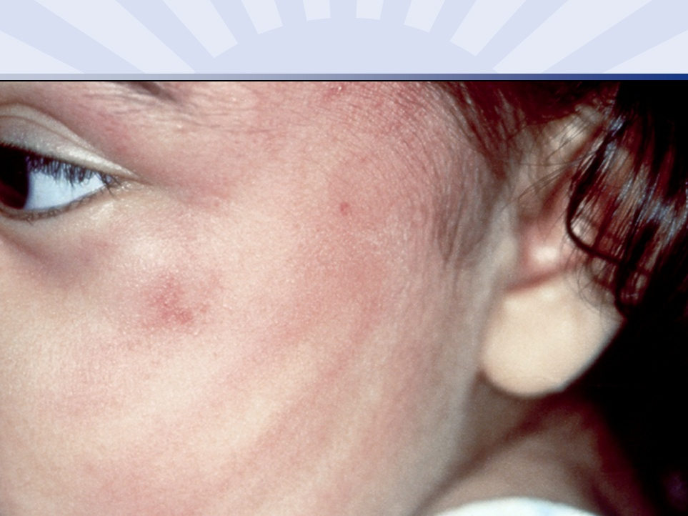
Handprint Injury
Notes:
‹#›
40

Slide 37
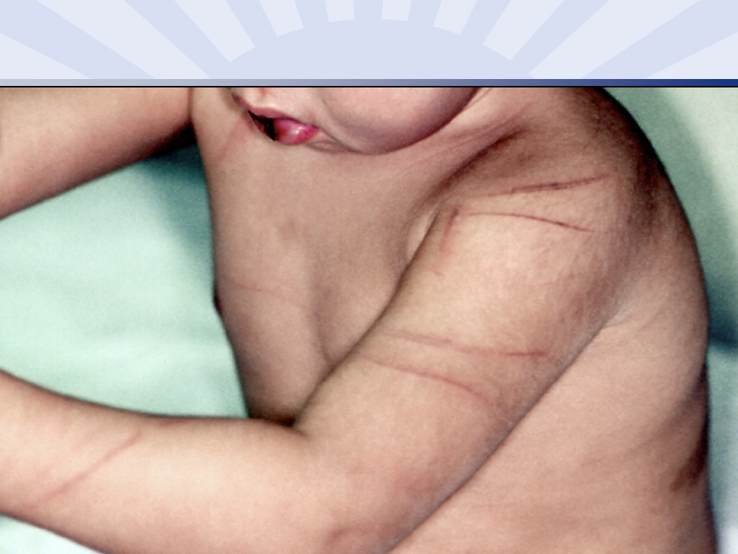
Looped Cord Injury
Notes:
‹#›
41

Slide 38
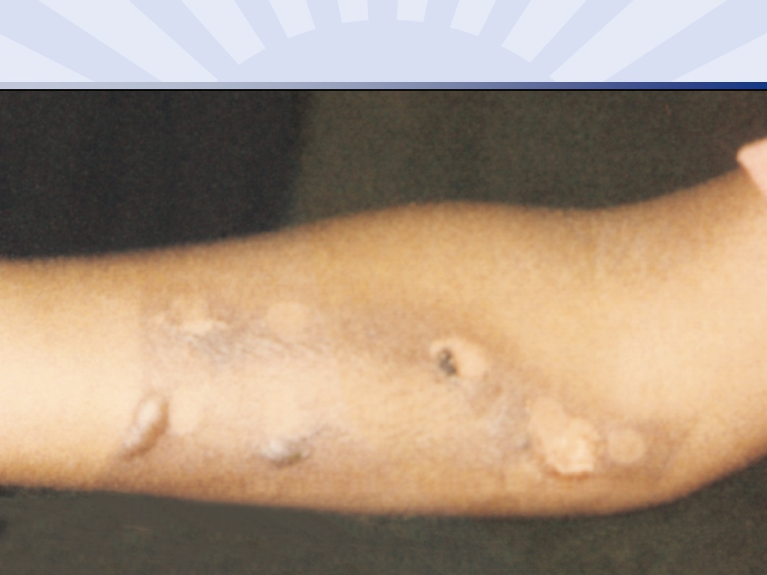
Steam Iron Injury
Notes:
‹#›
42

Slide 39
Behavioral Indicators of Abuse
This list is not exhaustive.
The child behaves in a wary fashion with parents or other adults
Anxious around other children
Extreme behavior such as aggressiveness, withdrawal, or extreme mood changes
Child states he/she is afraid to go home
Repeatedly running away from home
Child reports that he/she was deserving of punishment
Child engages in self-injurious behaviors and/or suicide attempts
Child comes to school dress in long sleeves or other concealing garments that may be inappropriate for the weather
Child has low self-esteem
The child’s report of an “accident” does not match the extent, severity, or type of injury

Slide 40
Physical Indicators of Maltreatment and Neglect
This list is not exhaustive.
The child is consistently hungry
The child has consistently poor hygiene: skin has not been washed, dental problems that go untreated
Child is consistently inappropriately dressed for the season
The child lacks supervision on a regular basis
Young child has a positive results on a toxicology test, or experiences drug withdrawal
The child is significantly behind in their physical development
The child has a untreated speech disorder or untreated health problems
The child is chronically truant

Slide 41
Behavioral Indicators of Maltreatment and Neglect
This list is not exhaustive.
The child steals food or is overly focused on food and/or eating
The child appears chronically tired or lacks energy
The child runs away from home
The child is engaged in delinquent behavior (e.g., stealing, using alcohol or drugs, bullying)
The child states that he/she is alone or not cared for
The child arrives at school very early and/or stays very late without explanation
Other serious behavioral problems such as compulsions, conduct disorder, aggressiveness, isolation

Slide 42
Physical Indicators of Sexual Abuse
This list is not exhaustive.
The child has difficulty walking or sitting
The child complains of pain or itching in the genital area or you can see them scratching
The child has bruises or bleeding in the genital or anal area
The child has bruises inside their mouth
The child tests positive for a sexually transmitted infection
A young girl becomes pregnant
The child complains of pain when urinating or has a series of urinary infections

Slide 43
Behavioral Indicators of Sexual Abuse
This list is not exhaustive.
The child possesses an unnatural interest in sex and/or has sexual behavior or knowledge inconsistent with his/her age
The child appears isolated from other children
The child is afraid of being touched
The child behaves at a much younger age than what should be expected
The child reports sexual contact by his/her custodian
The child exhibits delinquent behavior or self injurious behavior including suicide attempts

Slide 44
Characteristics of the Custodian
This list is not exhaustive.
The custodian is socially isolated from friends and family
The custodian is in an abusive relationship
The custodian may have been abused or neglected as child
The custodian has mental health problems and/or substance use problems
The custodian has significant stressors such as financial, employment, or housing problems
The custodian may have unreasonable expectations of the child
The custodian describes the child as inherently bad
The custodian describes corporal punishment as acceptable and/or necessary

Slide 45
When Talking with Children about Possible
Abuse, Neglect or Maltreatment
Do:
  Find a private place
  Remain calm
  Be honest, open, up-front, supportive
  Be an advocate
  Listen to the child
  Report the situation immediately
Notes:
‹#›
43

Slide 46
When Talking with Children about Possible Abuse, Neglect or Maltreatment
Don’t:
  Overreact
  Make judgments/promises
  Interrogate or investigate
Notes:
‹#›
44

Slide 47
Working with Case Material
You will now be presented with a total of eight case scenarios.
For the first four cases (A-D), you will be asked to answer four questions:
What indicators are present?
Is there reasonable cause to suspect abuse or maltreatment?
Is there a parent or other person responsible for the suspected abuse or maltreatment?
What are your next steps?
For cases 5-8, you will be asked to identify the next step.
Please have pen and paper handy.
Notes:
‹#›
48

Slide 48
Case Scenario A
A female, age 15, has come to the ER with a rash in her vaginal area. She disclosed that she has been engaging in sexual intercourse with her mother’s 38 year old boyfriend for the past two months. The boyfriend has resided in the home with the child and her mother for the past five years and is responsible for the care of the child when the mother is at work.

Slide 49
Case Scenario A CONTINUED
Please write out your answers to the following questions.
What indicators are present?
Is there reasonable cause to suspect abuse or maltreatment?
Is there a parent or other person responsible for the suspected abuse or maltreatment?
What are your next steps?

Slide 50
Case Scenario B
Seven-year-old Chris came to the doctor’s office for a physical. He has a bruise to the right side of his face and scrapes along this right arm. The child claims he fell off his bike. The child lives with his mother, a single parent. His mother says Chris is a very active child and at times can present challenging behaviors at school.

Slide 51
Case Scenario B CONTINUED
Please write out your answers to the following questions.
What indicators are present?
Is there reasonable cause to suspect abuse or maltreatment?
Is there a parent or other person responsible for the suspected abuse or maltreatment?
What are your next steps?

Slide 52
Case Scenario C
A mother delivers a baby that has
neonatal drug withdrawal. When talking
to the mother, you learn she has not
prepared for the baby to come home.

Slide 53
Case Scenario C CONTINUED
Please write out your answers to the following questions.
What indicators are present?
Is there reasonable cause to suspect abuse or maltreatment?
Is there a parent or other person responsible for the suspected abuse or maltreatment?
What are your next steps?

Slide 54
Case Scenario D
Eight year Jason comes to the ER with a
broken arm. His mother says he fell off
the bed. When Jason’s arm is x-ray there
is a spiral fracture to his humerus.

Slide 55
Case Scenario D CONTINUED
Please write out your answers to the following questions.
What indicators are present?
Is there reasonable cause to suspect abuse or maltreatment?
Is there a parent or other person responsible for the suspected abuse or maltreatment?
What are your next steps?

Slide 56
ANSWERS: Case Scenario A
A female, age 15, has come to the ER with a rash in her vaginal area. She disclosed that she ha been engaging in sexual intercourse with her mother’s 38 year old boyfriend for the past two months. The boyfriend has resided in the home with the child and her other for the past five years and is responsible for the care of the child when the mother is at work.
What indicators are present?
Sexual abuse and verbal disclosure
Is there a reasonable cause to suspect abuse or maltreatment?
Yes
Is there a person responsible for the suspected abuse or maltreatment?
The 38 year old boyfriend (an adult living in the home)
What are your next steps?
Call in report to SCR.

Slide 57
ANSWERS: Case Scenario B
Seven-year-old Chris came to the doctor’s office for a physical. He has a bruise to the right side of his face and scrapes along this right arm. The child claims he fell off his bike. The child lives with his mother, a single parent. His mother says Chris is a very active child and at times can present challenging behaviors at school.
What indicators are present?
Bruises, scrapes
Is there a reasonable cause to suspect abuse or maltreatment?
No, the story is consistent with a bike injury. Injuries sustained in an accidental fall would be along one side of the child’s body.
Is there a person responsible for the suspected abuse or maltreatment?
No
What are your next steps?
Treat child’s injuries.

Slide 58
ANSWERS: Case Scenario C
A mother delivers a baby that has neonatal drug withdrawal. When talking to the mother, you learn she has not prepared for the baby to come home.
What indicators are present?
Neonatal drug withdrawal, no plan for the baby
Is there a reasonable cause to suspect abuse or maltreatment?
Yes
Is there a person responsible for the suspected abuse or maltreatment?
Mother
What are your next steps?
Call in report to SCR.

Slide 59
ANSWERS: Case Scenario C
Eight year Jason comes to the ER with a broken arm. His mother says he fell off the bed. When Jason’s arm is x-ray there is a spiral fracture to his humerus.
What indicators are present?
Spiral fracture, No plausible explanation
Is there a reasonable cause to suspect abuse or maltreatment
Yes
Is there a person responsible for the suspected abuse or maltreatment?
Mother
What are your next steps?
Call in report to SCR.

Slide 60
More Case Application: Case 1
Please evaluate the following case and rate it by category.
A mother comes into the ER with black eyes as a result of domestic violence. She has to young children with her. She says her husband beat her. She also stated that he told her he would kill her and the two children if she told anyone.
Into which category does this case fall?
Category A This should be left to the family.
Category B Assistance to seek community agency or resource as appropriate.
Category C Report to State Central Register (SCR).
Category D Call the police immediately.

Slide 61
Case 2
Please evaluate the following case and rate it by category.
Mrs. Pitt has two daughters, ages seven and nine. The children suffer from impetigo, a contagious skin disease. Mrs. Pitt has kept clinic appointment and carried out the doctor’s instructions but the impetigo still persists.
Into which category does this case fall?
Category A This should be left to the family.
Category B Assistance to seek community agency or resource as appropriate.
Category C Report to State Central Register (SCR).
Category D Call the police immediately.

Slide 62
Case 3
Please evaluate the following case and rate it by category.
The Ross family has one child, a girl age five. The mother takes good care of her, but is extremely anxious that the child will contact a disease. She brings the child into the ER regularly for minor things. She states that she doesn’t allow her daughter to socialize with other kids because she’s afraid her daughter will catch something.
Into which category does this case fall?
Category A This should be left to the family.
Category B Assistance to seek community agency or resource as appropriate.
Category C Report to State Central Register (SCR).
Category D Call the police immediately.

Slide 63
Case 4
Please evaluate the following case and rate it by category.
Joshua, age seven, was brought to the ER by his parents. Upon medical evaluation, he is diagnosed with a life threatening illness requiring and emergency surgical procedure and the likelihood of a blood transfusion. His parents refuse to sign consent forms, claiming that a blood transfusion violates their religious beliefs.
Into which category does this case fall?
Category A This should be left to the family.
Category B Assistance to seek community agency or resource as appropriate.
Category C Report to State Central Register SCR)
Category D Call the police immediately.

Slide 64
Answers to Cases 1-4
Case 1 (mother with black eye) This falls into both Category D and C. Call the police immediately and then make a report to the SCR.
Case 2 (Mrs. Pitt and daughters with impetigo) This falls into Category A. Parents are providing appropriate medical care. The medical practitioner may want to offer other medical treatment.
Case 3 (mother is afraid daughter will become ill) This falls into Category B. Refer parent for counseling, parenting classes, or other services that may be necessary.
Case 4 (Parents refuse a transfusion for their son) This falls into Category C. You must report this even if the hospital intervenes for treatment of the child.
Notes:
‹#›
65

Slide 65
Making the call to the SCR

Slide 66
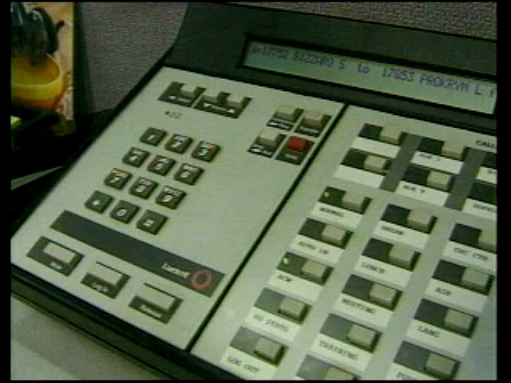

Slide 67
Call the mandated reporter express line of the New York State Child Abuse and Maltreatment Register
1-800-635-1522
Notes:
‹#›
67

Slide 68
You Will Need to Provide
Demographic information
Information whether the child has been harmed, or is at risk of harm, and how
A description of the role of parent or person legally responsible
Information whether this is an ongoing pattern
Notes:
‹#›
68
68
Demographics:Names and addresses of the child and his or her parents/legal guardian; location of the child at the time of the report, child’s age, gender, and race;nature and extent of the child’s injuries, maltreatment or neglect; effect of the injury on the child; name of the person or persons you suspect is responsible for the injury,maltreatment or neglect; family composition; where and how the person making the report can be contacted.

Slide 69
Other Important Information to Provide
Where is the child?
Are there any special needs or medications?
What are they?
Concerns for local CPS (weapons, dogs, etc).
Is an interpreter required?
Name, title, and contact information of other MRs and other persons with direct knowledge of abuse and neglect from your agency.
Any other information.
Notes:
‹#›
69
Actions taken by the reporting source could include: photographs, x-rays, notifying the medical examiner or coroner, and record keeping. You should always keep a written records of observations, actions, and time of each action.

Slide 70

Follow up the Call
Complete
Form
LDSS-2221A
within
48 hours
Send
to local
CPS
Notes:
‹#›
70

Slide 71
A flow chart of activities once the call has been made
Call to the SCR
Referred to LER
(Law Enforcement
Referral)
Report Registered
Report Not Registered
Transmit to Local CPS
Investigation/Safety Assessment
Ongoing Assessment
Services Offered
Indicated
Unfounded
No Services Provided
Services Provided
No Services Provided
Case Closed
Service Plan
Monitoring of Services
Case Closed
Notes:
‹#›
71

Slide 72
What Will the Local District’s Response Be?
They will begin an investigation within 24 hours
  Assess safety of child
  If necessary, take steps to protect child
They will make a determination of your report within 60 days
  Indicated
  Unfounded and sealed
Notes:
‹#›
72

Slide 73
If I make a report can there be any legal retaliation?

Slide 74
There are Legal Protections
for Mandated Reporters
You will have immunity. It is very important that you do not call anonymously
Your name will be kept confidential
There can be no retaliatory personnel action for making report
Notes:
‹#›
22
22
Immunity's 419 of Social Service Law: Mandated Reporters are immune from any criminal or civil liability if the report is made in good faith. Good faith is presumed. If any person accuses you of making a report in bad faith, they have to prove that you acted with gross negligence or willful misconduct. Confidentiality: SSL 422 (4) (A)- OCFS and CPS are not permitted to release to the subject of the report any data that would identifyb the source of the report unless the reporter has been given written permission for OCFS or CPS to do so. Information regarding the rpeort may be shared with certain individuals )i.e. courts, police, distyrict attorney), but only as provided by law. Penalties: Class A misdemeanor which can result in a penalty of up to a year in jail, a fine of $10,000 or both. Additionally, failing to report may result in a lawsuit in civil court for monetary damages for any harm caused by the mandated reporters failure to make the report to the SCR, including wrongful death suits.
* Good faith is presumed. A person would have to prove that the Mandated reporter acted maliciously, even if the case proves unfounded, to bring a charge of a negligent report.

Slide 75
There are Legal Protections
for Mandated Reporters
Immunity from liability
  Some mandated reporters face a conflict between their legal obligation to report and their legal obligation to maintain client or patient confidentiality
  Section 419 of the Social Services Law provides immunity form liability for mandated reporters
  Mandated reporters are immune from any criminal or civil liability if the report was made in good faith
  The good faith of such a person, official, or institution required to report is presumed. This means if a person accuses you of making a false report in bad faith, they have to PROVE you acted with gross negligence or willful misconduct
Notes:
‹#›
24

Slide 76
Legal Protections
Confidentiality
  New York State law provides confidentiality to those who make a report
  OFCS and local CPS are NOT permitted to release to the subject of the report any data that would identify the source of the report unless the reporter has given written permission for OFCS or CPS to do so
  Information regarding the source of the report may be shared by OFCS or by local CPS with certain individuals (e.g., courts, police, district attorney), but only as provided by law
Notes:
‹#›
25

Slide 77
Retaliatory Personnel Action
No medical or other public or private institution, school, facility, or agency shall take any retaliatory personnel action against an employee who made a report to the SCR.
No school, school official, child care provider, foster care provider, residential care facility provider, hospital, medical institution provider, or mental health facility provider shall impose any conditions, including prior approval or prior notification, upon a member of their staff mandated to report suspected child abuse or maltreatment
Notes:
‹#›
27

Slide 78
You have completed the course!

