Slide 1
BAT: Branding Assistive Technology for Social Good
Extending the CCNY Joint Senior Design Program on Assistive Technology Across School Boundaries

Slide 2
BAT: Branding Assistive Technology for Social Good
Extending the CCNY Joint Senior Design Program on Assistive Technology Across School Boundaries

Slide 3

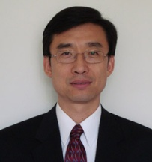
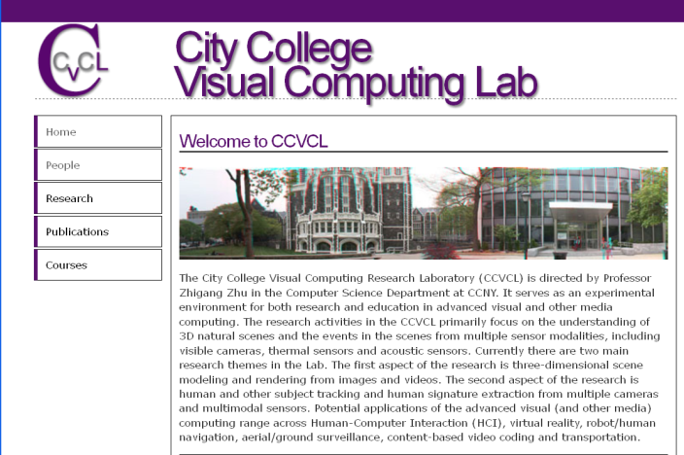
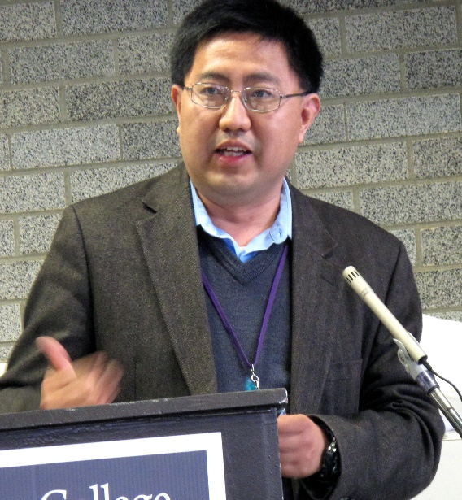
BACKGROUND: In the past eight years, there has been a cross-departmental joint senior design course for undergraduate seniors (20-30 students each year) majoring in Computer Science (CS), Computer Engineering (CpE) and Electrical Engineering (EE) in the Grove School of Engineering (GSOE) focused in exploring and developing assistive technologies for smart living of all.

Slide 4
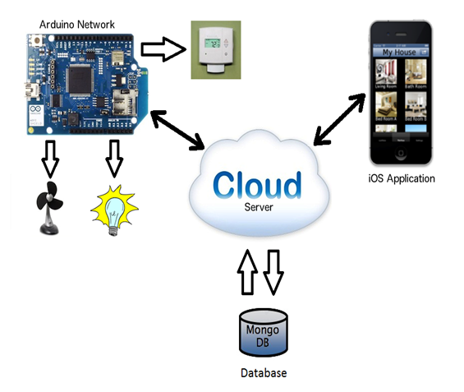
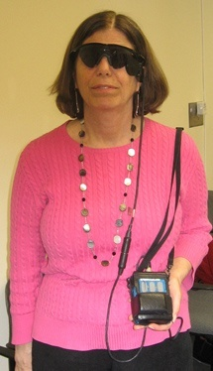
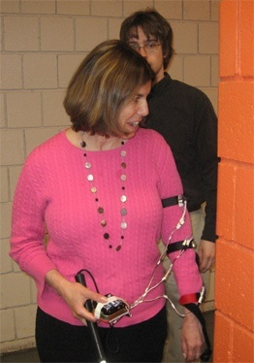

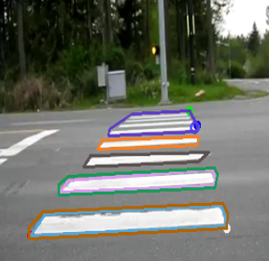
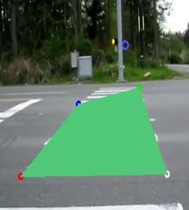
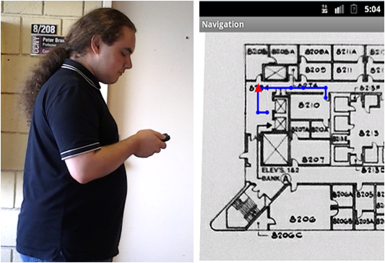
Cross-Disciplinary Projects (CS, CpE, EE)
Sensing approaches (camera, stereo, IR, ultrasonic, kinect, etc)
Data interpretation algorithms (hardware, smart phone, PC, etc)
Display methods (tactile, audio, speech, visual)
Apps for smart living, smart office, smart health, assistive/accessibility technologies

Slide 5






AT: Sponsors and Community Partners
NSF GARDE (Gen & Age Rel Disabilities Eng)
Senior Design Program on Assistive Technology to Aid Visually Impaired People (Award #1160046)
VentureWell (formerly NCIIA)
Course and Program: Human and Machine Intelligence - Perception, Computation and Action (Award # 10087-12)
NYSID CREATE
Cultivating Resources for Employment with Assistive Technology
Service Agencies (for ASD and BVIs)
Goodwill Industrials
Lighthouse Guild
NYS Commission for the Blind

Slide 6
BACKGROUND: In the past eight years, there has been a cross-departmental joint senior design course for undergraduate seniors majoring in Computer Science (CS), Computer Engineering (CpE) and Electrical Engineering (EE) in the Grove School of Engineering (GSOE) focused in exploring and developing assistive technologies for smart living of all.
BUT students may not know how to successfully communicate with the users, investors, stakeholders and community partners to really make their breakthrough work ACTIONABLE. Additionally, they may lack the entrepreneurship skills that will help them turn their brilliant ideas into reality.
THEREFORE we will to tap into CCNY’s resources (BIC program and the Zahn Center) teach them useful and practical the branding, storytelling and entrepreneurship skills they need.

Slide 7
CEN Members/Principal Investigators: PI: Zhigang Zhu, Kayser Chair Professor of Computer Science, GSOE, CCNY Co-PI: Gerardo A Blumenkrantz, Associate Professor, Media & Communication Arts, Branding + Integrated Communications (BIC) Creative Track, CCNY Co-PI: Devin Voorsanger, Managing Director, Zahn Innovation Center Other Collaborators and Partners: Jizhong Xiao, Professor of Electrical Engineering, Grove School of Engineering, CCNY Nancy R. Tag, Program Director, BIC Program, CCNY Marlene Leo, Program Specialist, BIC Program, CCNY Celina Cavalluzzi, Director of Day Services, Goodwill Industries NY/NJ Bill Seiple, Vice President and Director for Research, Lighthouse Guild Brian Bateman, Marketing Manager, NYS Industries for the Disabled (NYSID)

Slide 8
First Semester (Fall):
In addition to the regular class meets for basics on vision, robotics and assistive technology:
A seminar by a BIC instructor on branding.
A seminar by a Zahn staff on entrepreneurship and Zahn competition
BAT teams of CS/CpE/EE students develop proposals of projects– targeting to CREATE, Zahn, or VentureWell Competitions, and share them with BIC students.
Site visits to Goodwill/Lighthouse Guild/other places for customers with challenges (e.g. disabilities, elderly, Alzheimer’s etc.)
Invited community partners as speakers and judges for brainstorming customer discovery and proposal presentations
BAT teams revise their proposals for submitting to competitions

Slide 9
Second Semester (Spring): In addition to our weekly technical meetings for project development updating:
BIC students provide monthly feedback (via meetings or postings) with CS/CpE/EE teams for developing their video, demos and materials for the Zahn/CREATE/VentureWell presentations.
Invited community partners from Goodwill/Lighthouse Guild, BIC faculty and Zahn Center staff as judges for project presentations
Participation of the Zahn/CREATE/VentureWell competitions by the joint BAT teams, and follow-on work if winning awards

Slide 10

BAT: Branding Assistive Technology for Social Good
+
for

Slide 11
Course Assignments – Fall 2019 (Due in 1~2 weeks)
09/09. A1. Resume with Project Topic(s) and Teaming – 10%
09/23. A2. E-Proposals in wiki and quad chart – 10%
10/16. A3. BIC-Proposals shared in wiki or Google Drive – 10%
10/28. Proposal presentations to community partners (lunch) -15%
11/04. A4. BAT-Proposals submitted to CREATE/Zahn/etc. – 10%
11/11. A5. Vision Writing Questions (Feature Extraction). – 10%
11/18. A6. Vision Writing Questions (Stereo & Motion). – 10%
11/25. A7. Revised BAT-Proposals shared in wiki or Drive – 10%
12/09. Revised proposals presented to community partners (lunch) – 15%

Slide 12
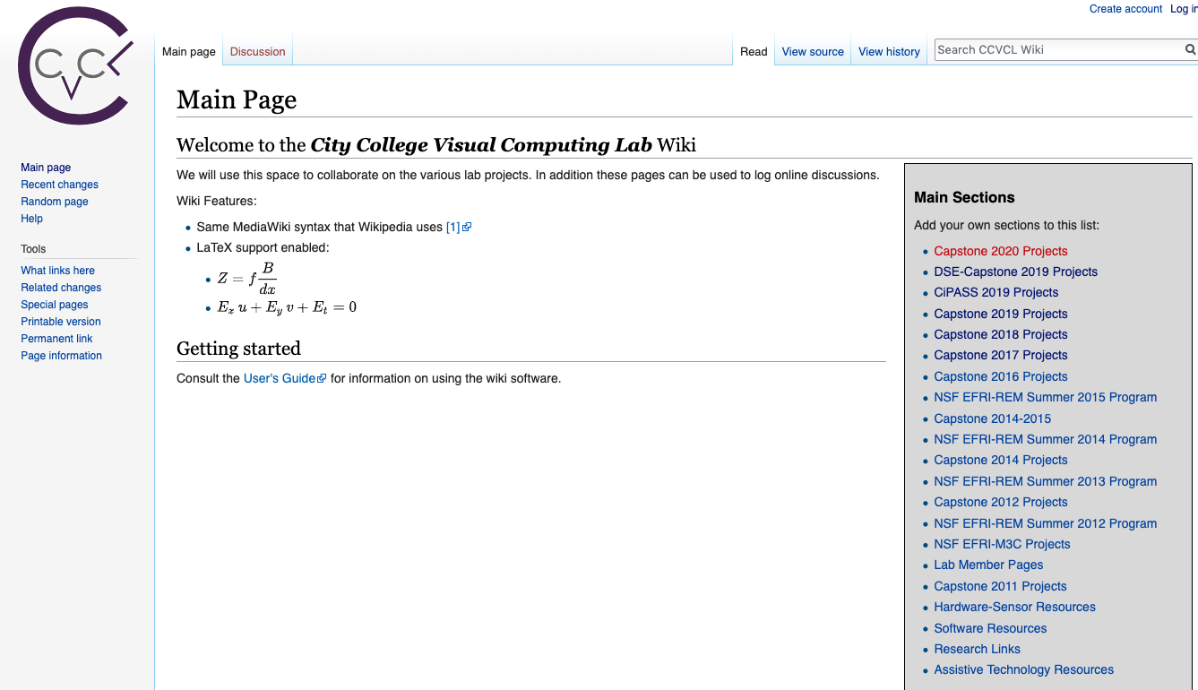
Wiki Page Weekly Updates
http://wiki.ccvcl.org
Create an account using your ccny email
Then check your email (incl. spam folder) to confirm
Before you come back to login

Slide 13
BAT: Branding Assistive Technology for Social Good
+
for

