Slide 1
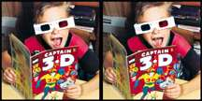
3D Vision
Computer Vision
Topic 3 of Part II
Stereo Vision
Zhigang Zhu, City College of New York zzhu@ccny.cuny.edu
Notes:
This course is a basic introduction to parts of the field of computer vision. This version of the course covers topics in 'early' or 'low' level vision and parts of 'intermediate' level vision. It assumes no background in computer vision, a minimal background in Artificial Intelligence and only basic concepts in calculus, linear algebra, and probability theory.

Slide 2
Stereo Vision
Problem
Infer 3D structure of a scene from two or more images taken from different viewpoints
Two primary Sub-problems
Correspondence problem (stereo match) -> disparity map
“Similar” instead of “Same”
Occlusion problem: some parts of the scene are visible only in one eye
Reconstruction problem -> 3D
What we need to know about the cameras’ parameters
Often a stereo calibration problem
Lectures on Stereo Vision
Stereo Geometry – Epipolar Geometry (*)
Correspondence Problem (*) – Two classes of approaches
3D Reconstruction Problems – Three approaches

Slide 3
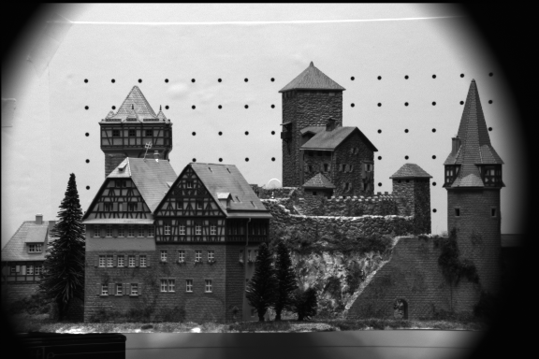
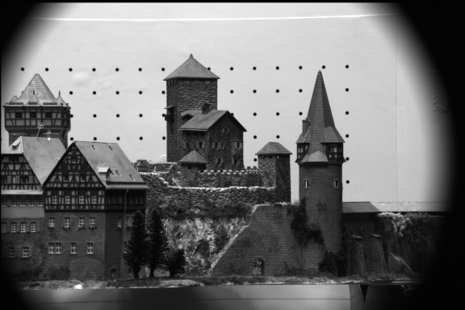
A Stereo Pair
Problems
Correspondence problem (stereo match) -> disparity map
Reconstruction problem -> 3D
3D?
?
CMU CIL Stereo Dataset : Castle sequence
http://www-2.cs.cmu.edu/afs/cs/project/cil/ftp/html/cil-ster.html

Slide 4
More Images…
Problems
Correspondence problem (stereo match) -> disparity map
Reconstruction problem -> 3D

Slide 5
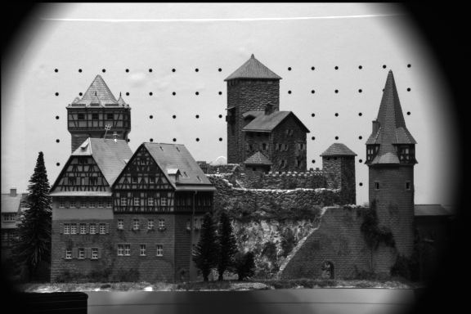
More Images…
Problems
Correspondence problem (stereo match) -> disparity map
Reconstruction problem -> 3D

Slide 6
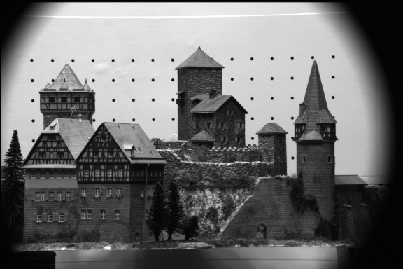
More Images…
Problems
Correspondence problem (stereo match) -> disparity map
Reconstruction problem -> 3D

Slide 7
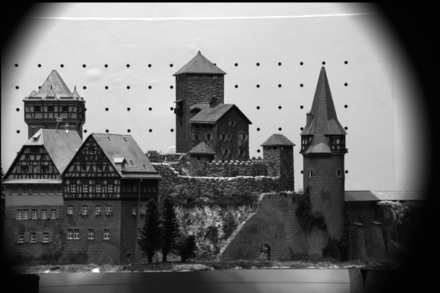
More Images…
Problems
Correspondence problem (stereo match) -> disparity map
Reconstruction problem -> 3D

Slide 8
More Images…
Problems
Correspondence problem (stereo match) -> disparity map
Reconstruction problem -> 3D

Slide 9
Part I. Stereo Geometry
A Simple Stereo Vision System
Disparity Equation
Depth Resolution
Fixated Stereo System
Zero-disparity Horopter
Epipolar Geometry
Epipolar lines – Where to search correspondences
Epipolar Plane, Epipolar Lines and Epipoles
http://www.ai.sri.com/~luong/research/Meta3DViewer/EpipolarGeo.html
Essential Matrix and Fundamental Matrix
Computing E & F by the Eight-Point Algorithm
Computing the Epipoles
Stereo Rectification

Slide 10
Stereo Geometry
P(X,Y,Z)
Converging Axes – Usual setup of human eyes
Depth obtained by triangulation
Correspondence problem: p_{l} and p_{r} correspond to the left and right projections of P, respectively.
Notes:
Binocular (or stereo) geometry is shown in the figure. The vergence angle is the angle between the two image planes, which for simplicity we assume are aligned so that the y-axes are parallel. Given either image of the pair, all we can say is that the object point imaged at Pr or Pl is along the respective rays through the lens center. If in addition we know that Pr and Pl are the image projections of the same object point, then the depth of this point can be computed using triangulation (we will return to this in more detail in the section on motion and stereo).
In addition to the camera geometry, the key additional piece of information in stereo vision is the knowledge that Pr and Pl are projections of the same object point. Given only the two images, the problem in stereo vision is to determine, for a given point in the left image (say), where the projection of this point is in the right image. This is called the correspondence problem. Many solutions to the correspondence problem have been proposed in the literature, but none have proven entirely satisfactory for general vision (although excellent results can be achieved in many cases).

Slide 11
A Simple Stereo System
LEFT CAMERA
RIGHT CAMERA
baseline
Left image:
reference
Right image:
target
disparity
Depth Z
Elevation Z_{w}
Z_{w}=0

Slide 12
Disparity Equation
P(X,Y,Z)
Stereo system with parallel optical axes
Depth
Disparity:
d = x_{r} - x_{l}
Image plane
Image plane
p_{l}(x_{l},y_{l})
pr(x_{r},y_{r})
f = focal length
f = focal length
Optical Center O_{l}
Optical Center O_{r}
B = Baseline
LEFT CAMERA
RIGHT CAMERA

Slide 13
Disparity vs. Baseline
P(X,Y,Z)
Stereo system with parallel optical axes
Depth
Disparity
d = x_{r} - x_{l}
Image plane
Image plane
p_{l}(x_{l},y_{l})
pr(x_{r},y_{r})
f = focal length
f = focal length
Optical Center O_{l}
Optical Center O_{r}
B = Baseline
LEFT CAMERA
RIGHT CAMERA

Slide 14
Depth Accuracy
Given the same image localization error
Angle of cones in the figure
Depth Accuracy (Depth Resolution) vs. Baseline
Depth Error ∝ 1/B (Baseline length)
PROS of Longer baseline,
better depth estimation
CONS
smaller common FOV
Correspondence harder due to occlusion
Depth Accuracy (Depth Resolution) vs. Depth
Disparity (>0) ∝ 1/ Depth
Depth Error ∝ Depth²
Nearer the point, better the depth estimation
An Example
f = 16 x 512/8 pixels, B = 0.5 m
Depth error vs. depth
Two viewpoints
O_{l}
O_{r}
Z₁
Z₂
∂Z₁
∂Z₂>∂Z₁
Absolute error
Relative error
Notes:
f = 16 x 512/8 pixels, B = 0.5 m, dZ = Z**2 /2**9 * 1 (pixel)
Z (m) 2 4 8 16 32 64
dZ(m) 1/128 1/32 1/8 ½ 2 8

Slide 15
Stereo with Converging Cameras
Stereo with Parallel Axes
Short baseline
large common FOV
large depth error
Long baseline
small depth error
small common FOV
More occlusion problems
Two optical axes intersect at the Fixation Point
converging angle θ
The common FOV Increases
FOV
Left
right

Slide 16
Stereo with Converging Cameras
Stereo with Parallel Axes
Short baseline
large common FOV
large depth error
Long baseline
small depth error
small common FOV
More occlusion problems
Two optical axes intersect at the Fixation Point
converging angle θ
The common FOV Increases
FOV
Left
right

Slide 17
Stereo with Converging Cameras
Two optical axes intersect at the Fixation Point
converging angle θ
The common FOV Increases
Disparity properties
Disparity uses angle instead of distance
Zero disparity at fixation point
and the Zero-disparity horopter
Disparity increases with the distance of objects from the fixation points
>0 : outside of the horopter
<0 : inside the horopter
Depth Accuracy vs. Depth
Depth Error ∝ Depth²
Nearer the point, better the depth estimation
Fixation point
FOV
θ
Left
right

Slide 18
Stereo with Converging Cameras
Two optical axes intersect at the Fixation Point
converging angle θ
The common FOV Increases
Disparity properties
Disparity uses angle instead of distance
Zero disparity at fixation point
and the Zero-disparity horopter
Disparity increases with the distance of objects from the fixation points
>0 : outside of the horopter
<0 : inside the horopter
Depth Accuracy vs. Depth
Depth Error ∝ Depth²
Nearer the point, better the depth estimation
Fixation point
Horopter
θ
α_{l}
α_{r}
α_{r} = α_{l}
dα = 0
Left
right

Slide 19
Stereo with Converging Cameras
Two optical axes intersect at the Fixation Point
converging angle θ
The common FOV Increases
Disparity properties
Disparity uses angle instead of distance
Zero disparity at fixation point
and the Zero-disparity horopter
Disparity increases with the distance of objects from the fixation points
>0 : outside of the horopter
<0 : inside the horopter
Depth Accuracy vs. Depth
Depth Error ∝ Depth²
Nearer the point, better the depth estimation
Fixation point
Horopter
θ
α_{l}
α_{r}
α_{r} > α_{l}
dα > 0
Left
right

Slide 20
Stereo with Converging Cameras
Two optical axes intersect at the Fixation Point
converging angle θ
The common FOV Increases
Disparity properties
Disparity uses angle instead of distance
Zero disparity at fixation point
and the Zero-disparity horopter
Disparity increases with the distance of objects from the fixation points
>0 : outside of the horopter
<0 : inside the horopter
Depth Accuracy vs. Depth
Depth Error ∝ Depth²
Nearer the point, better the depth estimation
Fixation point
Horopter
α_{r}
α_{l}
α_{r} < α_{l}
dα < 0
Left
right

Slide 21
Stereo with Converging Cameras
Two optical axes intersect at the Fixation Point
converging angle θ
The common FOV Increases
Disparity properties
Disparity uses angle instead of distance
Zero disparity at fixation point
and the Zero-disparity horopter
Disparity increases with the distance of objects from the fixation points
>0 : outside of the horopter
<0 : inside the horopter
Depth Accuracy vs. Depth
Depth Error ∝ Depth²
Nearer the point, better the depth estimation
Fixation point
Horopter
α_{l}
α_{r}
Δ(dα) ?
Left
right
Notes:
Fixation stereo does not change the fact that depth resolution is inversely proportional to square of depth
Since the increasing rate of the disparity decreases with the distance

Slide 22
Break
Homework #2 please observe the due date
Homework #3 online, please check out details
Mid-term Exam right before Spring Recess
Vision Project Discussions
In class now
Please send in your choice of projects and teaming by 04/04.
Presentation Day: Last day of the class for 15 students
One project per team (1 -2 students),
8 min (5+3) presentation for 1 student, 15 minutes (10+5) for a 2-student team
A writing report due on 05/15 (Monday).

Slide 23
Parameters of a Stereo System
Intrinsic Parameters
Characterize the transformation from camera to pixel coordinate systems of each camera
Focal length, image center, aspect ratio
Extrinsic parameters
Describe the relative position and orientation of the two cameras
Rotation matrix R and translation vector T
P
P_{l}
P_{r}
p
p
Y_{r}
Y_{l}
l
r
X_{l}
Z_{l}
Z_{r}
f_{l}
f_{r}
O_{l}
O_{r}
R, T
X_{r}

Slide 24
Epipolar Geometry
P
Notations
P_{l} =(X_{l}, Y_{l}, Z_{l}), P_{r} =(X_{r}, Y_{r}, Z_{r})
Vectors of the same 3-D point P, in the left and right camera coordinate systems respectively
Extrinsic Parameters
Translation Vector T = (O_{r}-O_{l})
Rotation Matrix R
p_{l} =(x_{l}, y_{l}, z_{l}), p_{r} =(x_{r}, y_{r}, z_{r})
Projections of P on the left and right image plane respectively
For all image points, we have z_{l}=f_{l}, z_{r}=f_{r}
P_{l}
P_{r}
p
p
Y_{r}
Y_{l}
l
r
Z_{l}
T
Z_{r}
X_{l}
f_{l}
f_{r}
O_{l}
O_{r}
R, T
X_{r}
Notes:
Left: reference camera
T: Vector in the left camera system
R: from Left to right
Image coordinates: in projective space

Slide 25
Epipolar Geometry
Motivation: where to search correspondences?
Epipolar Plane
A plane going through point P and the centers of projections (COPs) of the two cameras
Conjugated Epipolar Lines
Lines where epipolar plane intersects the image planes
Epipoles
The image of the COP of one camera in the other
Epipolar Constraint
Corresponding points must lie on conjugated epipolar lines
P
P_{l}
P_{r}
Epipolar Plane
Epipolar Lines
p
l
p
r
T
O_{l}
e_{l}
e_{r}
O_{r}
Epipoles

Slide 26
Essential Matrix
Equation of the epipolar plane
Co-planarity condition of vectors P_{l}, T and P_{l}-T
Essential Matrix E = RS
3x3 matrix constructed from R and T (extrinsic only)
Rank (E) = 2, two equal nonzero singular values
Rank (R) =3
Rank (S) =2
Notes:
The projection of TxPl in vector (Pl-T) is zero
Note: the epipolar line about pr will pass through pl IFF R = I , which says
p_{l}^{T} S p_{l} == 0
It is the FOE geometry in visual motion. Otherwise, NOT!

Slide 27
Essential Matrix
Essential Matrix E = RS
A natural link between the stereo point pair and the extrinsic parameters of the stereo system
One correspondence -> a linear equation of 9 entries
Given 8 pairs of (pl, pr) -> E
Mapping between points and epipolar lines we are looking for
Given p_{l}, E -> p_{r} on the projective line in the right plane
Equation represents the epipolar line of pr (or pl) in the right (or left) image
Note:
pl, pr are in the camera coordinate system, not pixel coordinates that we can measure
Notes:
(0). Essential Equation represents actually the epipolar plane in either the left or the right image
(1). Epipolar line in the right image given pl
(Ep_{l})^{T}p_{r}=0
zr = fr
extension of the equations in pr = (xr,yr,fr)
(2). Epipolar line in the left image given pr
(p_{r}^{T}E) p_{l}=0
zl = fl

Slide 28
Fundamental Matrix
Mapping between points and epipolar lines in the pixel coordinate systems
With no prior knowledge on the stereo system
From Camera to Pixels: Matrices of intrinsic parameters
Questions:
What are fx, fy, ox, oy ?
How to measure p_{l} in images?
Rank (M_{int}) =3
Notes:
Ml and Mr are intrinsic matrix of the left and the right cameras
fx = f/sx, fy = f/sy
P-bar = (-fx*x+f*ox, -fy*y+f*oy, f) = (-x/sx+ox, -y/sy+oy, 1)
Xim = x1/x3, yim = x2/x3
(x1, x2, x3) ?

Slide 29
Fundamental Matrix
Fundamental Matrix
Rank (F) = 2
Encodes info on both intrinsic and extrinsic parameters
Enables full reconstruction of the epipolar geometry
In pixel coordinate systems without any knowledge of the intrinsic and extrinsic parameters
Linear equation of the 9 entries of F
Notes:
(x1, x2, x3) <=> (x1/x3, x2/x3, 1)
When you find an epipole, always scale the third coordinate to 1 in this notation

Slide 30
Computing F: The Eight-point Algorithm
Input: n point correspondences ( n >= 8)
Construct homogeneous system Ax= 0 from
x = (f₁₁,f₁₂, ,f₁₃, f₂₁,f₂₂,f₂₃ f₃₁,f₃₂, f₃₃) : entries in F
Each correspondence give one equation
A is a nx9 matrix
Obtain estimate F^ by SVD of A
x (up to a scale) is column of V corresponding to the least singular value
Enforce singularity constraint: since Rank (F) = 2
Compute SVD of F^
Set the smallest singular value to 0: D -> D’
Correct estimate of F :
Output: the estimate of the fundamental matrix, F’
Similarly we can compute E given intrinsic parameters
Notes:
Why a homogeneous system?
Expand the F equation on blackboard

Slide 31
Locating the Epipoles from F
e_{l} lies on all the epipolar lines of the left image
P
P_{l}
P_{r}
Epipolar Plane
For every p_{r}
Epipolar Lines
F is not identically zero
p
l
p
r
O_{l}
e_{l}
e_{r}
O_{r}
Epipoles
Input: Fundamental Matrix F
Find the SVD of F
The epipole e_{l} is the column of V corresponding to the null singular value (as shown above)
The epipole e_{r} is the column of U corresponding to the null singular value
Output: Epipole e_{l} and e_{r}
Notes:
(1) Epipole on the left image
dot product of two vector pr , Fel = ql
F is not zero matrix
pr could be anything
ql must be zero vector
Fel = 0 => FtFel = 0
F = UDVt
Columns of V are the eigenvectors of FtF => The solution is the eigenvector corresponding to the null eigenvalue 0.
(2) Epipole on the right image
Do the similar thing to er

Slide 32
Stereo Rectification
P
Stereo System with Parallel Optical Axes
Epipoles are at infinity
Horizontal epipolar lines
P_{l}
P_{r}
p’
p’
l
r
Y’_{l}
Y’_{r}
Z’_{r}
Z’_{l}
X’_{l}
O_{l}
T
X’_{r}
Rectification
Given a stereo pair, the intrinsic and extrinsic parameters, find the image transformation to achieve a stereo system of horizontal epipolar lines
A simple algorithm: Assuming calibrated stereo cameras
O_{r}

Slide 33
Stereo Rectification
Algorithm
Rotate both left and right cameras so that they share the same X axis : O_{r}-O_{l} = T
Define a rotation matrix Rrect for the left camera
Rotation Matrix for the right camera is RrectR^{T}
Rotation can be implemented by image transformation
P
P_{l}
P_{r}
p
p
Y_{r}
Y_{l}
l
r
X_{l}
Z_{l}
Z_{r}
X’_{l}
O_{l}
T
O_{r}
R, T
X_{r}
X_{l}’ = T, Y_{l}’ = X_{l}’xZ_{l}, Z’_{l} = X_{l}’xY_{l}’
Notes:
Pr = R (Pl – T)
Pl’ = Rrect Pl
Pr’ = Rrect R^{T} Pr
First rotate the right camera so that it’s three axes parallel to the left camera; then
Rotate both cameras so that they have the same x axis, and Z axes are parallel

Slide 34
Stereo Rectification
Algorithm
Rotate both left and right cameras so that they share the same X axis : O_{r}-O_{l} = T
Define a rotation matrix Rrect for the left camera
Rotation Matrix for the right camera is RrectR^{T}
Rotation can be implemented by image transformation
P
P_{l}
P_{r}
p
p
Y_{r}
Y_{l}
l
r
X_{l}
Z_{l}
Z_{r}
X’_{l}
O_{l}
T
O_{r}
R, T
X_{r}
X_{l}’ = T, Y_{l}’ = X_{l}’xZ_{l}, Z’_{l} = X_{l}’xY_{l}’
Notes:
Pr = R (Pl – T)
Pl’ = Rrect Pl
Pr’ = Rrect R^{T} Pr
First rotate the right camera so that it’s three axes parallel to the left camera; then
Rotate both cameras so that they have the same x axis, and Z axes are parallel

Slide 35
Stereo Rectification
Algorithm
Rotate both left and right cameras so that they share the same X axis : O_{r}-O_{l} = T
Define a rotation matrix Rrect for the left camera
Rotation Matrix for the right camera is RrectR^{T}
Rotation can be implemented by image transformation
P
P_{l}
P_{r}
p’
p’
l
r
Y’_{l}
Y’_{r}
Z_{r}
Z’_{l}
X’_{l}
O_{l}
T
X’_{r}
O_{r}
R, T
T’ = (B, 0, 0), P’_{r} = P’_{l} – T’
Notes:
Pr = R (Pl – T)
Pl’ = Rrect Pl
Pr’ = Rrect R^{T} Pr
First rotate the right camera so that it’s three axes parallel to the left camera; then
Rotate both cameras so that they have the same x axis, and Z axes are parallel

Slide 36
Epipolar Geometry: Summary
Purpose
where to search correspondences
Epipolar plane, epipolar lines, and epipoles
known intrinsic (f) and extrinsic (R, T)
co-planarity equation
known intrinsic but unknown extrinsic
essential matrix
unknown intrinsic and extrinsic
fundamental matrix
Rectification
Generate stereo pair (by software) with parallel optical axis and thus horizontal epipolar lines
Notes:
(0). Essential Equation represents actually the epipolar plane in either the left or the right image
(1). Epipolar line in the right image given pl
(Ep_{l})^{T}p_{r}=0
zr = fr
extension of the equations in pr = (xr,yr,fr)
(2). Epipolar line in the left image given pr
(p_{r}^{T}E) p_{l}=0
zl = fl

Slide 37
Fundamental Matrix
Fundamental Matrix
Rank (F) = 2
Encodes info on both intrinsic and extrinsic parameters
Enables full reconstruction of the epipolar geometry
In pixel coordinate systems without any knowledge of the intrinsic and extrinsic parameters
Linear equation of the 9 entries of F
Notes:
(x1, x2, x3) <=> (x1/x3, x2/x3, 1)
When you find an epipole, always scale the third coordinate to 1 in this notation

Slide 38
Computing F: The Eight-point Algorithm
Input: n point correspondences ( n >= 8)
Construct homogeneous system Ax= 0 from
x = (f₁₁,f₁₂, ,f₁₃, f₂₁,f₂₂,f₂₃ f₃₁,f₃₂, f₃₃) : entries in F
Each correspondence give one equation
A is a nx9 matrix
Obtain estimate F^ by SVD of A
x (up to a scale) is column of V corresponding to the least singular value
Enforce singularity constraint: since Rank (F) = 2
Compute SVD of F^
Set the smallest singular value to 0: D -> D’
Correct estimate of F :
Output: the estimate of the fundamental matrix, F’
Similarly we can compute E given intrinsic parameters
Notes:
Why a homogeneous system?
Expand the F equation on blackboard

Slide 39
Break – Next Class
Required Items: Proposal, Presentation and Report
Please send in your choice of projects and teaming by 04/04.
A title, team members, a few sentences of what you will do
Presentation Day: Last day of the class for 15 students
One project per team (1 -2 students),
8 min (5+3) presentation for 1 student, 15 minutes (10+5) for a 2-student team
A writing report due on 05/15 (Monday).
Project Presentation and Report Requirement
Problem statement: why and what
Related work: what have been down
Proposed Approach
Results and Analysis
Conclusions and Discussions

Slide 40
3D Vision
Computer Vision
Topic 3 of Part II
Stereo Vision
Zhigang Zhu, City College of New York zzhu@ccny.cuny.edu
Notes:
This course is a basic introduction to parts of the field of computer vision. This version of the course covers topics in 'early' or 'low' level vision and parts of 'intermediate' level vision. It assumes no background in computer vision, a minimal background in Artificial Intelligence and only basic concepts in calculus, linear algebra, and probability theory.

Slide 41
Part II. Correspondence problem
Three Questions
What to match?
Features: point, line, area, structure?
Where to search correspondence?
Epipolar line?
How to measure similarity?
Depends on features
Approaches
Correlation-based approach
Feature-based approach
Advanced Topics
Image filtering to handle illumination changes
Adaptive windows to deal with multiple disparities
Local warping to account for perspective distortion
Sub-pixel matching to improve accuracy
Self-consistency to reduce false matches
Multi-baseline stereo

Slide 42
Correlation Approach
LEFT IMAGE
(x_{l}, y_{l})
For Each point (x_{l}, y_{l}) in the left image, define a window centered at the point

Slide 43

Correlation Approach
RIGHT IMAGE
(x_{l}, y_{l})
… search its corresponding point within a search region in the right image

Slide 44
Correlation Approach
RIGHT IMAGE
(x_{r}, y_{r})
d
(x_{l}, y_{l})
… the disparity (dx, dy) is the displacement when the correlation is maximum

Slide 45
Correlation Approach
Elements to be matched
Image window of fixed size centered at each pixel in the left image
Similarity criterion
A measure of similarity between windows in the two images
The corresponding element is given by window that maximizes the similarity criterion within a search region
Search regions
Theoretically, search region can be reduced to a 1-D segment, along the epipolar line, and within the disparity range.
In practice, search a slightly larger region due to errors in calibration

Slide 46
Correlation Approach
Equations
disparity
Similarity criterion
Cross-Correlation
Sum of Square Difference (SSD)
Sum of Absolute Difference(SAD)

Slide 47
Correlation Approach
PROS
Easy to implement
Produces dense disparity map
Maybe slow
CONS
Needs textured images to work well
Inadequate for matching image pairs from very different viewpoints due to illumination changes
Window may cover points with quite different disparities
Inaccurate disparities on the occluding boundaries

Slide 48
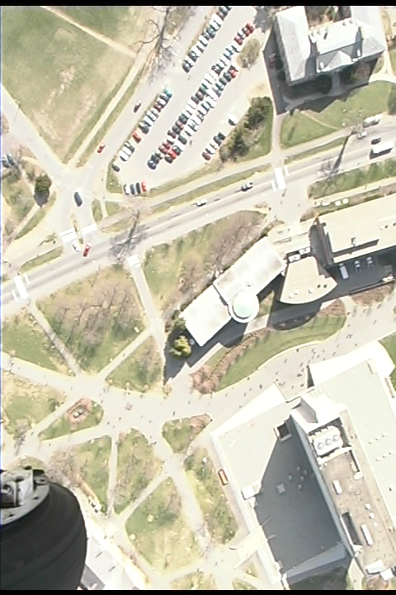
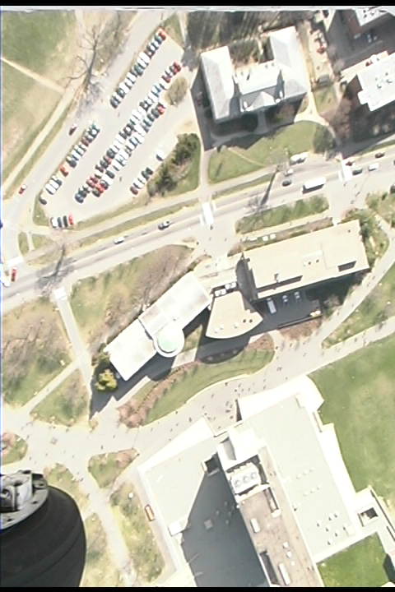
Correlation Approach
A Stereo Pair of UMass Campus – texture, boundaries and occlusion
Notes:
Homework 4 will use this pair
(1) Estimate F
(2) Find correspondences using correlation and features

Slide 49
Feature-based Approach
Features
Edge points
Lines (length, orientation, average contrast)
Corners
Matching algorithm
Extract features in the stereo pair
Define similarity measure
Search correspondences using similarity measure and the epipolar geometry

Slide 50
Feature-based Approach
LEFT IMAGE
corner
line
structure
For each feature in the left image…

Slide 51
Feature-based Approach
RIGHT IMAGE
corner
line
structure
Search in the right image… the disparity (dx, dy) is the displacement when the similarity measure is maximum

Slide 52
Feature-based Approach
PROS
Relatively insensitive to illumination changes
Good for man-made scenes with strong lines but weak texture or textureless surfaces
Work well on the occluding boundaries (edges)
Could be faster than the correlation approach
CONS
Only sparse depth map
Feature extraction may be tricky
Lines (Edges) might be partially extracted in one image
How to measure the similarity between two lines?

Slide 53
Advanced Topics
Mainly used in correlation-based approach, but can be applied to feature-based match
Image filtering to handle illumination changes
Image equalization
To make two images more similar in illumination
Laplacian filtering (2nd order derivative)
Use derivative rather than intensity (or original color)

Slide 54
Advanced Topics
Adaptive windows to deal with multiple disparities
Adaptive Window Approach (Kanade and Okutomi)
statistically adaptive technique which selects at each pixel the window size that minimizes the uncertainty in disparity estimates
A Stereo Matching Algorithm with an Adaptive Window: Theory and Experiment, T. Kanade and M. Okutomi. Proc. 1991 IEEE International Conference on Robotics and Automation, Vol. 2, April, 1991, pp. 1088-1095
Multiple window algorithm (Fusiello, et al)
Use 9 windows instead of just one to compute the SSD measure
The point with the smallest SSD error amongst the 9 windows and various search locations is chosen as the best estimate for the given points
A Fusiello, V. Roberto and E. Trucco, Efficient stereo with multiple windowing, IEEE CVPR pp858-863, 1997

Slide 55
Advanced Topics
Multiple windows to deal with multiple disparities
near
far
Smooth
regions
Corners
edges

Slide 56
Advanced Topics
Sub-pixel matching to improve accuracy
Find the peak in the correlation curves
Self-consistency to reduce false matches esp. for occlusions
Check the consistency of matches from L to R and from R to L
Multiple Resolution Approach
From coarse to fine for efficiency in searching correspondences
Local warping to account for perspective distortion
Warp from one view to the other for a small patch given an initial estimation of the (planar) surface normal
Multi-baseline Stereo
Improves both correspondences and 3D estimation by using more than two cameras (images)

Slide 57
3D Reconstruction Problem
What we have done
Correspondences using either correlation or feature based approaches
Epipolar Geometry from at least 8 point correspondences
Three cases of 3D reconstruction depending on the amount of a priori knowledge on the stereo system
Both intrinsic and extrinsic known - > can solve the reconstruction problem unambiguously by triangulation
Only intrinsic known -> recovery structure and extrinsic up to an unknown scaling factor
Only correspondences -> reconstruction only up to an unknown, global projective transformation (*)

Slide 58
Reconstruction by Triangulation
Assumption and Problem
Under the assumption that both intrinsic and extrinsic parameters are known
Compute the 3-D location from their projections, pl and pr
Solution
Triangulation: Two rays are known and the intersection can be computed
Problem: Two rays will not actually intersect in space due to errors in calibration and correspondences, and pixelization
Solution: find a point in space with minimum distance from both rays
P
p
p
r
l
O_{l}
O_{r}

Slide 59
Reconstruction up to a Scale Factor
Assumption and Problem Statement
Under the assumption that only intrinsic parameters and more than 8 point correspondences are given
Compute the 3-D location from their projections, pl and pr, as well as the extrinsic parameters
Solution
Compute the essential matrix E from at least 8 correspondences
Estimate T (up to a scale and a sign) from E (=RS) using the orthogonal constraint of R, and then R
End up with four different estimates of the pair (T, R)
Reconstruct the depth of each point, and pick up the correct sign of R and T.
Results: reconstructed 3D points (up to a common scale);
The scale can be determined if distance of two points (in space) are known
Notes:
Can be used in stereo from a moving camera

Slide 60
Reconstruction up to a Projective Transformation
(* not required for this course; needs advanced knowledge of projective geometry )
Assumption and Problem Statement
Under the assumption that only n (>=8) point correspondences are given
Compute the 3-D location from their projections, pl and pr
Solution
Compute the Fundamental matrix F from at least 8 correspondences, and the two epipoles
Determine the projection matrices
Select five points ( from correspondence pairs) as the projective basis
Compute the projective reconstruction
Unique up to the unknown projective transformation fixed by the choice of the five points
Notes:
Uncalibrated camera

Slide 61
Summary
Fundamental concepts and problems of stereo
Epipolar geometry and stereo rectification
Estimation of fundamental matrix from 8 point pairs
Correspondence problem and two techniques: correlation and feature based matching
Reconstruct 3-D structure from image correspondences given
Fully calibrated
Partially calibration
Uncalibrated stereo cameras (*)

Slide 62
Next
Understanding 3D structure and events from motion
Motion

