Slide 1

CSC212 Data Structure - Section EF
Lecture 23
Introduction to Graphs
Instructor: Zhigang Zhu
Department of Computer Science
City College of New York

Slide 2
Review
Linked Lists
13
10
15
7
null
Binary Trees
V
Q
L
E
T
A
Notes:
In our previous lectures we have got familiar with the concept of node. A node has a data field and a link field. Nodes can be linked together through their link fields. The Linked List is a linear structure where nodes are chained together along a single direction, i.e., there is only one path. If you have read the doubly linked list section in Chapter 5.5, the nodes can be linked in two directions, i.e., two paths. In Binary trees, a node can be linked to its two children, this makes the possible number of paths grow significantly. However, none of them given you the flexibility of allowing a node to link with any other node, for example, in linked list, 13 can not be linked to 15 directly. In the binary tree, V can not be linked to T directly. The graph data structure we are going to introduce today gives you the flexibility of linking a node to any other node that you want to connect. It is flexible, it is powerful yet it is much difficult to deal with. Many computer scientists have spent their whole lives on graph and there are a large amount of publications in this area. Today I am only giving you an introduction. Our department actually is very strong in graph related research. Professor Janos Pach and Gary S. Bloom are well known on their works in graph theory.

Slide 3
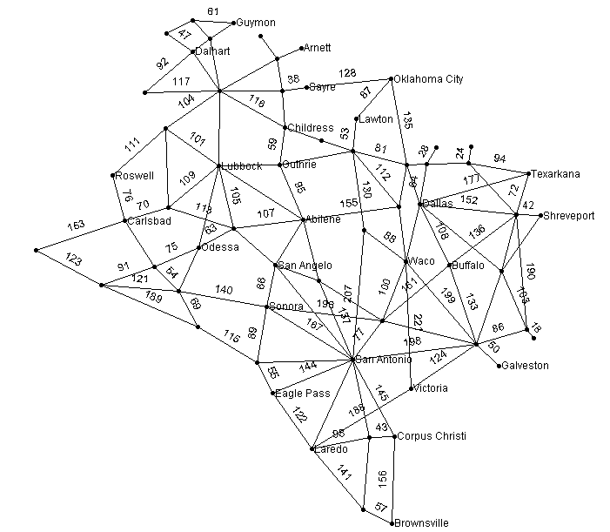
Examples: Texas Road Network
62 cities (nodes)
120 major roads (edges)
Minimum distance between Dallas and Corpus Christi?
Dijkstra single source path

Slide 4
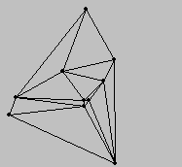
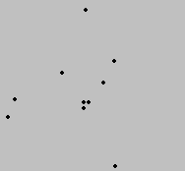
Examples: Delaunay Triangulation Network From a Point Data Set
Very useful for image morphing in movies and real-world applications
Notes:
Graphs can also be derived from point data. The points are connected according to some geometrical principles.

Slide 5
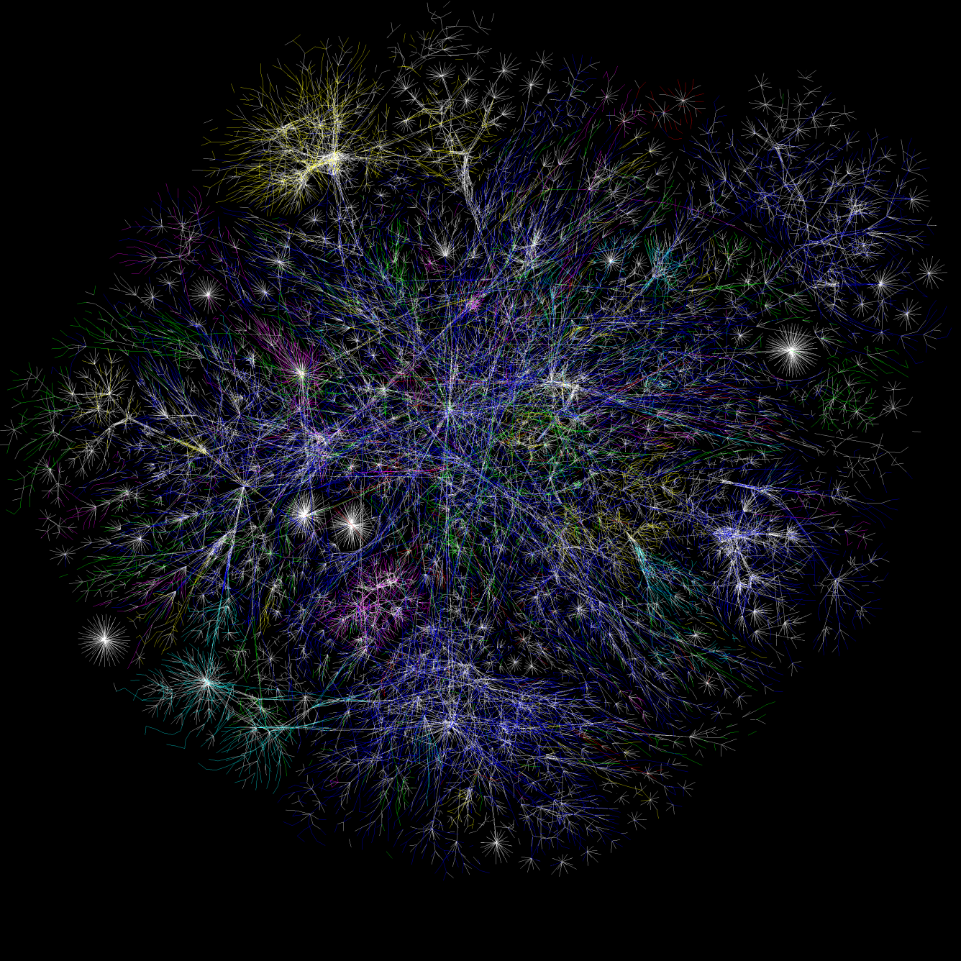
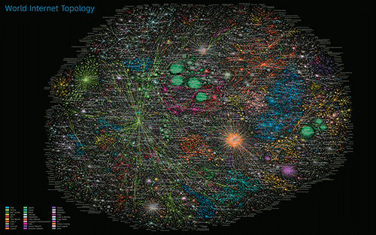
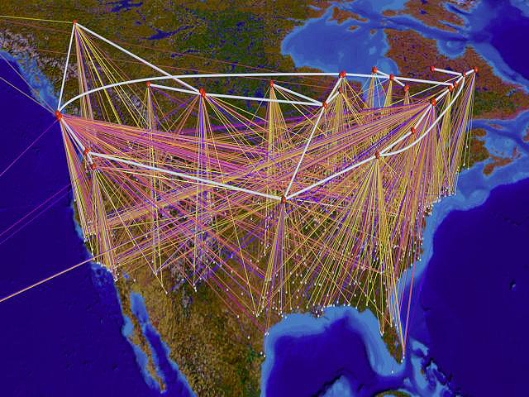
Examples: Internet Topology 01/16/2006
http://www.eee.bham.ac.uk/com_test/img%5Cdsnl%5Cinternet15jan06.png

Slide 6
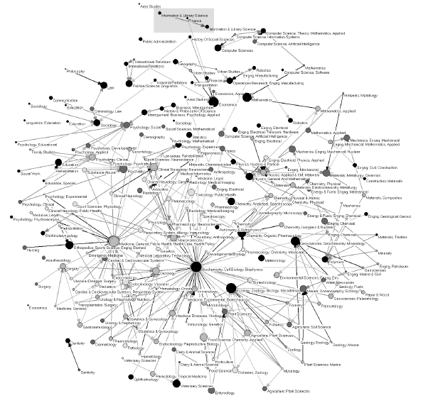
Examples: Backbone of Science With 212 clusters comprising 7000 journals
Kevin W Boyack, Richard Klavans, Katy Börner, Mapping the backbone of science, Scientometrics, Vol. 64, No. 3. (2005), pp. 351-374.
Computer Science
Mathematics
Geosciences, Geochemistry, Mineralogy
Biochemistry, Cell Biology, Biophyiscs
Notes:
Assuming there are 100 papers per year per journal and we have 40 years archive on average, the total number of papers, which is the number of nodes in the graph, would be 7000*100*40=28 m. If a paper cites 20 papers on average, then the number of connections would be over half a billion. The graph shown here is not the original graph, but the graph after clustering which has 212 clusters. It is already complex enough. As you might be able to see from the graph, Biochemistry, Cell Biology, Biophyiscs field is the hottest one.

Slide 7
Terminologies
A graph G = (V, E)
V: vertices /nodes
E : edges, pairs of vertices from V × V
Undirected Graph:
(u,v) is same as (v,u)
Directed Graph
(u,v) is different from (v,u)
Source (u)
Target (v)
A
B
C
D
E
F
G
H
A
B
C
D
E
F
G
H
I
Notes:
If you take u and v from V, then an edge would be (u,v)

Slide 8
More Terminologies – P 728
Loop: an edge that connects a vertex to itself.
Path: a sequence of vertices, p₀,p₁, …p_{m}, such that each adjacent pair of vertices p_{i} and p_{i+1} are connected by an edge.
Multiple Edges: two or more edges connecting the same two vertices in the same direction.
Simple graph: have no loops and no multiple edges – required for many applications.
Weighted graph and unweighted graph
Notes:
Draw graphs on the blackboard

Slide 9
Representations- Adjacency Matrix
An adjacency matrix represents the graph as a n x n matrix A:
A[i, j] = 1 if edge (i, j) ∈ E (or weight of edge)
= 0 if edge (i, j) ∉ E
 | 0 | 1 | 2 | 3
0 | 1 | 0 | 1 | 0
1 | 1 | 0 | 0 | 0
2 | 0 | 0 | 0 | 1
3 | 1 | 0 | 1 | 0
1
0
3
2
Space Complexity with respect to n = |V| and/or m = |E|?

Slide 10
Representations-Linked List
A directed graph with n vertices can be represented by n different linked lists. List number i provides the connections for vertex i. To be specific: for each entry j in the list number i, there is an edge from i to j.
0
1
2
3
0
2
1
0
0
3
3
2
0
2
Space Complexity with respect to n=|V| and/or m=|E|?

Slide 11
Graph Traversals
Traversal:
Tree traversals (ch 10): visit all the nodes of a tree and do some processing at each node
Types of Graph traversals
Depth First Search (DFS)
Breadth First Search (BFS)
Issues to consider
There is no root – need a start vertex
Be careful and do not enter a repetitive cycle – mark each vertex as it is processed

Slide 12
Graph Traversal-Recursive DFS
DFS(start)
Initialize the boolean visited array
Rec_DFS(start)
Rec_DFS(start)
For each of unvisited neighbor next of start
If (not visited) Rec_DFS(next)
0,1
0,1,3
0
0
0
0
2
2
2
1
1
1
4
4
4
6
3
5
6
3
5
6
3
5

Slide 13
Graph Traversal-DFS
0,1,3,5
0,1,3,5,6
0,1,3,5,6,4
0
0
0
2
2
2
1
1
1
4
4
4
6
3
5
6
3
5
6
3
5
0
2 is never visited
DFS search/spanning tree
Non-recursive version? (using a stack)
1
4
6
3
5
DFS Tree/Spanning Tree

Slide 14
Graph Traversal-BFS
BFS(start)
Initialize the boolean visited array
Add start to an empty queue Q
Visited[start]=true;
While(!Q.empty())
u=Q.dequeue () //top+pop/get_front
For each unvisited neighbor v of u
Q.enqueue(v) //push
Visited[v]=true

Slide 15
Graph Traversal-BFS
0
0,1,4
0,1,4,3
0
0
0
2
2
2
1
1
1
4
4
4
6
3
5
6
3
5
6
3
5
0
1
4
4
3
F
R
F
R
F
R

Slide 16
Graph Traversal-BFS
0,1,4,3
0,1,4,3,5,6
0,1,4,3,5,6
0
0
0
2
2
2
1
1
1
4
4
4
6
3
5
6
3
5
6
3
5
3
5
6
6
F
R
F
R
F
R

Slide 17
Graph Traversal-BFS
0
1
4
0,1,4,3,5,6
6
3
5
0
BFS Search: 0,1,4,3,5,6
BFS Spanning Tree
2
1
4
0
6
3
5
1
4
R
6
3
5
F
DFS Research: 0,1,3,5,6,4
DFS Spanning Tree

Slide 18
Further Information
Path Algorithms (Ch 15.4)
Dijkstra single source path
-> CSc 220 Algorithm
Alternative Bellman-Ford algorithm for graphs with negative weights http://en.wikipedia.org/wiki/Bellman-Ford_algorithm
All-pair shortest path algorithms
Floyd–Warshall algorithm http://en.wikipedia.org/wiki/Floyd-Warshall_algorithm
Shortest path in dynamic networks (graphs)
Graph Partition http://en.wikipedia.org/wiki/Graph_partitioning
Graph Layout/Drawing

