Slide 1
BEAT+: Adding Branding and Entrepreneurship for Real-World Applications Using Emerging Technologies: AI, AR, AT, and Apps
From AT to BEAT, and From BEAT to BEAT+
Zhigang Zhu, Kayser Chair Professor of Computer Science, GSOE, CCNY
Gerardo A Blumenkrantz, Associate Professor, Media & Communication Arts, Branding + Integrated Communications (BIC) Creative Track, CCNY
Katherine Olives, Program Manager, Zahn Innovation Center

Slide 2
BEAT: Branding and Entrepreneurship of Assistive Technology for Social Good
Extending the CCNY Joint Senior Design Program on Assistive Technology Across School Boundaries

Slide 3
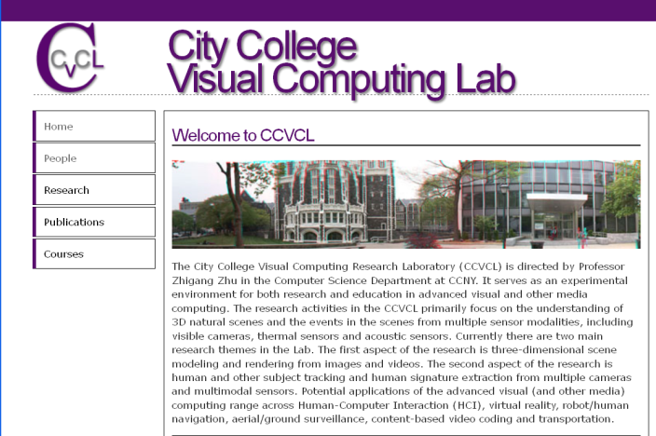






BEAT: Branding and Entrepreneurship of Assistive Technology for Social Good
+
for

Slide 4
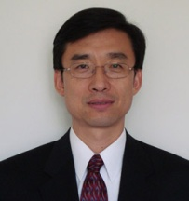
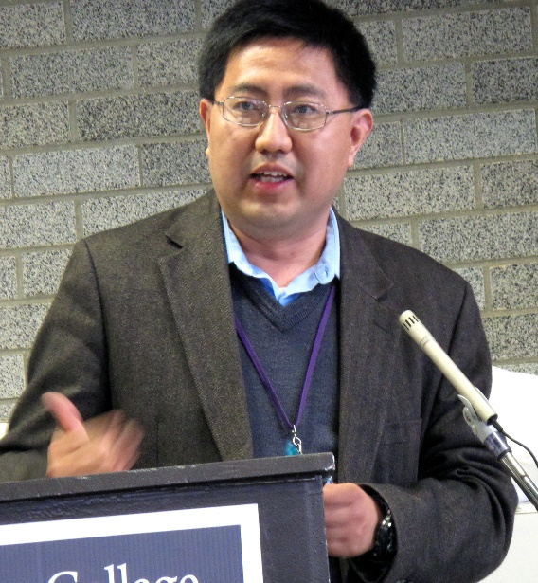
BACKGROUND: In the past eight years, there has been a cross-departmental joint senior design course for undergraduate seniors (20-30 students each year) majoring in Computer Science (CS), Computer Engineering (CpE) and Electrical Engineering (EE) in the Grove School of Engineering (GSOE) focused in exploring and developing assistive technologies for smart living of all.

Slide 5
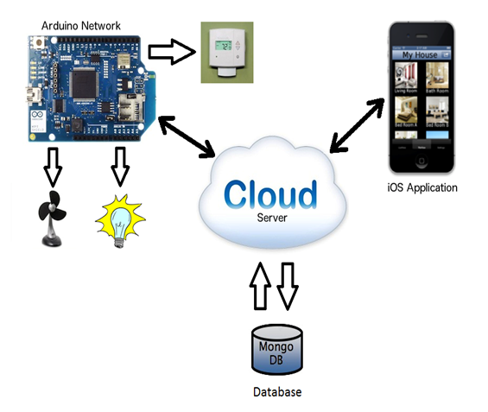
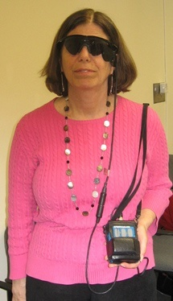
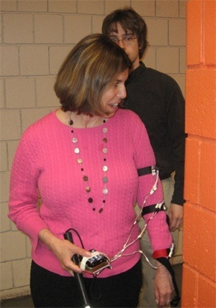

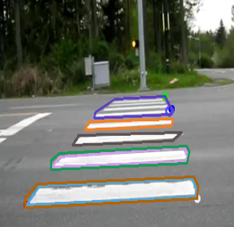
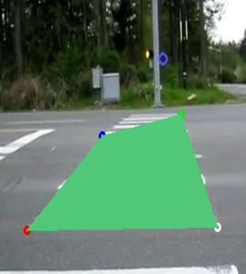
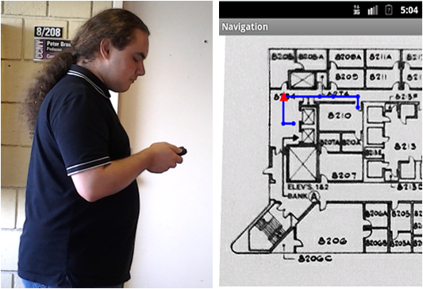
Cross-Disciplinary Projects (CS, CpE, EE)
Sensing approaches (camera, stereo, IR, ultrasonic, kinect, etc)
Data interpretation algorithms (hardware, smart phone, PC, etc)
Display methods (tactile, audio, speech, visual)
Apps for smart living, smart office, smart health, assistive/accessibility technologies

Slide 6



AT: Sponsors and Community Partners
NSF GARDE (Gen & Age Rel Disabilities Eng)
Senior Design Program on Assistive Technology to Aid Visually Impaired People (Award #1160046)
VentureWell (formerly NCIIA)
Course and Program: Human and Machine Intelligence - Perception, Computation and Action (Award # 10087-12)
NYSID CREATE
Cultivating Resources for Employment with Assistive Technology
Service Agencies (for ASD and BVIs)
Goodwill Industrials
Lighthouse Guild
NYS Commission for the Blind

Slide 7
BACKGROUND: In the past eight years, there has been a cross-departmental joint senior design course for undergraduate seniors majoring in Computer Science (CS), Computer Engineering (CpE) and Electrical Engineering (EE) in the Grove School of Engineering (GSOE) focused in exploring and developing assistive technologies for smart living of all.
BUT students may not know how to successfully communicate with the users, investors, stakeholders and community partners to really make their breakthrough work ACTIONABLE. Additionally, they may lack the entrepreneurship skills that will help them turn their brilliant ideas into reality.
THEREFORE we will to tap into CCNY’s resources (BIC program and the Zahn Center) teach them useful and practical the branding, storytelling and entrepreneurship skills they need.

Slide 8
BEAT Instructors: Zhigang Zhu, Kayser Chair Professor of Computer Science, GSOE, CCNY Gerardo A Blumenkrantz, Associate Prof., Branding + Integrated Comm. (BIC) Track, CCNY Katherine Olives, Program Manager, Zahn Innovation Center Other Collaborators and Partners: Nancy R. Tag, Program Director, BIC Program, CCNY Marlene Leo, Program Specialist, BIC Program, CCNY Kesia Hudson, Interim Executive Director, Zahn Innovation Center Steven Monzon, Operations Manager, Zahn Innovation Center Megan L. Tatro, Social Media and Marketing Strategist, NYSID Celina Cavalluzzi, Director of Day Services, Goodwill Industries NY/NJ Bill Seiple, Chief Research Officer at Lighthouse Guild; Research Prof. at NYU Medicine Cecilia Feeley, Manager of Autism Transportation Project, CAIT, Rutgers

Slide 9
First Semester (Fall):
In addition to the regular class meets for basics on vision, robotics and assistive technology:
A seminar by a BIC instructor on branding.
A seminar by a Zahn staff on entrepreneurship and Zahn competition
BEAT teams of CS/CpE/EE students develop proposals of projects– targeting to Zahn, CREATE or VentureWell Competitions, and share them with BIC students.
Site visits to Goodwill/Lighthouse Guild/other places for customers with challenges (e.g. disabilities, elderly, Alzheimer’s etc.)
Invited community partners as speakers and judges for brainstorming customer discovery and proposal presentations
BEAT teams revise their proposals for submitting to competitions

Slide 10
Second Semester (Spring): In addition to our weekly technical meetings for project development updating:
BIC students provide monthly feedback (via meetings or postings) with CS/CpE/EE teams for developing their video, demos and materials for the Zahn/CREATE/VentureWell presentations.
Invited community partners from Goodwill/Lighthouse Guild, BIC faculty and Zahn Center staff as judges for project presentations
Participation of the Zahn competitions by the joint BEAT teams, and follow-on work if winning awards
Submitting papers to conferences or journals (such as MIT UTRC, CSUN Assistive Technology, ACVR Workshop, etc.).

Slide 11
From BEAT to BEAT+
Branding and Entrepreneurship are adding components
Real world Applications expanded from Assistive Technologies to any projects for social good and with national priorities
Emerging Technologies include AI, AR, AT and Apps etc.
Real-world projects with external domain experts

Slide 12




From BEAT to BEAT+: Three Major Venues
NYSID CREATE Awards and with Goodwill NY/NJ
VentureWell and Zahn Innovation E-Competitions
Research Projects with External Experts

Slide 13
From BEAT to BEAT+ : External Experts
Digital Twins for Navigation and Safety, Digital Twins Arber Ruci/Fani Maksakuli/Jin Chen, Nearabl;
Autism Transportation, Cecilia Feeley, CAIT @ Rutgers;
AR/VR for Simulation and Training, Hao Tang, BMCC/CUNY;
Gamification for Vision Training- Bill Seiple, Lighthouse Guild;
Partnership with Goodwill for ASD (Celina Cavalluzzi, Assistant Vice President, Goodwill NY/NJ

Slide 14
Evaluation Guidelines: B.E.A.T.
Branding Appealing
Logo, fonts, colors, and communication (audio, video, text)
Entrepreneurship Awareness
Entrepreneurship Competition Participations
Conference/Journal Submissions
Application Relevance
In helping people (especially people in need)
For social good (common good)
Technology Soundness
What you have learned from classes (Data, Algorithms, Math)
What you will learn on your own of new things (AI, ML, HCI, apps)

Slide 15
Course Assignments – Fall 2021 (Due in 1~2 weeks)
09/08. A1. Resume with Project Interests and Teaming – 10%
10/03. A2. E-Proposals in wiki and quad chart – 10%
10/14. A3. BIC-Proposals shared in wiki or Google Drive – 10%
10/18. P1. Proposal presentations to community partners -15%
10/24-26, 11/14. A4. BEAT-Proposals to Zahn/CREATE/VentureWell – 10%
11/22. A5. Vision Writing Questions (Feature Extraction). – 10%
12/06. A6. Vision Writing Questions (Stereo & Motion). – 10%
12/12. A7. Revised BEAT-Proposals shared in wiki or Drive – 10%
12/13. P2. Revised proposals presented to community partners – 15%
Bonus for VentureWell, CREATE, Zahn and Research Outcomes - 5%
Bonus for attending AI4IA seminars – 1% each time

Slide 16
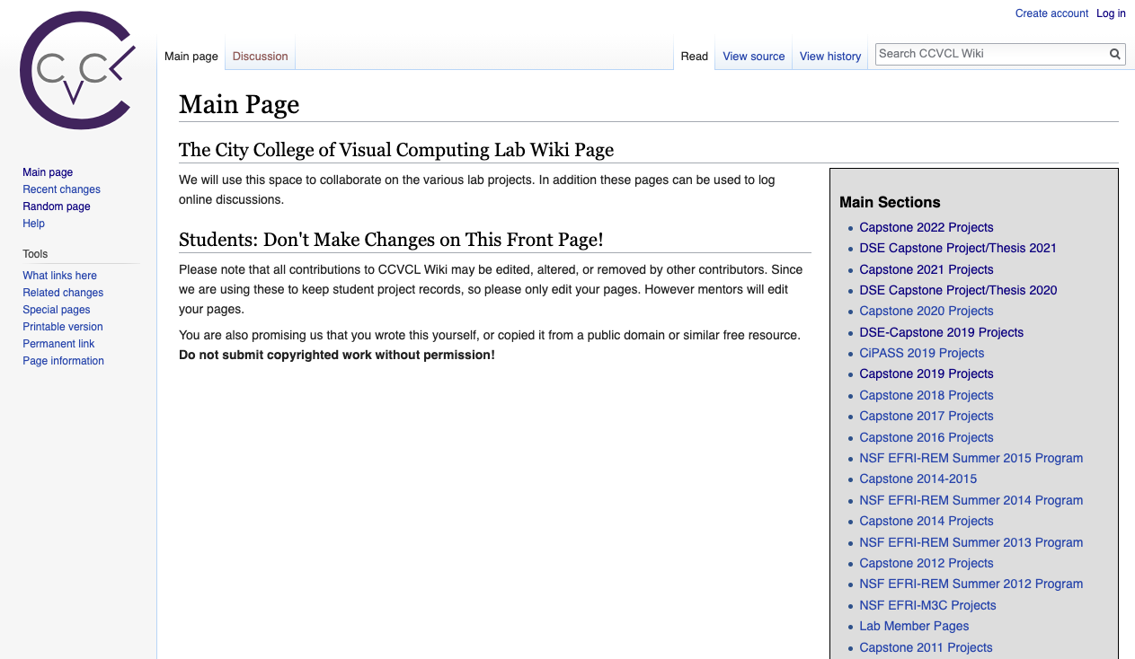
Wiki Page Weekly Updates
Create an account using your ccny email
Then check your email (incl. spam folder) to confirm
Before you come back to login
http://wiki.ccvcl.org

Slide 17
BEAT+: Adding Branding and Entrepreneurship for Real-World Applications Using Emerging Technologies: AI, AR, AT, and Apps
From AT to BEAT, and From BEAT to BEAT+
Zhigang Zhu, Kayser Chair Professor of Computer Science, GSOE, CCNY
Gerardo A Blumenkrantz, Associate Professor, Media & Communication Arts, Branding + Integrated Communications (BIC) Creative Track, CCNY
Katherine Olives, Program Manager, Zahn Innovation Center

