Slide 1

3D Vision
Capstone Class
Topic 1 of 3D Vision:
Stereo Vision
Zhigang Zhu, City College of New York zhu@cs.ccny.cuny.edu
Notes:
This course is a basic introduction to parts of the field of computer vision. This version of the course covers topics in 'early' or 'low' level vision and parts of 'intermediate' level vision. It assumes no background in computer vision, a minimal background in Artificial Intelligence and only basic concepts in calculus, linear algebra, and probability theory.

Slide 2
Stereo Vision
Problem
Infer 3D structure of a scene from two or more images taken from different viewpoints
Two primary Sub-problems
Correspondence problem (stereo match) -> disparity map
“Similar” instead of “Same”
Occlusion problem: some parts of the scene are visible only in one eye
Reconstruction problem -> 3D
What we need to know about the cameras’ parameters
Often a stereo calibration problem
Lectures on Stereo Vision
Stereo Geometry – Epipolar Geometry (*)
Correspondence Problem (*) – Two classes of approaches
3D Reconstruction Problems – Three approaches

Slide 3
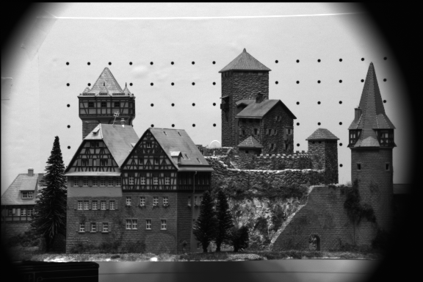
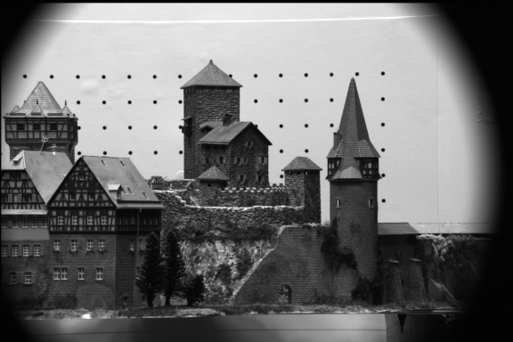
A Stereo Pair
Problems
Correspondence problem (stereo match) -> disparity map
Reconstruction problem -> 3D
3D?
?
CMU CIL Stereo Dataset : Castle sequence
http://www-2.cs.cmu.edu/afs/cs/project/cil/ftp/html/cil-ster.html

Slide 4
More Images…
Problems
Correspondence problem (stereo match) -> disparity map
Reconstruction problem -> 3D

Slide 5
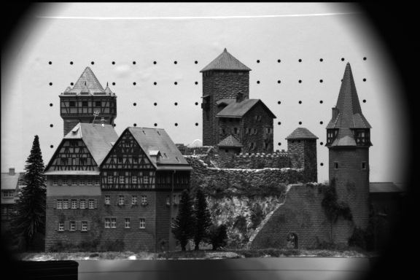
More Images…
Problems
Correspondence problem (stereo match) -> disparity map
Reconstruction problem -> 3D

Slide 6
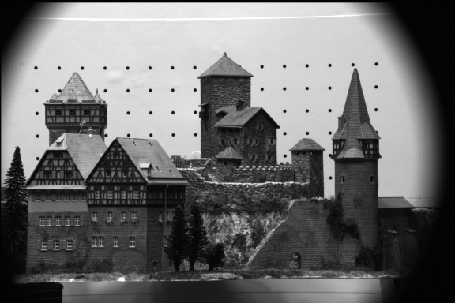
More Images…
Problems
Correspondence problem (stereo match) -> disparity map
Reconstruction problem -> 3D

Slide 7
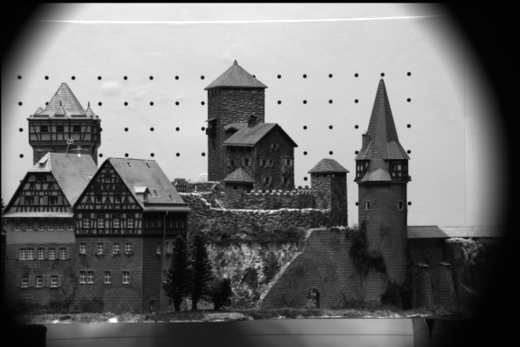
More Images…
Problems
Correspondence problem (stereo match) -> disparity map
Reconstruction problem -> 3D

Slide 8
More Images…
Problems
Correspondence problem (stereo match) -> disparity map
Reconstruction problem -> 3D

Slide 9
Part I. Stereo Geometry
A Simple Stereo Vision System
Disparity Equation
Depth Resolution
Fixated Stereo System
Epipolar Geometry
Epipolar lines – Where to search correspondences
Epipolar Plane, Epipolar Lines and Epipoles
Essential Matrix and Fundamental Matrix
Computing E & F by the Eight-Point Algorithm
Computing the Epipoles

Slide 10
Stereo Geometry
P(X,Y,Z)
Converging Axes – Usual setup of human eyes
Depth obtained by triangulation
Correspondence problem: p_{l} and p_{r} correspond to the left and right projections of P, respectively.
Notes:
Binocular (or stereo) geometry is shown in the figure. The vergence angle is the angle between the two image planes, which for simplicity we assume are aligned so that the y-axes are parallel. Given either image of the pair, all we can say is that the object point imaged at Pr or Pl is along the respective rays through the lens center. If in addition we know that Pr and Pl are the image projections of the same object point, then the depth of this point can be computed using triangulation (we will return to this in more detail in the section on motion and stereo).
In addition to the camera geometry, the key additional piece of information in stereo vision is the knowledge that Pr and Pl are projections of the same object point. Given only the two images, the problem in stereo vision is to determine, for a given point in the left image (say), where the projection of this point is in the right image. This is called the correspondence problem. Many solutions to the correspondence problem have been proposed in the literature, but none have proven entirely satisfactory for general vision (although excellent results can be achieved in many cases).

Slide 11
A Simple Stereo System
LEFT CAMERA
RIGHT CAMERA
baseline
Left image:
reference
Right image:
target
disparity
Depth Z
Elevation Z_{w}
Z_{w}=0

Slide 12
Disparity Equation
P(X,Y,Z)
Stereo system with parallel optical axes
Depth
Disparity:
d = x_{r} - x_{l}
Image plane
Image plane
p_{l}(x_{l},y_{l})
pr(x_{r},y_{r})
f = focal length
f = focal length
Optical Center O_{l}
Optical Center O_{r}
B = Baseline
LEFT CAMERA
RIGHT CAMERA

Slide 13
Disparity vs. Baseline
P(X,Y,Z)
Stereo system with parallel optical axes
Depth
Disparity
d = x_{r} - x_{l}
Image plane
Image plane
p_{l}(x_{l},y_{l})
pr(x_{r},y_{r})
f = focal length
f = focal length
Optical Center O_{l}
Optical Center O_{r}
B = Baseline
LEFT CAMERA
RIGHT CAMERA

Slide 14
Depth Accuracy
Given the same image localization error
Angle of cones in the figure
Depth Accuracy (Depth Resolution) vs. Baseline
Depth Error ∝ 1/B (Baseline length)
PROS of Longer baseline,
better depth estimation
CONS
smaller common FOV
Correspondence harder due to occlusion
Depth Accuracy (Depth Resolution) vs. Depth
Disparity (>0) ∝ 1/ Depth
Depth Error ∝ Depth²
Nearer the point, better the depth estimation
An Example
f = 16 x 512/8 pixels, B = 0.5 m
Depth error vs. depth
Two viewpoints
O_{l}
O_{r}
Z₁
Z₂
∂Z₁
∂Z₂>∂Z₁
Absolute error
Relative error
Notes:
f = 16 x 512/8 pixels, B = 0.5 m, dZ = Z**2 /2**9 * 1 (pixel)
Z (m) 2 4 8 16 32 64
dZ(m) 1/128 1/32 1/8 ½ 2 8

Slide 15
Stereo with Converging Cameras
Stereo with Parallel Axes
Short baseline
large common FOV
large depth error
Long baseline
small depth error
small common FOV
More occlusion problems
Two optical axes intersect at the Fixation Point
converging angle θ
The common FOV Increases
FOV
Left
right

Slide 16
Stereo with Converging Cameras
Stereo with Parallel Axes
Short baseline
large common FOV
large depth error
Long baseline
small depth error
small common FOV
More occlusion problems
Two optical axes intersect at the Fixation Point
converging angle θ
The common FOV Increases
FOV
Left
right

Slide 17
Stereo with Converging Cameras
Two optical axes intersect at the Fixation Point
converging angle θ
The common FOV Increases
Disparity properties
Disparity uses angle instead of distance
Zero disparity at fixation point
and the Zero-disparity horopter
Disparity increases with the distance of objects from the fixation points
>0 : outside of the horopter
<0 : inside the horopter
Depth Accuracy vs. Depth
Depth Error ∝ Depth²
Nearer the point, better the depth estimation
Fixation point
FOV
θ
Left
right

Slide 18
Parameters of a Stereo System
Intrinsic Parameters
Characterize the transformation from camera to pixel coordinate systems of each camera
Focal length, image center, aspect ratio
Extrinsic parameters
Describe the relative position and orientation of the two cameras
Rotation matrix R and translation vector T
P
P_{l}
P_{r}
p
p
Y_{r}
Y_{l}
l
r
X_{l}
Z_{l}
Z_{r}
f_{l}
f_{r}
O_{l}
O_{r}
R, T
X_{r}

Slide 19
Epipolar Geometry
P
Notations
P_{l} =(X_{l}, Y_{l}, Z_{l}), P_{r} =(X_{r}, Y_{r}, Z_{r})
Vectors of the same 3-D point P, in the left and right camera coordinate systems respectively
Extrinsic Parameters
Translation Vector T = (O_{r}-O_{l})
Rotation Matrix R
p_{l} =(x_{l}, y_{l}, z_{l}), p_{r} =(x_{r}, y_{r}, z_{r})
Projections of P on the left and right image plane respectively
For all image points, we have z_{l}=f_{l}, z_{r}=f_{r}
P_{l}
P_{r}
p
p
Y_{r}
Y_{l}
l
r
Z_{l}
Z_{r}
X_{l}
f_{l}
f_{r}
O_{l}
O_{r}
R, T
X_{r}
Notes:
Left: reference camera
T: Vector in the left camera system
R: from Left to right
Image coordinates: in projective space

Slide 20
Epipolar Geometry
Motivation: where to search correspondences?
Epipolar Plane
A plane going through point P and the centers of projections (COPs) of the two cameras
Conjugated Epipolar Lines
Lines where epipolar plane intersects the image planes
Epipoles
The image of the COP of one camera in the other
Epipolar Constraint
Corresponding points must lie on conjugated epipolar lines
P
P_{l}
P_{r}
Epipolar Plane
Epipolar Lines
p
l
p
r
O_{l}
e_{l}
e_{r}
O_{r}
Epipoles

Slide 21
Essential Matrix
Equation of the epipolar plane
Co-planarity condition of vectors P_{l}, T and P_{l}-T
Essential Matrix E = RS
3x3 matrix constructed from R and T (extrinsic only)
Rank (E) = 2, two equal nonzero singular values
Rank (R) =3
Rank (S) =2
Notes:
The projection of TxPl in vector (Pl-T) is zero
Note: the epipolar line about pr will pass through pl IFF R = I , which says
p_{l}^{T} S p_{l} == 0
It is the FOE geometry in visual motion. Otherwise, NOT!

Slide 22
Essential Matrix
Essential Matrix E = RS
A natural link between the stereo point pair and the extrinsic parameters of the stereo system
One correspondence -> a linear equation of 9 entries
Given 8 pairs of (pl, pr) -> E
Mapping between points and epipolar lines we are looking for
Given p_{l}, E -> p_{r} on the projective line in the right plane
Equation represents the epipolar line of pr (or pl) in the right (or left) image
Note:
pl, pr are in the camera coordinate system, not pixel coordinates that we can measure
Notes:
(0). Essential Equation represents actually the epipolar plane in either the left or the right image
(1). Epipolar line in the right image given pl
(Ep_{l})^{T}p_{r}=0
zr = fr
extension of the equations in pr = (xr,yr,fr)
(2). Epipolar line in the left image given pr
(p_{r}^{T}E) p_{l}=0
zl = fl

Slide 23
Fundamental Matrix
Mapping between points and epipolar lines in the pixel coordinate systems
With no prior knowledge on the stereo system
From Camera to Pixels: Matrices of intrinsic parameters
Questions:
What are fx, fy, ox, oy ?
How to measure p_{l} in images?
Rank (M_{int}) =3
Notes:
Ml and Mr are intrinsic matrix of the left and the right cameras
fx = f/sx, fy = f/sy
P-bar = (-fx*x+f*ox, -fy*y+f*oy, f) = (-x/sx+ox, -y/sy+oy, 1)
Xim = x1/x3, yim = x2/x3
(x1, x2, x3) ?

Slide 24
Fundamental Matrix
Fundamental Matrix
Rank (F) = 2
Encodes info on both intrinsic and extrinsic parameters
Enables full reconstruction of the epipolar geometry
In pixel coordinate systems without any knowledge of the intrinsic and extrinsic parameters
Linear equation of the 9 entries of F
Notes:
(x1, x2, x3) <=> (x1/x3, x2/x3, 1)
When you find an epipole, always scale the third coordinate to 1 in this notation

Slide 25
Computing F: The Eight-point Algorithm
Input: n point correspondences ( n >= 8)
Construct homogeneous system Ax= 0 from
x = (f₁₁,f₁₂, ,f₁₃, f₂₁,f₂₂,f₂₃ f₃₁,f₃₂, f₃₃) : entries in F
Each correspondence give one equation
A is a nx9 matrix
Obtain estimate F^ by SVD of A
x (up to a scale) is column of V corresponding to the least singular value
Enforce singularity constraint: since Rank (F) = 2
Compute SVD of F^
Set the smallest singular value to 0: D -> D’
Correct estimate of F :
Output: the estimate of the fundamental matrix, F’
Similarly we can compute E given intrinsic parameters
Notes:
Why a homogeneous system?
Expand the F equation on blackboard

Slide 26
Epipolar Geometry: Summary
Purpose
where to search correspondences
Epipolar plane, epipolar lines, and epipoles
known intrinsic (f) and extrinsic (R, T)
co-planarity equation
known intrinsic but unknown extrinsic
essential matrix
unknown intrinsic and extrinsic
fundamental matrix
Notes:
(0). Essential Equation represents actually the epipolar plane in either the left or the right image
(1). Epipolar line in the right image given pl
(Ep_{l})^{T}p_{r}=0
zr = fr
extension of the equations in pr = (xr,yr,fr)
(2). Epipolar line in the left image given pr
(p_{r}^{T}E) p_{l}=0
zl = fl

Slide 27
Part II. Correspondence problem
Three Questions
What to match?
Features: point, line, area, structure?
Where to search correspondence?
Epipolar line?
How to measure similarity?
Depends on features
Approaches
Correlation-based approach
Feature-based approach
Advanced Topics
Image filtering to handle illumination changes
Adaptive windows to deal with multiple disparities
Local warping to account for perspective distortion
Sub-pixel matching to improve accuracy
Self-consistency to reduce false matches
Multi-baseline stereo

Slide 28
Correlation Approach
LEFT IMAGE
(x_{l}, y_{l})
For Each point (x_{l}, y_{l}) in the left image, define a window centered at the point

Slide 29

Correlation Approach
RIGHT IMAGE
(x_{l}, y_{l})
… search its corresponding point within a search region in the right image

Slide 30
Correlation Approach
RIGHT IMAGE
(x_{r}, y_{r})
d
(x_{l}, y_{l})
… the disparity (dx, dy) is the displacement when the correlation is maximum

Slide 31
Correlation Approach
Elements to be matched
Image window of fixed size centered at each pixel in the left image
Similarity criterion
A measure of similarity between windows in the two images
The corresponding element is given by window that maximizes the similarity criterion within a search region
Search regions
Theoretically, search region can be reduced to a 1-D segment, along the epipolar line, and within the disparity range.
In practice, search a slightly larger region due to errors in calibration

Slide 32
Correlation Approach
Equations
disparity
Similarity criterion
Cross-Correlation
Sum of Square Difference (SSD)
Sum of Absolute Difference(SAD)

Slide 33
Correlation Approach
PROS
Easy to implement
Produces dense disparity map
Maybe slow
CONS
Needs textured images to work well
Inadequate for matching image pairs from very different viewpoints due to illumination changes
Window may cover points with quite different disparities
Inaccurate disparities on the occluding boundaries

Slide 34
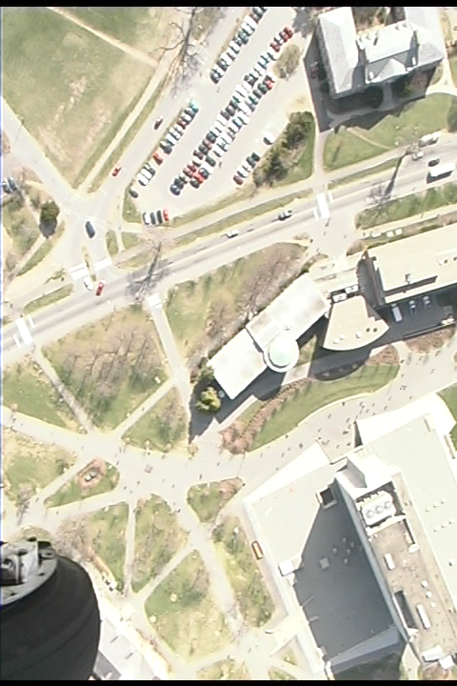
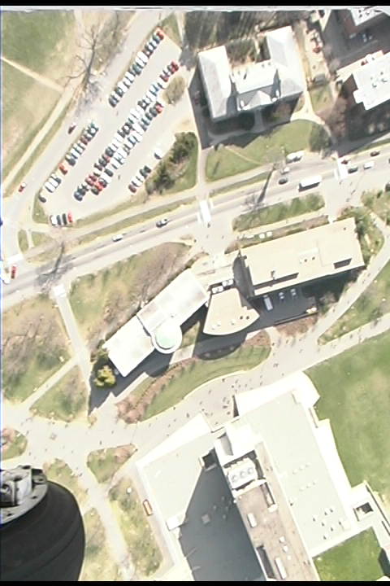
Correlation Approach
A Stereo Pair of UMass Campus – texture, boundaries and occlusion
Notes:
Homework 4 will use this pair
(1) Estimate F
(2) Find correspondences using correlation and features

Slide 35
Feature-based Approach
Features
Edge points
Lines (length, orientation, average contrast)
Corners
Matching algorithm
Extract features in the stereo pair
Define similarity measure
Search correspondences using similarity measure and the epipolar geometry

Slide 36
Feature-based Approach
LEFT IMAGE
corner
line
structure
For each feature in the left image…

Slide 37
Feature-based Approach
RIGHT IMAGE
corner
line
structure
Search in the right image… the disparity (dx, dy) is the displacement when the similarity measure is maximum

Slide 38
Feature-based Approach
PROS
Relatively insensitive to illumination changes
Good for man-made scenes with strong lines but weak texture or textureless surfaces
Work well on the occluding boundaries (edges)
Could be faster than the correlation approach
CONS
Only sparse depth map
Feature extraction may be tricky
Lines (Edges) might be partially extracted in one image
How to measure the similarity between two lines?

Slide 39
Advanced Topics
Sub-pixel matching to improve accuracy
Find the peak in the correlation curves
Self-consistency to reduce false matches esp. for occlusions
Check the consistency of matches from L to R and from R to L
Multiple Resolution Approach
From coarse to fine for efficiency in searching correspondences
Local warping to account for perspective distortion
Warp from one view to the other for a small patch given an initial estimation of the (planar) surface normal
Multi-baseline Stereo
Improves both correspondences and 3D estimation by using more than two cameras (images)

Slide 40
3D Reconstruction Problem
What we have done
Correspondences using either correlation or feature based approaches
Epipolar Geometry from at least 8 point correspondences
Three cases of 3D reconstruction depending on the amount of a priori knowledge on the stereo system
Both intrinsic and extrinsic known - > can solve the reconstruction problem unambiguously by triangulation
Only intrinsic known -> recovery structure and extrinsic up to an unknown scaling factor
Only correspondences -> reconstruction only up to an unknown, global projective transformation (*)

Slide 41
Reconstruction by Triangulation
Assumption and Problem
Under the assumption that both intrinsic and extrinsic parameters are known
Compute the 3-D location from their projections, pl and pr
Solution
Triangulation: Two rays are known and the intersection can be computed
Problem: Two rays will not actually intersect in space due to errors in calibration and correspondences, and pixelization
Solution: find a point in space with minimum distance from both rays
P
p
p
r
l
O_{l}
O_{r}

Slide 42
Reconstruction up to a Scale Factor
(optional)
Assumption and Problem Statement
Under the assumption that only intrinsic parameters and more than 8 point correspondences are given
Compute the 3-D location from their projections, pl and pr, as well as the extrinsic parameters
Solution
Compute the essential matrix E from at least 8 correspondences
Estimate T (up to a scale and a sign) from E (=RS) using the orthogonal constraint of R, and then R
End up with four different estimates of the pair (T, R)
Reconstruct the depth of each point, and pick up the correct sign of R and T.
Results: reconstructed 3D points (up to a common scale);
The scale can be determined if distance of two points (in space) are known
Notes:
Can be used in stereo from a moving camera

Slide 43
Summary
Fundamental concepts and problems of stereo
Epipolar geometry and stereo rectification
Estimation of fundamental matrix from 8 point pairs
Correspondence problem and two techniques: correlation and feature based matching
Reconstruct 3-D structure from image correspondences given
Fully calibrated
Partially calibration
Uncalibrated stereo cameras (*)

Slide 44
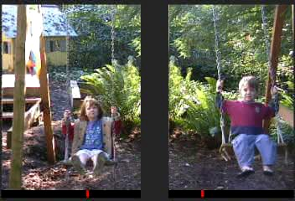
3D Vision
Capstone Class
Topic 2 of 3D Vision:
Visual Motion
Zhigang Zhu, City College of New York zhu@cs.ccny.cuny.edu
Cover Image/video credits: Rick Szeliski, MSR

Slide 45
Outline of Motion
Problems and Applications
The importance of visual motion
Problem Statement
The Motion Field of Rigid Motion
Basics – Notations and Equations
Three Important Special Cases: Translation, Rotation and Moving Plane
Motion Parallax
Optical Flow
Optical flow equation and the aperture problem
Estimating optical flow
3D motion & structure from optical flow
Feature-based Approach
Two-frame algorithm
Multi-frame algorithm
Structure from motion – Factorization method
Advanced Topics
Spatio-Temporal Image and Epipolar Plane Image
Video Mosaicing and Panorama Generation
Motion-based Segmentation and Layered Representation

Slide 46
The Importance of Visual Motion
Structure from Motion
Apparent motion is a strong visual clue for 3D reconstruction
More than a multi-camera stereo system
Recognition by motion (only)
Biological visual systems use visual motion to infer properties of 3D world with little a priori knowledge of it
Blurred image sequence
Visual Motion = Video ! [Go to CVPR 2004-2019 Sites for Workshops]
Mobile Vision and First-Person Vision
Video Understanding (Humans, Traffic, Activities)
HCI using Human Emotion & Gestures
Image-based Modeling and Rendering
Camera-based Sensor Network and Surveillance
… …

Slide 47

Blurred Sequence
Recognition by Actions: Recognize object from motion even if we cannot distinguish it in any images …
An up-sampling from images of resolution 15x20 pixels
From: James W. Davis. MIT Media Lab

Slide 48
Problem Statement
Two Subproblems
Correspondence: Which elements of a frame correspond to which elements in the next frame?
Reconstruction :Given a number of correspondences, and possibly the knowledge of the camera’s intrinsic parameters, how to recovery the 3-D motion and structure of the observed world
Main Difference between Motion and Stereo
Correspondence: the disparities between consecutive frames are much smaller due to dense temporal sampling
Reconstruction: the visual motion could be caused by multiple motions ( instead of a single 3D rigid transformation)
The Third Subproblem, and Fourth….
Motion Segmentation: what are the regions on the image plane corresponding to different moving objects?
Motion Understanding: lip reading, gesture, expression, event…

Slide 49
Approaches
Two Subproblems
Correspondence:
Differential Methods - >dense measure (optical flow)
Matching Methods -> sparse measure
Reconstruction : More difficult than stereo since
Motion (3D transformation between frames) as well as structure needs to be recovered
Small baseline causes large errors
The Third Subproblem
Motion Segmentation: Chicken and Egg problem
Which should be solved first? Matching or Segmentation
Segmentation for matching elements
Matching for Segmentation

Slide 50
The Motion Field of Rigid Objects
Motion:
3D Motion ( R, T):
camera motion (static scene)
or single object motion
Only one rigid, relative motion between the camera and the scene (object)
Image motion field:
2D vector field of velocities of the image points induced by the relative motion.
Data: Image sequence
Many frames
captured at time t=0, 1, 2, …
Basics: only consider two consecutive frames
We consider a reference frame and its consecutive frame
Image motion field
can be viewed as a disparity map of the two frames captured at two consecutive camera locations ( assuming we have a moving camera)

Slide 51
The Motion Field of Rigid Objects
Notations
P = (X,Y,Z)^{T}: 3-D point in the camera reference frame
p = (x,y,f)^{T} : the projection of the scene point in the pinhole camera
Relative motion between P and the camera
T= (T_{x},T_{y},T_{z})^{T}: translation component of the motion
ω=(ω_{x}, ω_{y},ω_{z})^{Τ}: the angular velocity
Note:
How to connect this with stereo geometry (with R, T)?
Image velocity v= ?
P
V
p
Y
v
Z
X
f
O
Notes:
Illustrate the geometry on blackboard using figures
Motion of the camera
Angular velocity: rotation axis and angle, so w x P (cross product) is the move of P by rotation

Slide 52
The Motion Field of Rigid Objects
Notations
P = (X,Y,Z)^{T}: 3-D point in the camera reference frame
p = (x,y,f)^{T} : the projection of the scene point in the pinhole camera
Relative motion between P and the camera
T= (T_{x},T_{y},T_{z})^{T}: translation component of the motion
ω=(ω_{x}, ω_{y},ω_{z})^{Τ}: the angular velocity
Note:
How to connect this with stereo geometry (with R, T)?
Notes:
Illustrate the geometry on blackboard using figures
P’ after motion
P before motion

Slide 53
Basic Equations of Motion Field
Notes:
Take the time derivative of both sides of the projection equation
The motion field is the sum of two components
Translational part
Rotational part
Assume known intrinsic parameters
Rotation part: no depth information
Translation part: depth Z
Notes:
V = dp / dt = d (f P/Z) /dt

Slide 54
Special Case 1: Pure Translation
Pure Translation (ω =0)
Radial Motion Field (Tz <> 0)
Vanishing point p0 =(x₀, y₀)^{T} :
motion direction
FOE (focus of expansion)
Vectors away from p0 if Tz < 0
FOC (focus of contraction)
Vectors towards p0 if Tz > 0
Depth estimation
depth inversely proportional to magnitude of motion vector v, and also proportional to distance from p to p₀
Parallel Motion Field (Tz= 0)
Depth estimation:
depth inversely proportional to magnitude of motion vector v
Tz =0
Notes:
Draw FOE on blackboard
Derive the relation when Tz = 0 and Tz <>0
(1) Tz = 0
(v_{x}, v_{y}) =(-f Tx , -f Ty) /Z = -f/Z (Tx, Ty)
Note: parallel velocity field
(2) Tz <>0
(v_{x}, v_{y}) =(xTz - f Tx , yTz - f Ty) /Z = Tz / Z ( x – f Tx/Tz, y – f Ty/Tz)= Tz (x-x0, y-y0) /Z
Note: vx/ vy = (x-x0) / (y-y0)
Where FOE (x0, y0) = f/Tz (Tx, Ty)
v = |(vx,vy)|

Slide 55
Special Case 2: Pure Rotation
Pure Rotation (T =0)
Does not carry 3D information
Motion Field (approximation)
Small motion
A quadratic polynomial in image coordinates (x,y,f)^{T}
Image Transformation between two frames (accurate)
Motion can be large
Homography (3x3 matrix) for all points
Image mosaicing from a rotating camera
360 degree panorama

Slide 56
Special Case 3: Moving Plane
Planes are common in the man-made world
Motion Field (approximation)
Given small motion
a quadratic polynomial in image
Image Transformation between two frames (accurate)
Any amount of motion (arbitrary)
Homography (3x3 matrix) for all points
See Topic 5 Camera Models
Image Mosaicing for a planar scene
Aerial image sequence
Video of blackboard
Only has 8 independent parameters (write it out!)
Notes:
n^{T} = (nx, ny, nz)
P = (X, Y,Z)^{T}

Slide 57
Special Cases: A Summary
Pure Translation
Vanishing point and FOE (focus of expansion)
Only translation contributes to depth estimation
Pure Rotation
Does not carry 3D information
Motion field: a quadratic polynomial in image, or
Transform: Homography (3x3 matrix R) for all points
Image mosaicing from a rotating camera
Moving Plane
Motion field is a quadratic polynomial in image, or
Transform: Homography (3x3 matrix A) for all points
Image mosaicing for a planar scene

Slide 58
Motion Parallax (optional)
[Observation 1] The relative motion field of two instantaneously coincident points
Does not depend on the rotational component of motion
Points towards (away from) the vanishing point of the translation direction
[Observation 2] The motion field of two frames after rotation compensation
only includes the translation component
points towards (away from) the vanishing point p0 ( the instantaneous epipole)
the length of each motion vector is inversely proportional to the depth, and also proportional to the distance from point p to the vanishing point p0 of the translation direction
Question: how to remove rotation?
Active vision : rotation known approximately?

Slide 59
Motion Parallax (optional)
[Observation 1] The relative motion field of two instantaneously coincident points
Does not depend on the rotational component of motion
Points towards (away from) the vanishing point of the translation direction (the instantaneous epipole)
At instant t, three pairs of points happen to be coincident
The difference of the motion vectors of each pair cancels the rotational components
Epipole (x₀, y₀)
. … and the relative motion field point in ( towards or away from) the VP of the translational direction
Notes:
Observatoion 1 was derived from image motion equation since (x,y) is the same for two instantaneously coincident points

Slide 60
Motion Parallax (optional)
[Observation 2] The motion field of two frames after rotation compensation
only includes the translation component
points towards (away from) the vanishing point p0 ( the instantaneous epipole)
the length of each motion vector is inversely proportional to the depth,
and also proportional to the distance from point p to the vanishing point p0 of the translation direction (if Tz <> 0)
Question: how to remove rotation?
Active vision : rotation known approximately?
Rotation compensation can be done by image warping after finding three (3) pairs of coincident points
p₀
FOE
p
v

Slide 61
Summary
Importance of visual motion (apparent motion)
Many applications…
Problems:
correspondence, reconstruction, segmentation, understanding in x-y-t space
Image motion field of rigid objects
Time derivative of both sides of the projection equation
Three important special cases
Pure translation – FOE
Pure rotation – no 3D information, but lead to mosaicing
Moving plane – homography with arbitrary motion
Motion parallax
Only depends on translational component of motion

Slide 62
Notion of Optical Flow
The Notion of Optical Flow
Brightness constancy equation
Under most circumstance, the apparent brightness of moving objects remain constant
Optical Flow Equation
Relation of the apparent motion with the spatial and temporal derivatives of the image brightness
Aperture problem
Only the component of the motion field in the direction of the spatial image gradient can be determined
The component in the direction perpendicular to the spatial gradient is not constrained by the optical flow equation
?
H.O.T.
Notes:
http://en.wikipedia.org/wiki/Optical_flow
For a 2D+t dimensional case (3D or n-D cases are similar) a voxel at location (x,y,t) with intensity I(x,y,t) will have moved by δx, δy and δt between the two image frames, and the following image constraint equation can be given:
I(x,y,t) = I(x + δx,y + δy,t + δt) Assuming the movement to be small, the image constraint at I(x,y,t) with Taylor series can be developed to get:
---------------------------
Partial derivatives in x, y, and t directions
Ex dx/dt + Ey dy/dt + Et = 0
Check the text book !
Aperture problem : two variables, one equation for each point

Slide 63
Estimating Optical Flow
Constant Flow Method
Assumption: the motion field is well approximated by a constant vector within any small region of the image plane
Solution: Least square of two variables (u,v) from NxN Equations – NxN (=5x5) planar patch
Condition: A^{T}A is NOT singular (null or parallel gradients)
Weighted Least Square Method
Assumption: the motion field is approximated by a constant vector within any small region, and the error made by the approximation increases with the distance from the center where optical flow is to be computed
Solution: Weighted least square of two variables (u,v) from NxN Equations – NxN patch
Affine Flow Method
Assumption: the motion field is well approximated by a affine parametric model u^{T} = Ap^{T}+b (a plane patch with arbitrary orientation)
Solution: Least square of 6 variables (A,b) from NxN Equations – NxN planar patch

Slide 64
Using Optical Flow (optional)
3D motion and structure from optical flow (p 208- 212)
Input:
Intrinsic camera parameters
dense motion field (optical flow) of single rigid motion
Algorithm
( good compromise between ease of implementation and quality of results)
Stage 1: Translation direction
Epipole (x0, y0) through approximate motion parallax
Key: Instantaneously coincident image points
Approximation: estimating differences for ALMOST coincident image points
Stage 2: Rotation flow and depth
Knowns: flow vector, and direction of translational component
One point, one equation (without depth)–
Least square approximation of the rotational component of flow
From motion field to depth
Output
Direction of translation (f Tx/Tz, f Ty/Tz, f) = (x0, y0, f)
Angular velocity
3-D coordinates of scene points (up to a common unknown scale)

Slide 65
Some Details (optional)
Step 1. Get (Tx, Ty, Tz) = s (x0,y0,f)
Step 2. For every point (x,y,f) with known v, get one equation about ω from the motion equation (by eliminate Z since it’s different from point to point)
Step 3. Get Z (up to a scale s) given T/s and ω
Rotation part: no depth information
Translation part: depth Z

Slide 66
Feature-Based Approach
Two frame method - Feature matching
An Algorithm Based on the Constant Flow Method
Features – corners detection by observing the coefficient matrix of the spatial gradient evaluation (2x2 matrix A^{T}A)
Iteration approach: estimation – warping – comparison
Multiple frame method - Feature tracking
Kalman Filter Algorithm
Estimating the position and uncertainty of a moving feature in the next frame
Two parts: prediction (from previous trajectory) and measurement from feature matching
Using a sparse motion field
3D motion and structure by feature tracking over frames
Factorization method
Orthographic projection model
Feature tracking over multiple frames
SVD

Slide 67
Motion-Based Segmentation
Change Detection
Stationary camera(s), multiple moving subjects
Background modeling and updating
Background subtraction
Occlusion handling
Layered representation (I)– rotating camera
Rotating camera + Independent moving objects
Sprite - background mosaicing
Synopsis – foreground object sequences
Layered representation (II)– translating (and rotating) camera
Arbitrary camera motion
Scene segmentation into layers

Slide 68
Summary
After learning motion, you should be able to
Explain the fundamental problems of motion analysis
Understand the relation of motion and stereo
Estimate optical flow from a image sequence
Extract and track image features over time
Estimate 3D motion and structure from sparse motion field
Extract Depth from 3D ST image formation under translational motion
Know some important application of motion, such as change detection, image mosaicing and motion-based segmentation

Slide 69
Next
Get Ready for your presentations!
Next: Team Presentations

