Slide 1
Vision and Brain
Vision and Brain
How We Perceive the World
4. Color
Zhigang Zhu, Herbert G. Kayser Chair Professor
Department of Computer Science
CUNY City College and Graduate Center

Slide 2
Acknowledgments
Textbook:
Vision and Brain - How We Perceive the World, By James V. Stone, The MIT Press
Slides:
Most of the figures were taken from the textbook (with permission for use in this class). Please do not distribute or use them for other purposes

Slide 3
Outline (Ch. 7)
Color & Light
Information: Bit by Bit –after class reading
Retina Cells as Information Channels –a.c.r.
Color Systems and Conversions

Slide 4
Outline (Ch. 7)
Color & Light
Information: Bit by Bit
Retina Cells as Information Channels
Color Systems and Conversions

Slide 5
Color & Light
Light
Cones & Rods
Where the Light Gets In
Color Aftereffect
Color Display

Slide 6
Light
- Spectrum of electromagnetic radiation, showing an expanded version of the spectrum’s visible part between 400 and 700 nm
- Visible light appears to us as the colors of the rainbow: red, orange, yellow,
green, blue, indigo, and violet( ROY G BIV) 赤橙黄绿青蓝紫，谁持彩练当空舞？

Slide 7
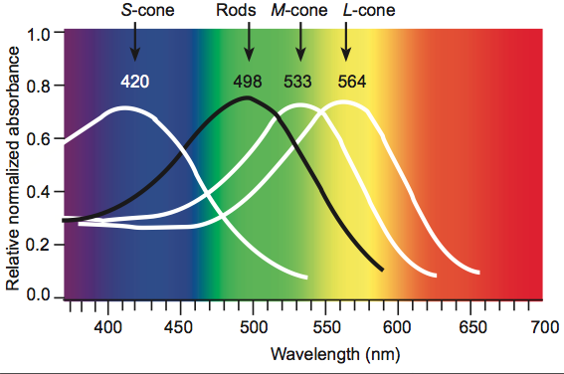
Cones and Rods: tuning curves
Light itself is not colored. Color is what we see when light rays with a particular range of wavelengths strike the retina.

Slide 8
Cones and Rods
Comparison of wavelengths for retinal photoreceptors. The red curve shows the wavelength (564 nm) of light to which red L-cones are most sensitive, green shows the wavelength (533 nm) to which green M-cones are most sensitive, and blue shows the wavelength (420 nm) to which blue S-cones are most sensitive. The black curve shows the wavelength (498 nm) to which rods are most sensitive.
564
533
498
420

Slide 9
There Is a Hole in the Sky
The energy in sunlight peaks within the visible range of wavelengths between 400 and 700 nm; it falls off sharply for shorter wavelengths, and more gradually for longer wavelengths,
The Earth’s atmosphere blocks wavelengths shorter than about 400 nm and attenuates those longer than 700 nm,

Slide 10
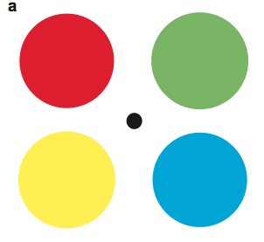
Color Aftereffect
Fix your gaze on the central black dot in (a) for about 30 seconds, then transfer your gaze to the black dot in (b) and notice the perceived color of the disks.

Slide 11
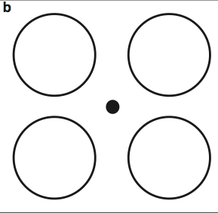
Color Aftereffect
Does red give a green and blue a yellow aftereffect?

Slide 12
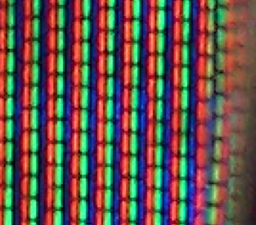
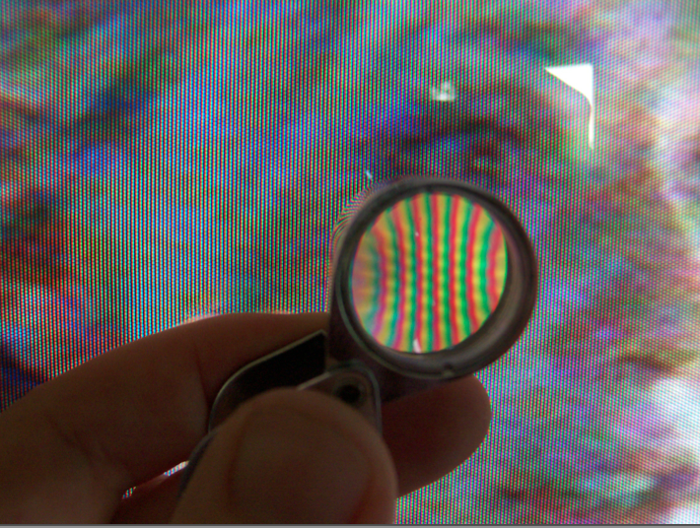
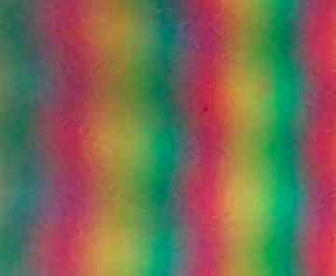
Color Display
Color television picture consists of a mosaic of triplets of red-, green-, and blue-colored pixels, which can be seen through a magnifying glass, or by simply zooming in the image

Slide 13
Outline (Ch. 7)
Color & Light
Information: Bit by Bit –after class reading
Retina Cells as Information Channels
Color Systems and Conversions

Slide 14
Information: Bit by Bit
Information Theory: Basics
Bits, Binary Digits & Entropy
Photoreceptors as Information Channels

Slide 15
Information Theory: Basics
The Information Theory (Shannon 1948) states that each information channel has a finite capacity, some of which is usually wasted, and that the full capacity of information channels can be achieved by judicious recoding of the messages to be communicated. The unit of information is the bit (from “binary” and “digit”; a zero or a one). One bit of information tells you which alternative to choose between two equally likely alternatives.

Slide 16
Bits, Binary Digits & Entropy
A binary digit is a zero or a one, whereas a bit is an amount of information, which can be conveyed by a binary digit or, more generally, by any symbol or word (e.g., yes/no).
The amount of information you receive is the same as your degree of surprise regarding each alternative.
Claude Shannon proved in 1949 that the amount of surprise associated with the value of any symbol s (such as a binary digit) is H = log₂1/p(s), where p(s) denotes the probability of a specific value of s, and H is now known as “Shannon information”
The average Shannon information provided by a variable such as s is known as the “entropy” of s.
E = Σ p(s) log₂1/p(s)

Slide 17
Photoreceptors as Information Channels
Bin 5
If the output voltage of a cone is divided into eight levels or bins between 1 and 80 mV, then three bits* are sufficient to specify which one of eight possible voltage bins it’s in (bin number 5 here).

Slide 18
Outline (Ch. 7)
Color & Light
Information: Bit by Bit
Retina Cells as Information Channels –a.c.r.
Color Systems and Conversions

Slide 19
Retina as Information Channels
Bits and Bins in the Visual System
Sum-Difference Encoding
Ganglion Cells as Information Channels
Color Aftereffect: An Explanation
Are Cones Tuning Curves Optimal
Facts Behind the Simplifications

Slide 20
Bits and Bins in the Visual System
A photoreceptor or a neuron is essentially an information channel: it has a finite capacity, so we can squeeze only so much information through it
For a photoreceptor, this information takes the form of its output voltage, as we have seen in the example above. For a neuron (e.g., a ganglion cell), information usually takes the form of action potentials or spikes
Red and green are correlated, so the difference of +/- 1 between them won’t need 3 bits if each has 8 states.
1 bit, 2 states; 3 bits, 8 states

Slide 21
Sum-Difference Encoding
Combining cone outputs to produce three color information channels. The red +green channel is known as the “luminance channel.”

Slide 22
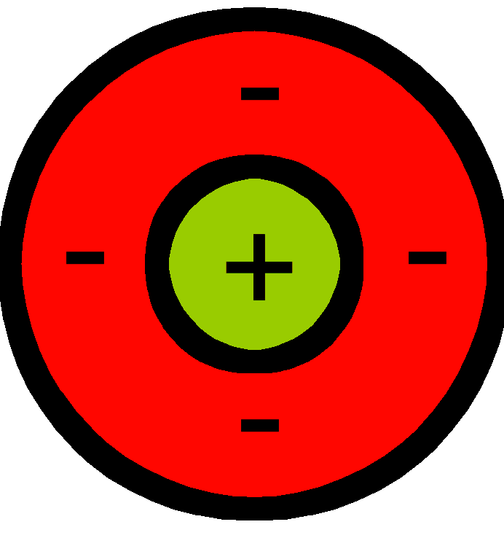
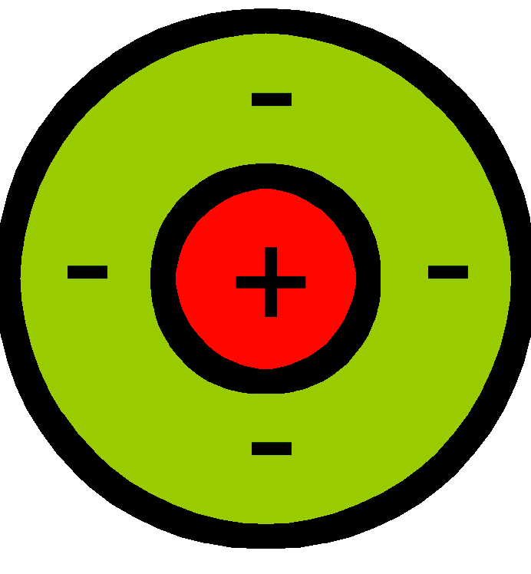
Ganglion Cells as Information Channels
The information from the 126 million photoreceptors in the retina is translated into the outputs of one million ganglion cells of the optic nerve, and these ganglion cells seem to use sum-difference recoding.
Each parasol retinal ganglion cell which projects to the magno layer of LGN, has an output that is the sum of red and green cone outputs.
Each midget retinal ganglion cell, which projects to the parvo layer of LGN, has an output that is the difference between red and green cone outputs in the fovea
The output of each bistratified retinal ganglion cell, which projects to the konio layers of LGN, corresponds roughly to the difference between blue channel (cone) outputs and the yellow channel (i.e., the sum of the red and green cone outputs),

Slide 23
Color Aftereffect: An Explanation
Now we can see that the recoding that begins in the retina creates a red − green channel and a blue − yellow channel. If, as seems likely, each channel is implemented as pairs of push-pull cells, then this may account or the aftereffects observed. These effects are conventionally described in terms of “red/green” and “blue/yellow opponent processes.”

Slide 24
Are Cones Tuning Curves Optimal?
Accounting for the massive overlap between the tuning curves of the red and green cones has always presented a challenge to vision scientists.
The overlapping tuning curves of the red and green cones contribute to vision at fine spatial scales (due to R+G) in good lighting conditions, and reduce the impact of noise (due to R+G) under low-light conditions.
A large overlap between the tuning curves of the red and green cones gives accurate spatial information at the cost of more noisy chromatic information (R-G) particularly under low-light conditions.

Slide 25
A Few Facts Behind the Simplifications
There are almost no blue cones in the fovea, reducing chromatic aberration
Each ganglion cell transmits information about the inputs it receives from photoreceptors at a rate between 0.5 to 41.2 bits per second
The output of a photoreceptor approximates a logarithmic function of the amount of light captured by that photoreceptor, which allows their outputs to span the enormous range of luminance levels （10¹⁰） encountered in different lighting conditions

Slide 26
Outline (Ch. 7)
Color & Light
Information: Bit by Bit
Retina Cells as Information Channels
Color Systems and Conversions

Slide 27
Color Systems and Conversions
RGB Cube for Image Representation
HSI Cone for Human Perception
YUV for Image & Video Encoding

Slide 28
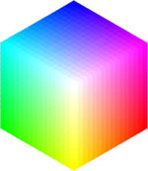
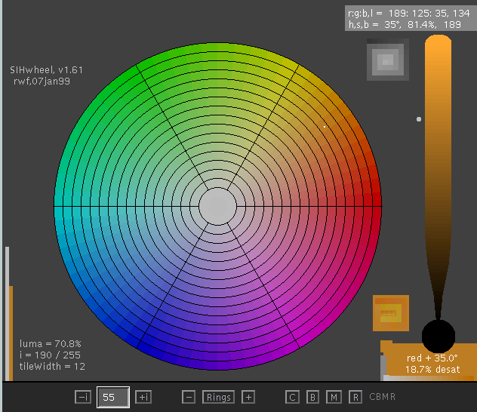
Color Representation
Color Cube and Color Wheel
For color spaces, please read
Color and Color Spaces
Color Wheel ???
Color Processing: RGB <-> HSI
B
H
I
S
G
R

Slide 29
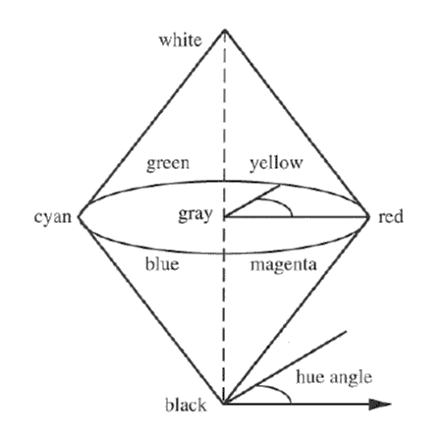
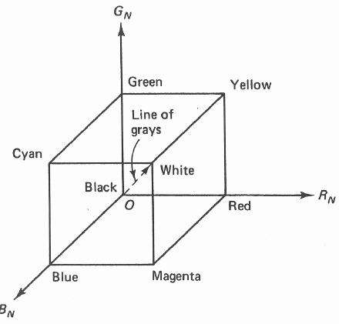
The RGB Cube and Cone Models

Slide 30


RGB <-> YUV
http://en.wikipedia.org/wiki/YUV

Slide 31
Outline (Ch. 7)
Color & Light
Information: Bit by Bit
Retina Cells as Information Channels
Color Systems and Conversions

