Slide 1
BEAT+: Adding Branding and Entrepreneurship for Real-World Applications Using Emerging Technologies: AI, AR, AT, and Apps
CSc 59866/59867 Capstone I/II Fall 2023-Spring 2024
Project Showcases
Zhigang Zhu, Kayser Chair Professor of Computer Science, GSOE, CCNY
Gerardo A Blumenkrantz, Associate Professor, Media & Communication Arts, Branding + Integrated Communications (BIC) Creative Track, CCNY
Chris Bobko, Ph.D., Executive Director, Zahn Innovation Center

Slide 2
Past Projects
From 2011 to 2023

Slide 3
Past Projects (2011 and 2012)
2011-2012 Cohort
1 V.I.S.T.A.: Vibro-tactile Intelligent System for Travelling Aid: a Wearable Alternative (Kaylie First Place)
2. KinDetect: Kinect Detecting Objects (an ICCHP 2012 Paper)
3. LANE: Location and Navigation Evaluation in a Mapped Building Environment (a Journal Paper)
4. Irisπ: an ultra-low-cost solution for the blind in the city
2012-2013 Cohort ->2013 Edition of the NSF Projects to Aid Persons with Disabilities (ed. John Enderle)
5. Smart House for All
6. A Low-cost Outdoor Assistive Navigation System for Blind People
7. Smartphone-Based Indoor Navigation for the Visually Impaired
8. Electronic Travel Aid for the Visually Impaired With a Depth Sensor and Vibrotactile Belt
9. 3D and Image Stitching with the Lytro Light-Field Camera

Slide 4
Past Projects (2011 and 2012)
2011-2012 Cohort
1 V.I.S.T.A.: Vibro-tactile Intelligent System for Travelling Aid: a Wearable Alternative (Kaylie First Place)
2. KinDetect: Kinect Detecting Objects (an ICCHP 2012 Paper)
3. LANE: Location and Navigation Evaluation in a Mapped Building Environment (a Journal Paper)
4. Irisπ: an ultra-low-cost solution for the blind in the city
2012-2013 Cohort ->2013 Edition of the NSF Projects to Aid Persons with Disabilities (ed. John Enderle)
5. Smart House for All
6. A Low-cost Outdoor Assistive Navigation System for Blind People
7. Smartphone-Based Indoor Navigation for the Visually Impaired
8. Electronic Travel Aid for the Visually Impaired With a Depth Sensor and Vibrotactile Belt
9. 3D and Image Stitching with the Lytro Light-Field Camera

Slide 5

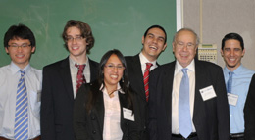
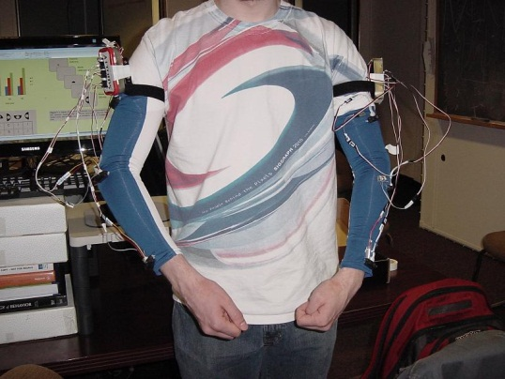
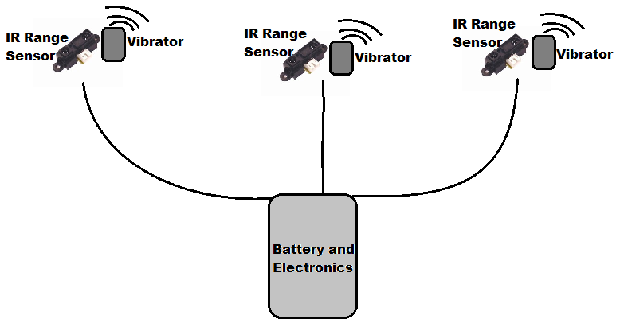
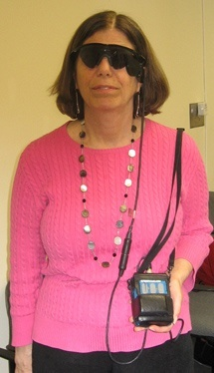
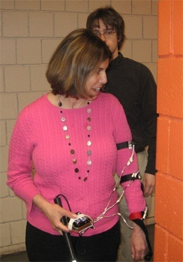
1. Vibro-tactile Intelligent System for Travelling Aid (V.I.S.T.A.) – 2012 Kaylie First Place Winner
Team: Javier Montesino*, Lei Ai+, Cindy Rodríguez*, Frank Palmer*, Daniel Zuleta*
Project Advisors: Dr. Zhigang Zhu*, Dr. Tony Ro+ (*CS/CpE, +Psy)
Eyes of Skin
whole-body wearable range-tactile pairs
Eyes of Skin
– Time, Aug12, 2013
Arm sets on sleeves
Retina implants and IR rangers

Slide 6
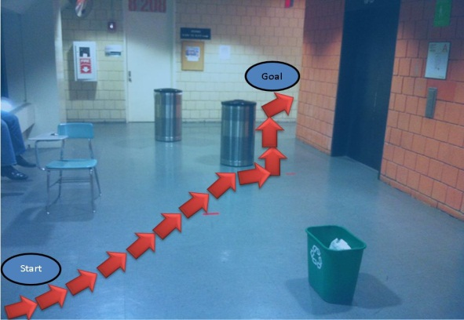
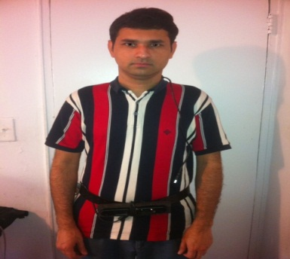
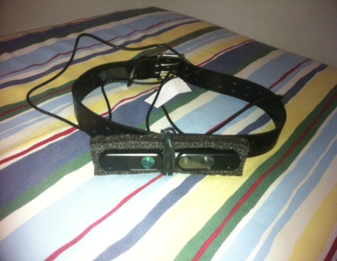
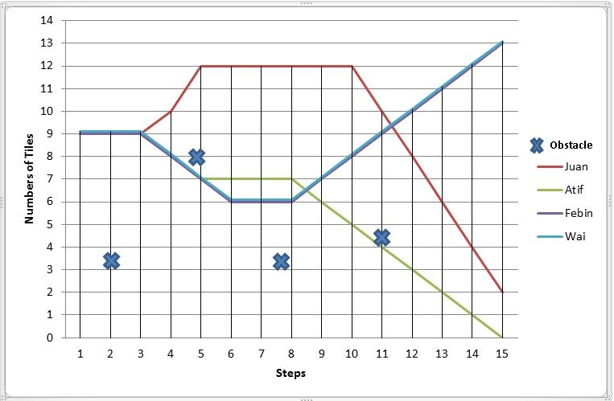
2. KinDetect: Kinect Detecting Objects
Atif Khan, Febin Moideen, Juan Lopez (A Conference Paper)
Project Advisors: Dr. Zhigang Zhu, Wai Khoo
A. Khan, F. Moideen, W. Khoo, Z. Zhu, and J. Lopez, KinDetect: Kinect Detecting Objects , 13th International Conference on Computers Helping People with Special Needs, 7383, Miesenberger, Klaus and Karshmer, Arthur and Penaz, Petr and Zagler, Wolfgang, Springer Berlin Heidelberg, Linz, Austria, July 11-13, 2012 , 588-595

Slide 7
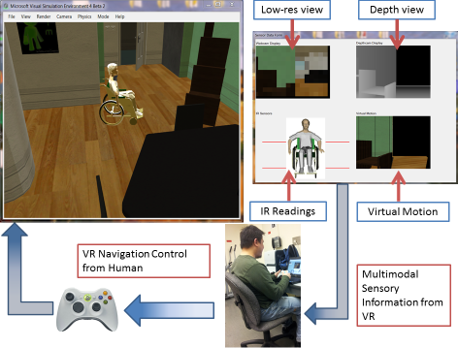
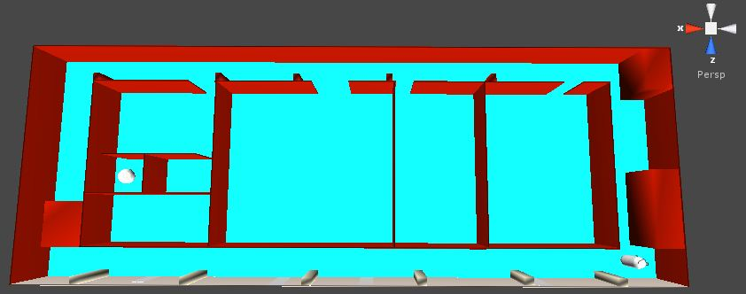
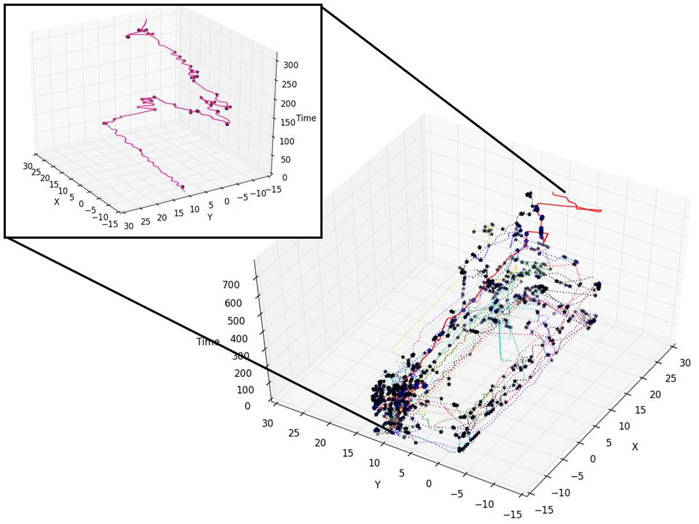
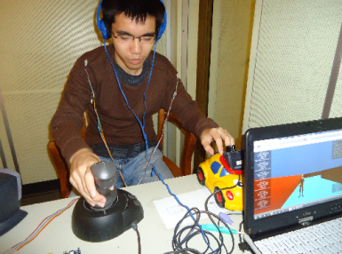
3. Location and Navigation Evaluation in a Mapped Building Environment
Joey Knapp Eric L. Seidel Suri Wigder (lead to a journal paper)
Project Advisors: Wai Khoo, Edgardo Molina, Zhigang Zhu
Microsoft Robotics Studio -> Unity 3D (some work done after capstone)
A complex hall way in VR
Trajectory plots of 18 human subjects
Testing in Unity 3D
Khoo, W. L., Knapp, J., Palmer, F., Ro, T., & Zhu, Z. Journal of Assistive Technologies.

Slide 8


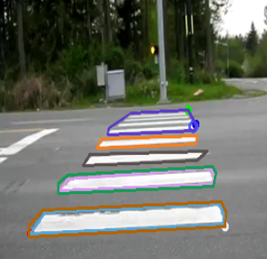
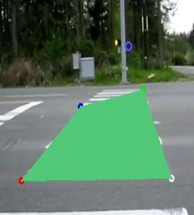
4. Irisπ: an ultra-low-cost solution for the blind in the city
Luis Maurad, Jason Kwong, Jean Sanchez
Project Advisor: Zhigang Zhu, PhD
The Irisπ was built using the following components:
Laptop running Linux (as a replacement for the originally planned Raspberry Pi)
USB Endoscope Camera x2
USB Numeric Keypad
Small Speaker
Sunglasses
Development Tools
OpenCV(C++) v.2.3
Qt Creator
Flite Speech Synthesis System
Gcc Compiler

Slide 9
Past Projects (2011 and 2012)
2011-2012 Cohort
1 V.I.S.T.A.: Vibro-tactile Intelligent System for Travelling Aid: a Wearable Alternative (Kaylie First Place)
2. KinDetect: Kinect Detecting Objects (an ICCHP 2012 Paper)
3. LANE: Location and Navigation Evaluation in a Mapped Building Environment (a Journal Paper)
4. Irisπ: an ultra-low-cost solution for the blind in the city
2012-2013 Cohort ->2013 Edition of the NSF Projects to Aid Persons with Disabilities (ed. John Enderle)
5. Smart House for All
6. A Low-cost Outdoor Assistive Navigation System for Blind People
7. Smartphone-Based Indoor Navigation for the Visually Impaired
8. Electronic Travel Aid for the Visually Impaired With a Depth Sensor and Vibrotactile Belt
9. 3D and Image Stitching with the Lytro Light-Field Camera

Slide 10
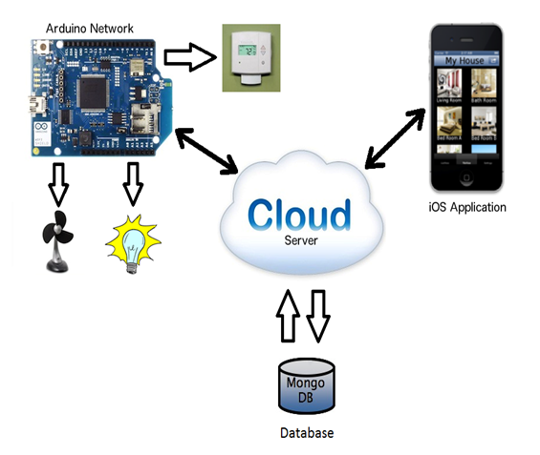
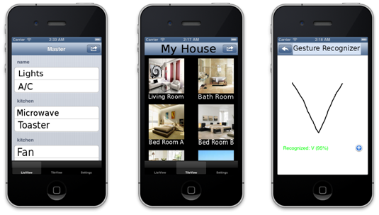
5. Smart House for All
Designers: Karim Abdelrazek , David Leonard, Carlos Chinchilla, Hery Ratsimihah, Michael Klein,Chirag Shah
Client Coordinator: Barbara Campbell, NYS Commission for the Blind
Supervising Professors: Dr. Zhigang Zhu, Department of Computer Science, Dr. Jizhong Xiao, Department of Electrical Engineering
Our iOS app with three types of views: list view, tile view and gesture recognizer

Slide 11
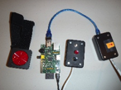
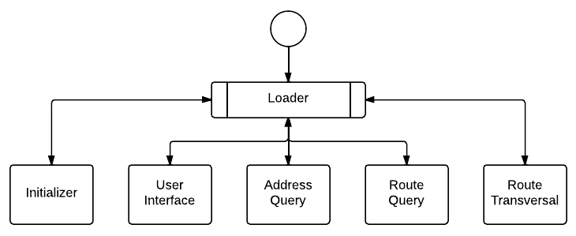
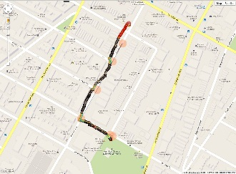
6. A Low-cost Outdoor Assistive Navigation System for Blind People
Designers: Kevin Ramdath, Manor Iosilevish, Dharmdeo Sigh, Anastasis Tsakas
Client Coordinator: Aries Arditi, Visibility Metrics LLC
Supervising Professor: Dr. Jizhong Xiao
Department of Electrical Engineering
Bluetooth GPS receiver, Raspberry Pi, Buttons for user interface.
The navigation result in residential area with reliable GPS signal

Slide 12
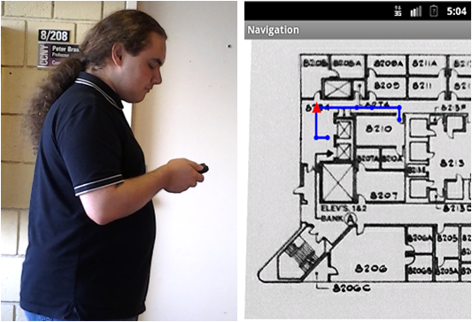
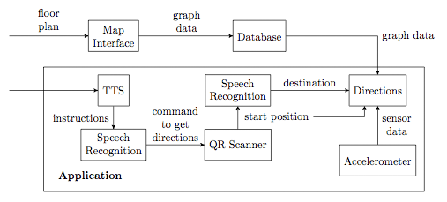
7. Smartphone-Based Indoor Navigation for the Visually Impaired
Designers: Yuriy Stejko, Qiang Wang, Linda Wong
Client Coordinator: Barbara Campbell, NYS Commission for the Blind
Supervising Professor: Dr. Zhigang Zhu
Distance | Average Measured | Error | Standard Deviation
6 m | 6.535 | 8.9% | 0.447
12 m | 12.827 | 6.9% | 0.988
18 m | 18.729 | 4.0% | 0.729
24 m | 24.484 | 2.0% | 0.971
30 m | 29.947 | 0.2% | 1.348
Average distance computed, error, and variance over 20 trials using step detection

Slide 13
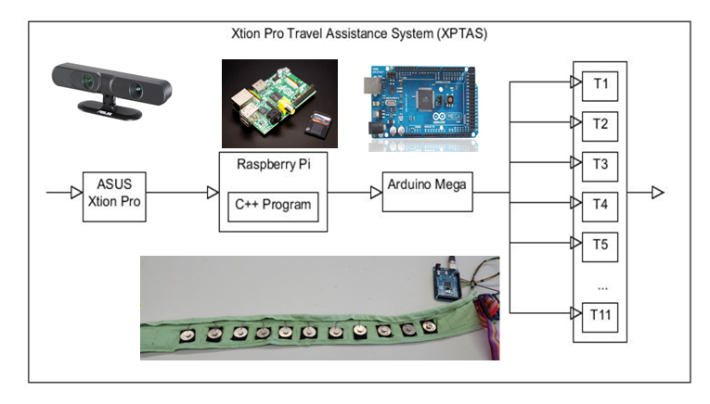
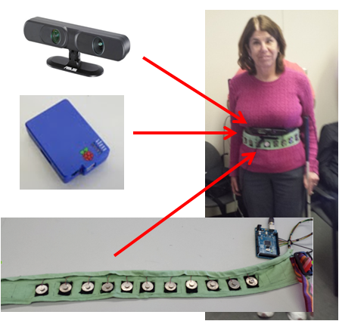
8.Electronic Travel Aid for the Visually Impaired With a Depth Sensor and Vibrotactile Belt
Designers: Raymon Ang, Serge Armond, Gaurav Munjal
Client Coordinator: Barbara Campbell, NYS Commission for the Blind
Supervising Professor: Dr. Zhigang Zhu
Our depth-vibro ETA system: Xtion Pro Depth Sensor (top left), Raspberry Pi with enclosure (middle left), our Vibrotactile belt connected to an Arduino Mega (bottom-left) and testing system on a visually Impaired user (right)

Slide 14
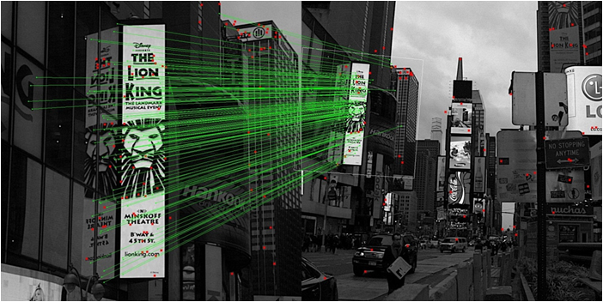
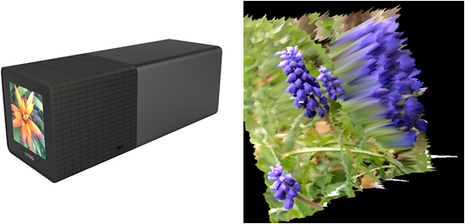
9. 3D and Image Stitching with the Lytro Light-Field Camera
Designers: William Lu, Wan Kim Mok, Jeremy Neiman
Client Coordinator: Barbara Campbell, NYS Commission for the Blind
Supervising Professor: Dr. Zhigang Zhu

Slide 15



CS/CpE/EE/Psy Joint Senior Design Program Fall 2013-Spring 2014 Smart Living and Assistive Technologies for People in Need Instructors: Zhigang Zhu (CS), Jizhong Xiao (EE), Tony Ro (Psy) Projector Mentors: Xudong Li, Edgardo Molina, Wai L. Khoo The City College of New York, NAC 4/115, May 15th (Thursday), 12:00 pm – 3:00 pm A light lunch will be provided. Demos will be shown at the end of the presentations
Time | Presenters | Titles
12:30 pm | Jorge Yau ,Sung Hoon Kim | 3D Sound Graphing
12:45 pm | Keya Bhowmik,Naing Tint, Miron Veryanskiy | Assistive Photography
01:00 pm | Owais Naeem, Luis Disla | Fall Prevention for the Elderly (Kaylie 2nd Prize Team)
01:15 pm | Yeuk Hon Wong | Navigate the web with voice command
01:30 pm | Jason Zhang,Franco Pacheco,Jing Chen | Independent Displacement Tracking
01:45 pm | Carlos Moreaux, Christopher Balisky | Object Detection with 2D Camera
02:00 pm | Jose Chomba, Shaofeng Liu | Blind Reading Text: A mobile application
NSF (Award #1160046) NCIIA (Award #10087-12 )

Slide 16
Fall 2014- Spring 2015
Team 1. SmartCane: Navigation Using Depth Sensor and Novel Alternative Feedback
Team 2 HAST: Health and Support for the Visually Impaired using Angel Open Sensor Wristband (Social Innovation Winner)
Team 3: IndoorMapRGB-D: Indoor Navigation Map Using RGB-D
Team 4: FaceConnect: Face Connect for the Visually Impaired
Team 5: AndriodVE: A Mobile Android Virtual Environment for Cognitive Mapping
Team 6: OWL: Reading On-the-Go for the Blind
Team 7: NFCPublic: NFC Tags to Provide Information in Public Settings Using a Smart Phone
Team 8: GorceryDetect: Grocery Detection for the Blind
Team 9: AutoPhoto: Auto Photography With Guided Focus

Slide 17
Fall 2015- Spring 2016
Team 1. Green Jacket: a website and mobile app pair that helps people with ASD with ordering food in restaurants (CREATE Award)
Team 2 CuraWatch: a time management system designed for community centers and employers who assist in helping ASD inviduals gain and hold onto employment. (CREATE Award)
Team 3: GLEAM: an online therapy model aimed to make mental healthcare more accessible and affordable (Zahn Finalist)
Team 4: QR Navigation: an Android phone app scanning QR Codes in real-time to help ASD individuals navigate (CREATE Award)
Team 5: Hearing Assistive: an Android App helps hearing impaired detect surrounding sound and reduce their chance of injury
Team 6: ASH: help Alzheimer's patients have a more fulfilling social life with their loved ones
Team 7: iBean: an Android App to capture vital signs and location of patients within a health care facility
Team 8: 3D Printing: an Electronics Technician at Makerbot in the 3D printing industry

Slide 18
Fall 2016- Spring 2017
1 Seek and Cross: Zebra Crosswalks and Signal Recognition for VIPs
2 EyeExercise: Improving Vision through Simple Exercises and Better Habits
3 Face Assistant: Identify Loved Ones by Their Faces
4 Mind, Body, Freedom (Zahn Center Competition Finalist)
5 Panoramik: Finding and Locating Objects via Multi-Perspective Camera Technique (CREATE Winner) (a CSUN Assistive Technology Journal Paper)
6 CCNY Smart Cane (CREATE Winner) (an IEEE CYBER Conference Paper)
7 VR for ASD: Therapeutic Virtual Environments for Individuals on the Autism Spectrum (CREATE Winner) (a CSUN Assistive Technology Journal Paper)
8 The Fourth Dimension: Workforce Management System for ASD individuals (CREATE Winner)
9 RescueSenior: Location aware health emergency solution for senior citizens

Slide 19
Fall 2017- Spring 2018
ASSIST (Assistive Sensor Solution for Independent and Safe Travel, by Vishnu Nair and Manjekar Budhai) was in the Spectrum Local News (Manjekar talking at the meeting while Vishnu testing in the field) (a CSUN Assistive Technology Journal Paper and a ACVR Conference Paper)
AVR4ASD (Augmented and Virtual Reality for Individuals with Autism Spectrum Disorder, by Xinyu Xiong, Rafael Li Chen and Yuxuan Huang) won Second Place Prize of the CREATE Competition (in the picture: Rafael, Xinyu and Prof. Zhigang Zhu).
This is a partnership with Ms. Celina Canvalluzzi, Director of Day Services at Goodwill Industries of Greater New York and Northern New Jersey. More details please see a news release at CCNY.

Slide 20
Capstone 2018-2019 (all teams except 9 &10 were in the CREATE 4)
No | Teams | Team Members | Reporting Check Contacts
1 | Indoor.Framework | Jane Chen, Joseph S. | Yaocheng Wu
2 | ARKit Nav | Ben Lin, Jinyun L., | Yaohua Chang
3 | HololensWires | James W., Sebastian P. | Francisco, Hao Tang
4 | ARCore Nav | Jin Zhang, Hanna N., | Yaocheng
5 | VR-Interview | Vincent Yu, Jamie Fung | Kartik
6 | Pre-Journey-VR | David Cao, Hanyu Huang, | MD, Hao Tang
7 | Gesture in VR | Dixon Lu, Haresh S., Areesha R. | Francisco, Hao Tang
8 | VirtualMTA | Lianming Wu, Hongze Wu, | Maui
9 | O3 Joy Music | William G. Chris Huang, Weimin G. | Jizhong Xiao
10 | Nuravine | Sam Mundle, Hugo M. | Alex
11 | EEGStressMeter | Pooneet T., Angelique C., Arslan S. | Hanssel
12 | Smart Cane | Arjun L. | Jizhong Xiao

Slide 21
Capstone 2019-2020 : BEAT
Team Name | Team Member
1. Undaunted: VR for ASD individuals to learn social norms (CREATE) | Abigal B. Carlos S., Raymund R.
2 .ParaShop: Assistive people with ASD in shopping (MIT UTRC//CSUN) | Nan C., Mengting X., Yuemin T.
3. Share&Care: Senior friendly app for fighting loneness (MIT UTRC//CSUN) | Jin C., Xiaohong Z., Yuting Y.
4. VPP: Voice Powered Player for people with mobility disability (Zahn) | Shi-Bin H., Hongzhi P., Xin Z.
5. Worktual Reality: Overcoming social difficulties in conversation (CREATE) | Oscar C., David H., Michael T., Dzhonibek P.
6. Bera: A practical employment analyst for people with Autism (CREATE) (Zahn) | Yorli C., Luis C.,
7. GoodPlan: Interactive activity planning and recommendation for people with ASD (Goodwill) | Xiaoyan Z., Songren Z., Hyo Jun M.
8. GazeIntoView: Training eye contract in interviews. (Zahn) | Krystal L., Fayrouz M., Frank O.
http://ccvcl.org/bat-branding-assistive-technologies-for-social-good/beat-2019-2020-projects-and-video/

Slide 22
Capstone 2020-2021: BEAT
Team Name | Team Member
1. The Companion: A mobile app for people with OCD | Farshed A., Raihan A., Rashidul S.
2 .UBraille: A mobile app to learn Braille | Hyunmin C., Edgar P.
3. Cherished Memory: A mobile app for patients with Alzheimer’s | Florence F., Hanssel H., Chris P.
4. Colorful World: Helping color blind persons with colors and objects | Ibrahim H., Mena M., Eric N.
5. DTD Hero: Mobile app for DTD navigation (Zahn Bux Award) | Mahin K., Wei-Cheng L., Sumaiya M., Risa M.
6. PALM: An app for chidren with Down Syndrome (Personal Gift from Dr. Xiaoyan Li at Princeton) | Zakia M., Fardin S., Kamil S.
7. Remember Me: An app for people with memory loss | Ahmdullah S., Ekramul S.
8. AlgoRhythm: An app to learn algorithms by ASD persons (Zahn Tech 1st Prize) | Bryan R, Shahzeb R., YanWing T.
http://ccvcl.org/professor-zhigang-zhu/csc-59866-7-capstone-i-ii-fall-2020-spring-2021/ccny-beat-2020-2021-projects-and-video/

Slide 23
Capstone 2021-2022: BEAT+
Team Name | Team Member
1. Outreach3D. A feedback-based web app for urban design | Siddharth R., kash A., Jennifer C.
2. Schedule and Structure. A smart app for ASD (CREATE 3rd Prize) | Sk A., Bethanie C., Kelly D.
3. MEDTalk. A picture-based app for hospital (Zahn Women+Tech Finalist) | Progga C., Faez F., Md Sakil K.
4. Autism Bridge. A network app for job seekers with ASD (Zahn 1st Prize, Bux Prize and Audience Choice Award; CREATE Grant) | Ai Hua L., Billy D., Ziyi H.
5. VoiceParadise. Social media via voice | Kczynzky D. M Moshahid UI K. Farah S.
6. Rx Reminder. An app for senior citizens (Zahn Women+Tech Finalist & Bux Prize) | Nour E., Nayma L., Sanjida N.
7. Altri. An app with a scheduler and an AI Bot (CREATE Grant) | Paul A F., Valeryia P., Anthony Y.
8. NeuroGen. All-in-one for people with Alzheimer’s | Mohfujul M. QianXing O., YiYang W.
9.ASLNow. An app for hard-hearing (CREATE 3rd Prize) | Aliaa A., Randy C., Luigi O.
http://ccvcl.org/professor-zhigang-zhu/csc-59866-7-capstone-i-ii-fall-2021-spring-2022/ccny-beat-2021-2022-projects-and-video/

Slide 24
Capstone 2022-2023: BEAT+
Team Name | Team Member
1. BusSense: An iOS app for BLV to nagivate MTA | Daniel Aguilar-Rodriguez, Joshua Burdon, Suhaima Islam, Min Zhang
2. walkIT: App for goal-setting for ASD (CREATE) | Jeevan Bastola, Dawa Sherpa
3. SafeMap: An app to help ASD users tackle travel challenges | Ashley Diaz, Rishika Lama Tamang, Ruhi Rownak, Solomon Zhang
4. SiGHT: Optimal path to walk for BVI (CREATE) | Justin Jacob, Jed Rendo Magracia, Raynel Sanchez
5. Nusketch: An image tracer app for ASD (CREATE) | Hussam Marzooq, Willie Shi, Jessie Su
6. Delicious Donations: A food donation system app in which restaurants can find suitable charities | Samia Omar(CpE), Ishmael Quansah(CpE), John Yauri(CpE)
7. MAC-U-Vision: App for progressive training for AMD patients (an UTRC paper) | Max Sehaumpai, Alan Tepoxtecatl, Crystal Yang
8. Productify: A note taking and time management app (CREATE) (1st Prize in Zahn Social Good) | Diego Perez, Benjamin Trinh, Andy Zhou
http://ccvcl.org/csc-59866-7-capstone-i-ii-fall-2022-spring-2023/ccny-beat-2022-2023-projects-and-video/

Slide 25
BEAT+: AI, AR, AT and Apps
Find topics from users’ needs
Look into the past projects for ideas
http://wiki.ccvcl.org
https://www.nysid.org/create/projects/
(Check out CCNY Teams)
Talk with me for project topics
Pick up projects from external experts
Align with Zahn/CREATE/ VetureWell competitions

Slide 26
To Do List (Capstone 2023)
Send me your 1-page (!) resume (before 9/05)
Name, Email, Phone and Your Average GPA so far
Education (CS, CpE, and others) & Work Experience
Honors/Awards and Skills
Your Favorite Courses
Your interests of Topics (please list your top 2 tentative choices – we will have experts coming to class on 9/11 and 9/18, and site visits on 10/02 for real-world problems).
Potential teammates (up to 2 names except yourself)
Reading Assignments
Talk with people in needs
Look online for ideas

Slide 27
BEAT+: Adding Branding and Entrepreneurship for Real-World Applications Using Emerging Technologies: AI, AR, AT, and Apps
CSc 59866/59867 Capstone I/II Fall 2022-Spring 2023
Project Showcases
Zhigang Zhu, Kayser Chair Professor of Computer Science, GSOE, CCNY
Gerardo A Blumenkrantz, Associate Professor, Media & Communication Arts, Branding + Integrated Communications (BIC) Creative Track, CCNY
Chris Bobko, Ph.D., Executive Director, Zahn Innovation Center

