Slide 1
BEAT+: Adding Branding and Entrepreneurship for Real-World Applications Using Emerging Technologies: AI, AR, AT, Apps, +etc.
From AT to BEAT, and From BEAT to BEAT+
Zhigang Zhu, Kayser Chair Professor of Computer Science, GSOE, CCNY
Gerardo A Blumenkrantz, Associate Professor, Media & Communication Arts, Branding + Integrated Communications (BIC) Creative Track, CCNY
Chris Bobko, Ph.D., Executive Director, Zahn Innovation Center

Slide 2
BEAT: Branding and Entrepreneurship of Assistive Technology for Social Good
Extending the CCNY Joint Senior Design Program on Assistive Technology Across School Boundaries

Slide 3
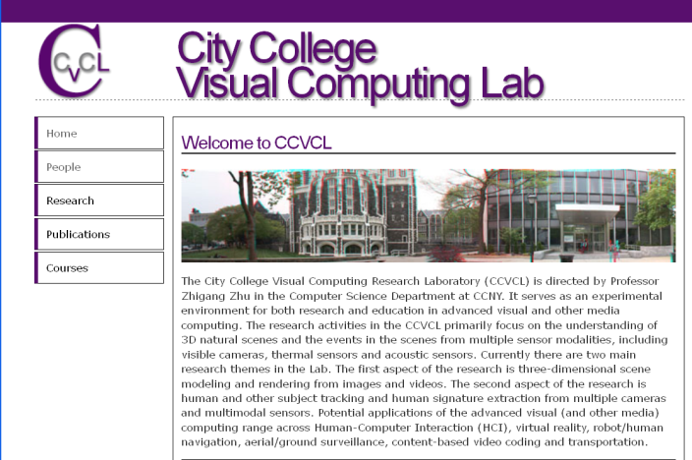







BEAT: Branding and Entrepreneurship of Assistive Technology for Social Good
+
for

Slide 4
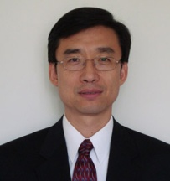
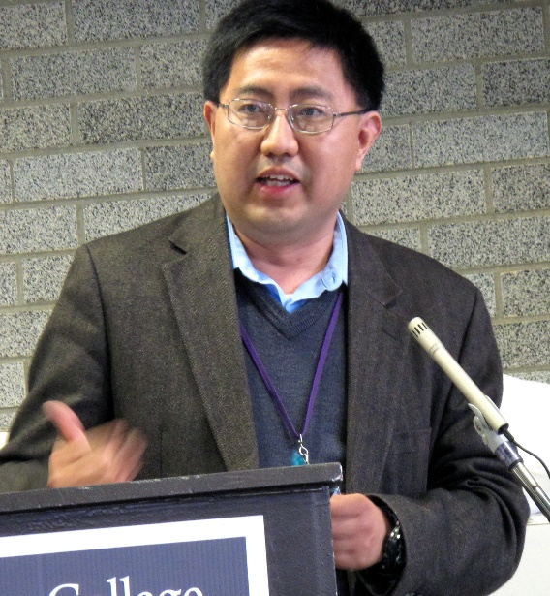
BACKGROUND: For eight years before 2019, there has been a cross-departmental joint senior design course for undergraduate seniors (20-30 students each year) majoring in Computer Science (CS), Computer Engineering (CpE) and Electrical Engineering (EE) in the Grove School of Engineering (GSOE) focused in exploring and developing assistive technologies for smart living of all.

Slide 5
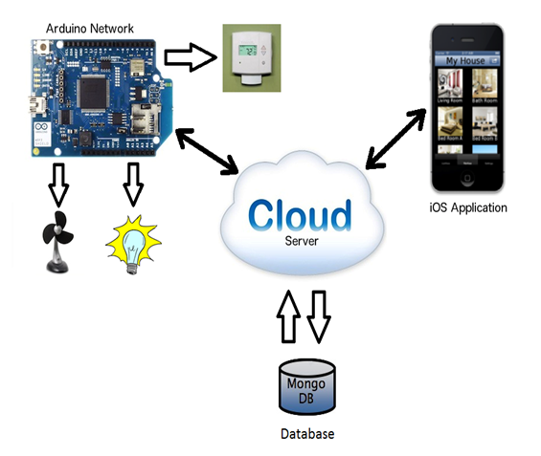
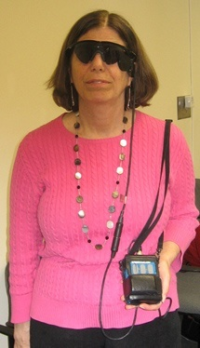
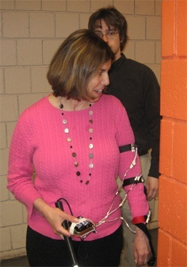

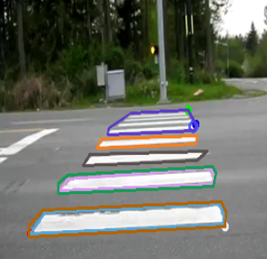
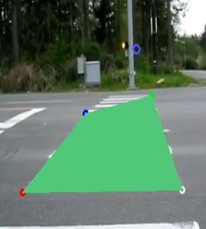
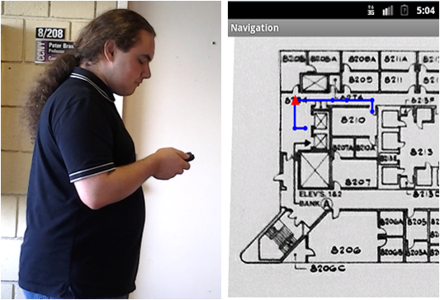
Cross-Disciplinary Projects (CS, CpE, EE)
Sensing approaches (camera, stereo, IR, ultrasonic, kinect, etc)
Data interpretation algorithms (hardware, smart phone, PC, etc)
Display methods (tactile, audio, speech, visual)
Apps for smart living, smart office, smart health, assistive/accessibility technologies

Slide 6



AT: Sponsors and Community Partners
NSF GARDE (Gen & Age Rel Disabilities Eng)
Senior Design Program on Assistive Technology to Aid Visually Impaired People (Award #1160046)
VentureWell (formerly NCIIA)
Course and Program: Human and Machine Intelligence - Perception, Computation and Action (Award # 10087-12)
NYSID CREATE
Cultivating Resources for Employment with Assistive Technology
Service Agencies (for ASD and BVIs)
Goodwill Industrials
Lighthouse Guild
NYS Commission for the Blind

Slide 7
BACKGROUND: For eight years before 2019, there has been a cross-departmental joint senior design course for undergraduate seniors majoring in Computer Science (CS), Computer Engineering (CpE) and Electrical Engineering (EE) in the Grove School of Engineering (GSOE) focused in exploring and developing assistive technologies for smart living of all.
BUT students may not know how to successfully communicate with the users, investors, stakeholders and community partners to really make their breakthrough work ACTIONABLE. Additionally, they may lack the entrepreneurship skills that will help them turn their brilliant ideas into reality.
THEREFORE in 2019 we tapped into CCNY’s resources (BIC program and the Zahn Center) teach them useful and practical the branding, storytelling and entrepreneurship skills they need.

Slide 8
BEAT Instructors (as of now): Zhigang Zhu, Kayser Chair Professor of Computer Science, GSOE, CCNY Chris Bobko, Ph.D., Executive Director, Zahn Innovation Center Gerardo A Blumenkrantz, Associate Prof., Branding + Integrated Comm. (BIC) Track, CCNY Other Collaborators and Partners: Megan L. Tatro, Social Media and Marketing Strategist, NYSID Celina Cavalluzzi, Director of Day Services, Goodwill Industries NY/NJ Bill Seiple, Chief Research Officer at Lighthouse Guild; Research Prof. at NYU Medicine Abby Copper, Owner, Kennedy Douglas Consulting Hao Tang, Professor, CUNY BMCC and Graduate Center Arber Ruci, CEO, Nearabl / Instructor, NSF I-Corps Node Jin Chen, CTO, Nearabl Fani Maksakuli, System Architect, Nearabl

Slide 9
First Semester (Fall):
In addition to the regular class meets for basics on vision, robotics and assistive technology:
A seminar by a BIC instructor on branding.
A seminar by a Zahn staff on entrepreneurship and Zahn competition
A seminar by Arber Ruci from the CUNY NSF I-Corps Node on customer discovery.
BEAT teams of CS/CpE/EE students develop proposals of projects– targeting to Zahn, CREATE or VentureWell Competitions.
Site visits to Goodwill/Lighthouse Guild/other places for customers with challenges (e.g. disabilities, elderly, Alzheimer’s etc.)
Invited community partners as speakers and judges for brainstorming customer discovery and proposal presentations
BEAT teams revise their proposals for submitting to competitions

Slide 10
Second Semester (Spring): In addition to our weekly technical meetings for project development updating:
Users provide feedback (via surveys) to CS/CpE/EE teams for developing their video, demos and materials for the Zahn/CREATE/VentureWell presentations.
Invited community partners from Goodwill/Lighthouse Guild, BIC faculty and Zahn Center staff as judges for project presentations
Participation of the Zahn competitions by the joint BEAT teams, and follow-on work if winning awards
Submitting papers to conferences or journals (such as MIT UTRC, CSUN Assistive Technology, ACVR Workshop, etc.).

Slide 11
2021: From BEAT to BEAT+
Branding and Entrepreneurship are still the added components
Real world Applications expanded from Assistive Technologies to any projects for social good and with national priorities
Emerging Technologies include AI, AR, AT and Apps, etc.
Real-world projects with external domain experts

Slide 12






From BEAT to BEAT+: Three Major Venues
NYSID CREATE Awards, with Goodwill NY/NJ & AHRC NYC (4 Teams, with bonus)
VentureWell, NYC I-Corps and Zahn Innovation E-Competitions (optional with bonus)
Research Projects with External Experts (optional with bonus)

Slide 13
From BEAT to BEAT+ : External Experts
Digital Twins for Navigation and Safety, Arber Ruci/Fani Maksakuli/Jin Chen, Nearabl;
AR/VR for Simulation and Training, Hao Tang, Professor, CCVCL, BMCC and GC at CUNY;
Gamification for Vision Training, Bill Seiple, Chief Research Officer, Lighthouse Guild;
Partnership with Goodwill for ASD, Celina Cavalluzzi, Assistant Vice President, Goodwill NY/NJ

Slide 14
Evaluation Guidelines: B.E.A.T.
Branding Appealing
Logo, fonts, colors, and communication (audio, video, text)
Oral presentations and written reports
Entrepreneurship Awareness
Entrepreneurship & Competition Participations (user surveys, customer discovery, MVP)
Conference/Journal Submissions (if more academic research)
Application Relevance
In helping people (especially people with disabilities or in need)
For social good (common good) and national priorities
Technology Soundness
The use of what you have learned from classes (Data, Algorithms, Math)
The ability of what you will learn on your own of new things (AI, ML, HCI, apps)

Slide 15
To Do List After the Class (Capstone 2023)
Send me your 1-page (!) resume (before 9/05)
Name, Email, Phone and Your Average GPA so far
Education (CS, CpE, and others) & Work Experience
Honors/Awards and Skills
Your Favorite Courses
Your interests of Topics (please list your top 2 choices – you can refine them afterward; we will have experts coming to class on 9/11 and 9/18, and site visits on 10/02 for real-world problems).
Potential teammates (up to 2 names except yourself)
Reading Assignments
Talk with people in need of assistive technologies
Look online for ideas (including our course website)

Slide 16
Course Assignments – Fall 2023 (Due in every 1~2 weeks)
09/05. A1. Resume with Project Interests and Teaming – 10%
10/08. A2. E-Proposals in wiki and quad chart – 10%
10/16. A3. BIC-Proposals shared in wiki or Google Drive – 10%
10/23. P1. Proposal presentations to community partners -20%
11/20. A4. Vision Writing Questions (Feature Extraction). – 10%
11/27. A5. Vision Writing Questions (Stereo & Motion). – 10%
12/10. A6. Revised BEAT-Proposals shared in wiki (Part 1 and Part 2)– 10%
12/11. P2. Revised proposals presented to community partners – 20%
12/14. Bonus for VentureWell, CREATE, Zahn and Research Outcomes – up to 5%
Tech: The total for the Technical Part (105%) which accounts for 2/3 of your final
Ethics: The total for the Ethics part (lectures), which accounts for 1/3 of your final

Slide 17
How to Live a FULFILLing/FULFILLed Life? fulfill: (1) bring to completion or reality; (2) carry out as required
Follow Instructions
Use Proper Words (Subject Lines, Titles, File Names, etc.)
Let Your Identity Speak (Sign Your Names!)
Follow Up with The Right Persons if Slow or No Responses (Note “CC”!)
Initialize Action and Cause It to Happen
Lead the Way by Asking Questions (Even If You Don’t Get It)
Live Out Loud: Be Yourself!

Slide 18
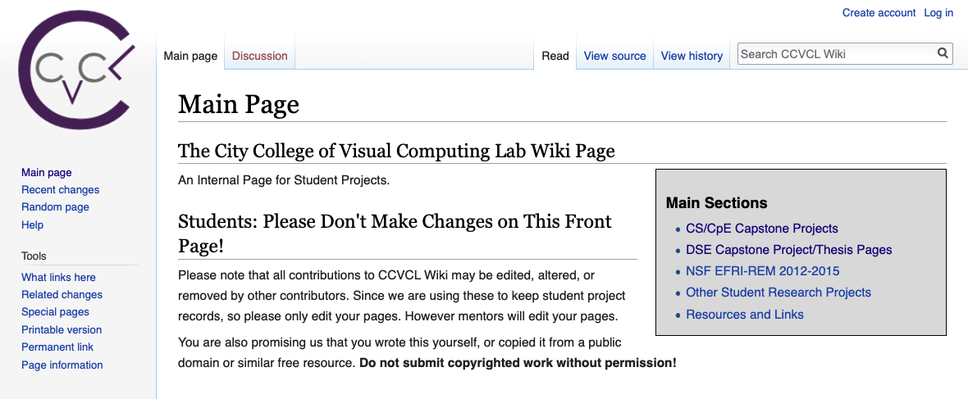
Wiki Page Weekly Updates
1. Create an account using your ccny email, with a username a password.
2. Then check your email (incl. spam folder) to confirm before you come back to login
3. Contact Xuan Wang <xwang4@gradcenter.cuny.edu> if any questions.
http://wiki.ccvcl.org

Slide 19
BEAT+: Adding Branding and Entrepreneurship for Real-World Applications Using Emerging Technologies: AI, AR, AT, Apps, +etc.
From AT to BEAT, and From BEAT to BEAT+
Zhigang Zhu, Kayser Chair Professor of Computer Science, GSOE, CCNY
Gerardo A Blumenkrantz, Associate Professor, Media & Communication Arts, Branding + Integrated Communications (BIC) Creative Track, CCNY
Chris Bobko, Ph.D., Executive Director, Zahn Innovation Center

