Slide 1
CSc I6716 Computer Vision
Exam Review
Fall 2023

Slide 2
Assignment 3
1 (Camera Models- 20 points) Prove that the vector from the viewpoint of a pinhole camera to the vanishing point (in the image plane) of a set of 3D parallel lines is parallel to the direction of the parallel lines. Please show the steps of your proof.
Hint: You can either use geometric reasoning or algebraic calculation.
If you choose to use geometric reasoning, you can use the fact that the projection of a 3D line in space is the intersection of its “interpretation plane” with the image plane. Here the interpretation plane (IP) of a 3D line is a plane passing through the 3D line and the center of projection (viewpoint) of the camera. Also, the interpretation planes of two parallel lines intersect in a line passing through the viewpoint, and the intersection line is parallel to the parallel lines.
If you select to use algebraic calculation, you may use the parametric representation of a 3D line: P = P0 +tV, where P= (X,Y,Z)^{T} is any point on the line (here ^{T} denote for transpose), P0 = (X0,Y0,Z0)^{T} is a given fixed point on the line, vector V = (a,b,c)^{T} represents the direction of the line, and t is the scalar parameter that controls the distance (with sign) between P and P0.
If you want to use the determinant formed by three 3D points, you will need to explain details of both the meaning of the determinant, and the steps to arrive your conclusion. Finding a solution somewhere online and copy it in your submission doesn’t work for you.

Slide 3
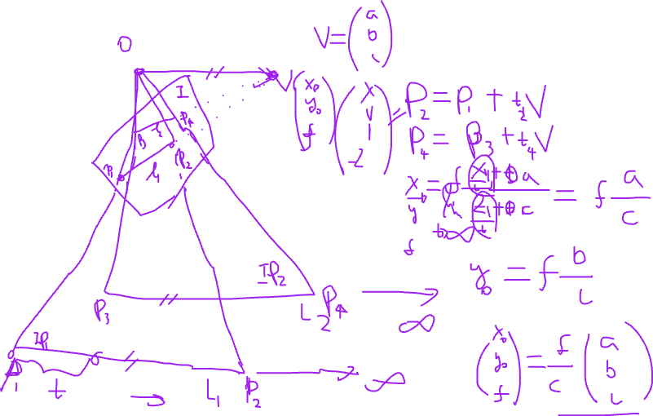

Slide 4
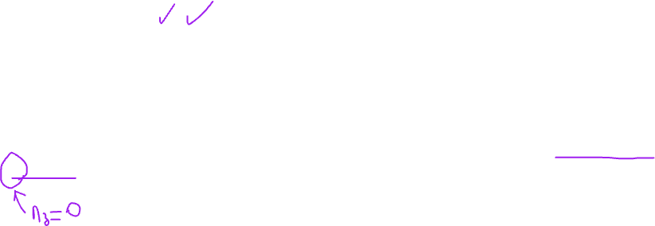
Assignment 3
2. (Camera Models- 20 points) Show that relation between any image point (xim, yim)^{T} of a plane (in the form of (x1,x2,x3)^{T} in projective space ) and its corresponding point (Xw, Yw, Zw)^{T} on the plane in 3D space can be represented by a 3×3 matrix. You should start from the general form of the camera model (x1,x2,x3)^{T} = M_{int}M_{ext}(Xw, Yw, Zw, 1)^{T}, where M = M_{int}M_{ext} is a 3×4 matrix, with the image center (ox, oy), the focal length f, the scaling factors( sx and sy), the rotation matrix R and the translation vector T all unknown. Note that in the course slides and the lecture notes, I used a simplified model of the perspective project by assuming ox and oy are known and sx = sy =1, and only discussed the special cases of planes.. So you cannot directly copy those equations I used. Nor can you simply derive the 3×4 matrix M. Instead you should use the general form of the projective matrix (5 points), and the general form of a plane n_{x} X_{w} + n_{y} Y_{w} + n_{z} Z_{w} = d (5 points), work on an integration (5 points), to form a 3×3 matrix between a 3D point on the plane and its 2D image projection (5 points).

Slide 6

Assignment 3
3. (Calibration- 20 points ) Prove the Orthocenter Theorem by geometric arguments: Let T be the triangle on the image plane defined by the three vanishing points of three mutually orthogonal sets of parallel lines in space. Then the image center is the orthocenter of the triangle T (i.e., the common intersection of the three altitudes.
(1) Basic proof: use the result of Question 1, assuming the aspect ratio of the camera is 1. Note that you are asked to prove the Orthcenter Theorem, not just the orthcenter of a triangle (10 points) (2) If you do not know the focal length of the camera, can you still find the image center using the Orthocenter Theorem? Explain why or why not (2 points). Can you also estimate the focal length after you find the image center? If yes, how, and if not, why (3 points) (3) If you do not know the aspect ratio and the focal length of the camera, can you still find the image center using the Orthocenter Theorem (2 points)? Explain why or why not (3 points).

Slide 7
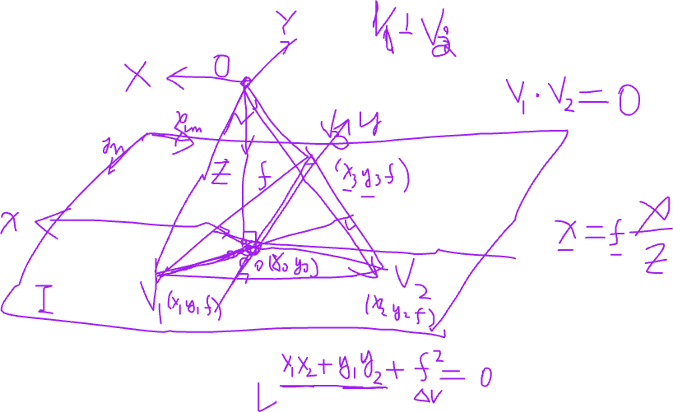

Slide 8
Types of Questions (40% to Final)
Multiple Choices (20 points)
10 questions, 2x10 points = 20 points
Short Answers (80 points)
4 questions, 20 points each
Proof, description, analysis of stereo, motion and vision systems

Slide 9
Course Outline
Complete syllabus on the web pages (14 class meets)
Rough Outline ( 3D Computer Vision):
Part 1. Vision Basics (Total 4)
1. Introduction (1)
2. Image Formation and Processing (1) (hw 1, matlab)
3. Image Enhancement (1)
4. Edge Detection (1) ( hw 2)
Part 2. 3D Vision (Total 6)
5. Camera Models (1)
6. Camera Calibration (1)(hw 3)
7/8. Stereo Vision (2) (project assignments)
9/10. Visual Motion (2) (review for exam) (hw 4)
Part 3. Advanced Topics and Projects (Total 4)
11. Midterm exam (1) – 11/20
12. Computer Vision in Space and Time (1)
13. Project and Exam discussions and a quick quiz (1)
14. Student Project presentations (1)
Notes:
The course outline is a top level preview of those topics contained in these notes. However, not all of these topics are necessarily covered in the course lectures. In general, the topics cover areas of 3D vision which have received a reasonable amount of attention in computer vision research literature. To some extent, they also represent the personal biases of the authors. There are important areas of vision which are not yet specifically addressed as separate topics in these notes.
For example, the perception, representation, manipulation, and use of color information is an important issue in both human and machine vision. This topic is also very broad and can be approached from a number of different perspectives.
The issue of color is introduced only as needed in the course notes, but you are encouraged to consult the literature if more detailed knowledge is of interest to you.

Slide 10
Image Formation
Computer Vision
Image Formation Basic Steps
Geometry
Pinhole camera model & Thin lens model
Perspective projection & Fundamental equation
Radiometry
Photometry
Color, human vision, & digital imaging
Digitalization
Sampling, quantization & tessellations
More on Digital Images
Neighbors, connectedness & distances

Slide 11
Feature Extraction
Computer Vision
Image Enhancement
Brightness mapping
Contrast stretching/enhancement
Histogram modification
Noise Reduction
……...
Mathematical Techniques
Convolution
Gaussian Filtering
Edge and Line Detection and Extraction
Region Segmentation
Contour Extraction
Corner Detection

Slide 12
Camera Models
Computer Vision
Geometric Projection of a Camera
Pinhole camera model
Perspective projection
Weak-Perspective Projection
Camera Parameters
Intrinsic Parameters: define mapping from 3D to 2D
Extrinsic parameters: define viewpoint and viewing direction
Basic Vector and Matrix Operations, Rotation
Camera Models Revisited
Linear Version of the Projection Transformation Equation
Perspective Camera Model
Weak-Perspective Camera Model
Affine Camera Model
Camera Model for Planes
Summary

Slide 13
Camera Calibration
Computer Vision
Calibration: Find the intrinsic and extrinsic parameters
Problem and assumptions
Direct parameter estimation approach
Projection matrix approach
Direct Parameter Estimation Approach
Basic equations (from Lecture 5)
Homogeneous System
Estimating the Image center using vanishing points
SVD (Singular Value Decomposition)
Focal length, Aspect ratio, and extrinsic parameters
Discussion: Why not do all the parameters together?
Projection Matrix Approach (…after-class reading)
Estimating the projection matrix M
Computing the camera parameters from M
Discussion
Comparison and Summary
Any difference?

Slide 14
Stereo Vision
Computer Vision
Problem
Infer 3D structure of a scene from two or more images taken from different viewpoints
Two primary Sub-problems
Correspondence problem (stereo match) -> disparity map
“Similar” instead of “Same”
Occlusion problem: some parts of the scene are visible only in one eye
Reconstruction problem -> 3D
What we need to know about the cameras’ parameters
Often a stereo calibration problem
Lectures on Stereo Vision
Stereo Geometry – Epipolar Geometry (*)
Correspondence Problem (*) – Two classes of approaches
3D Reconstruction Problems – Three approaches

Slide 15
Visual Motion
Computer Vision
Problems and Applications
The importance of visual motion
Problem Statement
The Motion Field of Rigid Motion
Basics – Notations and Equations
Three Important Special Cases: Translation, Rotation and Moving Plane
Motion Parallax
Optical Flow
Optical flow equation and the aperture problem
Estimating optical flow
3D motion & structure from optical flow
Feature-based Approach
Two-frame algorithm
Multi-frame algorithm
Structure from motion – Factorization method
Advanced Topics
Spatio-Temporal Image and Epipolar Plane Image
Video Mosaicing and Panorama Generation
Motion-based Segmentation and Layered Representation

Slide 16
Types of Questions (40% to Final)
Multiple Choices (20 points)
10 questions, 2x10 points = 20 points
Short Answers (80 points)
4 questions, 20 points each
Proof, description, analysis of stereo, motion and vision systems

