Slide 1
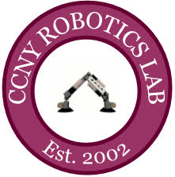





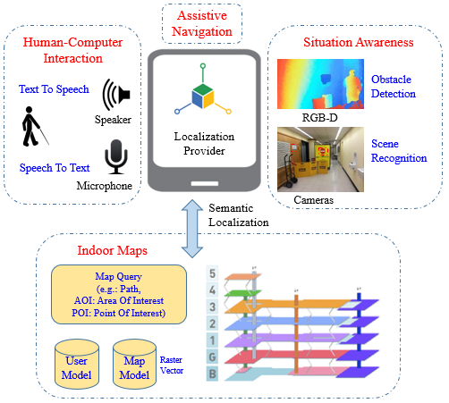
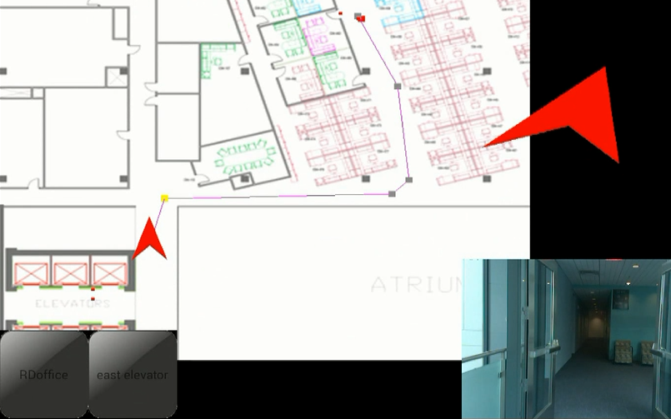
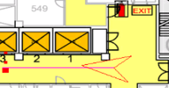
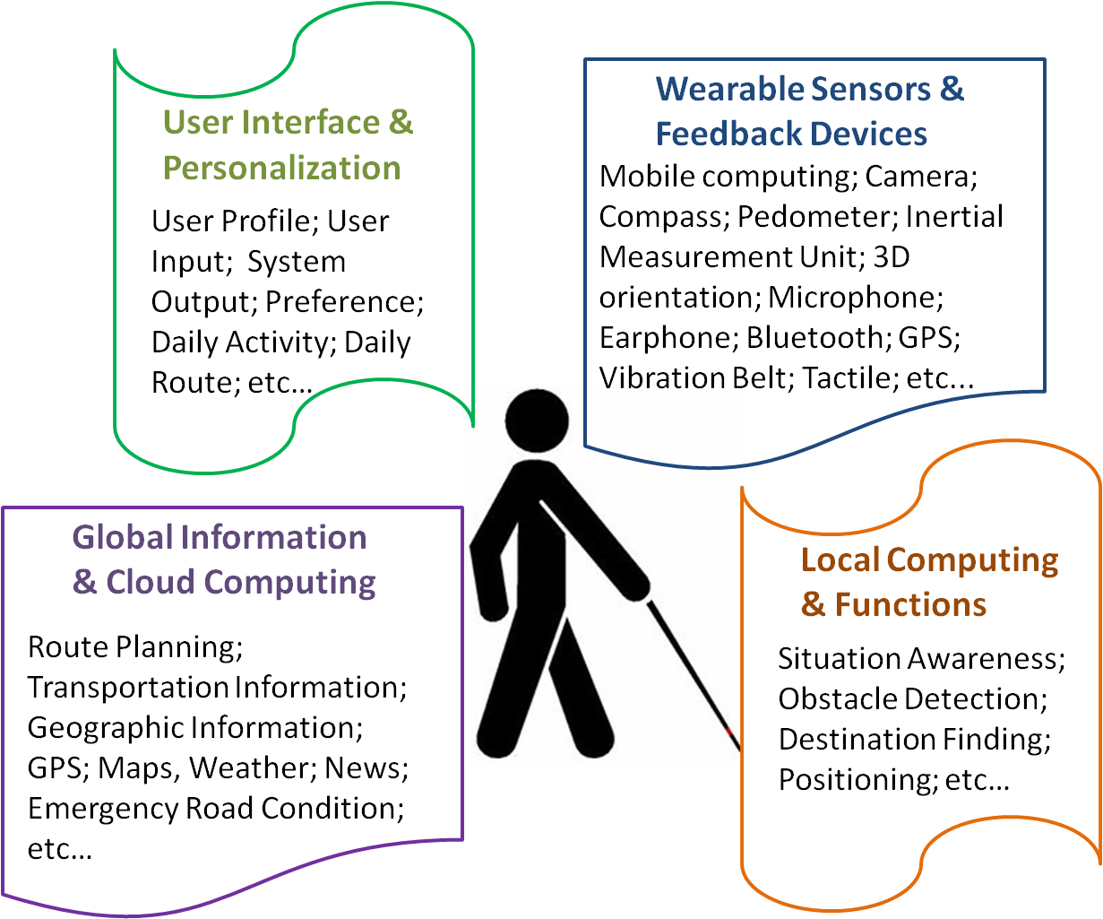

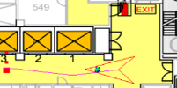

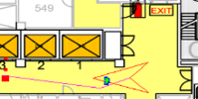
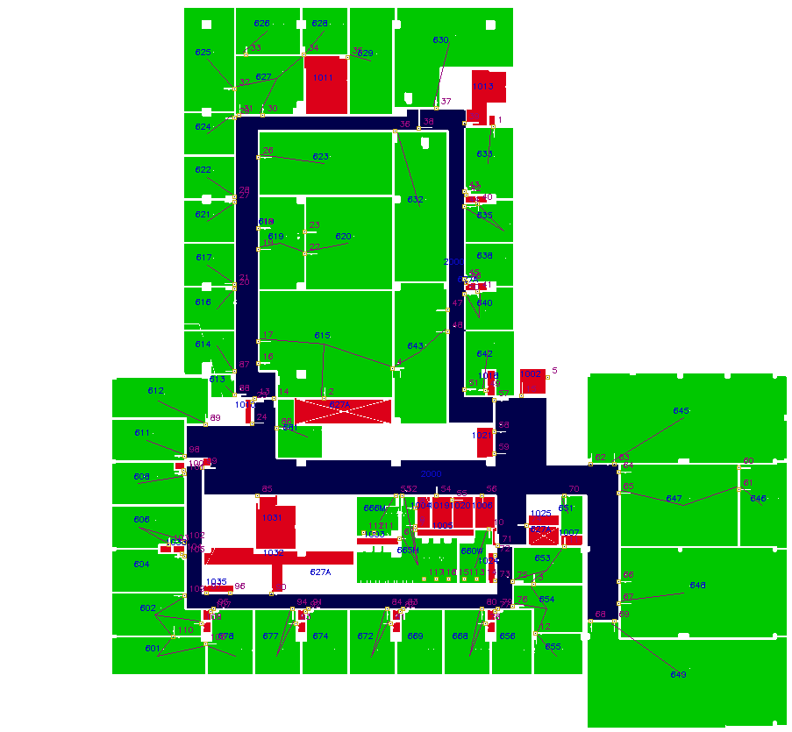
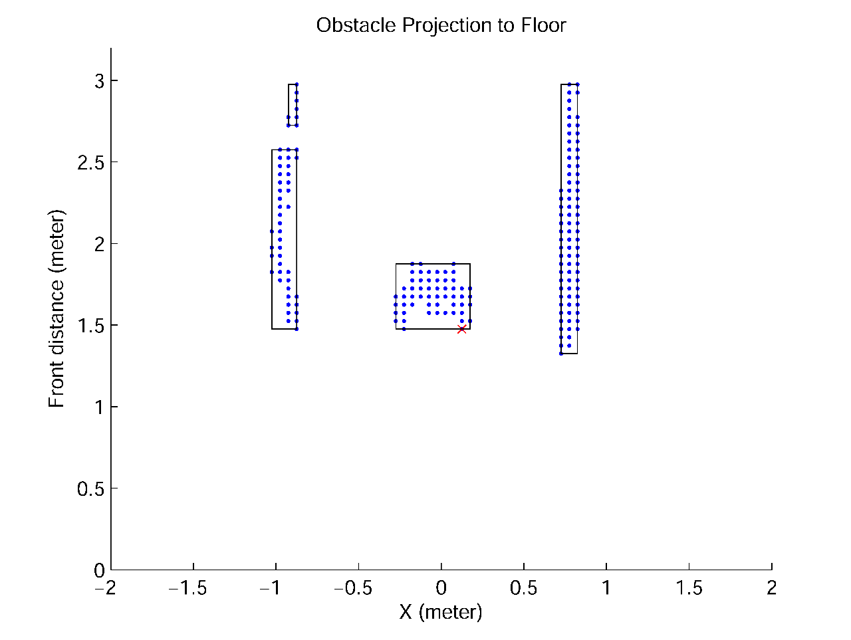
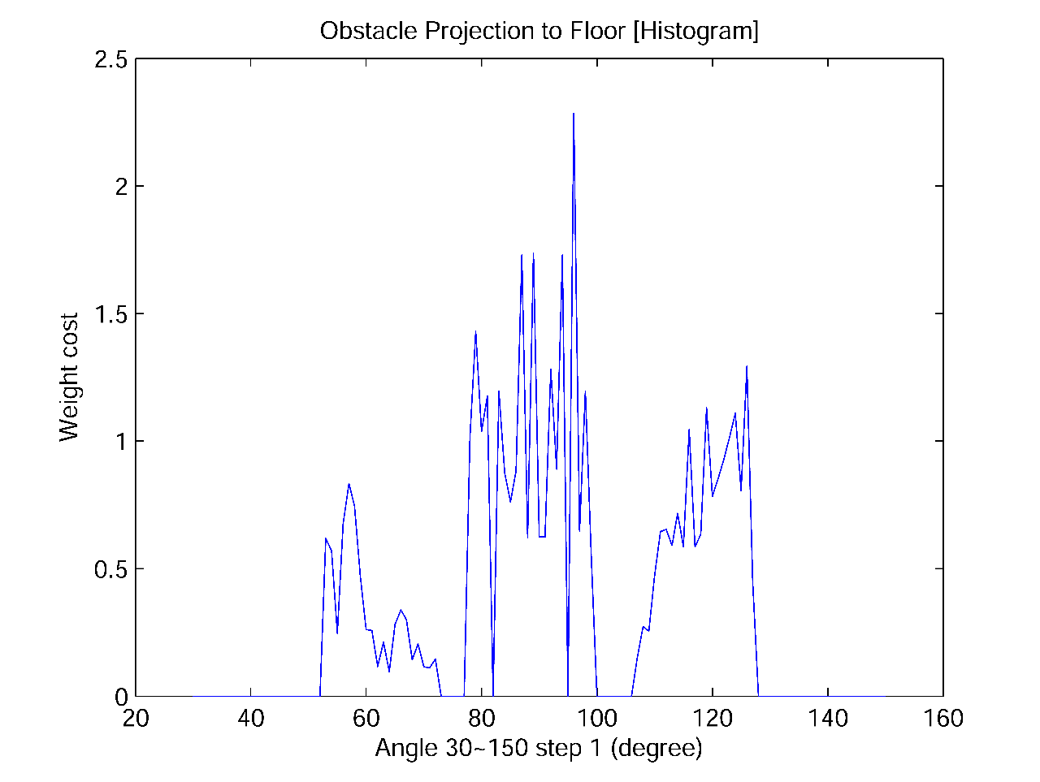
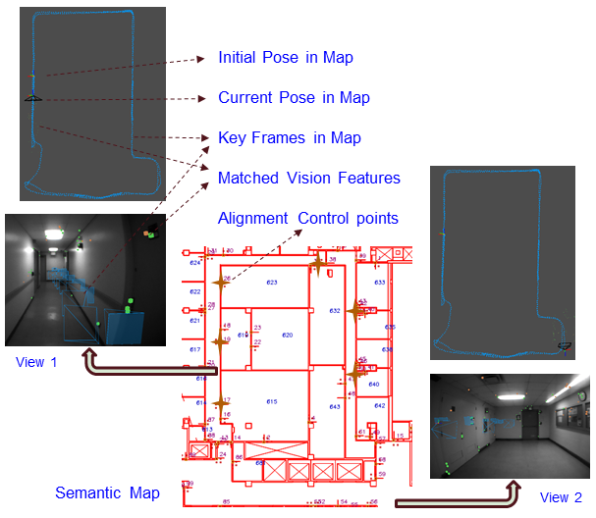
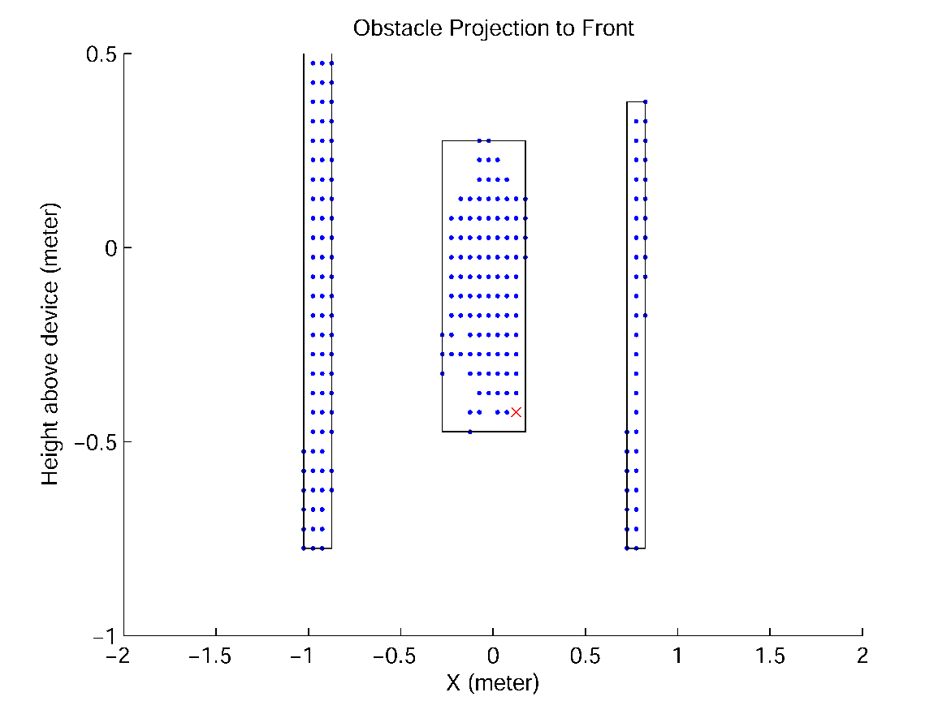
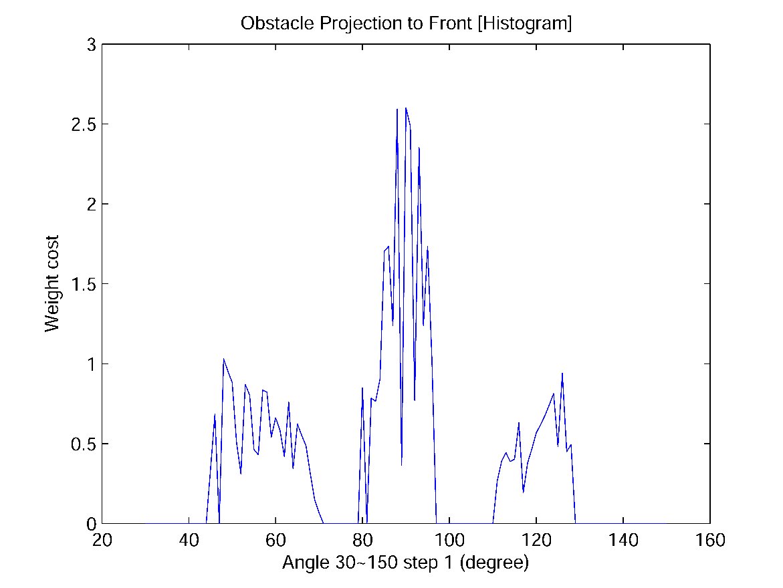
CCNY Robotics Lab
CCNY Media Lab
Visibility Metrics LLC
Grant DTFH61-12-H-00002
ISANA: Wearable Context-Aware Indoor Assistive Navigation with Obstacle Avoidance for the Blind
Bing Li ¹, J. Pablo Muñoz², Xuejian Rong¹, Jizhong Xiao^{1,2}, Yingli Tian^{1,2}, Aries Arditi³
¹The City College, The City University of New York (CUNY), ²Graduate Center, CUNY, ³Visibility Metrics LLC
Motivation
System Overview
Experiment
285 million people are estimated to be visually impaired worldwide: 39 million are blind and 246 million have low vision (World Health Organization August 2014).
As people aged, higher probability of becoming visually impaired.
Improve quality of life, reduce risks and avoid dangers.
Enhance independent living.
Technology can be extended to other disabilities.
Goal
Develop indoor assistive navigation for the visually impaired people by integrating the cutting edges.
Multi-floor navigation demo in Department Of Transportation (DOT)
  Navigate multi-floor to the destination
  User commands by voice
  Audio and sonic feedback for navigation
  and situation awareness
  Obstacle avoidance
  The navigation map to final destination:
Path planning with obstacle avoidance
(CCNY Steinman Hall 5th floor)
(1) Path without detected obstacle
(2) New path when obstacle is in front
(3) Path keeps updating when obstacle is moving
Waypoints
route
Walking direction to
next Waypoint
(1)
What & Where
& How ?
(2)
current pose
real-time camera view
(3)
Semantic & ADF Maps Alignment
Semantic map retrieved from CAD:
  Occupancy grid
  Topological connections
  Point of Interest
  Area of Interest
Left(up/down figures): Obstacle detection floor/vertical plane projection, red “x” is the closest point, the horizontal axis is the left to right direction in meter, and the vertical axis represents the forward/vertical direction in meter.
Right(up/down figures): Obstacle histogram, the horizontal axis is the angular direction of obstacle in degree, and the vertical axis represents the weighted cost of obstacle points with related to their distance in floor/vertical plane to ISANA.
Approach
To achieve indoor assistive navigation, we integrated the robotics simultaneous localization and mapping (SLAM), path planning techniques, and built Map-Editor to parse semantic map from priori CAD model for semantic layers.
For the situation awareness and safety of the visually impaired people, we developed computer vision algorithms (scene text recognition and obstacle detection).
The software is built as ISANA App in portable Google Tango Android tablets with audio/voice Human-Machine Interaction (HMI).
Semantic & Area Description File (ADF) maps alignment using singular value decomposition (SVD)

