Slide 1

What is Capital Punishment?
Known simply as the death penalty.
System of punishment in which capital crimes are punished by death.
Different states have different definitions of a capital crime.

Slide 2
California's Definition of a Capital Crime
Sabotage
Train wrecking resulting in death
Treason
Perjury causing execution of an innocent person
First-degree murder with special circumstances

Slide 3
First-Degree Murder with Special Circumstances
A murder in which the killer benefited financially.
The murder was committed with an explosive device.
The murder was committed while resisting arrest.
The murder of any of these people while on duty: peace officer, firefighter, witness to a crime, prosecutor, judge, juror, or bus driver.
The murder was heinous, cruel, or classified as torture.

Slide 4
A Brief History of the Death Penalty in the United States
In 1972, the Supreme Court ruled it unconstitutional (cruel and unusual punishment) to execute a criminal.
Every state was banned from using the death penalty between 1972 and 1976.
In 1976, the Supreme Court withdrew their ruling, and capital punishment was legal in the states again.
However, fourteen states refused to re-instate the death penalty.

Slide 5
States without the Death Penalty
Alaska
Hawaii
Iowa
Massachusettes
Michigan
Minnesota
New Jersy
New Mexico
New York
North Dakota
Rhode Island
Vermont
West Virginia
Wisconsin

Slide 6
The Issue
The use of the death penalty has become an issue of debate.
According to a 2009 Gallup Poll, almost 65% of this country favors the death penalty.
Many people in this majority do not understand how the death penalty works.
It is a flaw-filled, inefficient, and wasteful system.

Slide 7
Does the Death Penalty Deter Crime?
According to the FBI, the South has the highest murder rate in the country; it also has the highest death penalty execution rate.
The Northeast has the lowest murder rate in the country, and it has the lowest number of death penalty executions.
88% of expert criminologists say that the death penalty does not deter crime.
Police chiefs from around the country ranked the death penalty last as a measure to reduce crime.

Slide 8
The Cost of the Death Penalty
It costs California tax-payers over $250 million per execution of a death-row inmate.
It costs California tax-payers, on top of the execution costs, $125.5 million per year to keep the 694 inmates on death row.
It would only cost $11.5 million to give death-row inmates life in prison without chance of parole.

Slide 9
Innocence on Death Row
On average, 3 death-row inmates are found innocent every year.
In 2009, a total of 9 death-row inmates were found innocent prior to their execution.

Slide 10
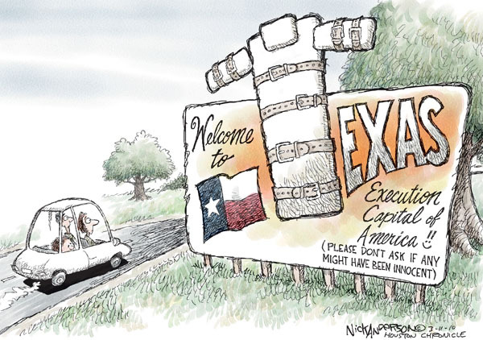

Slide 11
The Solution
Eliminate the death penalty.
Change the death sentence to life in prison without the possibility of parole.
California would save over $125.5 million per year.
California can use this money for expanding prisons, funding education, and to help eliminate our budget deficit.

