Slide 1
For Live Session
UNIT 3: Case Studies

Slide 2
For Live Session: Part 1
1. Read the following case study
https://data-flair.training/blogs/data-science-at-netflix/
2. Similar to what was done for Target and Amazon, apply DELTTAA, FACE and Pachinko (Separate slides) to this case study. You may use intuition or outside resources to address any pieces that are not explicitly mentioned the case study. There is not one correct answer, DELTTAA, FACE and Pachinko are designed to help organize the issues and challenges of a complex business problem.
3. Are there any ethical or legal issues to consider?
4. Research the skills required / in demand of a data scientist at NetFlix.

Slide 3
Delttaa Data
Data- The films or tv shows associated with each Netflix user account. As of July 2018, Netflix has 130 million worldwide streaming subscribers. Having this large user base allows Netflix to gather a tremendous amount of data.

Slide 4
Delttaa Data
This is just Some of the “events” Netflix tracks to enhance user experience:
When you pause, rewind, or fast forward
Searches
Browsing and scrolling behavior
What time you watch content
User location data

Slide 5
Delttaa Enterprise
Netflix predictive analytics department call Netflix Research
Research applications span many areas including personalization algorithms, content valuation, and streaming optimization.

Slide 6
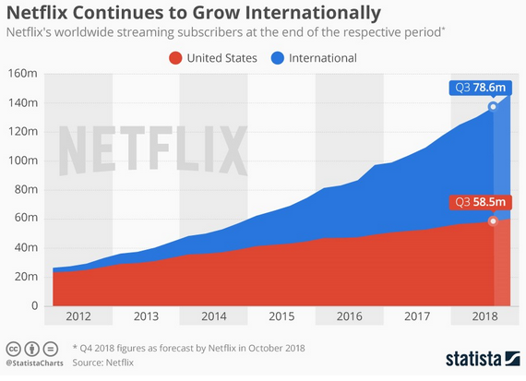
Delttaa Leadership
The following chart shows Netflix’s subscriber growth since it made its controversial decision to ban VPNs from international countries and hike its prices in 2016.

Slide 7
Delttaa Targets
Provides its users with various contents based on their preferences and likings based on a recommendation system
An estimated 80 percent of content streamed on its platform is influenced by its recommendation system.

Slide 8
Delttaa Technologies
SQL, python from job posting
Uses Amazon’s S3 to warehouse its data allowing it to spin up multiple Hadoop clusters for different workloads accessing the same data.

Slide 9
Delttaa Analytical Techniques
Analytical Techniques- A/b testing, machine learning(recommendation systems), NLP

Slide 10
Delttaa Analysts
Analysts- the data scientists or analysts that work at Netflix

Slide 11
FACE Netflix
Framing the problem- Can you recommend what content a user would watch by the previous content they watched and liked. Provide recommendations based on the similar profiles of different users and content.

Slide 12
FACE Netflix
Solving the problem
Data Collection
Netflix’s huge user base with 139 million subscribers
Metadata from third parties like Nielsen
Social media data from Facebook and Twitter
Modeling
Recommendation System targeted content promotion that an estimated 80 percent of content streamed on its platform is influenced by it.
Data Analysis
A/B testing

Slide 13
FACE Netflix

Slide 14
FACE Netflix

Slide 15
Pachinko Netflix
Decision- What content to recommend “ongoing”
Predictive- Predict what shows customers would like.
Prescriptive-
Testing- a/b, recommendation system
Python, SQL,

Slide 16
Ethical/Legal Issues
If kids are watching inappropriate content under a parents account without them knowing. Then Netflix would recommend this content and the parent would be wondering why since they never watched any of that inappropriate content

Slide 17
Job at Netflix
https://jobs.netflix.com/jobs/868431
Ph.D. in Computer Science, Statistics, Physics, or related quantitative field
Natural Language Processing (NLP). Strong fundamental knowledge of regression, decision trees, pattern recognition, probability theory, neural networks.
Expert in Python and extensive experience with SQL

Slide 18
For Live Session: Part 2
Re-read the Safety section on page 112 and 113 of the Competing on Analytics Book about First Analytics and Union Pacific Railroad
Read and watch these articles:
https://www.firstanalytics.com/single-post/2017/07/25/Analytics-Helps-Union-Pacific-Become-the-Safest-US-Railroad (Including 4 minute video)
https://www.up.com/aboutup/community/safety/technology/index.htm
https://www.up.com/aboutup/community/inside_track/predictive-analytics-09-18-2018.htm
Similar to what was done for Target and Amazon, apply DELTTAA, FACE and Pachinko (Separate slides) to this case study. There is not one correct answer, DELTTAA, FACE and Pachinko are designed to help organize the issues and challenges of a complex business problem.
Are there any ethical or legal issues to consider?

Slide 19
Delttaa Data
Data collected across more than 32,000 miles of track that Union Pacific uses
past incidents
road bed conditions
track materials
physical wear

Slide 20
Delttaa Enterprise
Union Pacific’s decision analytics, engineering and safety teams have been working to create a predictive analytics model to generate a list of the most at-risk track sections, mile-by-mile

Slide 21
Delttaa Leadership
Union Pacific's rail equipment incident rate in 2017 improved nearly 3 percent from 2016.

Slide 22
Delttaa Targets
Predict where on the tracks will break and find the most at risk sections for incidents.

Slide 23
Delttaa Technologies
ETL and loading in SQL Server.
R, Python
Post-Derailment Simulations
Wayside Detectors

Slide 24
Delttaa Analytical Techniques
predictive analysis with logistic regression

Slide 25
Delttaa Analysts
Union Pacific Associate Systems Engineer Nina Lahvinovich assembled and tested the numerous data elements using a tool called a logistic regression model, a highly sophisticated probability method used to predict what will happen based on what’s already happened.

Slide 26
FACE Union Pacific
Framing the Problem- can we reduce the risk of employee and public accidents and injuries.

Slide 27
FACE Union Pacific
Solving the problem
Data Collection
employee shift records, training, discipline, employee surveys, vacation, fatigue scores, demographics, environmental factors, weather, etc.
Modeling
predictive models to reduce the risk of employee and public accidents and injuries.
Data Analysis
logistic regression, clustering

Slide 28
FACE Union Pacific
Embedded

Slide 29
FACE Union Pacific
Communication

Slide 30
Pachinko Union Pacific
Decision- How to protect employees “always ongoing”
Predictive- reduce the risk of employee and public accidents and injuries
Prescriptive-
Stochastic- assess at-risk employees as they are scheduled for a particular shift
Testing- logistic regression
Python, SQL server, R, ETL

Slide 31
For Live Session: Part 3
Takeaways and Questions!!!
Please list at least 3 – 5 take-aways from this unit.
Please also include any questions you had from this unit or any comments as well! We can use these to design the live session!

