Slide 1
UNIT 4: For Live Session

Slide 2
Empirical Study of Revenue Management
Download the Paper: An Empirical Study of Revenue Management Practices in the Airline Industry http://faculty.washington.edu/yongpin/RM_Nov_15_07.pdf
Read these sections of the paper:
Section 1: Introduction
Section 2: Literature Review (THIS IS NOT REQUIRED BUT IS INTERESTING). IF TIME IS SHORT, YOU MAY SKIP THIS SECTION.
Section 3: Data and Variables
Section 4: Hypotheses and Models
Put special focus on 4.3 Revenue
Put special focus on the model for Revenue in 4.4
Section 5: Results (Pay close attention to the results pertaining to revenue.)
3. Make at least one slide to answer each of the following questions
a. GINI SCORE
i. Provide a formula for the GINI score and describe what it measures in this context. (Define price dispersion as part of this effort).
ii. Get a feel for the GINI score. Calculate a GINI score for: (Show your calculations.)
a. Ticket Prices: $350, $150, $600 $1300
b. Ticket Prices $600, $400, $700, $700
b. Investigate the Data Sources. Find a snapshot of at least 1 of the three data sources.
c. Investigate the model for Revenue (Model (5))
i. Specify the model (what is the mathematical form of the model?)
ii. Define endogenous vs. exogenous variables. https://www.sciencedirect.com/topics/nursing-and-health-professions/exogenous-variable
iii. What are the 3 methods of parameter estimation considered?
iv. Why were the OLS parameter estimates not recommended?
v. Was multicollinearity an issue? Why or why not?
vi. Which is the “right” model … the model the data were generated from? OLS, Random Effects, Hausman-Taylor (HT)
vii. Using Table 6, interpret the HT parameter estimate for Load Capacity. Assume this slide is meant for a client or audience that does not have a background in statistics. Phrase your interpretation in the language of the problem and industry.
viii. Using Table 6, interpret the HT parameter estimate for GINI (price dispersion) Assume this slide is meant for a client or audience that does not have a background in statistics. Phrase your interpretation in the language of the problem and industry. (Does it appear that price dispersion and thus revenue management (RM) is positively associated with revenue (RASM)?
http://www.businessdictionary.com/definition/exogenous-variable.html
https://www.transtats.bts.gov/tables.asp?Table_ID=310&SYS_Table_Name=T_T100D_MARKET_ALL_CARRIER
https://www.sciencedirect.com/topics/nursing-and-health-professions/exogenous-variable

Slide 3

GINI Score
Formula
It is a measure of price dispersion or price inequality between airlines.
Higher the score indicates higher price dispersion

Slide 4
Calculating a Gini score
a. Ticket Prices: $350, $150, $600 $1300
150/2400=.0625, 350/2400=.1458, 600/2400=.25,1300/2400=.5417
Covariance of 115.5, mean= 600,
(115.5/600)*2 Score of .385
b. Ticket Prices $600, $400, $700, $700
600/2400=.25, 400/2400=.1666, 700/2400=.2917,700/2400=.2917
Covariance of 31.2, mean= 600,
(31.2/600)*2 Score of .104
There is less price dispersion in the second list of prices with a score of .104

Slide 5
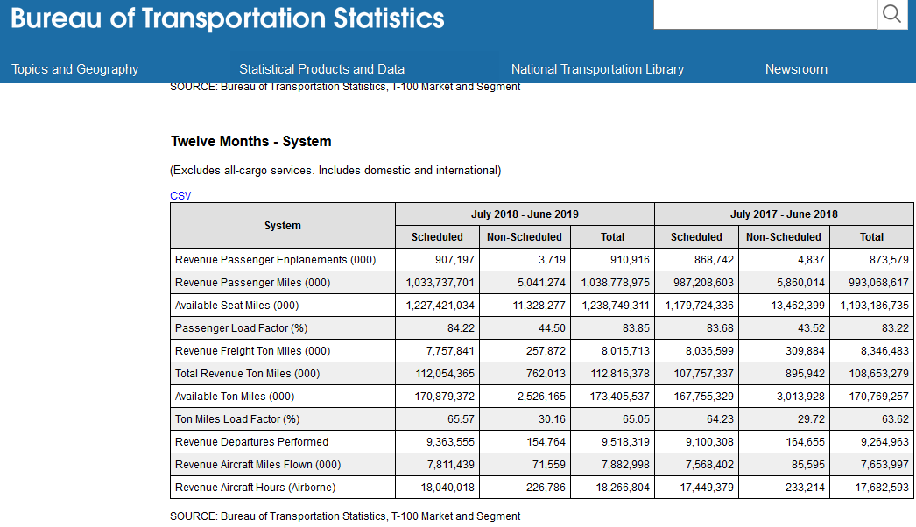
Data Sources
Air Carrier Statistics over 12 months

Slide 6
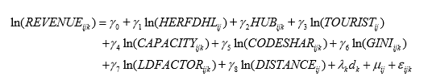
Revenue Model
I. Model used
II. Endogenous variables have values that are determined by other variables(exogenous) in the system while an exogenous variable is a variable that is not affected by other variables in the system.

Slide 7
III. Ordinary least squares(OLS), random effects & Hausman-Taylor are the 3 methods of parameter estimation considered
IV. The OLS is not recommended since it does not account for the route effects which can result in biased estimates.
V. Multicollinearity is not a problem since the variance inflation factor (VIF) for all the independent variables was below the threshold of 10
VI. The Hausman-Taylor (HT) model was the “right model” since it used a two step instrument variable (IV) method to provide consistent estimation of the coefficients.

Slide 8
VII. Load Capacity has a very positive effect on revenue ,when you have a higher capacity that effect load factor which leads to higher revenue.
VIII. price dispersion (GINI) has a positive effect on revenue, so RM practices do achieve its goal of increasing airline revenue

Slide 9
Optimization
This Unit provided some insight into the use of optimization in the airline industry.
Does your work or the company you work (or one you have worked for in the past … or one you would like to work for) for currently make use of prescriptive statistics? Optimization? I am sure NASA does but I can’t think of how prescriptive statistics is implemented in it.
Could your company (or one you have worked for in the past … or one you would like to work for) take advantage of prescriptive statistics?

Slide 10
Key Takeaways and Questions!
Please list your key takeaways from this Unit!
Please include any questions that you had in this unit.
Is there an easy way to do the gini calculations, I figured it out but took awhile to understand the formula that was provided in the reading.

