Slide 1
For Live Session
Unit 5
Studnet

Slide 2
Activity 1
Be prepared to discuss the discussion topics that you responded to in the asynch material. You don’t need to include any slides for this (but you can if you like).
Dicuss any "opportunities and/or threats" data and data science represented in your field/experience?
What software / languages do you / have you used at your company or in your career? If this is a long list, just think about the most ones you have used most recently, or are the most familiar with.
Have you ever encountered a business challenge like the ones described by Diana?
If so, be prepared to describe your experience.
If not, be prepared to discuss a business challenge (or academic challenge) that you do have experience with.

Slide 3
Activity 2
On one or two slides, DELTTAA or FACE or PACHINKO Diana’s project given what you learned from the videos.
This should fit on 2 slides or less. It does not need to be super detailed or researched outside of the asynch material.

Slide 4
Delttaa
Data-Database of Southwest Airline data
Enterprise-Southwest Analytics department
Leadership- Happy with the results and showing support to the team
Target-See what influences OTP
Technologies-Tableau, Python, R
Analytical Techniques-Cross Validation, LASSO
Analysts-Diana Shen was main data scientist for OTP

Slide 5
Activity 3
For Live Session
There is an R package called nycflights13 that contains a record of all flights into and out of New York City in 2013. These records are in the dataset flights that is included in the package. the package includes 4 additional datasets that includes information about the weather, the airlines, the airports and planes themselves.
Create a new data set in R or Python (or Tableau) that calculates On Time Performance (OTP) for Delta (DL), American (AA) and Southwest (WN) Airlines for each day. Show the head of this data with a screen shot.
Bring in this data set (if it is not already in Tableau) into Tableau. Bring in the airlines dataset as well. No slide is needed here.
In DS 6306 (DDS) we discussed merging and joining datasets. In Tableau, merge the data set you created with the airlines data frame to create one data set that includes the date (by day), the carrier, the flightnumber, the on time performance (otp) and the airline name. Show the head of this dataset with a screen shot.
In Tableau, create a time series plot of OTP with a separate series for each airline. To be clear, there should be three time series plots (color coded) on the same coordinate plane with OTP on the y axis and time (in days) on the x-axis. Provide a screen shot of this plot and be prepared to share you Tableau workbook in class.
What inference / insights can you get derive from these plots? (One Slide)
Use Tableau to forecast (and plot) the next week (7 days) of OTP. Hint: Check out the Analytics Tab. Can you provide any additional insight? Provide a slide with a screen shot of this plot and include any additional insights. Also, research and find out what type of forecast Tableau is providing here.
FREE STYLE! Use the data sets in the nycflights13 R package and Tableau to create a plot / analysis of something you find interesting! What inference/ insight do you derive from this analysis? (This should be on a separate “Sheet” in Tableau but in the same workbook. One or two slides should work here.

Slide 6
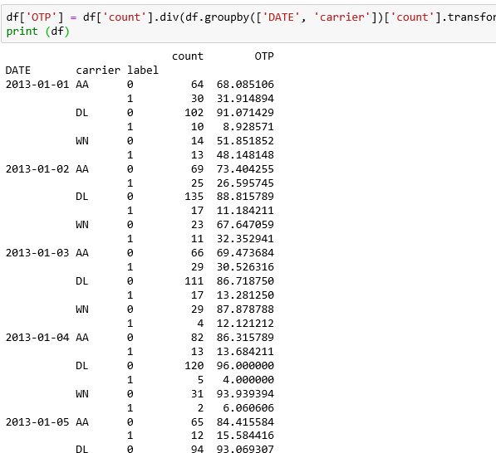
OTP in percentages for each day
0 is for under 15mins, 1 for over 15mins

Slide 7
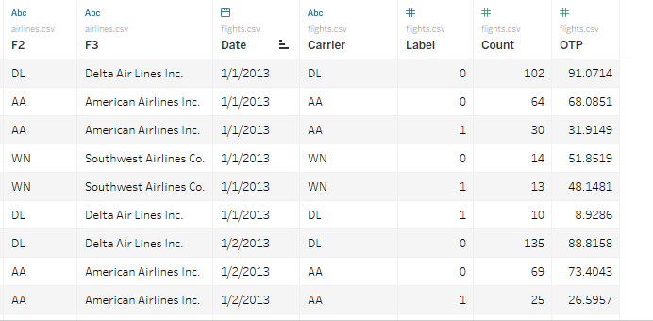
Merged Data
I didn’t do flight number since it would of broken down that data set too much for me to find the OTP

Slide 8
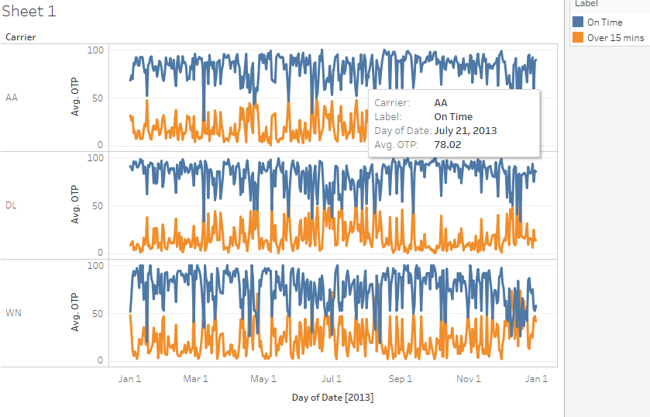
Time Series Plot for each Airline
Looks like Delta and American Airlines are most consistent with OTP than Southwest.

Slide 9
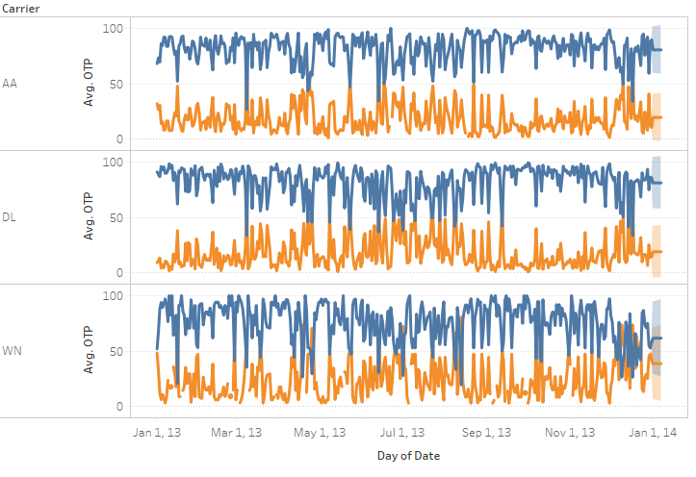
Forecast
By uses days as the option it is hard to see the forecast but Southwest has the smallest difference between being on time or over 15 mins late

Slide 10
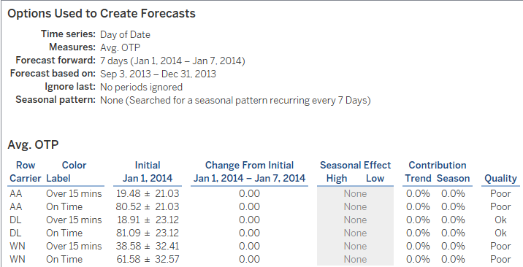
Forecast Cont.
Forecast was based off Sep 3 –Dec 31 2013 since days was the option used on the plot, it would increase if using months or years.
You can also see that Southwest has the smallest difference here also.

Slide 11
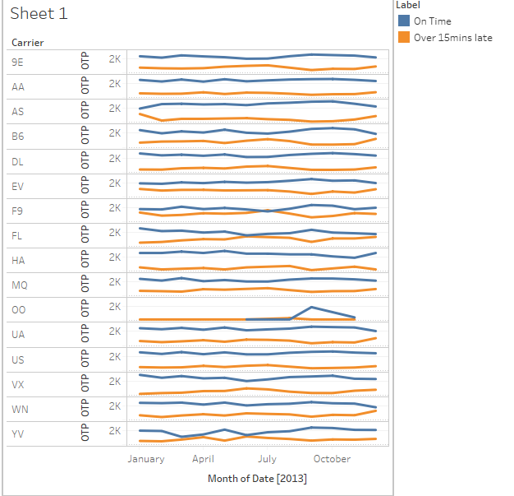
Free Style on Airline Data
I just ran a Sum of OTP for each airline monthly.
American and Hawaiian were pretty consistent with their OTP each month with bigger differences in the monthly SUM

