Slide 1
Service Catalog based IDP
Internal Development Platform
ccoe.io

Slide 2
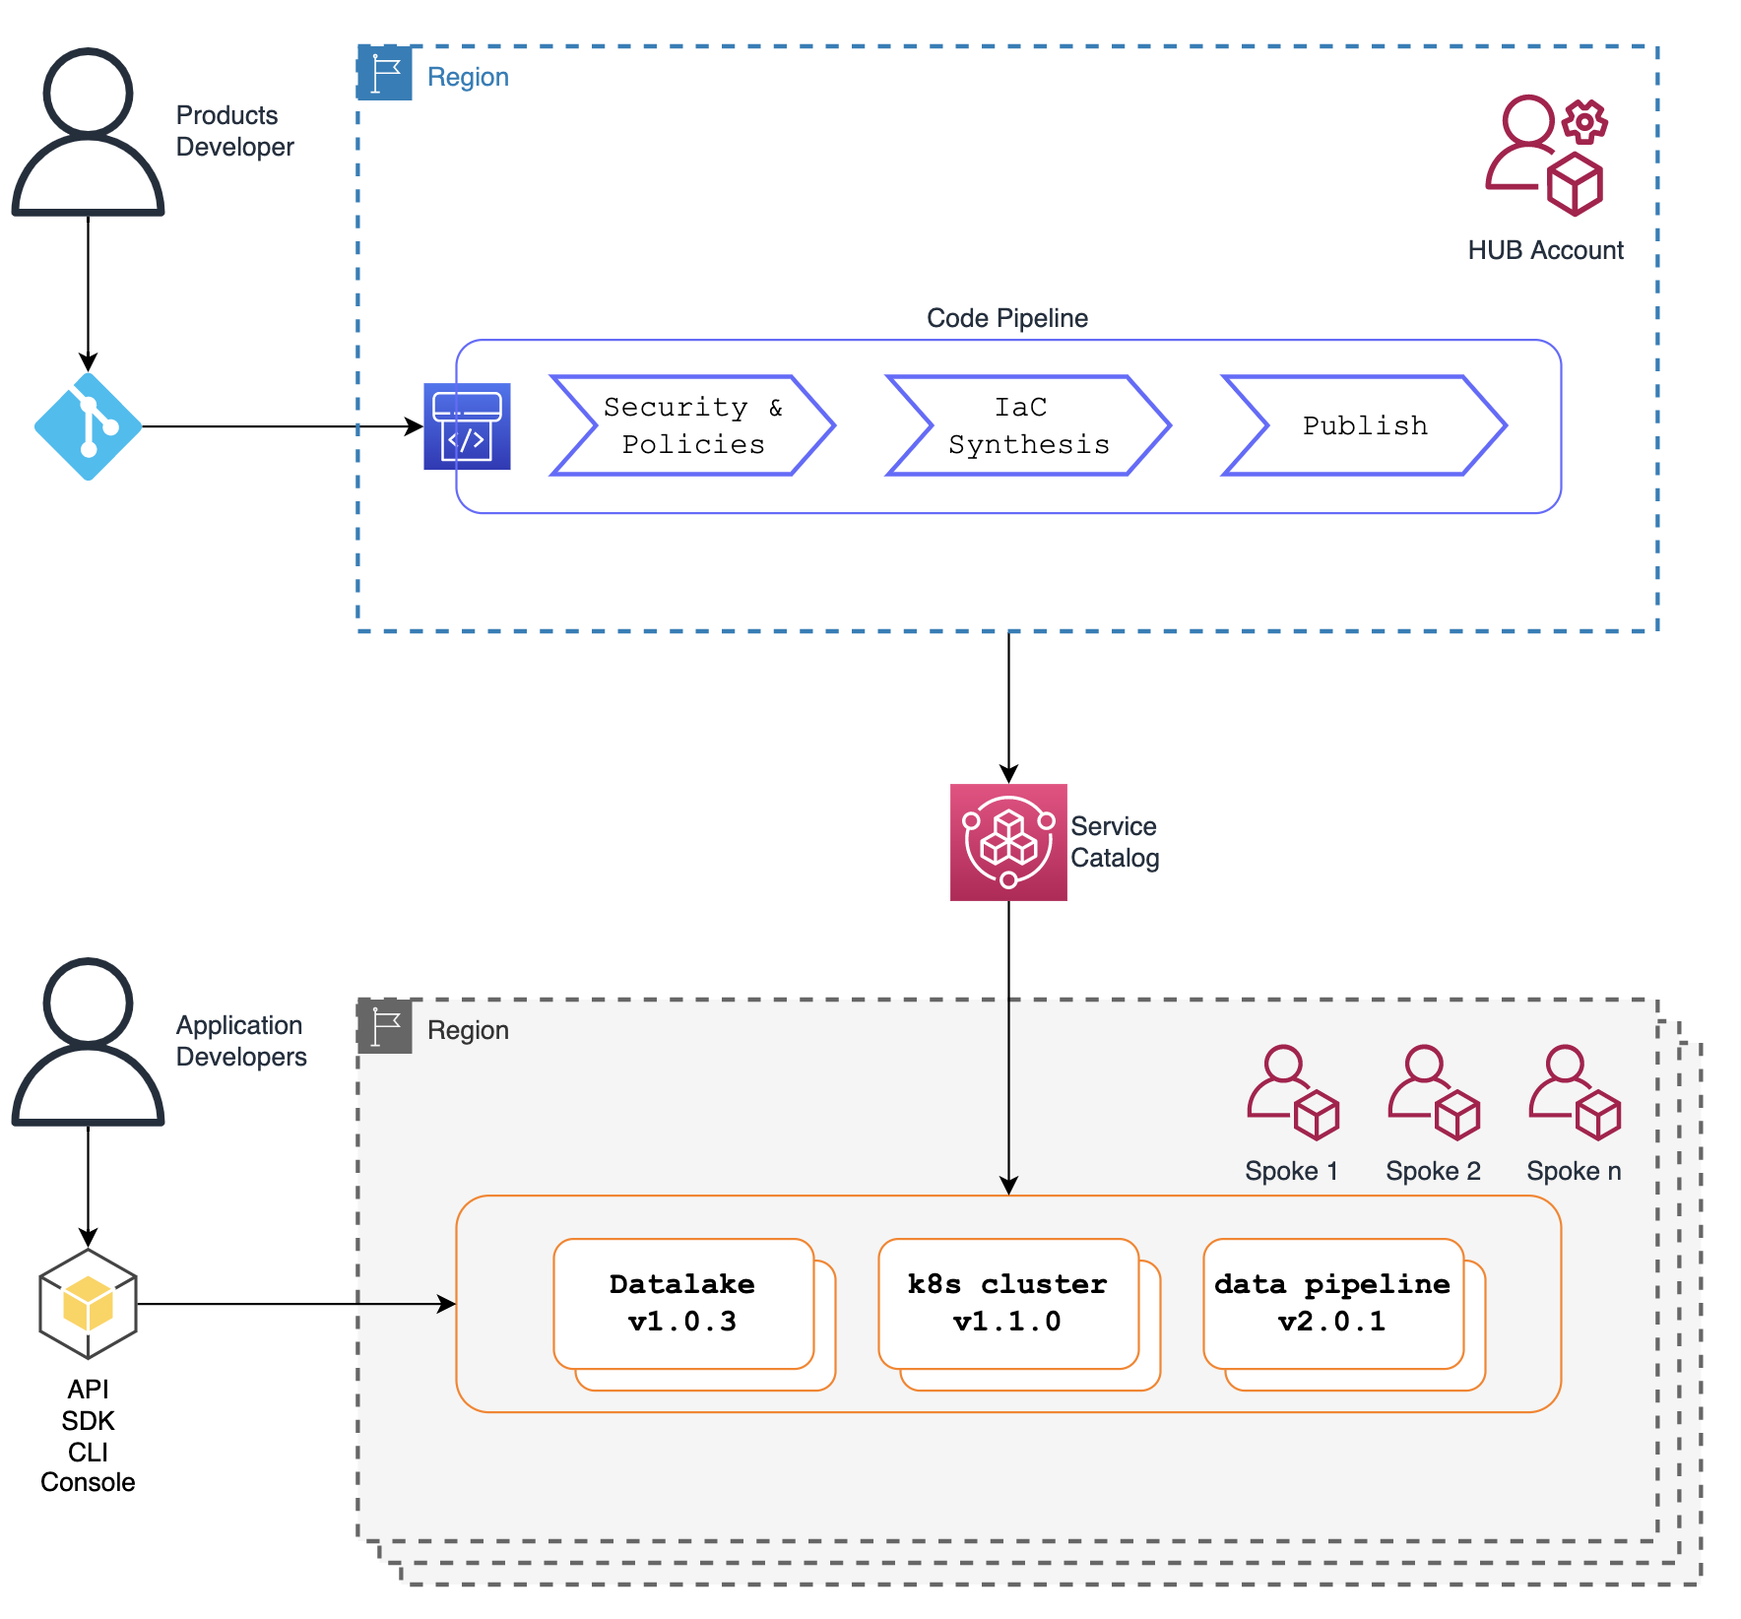
Design Diagram

Slide 3
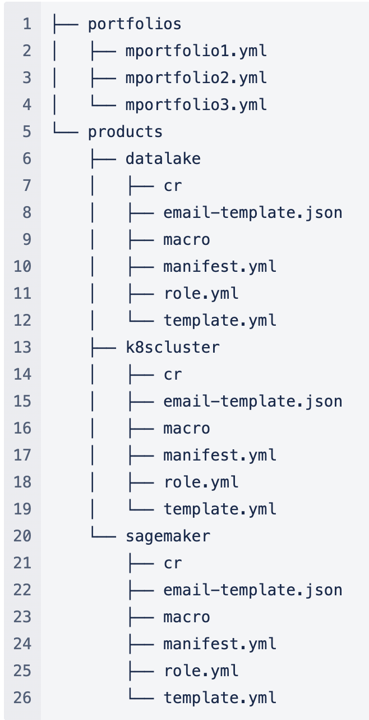
Catalog Repository

Slide 4
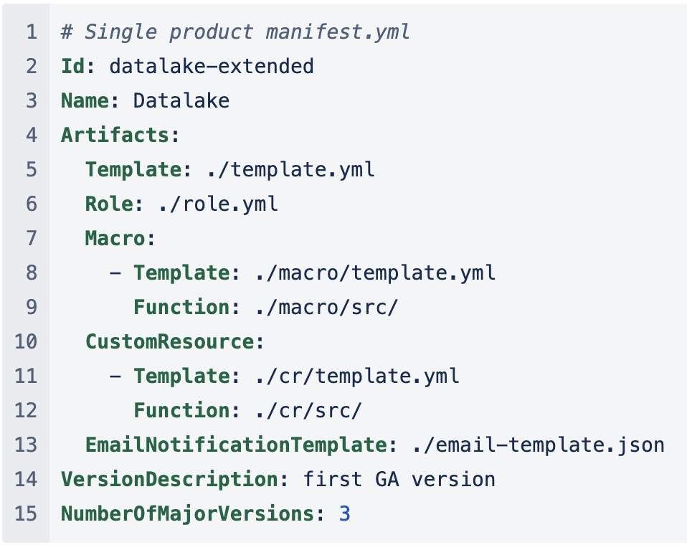
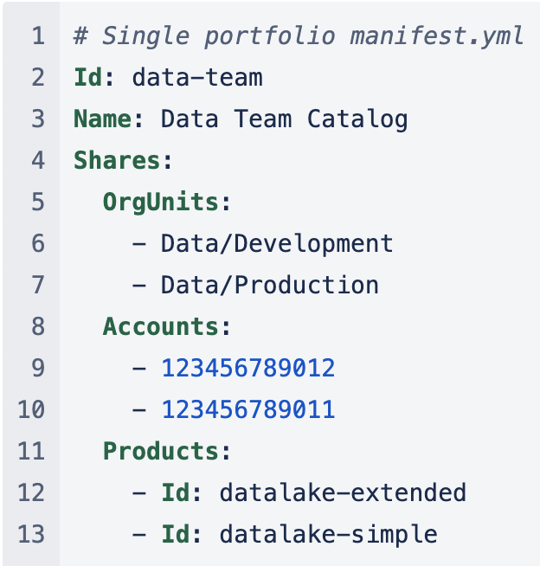
Manifests
Portfolio
Product

Slide 5
Epics
Platform Design
Describe the platform resources (CDK)
Render CFT(s) from Catalog Manifests
Products validation
Products versioning
Deploy product dependencies
Deploy catalog portfolios/products
Consumers access
Notification mechanism
Develop product: S3
Develop prodcut: RDS Empty
Develop prodcut: Route53
Develop prodcut: Cognito
Develop prodcut: WAF
Develop prodcut: SNS/SQS/Lambda
Products should support AMS accounts

