Slide 1
Memcached and Redis
CSE-291 Cloud Computing, Fall 2016
Kesden

Slide 2
Classic Problems
Web servers query from disk
Main memory is wasted
Underlying databases queries can be redundant and slow
Distributing load among Web servers partitions main memory
Redundant memory cache, not larger memory cache
Dedicated caching can often maintain whole, or large portions of, the working set, limiting the need to go to disk

Slide 3

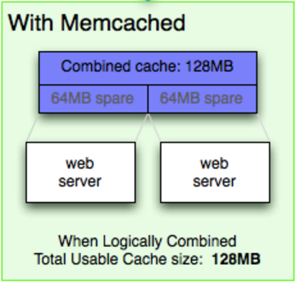
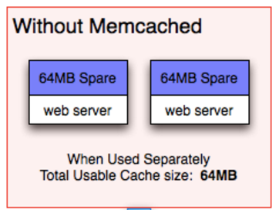
Common Use of Memcached (But, dedicated servers are also common)
https://memcached.org/about

Slide 4
Memcached Overview
Distributed hashtable (Key-Value Store)
Except that “Forgetting is a feature”
When full – LRU gets dumped
Excellent for high-throughput servers
Memory is much lower latency than disk
Excellent for high-latency queries
Caching results can prevent the need to repeat these big units of work

Slide 5
Memcached Architecture
Servers maintain a “key-value” store
Clients know about all servers
Clients query server by key to get value
Two hash functions
Key--->Server
Key-->Associative Array, within server
All clients know everything.

Slide 6
Code, From Wikipedia
function get_foo(int userid) {
data = db_select("SELECT * FROM users WHERE userid = ?", userid);
return data;
}
function get_foo(int userid) {
/* first try the cache */
data = memcached_fetch("userrow:" + userid);
if (!data) {
/* not found : request database */
data = db_select("SELECT * FROM users WHERE userid = ?", userid);
/* then store in cache until next get */
memcached_add("userrow:" + userid, data);
}
return data;
}

Slide 7
Memcached: No replication
Designed for volatile data
Failure: Just go to disk
Recovery: Just turn back on and wait
Need redundancy?
Build above memcached
Just build multiple instances

Slide 8
REDIS REmote DIctionary SErver
Like Memcached in that it provides a key value store
But, much richer
Lists of strings
Sets of strings (collections of non-repeating unsorted elements)
Sorted sets of strings (collections of non-repeating elements ordered by a floating-point number called score)
Hash tables where keys and values are strings
HyperLogLogs used for approximated set cardinality size estimation.
(List from Wikipedia)

Slide 9
REDIS REmote DIctionary SErver
Each data type has associated operations, e.g. get the one in particular position in a list, intersect sets, etc.
Transaction support
Configurable cache policy
LRU-ish, Random, keep everything, etc.

Slide 10
REDIS: Persistence
Periodic snapshotting to disk
Append-only log to disk as data is updated
Compressed in background
Updates to disk every 2 seconds to balance performance and risk
Single process, single thread

Slide 11
REDIS Clustering: Old School
Old School
Divide up yourself
Clients hash
Clients divide range
Clients Interact with Proxy which does the same
Hard to handle queries involving multiple keys

Slide 12
REDIS Clustering: New School
REDIS Cluster
Distribute REDIS across nodes
Multiple key queries okay, so long as all keys in query in same slot
Hash tags used to force keys into the same slot.
this{foo}key and that{foo}key in the same slot
Only {foo} is hashed

