Slide 1



Redis:~
Author
Anil Sharma
http://tyagibhai.com
Data Structure server

Slide 2
What is Redis?
It stands for
Remote Directory Server
Redis is an open source (BSD licensed), in-memory data structure store, used as a database, cache and message broker. It supports data structures such as strings, hashes, lists, sets, sorted sets with range queries, bitmaps, hyperloglogs and geospatial indexes with radius queries. Redis has built-in replication, Lua scripting, LRU eviction, transactions and different levels of on-disk persistence, and provides high availability via Redis Sentinel and automatic partitioning with Redis Cluster.

Slide 3







Who is using redis?
source:http://techstacks.io/tech/redis

Slide 4

Why Redis

Slide 5
Ridiculously fast/Low latency

Slide 6

I am tired

Slide 7

Whooo...

Slide 8
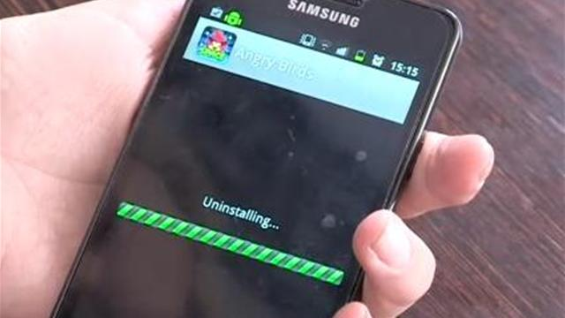

Slide 9
Ridiculously fast/Low latency
Data structure storage
Open source and easy to use
Replication and persistence
Support for your favorite development language
Auto expire
Transactions and Event queue/PubSub
Lua scripting

Slide 10

When redis?

Slide 11
Page Caching / Session caching / Cookie Storage / Search Engine
Counter / Analytics / Fraud Detection
Data that expires / Leaderboards
Ad targeting
Messaging
High I/O workload
Geo searches
Configuration management

Slide 12
Data Types:
Strings — a sequence of binary safe bytes up to 512 MB
Hashes — a collection of key value pairs
Lists — an in-insertion-order collection of strings
Sets — a collection of unique strings with no ordering
Sorted sets — a collection of unique strings ordered by user defined scoring
Bitmaps
Hyperloglogs
Geospatial indexes with radius queries

Slide 13
Namespacing:
We can use “.” or “-” to make it easy
Ex.
Video.category.id.downloads
Video.category.id.likes
Video.category.id.comments
Image.category.id.downloads
User.id.userinfo
User.id.lastLogin

Slide 14
What is redis not good for
Neither SQL nor NoSQL
Need ACID Transaction
Every byte is precious
Single threading
Memory problem
6. Security

Slide 15

How to?

Slide 16
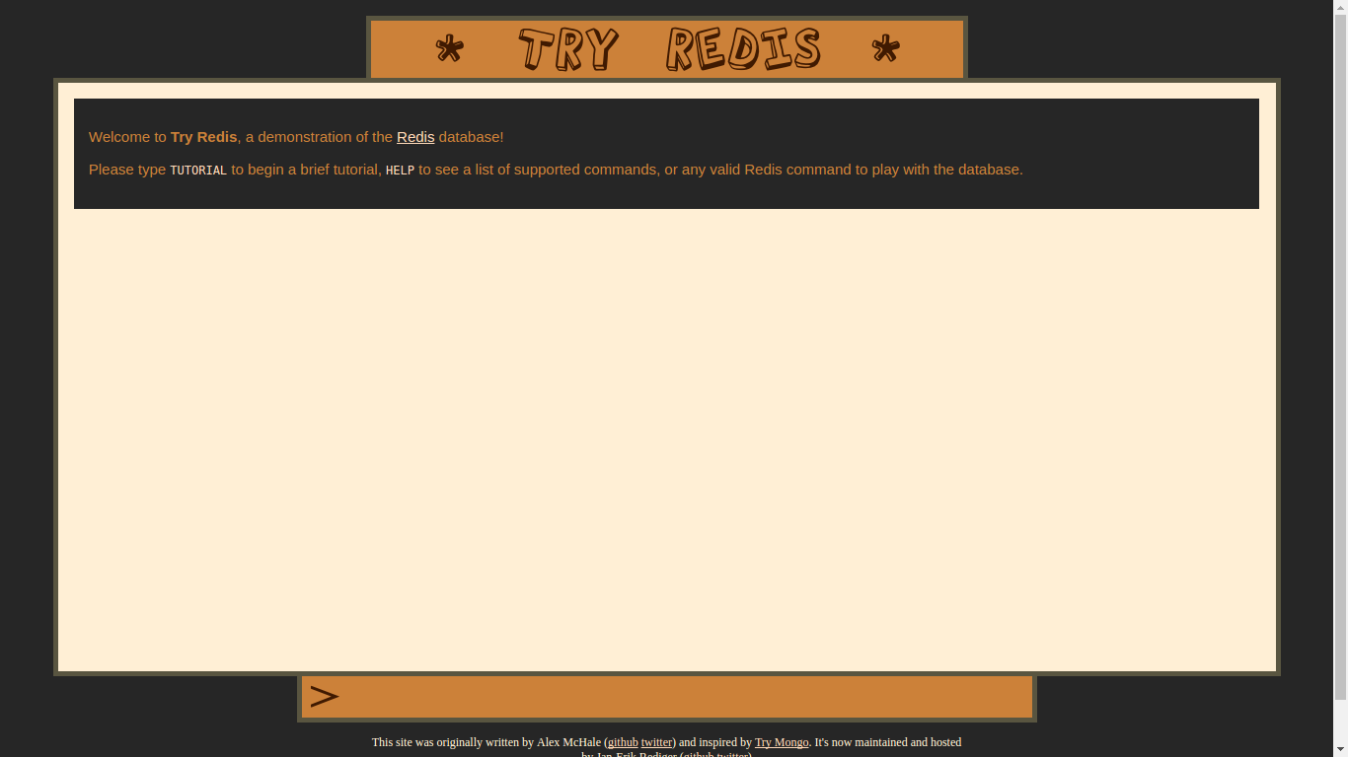
http://try.redis.io/
http://try.redis.io/

Slide 17
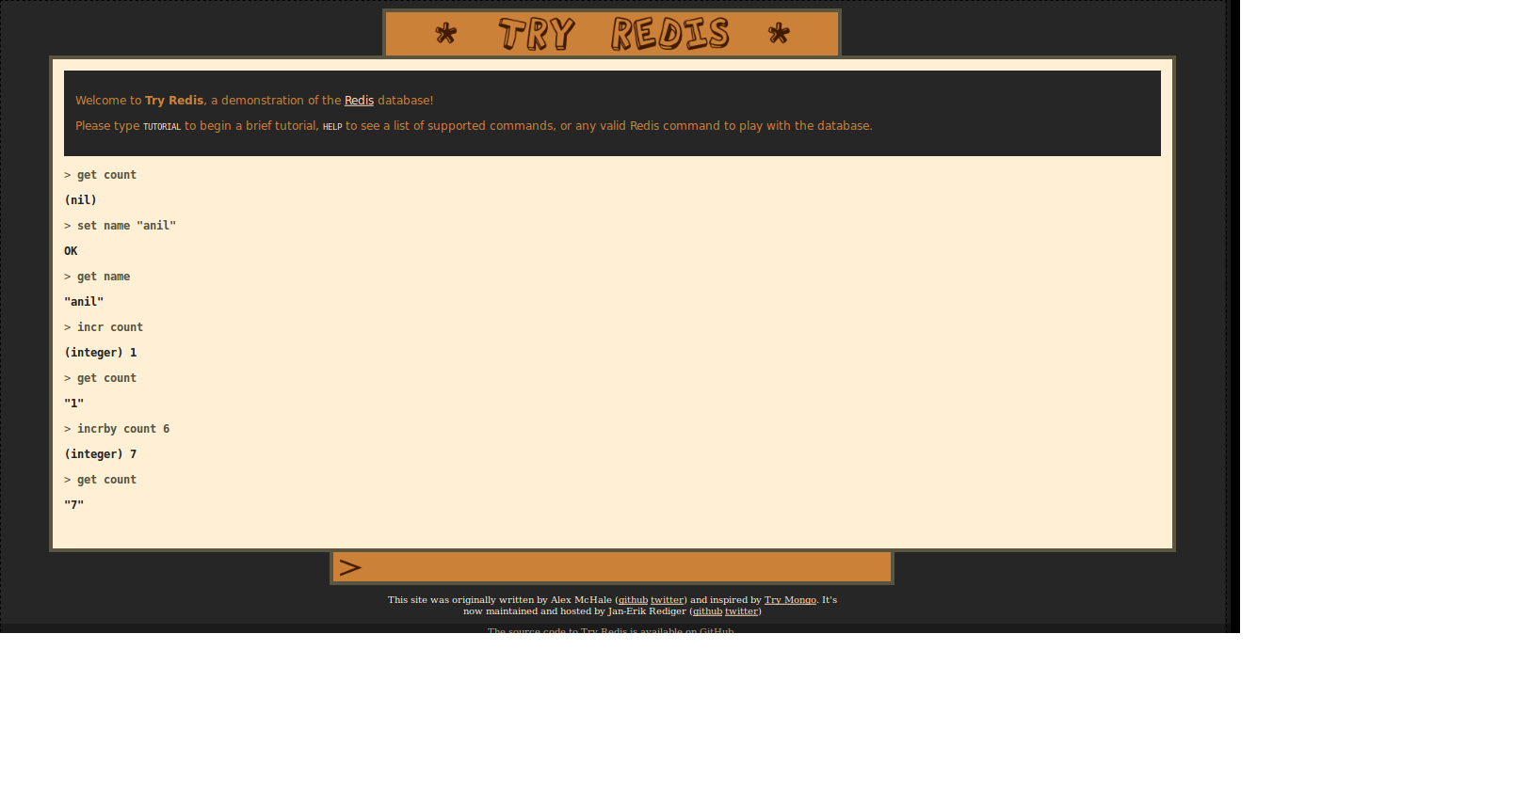

Slide 18
Thankyou
Ask question : goo.gl/slides/qqgryu
Tweet : @realAnilSharma with #Redis

