Slide 1


My final report
Internship in the University of Malta
From : 27th August to 27th November
Thessalène JEAN-LOUIS

Slide 2

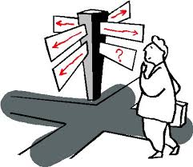
Summary
Description of the project
My realisations
Review of my missions

Slide 3
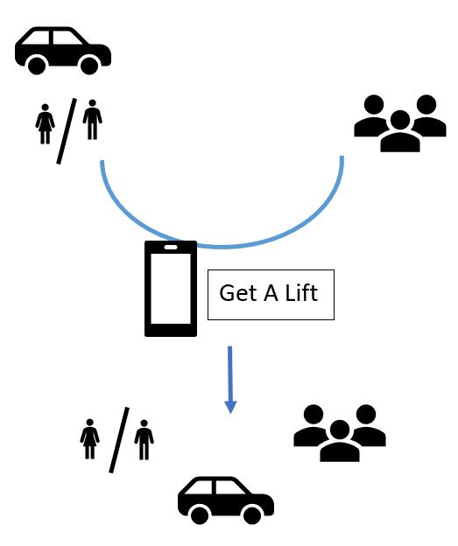

Description of the project

Slide 4
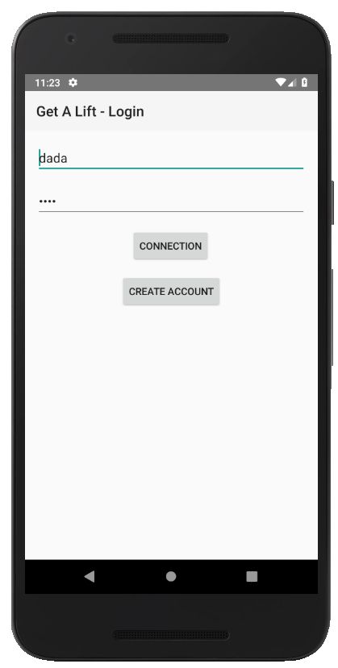
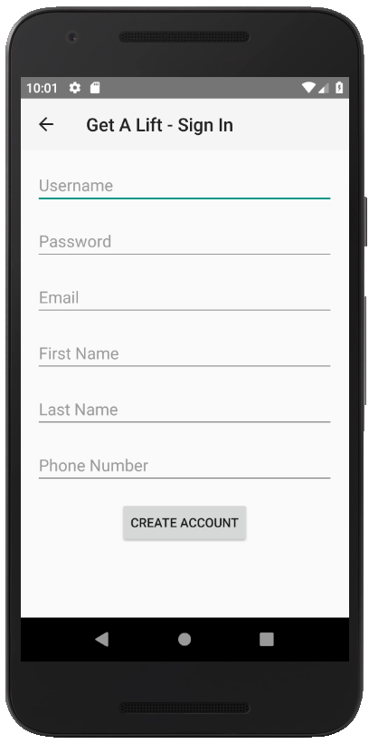
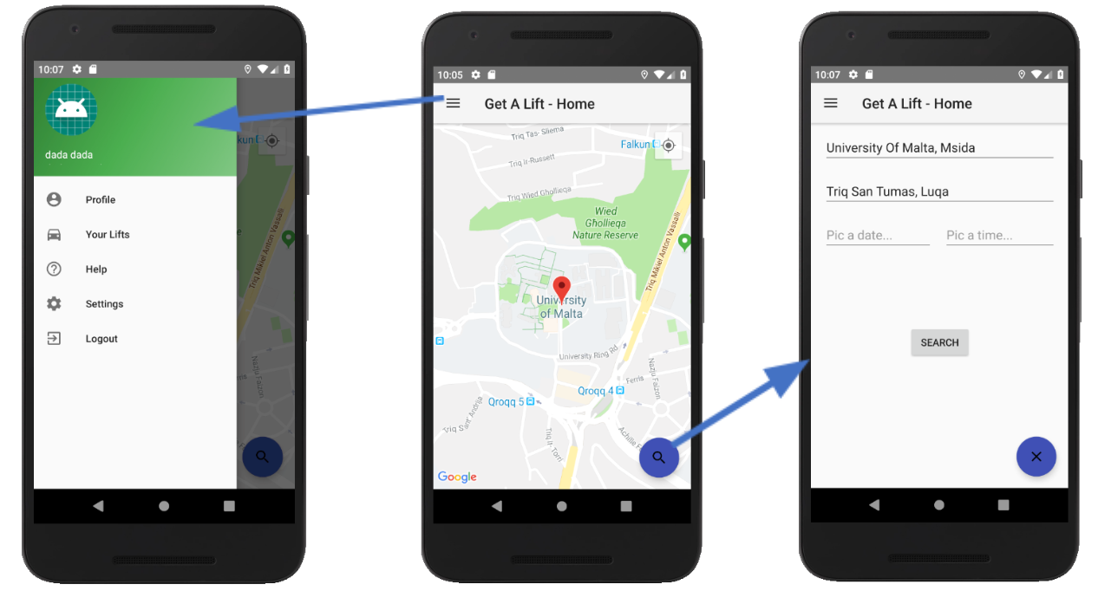
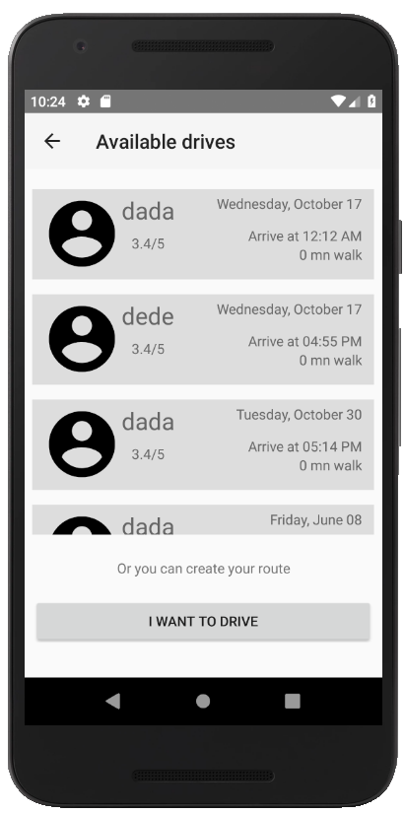
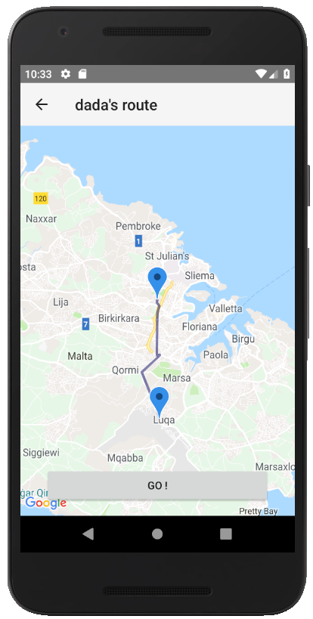
Description of the project

Slide 5

My realisations
Help page
Settings page
Google maps problem
View Activity pages and alerts
Create Ride Activity
Some improvements

Slide 6
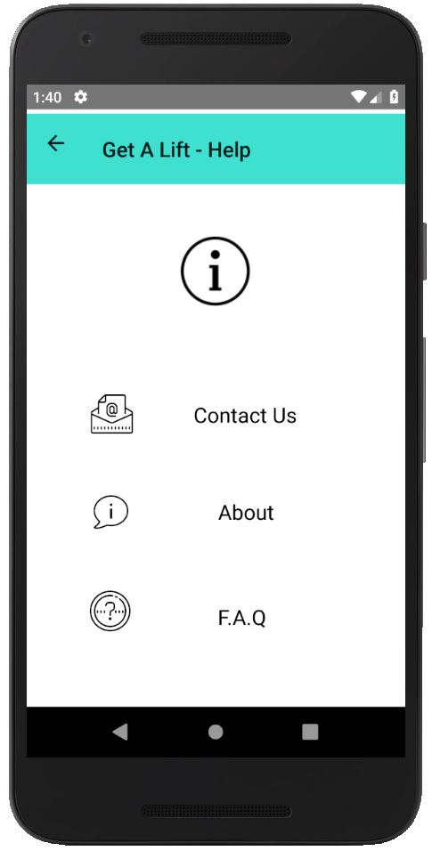
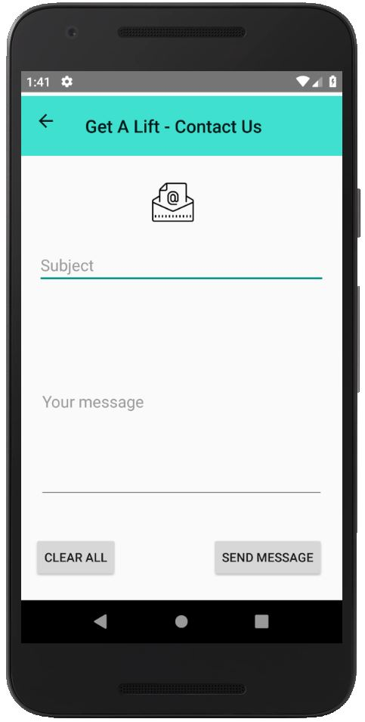
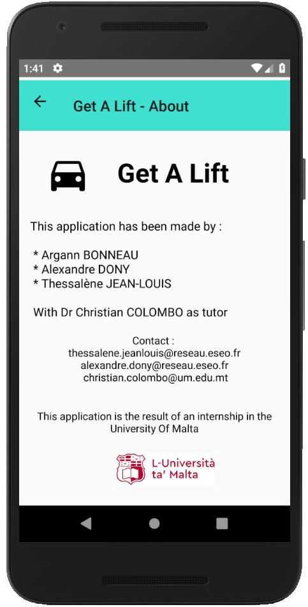
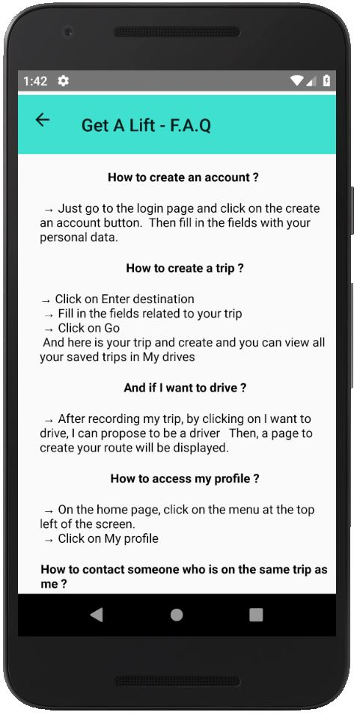
Help page

Slide 7
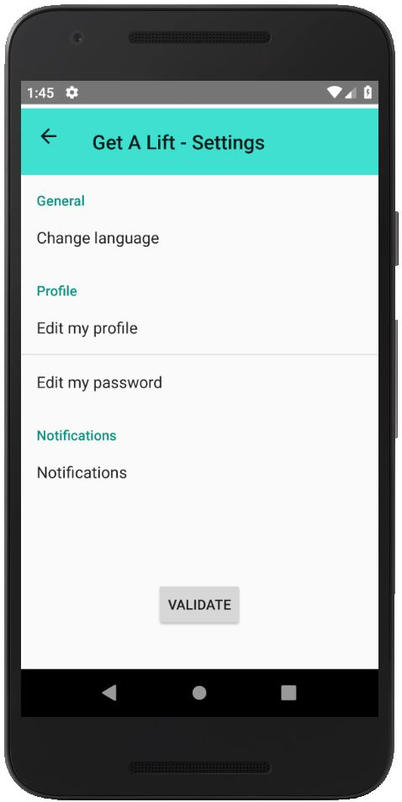
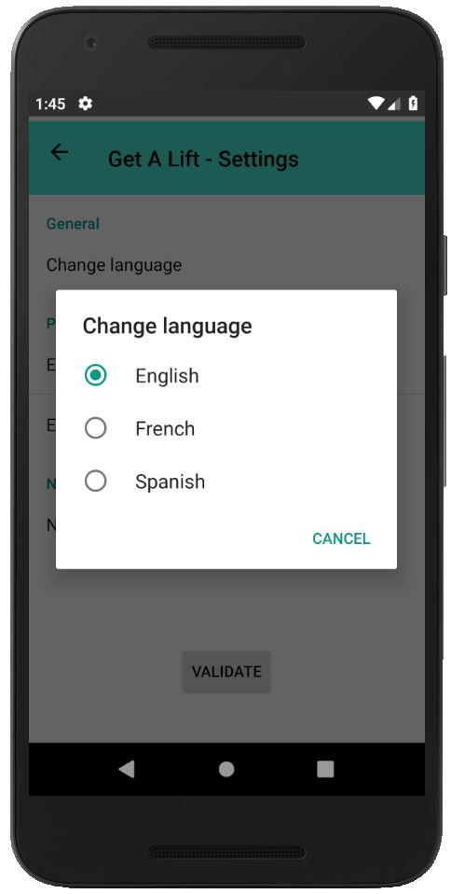
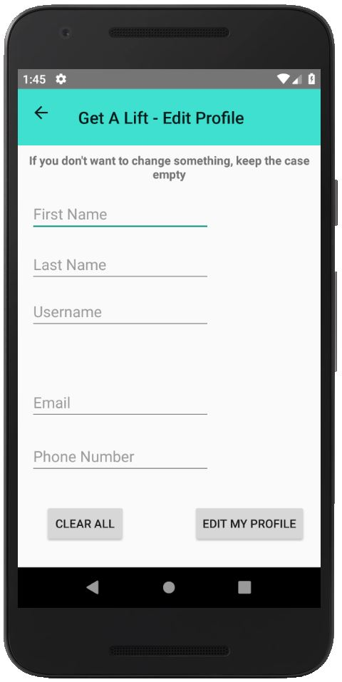
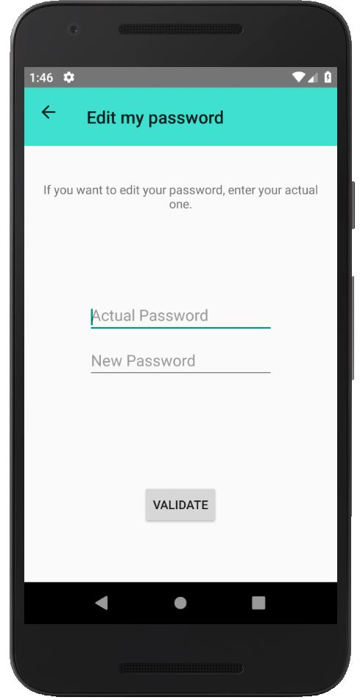
Settings page

Slide 8

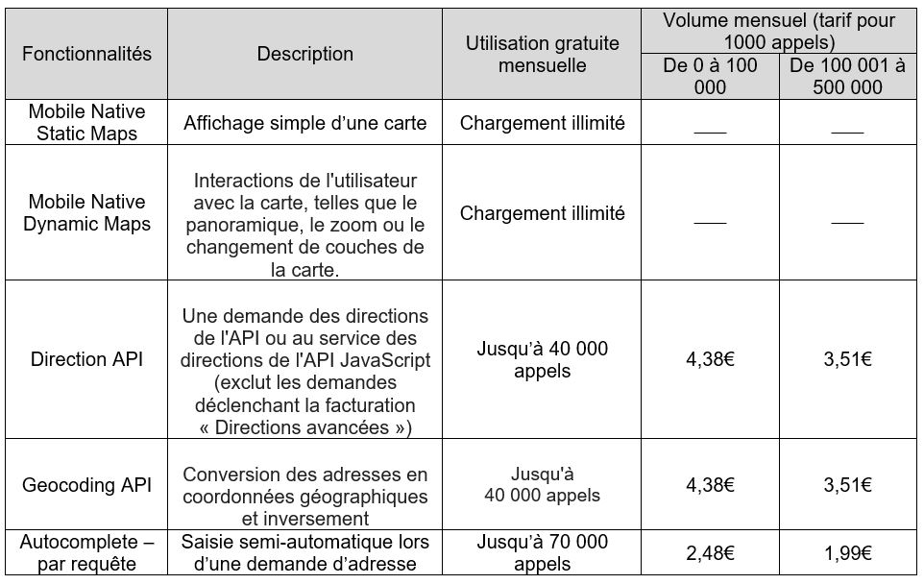

Google maps problem

Slide 9
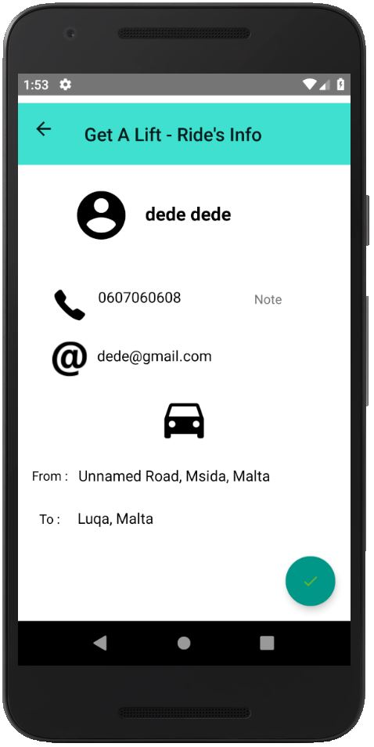
View Ride Info page
The user can contact the driver (by call or email) by clicking on the associated icons
After he can be added as passenger
Several constraints

Slide 10


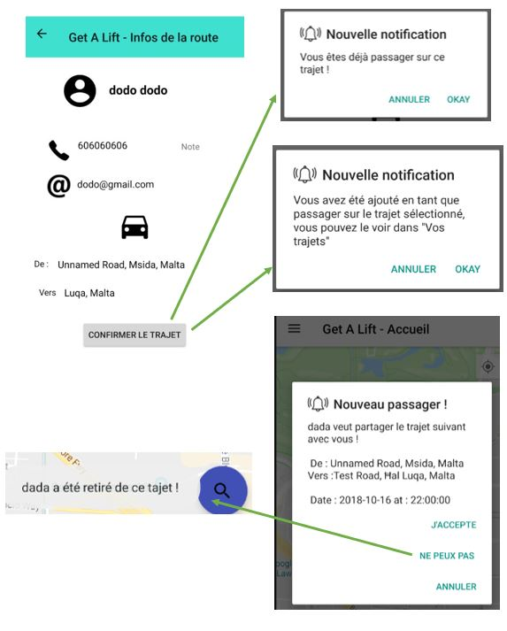
Be added as passenger
Already driver
You have been added as passenger
Alert the driver of the new passenger

Slide 11
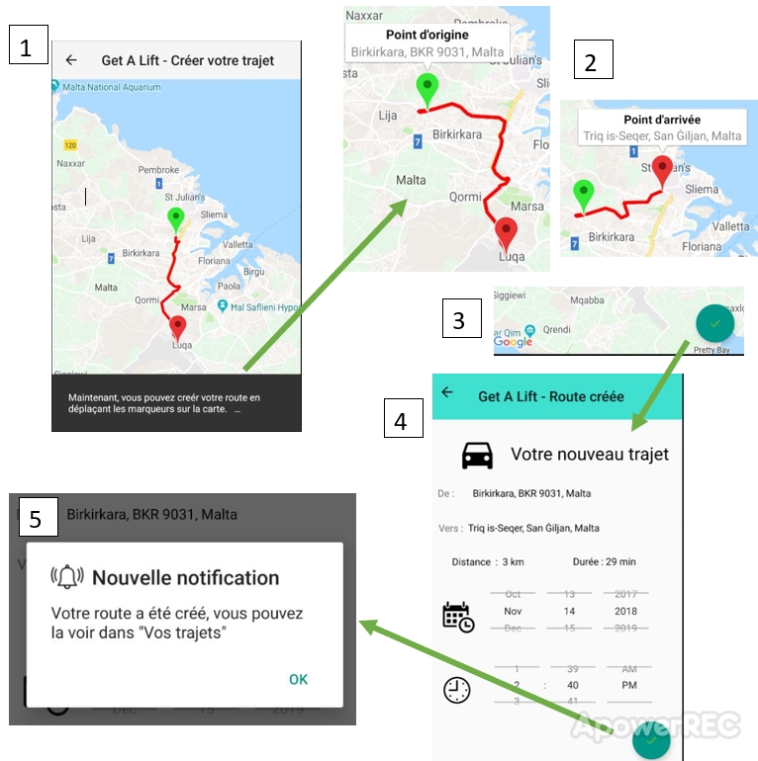
Create Ride Activity
Edit the ride by dragging the markers
Add the route to the database
Allow the user to edit the route after have been create one

Slide 12
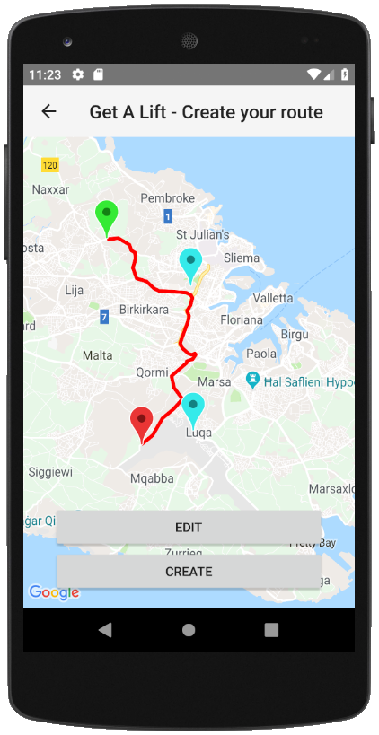
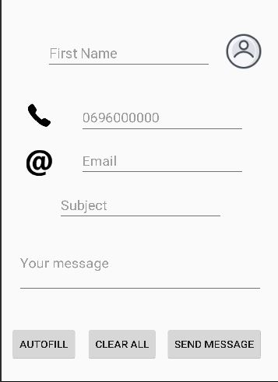
Some improvements

Slide 13
Possible improvements
Design to be more like the IOS version
Allow the user to create an account by Facebook or Gmail (as IOS)
Take in consideration the weekly recurrence
Alert the user when the driver says ‘no’ and display the number of person already passenger in the ride
Allow the user to suppress a ride if he won’t make it (driver list)
Implement real notification (visible even outside the app)

Slide 14


Thanks for your attention

