Slide 1
Vitis DSP Library
石思宇
邱崇喆

Slide 2
Overview
Consists of two library:
PL library:
consists of L1 PL primitives, L2 PL kernels, while L3 is not provided
L1 are implemented as HLS C++ modules
L2 are presented as OpenCL kernels and host programs
provides a fully synthesizable PL based Super Sample data Rate (SSR)1D-FFT, as well as a 2D version
AI Engine library: (targeting Versal® Adaptive Computing Acceleration Platform (ACAP))
consists of various implementations for DSP algorithms, such as FFT, DDS, GEMM and FIR
L1 AIE kernels
L2 AIE graphs, host programs

Slide 3
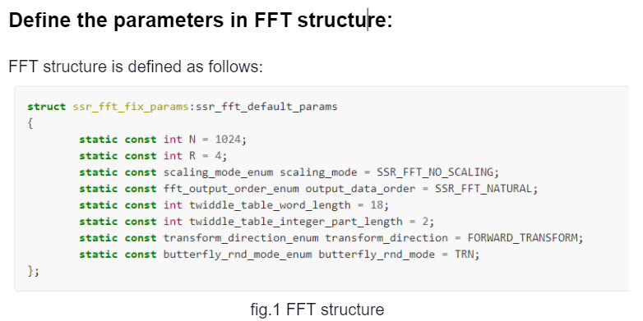

Slide 4
N is the size of transform
R is the number of samples to be processed in parallel SSR Factor and radix of FFT algorithm used
scaling_mode: The scaling mode as enumeration type (SSR FFT has three different scaling modes)
output_data_order: Which will decide if data will be in natural order or digit reversed transposed order
twiddle_table_word_length: Defines total number of bits to be used for storing twiddle table factors
twiddle_table_integer_part_length: The number of integer bits used for storing integer part of twiddles
transform_direction : Defines the direction of transform, inverse transform (SSR IFFT) or forward transform (SSR FFT)
butterfly_rnd_mode : Defines the rounding mode used by butterflies in SSR FFT stages

Slide 5
Scaling mode
“The 1-D SSR FFT computation is done in stages with one stage feeding the next stage, so essentially it is a pipeline of stages. One of the downfalls of uncontrolled bit growth is that at some point, in a certain stage when output widths of one stage increase beyond a limit where multiplication operation cannot map to DSP blocks on the FPGA, the design performance in terms of speed may fall considerably” — from https://xilinx.github.io/Vitis_Libraries/dsp/2022.1/user_guide/L1.html
Three modes are supported to manage bit growth between SSR FFT stages:
SSR_FFT_NO_SCALE
No scaling but the output bit can grow beyond 27 bits
The multiplication may not map to only DSPs, but use FPGA fabric logic when output bit grow beyond 27 bits
Best precision but more resources utilization and clock cycles
SSR_FFT_GROW_TO_MAX_WIDTH
The output bit width grows until 27 bits for mapping operations onto DSPs
When the bit width grows beyond what can be mapped to DSP blocks, it will start scaling the output.
SSR_FFT_SCALE
This scales the output in every stage by right shifting the output by log2 (SSR=R) in every stage
The output will not grow beyond 27 bits so that multiplication can be mapped to DSPs
precision
speed

Slide 6
sin/cos table (twiddle factors/complex exponential) setup
By default, it is set to use 18 bits with 2 bits reserved for the signed integer part, which ensures that during operations, twiddle/sin/cos inputs are mapped to the 18-bit input of the DSP block.
We can set the number greater than 18 bits, but this may incur FPGA fabric usage.

Slide 7
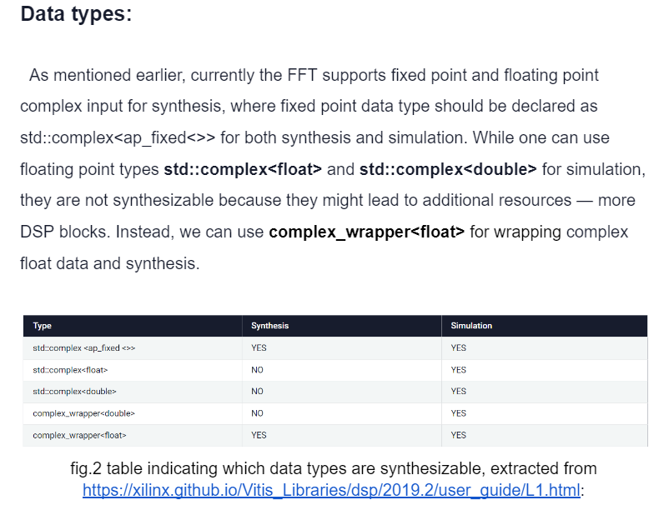
FFT supports fixed point and floating point complex input for synthesis and simulation:
Fixed point: declared as std::complex<ap_fixed<WL, IL>> for both synthesis and simulation. (WL = IL + FL)
Floating point: std::complex<float> and std::complex<double> are only for simulation, but not synthesizable now. Instead, use complex_wrapper<float> for wrapping complex float data for synthesis and simulation.
Notes:
Limiting the data bit width to 27 bits (integer + fraction) will help mapping it onto a single DSP block

Slide 8
Implementation flow
choose datatype
setup the FFT structure
Scaling mode
twiddle table word length
verify results (with Matlab for example)
If the RMS is acceptable, try other FFT structures for better resources utilization (while the RMS is still acceptable)

Slide 9
1D fixed point FFT with impulse test data

Slide 10
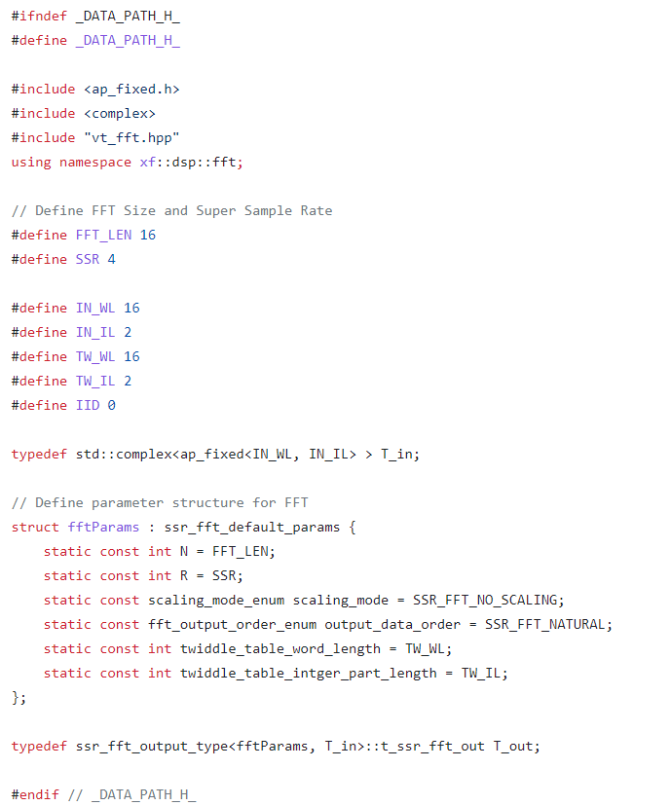

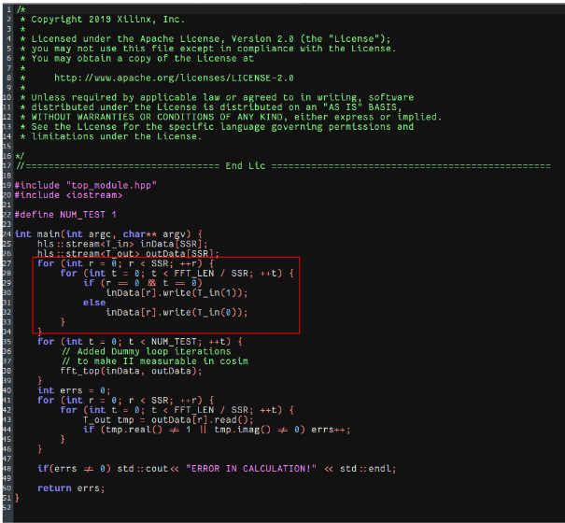
Top function and FFT function call
Test program with impulse input:
input datatype
FFT structure definition
output datatype

Slide 11
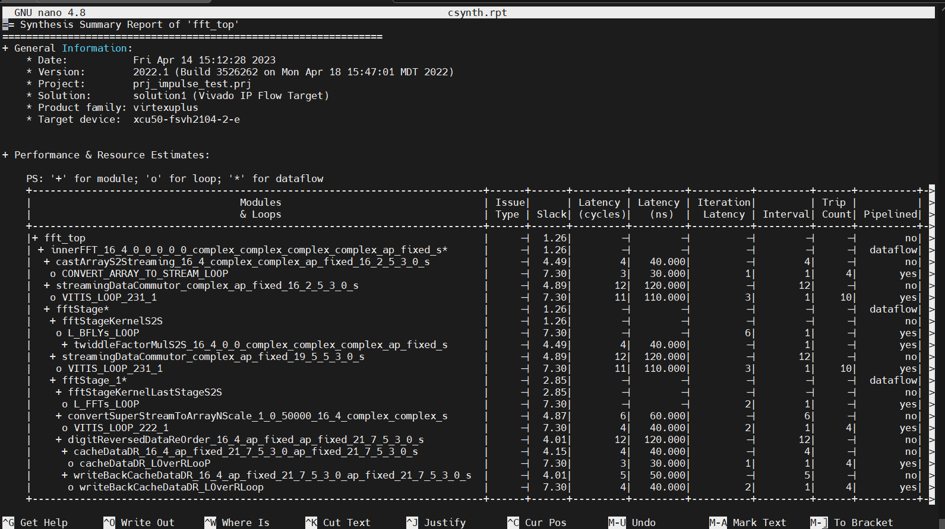
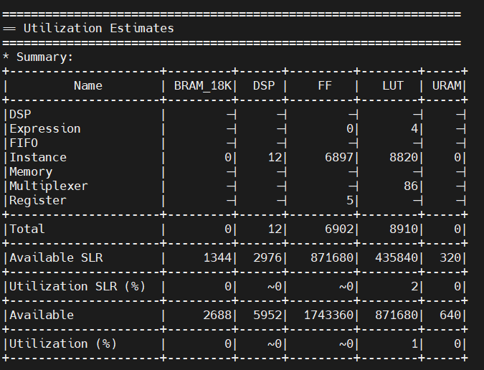
synthesis

Slide 12
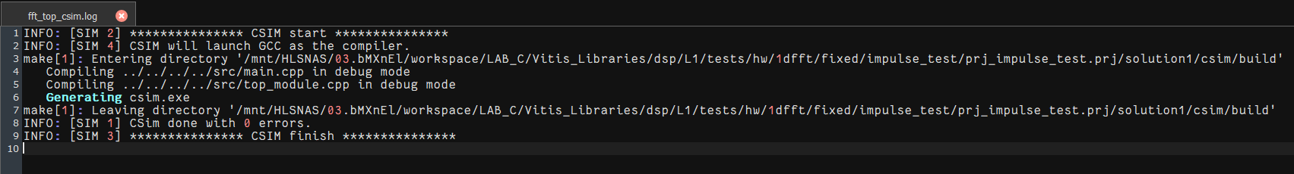
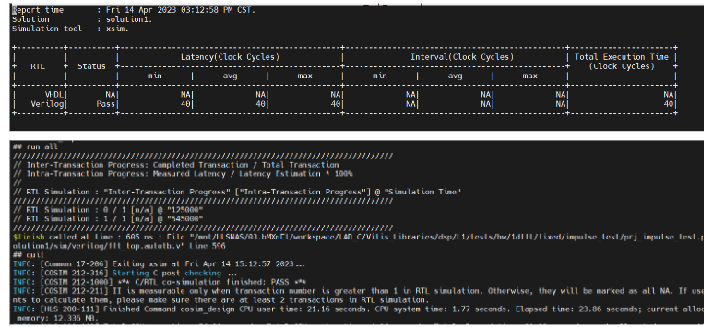
csim and cosim

Slide 13
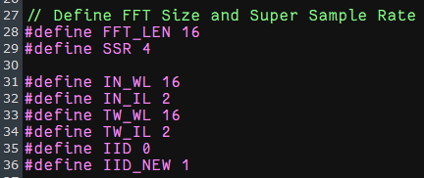
Multi-instance support
use different template parameter IID for instantiating more FFT kernels

Slide 14
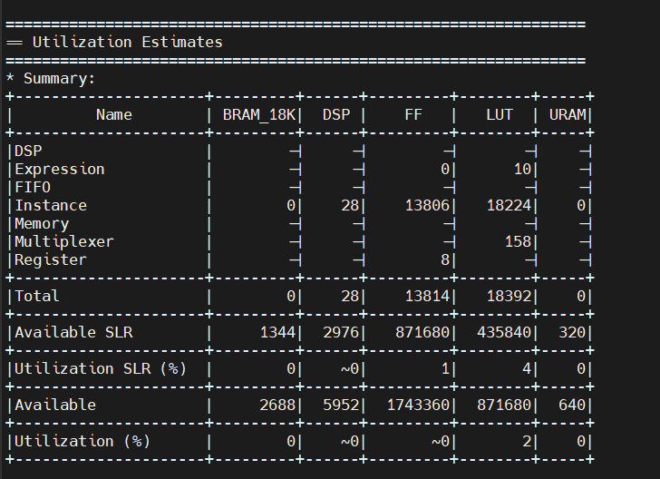
synthesis result of Multi-instance
utilization is about twice as much as that of single instance case

Slide 15
1D float point FFT with test data

Slide 16
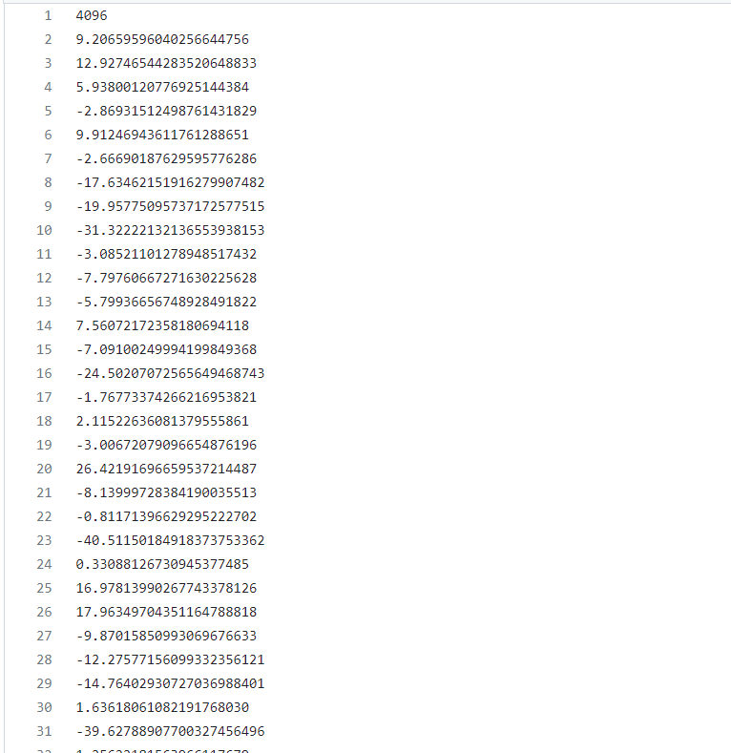
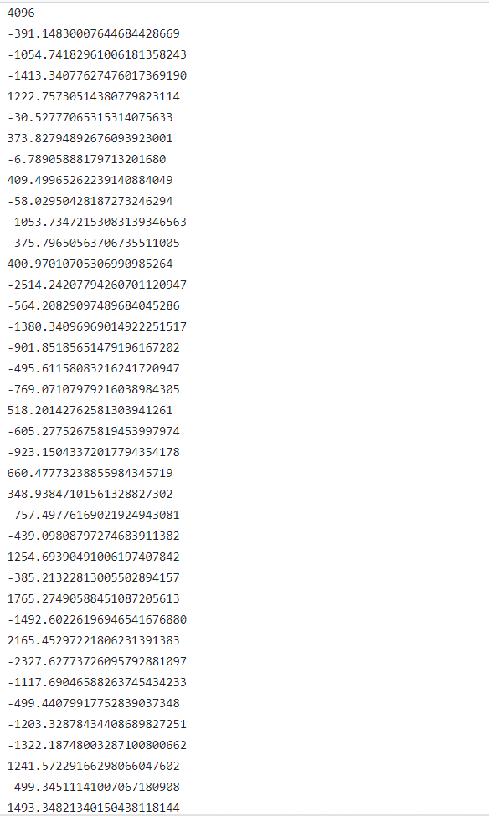
test data and verification data
test file: fftStimulusIn_L4096.verif output verification file: fftGoldenOut_L4096.verif

Slide 17
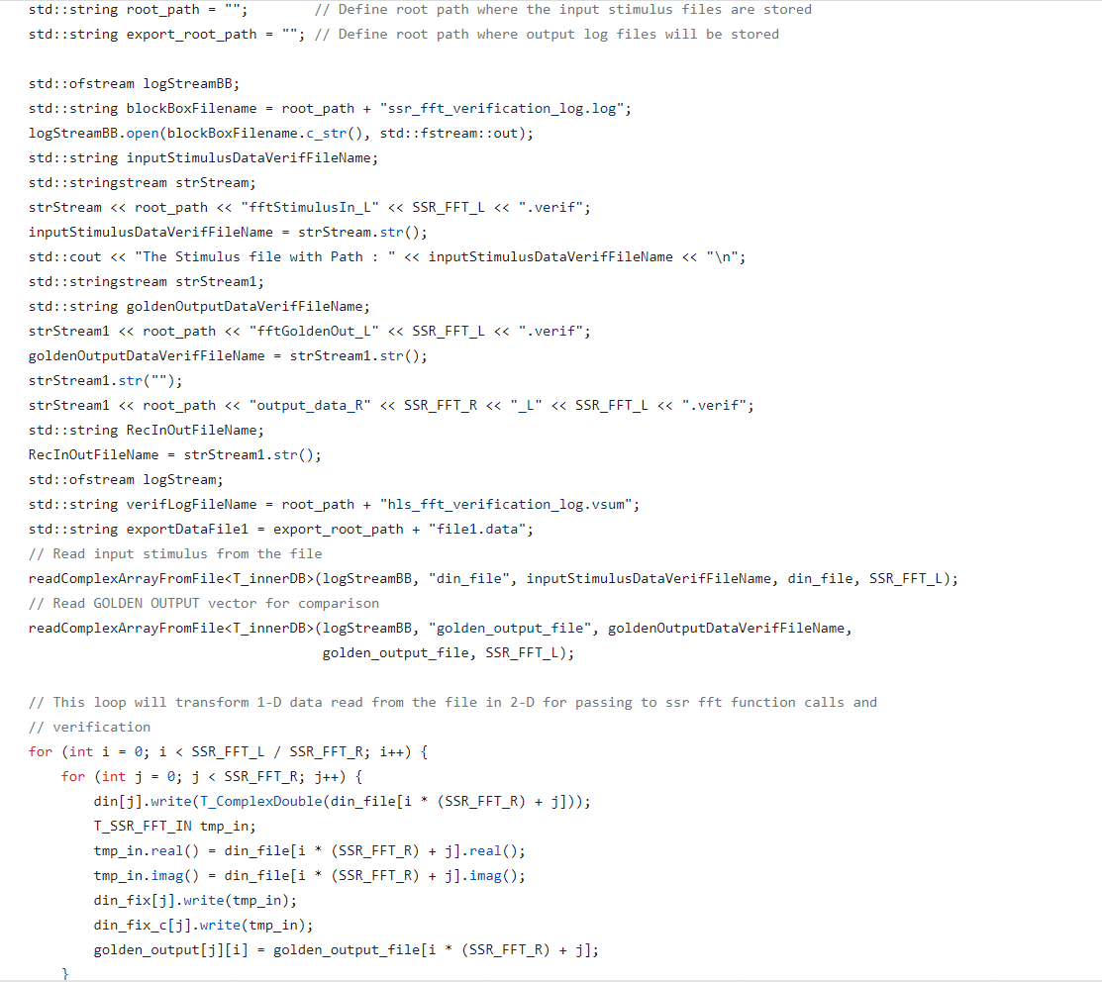
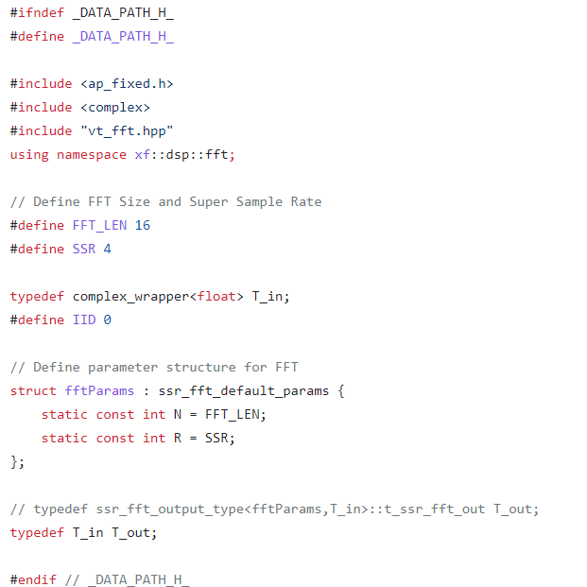

Slide 18
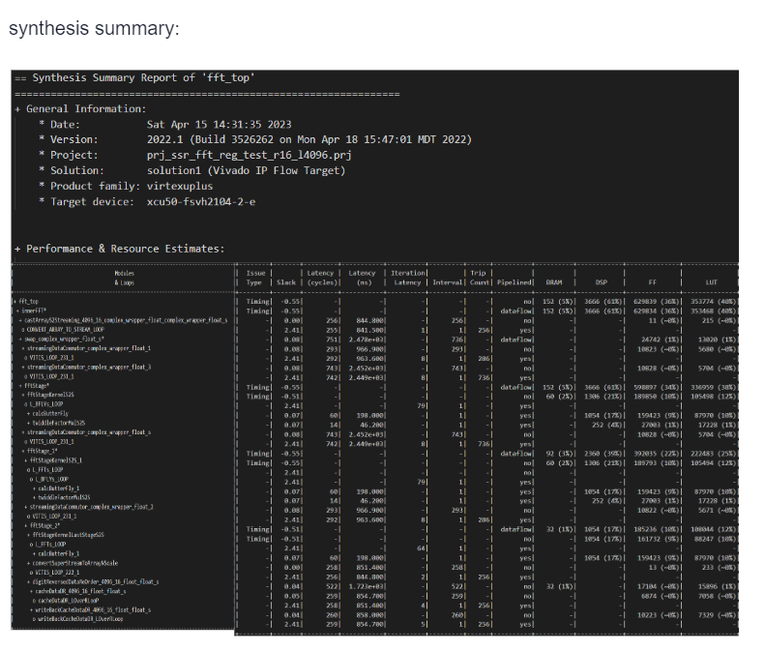

Slide 19
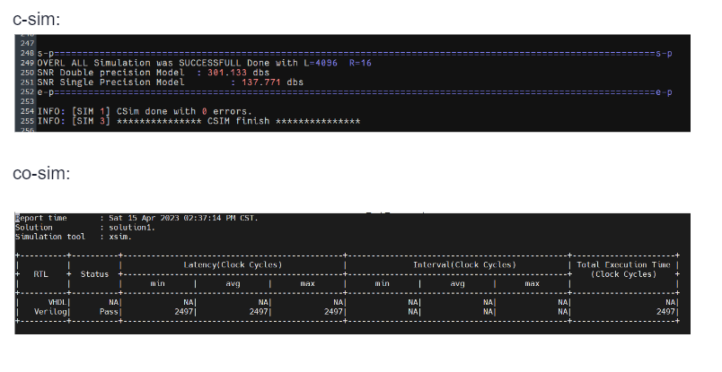

Slide 20
2D-FFT

Slide 21
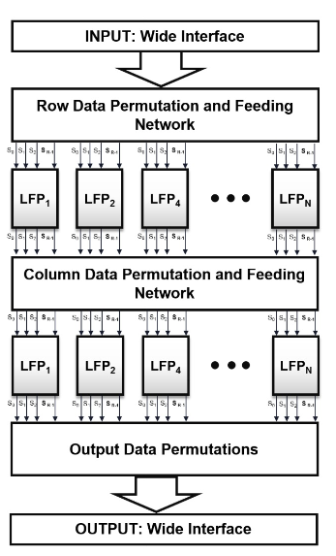
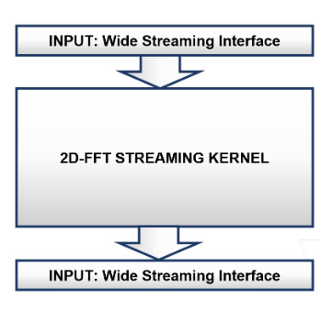
We can implement 2D-FFT by deploying multiple 1D-FFT processors (structures) in parallel, however, 2-D SSR FFT throughput can also be increased by using a task level pipeline.
That is, one set of 1-D SSR FFT processors works row wise on 2-D input data and another set of works column wise in a task level pipeline on data produced by row processors as shown in the figure below.
The row processors perform 1-D SSR FFT row by row and column processors perform transforms on columns. Row processors connect to column processors through a matrix transposer.
Block level interface, array of stream interface at the input and the output, from https://xilinx.github.io/Vitis_Libraries/dsp/2022.1/user_guide/L1_2dfft.html
2D-FFT architecture, from https://xilinx.github.io/Vitis_Libraries/dsp/2022.1/user_guide/L1_2dfft.html

Slide 22
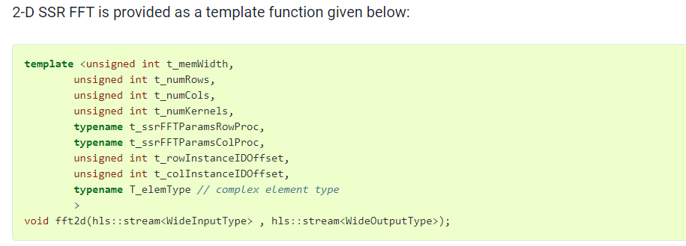
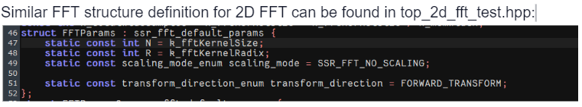
2D-FFT structure
extracted from https://xilinx.github.io/Vitis_Libraries/dsp/2022.1/user_guide/L1_2dfft.html

Slide 23
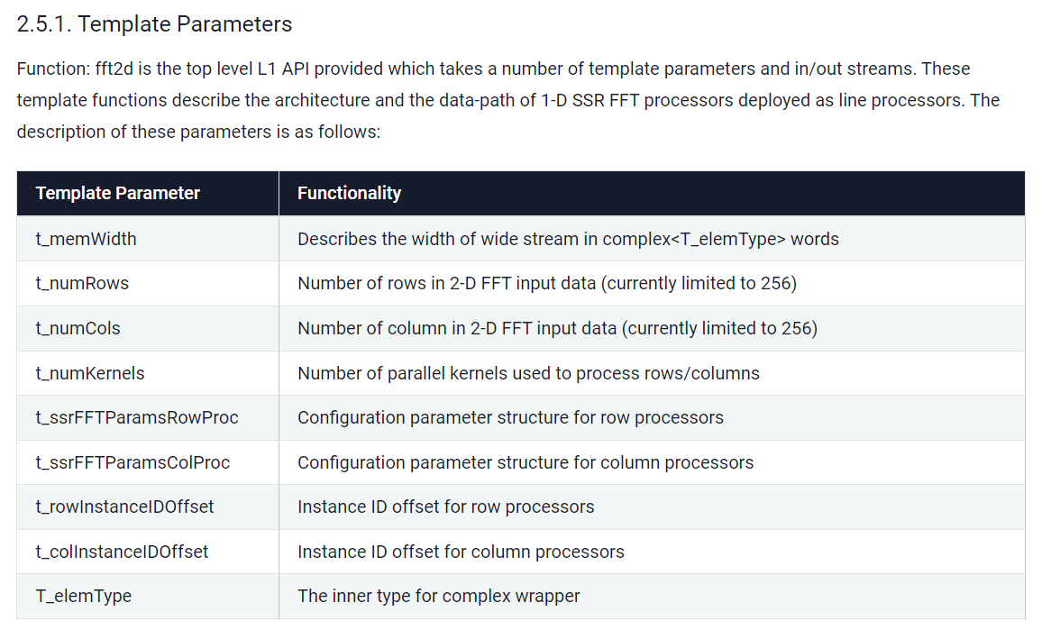
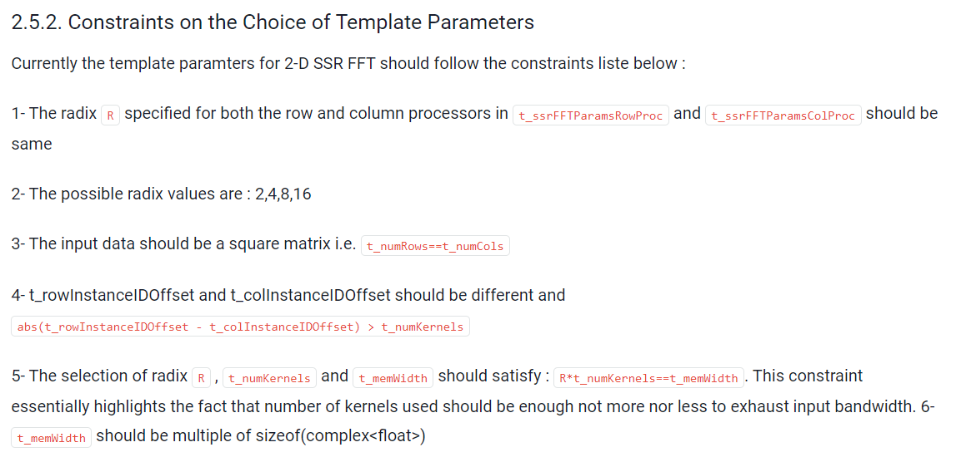
extracted from https://xilinx.github.io/Vitis_Libraries/dsp/2022.1/user_guide/L1_2dfft.html
Number of kernels used along rows and columns are same and equal t_numKernels

Slide 24
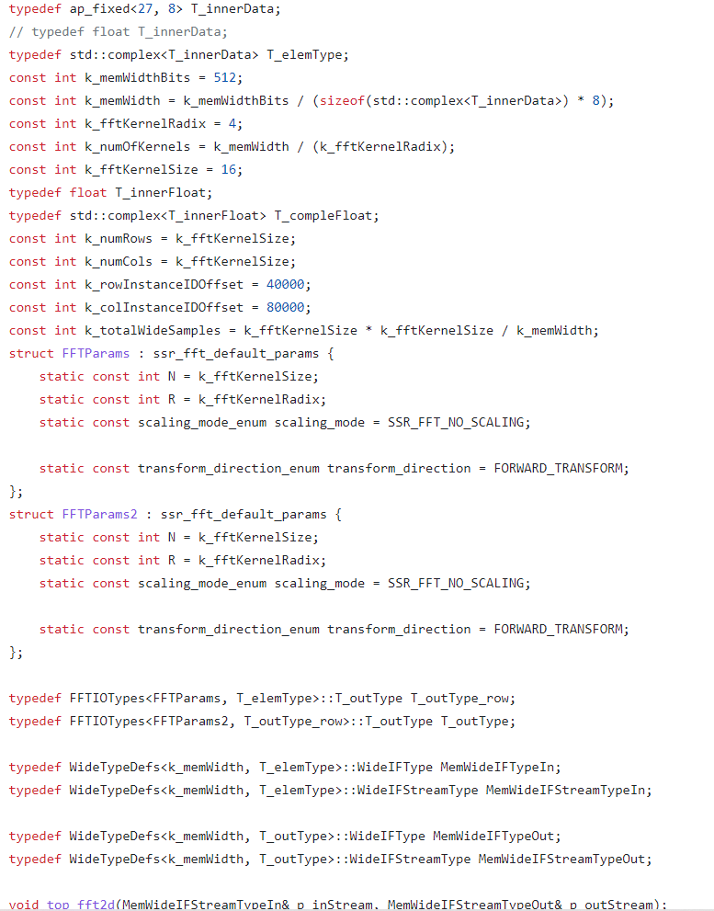
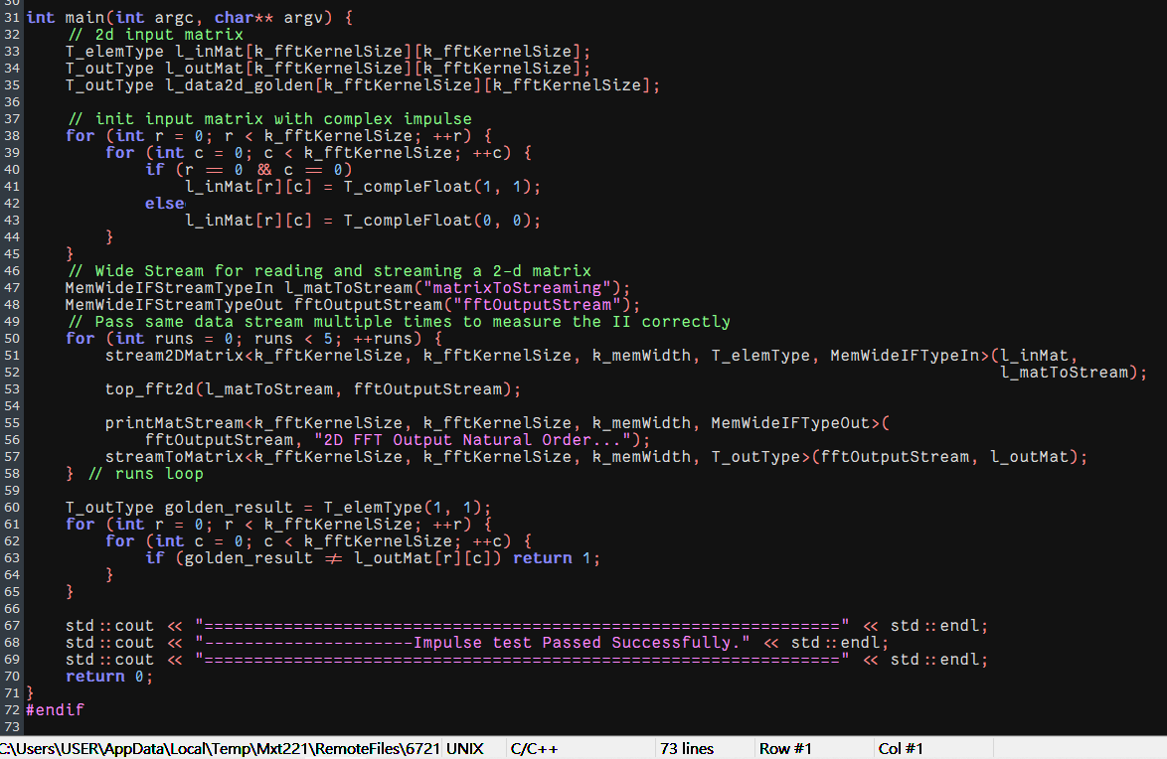
Template parameters definition
Test program generates impulse input data for 2D-FFT

Slide 25
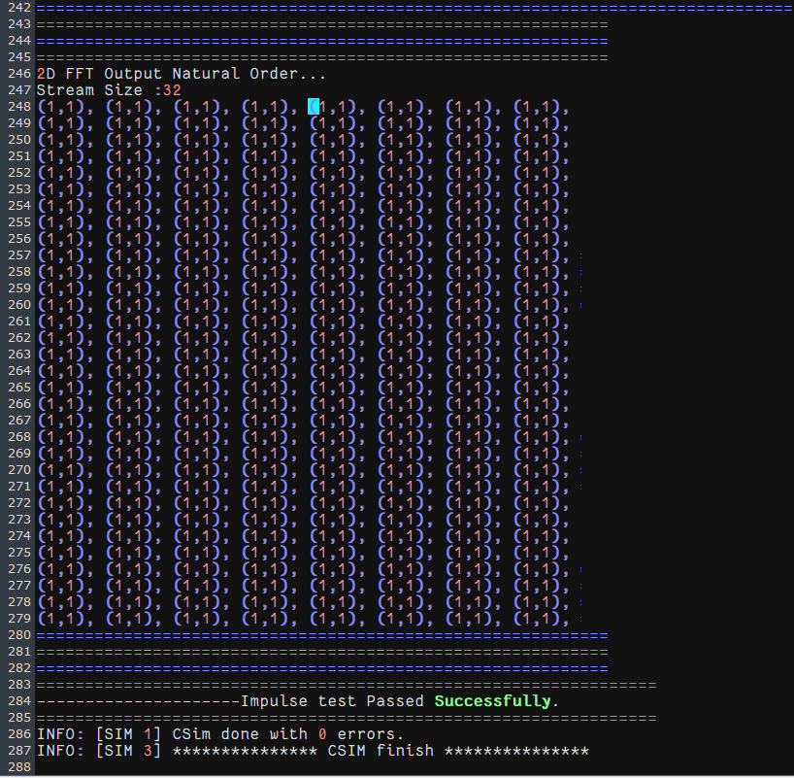
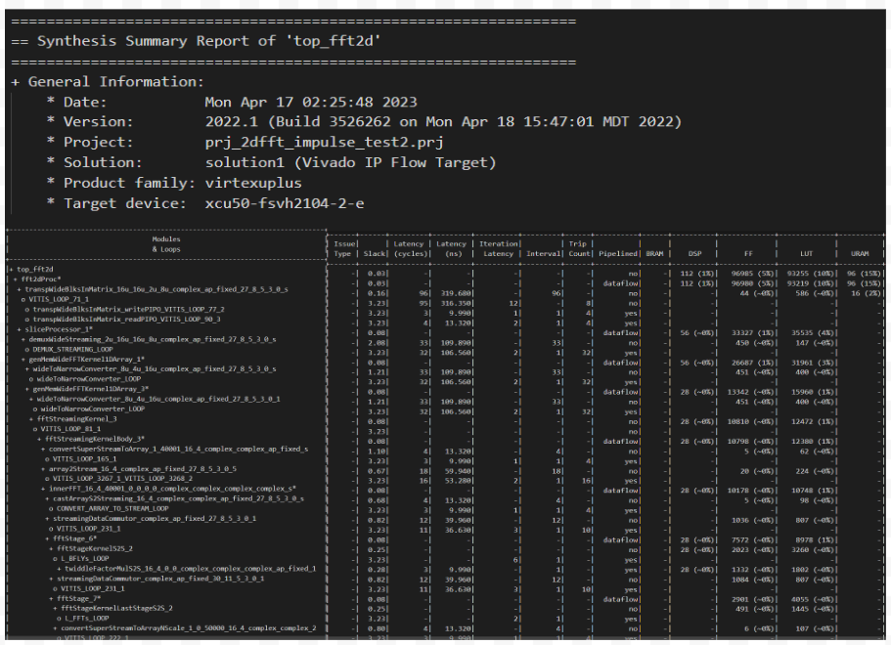
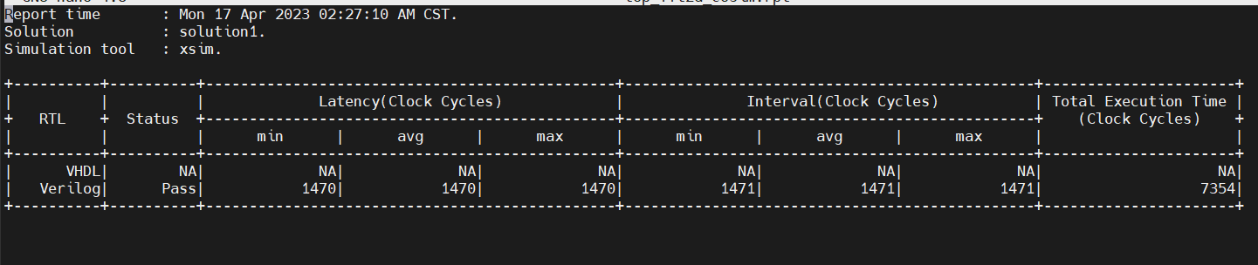
synthesis & csim & cosim

Slide 26
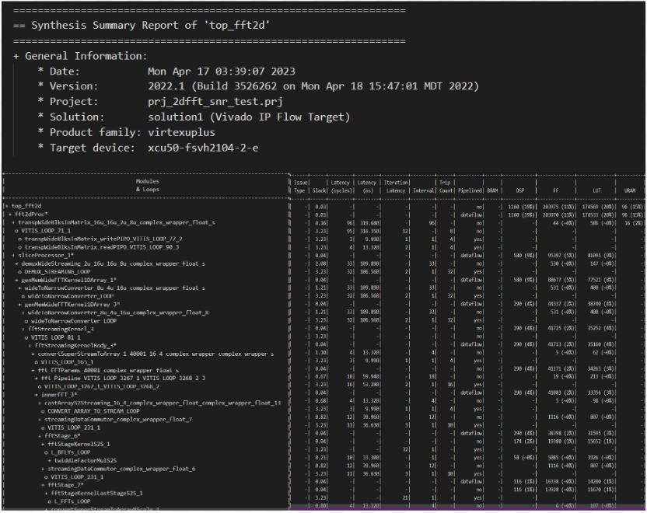
synthesis of 2D-FFT with floating datatype

Slide 27
L2 SSD FFT
Objectives:
Run SSD FFT Kernel on X86 host with Vitis
Run Software Emulation
Run Hardware Emulation
Run Hardware
Check run_summary.xrt file
Target board: xilinx_u50_gen3x16_xdma_5_202210_1

Slide 28
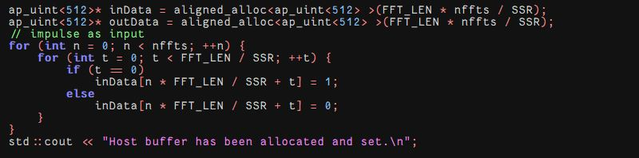
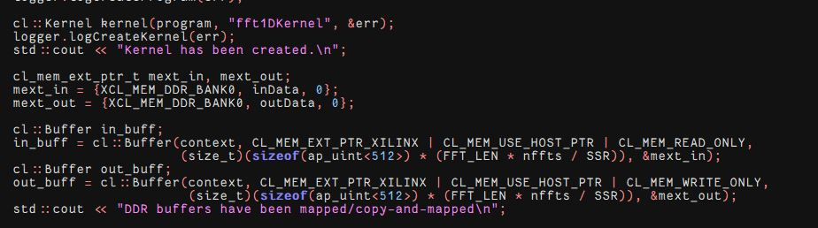
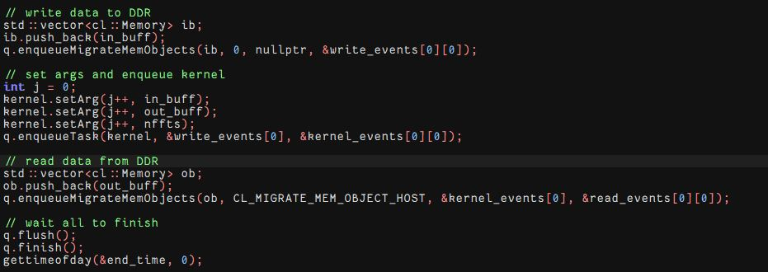
main.cpp code
declaration and initialization of memory locations
memory mapping between DDR and the host’s virtual memory
data transfer between the kernel and global memory

Slide 29
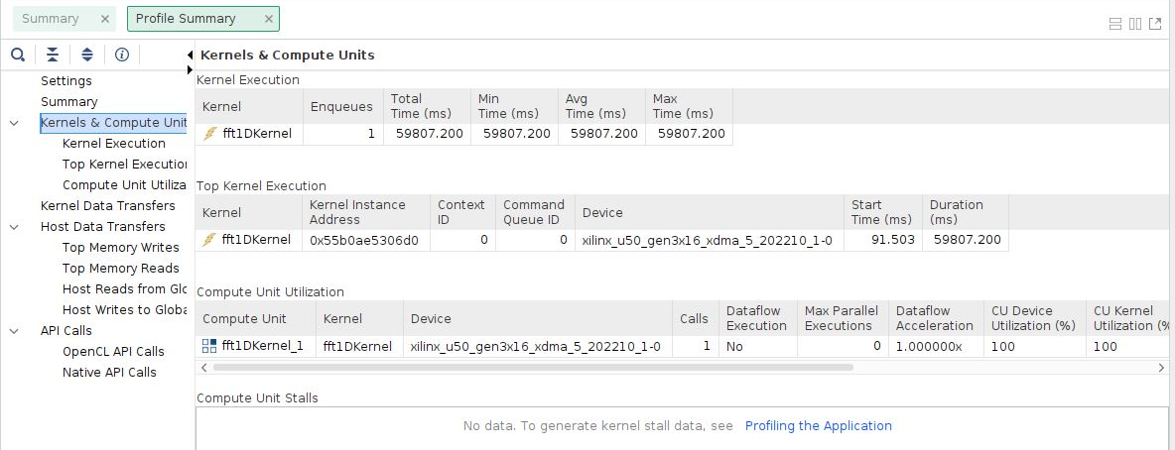
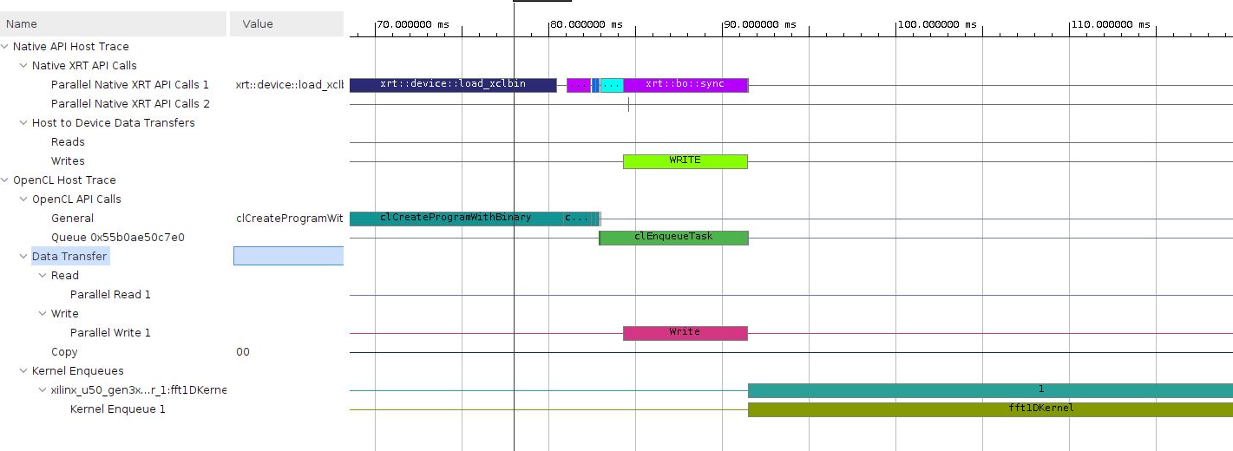
Software Emulation

Slide 30
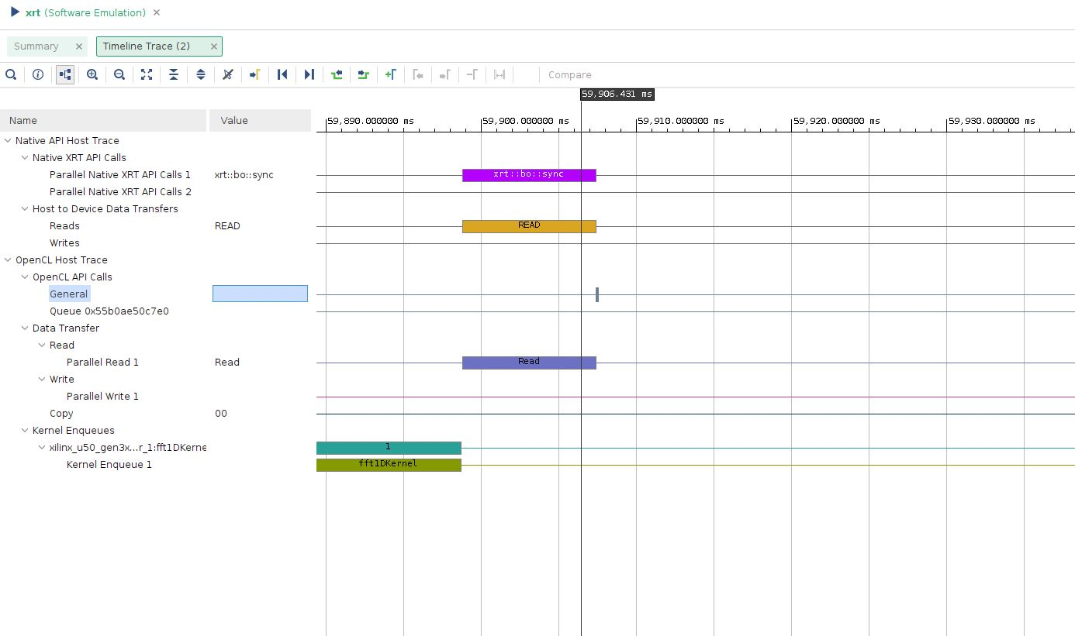

Slide 31
DSP AIE Library
Running an L2 AIE example fir_129t_sym
targeting VCK190 base platform

Slide 32
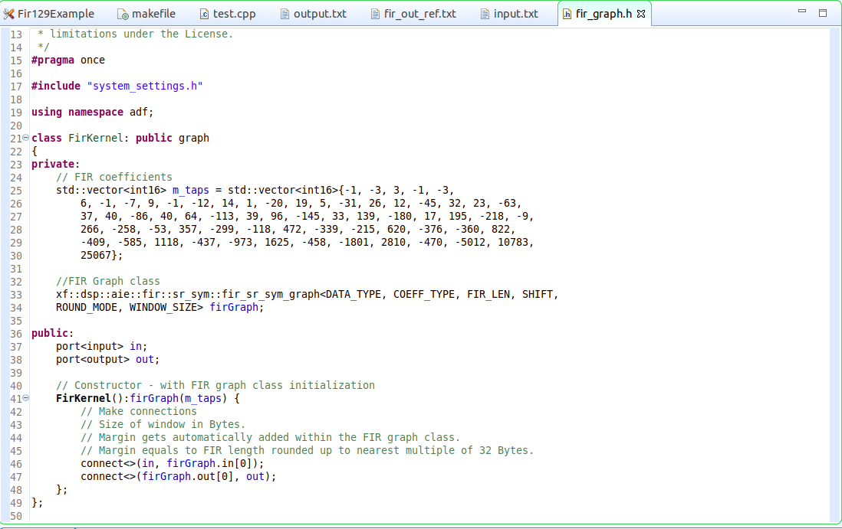
fir graph class

Slide 33
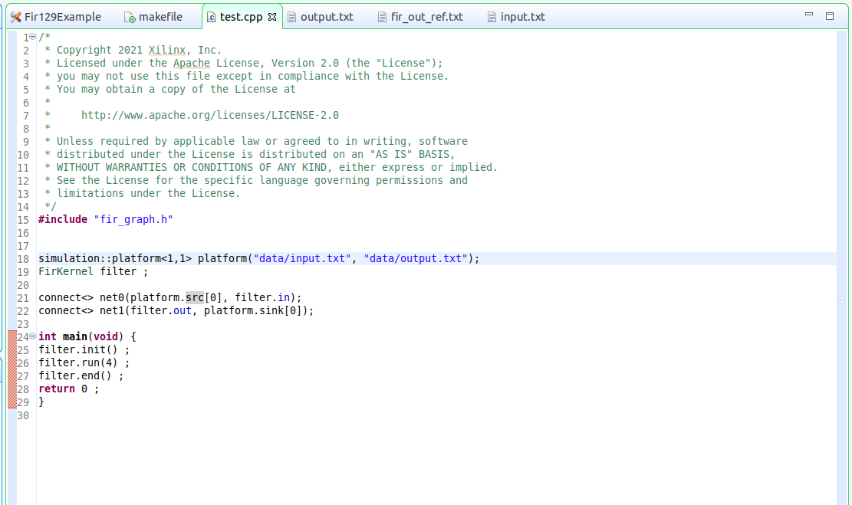
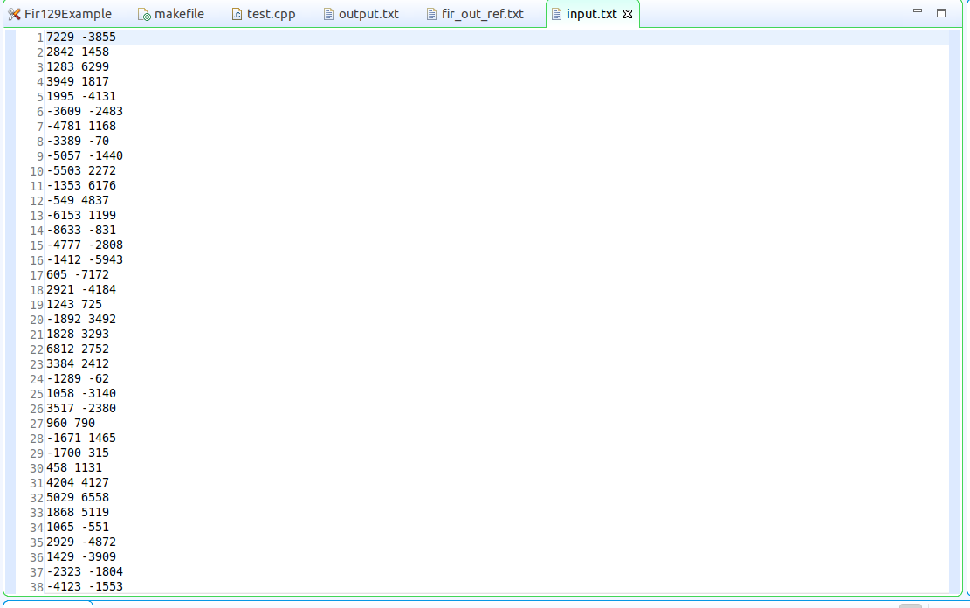
test program & test data

Slide 34
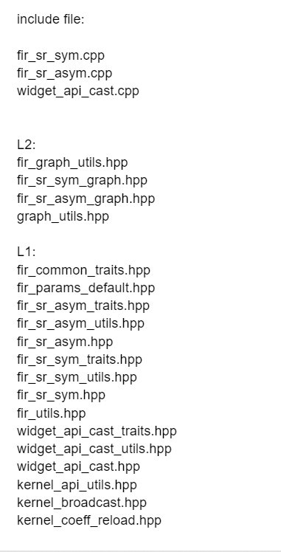
included files

Slide 35
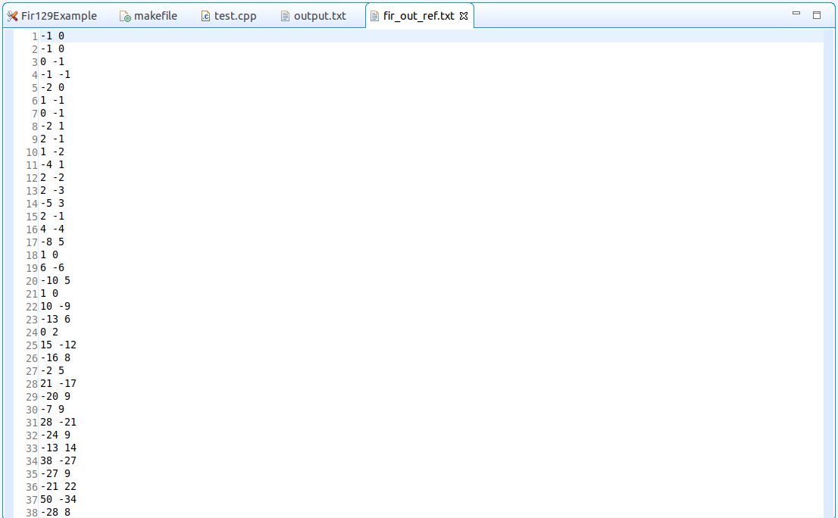
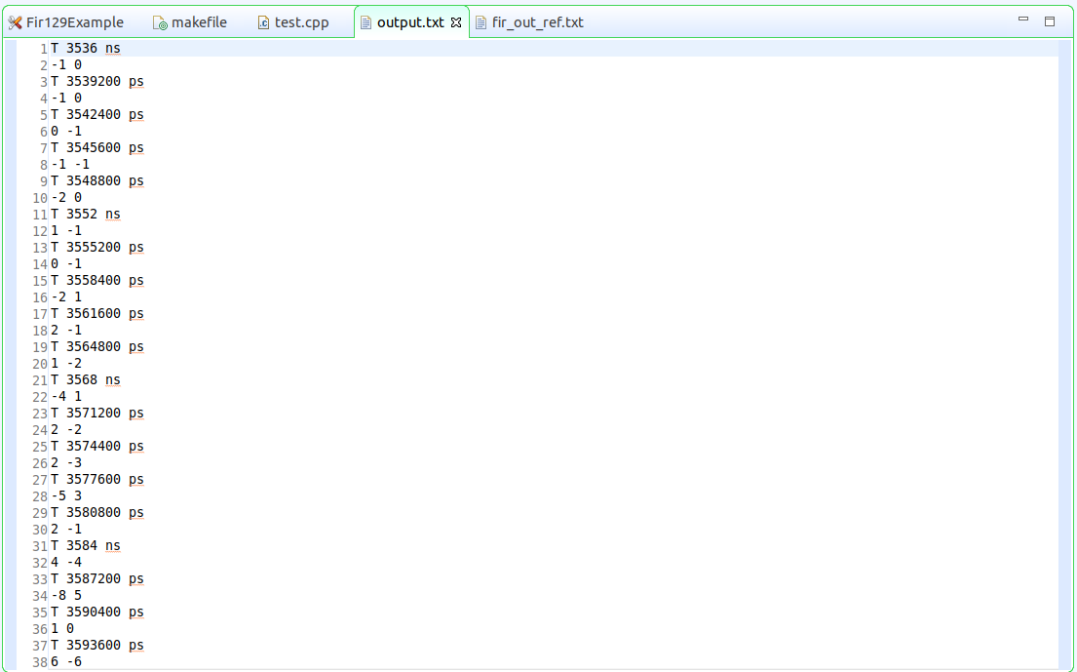
output comparison
reference output (left) v.s. generated output by AIE (right)

Slide 36
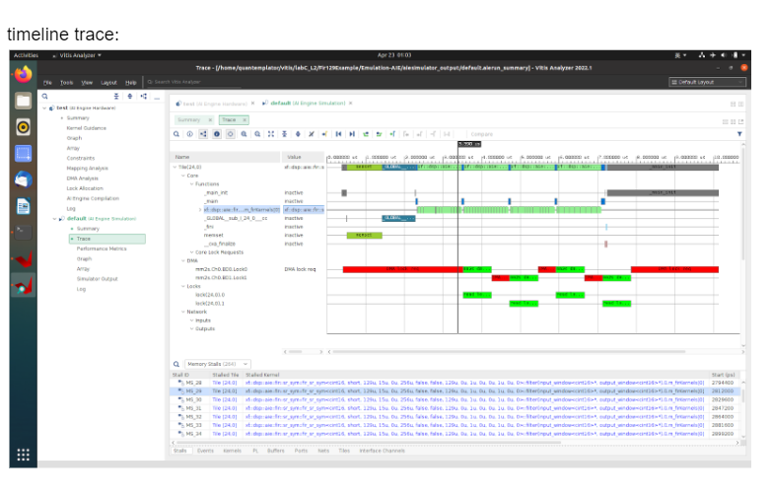

Slide 37
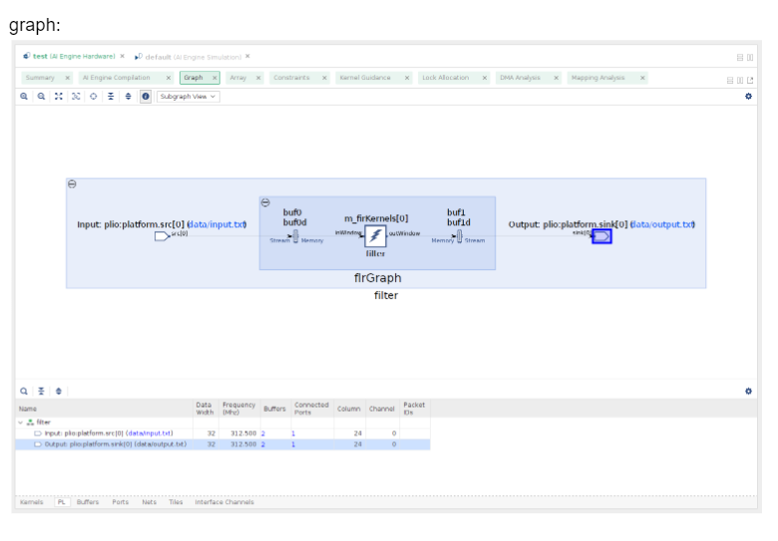

Slide 38
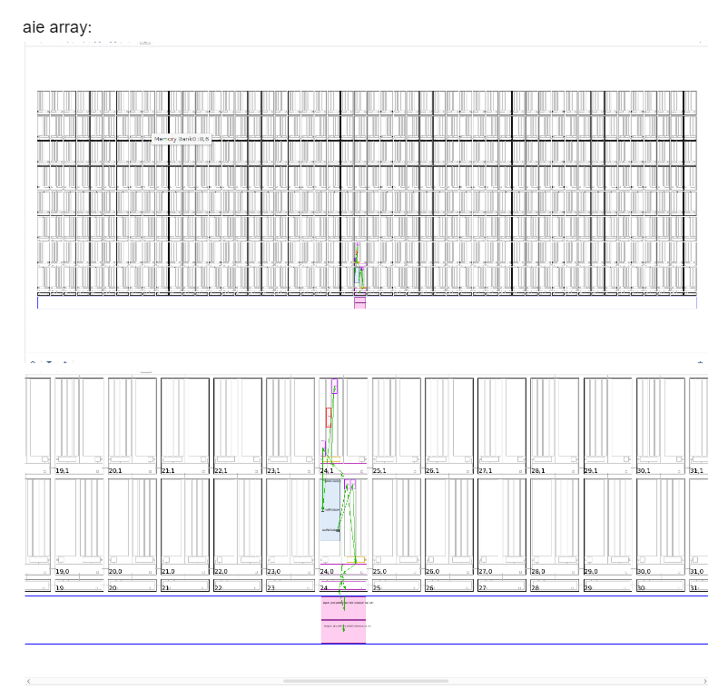

Slide 39
Reference
https://xilinx.github.io/Vitis_Libraries/dsp/2022.1/user_guide/L1.html
https://xilinx.github.io/Vitis_Libraries/dsp/2022.1/user_guide/L1_2dfft.html
https://www.xilinx.com/content/dam/xilinx/support/documents/sw_manuals/xilinx2022_2/ug1079-ai-engine-kernel-coding.pdf
https://xilinx.github.io/Vitis_Libraries/dsp/2021.1/user_guide/L2/3-using-examples.html

