Slide 1
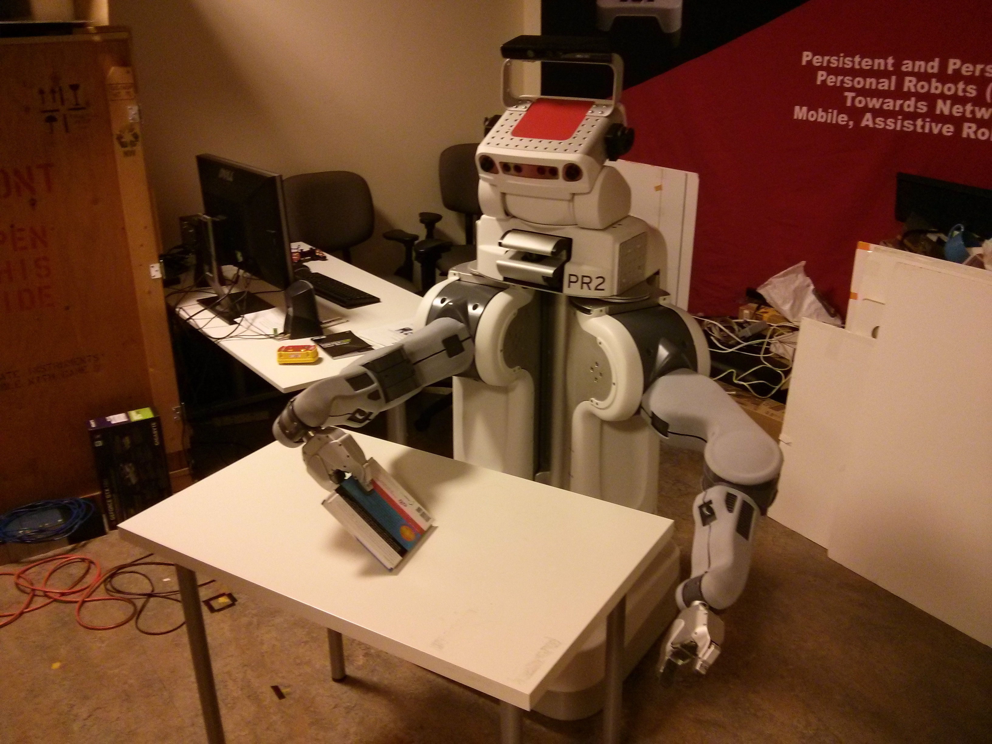
INTERACTIVE OBJECT RECOGNITION
PGM Class Project Presentation
Karol Hausman
Chet Corcos
Timmy Mbaya

Slide 2
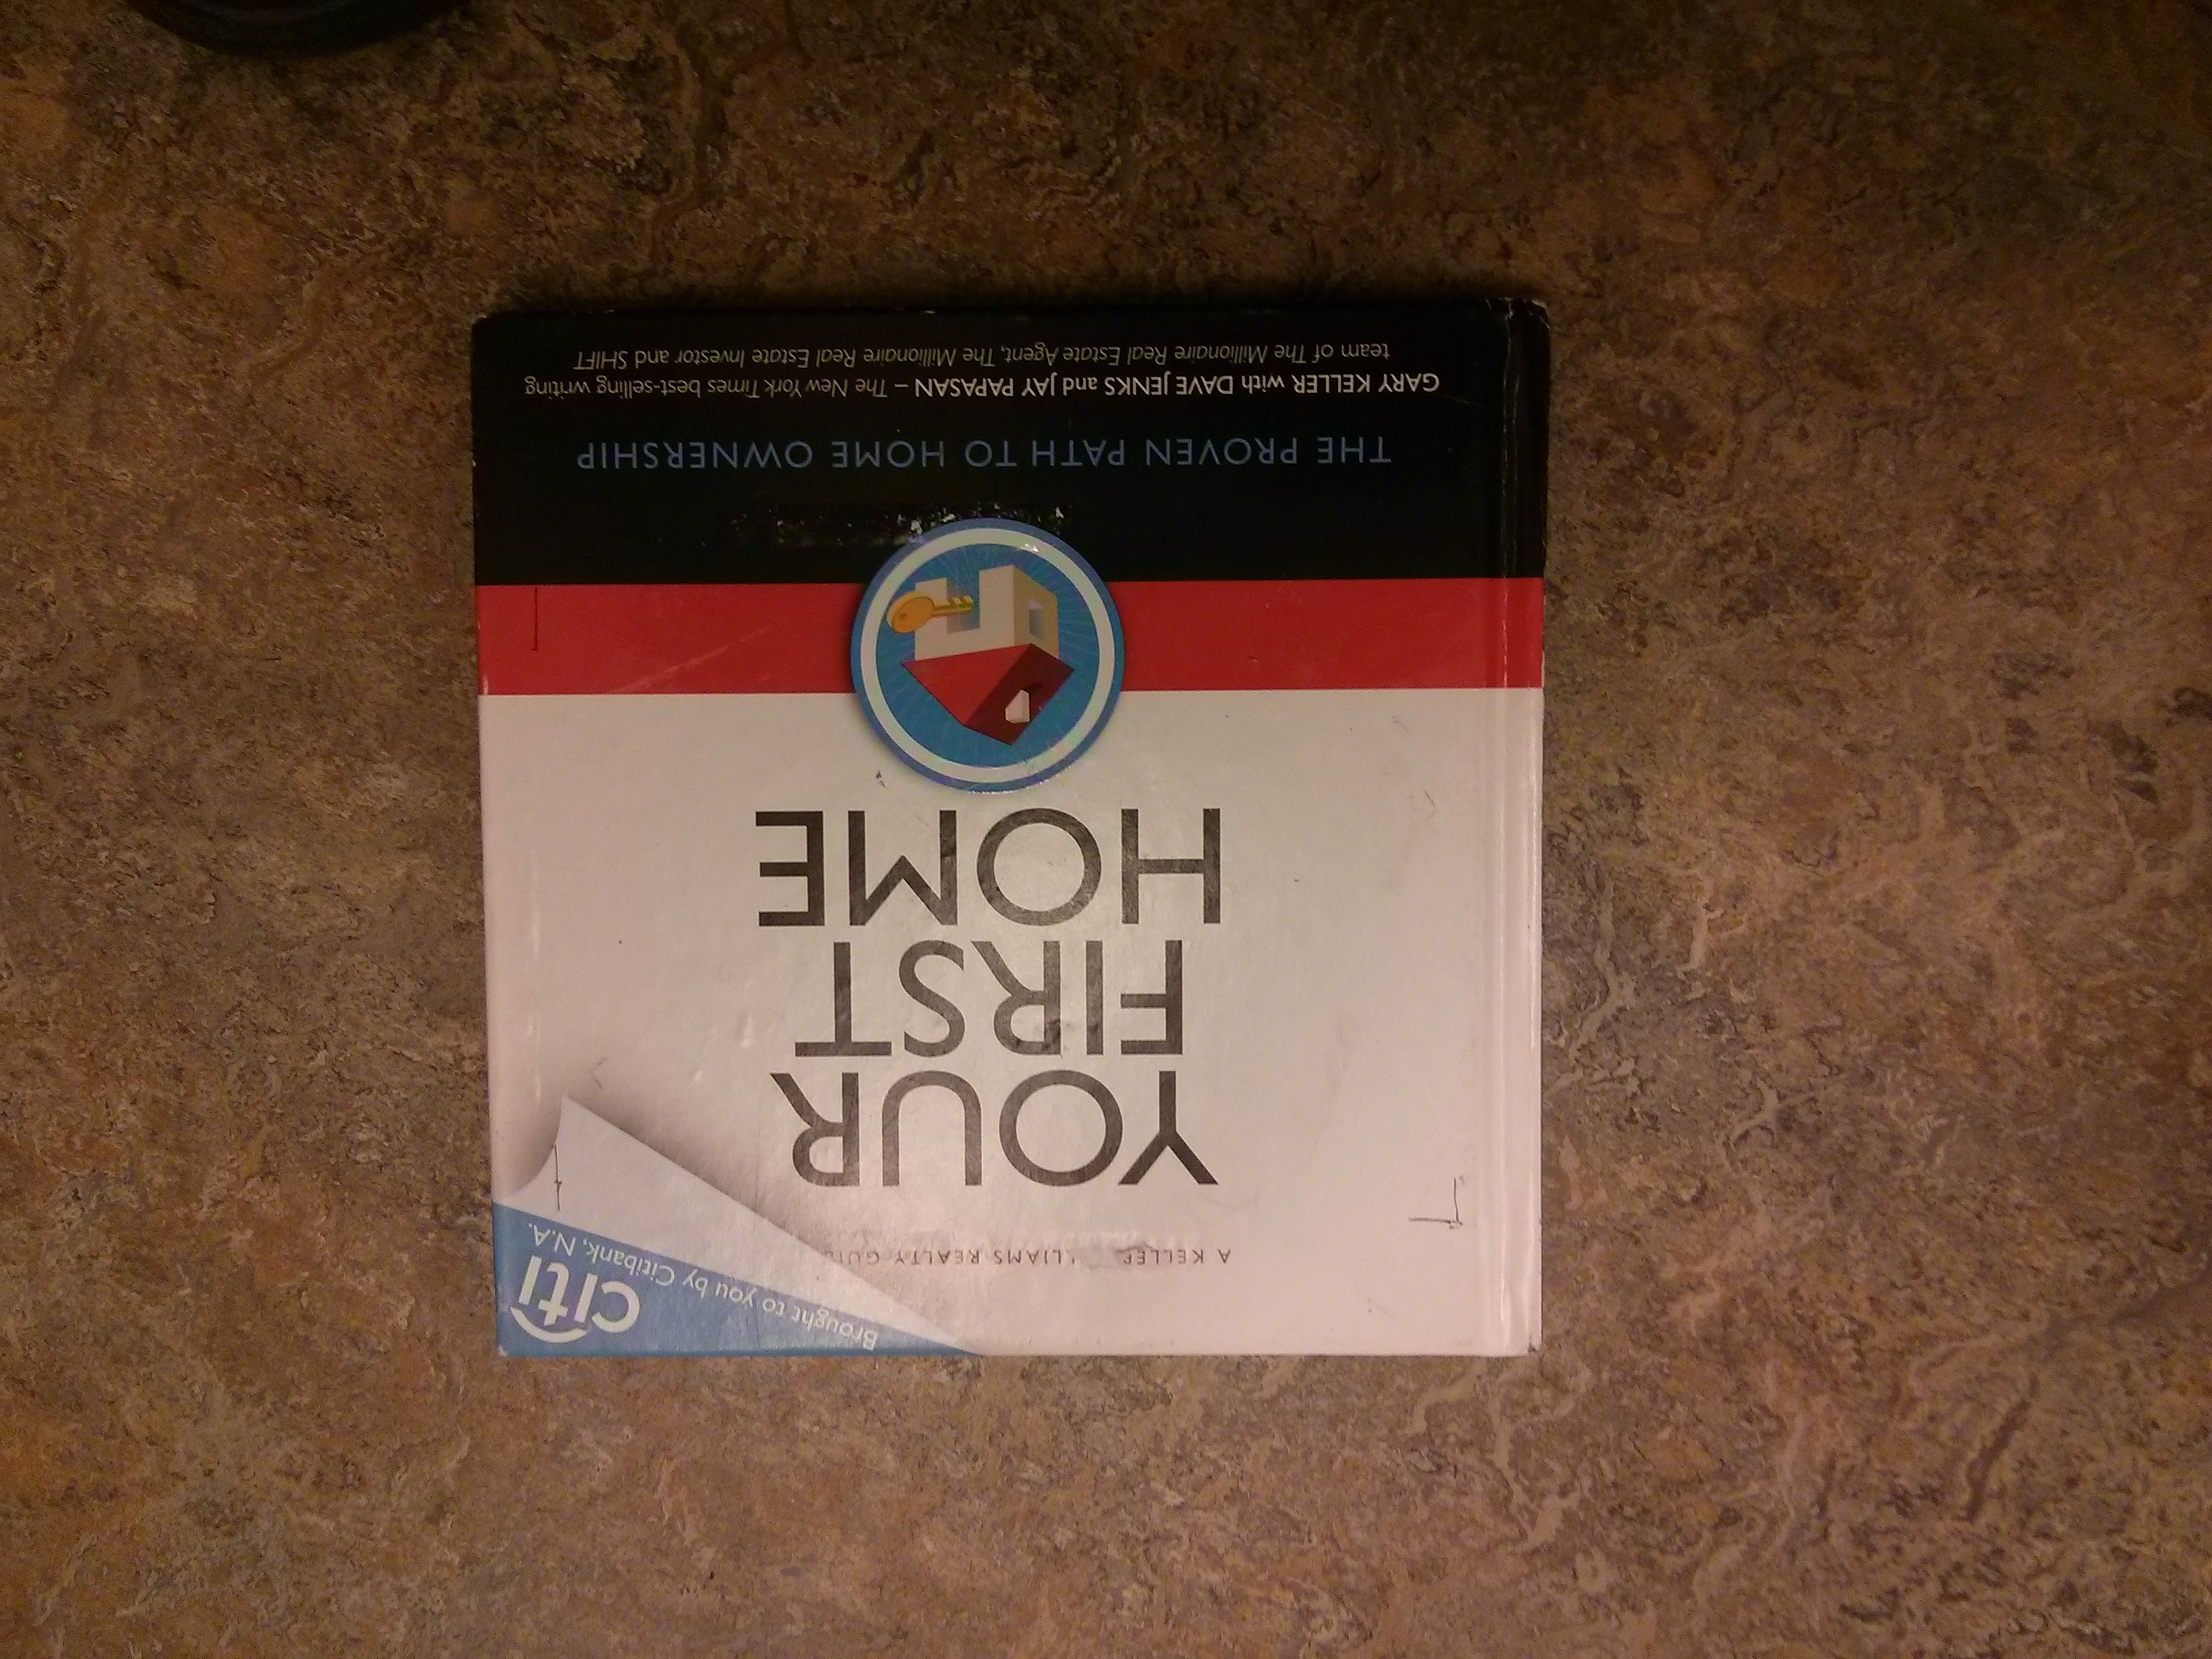
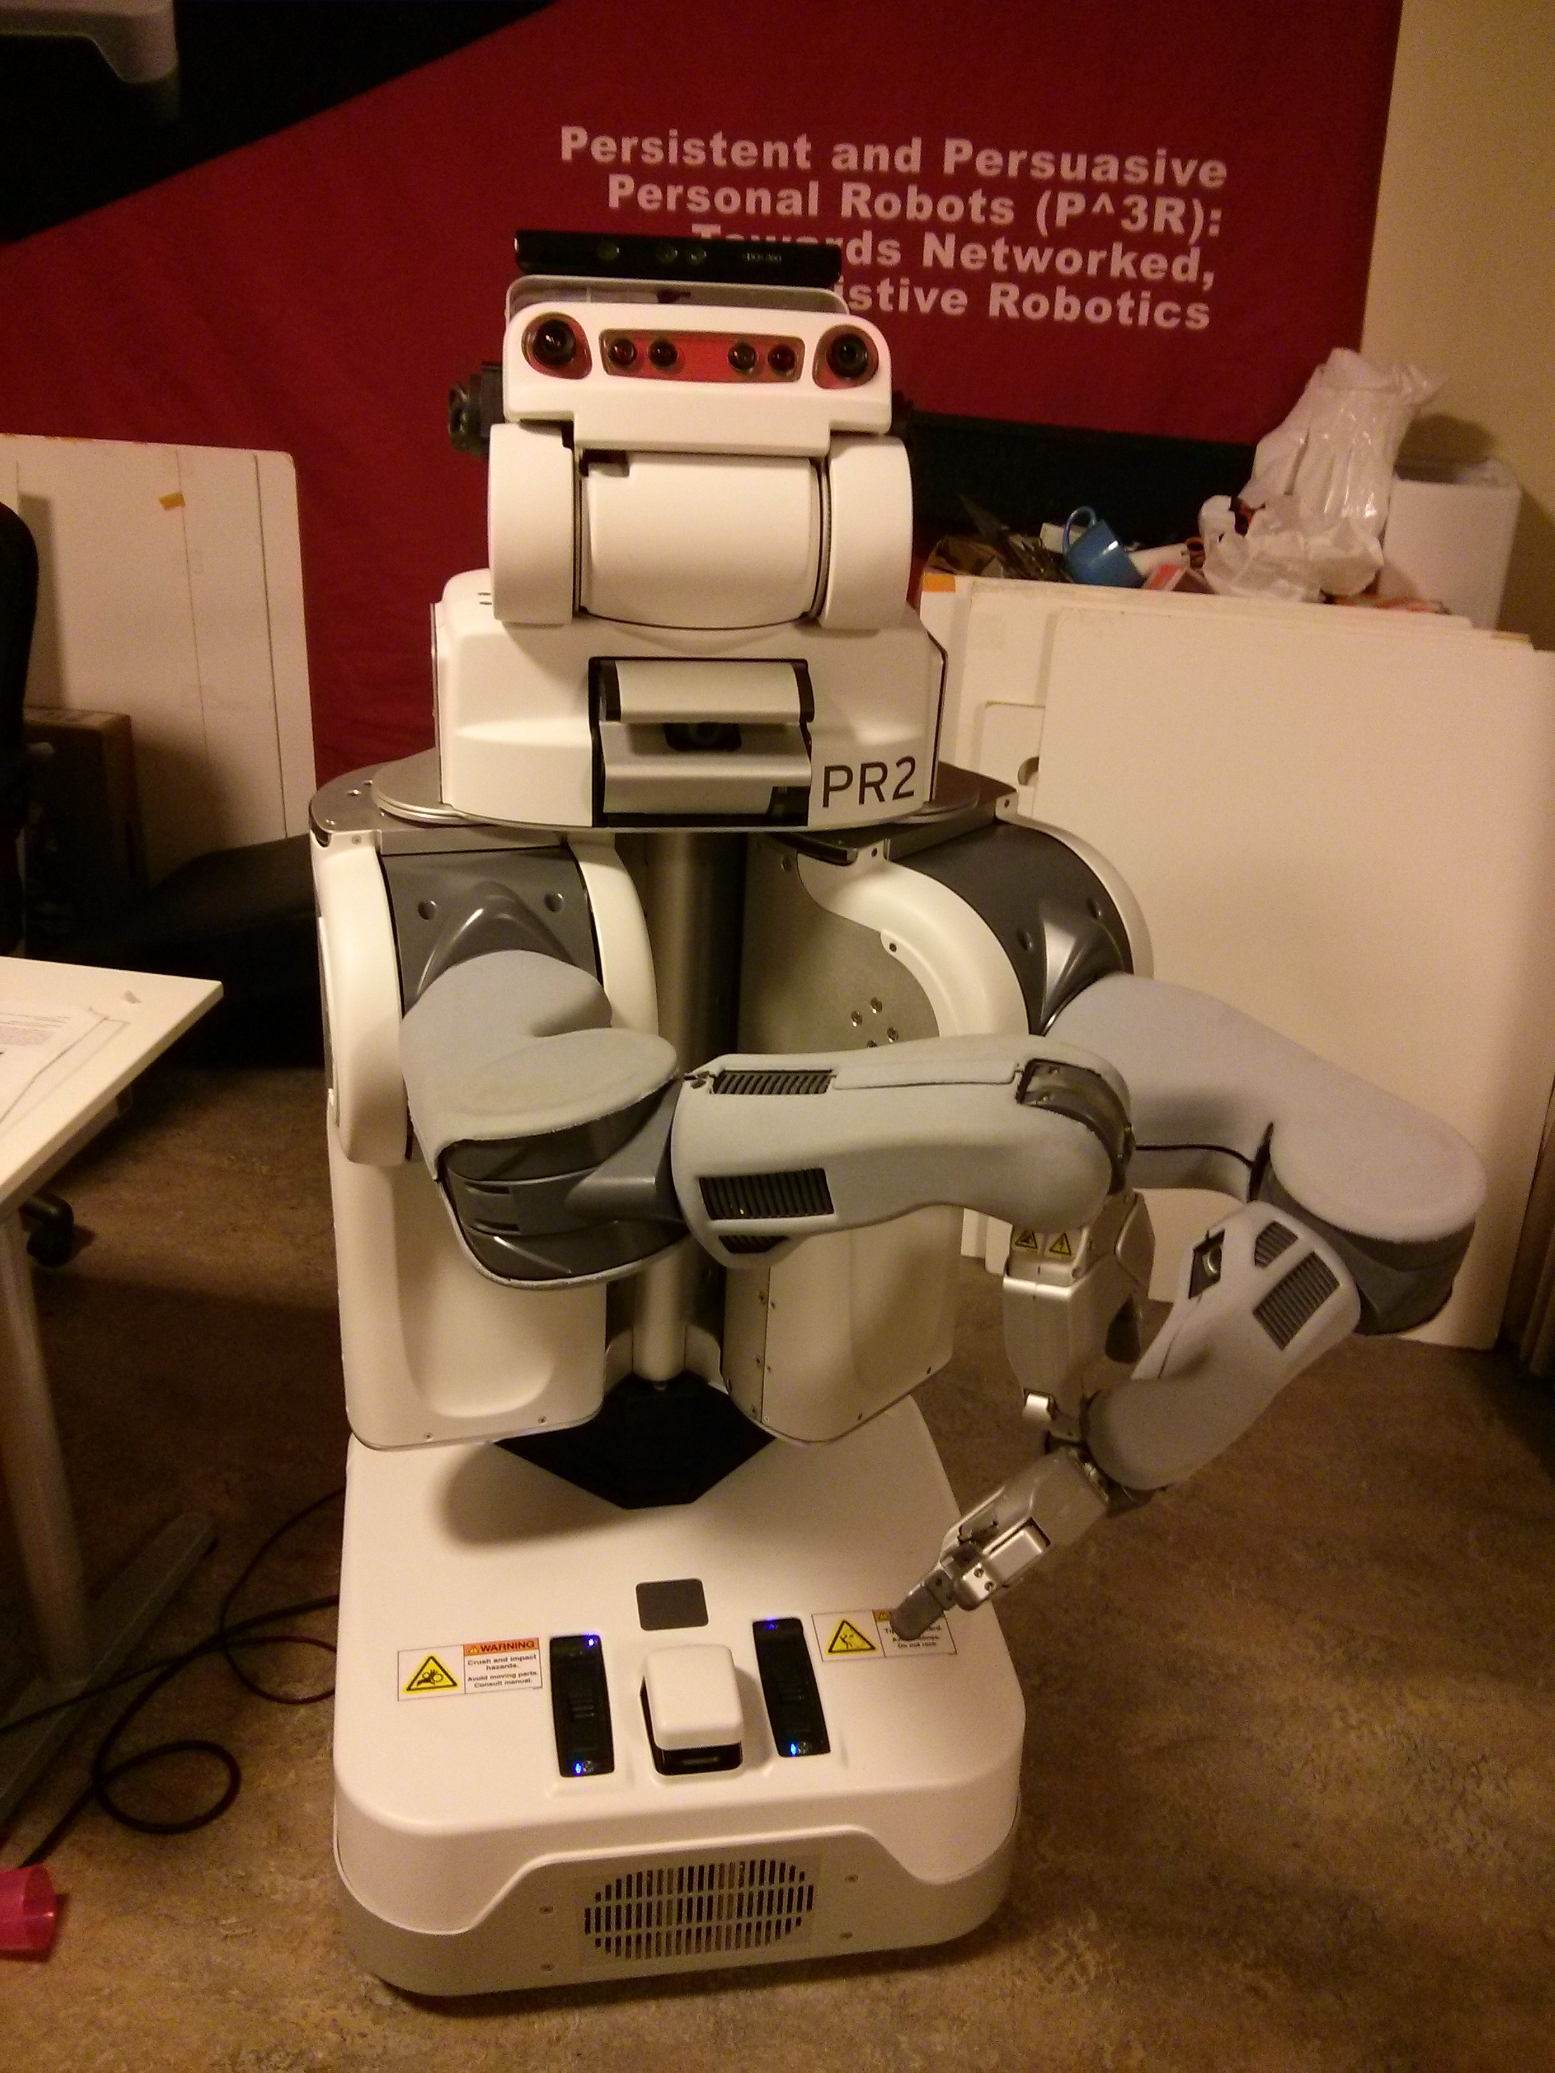
PROBLEM
Recognize objects from a given database
CV community Robotics perception
+

Slide 3
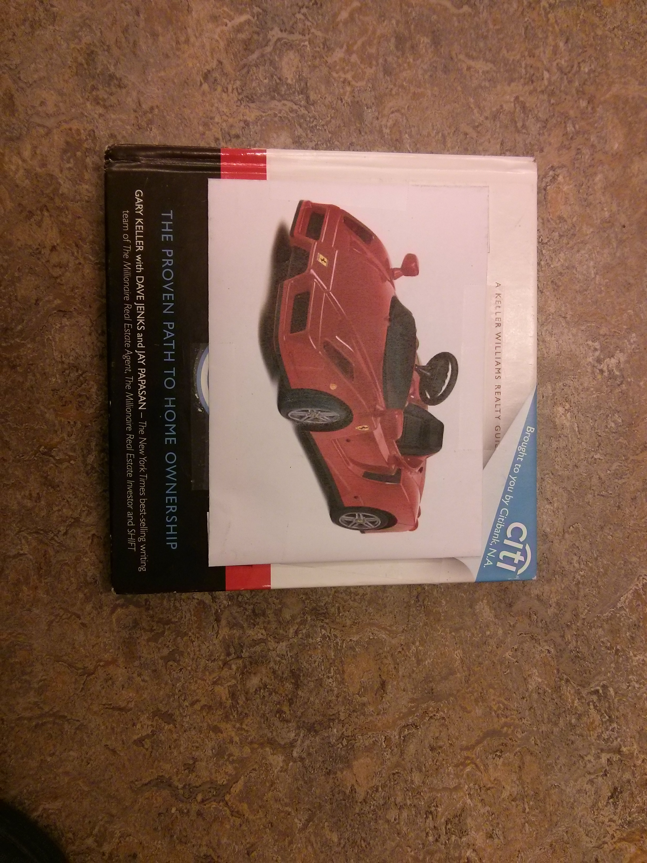
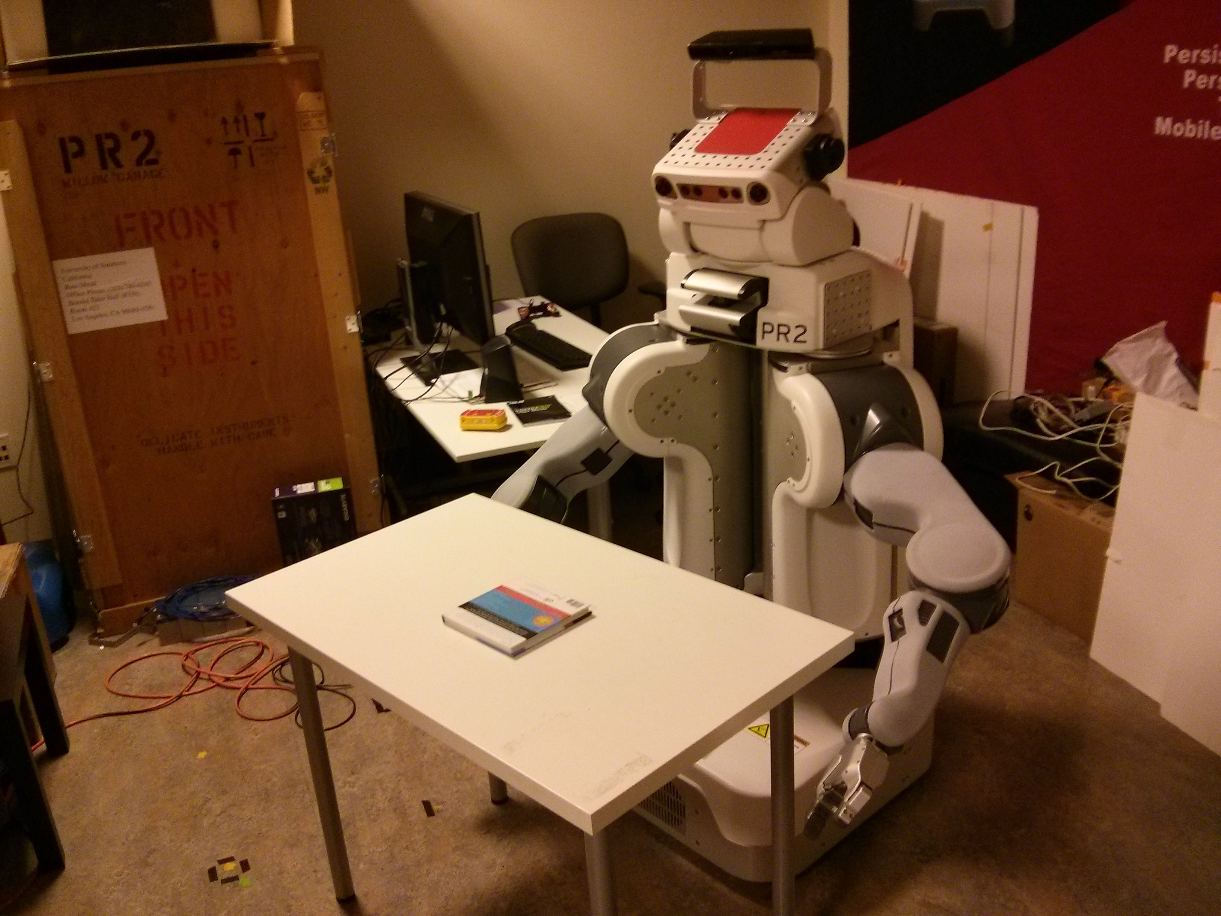
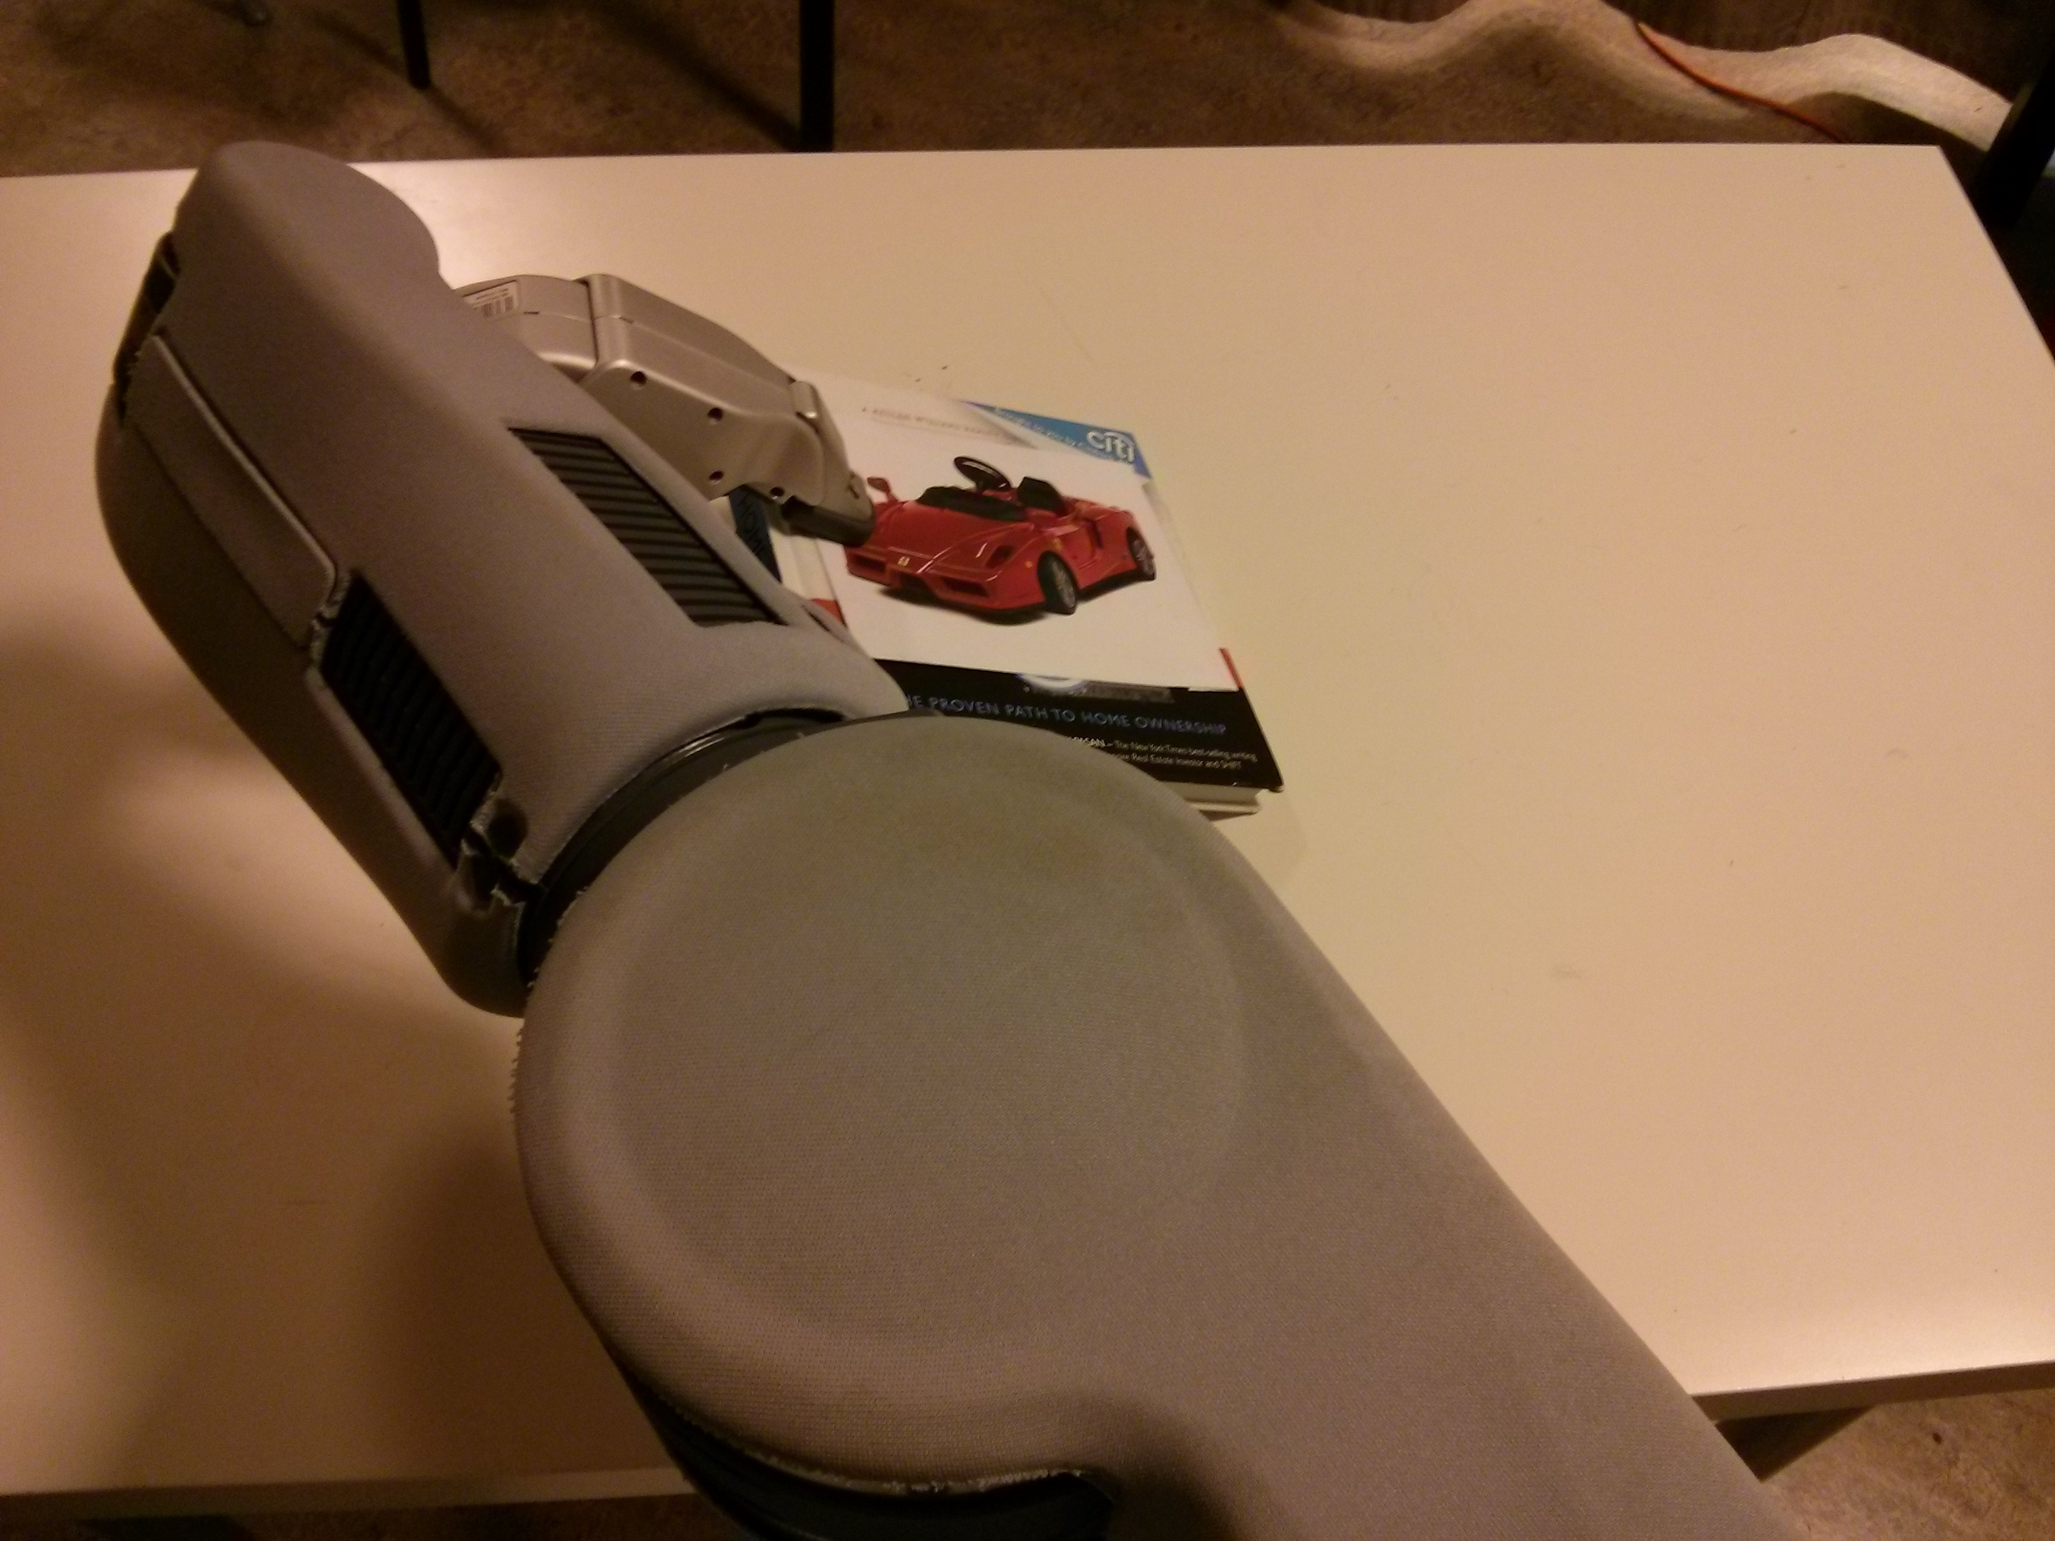

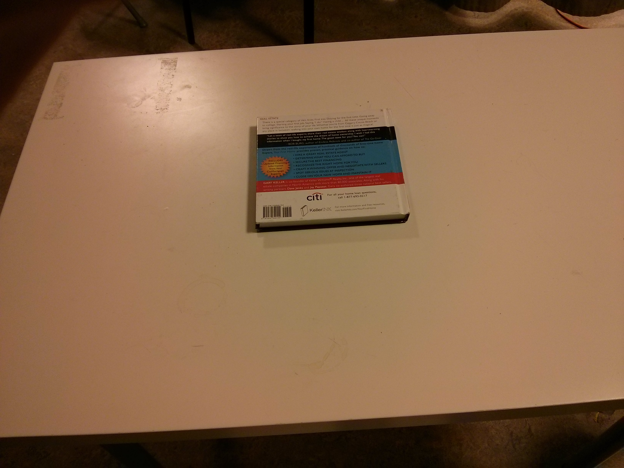

PROBLEM
How to move an object such that we can recognize it?
Book 1 Book 2
vs

Slide 4
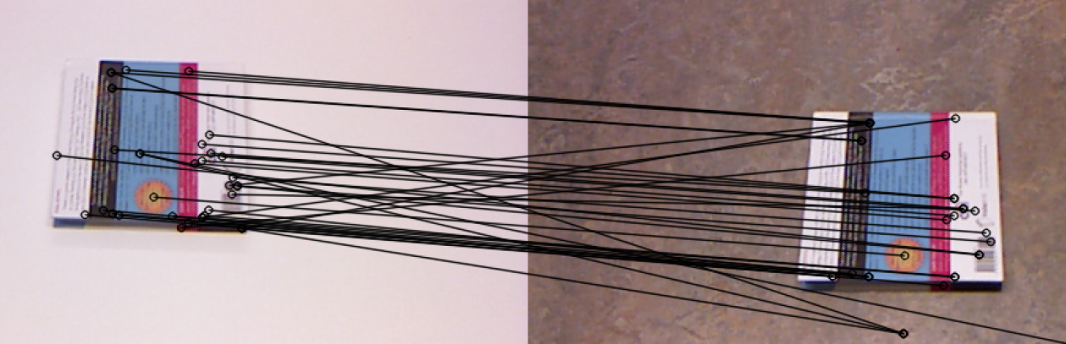
METHODS
Scale invariant SIFT Features
Matching errors as features to classify

Slide 5
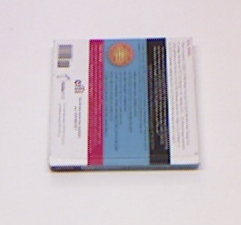

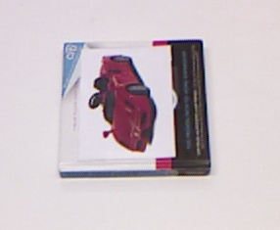

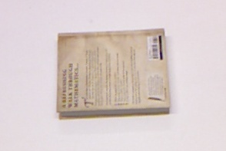
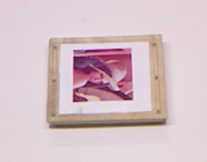
METHODS
Extract SIFT features from perfect images and store them in the database

Slide 6
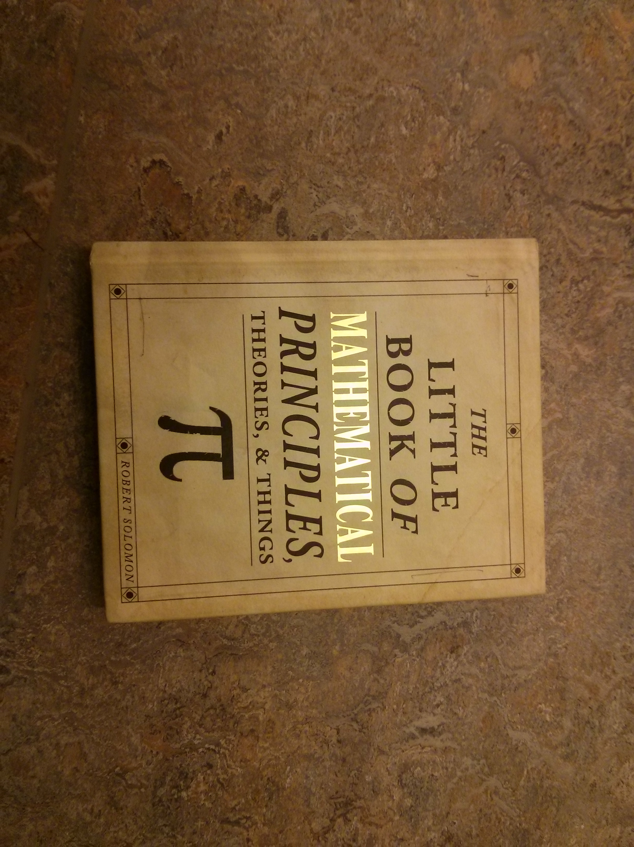
METHODS
Learning matching error distribution
...
.
.
.
...

Slide 7
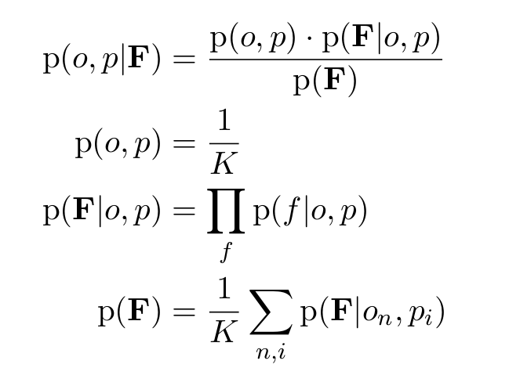
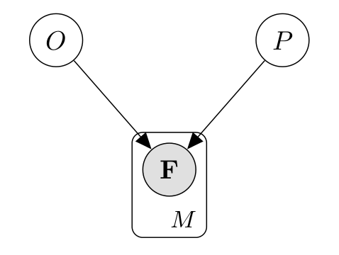
METHODS

Slide 8
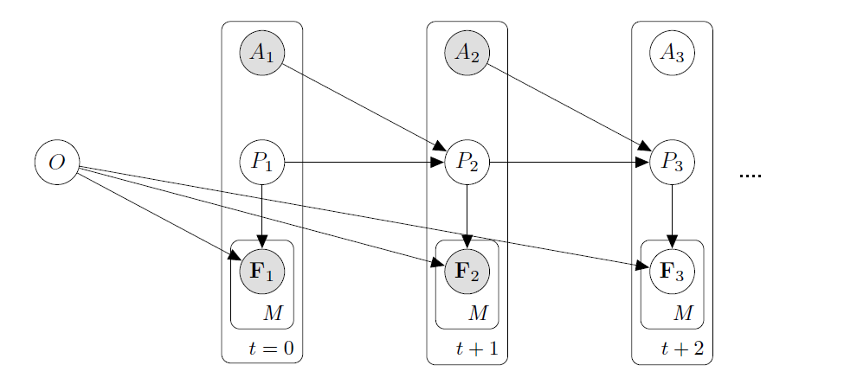
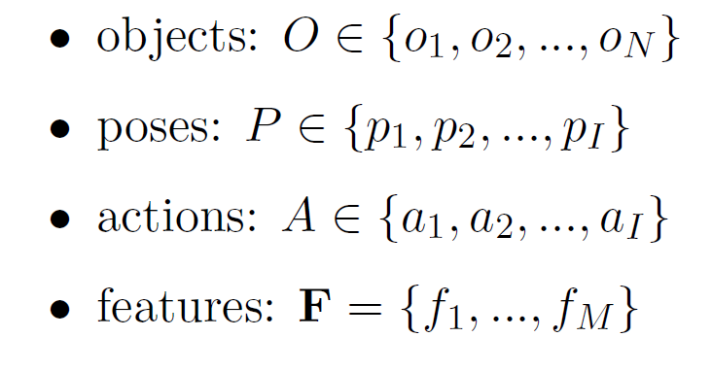
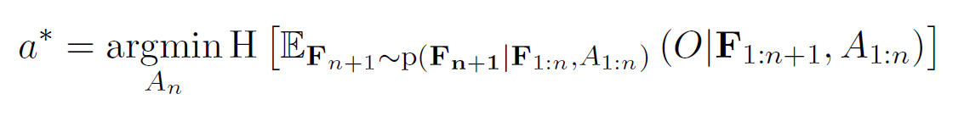
METHODS

Slide 9
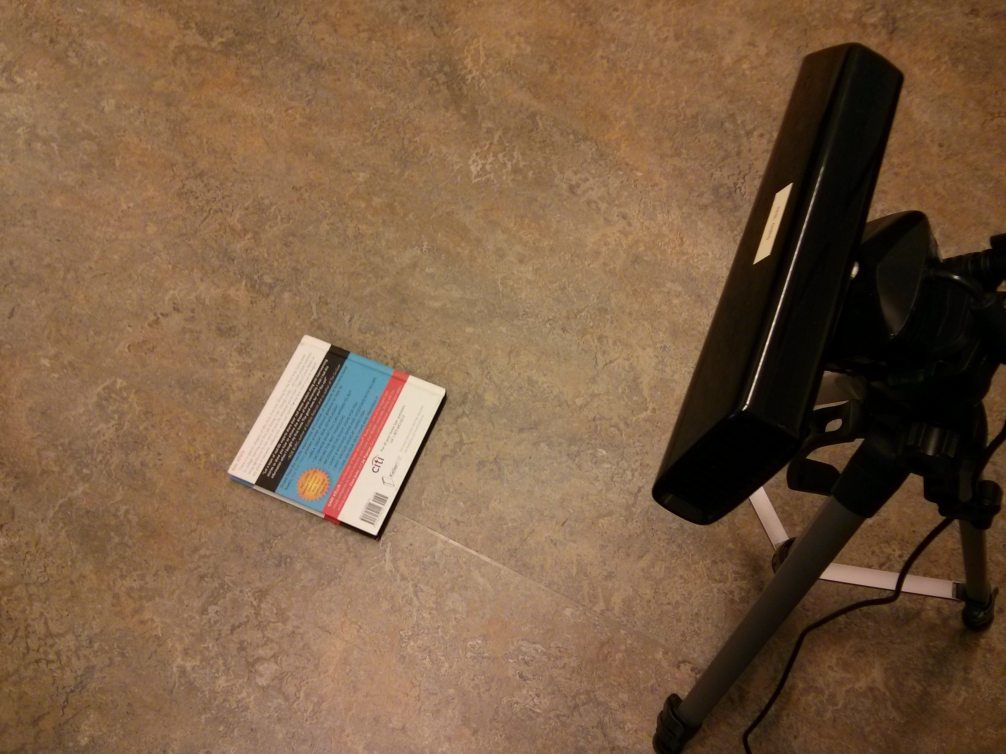
DATASET
4 books (2 with the same back) in 4 poses
4 possible actions
~50 SIFT features per object-pose pair
100 training images per object-pose pair

Slide 10
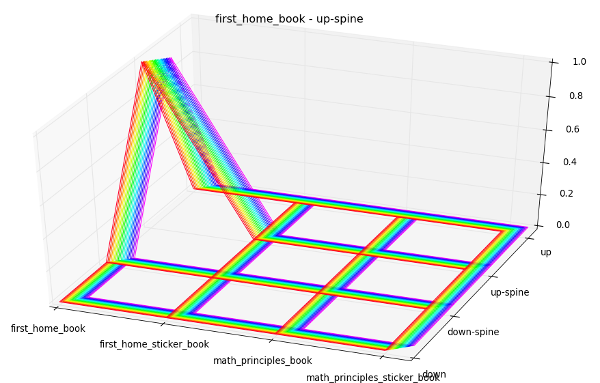
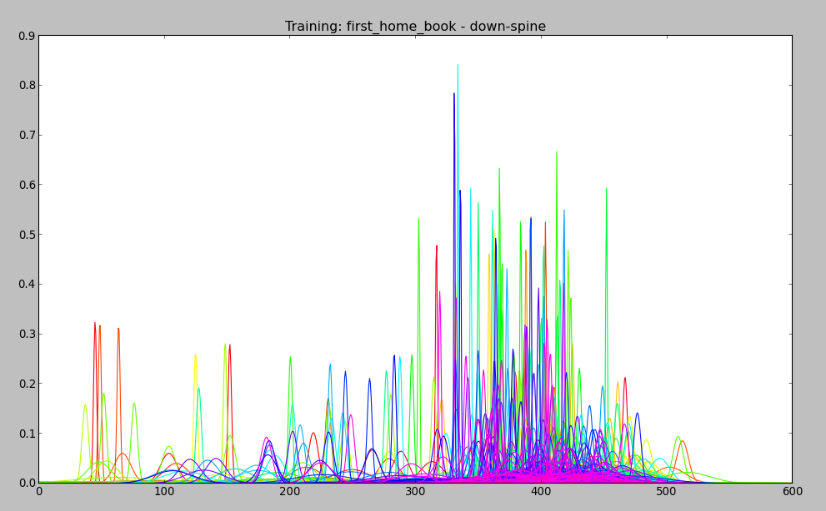
RESULTS
Learning
Cross Validation

Slide 11
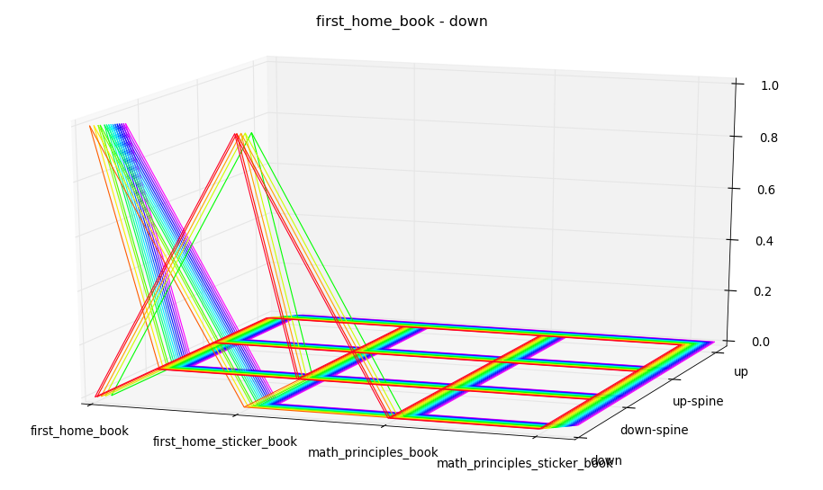
RESULTS
Cross validation
Problem of over-fitting

Slide 12
FUTURE WORK
Work on the optimal action algorithm
Solve the over-fitting issue
Extend it to work with continuous poses that may not be easily defined
Larger number of objects and environments
Implement it on the robot

