Slide 1


Team 6: Bring Your Daughter To Clemson
Team Members: Evan Dorn, Chris Cornejo, Brad Kennedy
Co-Mentor: Ms. Robin Rast
Dorn, Kennedy, Cornejo. Brown Room. Clemson University. 12/7/15

Slide 2
Objectives
Develop an application for conferences at Clemson for young girls. (Age 6 - 16)
Benefit both the end-users and the conference organizers.
Allow for a more efficient and interactive experience for the conference guests at Clemson University.
Dorn, Kennedy, Cornejo. Brown Room. Clemson University. 12/7/15

Slide 3
Stakeholders
Future students taking iOS development at Clemson. (technical reference manual)
Conference organizers, and event attendees using the app. (user reference manual)
Dorn, Kennedy, Cornejo. Brown Room. Clemson University. 12/7/15

Slide 4
Features
Scavenger Hunt
Important Contact Information
Schedule of events + Personal Agenda
Map Display of Event Locations
External Database Access. (for organizers)
Dorn, Kennedy, Cornejo. Brown Room. Clemson University. 12/7/15

Slide 5
Development Plan
Agile development practices… Developed the app in a sprint and then made subtile iterative improvements.
Used Git (hosted on Github) for source control.
Tasks:
Brad - Backend databases, authoring tool
Chris - Design and storyboards, documentation
Evan - Front end view controllers
Dorn, Kennedy, Cornejo. Brown Room. Clemson University. 12/7/15

Slide 6
Accomplishments
Built iOS app using Xcode 6 and Swift 1.2
Developed Backend Database
Developed Simple DB Authoring Tool
Dorn, Kennedy, Cornejo. Brown Room. Clemson University. 12/7/15

Slide 7
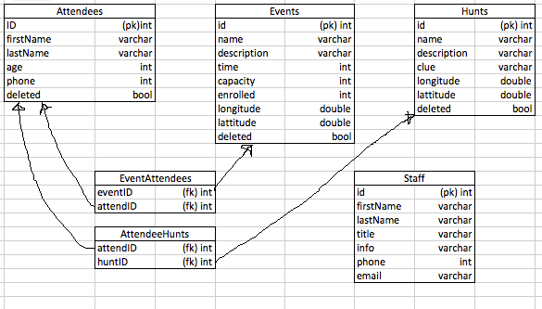
Schemas
External
Dorn, Kennedy, Cornejo. Brown Room. Clemson University. 12/7/15

Slide 8
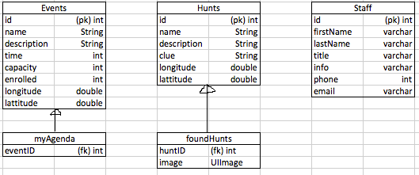
Schemas (cont.)
Internal
Dorn, Kennedy, Cornejo. Brown Room. Clemson University. 12/7/15

Slide 9
Future Plans
Implement camera view in swift
Label on home screen for username
Improved UI and usability
Continue development and adding features…
Dorn, Kennedy, Cornejo. Brown Room. Clemson University. 12/7/15

Slide 10
Thank You.
https://github.com/evandorn/ios_final_project
Dorn, Kennedy, Cornejo. Brown Room. Clemson University. 12/7/15

