Slide 1
Movie Analysis
Phase 1 Project

Slide 2
Summary
With Microsoft as a leader within the technology space, the organization would like to embark in a new venture--this time into the big screen. This project focuses on gathering pertinent data to create an analysis on which direction the tech giant should focus on for their first major film.

Slide 3
Outline
Business Problem
Data
Methods
Results
Conclusions

Slide 4
Business Problem
It’s not about reinventing the wheel, but who can we model to replicate success in the first production.
Are online movie database ratings relevant to potential gross earning success.
What direction should the movie studio take to replicate a profitable lifetime gross earning success.

Slide 5
Data
API
The Movie DB, we attempted to to do an API call, which was successful. This API was our initial dataset, however we decided to move towards a different direction.
Web Scraping
IMDB’s Top 1000 movie list the following characteristics were used: movie, year, time_minute, genre, imdb_rating, metascore, vote, and gross_earning.
Box Office Mojo Lifetime High Gross Earning Movie list of characteristics: worldwide, domestic, and foreign

Slide 6
Methods
Finding the most successful movies from a global and domestic perspective.
Finding the features of the top worldwide grossing movie and creating a dataframe that shows similar character attributes.
Finding relationships based on character attributes.
Coming up with inferences based on visualizations and select attributes within the data.

Slide 7
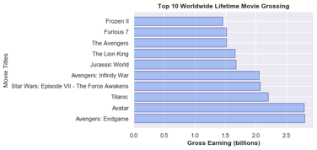
Box Office Mojo

Slide 8
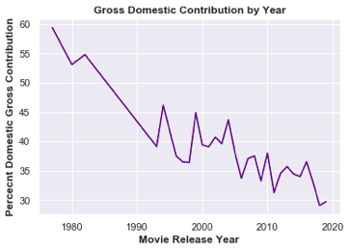
Box Office Mojo

Slide 9
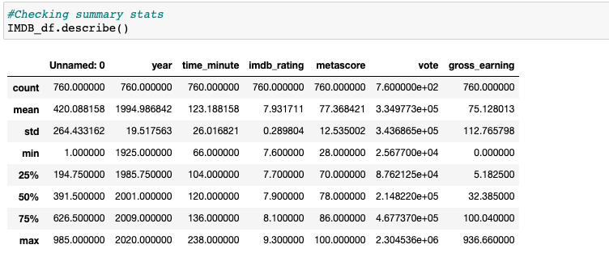
IMDB Analysis

Slide 10
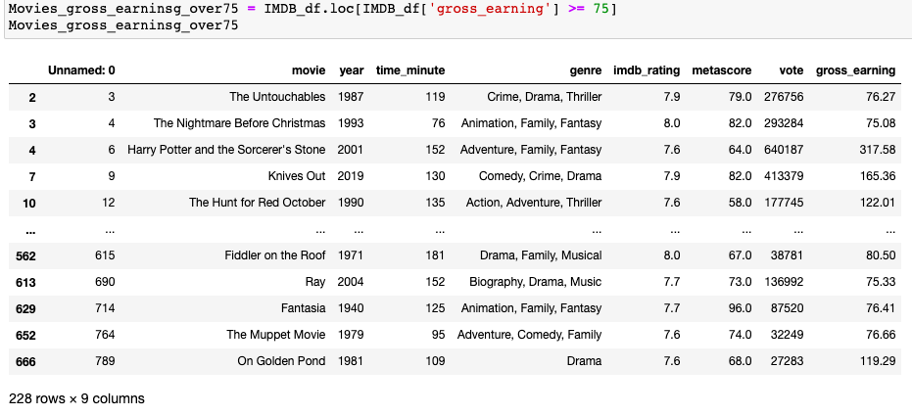
IMDB Analysis

Slide 11
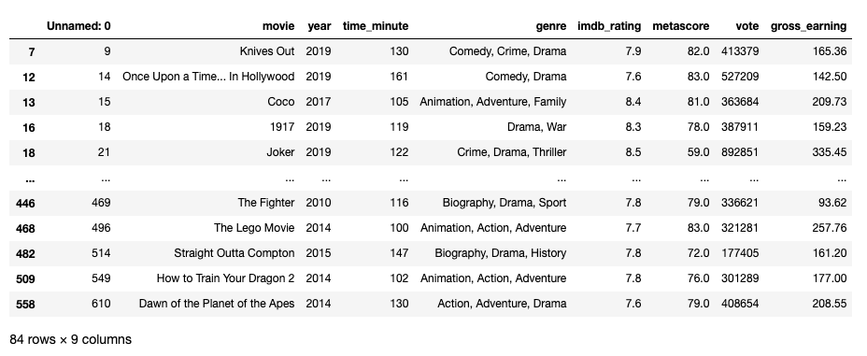
IMDB Analysis

Slide 12

The ideal Movie

Slide 13
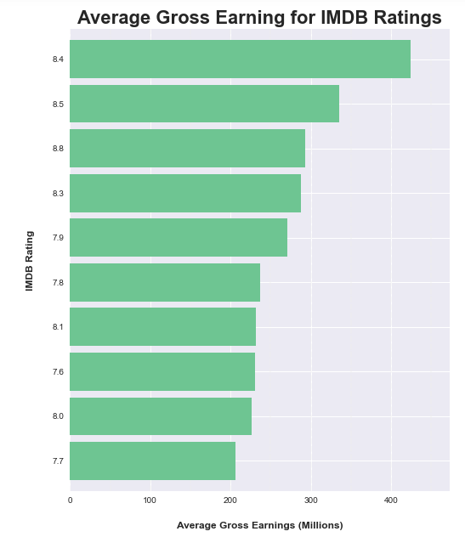

Slide 14
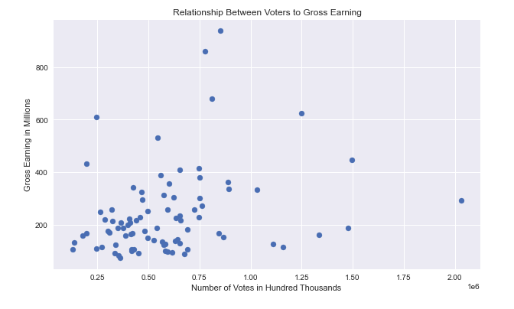

Slide 15
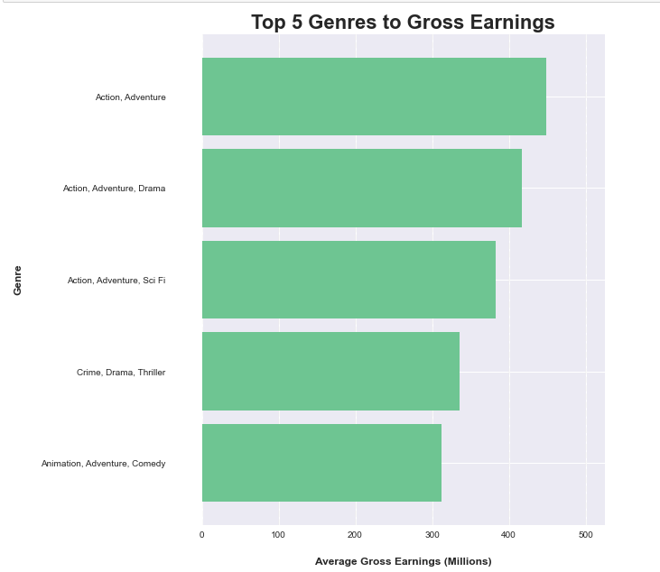

Slide 16
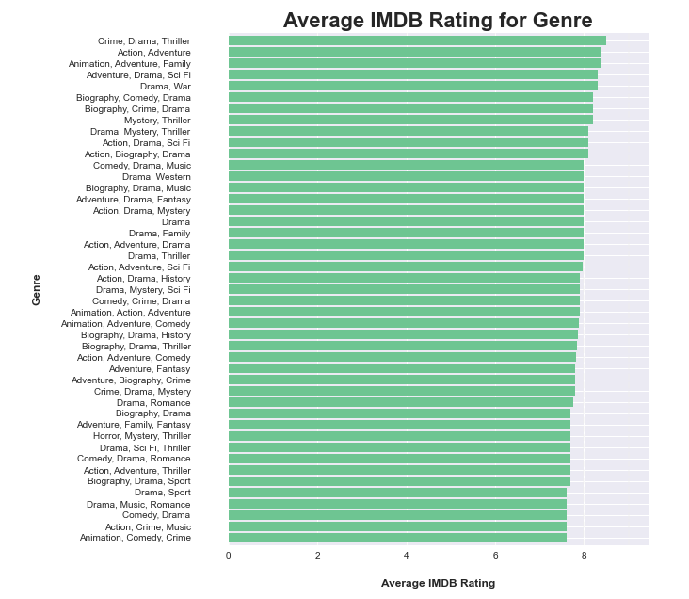

Slide 17
Conclusions
Who can we mimic?
Modeling the success of Avengers: Endgame would be the the most ideal route in in terms of box office success and rating.
What about the ratings?
We did find that ratings to gross earning do share a relationship, but the number of votes do not necessarily contribute to a movies overall lifetime gross earnings
How are we going to mimic success.
We found that a specific genres (Action and Adventure) are both profitable and popular, with an aim for an IMDB rating over 7.8

Slide 18
Next Steps
Further considerations in optimizing data and models.
Financial conversations (budget and potential expenses)
Casting recommendations
Director recommendations
Box office release locations (foreign vs domestic)
Projecting earnings
See next for preview for Relationship Between Movie Runtime to Gross Earning

Slide 19
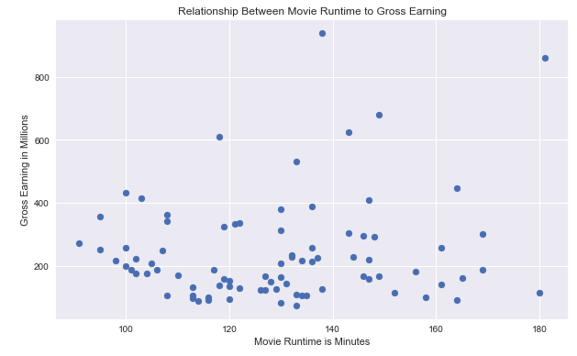

Slide 20
Thank You!
Christian Corrales
Ijeoma Akamnonu
GitHub: https://github.com/ccorrales1228/Phase_1_Project

