Slide 1


Movie Analysis
Phase 1 Project

Slide 2

Summary
With Microsoft already being a leader in the technology space, the organization would like to embark on a new venture--this time onto the big screen. This project focuses on gathering pertinent data to create an analysis on which direction this tech giant should focus on to augment success for their first major film.

Slide 3

Outline
Business Problem
Data
Methods
Results
Conclusions

Slide 4
Business Problem
It’s not about reinventing the wheel here. Who can we model to replicate success in the first production.
Are online movie database ratings relevant to potential gross earning success.
What direction should the movie studio take to replicate such optimal gross earnings.

Slide 5
Data
API
The Movie DB, we attempted to to do an API call, which was successful. This API was our initial dataset, however we decided to move towards a different direction.
Web Scraping
IMDB’s Top 1000 movies list the following characteristics were used: movie, year, time_minute, genre, imdb_rating, metascore, vote, and gross_earning.
Box Office Mojo’s Top 1000 movies list: title, year, worldwide_lifetime_gross, domestic_lifetime_gross, domestic_%, foreign_lifetime_gross, and foreign_%.

Slide 6
Methods
Finding the most successful movies from a global and domestic perspective.
Finding the features of the top worldwide grossing movies and creating a dataframe that shows similar character attributes.
Finding relationships based on character attributes.
Coming up with inferences based on visualizations and selecting characteristics within the dataset.

Slide 7
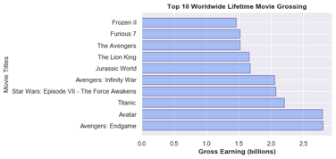
Box Office Mojo

Slide 8

The ideal Movie

Slide 9
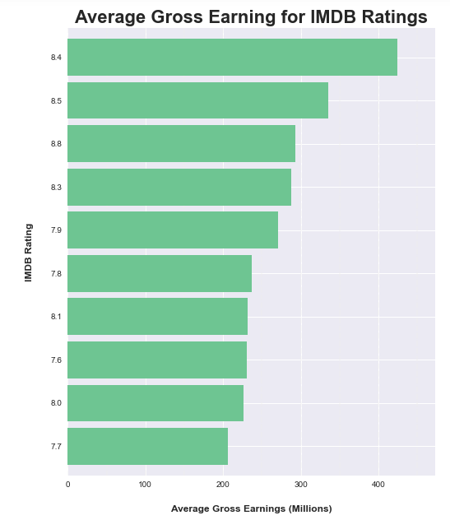

Slide 10
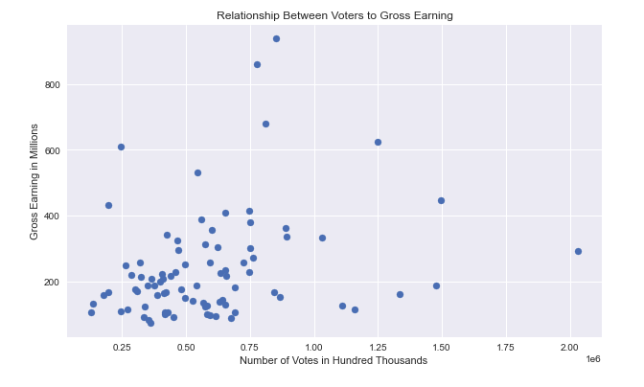

Slide 11
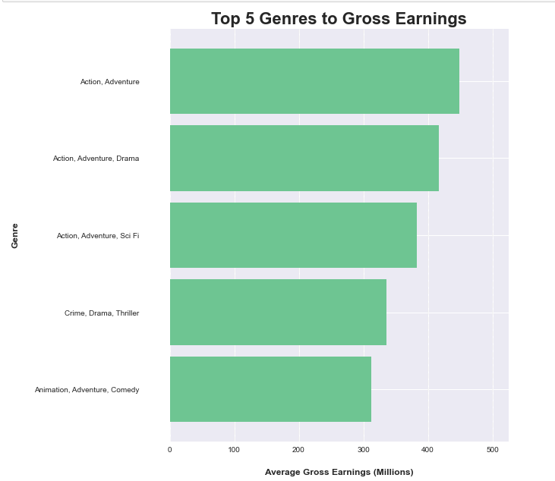

Slide 12
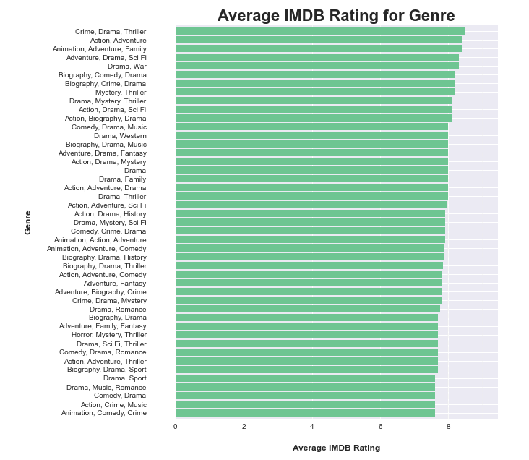

Slide 13
Conclusions
Who can we mimic?
Modeling the success of Avengers: Endgame would be the the most ideal route in in terms of box office success and rating.
What about the ratings?
We did find that ratings to gross earning do share a relationship, but the number of votes do not necessarily contribute to a movies overall lifetime gross earnings
How are we going to mimic success.
We found that a specific genres (Action and Adventure) are both profitable and popular, with an aim for an IMDB rating over 7.8

Slide 14
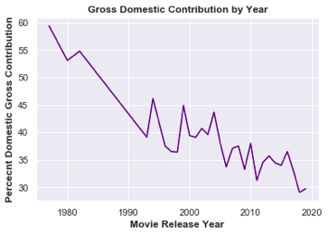
Next Steps
Further considerations in optimizing data and models.
Financial conversations (budget and potential expenses)
Casting recommendations
Director recommendations
Box office release locations (foreign vs domestic)
Projecting earnings
See next for preview for Relationship Between Movie Runtime to Gross Earning

Slide 15
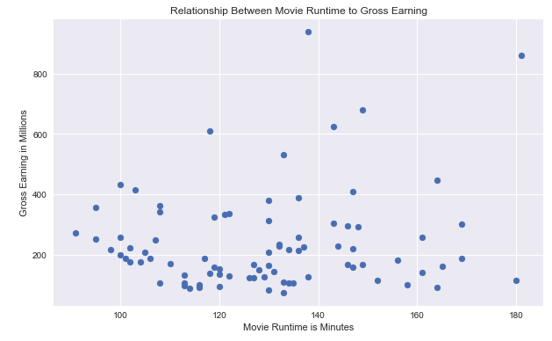

Slide 16
Thank You!
Christian Corrales
Ijeoma Akamnonu
GitHub: https://github.com/ccorrales1228/Phase_1_Project

