Slide 1




CCP5 Software tools: DL_FIELD and DL_ANALYSER
Chin W Yong
Computational Chemistry Group,
Scientific Computing Department,
STFC,
Daresbury Laboratory, Sci-Tech Daresbury,
Warrington WA4 4AD
CCPBioMed, EBI, Jan. 2018

Slide 2
Collaborative Computational Project for computer simulation of condensed phase materials at length scales spanning from atomistic to mesoscopic levels. Materials of interest are such as liquids, polymers, solids, surface materials and macromolecules.
Funded by EPSRC and operated via CoSeC, CCP5 is a network community bringing together people with common interests serving primarily the UK but also international scientists.
Provide and maintain software infrastructure (DL_software) spanning across multi-length and time scales, from ab-initio electronic calculations to molecular and mesoscopic levels.
Annual general meeting – talks on latest modelling, simulations, methodologies. Poster presentations, fostering collaborative environment for the community.
Program outreach. Software training workshops, workshops with themes leaning towards experimentalists and industrialists. Joint CCPs activities: CCPBioSim/CCP5 workshops.
Provide funding to community members for organising workshops, collaboration visits, special visitor guests (lecture tours), summer bursaries.

Slide 3
A selection of DL_Software
Many of the software projects are funded by EPSRC via CCP5
and HEC consortia (MCC, UKCOMES).
DL_POLY - The molecular dynamics (MD) program suite.
DL_FIELD - Force-field model setup tool for DL_POLYs.
DL_ANALYSER - General analysis tool for DL_POLY.
DL_CGMAP - Coarse-graining utility for DL_POLY
DL_MONTE - The monte-carlo simulation program.
DL_MESO - Mesoscopic simulation including lattice Boltzmann and dissipative particle dynamics.
CHEMSHELL - Program interface that handles data and communications of various computational chemistry packages.
Details, registrations: https://www.ccp5.ac.uk/software

Slide 4
DL_FIELD
Utility software for setting up force field models for DL_POLY.
Available force field: CHARMM, AMBER, OPLS-AA/2005, DREIDING, PCFF, CVFF, Gromos-G54A7 – all expressed in a single-unified format.
Inorganic (clay, oxides, glass).
System models: Proteins, sugars, drug molecules, polymers, networked structures, random structures, etc.
Multiple-potential models: organic/inorganic systems
Full automatic atom typing and identification of chemical nature of atoms (making use of the universal atom typing notation – the DL_F Notation).
XYZ
or
PDB
DL_FIELD
FIELD
CONFIG
‘black box’

Slide 5
DL_F Notation
C. W. Yong, J. Chem. Inf. Model. vol.56, pp 1405-1409 (2016)
Expression of the universal, standardised atom typing notation
that is contiguous across a range of force field.
Universal automatic typing that smoothen data transition with minimum
learning curve when migrating from one force field to another.
Easy to identify, with sensible format of naming atoms that indicates
precisely the chemical nature of every atom in the system.
5

Slide 6
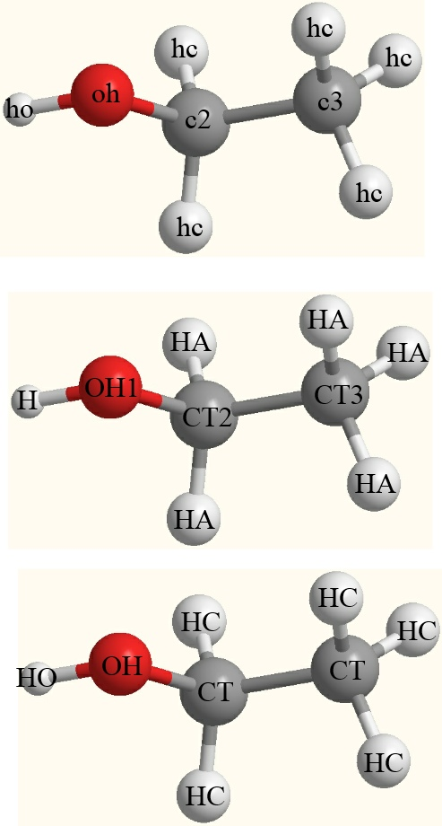
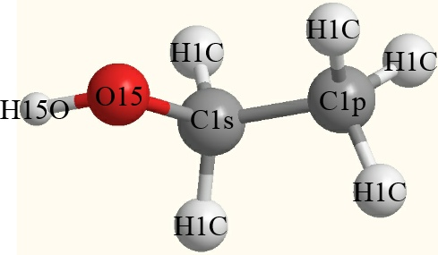
Atom typing variation
with cryptic symbols
DL_F Notation
PCFF
ATOM_KEYs
CHARMM
The numerical values (CGI) uniquely
identify the Chemical Groups.
OPLS
6

Slide 7
DL_F Notation
ATOM_KEYs
ATOM_TYPEs
C1p = Cp_alkane
C1s = Cs_alkane
H1C = HC_alkane
O15 = O_alcohol
H15O = HO_alcohol
in-situ conversion

Slide 8
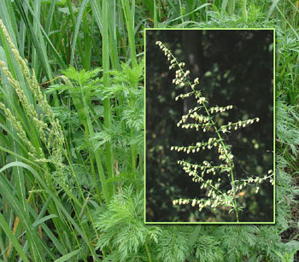
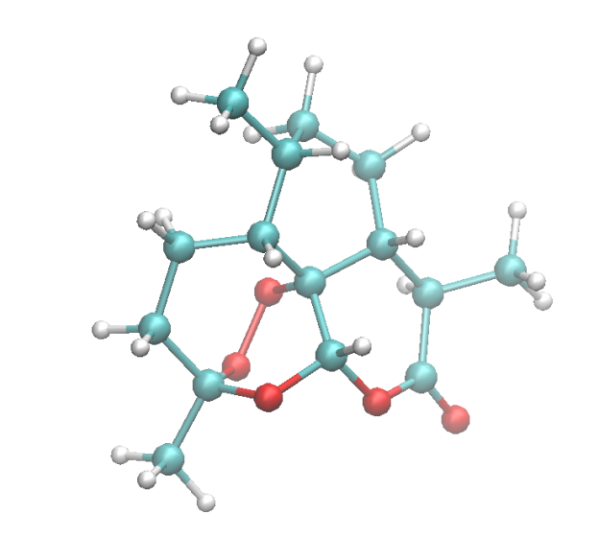
Artemisinin
青蒿素
- drug against malaria
O 2.129000 0.063000 2.421000
C 2.004000 0.182000 1.026000
H 1.513000 -1.209000 -0.602000
C 1.611000 -1.202000 0.507000
C 0.907000 1.179000 0.657000
H 0.657000 1.067000 -0.426000
C 1.146000 2.672000 0.936000
H -0.012000 0.872000 1.214000
C 2.015000 2.959000 2.178000
H 0.148000 3.161000 1.037000
…
…
H 0.806000 5.428000 1.070000
1 - O_acetal
2 - Cq_alkane
3 - HC_alkane
4 - Cp_alkane
5 - Cs_alkane
6 - HC_alkane
7 - Cs_alkane
8 - HC_alkane
9 - Ct_alkane
10 - HC_alkane
11 - HC_alkane
12 - Ct_alkane
13 - Cq_alkane
14 - HC_alkane
15 - Ct_alkane
16 - O_peroxide
17 - C_acetal
18 - OL_ester
19 - HC_alkane
20 - HC_acetal
21 - HC_alkane
22 - O_peroxide
23 - C_ester
24 - OE_ester
25 - Ct_alkane
26 - Cp_alkane
27 - HC_alkane
…
…
OPLS2005
Generated by DL_FIELD v3.40
Units kcal/mol
Molecular types 1
Molecule name not_define
nummols 1
atoms 42
OS 15.99940 -0.40000 1 0
CT 12.01150 0.40000 1 0
HC 1.00797 0.06000 1 0
CT 12.01150 -0.18000 1 0
CT 12.01150 -0.12000 1 0
HC 1.00797 0.06000 1 0
CT 12.01150 -0.12000 1 0
HC 1.00797 0.06000 1 0
…
8

Slide 9
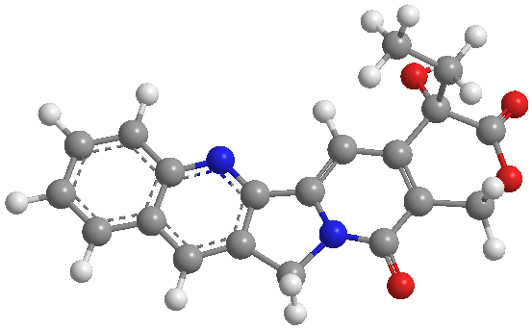
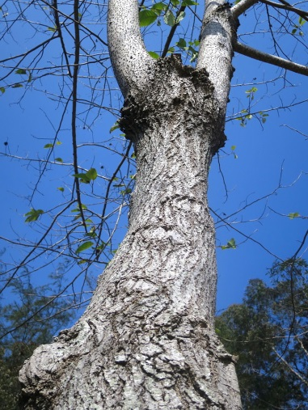
Camptothecin – a quinoline alkaloid
1 - C6_quinoline
2 - C7_quinoline
3 - C8_quinoline
4 - C8a_quinoline
5 - C4a_quinoline
6 - C5_quinoline
7 - N1_quinoline
8 - C2_quinoline
9 - C3_quinoline
10 - C4_quinoline
11 - CE_alkene
12 - Nt_amide
13 - Cs_alkane
14 - CL_alkene
15 - CL_alkene
16 - CE_alkene
17 - C_amide
18 - Cq_alkane
19 - C_ester
20 - OL_ester
21 - Cs_alkane
22 - O_amide
23 - OE_ester
24 - O_alcohol
25 - Cs_alkane
26 - Cp_alkane
27 - HC_aromatic
28 - HC_aromatic
29 - HC_aromatic
30 - HC_aromatic
31 - HC_aromatic
32 - HC_alkane
33 - HC_alkane
34 - HC_alkene
35 - HC_alkane
36 - HC_alkane
37 - HO_alcohol
38 - HC_alkane
39 - HC_alkane
40 - HC_alkane
41 - HC_alkane
42 - HC_alkane
PCFF
Camptotheca acuminata
Generated by DL_FIELD v3.50
Units kcal/mol
Molecular types 1
Molecule name not_define
nummols 1
atoms 42
cp 12.01150 -0.12680 1 0
cp 12.01150 -0.12680 1 0
cp 12.01150 -0.12680 1 0
cp 12.01150 0.24050 1 0
cp 12.01150 0.00000 1 0
cp 12.01150 -0.12680 1 0
np 14.00670 -0.48100 1 0
…

Slide 10
36 - Cs_alkane
37 - Cs_alkane
38 - Ns_amide
39 - C_amide
40 - CA_amino_acid
41 - O_amide
42 - CA_amino_acid
43 - C_amide
44 - Cs_alkane
45 - Cs_alkane
46 - Np_amine
47 - Ns_amide
48 - O_amide
49 - CA_amino_acid
50 - CB_leucine
51 - CG_leucine
52 - CD1_leucine
53 - CD2_leucine
54 - C_amide
55 - Ns_amide
56 - O_amide
57 - CA_amino_acid
58 - CB_leucine
59 - CG_leucine
60 - CD1_leucine
61 - CD2_leucine
62 - C_amide
63 - Ns_amide
64 - O_amide
65 - CA_amino_acid
66 - Cs_alkane
67 - Cs_alkane
68 - Np_amine
69 - C_amide
70 - Ns_amide
71 - O_amide
72 - CA_amino_acid
73 - Ns_amide
74 - CB_threonine
75 - CG_threonine
76 - O_threonine
77 - C_amide
78 - O_amide
79 - Cs_alkane
80 - Cs_alkane
81 - Np_amine
82 - HC_alkane
83 - HC_alkane
84 - HC_alkane
85 - HC_alkane
86 - HC_alkane
87 - HC_alkane
88 - HC_alkane
89 - HC_alkane
90 - HC_alkane
91 - HC_alkane
92 - HC_alkane
93 - HC_alkane
94 - HN_amide
95 - HC_alkane
96 - HC_alkane
97 - HC_alkane
98 – HCA_amino_acid
99 - HC_alkane
100 - HC_alkane
…
…
Colistin (polypeptide antibiotic)
effective against gram-negative bacteria
1 - Cs_alkane
2 - Cp_alkane
3 - Ct_alkane
4 - Cs_alkane
5 - Cs_alkane
6 - Cs_alkane
7 - C_amide
8 - Ns_amide
9 - O_amide
10 - Cp_alkane
11 - CA_amino_acid
12 - C_amide
13 - Cs_alkane
14 - Cs_alkane
15 - Np_amine
16 - Ns_amide
17 - O_amide
18 - CA_amino_acid
19 - CB_threonine
20 - CG_threonine
21 - C_amide
22 - Ns_amide
23 - O_threonine
24 - O_amide
25 - CA_amino_acid
26 - C_amide
27 - Cs_alkane
28 - Cs_alkane
29 - Np_amine
30 - Ns_amide
31 - O_amide
32 - CA_amino_acid
33 - C_amide
34 - Ns_amide
35 - O_amide
(DL_FIELD version 4.1)
10

Slide 11
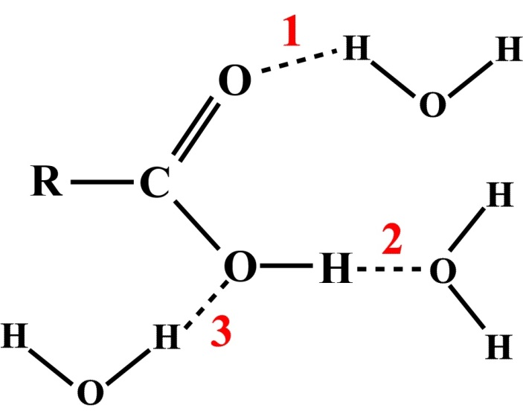
Use of the DL_F Notation to identify, quantify and annotate
the molecular interactions at atomistic details.
Introducing new standard expression system to
annotate specific atomic interactions:
The DL_ANALYSER Notation for Atomic Interactions (DANAI)
(C. W. Yong & I. T. Todorov, Molecules (2018), 23, 36)
Typical pictorial representation
of H-bond between carboxylic
acid and water molecules.

Slide 12
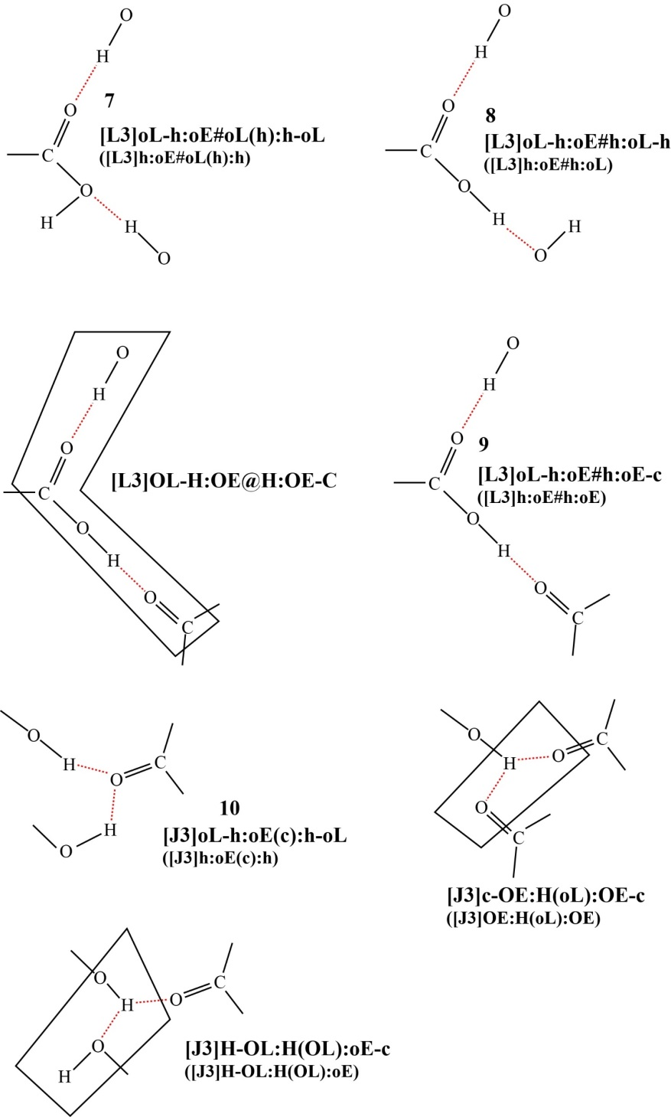
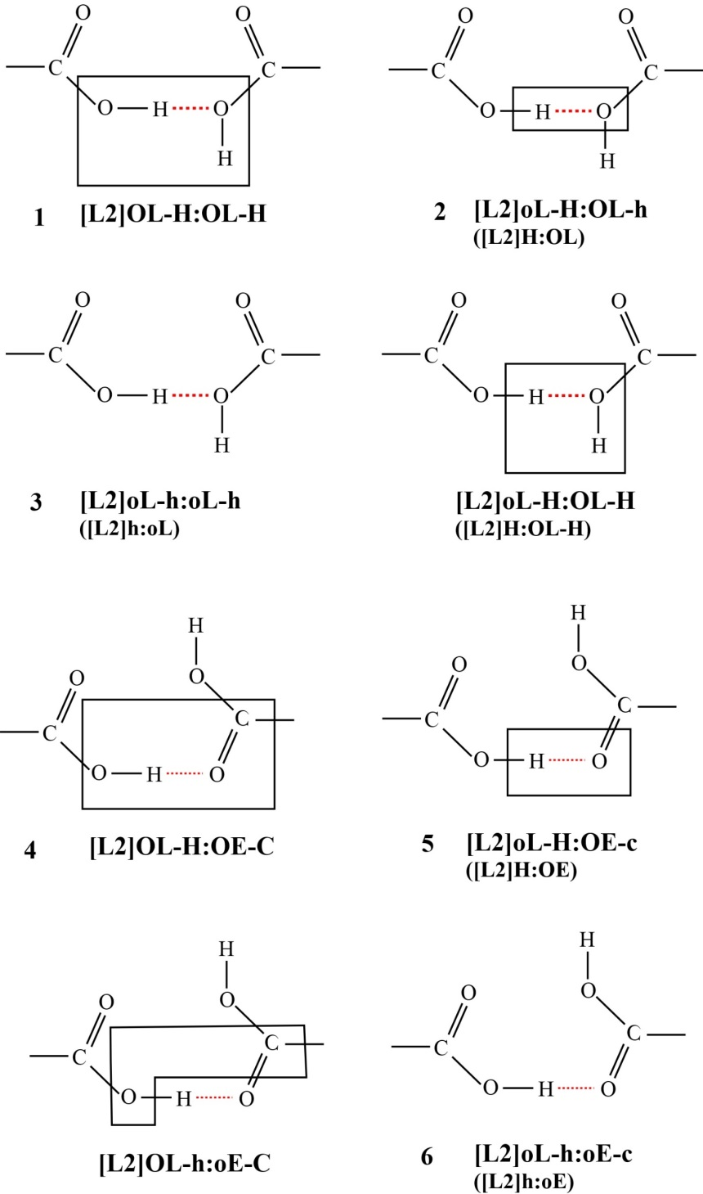
Carboxylic-carboxylic interactions
(HB_20_20)

Slide 13
HB_20_20
DANAI expression, i | number of interactions, m_{i}
1. [L2]OL-H:OL-H | 1.69 ± 1.27
2. [L2]oL-H:OL-h | 79.34 ± 7.58
3. [L2]oL-h:oL-h | 113.50 ± 8.75
4. [L2]OL-H:OE-C | 418.90 ± 14.65
5. [L2]oL-H:OE-c | 504.61 ± 10.76
6. [L2]oL-h:oE-c | 581.28 ± 8.50
7. [L3]oL-h:oE#oL(h):h-oL | 59.64 ± 6.17
8. [L3]oL-h:oE#h:oL-h | 92.95 ± 7.38
9. [L3]oL-h:oE#h:oE-c | 477.39 ± 13.60
10. [J3]oL-h:oE(c):h-oL | 22.32 ± 4.35
MD simulations of pure ethanoic acid
at 300 K using OPLS2005 FF.
 | 1 | 2 | 3 | 4 | 5 | 6 | 7 | 8 | 9 | 10
1 | 1.000 | 0.056 | -0.001 | -0.004 | -0.080 | -0.182 | 0.005 | -0.009 | -0.163 | -0.063
2 |  | 1.000 | 0.764 | -0.610 | -0.444 | -0.811 | 0.627 | 0.644 | -0.794 | -0.253
3 |  |  | 1.000 | -0.834 | -0.653 | -0.628 | 0.617 | 0.853 | -0.651 | -0.067
4 |  |  |  | 1.000 | 0.906 | 0.526 | -0.445 | -0.696 | 0.676 | -0.312
5 |  |  |  |  | 1.000 | 0.405 | -0.286 | -0.506 | 0.616 | -0.546
6 |  |  |  |  |  | 1.000 | -0.482 | -0.461 | 0.915 | 0.364
7 |  |  |  |  |  |  | 1.000 | 0.521 | -0.457 | -0.243
8 |  |  |  |  |  |  |  | 1.000 | -0.562 | -0.094
9 |  |  |  |  |  |  |  |  | 1.000 | 0.077
10 |  |  |  |  |  |  |  |  |  | 1.000

Slide 14
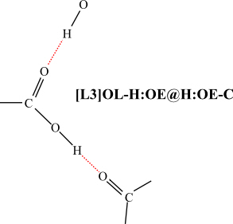
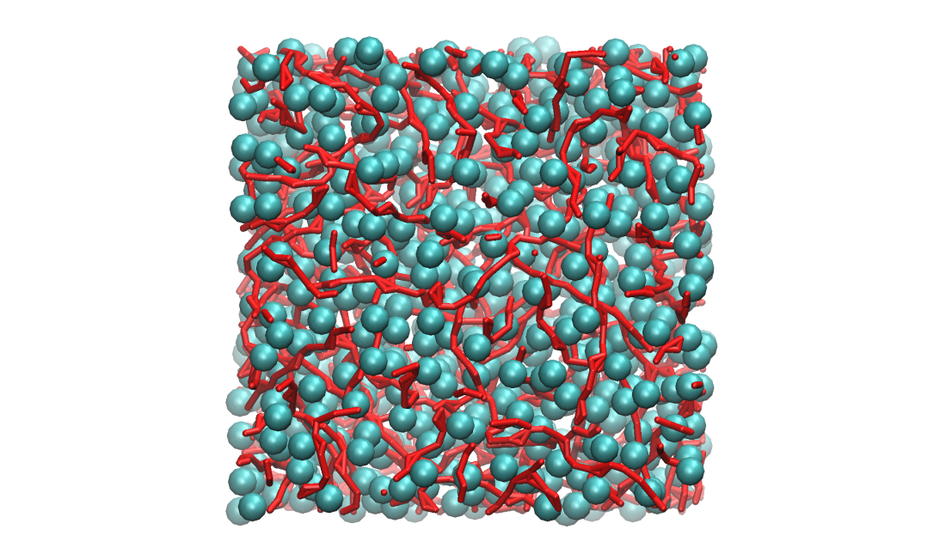
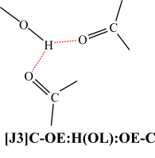
Predominant form of
H-bond interactions:
‘head-to-tail’
Ethanoic acid liquid interactions.
Form polymeric chains,
up to 10 carboxylic groups
(Red streaks)
branching
Methyl groups (cyan spheres)
hydrophobic interactions, forming a sponge-like
super-structure that permeates across the
whole system.
Can also carry out cross-correlation analysis between
HB and HP interactions.

Slide 15
Thank you

