Slide 1
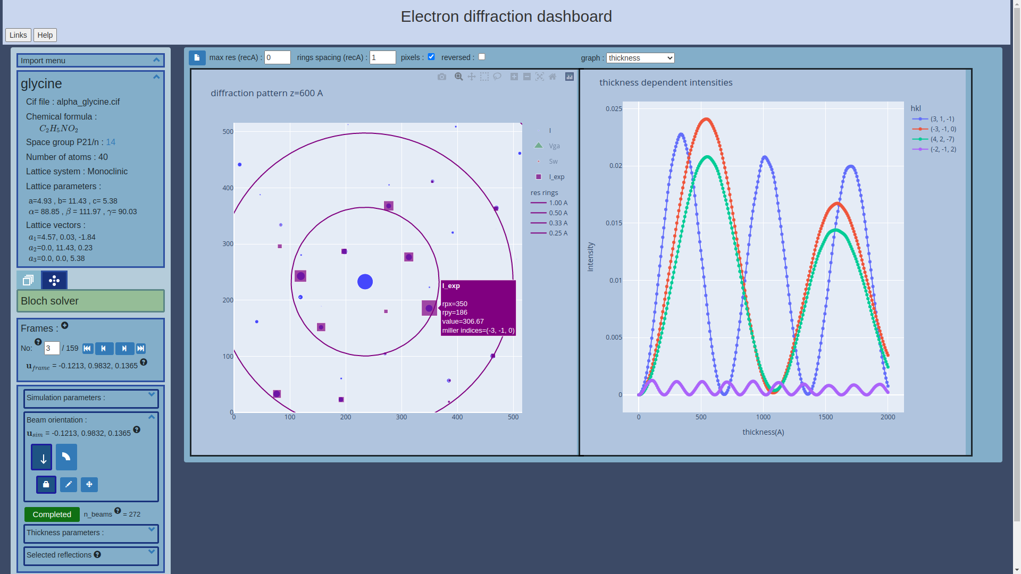
Bloch wave: an online simulator
Import menu:
A project, experimental frames, a CIF file or processed data with pets,dials or xds
Diffracted intensities
A Compare spot location and intensities to experimental values
Graph selection
Analyse thickness dependent intensities per reflection, rocking curves, integrated values
Molecule info
Formula, space group, parameters,...
Mode selection :
Frame viewer
Bloch solver
Frame panel :
Tracks experimental frames with beam orientation
Solver settings :
Beam orientation, wavelength, ...
Analysis :
Thickness and reflection selection
https://www.ccp4.ac.uk/edly/viewer​

Slide 2
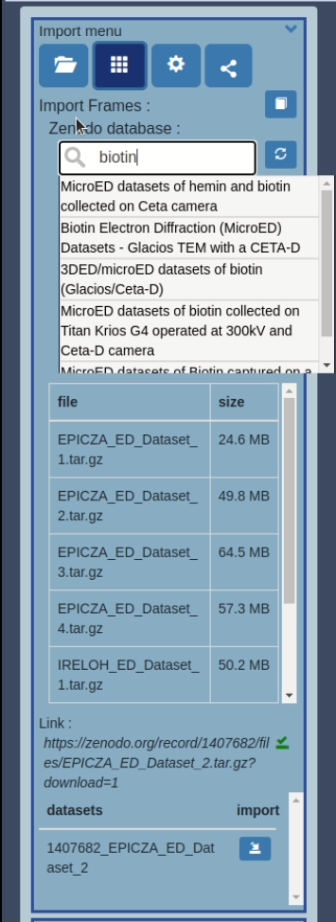
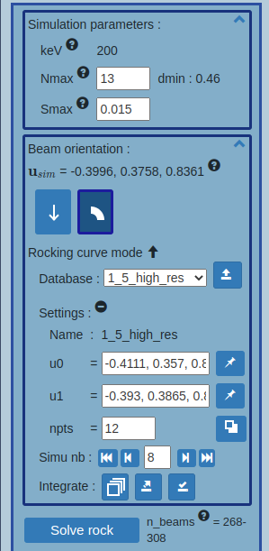
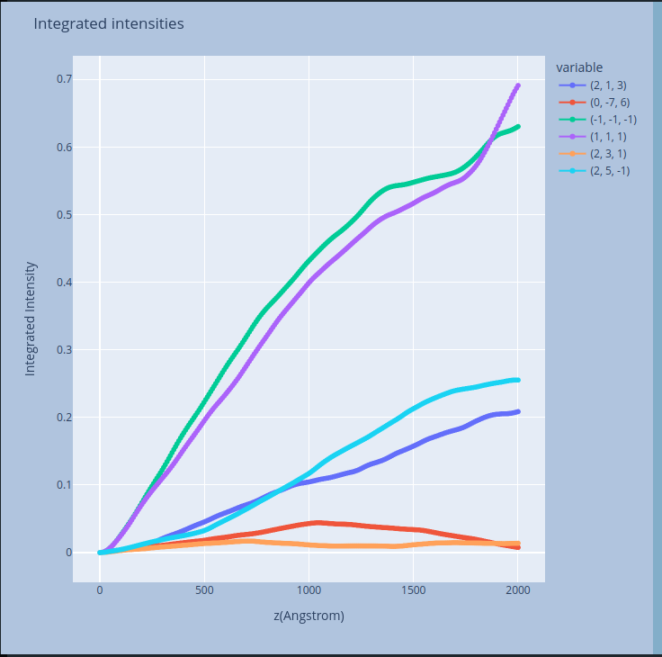
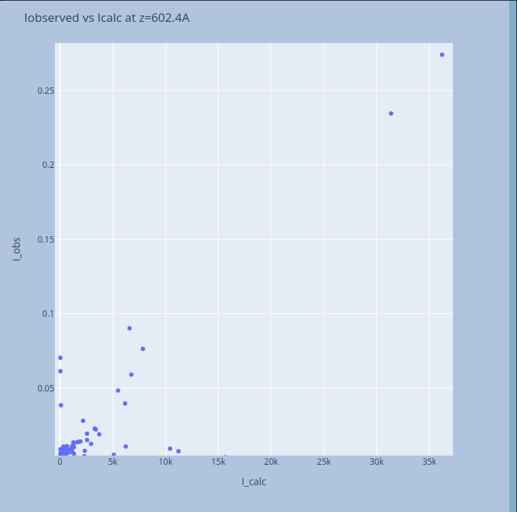
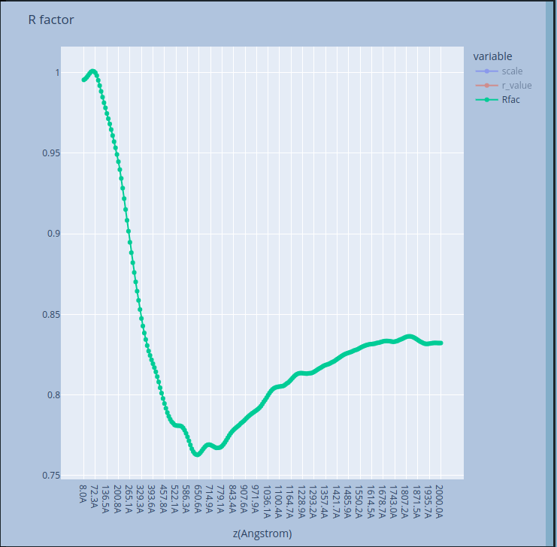
New features
Zenodo frames importer :
Browse and import datasets from community database Zenodo
Rocking curve simulations
Load, save, export, integrate previously simulated rocking curve data
Visualization graphs
Thickness dependent simulated integrated intensities and Rfactor as well as Iobs vs Icalc graphs.
Integrated intensities
Io vs Ic graphs
Rfactor

Slide 3
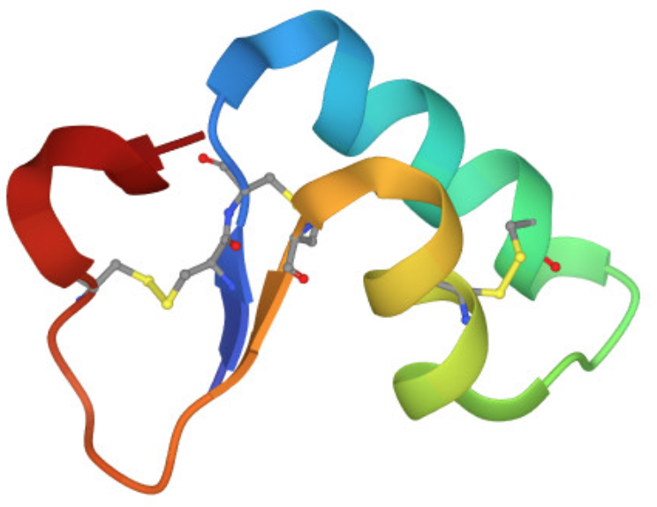
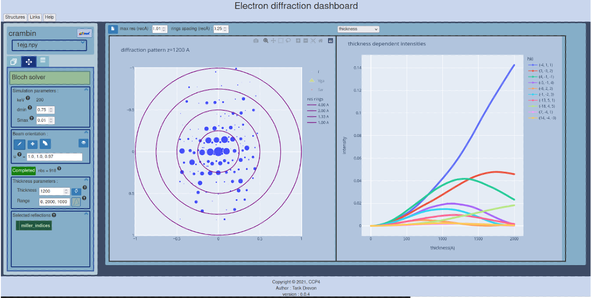
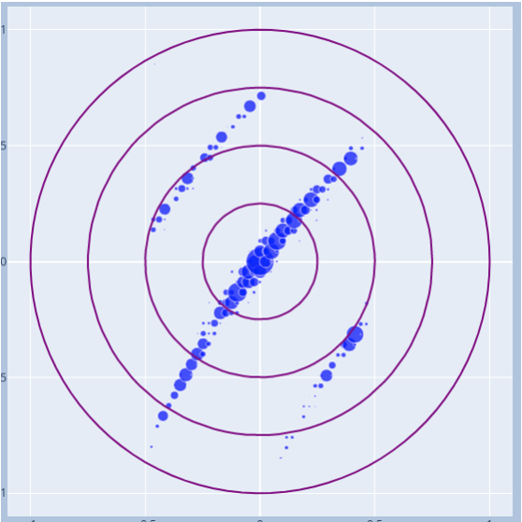
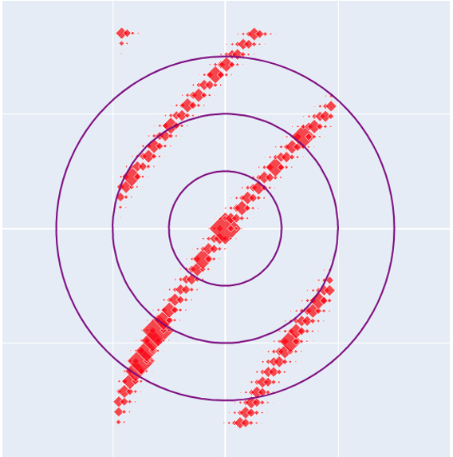
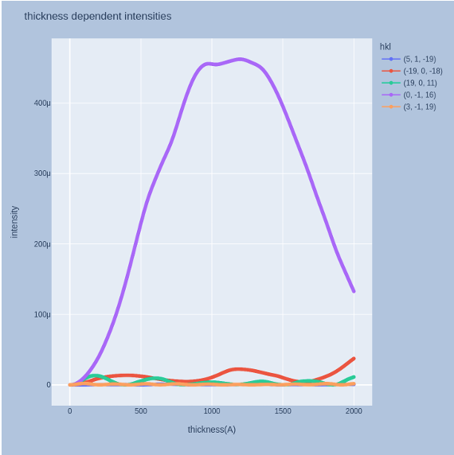
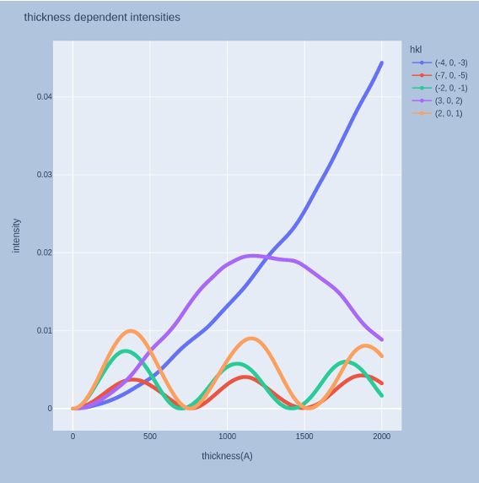
ED Simulations of Crambin
Simulation up to 1A resolution for non zone axis orientations
The number of beams grows quickly with simulated resolution
Simulation should be at significantly higher resolution than experiment as weakly excited beams can affect intensities of stronger beams
Simulation with perturbation theory could include such weakly excited beam effect without affecting the number of beams used in the matrix diagonalization
Weak beam thickness dependent intensity tend to show stronger dynamical behaviour
Simulation for non zone axis orientation [1,1,0.97]
Pattern for [-0.87,1,0.05]
Excitation error
Weak beam intensities
Strong beam intensities

