Slide 1


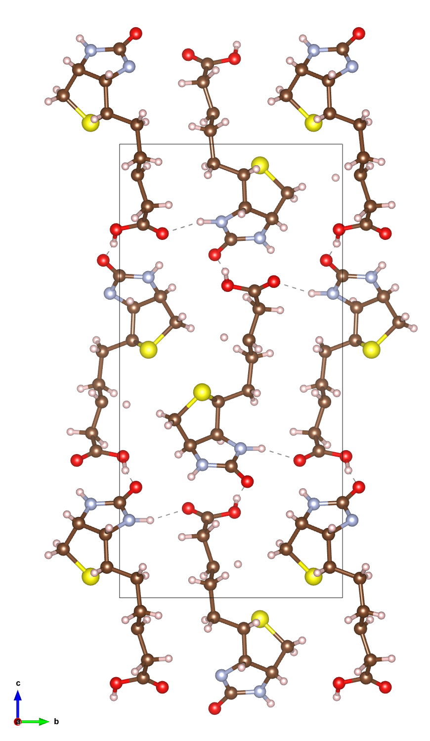
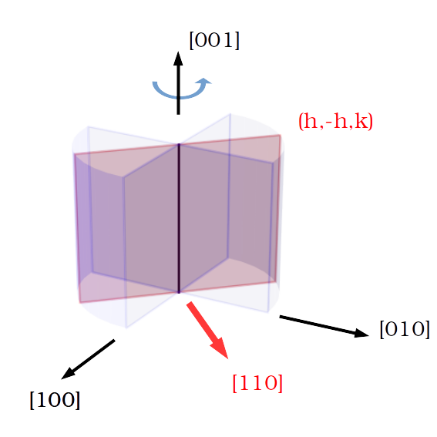
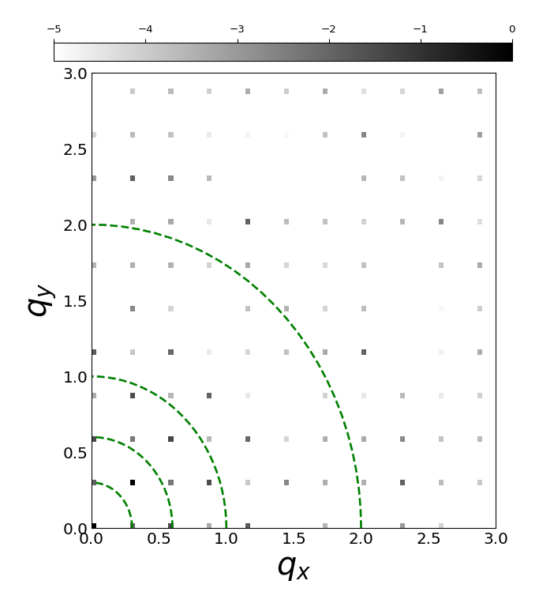

Simulation of Dynamical Scattering in Electron Diffraction Patterns
Tarik Drevon, David Waterman, Eugene Krissinel
Notes:
I am Tarik Drevon, I work in the Biology and life science department with David Waterman and Eugene Krissinel within the CCP4 group. I started 02/2020.
CCP4 is a software used to solve macromolecular structures from X-ray diffraction data and there is currently an interest in the group to expand those capabilities to handle electron diffraction data. The main reason is that electron diffraction technique shows benefits for handling proteins that only grow to nanocrystal scale.
Ideally, we would like to implement some corrections at different stages of the structure determination process to handle Electron Diffraction data while still using the same overall framework as used for X-ray data.
To identify those correction opportunities, we wanted to simulate electron diffraction patterns.

Slide 2
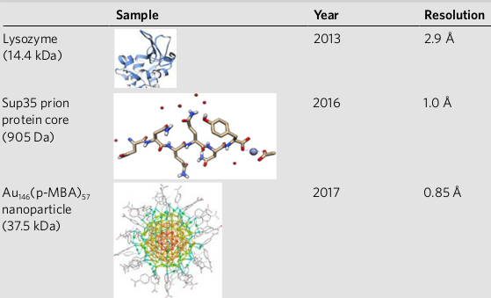
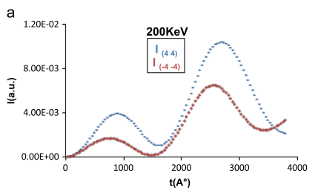
Discrepancy between theory and experiments
Macromolecules solved from experimental Electron Diffraction (ED) data
Multiple scattering should prevent use of standard X-ray kinematic technique
B. L. Nannenga and T. Gonen, “The cryo-EM method microcrystal electron diffraction (MicroED),” Nat. Methods, vol. 16, no. May, pp. 369–379, 2019
G. Subramanian, S. Basu, H. Liu, J. Zuo, and J. C. H. Spence, “Solving protein nanocrystals by cryo-EM diffraction : Multiple scattering artifacts,” Ultramicroscopy, vol. 148, pp. 87–93, 2015
Notes:
The main motivation for doing so is that there seems to be some disagreement between ED experiments and theory of electron diffraction.
On the left, some macromolecules(14kDa) registered to the PDB database using ED data at high resolution, mainly solved with standard MX. This shows that it possible in practice at least in some cases to use ED data.
<!-- Which could not be solved with X-ray due to crystal size?? -->
On the right, theoretical work among others showing why this should not be possible. You can see the intensity of a diffraction spot and its Friedel pair as the thickness of the crystal is increased. In MX Friedel mates must have identical intensities and it can be seen that above 50nm crystal thickness this Friedel symmetry law is violated.
<!-- There is also an oscillation which is different than what happens in MX. -->
So in theory there seem to be a problem in handling ED data with standard MX and is attributed to dynamical scattering which is absent in X-ray experiments.

Slide 3
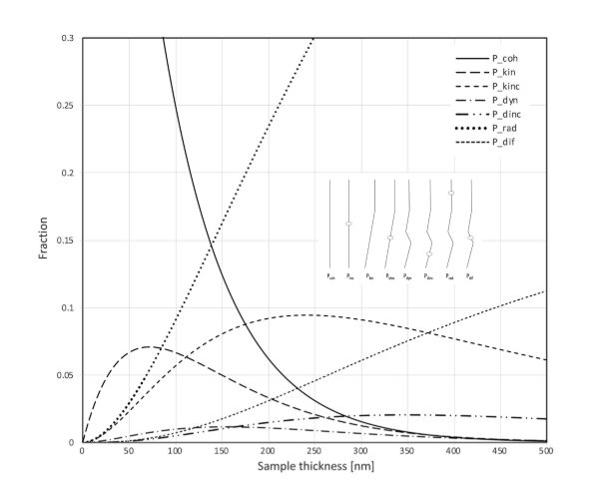
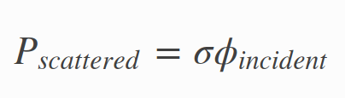
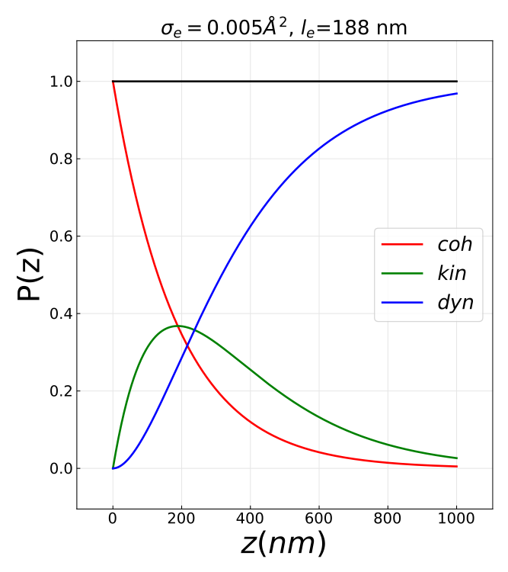
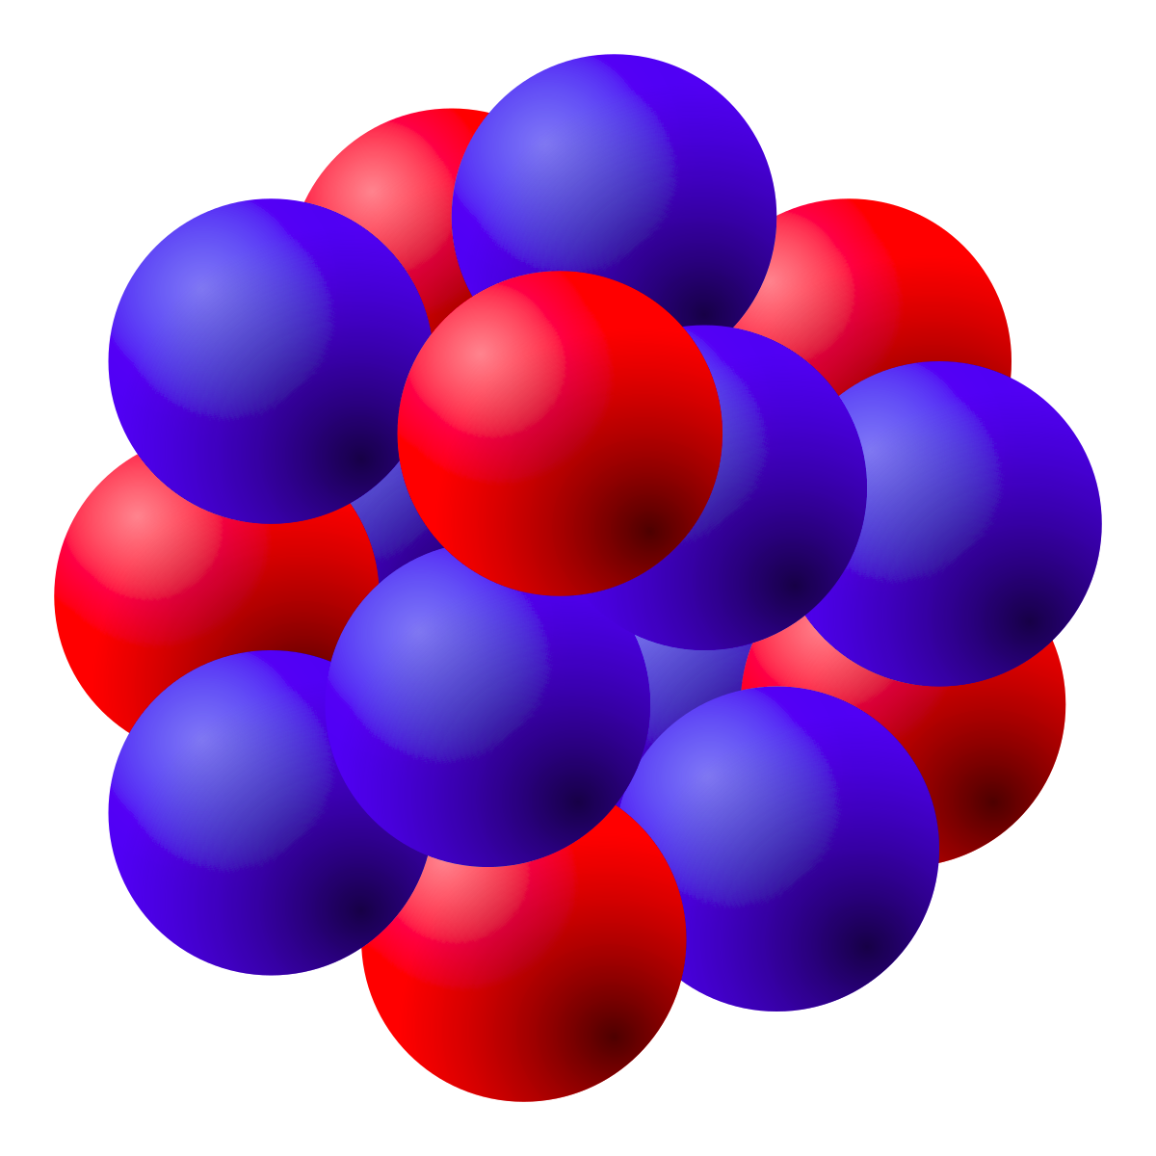
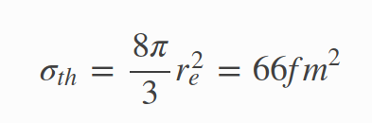

Electron diffraction and dynamical scattering
Atomic interation cross section
Mean free path
l_{e} = 200nm
σ
X-rays (Thomson scattering)
Electrons (Coulomb scattering)
T. Latychevskaia and J. P. Abrahams, “Inelastic scattering and solvent scattering reduce dynamical diffraction in biological crystals,” Acta Crystallogr. Sect. B Struct. Sci. Cryst. Eng. Mater., vol. 75, pp. 523–531, 2019
Notes:
The core difference between X-ray and ED exp lies in the strength of the interaction between the specimen and the probing source : ED involves Coulomb scattering which is orders of magnitude stronger than Thomson scattering involved in X-ray.
We measure the strength of an interaction with the interaction cross section which can be determined from first principles as you can see below.
The cross section is an area with a simple meaning.
If you take a beam of particles(X-rays or electrons) with a given flux(part/s/m^2) incident onto a scatterer(atom), the interaction cross section gives you the number of particles that will be scattered per second. So large cross section means strong interaction.
For X-rays, the cross section is proportional to the square of the classical radius of the electron which is tiny.
<!-- For Thomson scattering the cross section from X-ray with a atomic electron is basically the square of the classical radius of the electron which results in a tiny cross section. Scattering from the atom then somehow linearly increases with its number of electrons. -->
For electron scattering, the typical cross section is orders of magnitude stronger. In fact, combining the cross section and typical material density gives a mean free path less than 200nm.
On the figure, you can see the probability of electron scattering events as a function of specimen thickness. In red, no scattering, in green scattered only once(so kinematic) and blue more than once (so dynamical)
As you can see for samples larger than 200nm, which is below typical crystal sizes, dynamical diffraction starts to dominate.
<!--Can we grow crystals smaller than 200nm ? exp ED crystal sizes ?-->

Slide 4
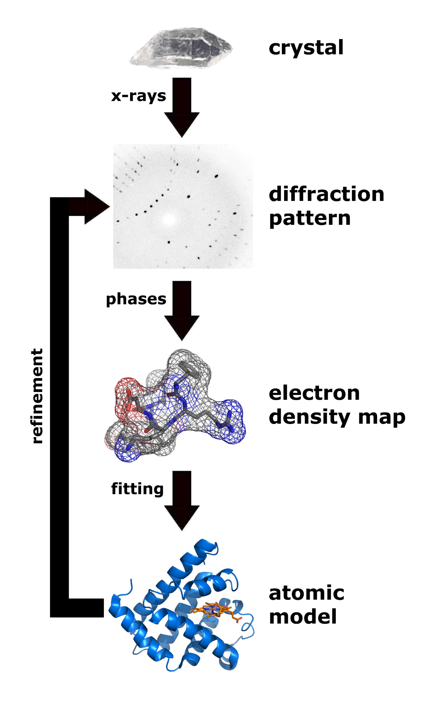
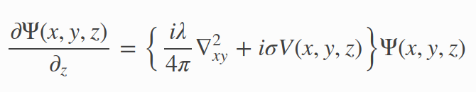

Numerical simulation tools of ED patterns
Born approximation (used for X-rays)
Schrodinger’s fast electron wave equation
Refinement
+phases
FFT⁻¹
Electron density
Model
Method | Exact/consistent | Speed | Memory (per atoms) | Periodic structure | Grid based | Package
Multislice (MS) (physical optics based approach) | no | fast | 10 points | yes | yes | TEMSIM (pyMS) PRISM,...
Bloch wave (diagonalization in reciprocal space) | yes | slow | 10 points | yes | no | EDM,PyQt,...
Near bragg (real space path differences) | no | ?? | 1 point | no | no | NearBragg (James Holton)
Notes:
Here is the standard MX technique framework.
X-rays are sent through a crystal which is continuously rotated around an axis to produce series of diffraction patterns.
The square root of the diffraction patterns are enriched with the adequate phases known as the structure factor.
An inverse Fourier transform of the structure factor yields the electron density map.
Note that for electron diffraction, the inverse Fourier transform
would yield the electrostatic potential map which provides more direct information about the location of the nucleus.
The problem is that when dynamical diffraction is present as in electron diffraction, this transformation no longer holds as is is based on the single or kinematic scattering assumption.
Instead the diffraction patterns are found from directly solving Schroedinger's equation where V is the electrostatic potential of the crystal, Psi the incident electron beam wave function and E the energy of the electron(typically 100keV). The actual equation solved uses the small scattering angle assumption and is shown below.
To simulate a diffraction pattern, there are a few possible approaches with pros and cons. The most popular is the multislice with various opensource packages. Among them, TEMSIM a very well documented and easy to use that we have chosen.
We are also developing an alternative approach which should have some benefits for macromolecular crystals but I will not cover it here.

Slide 5
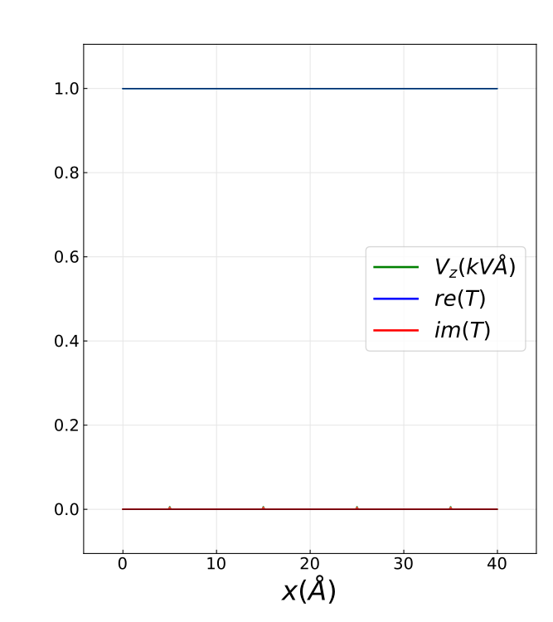
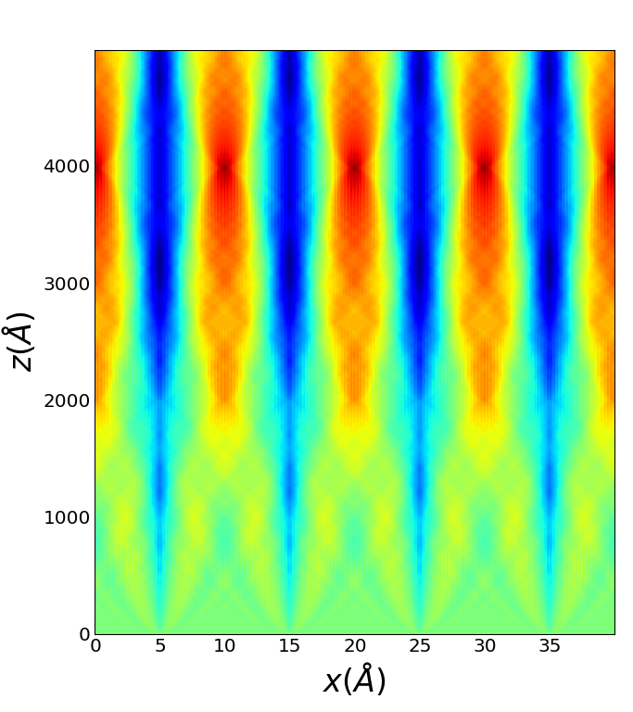
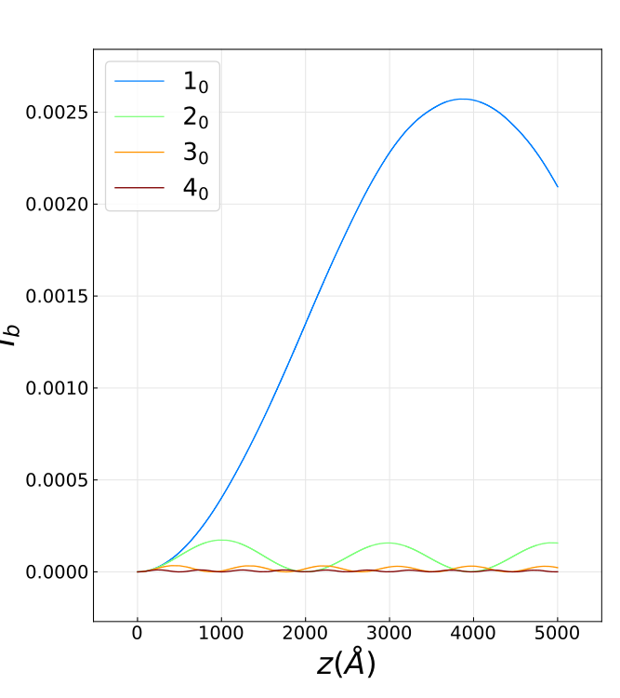
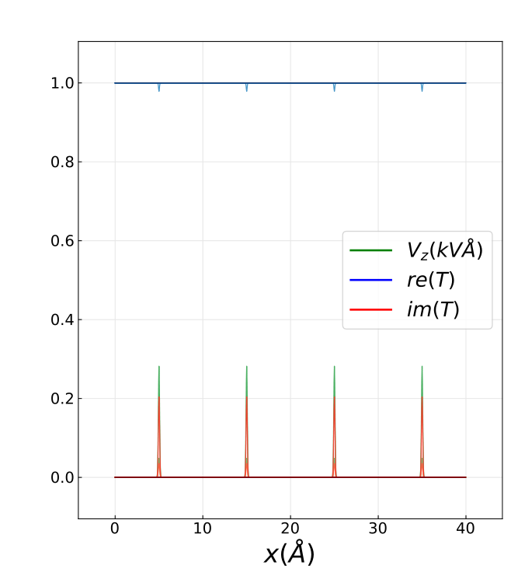
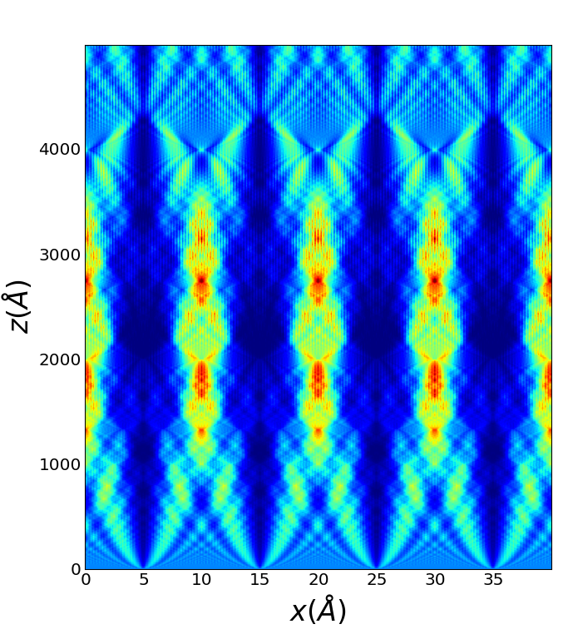
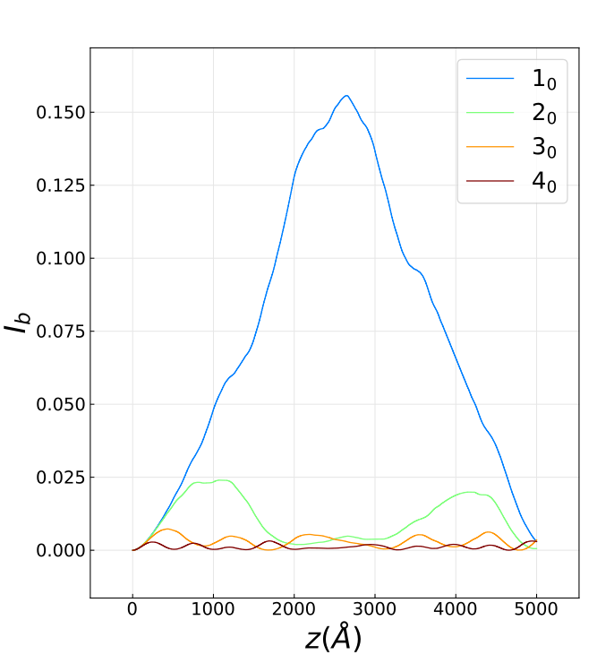
Multislice 2D examples : electrostatic potential
Potential strength
Transmission function and projected potential
Wave function inside the crystal
Beams intensities in Reciprocal space
Weak
Strong

Slide 6
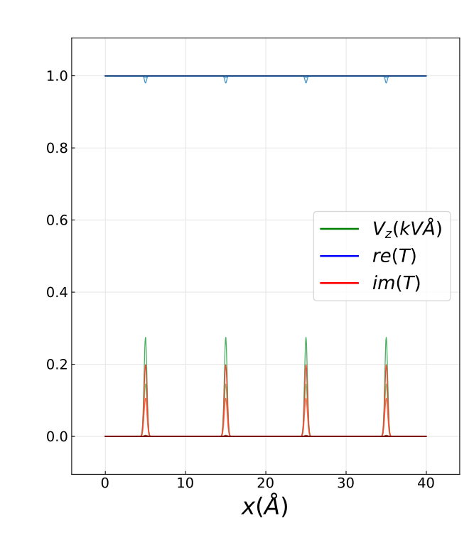
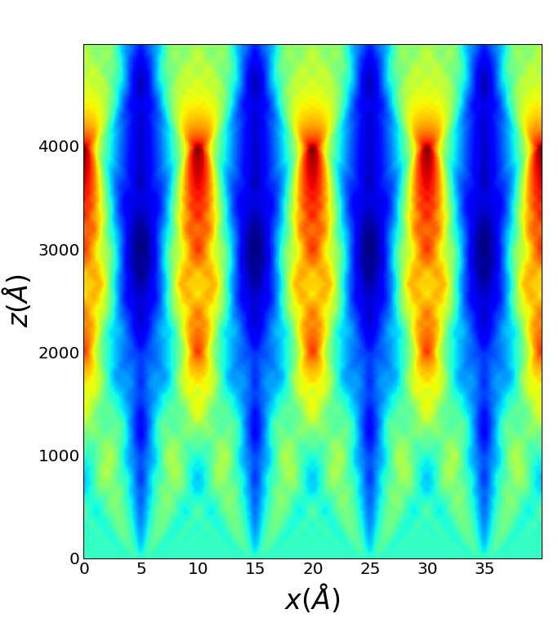

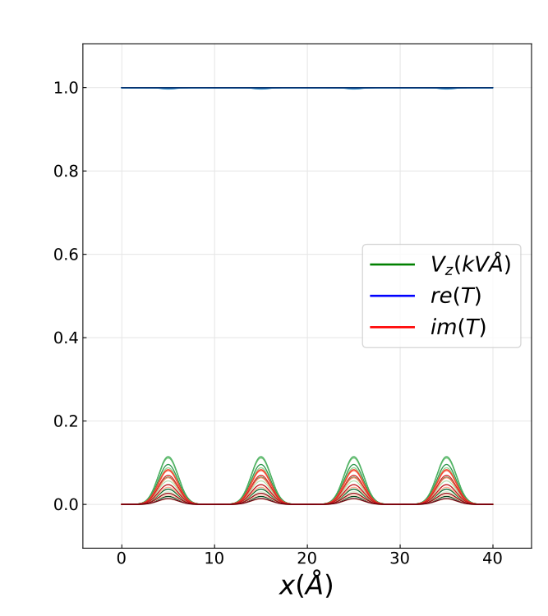
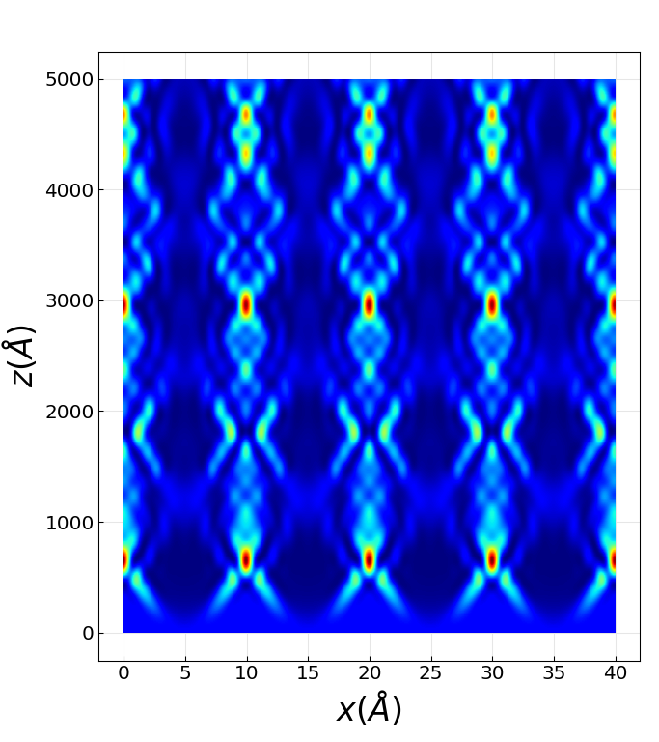
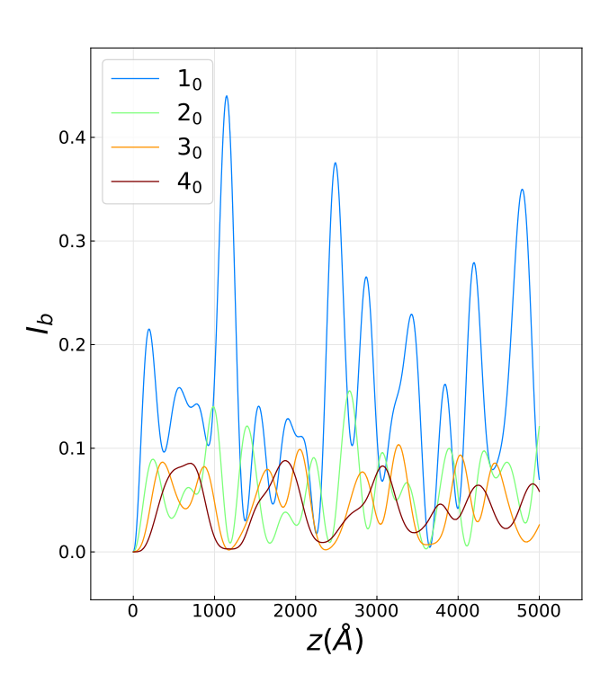
Multislice 2D examples : electrostatic potential
Potential
Transmission function and projected potential
Wave function inside the crystal
Beams intensities in Reciprocal space
small atomic overlap
large atomic overlap

Slide 7
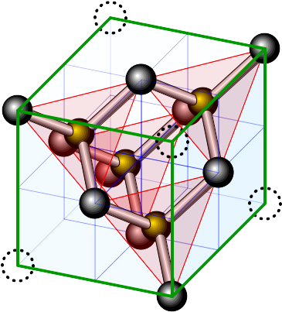
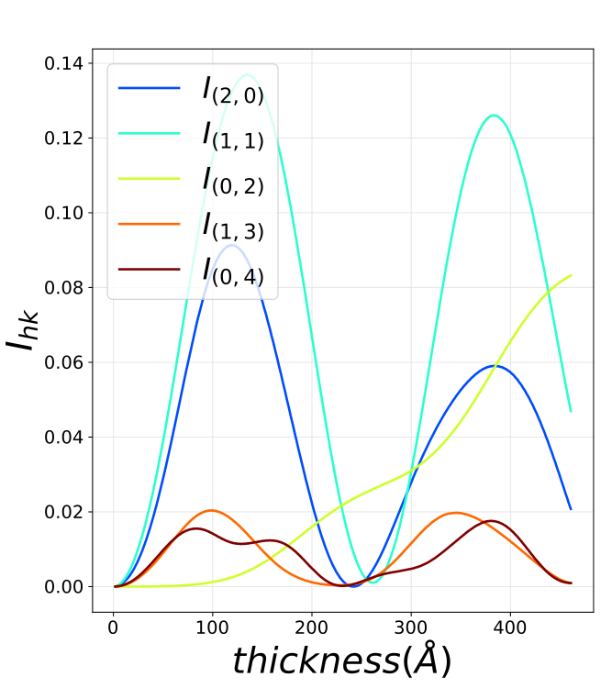
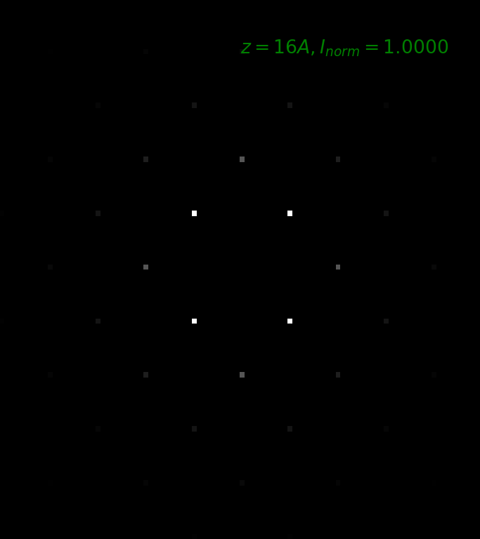
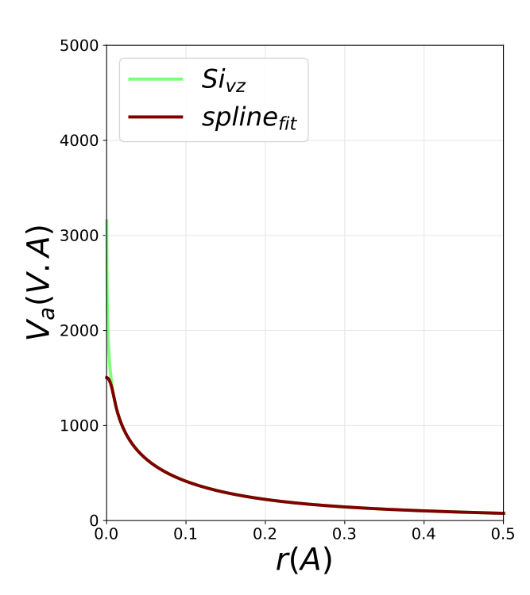
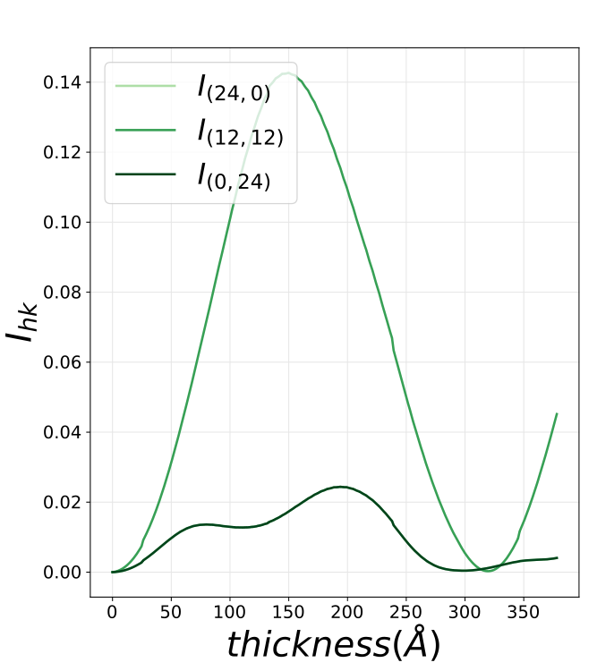
Multislice Silicon Diamond Structure
[110] vs [100]

Slide 8


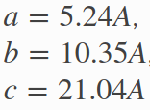
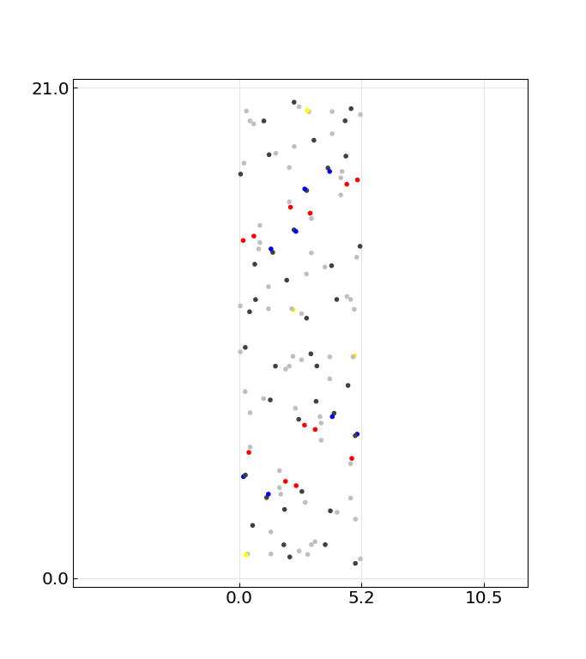
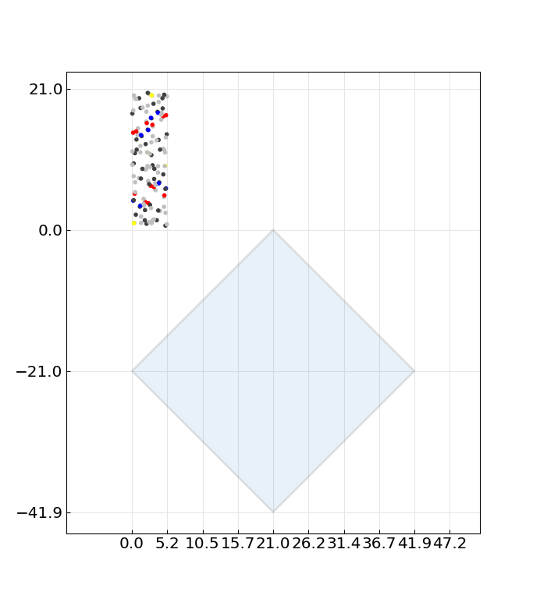
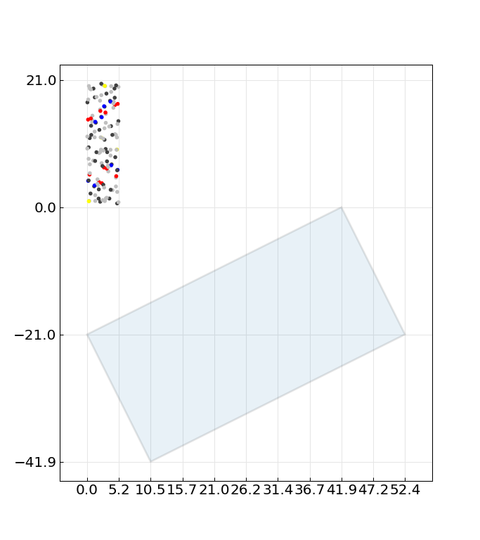
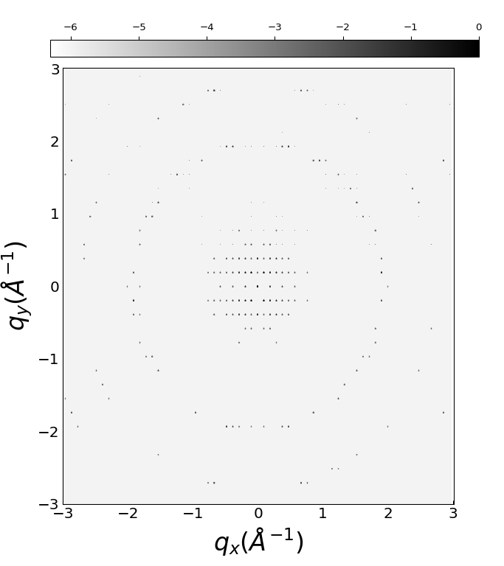
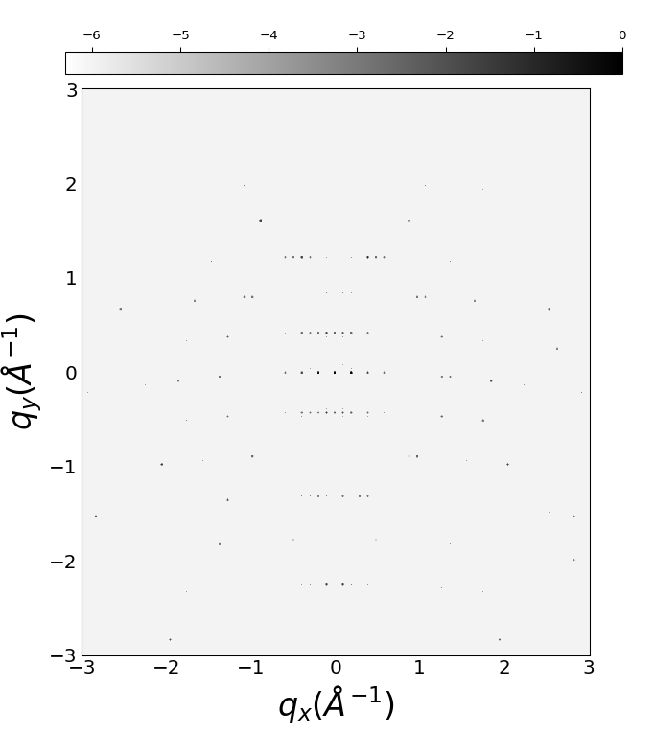
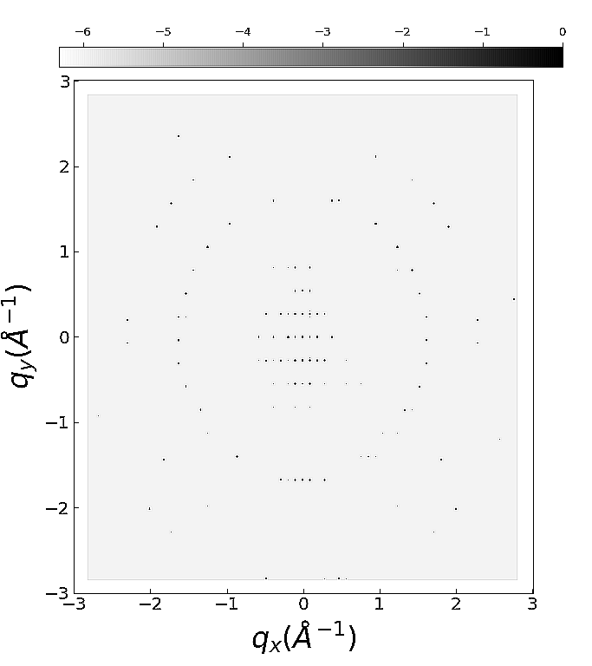
Simulation of biotin
Structure
[001]=0deg
[401]=45deg
[801]=64deg

Slide 9
What‘s next?
- Use CCP4 with the simulated data
- Investigate effect of defects, solvent, inelastic scattering
- Further develop nearBragg approach
- Make python interface available from the python index pypi
More info http://brno.rc-harwell.ac.uk:8000/ RCaH VPN required

