Slide 1


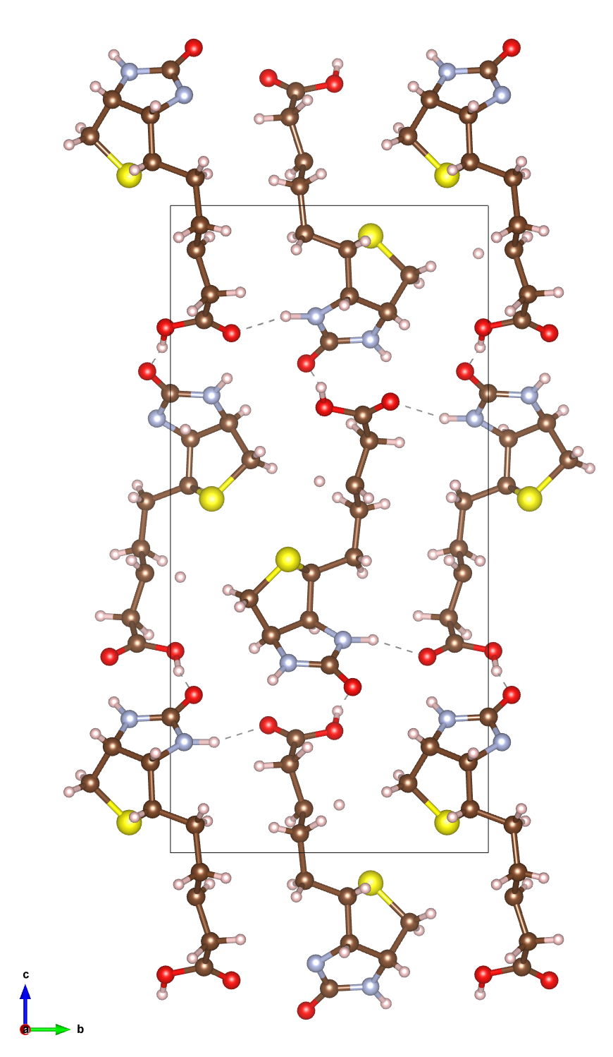
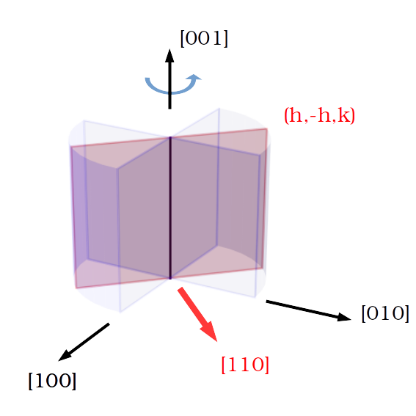
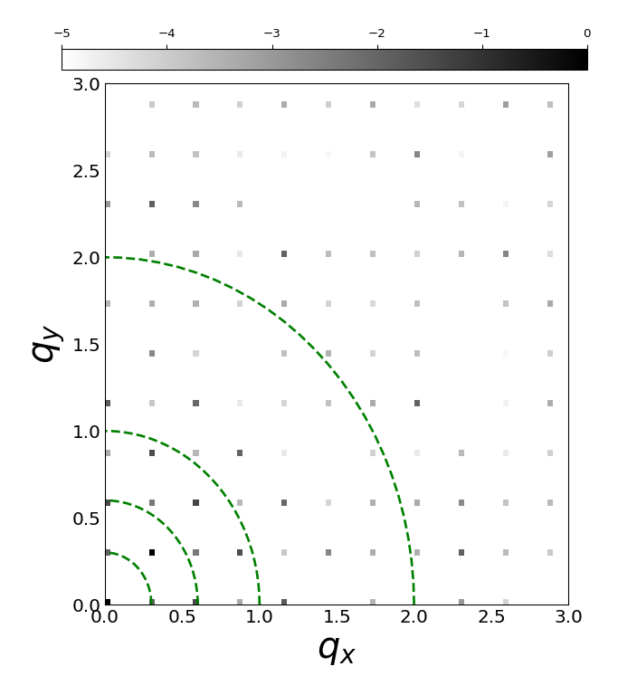

Simulation of Dynamical Scattering Effect in Electron Diffraction Patterns
Tarik Drevon, David Waterman, Eugene Krissinel
Notes:
I am Tarik Drevon, I work in the Biology and life science department with David Waterman and Eugene Krissinel within the CCP4 group. I started 02/2020.
CCP4 is a software used to solve macromolecular structures from X-ray diffraction data and there is currently an interest in the group to expand those capabilities to handle electron diffraction data. The main reason is that electron diffraction technique shows benefits for handling proteins that only grow to nanocrystal scale.
Ideally, we would like to implement some corrections at different stages of the structure determination process to handle Electron Diffraction data while still using the same overall framework as used for X-ray data.
To identify those correction opportunities, we wanted to simulate electron diffraction patterns.

Slide 2
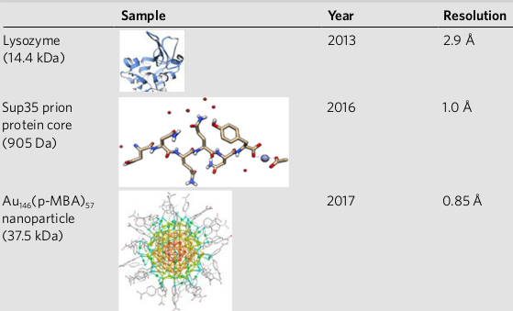
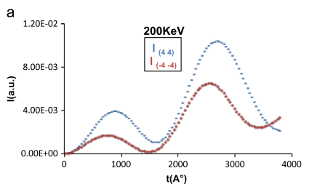
Discrepancy between theory and experiments
Macromolecules solved from experimental Electron Diffraction (ED) data
Multiple scattering should prevent use of standard X-ray kinematic technique
B. L. Nannenga and T. Gonen, “The cryo-EM method microcrystal electron diffraction (MicroED),” Nat. Methods, vol. 16, no. May, pp. 369–379, 2019
G. Subramanian, S. Basu, H. Liu, J. Zuo, and J. C. H. Spence, “Solving protein nanocrystals by cryo-EM diffraction : Multiple scattering artifacts,” Ultramicroscopy, vol. 148, pp. 87–93, 2015
Notes:
The main motivation for doing so is that there seems to be some disagreement between ED experiments and theory of electron diffraction.
On the left, some macromolecules(14kDa) registered to the PDB database using ED data at high resolution, mainly solved with standard MX. This shows that it possible in practice at least in some cases to use ED data.
<!-- Which could not be solved with X-ray due to crystal size?? -->
On the right, theoretical work among others showing why this should not be possible. You can see the intensity of a diffraction spot and its Friedel pair as the thickness of the crystal is increased. In MX Friedel mates must have identical intensities and it can be seen that above 50nm crystal thickness this Friedel symmetry law is violated.
<!-- There is also an oscillation which is different than what happens in MX. -->
So in theory there seem to be a problem in handling ED data with standard MX and is attributed to dynamical scattering which is absent in X-ray experiments.

Slide 3
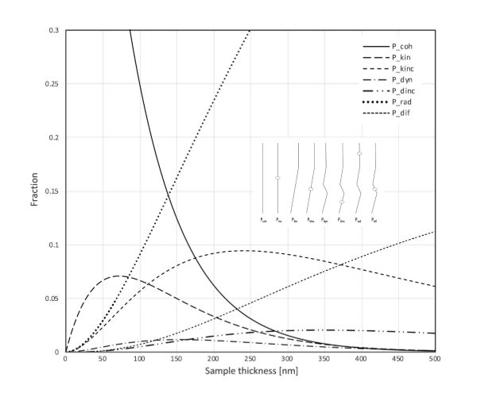
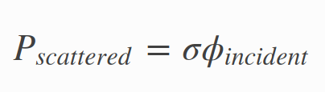
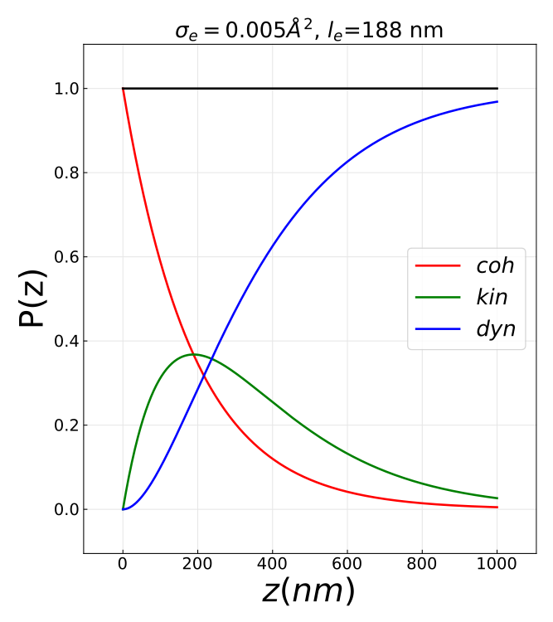
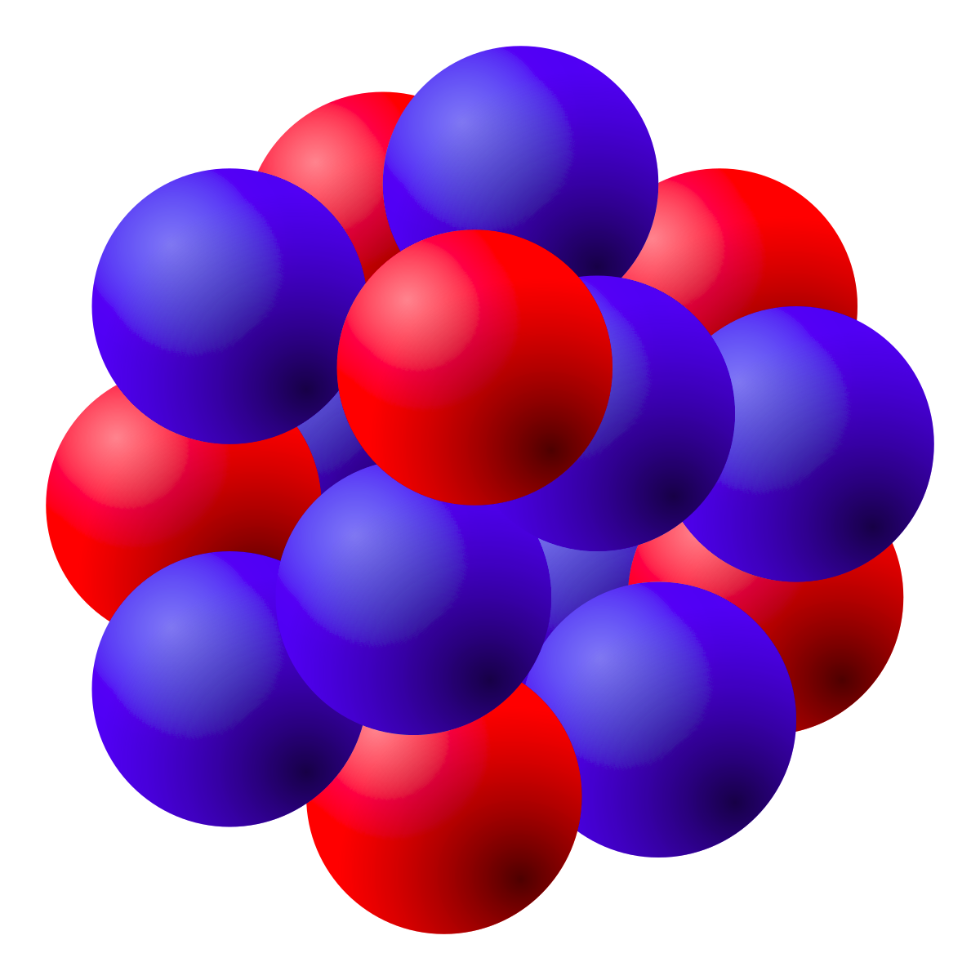
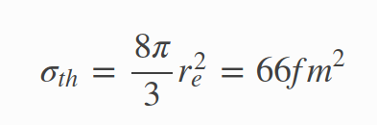

Multiple scattering in Electron diffraction
Atomic interation cross section
Mean free path
l_{e} = 200nm
σ
X-rays (Thomson scattering)
Electrons (Coulomb scattering)
T. Latychevskaia and J. P. Abrahams, “Inelastic scattering and solvent scattering reduce dynamical diffraction in biological crystals,” Acta Crystallogr. Sect. B Struct. Sci. Cryst. Eng. Mater., vol. 75, pp. 523–531, 2019
Notes:
The core difference between X-ray and ED exp lies in the strength of the interaction between the specimen and the probing source : ED involves Coulomb scattering which is orders of magnitude stronger than Thomson scattering involved in X-ray.
We measure the strength of an interaction with the interaction cross section which can be determined from first principles as you can see below.
The cross section is an area with a simple meaning.
If you take a beam of particles(X-rays or electrons) with a given flux(part/s/m^2) incident onto a scatterer(atom), the interaction cross section gives you the number of particles that will be scattered per second. So large cross section means strong interaction.
For X-rays, the cross section is proportional to the square of the classical radius of the electron which is tiny.
<!-- For Thomson scattering the cross section from X-ray with a atomic electron is basically the square of the classical radius of the electron which results in a tiny cross section. Scattering from the atom then somehow linearly increases with its number of electrons. -->
For electron scattering, the typical cross section is orders of magnitude stronger. In fact, combining the cross section and typical material density gives a mean free path less than 200nm.
On the figure, you can see the probability of electron scattering events as a function of specimen thickness. In red, no scattering, in green scattered only once(so kinematic) and blue more than once (so dynamical)
As you can see for samples larger than 200nm, which is below typical crystal sizes, dynamical diffraction starts to dominate.
<!--Can we grow crystals smaller than 200nm ? exp ED crystal sizes ?-->

Slide 4
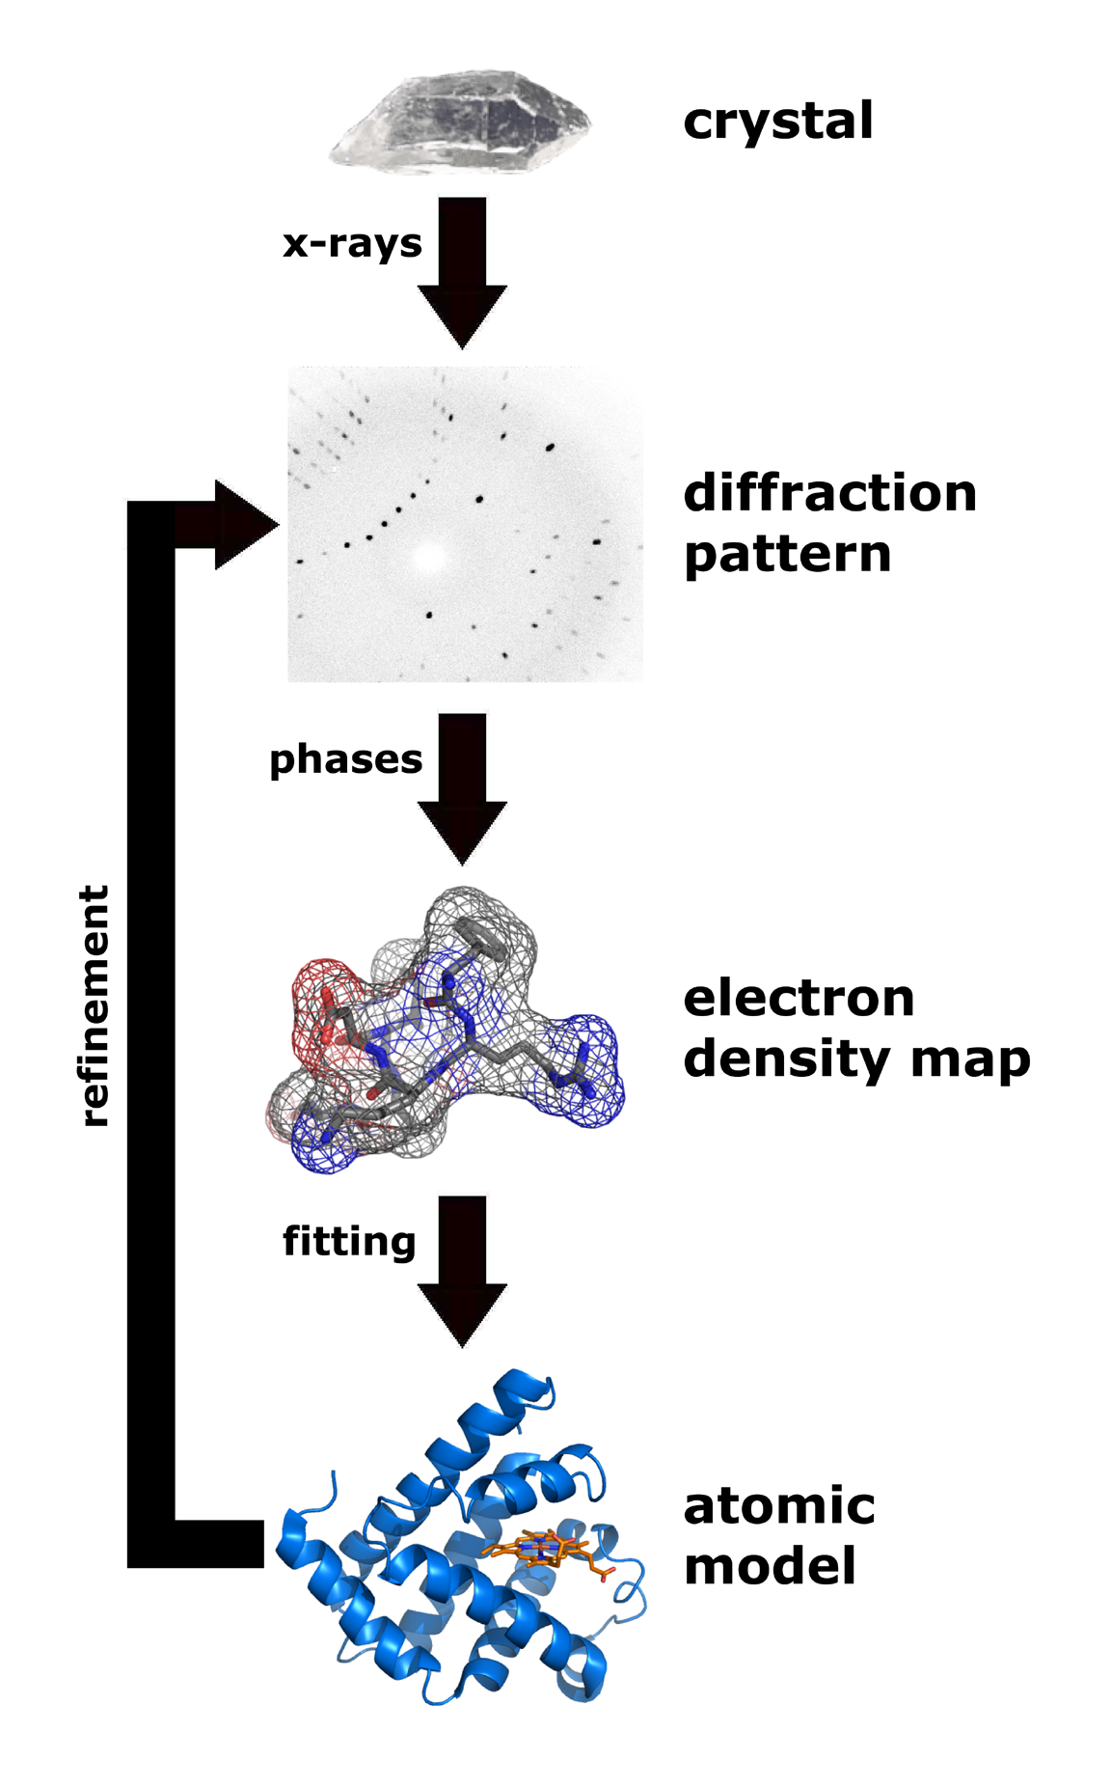

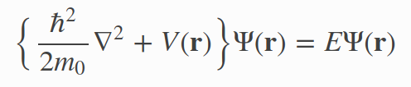
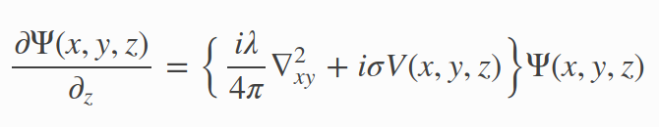

Numerical simulation tools of ED patterns
Kinematic approximation
Refinement
+phases
FFT⁻¹
Electron density
Model
Schrodinger’s fast electron wave equation
Notes:
Here is the standard MX technique framework.
X-rays are sent through a crystal which is continuously rotated around an axis to produce series of diffraction patterns.
The square root of the diffraction patterns are enriched with the adequate phases known as the structure factor.
An inverse Fourier transform of the structure factor yields the electron density map.
Note that for electron diffraction, the inverse Fourier transform
would yield the electrostatic potential map which provides more direct information about the location of the nucleus.
The problem is that when dynamical diffraction is present as in electron diffraction, this transformation no longer holds as is is based on the single or kinematic scattering assumption.
Instead the diffraction patterns are found from directly solving Schroedinger's equation where V is the electrostatic potential of the crystal, Psi the incident electron beam wave function and E the energy of the electron(typically 100keV). The actual equation solved uses the small scattering angle assumption and is shown below.
To simulate a diffraction pattern, there are a few possible approaches with pros and cons. The most popular is the multislice with various opensource packages. Among them, TEMSIM a very well documented and easy to use that we have chosen.
We are also developing an alternative approach which should have some benefits for macromolecular crystals but I will not cover it here.

Slide 5
Numerical simulation tools of ED patterns
Method | Exact | Speed | Mem (beam per atom) | Periodic structure | Grid based | Parallelization type | Package
Multislice (MS) (physical optics based approach) | no | N_{z}N_{b}logN_{b} | 100 | yes | yes | FFTw one slice after another | TEMSIM (pyMS) PRISM,...
Bloch wave (diagonalization in reciprocal space) | yes | N_{b}³ | 10 | yes | no | Matrix diagonalization | EDM, PyQt,...
Near bragg (real space path differences) | no | N_{z}N_{b}²N_{p} | 1 | no | no | per pixel | NearBragg (James Holton)

Slide 6

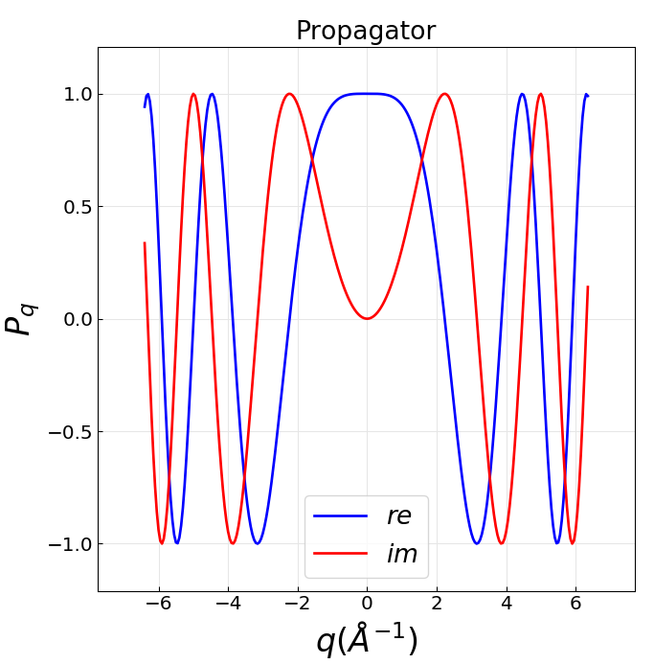
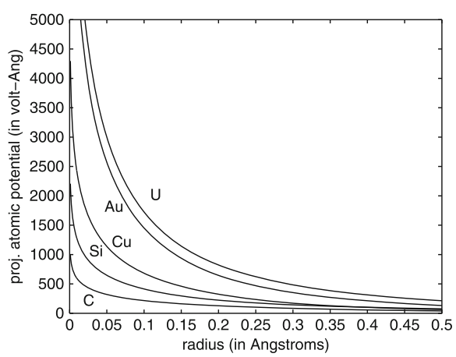


Multislice algorithm (MS)
Multislice algorithm (MS)
FFT
Fresnel propagator
Transmission function
Projected potential
Weak potential
Notes:
The multislice method was proposed in 1957 by CowleyMoodie based on physical optics principles. If proposed the following analytical solution to Schroedinger's equation.
The specimen is cut in slices along the beam propagation direction and the electron wave function is computed at a given slice from its expression at the previous slice.
The slice is represented by a transmission function which changes the phase of the wave function through the projected electrostatic potential that you can see for a few atoms here.
The wave function is then propagated to the next slice using Fresnel diffraction framework which corresponds to performing a convolution with the Fresnel propagation function.
Once propagation has gone through the whole specimen, a Fourier transform is used to compute the diffraction pattern from the exit wave function.
The popularity of the multislice method comes from its efficiency because this convolution can be done using products and Fourier transforms.
Below you can see the complex propagator function represented in reciprocal space.
Note that if the potential was very weak the transmission function is approximated by a real constant forward propagation term and an imaginary term proportional the projected potential.
In the case where the slice thickness is the whole sample itself, the method reduces to standard MX.

Slide 7
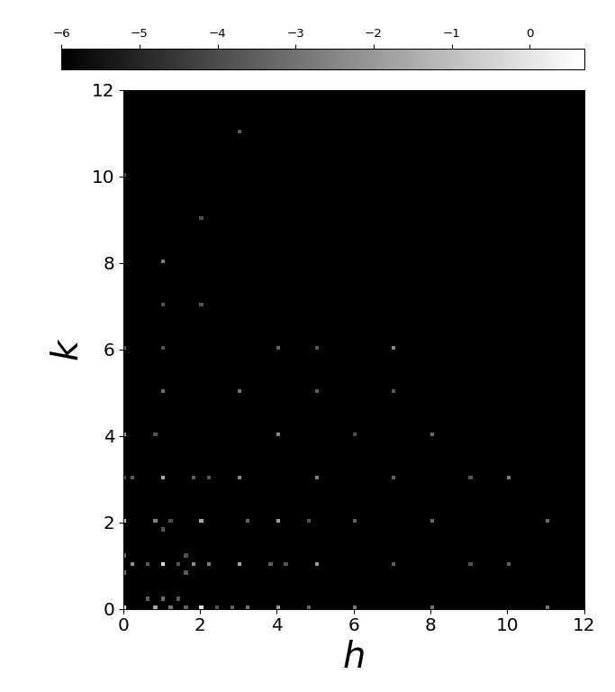
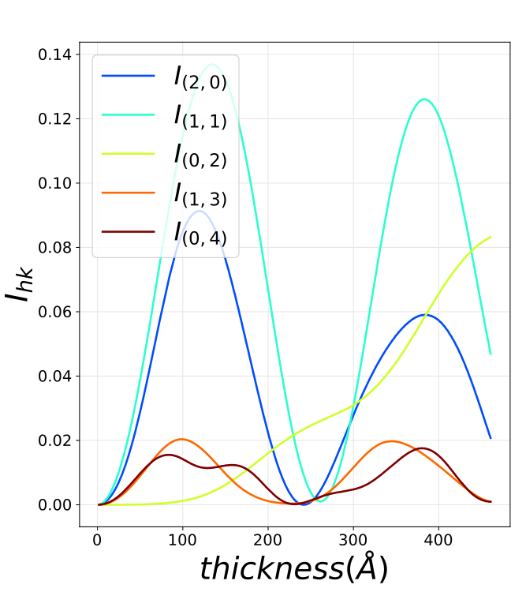
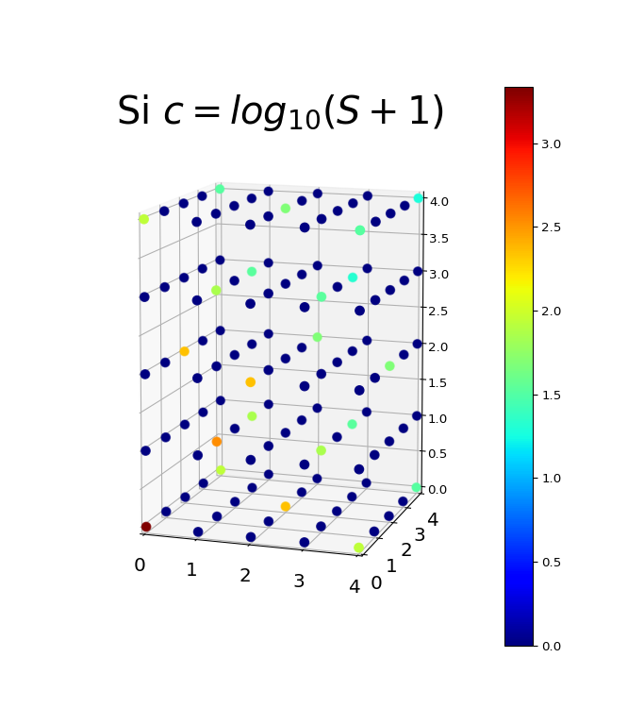
Multislice Silicon [110]
Diffraction pattern 40nm
Evolution of major beam intensities

Slide 8
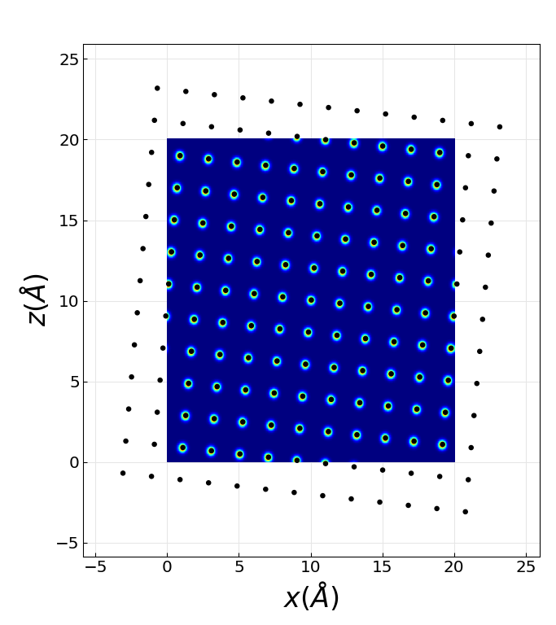
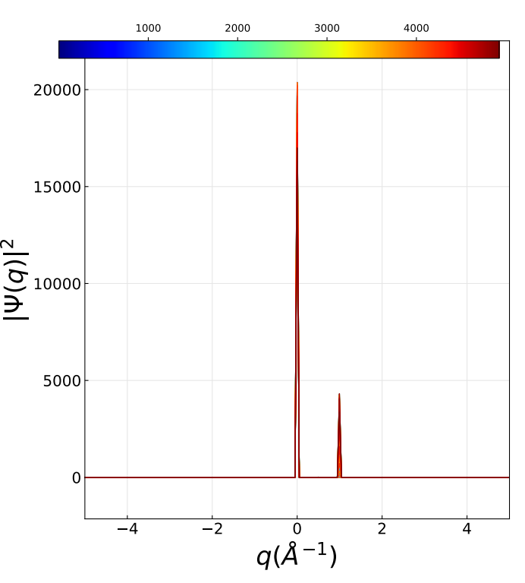
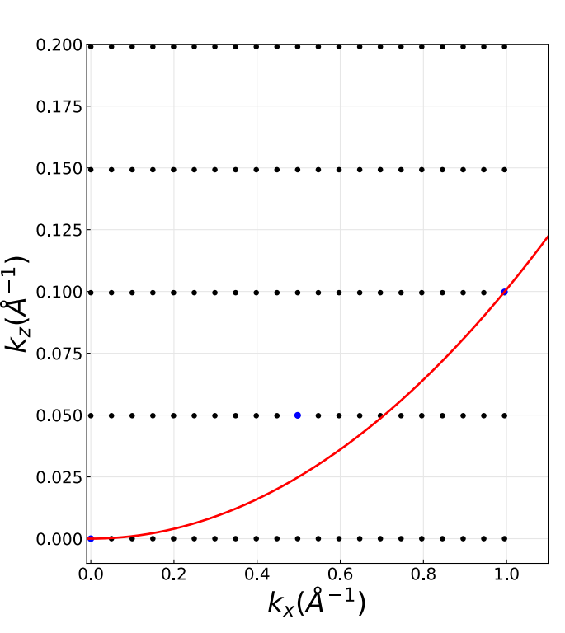
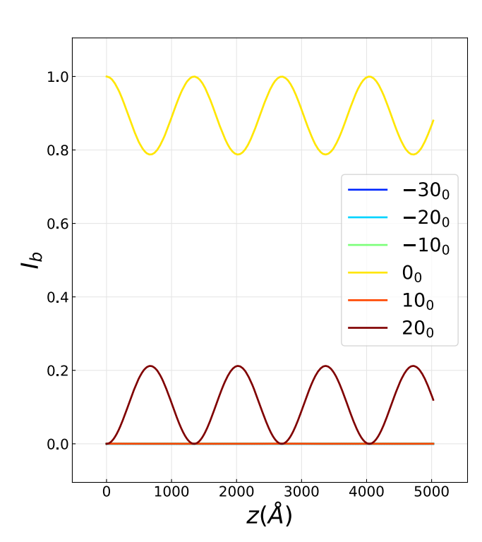
Multislice 2-beam diffraction case
Beams with thickness
2-beam setup

Slide 9
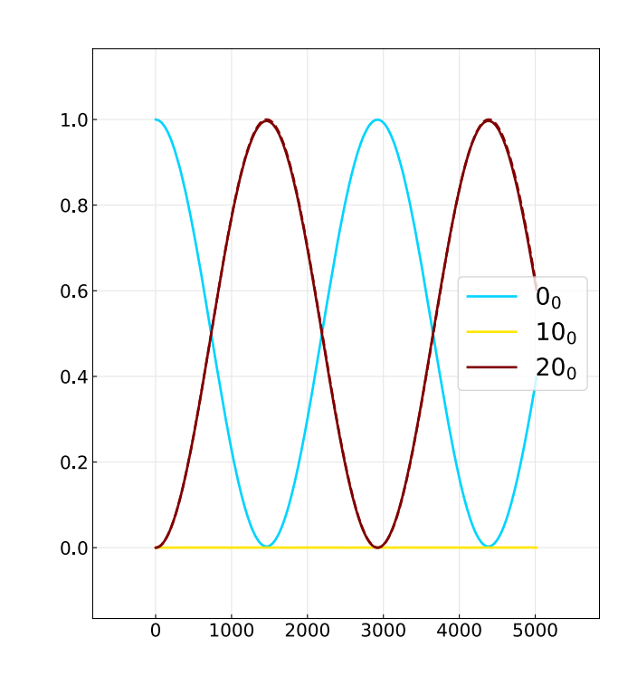
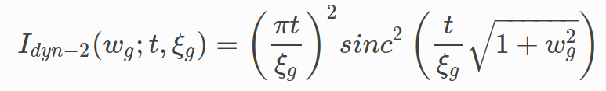
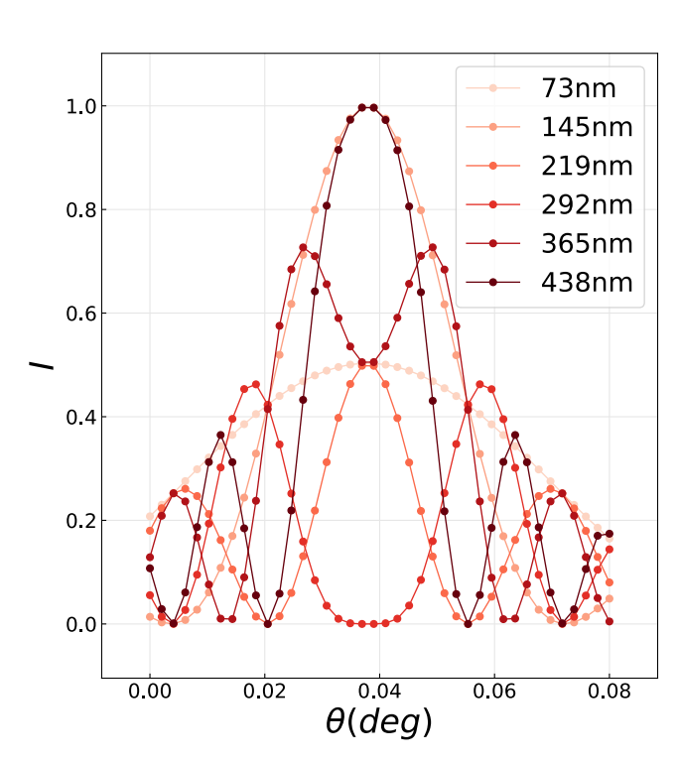
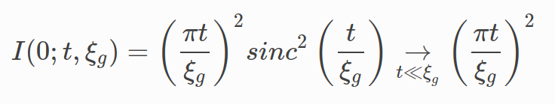
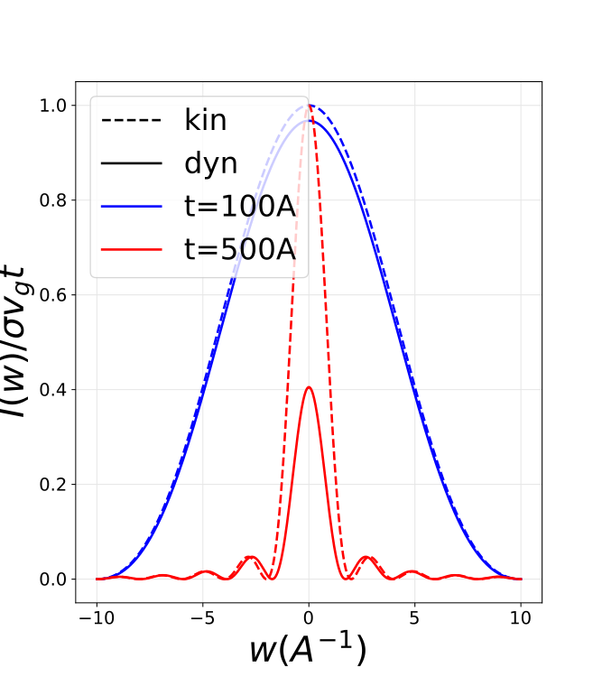
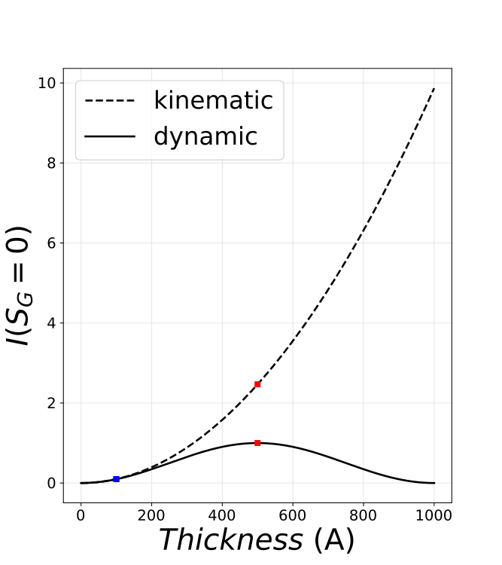
2-beam Rocking Curves
2-beam rocking curve

Slide 10
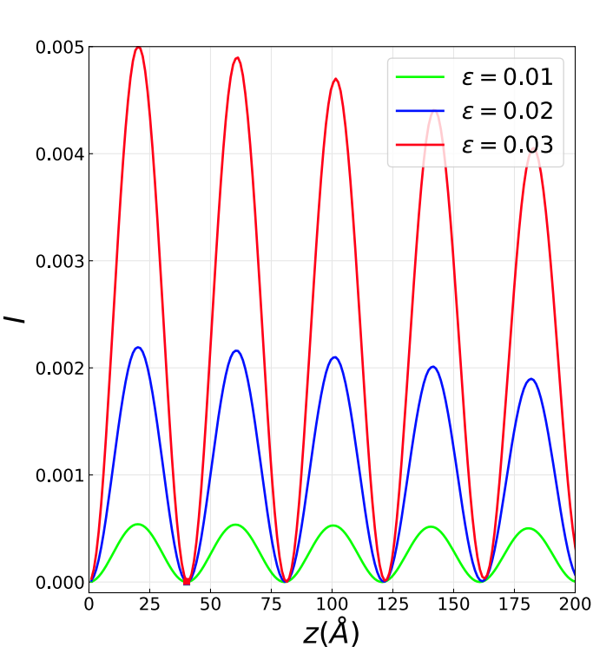
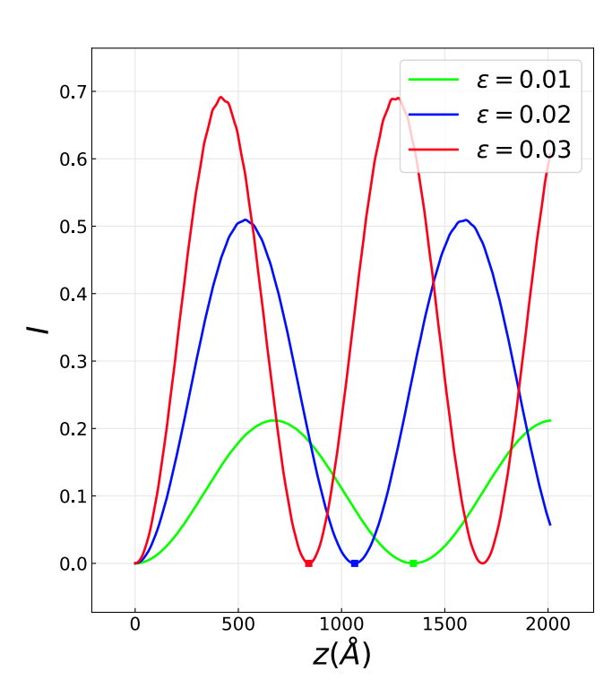
Dynamical diffraction extinction distance
Kinematic Ewald sphere
curvature effect weakly diffracted beam
Potential dependent extinction distance for strongly diffracting beam

Slide 11
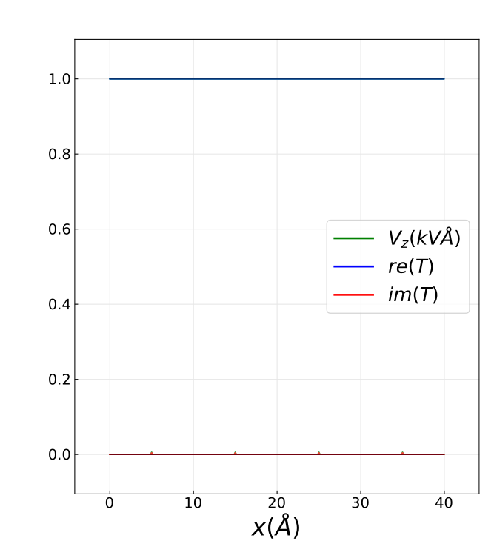
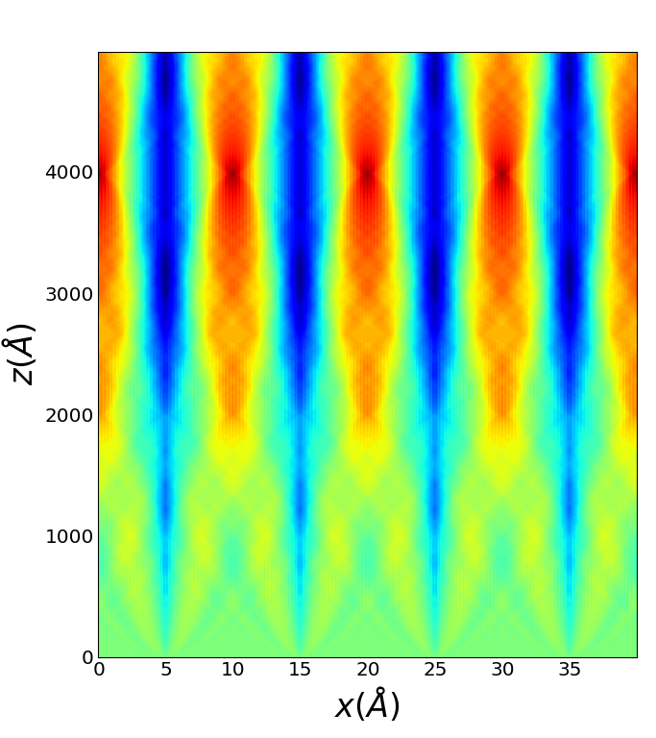
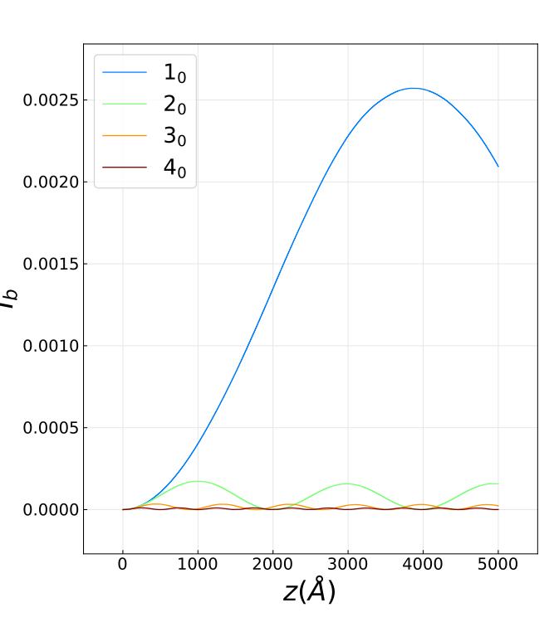
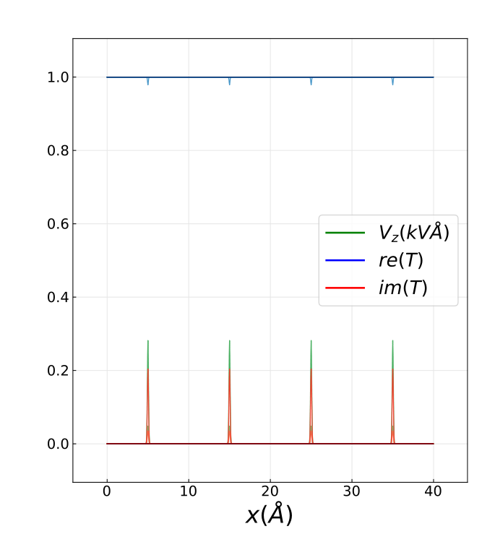
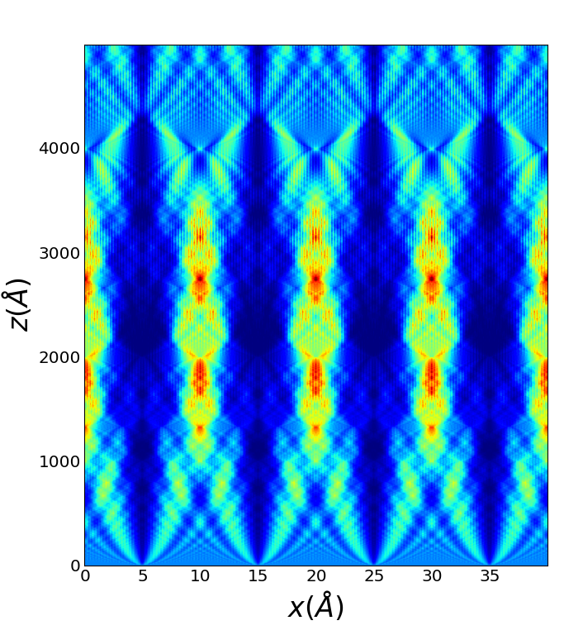
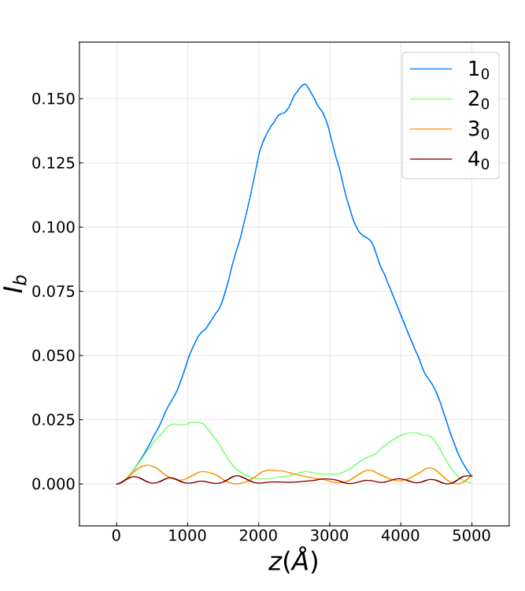
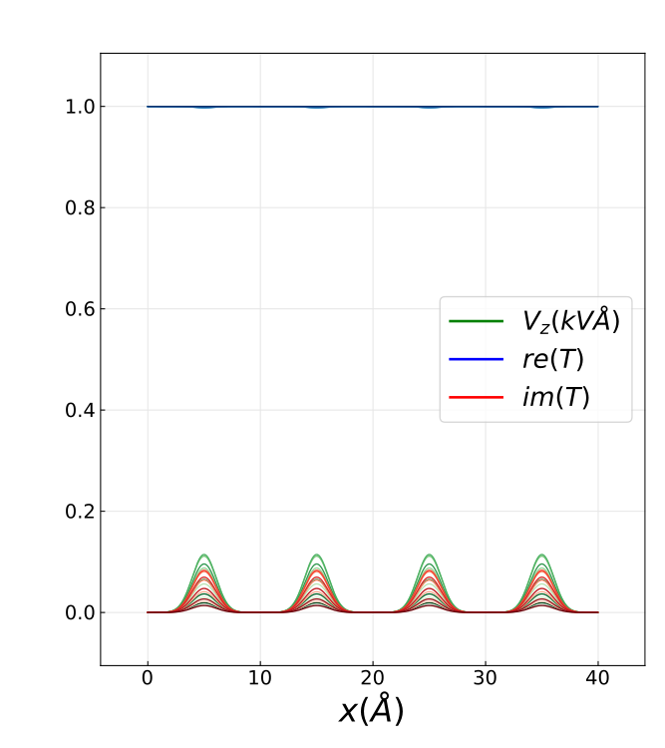
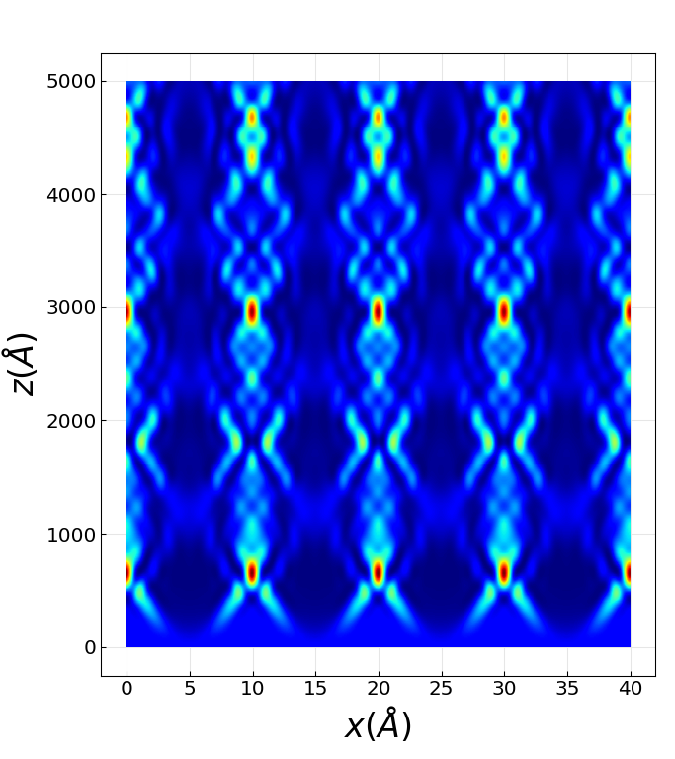
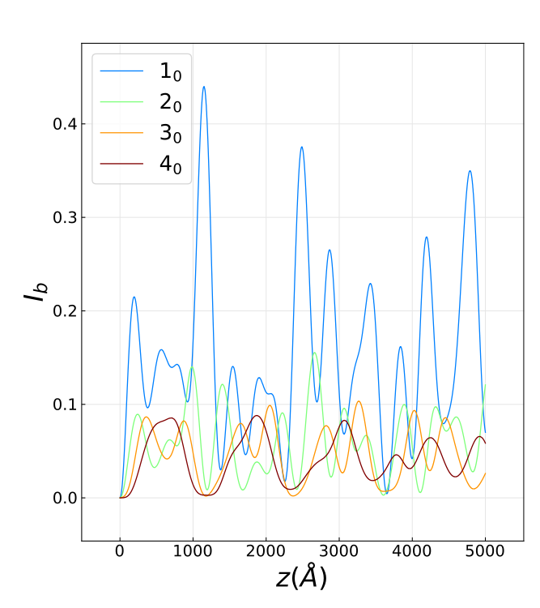
 | Transmission function and projected potential | Wave function inside the crystal | Beams intensities in Reciprocal space
Weak potential strength, no overlap
Strong potential strength, no overlap
Medium potential strength, large atomic overlap

Slide 12
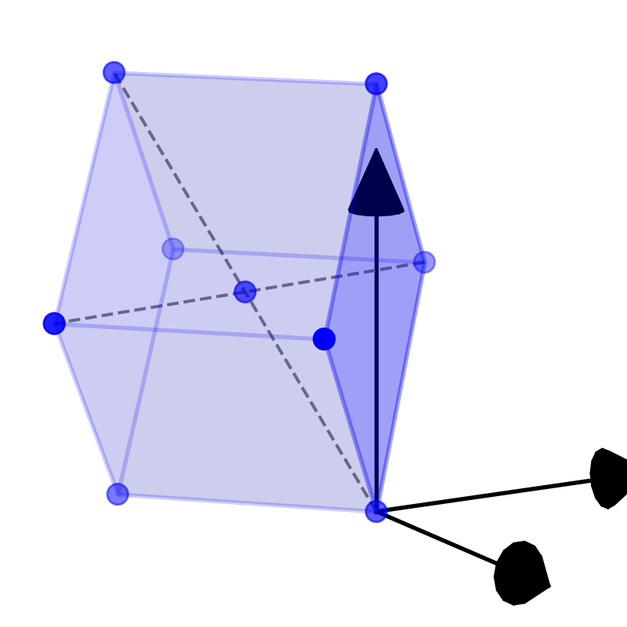
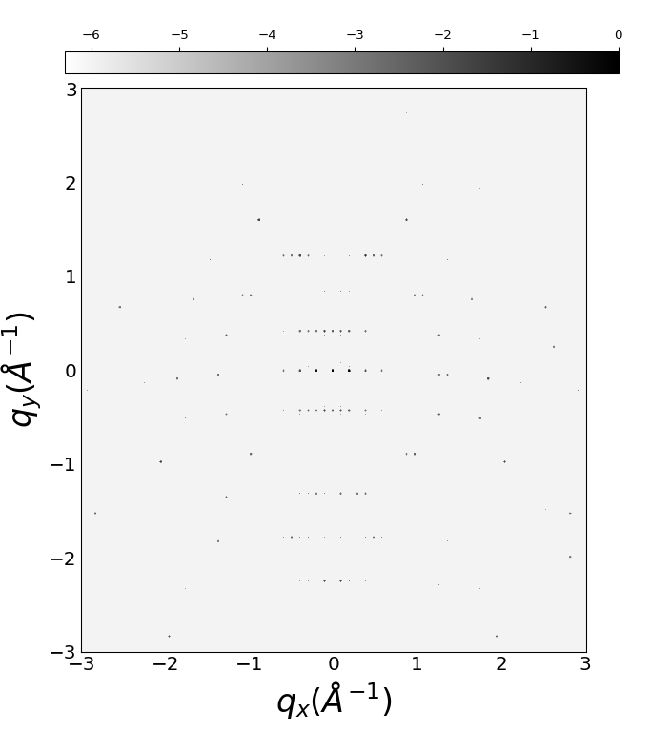
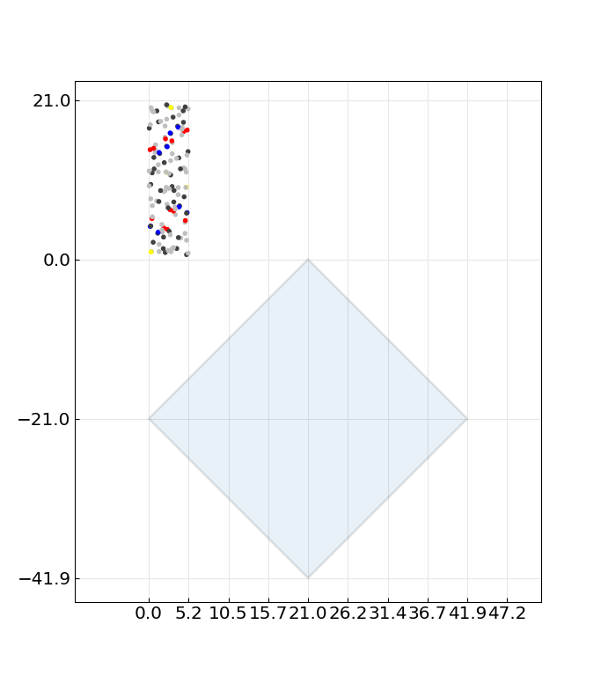
Diffraction patterns of biotin
C₁₀H₁₆N₂O₃S
Structure : P2₁2₁2₁
Diffraction pattern
[401]=45deg
alpha=90, beta=90, gamma=90
a=5.24A, b=10.35A, c=21.04A

Slide 13
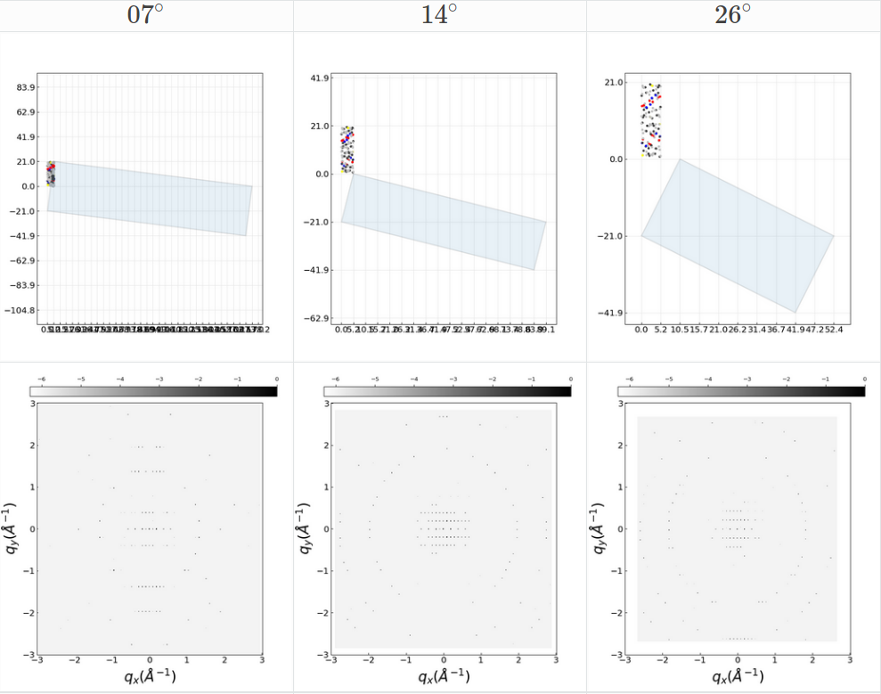
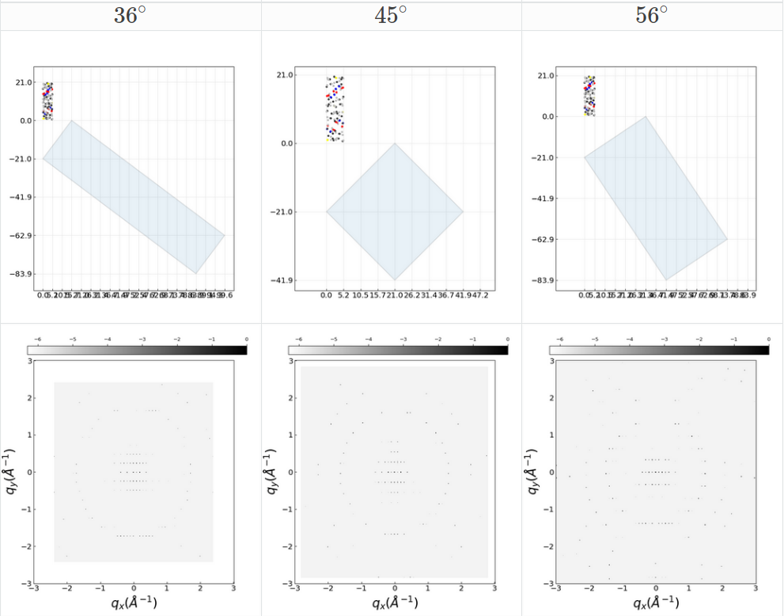
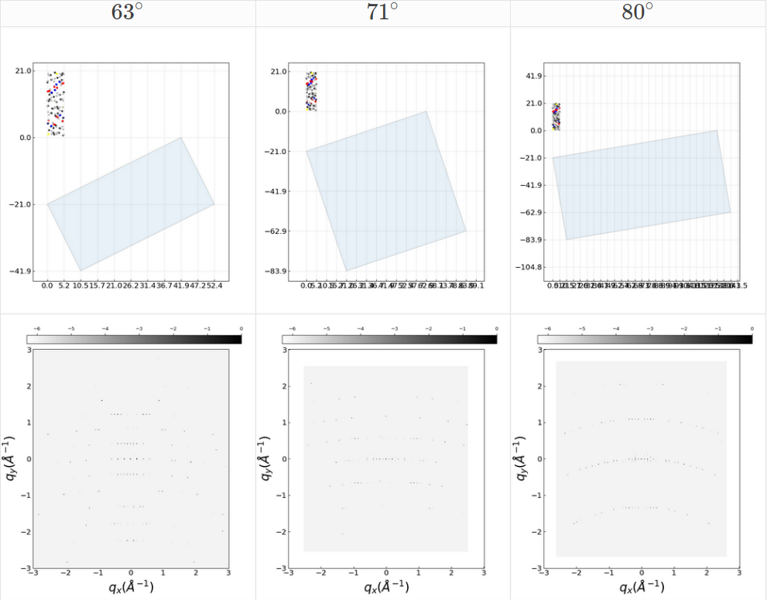
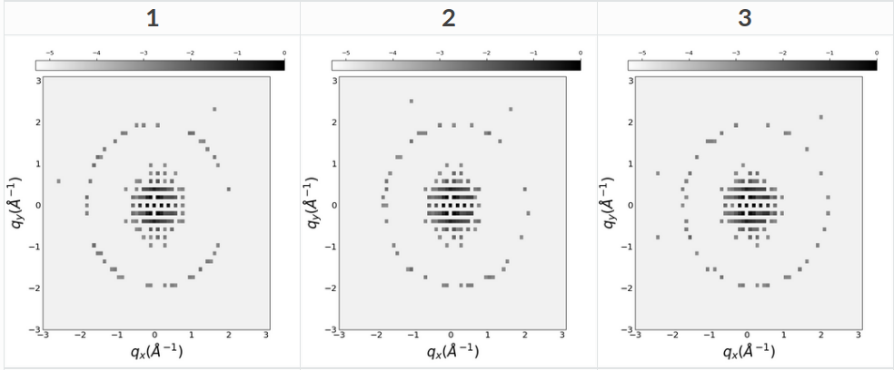
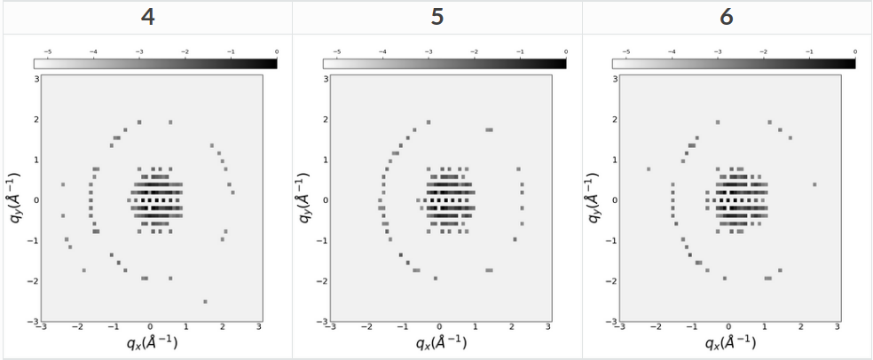
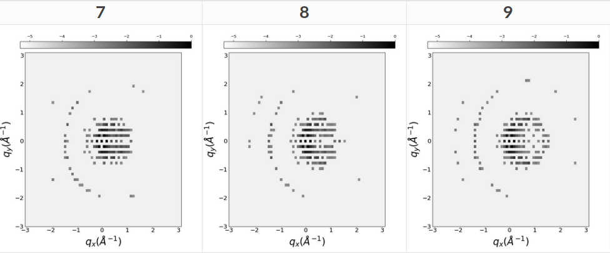
Full rotation simulation
Simulations with small tilts [-5,+5] deg^{[1]}
[1] J.H. Chen, D. Van Dyck, and M. Op De Beeck, “Multislice Method for Large Beam Tilt with Application to HOLZ Effects in Triclinic and Monoclinic Crystals,” Acta Crystallogr. Sect. A Found. Crystallogr., vol. 53, no. 5, pp. 576–589, 1997

Slide 14
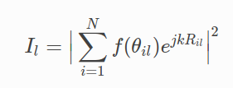

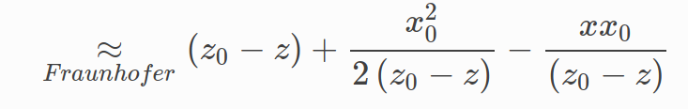

Near Bragg approach
θ
θ_{B}
Pixel detector
l

Slide 15




Near Bragg vs multislice
Weak potential
kinematic approximation
Strong potential
2-level scattering approximation

Slide 16
Current challenges
- Compare simluation to experimental dataset for biotin with rotation axis close to a zone axis
- Simulate non orhtorombic crystals in arbitrary configuration with arbitrary lattice constants
- Simulate defects (modelling and computationnal), Thermal difffusive scattering, inelastic scattering
- adapt nearBragg approach to multiple scattering events
- model partially coherent beam as produced by LaB₆ guns
More info http://brno.rc-harwell.ac.uk:8000/ RCaH VPN required

