Slide 1


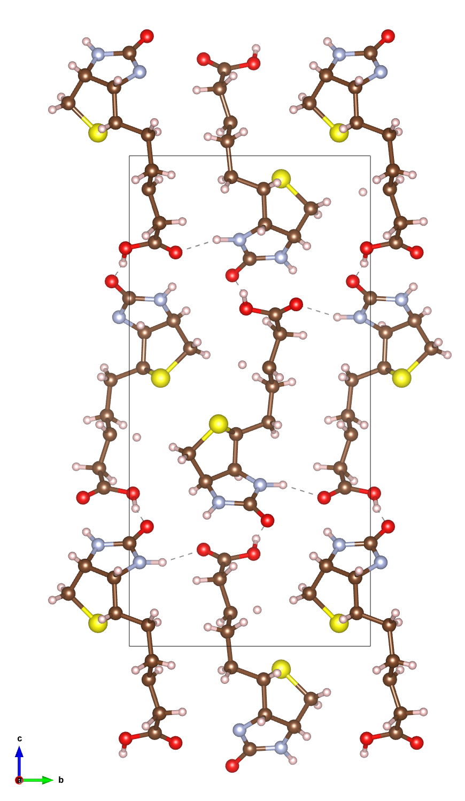
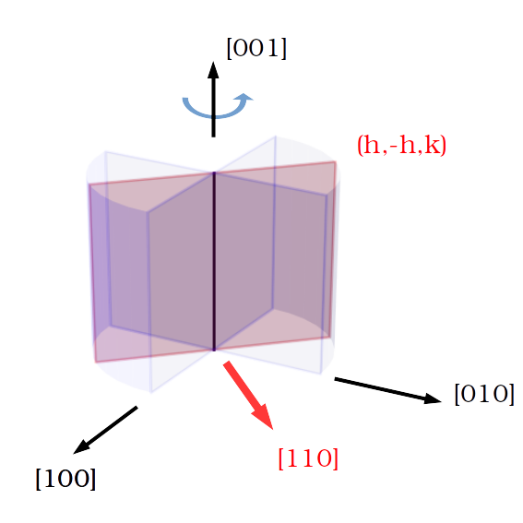
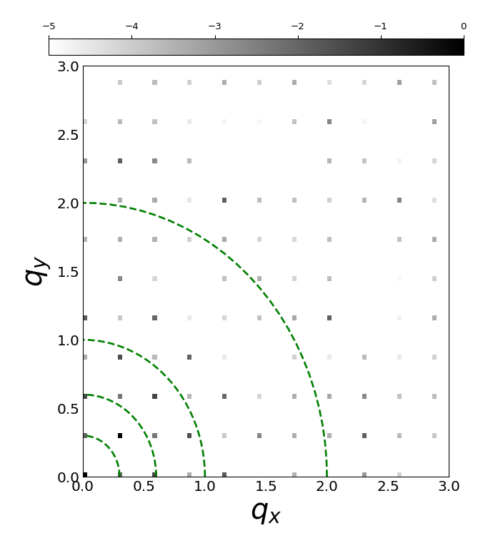

Simulation of Dynamical Scattering Effect in Electron Diffraction Patterns
Tarik Drevon, David Waterman, Eugene Krissinel
Notes:
I am Tarik Drevon, I work in the Biology and life science department with David Waterman and Eugene Krissinel within the CCP4 group. I started 02/2020.
CCP4 is a software used to solve macromolecular structures from X-ray diffraction data and there is currently an interest in the group to expand those capabilities to handle electron diffraction data. The main reason is that electron diffraction technique shows benefits for handling proteins that only grow to nanocrystal scale.
Ideally, we would like to implement some corrections at different stages of the structure determination process to handle Electron Diffraction data while still using the same overall framework as used for X-ray data.
To identify those correction opportunities, we wanted to simulate electron diffraction patterns.

Slide 2
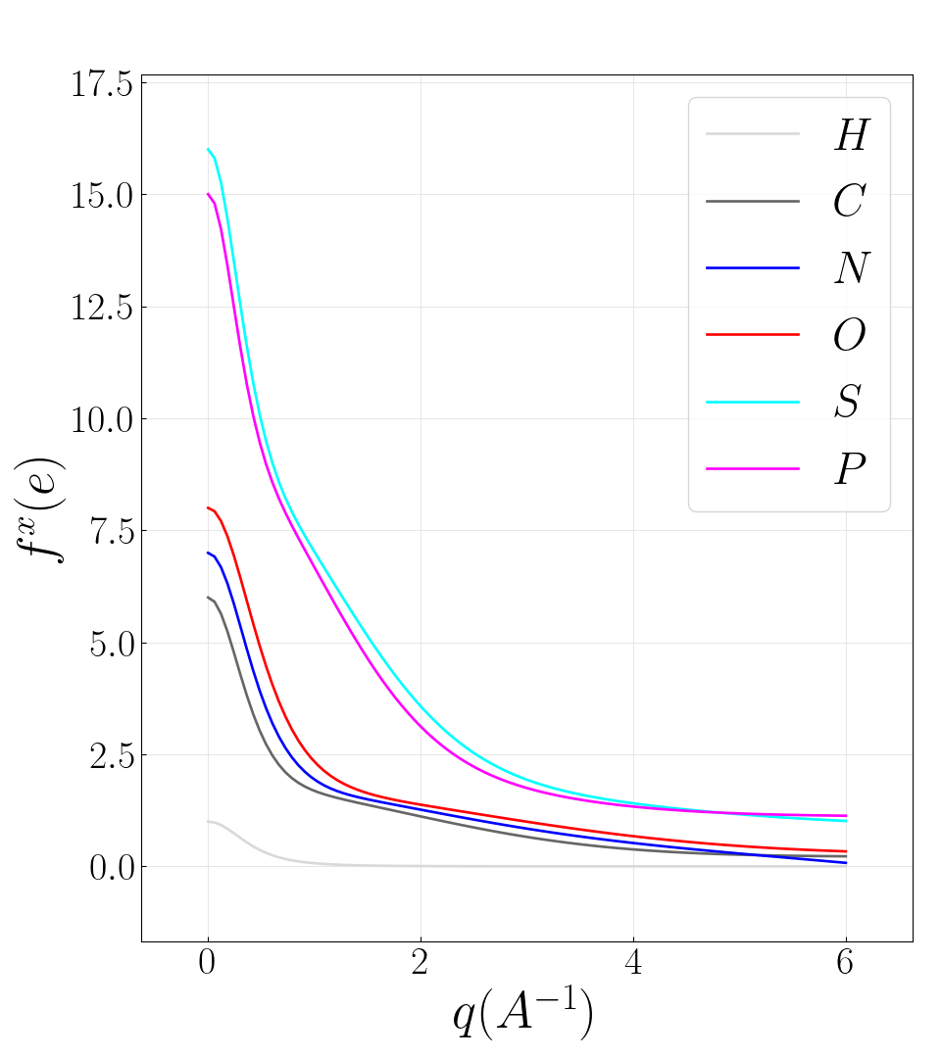
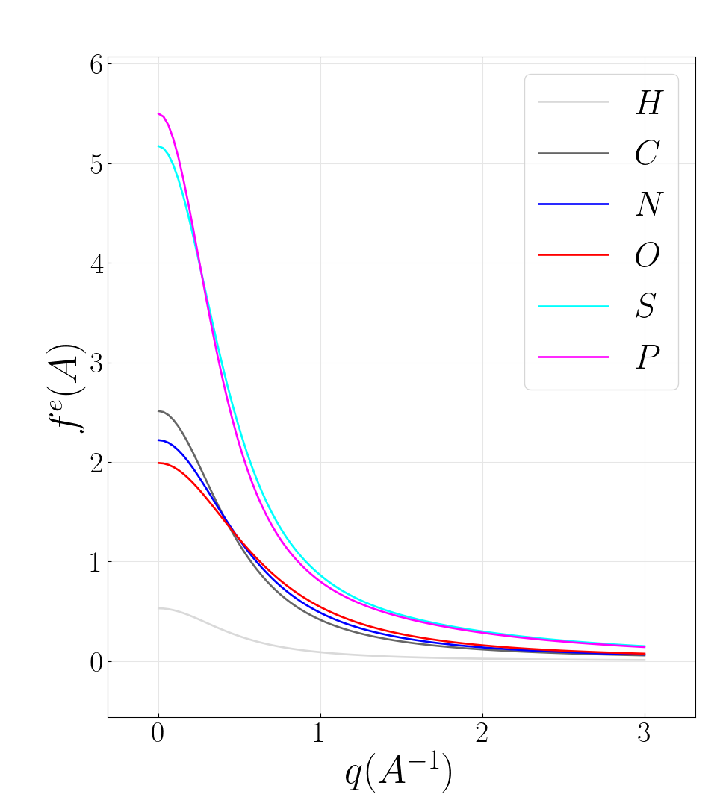
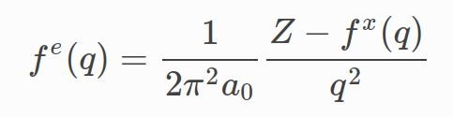
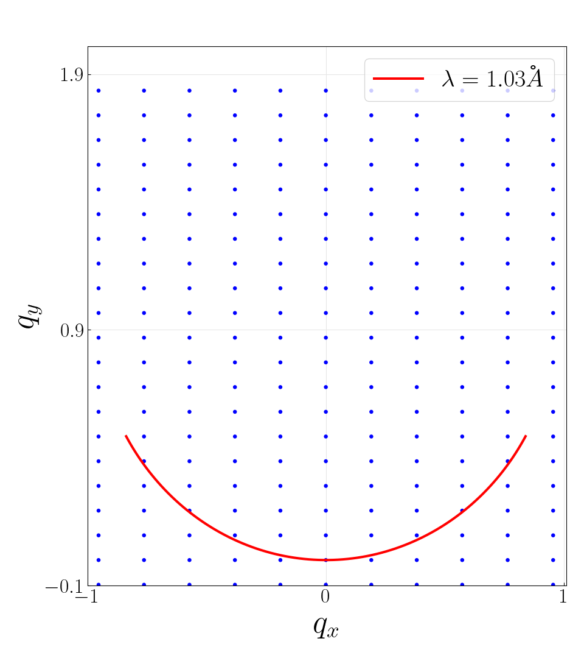
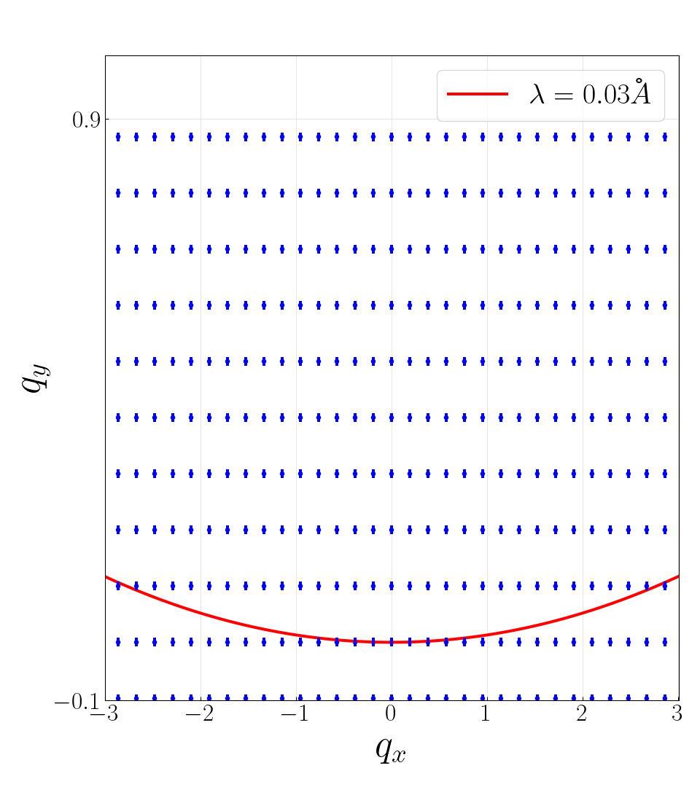
X-ray (MX) vs electron diffraction (ED) for biotin
ED 200keV≅0.025Å
MX 12keV≅1Å
Form factor
Electrostatic potential
Coulomb scattering
Large cross section
Dynamical scattering
Mott-Bethe formula
Form factor
Electronic density
Thomson scattering
Small cross section
Kinematic scattering
Ewald sphere curvature
Large curvature
High order Laue zones
Thick sample t=20𝜇m
Narrow rocking curve
Ewald Sphere curvature
Flat Ewald sphere
First order Laue zone
Thin sample t=0.2𝜇m
Wide rocking curve
Thickness dependent rocking curve shape

Slide 3
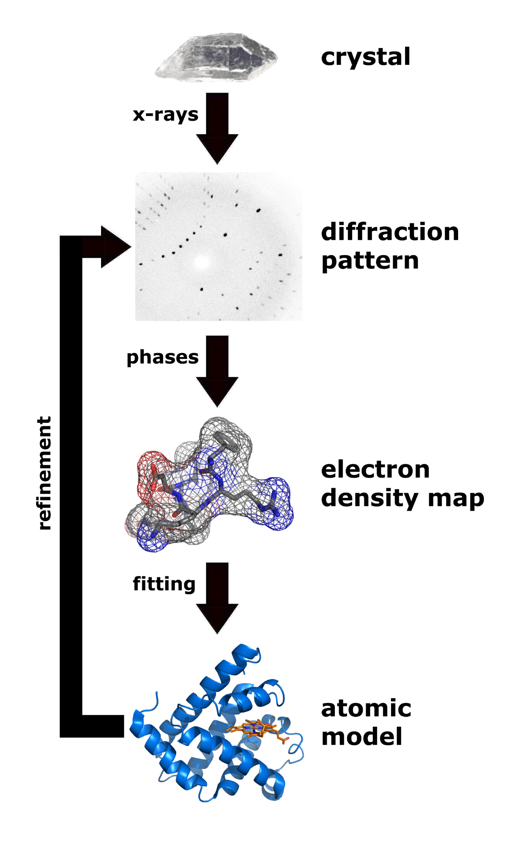

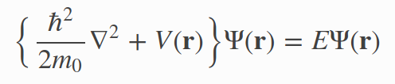
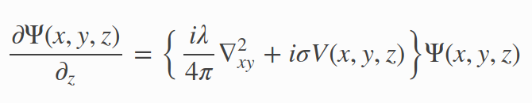

Numerical simulation tools of ED patterns
Kinematic approximation
Refinement
+phases
FFT⁻¹
Electron density
Model
Schroedinger’s fast electron wave equation
Notes:
Here is the standard MX technique framework.
X-rays are sent through a crystal which is continuously rotated around an axis to produce series of diffraction patterns.
The square root of the diffraction patterns are enriched with the adequate phases known as the structure factor.
An inverse Fourier transform of the structure factor yields the electron density map.
Note that for electron diffraction, the inverse Fourier transform
would yield the electrostatic potential map which provides more direct information about the location of the nucleus.
The problem is that when dynamical diffraction is present as in electron diffraction, this transformation no longer holds as is is based on the single or kinematic scattering assumption.
Instead the diffraction patterns are found from directly solving Schroedinger's equation where V is the electrostatic potential of the crystal, Psi the incident electron beam wave function and E the energy of the electron(typically 100keV). The actual equation solved uses the small scattering angle assumption and is shown below.
To simulate a diffraction pattern, there are a few possible approaches with pros and cons. The most popular is the multislice with various opensource packages. Among them, TEMSIM a very well documented and easy to use that we have chosen.
We are also developing an alternative approach which should have some benefits for macromolecular crystals but I will not cover it here.

Slide 4
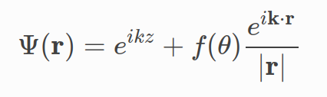
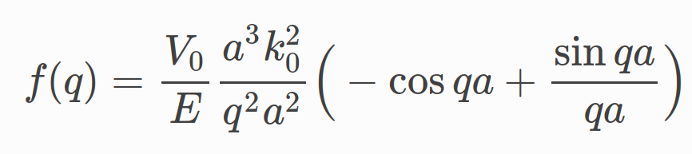

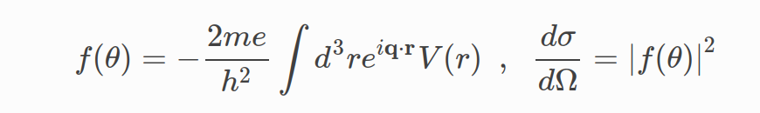
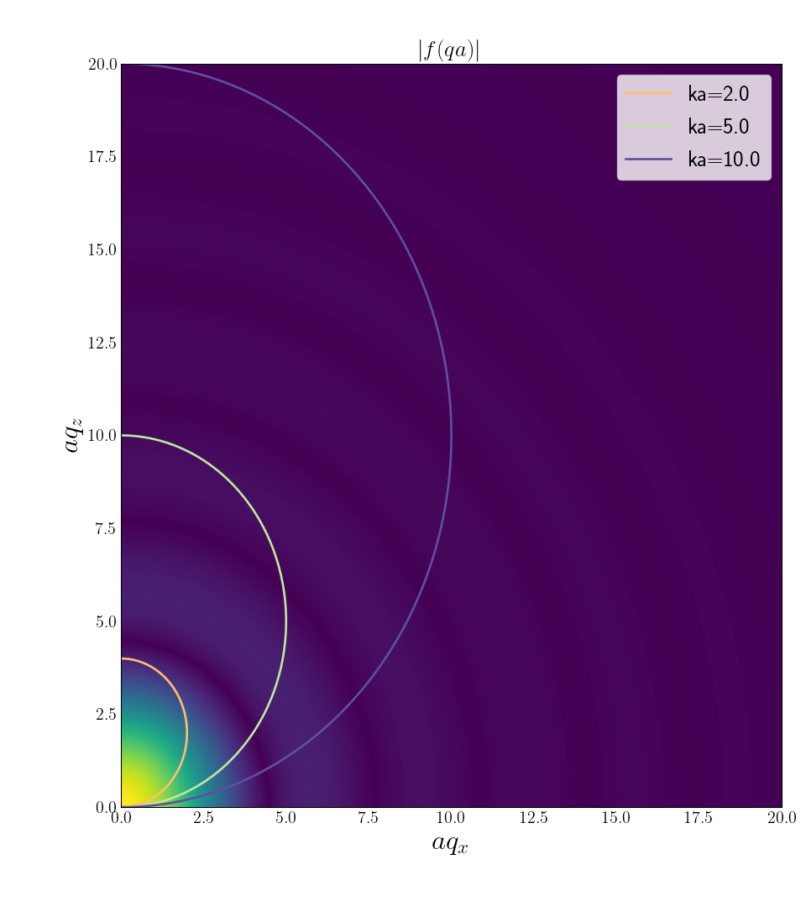
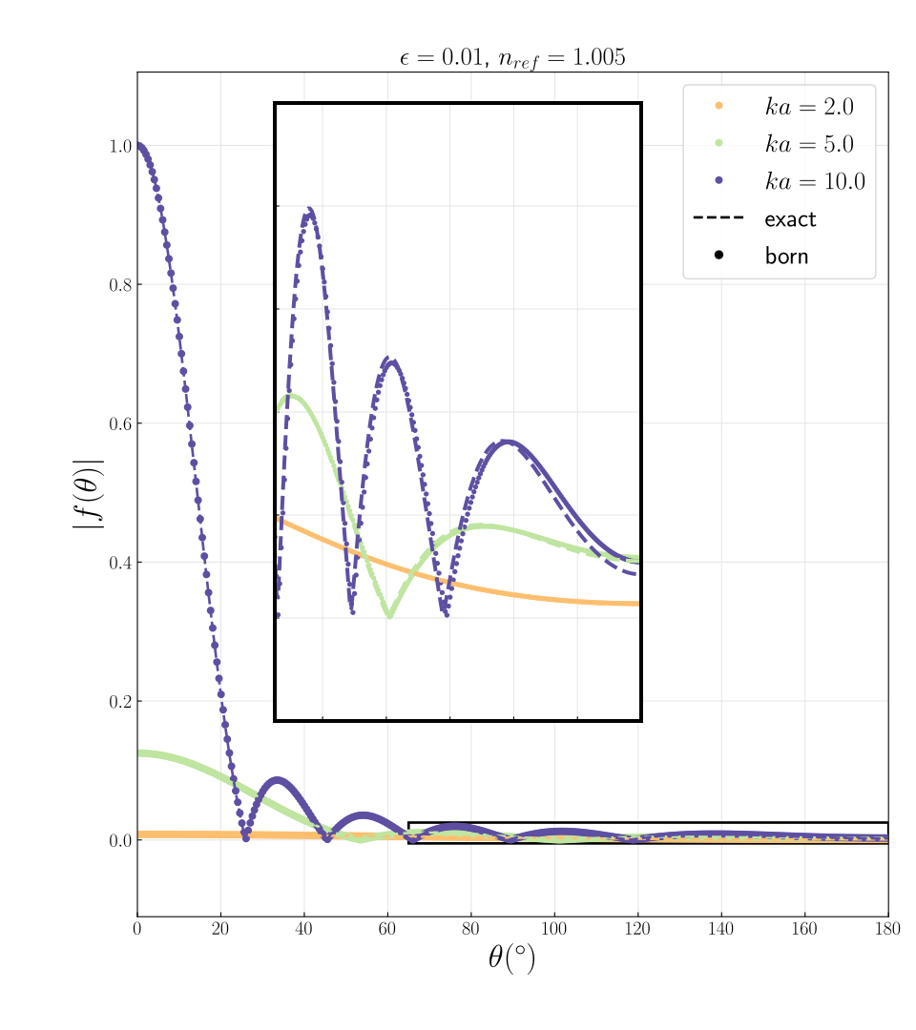
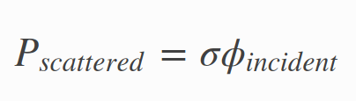
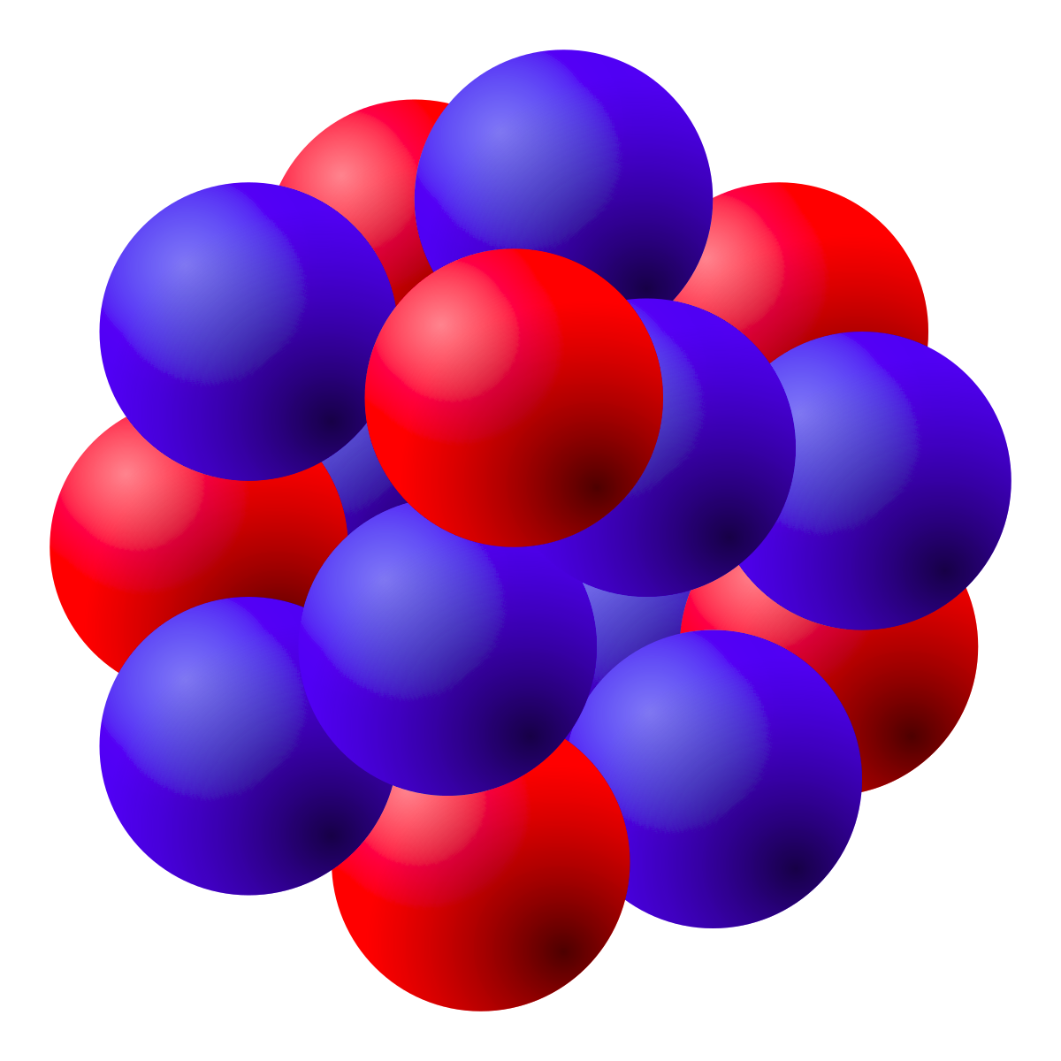
Kinematic theory of scattering
Kinematic solution
Application to scattering by a single qdot sphere
Born approximation
σ

Slide 5
Numerical simulation tools of ED patterns
Method | Exact | Speed | Mem (beam per atom) | Periodic structure | Grid based | Parallelization type | Package
Multislice (MS) (physical optics based approach) | no | N_{z}N_{b}logN_{b} | 100 | yes | yes | FFTw one slice after another | TEMSIM (pyMS) PRISM,...
Near bragg (real space path differences) | no | N_{z}N_{b}²N_{p} | 1 | no | no | per pixel | NearBragg (James Holton)

Slide 6
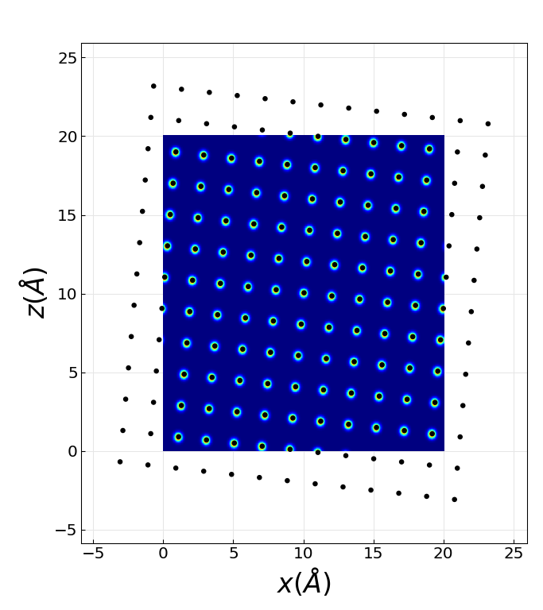
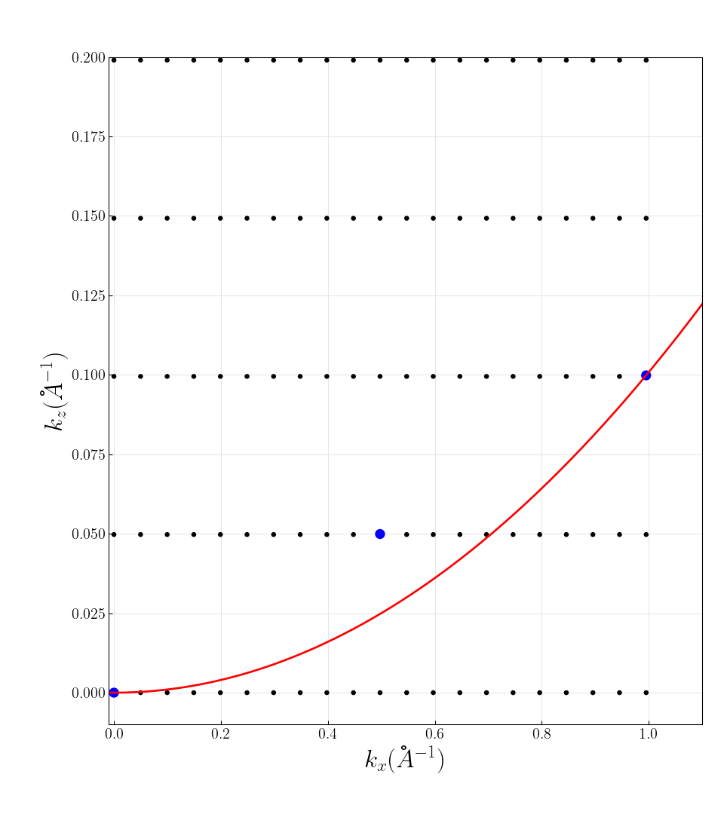
Multislice 2-beam diffraction case
Simulation setup
Ewald configuration

Slide 7
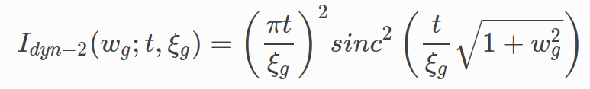
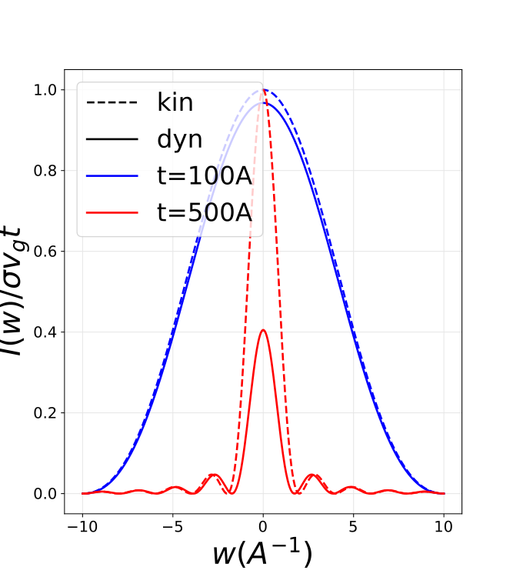
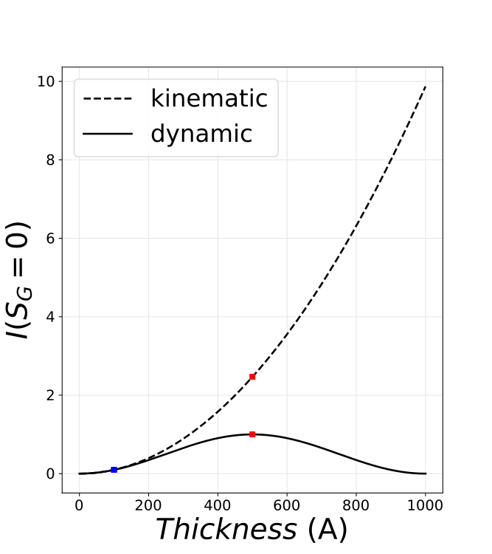
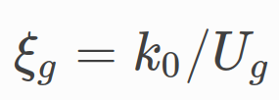
Theoretical 2-beam rocking curves
Beam intensity with excitation error w_{g}=ξ_{g}S_{G} and thickness t
No excitation error

Slide 8
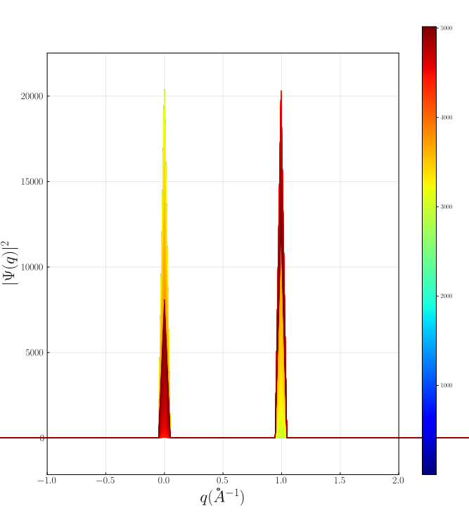
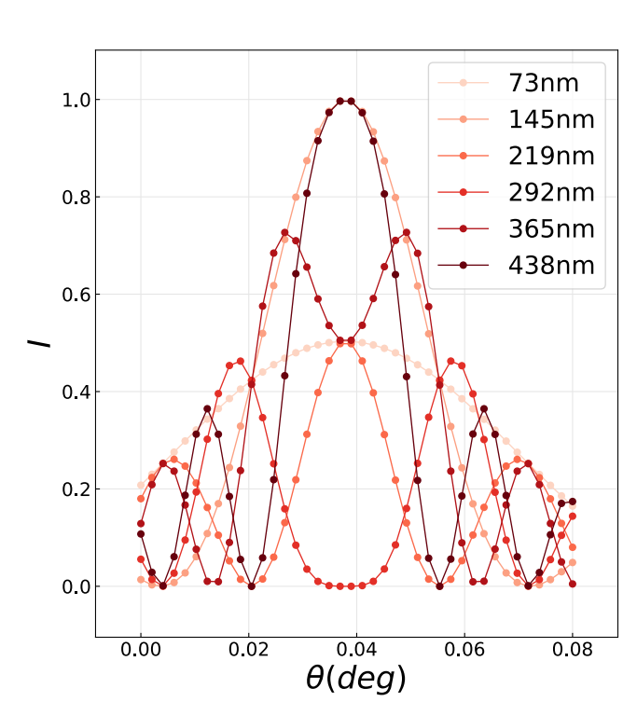
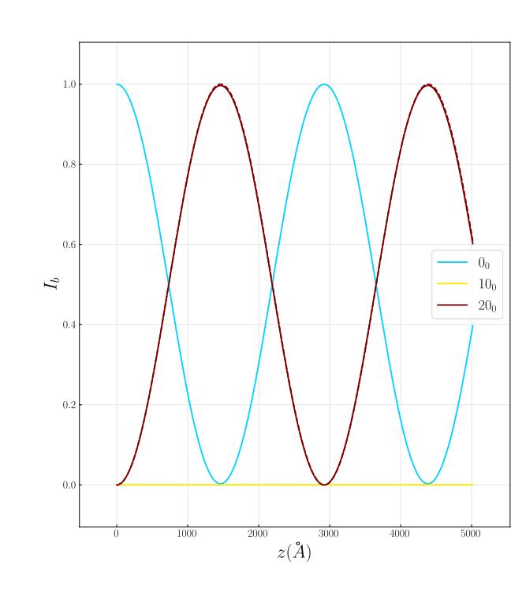
Simulated rocking curves
Rocking curves at different different thicknesses
Beams with thickness at exact Bragg condition

Slide 9
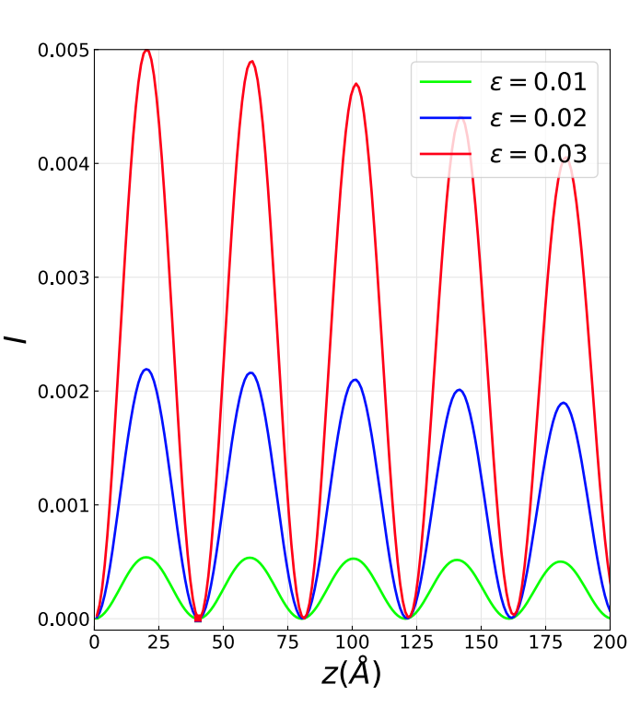
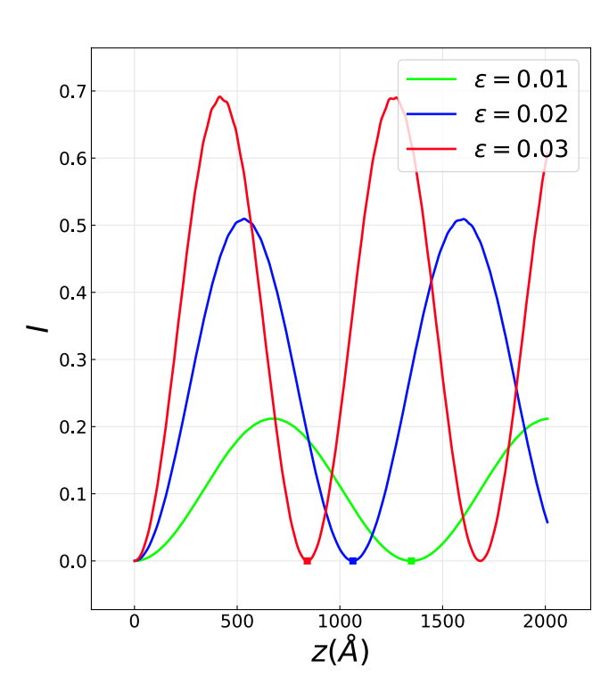
Extinction distance : Kinematic vs Dynamical diffraction
Kinematic : Ewald sphere
curvature effect of weakly excited beams with identical excitation errors
Potential dependent extinction for strongly excited beams with identical excitation errors

Slide 10
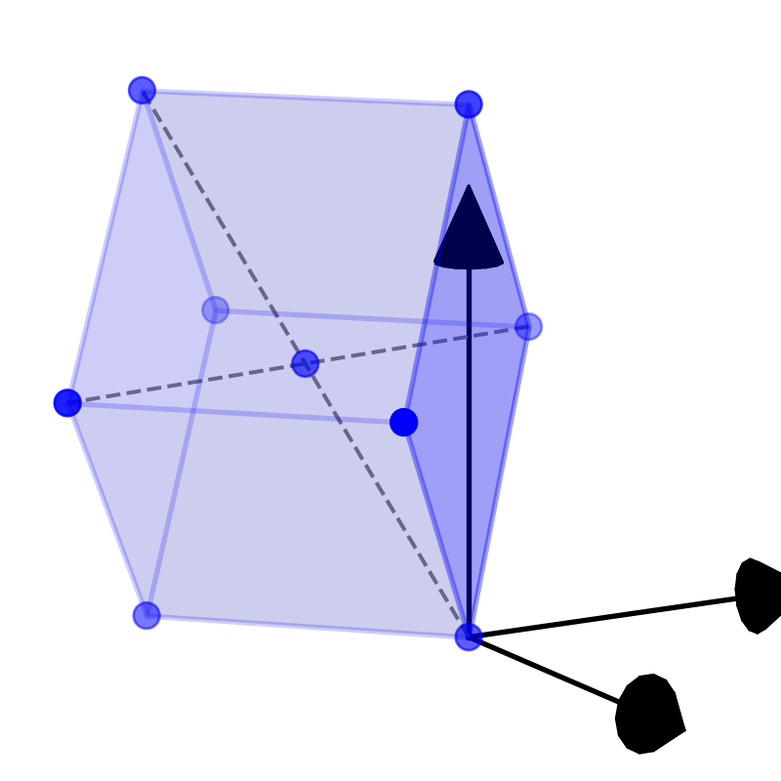
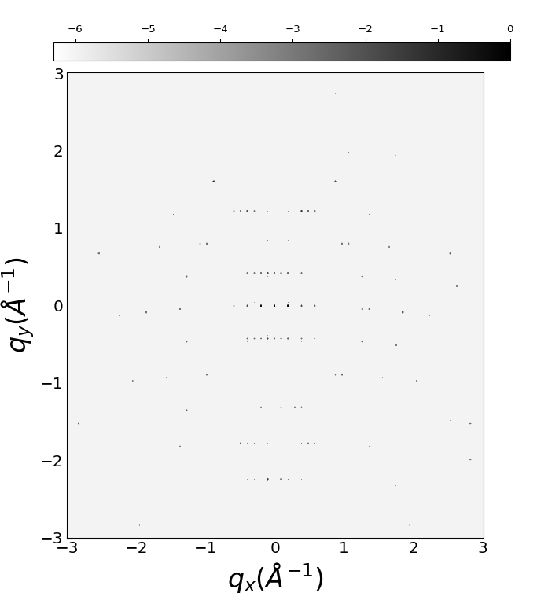
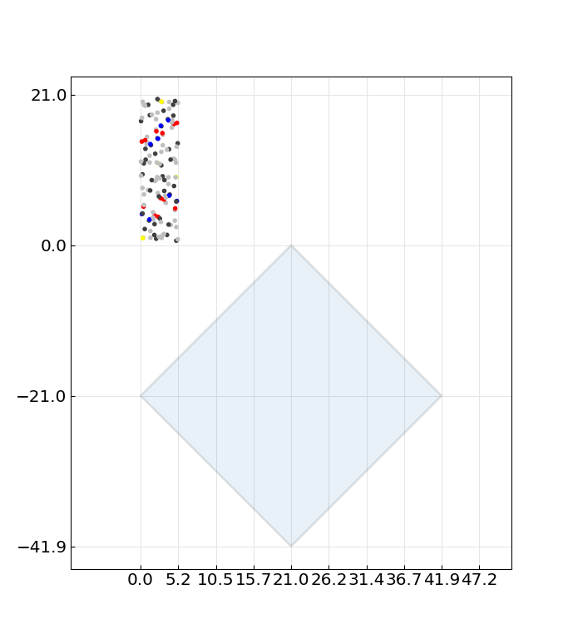
Diffraction pattern for biotin
C₁₀H₁₆N₂O₃S
Structure : P2₁2₁2₁
Diffraction pattern
[401]=45deg
alpha=90, beta=90, gamma=90
a=5.24A, b=10.35A, c=21.04A

Slide 11
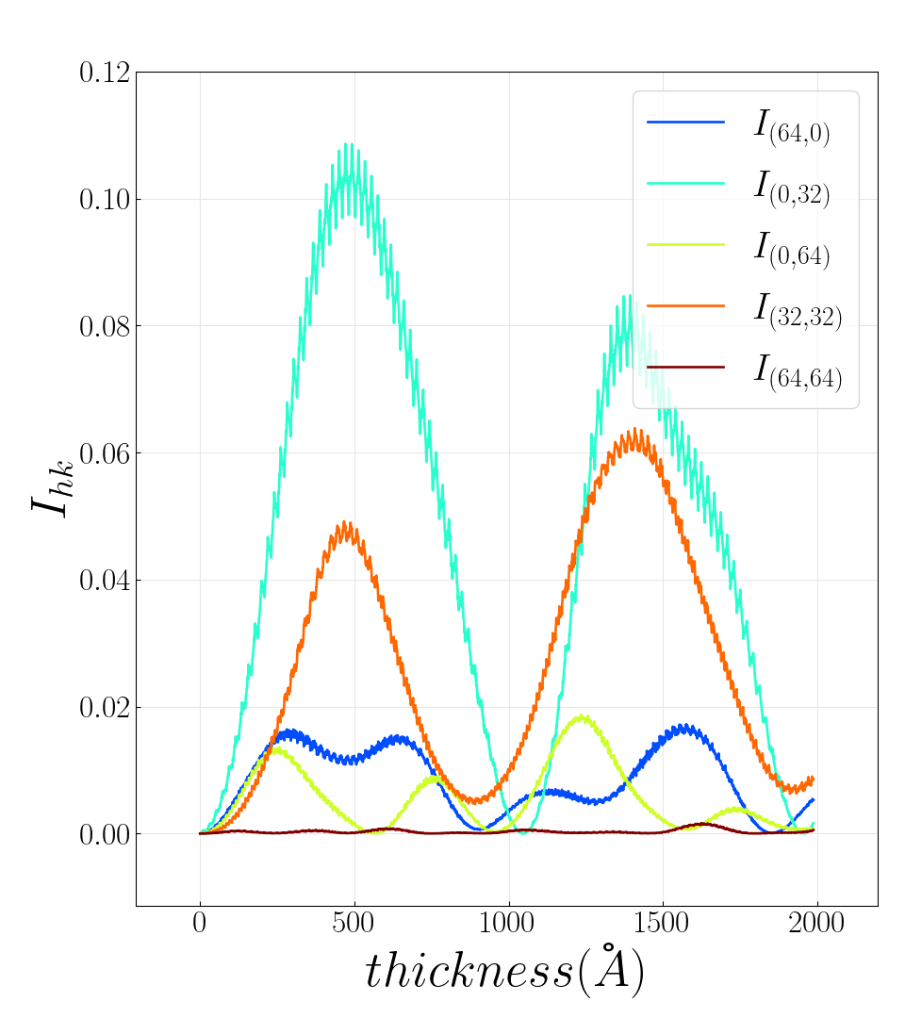
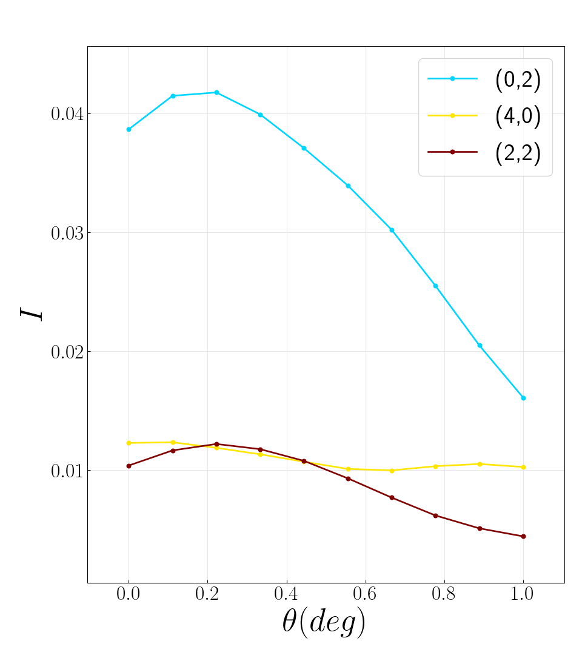
Biotin
Beam vs thickness
Rocking curve at 2000A

Slide 12
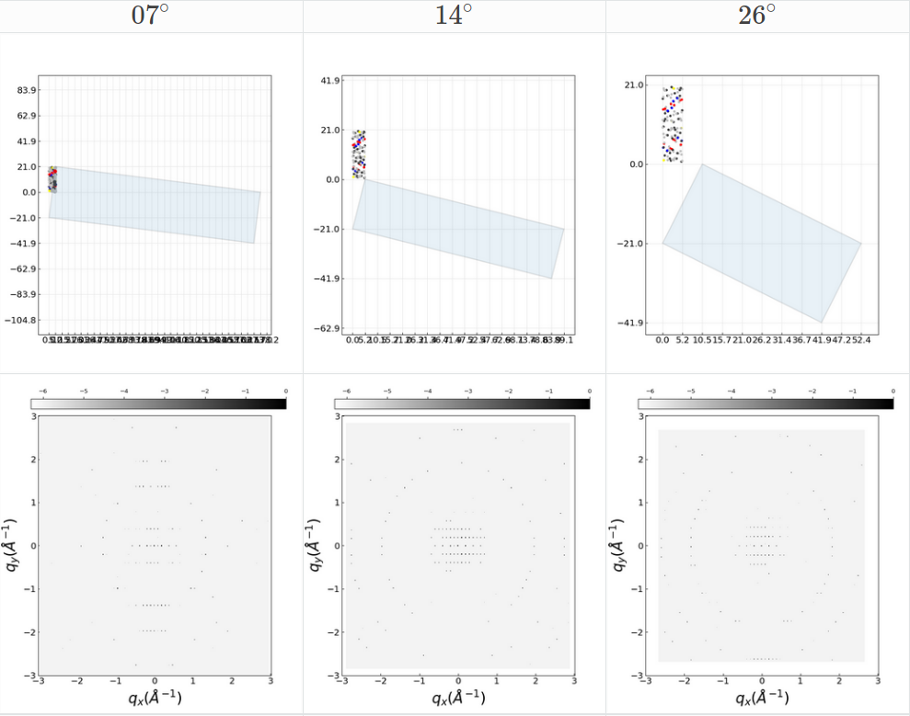
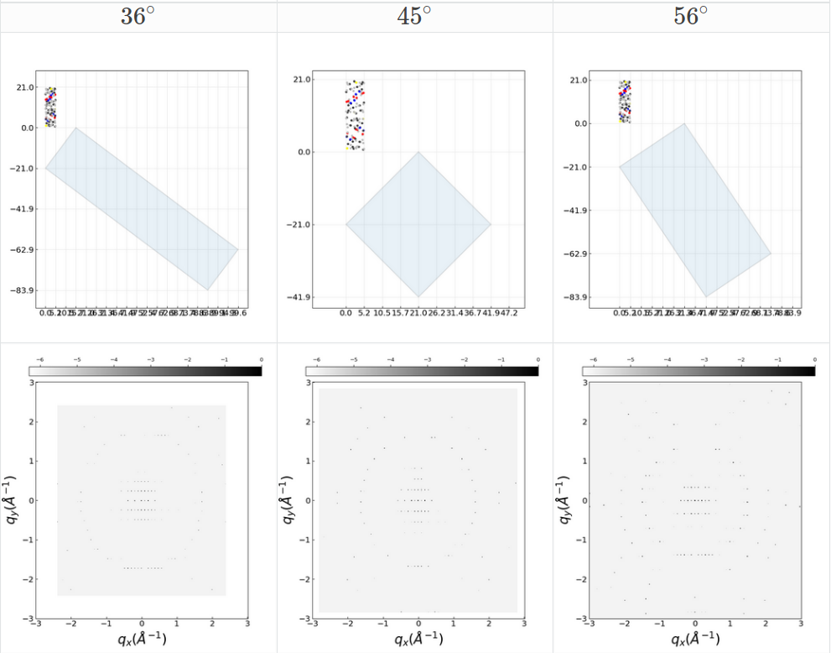
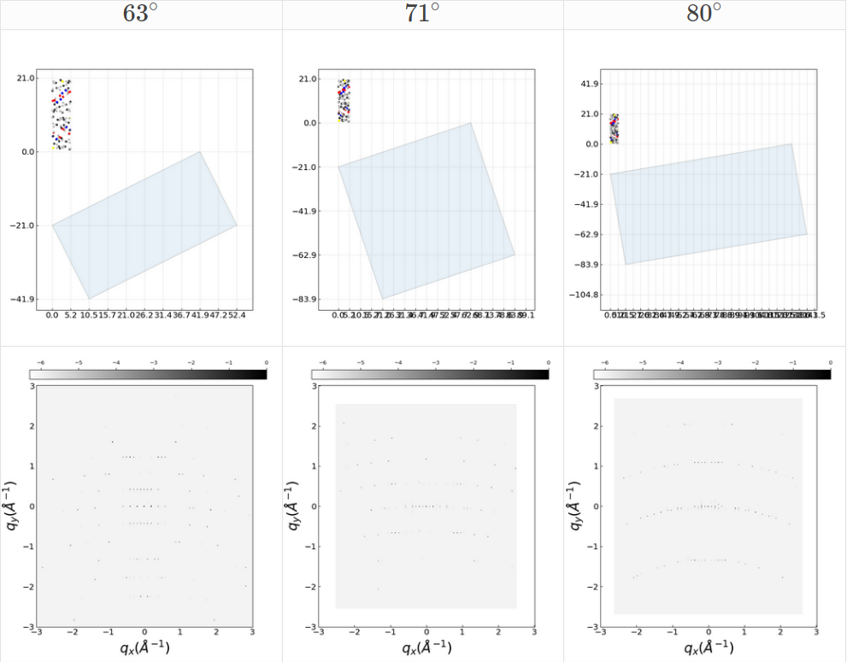
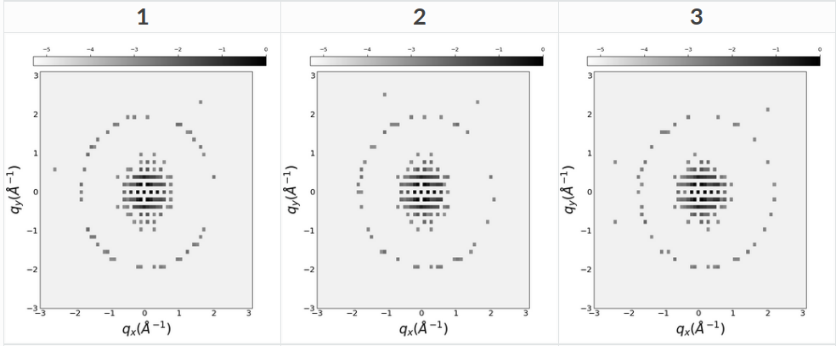
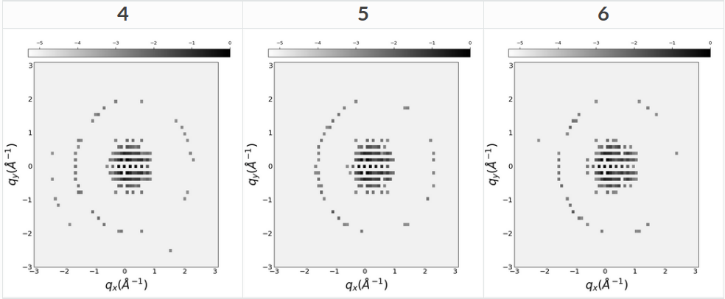
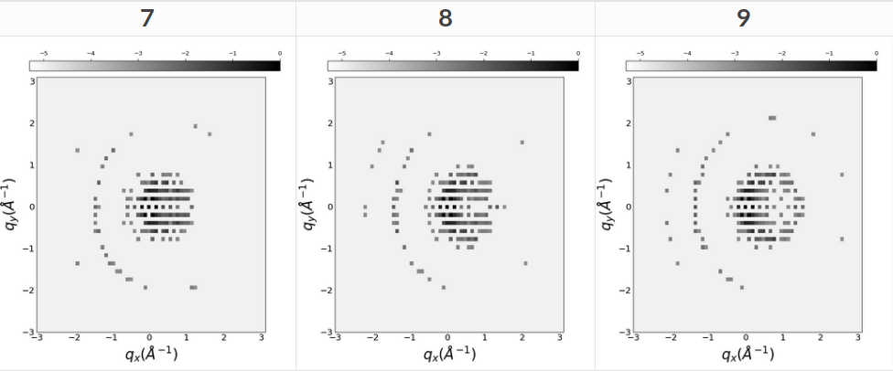
Full rotation simulation
Simulations with small tilts [-5,+5] deg^{[1]}
[1] J.H. Chen, D. Van Dyck, and M. Op De Beeck, “Multislice Method for Large Beam Tilt with Application to HOLZ Effects in Triclinic and Monoclinic Crystals,” Acta Crystallogr. Sect. A Found. Crystallogr., vol. 53, no. 5, pp. 576–589, 1997

Slide 13
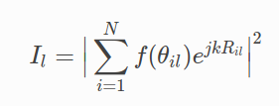

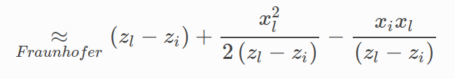
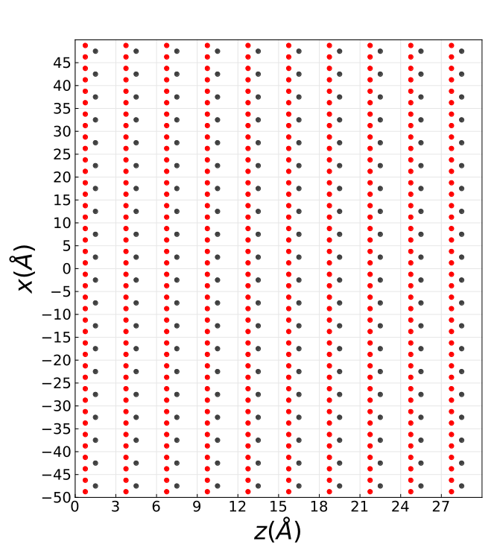
Near Bragg
θ
θ_{B}
Atom i
Pixel detector
l
Plane wave

Slide 14
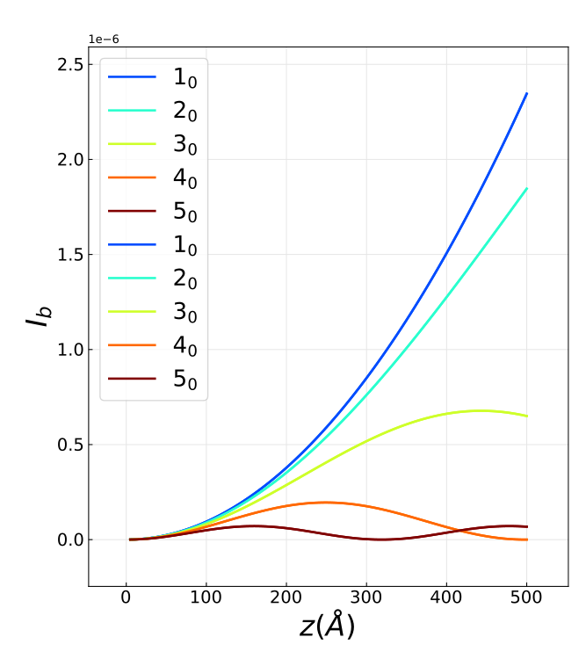
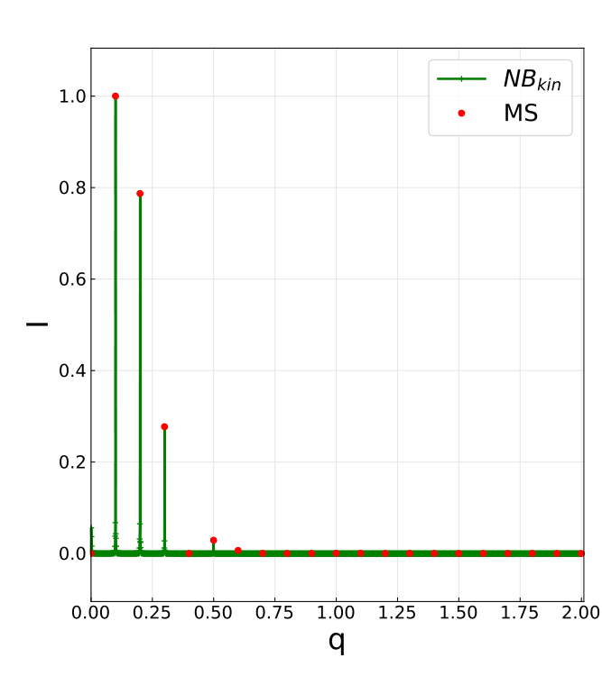
Validation for the kinematic approximation

Slide 15
Extension to multiple scattering
θ_{ij}⁽¹⁾
θ_{i}
θ_{ij}⁽¹⁾
Plane wave

Slide 16
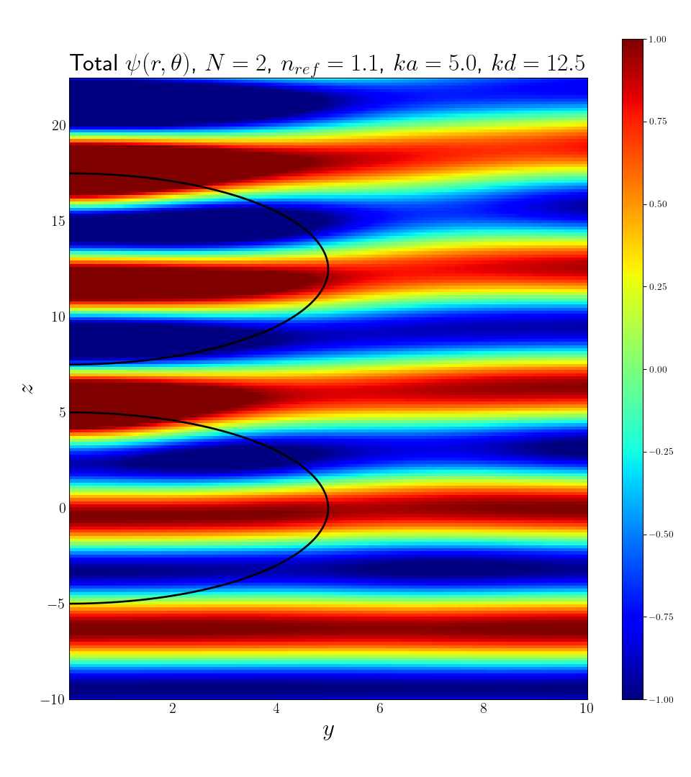
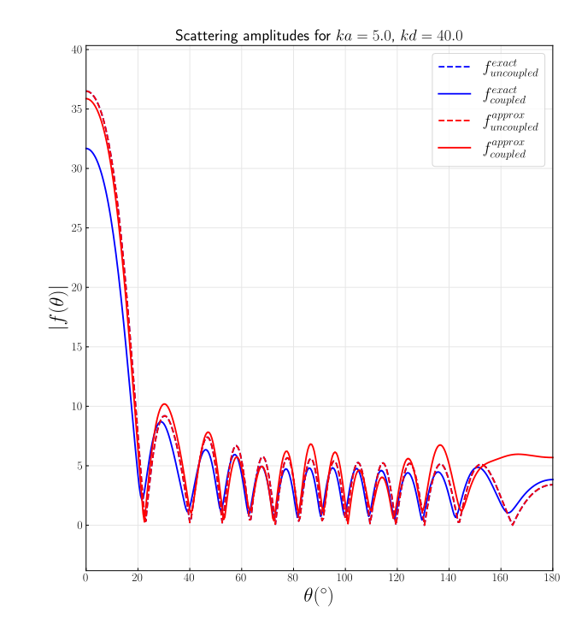
Application to two scattering spherical atoms
Near field Scattering amplitude
Far field Scattering amplitude

Slide 17
Next steps
- Compare simulation to available experimental dataset (ireloh, epixa)
- Fix nearBragg approximation approach to dynamical diffraction case
- Simulate solvent scattering, inelastic scattering, defects, thermal diffuse scattering
- Model partially coherent beam as produced by LaB₆ guns

