Slide 1


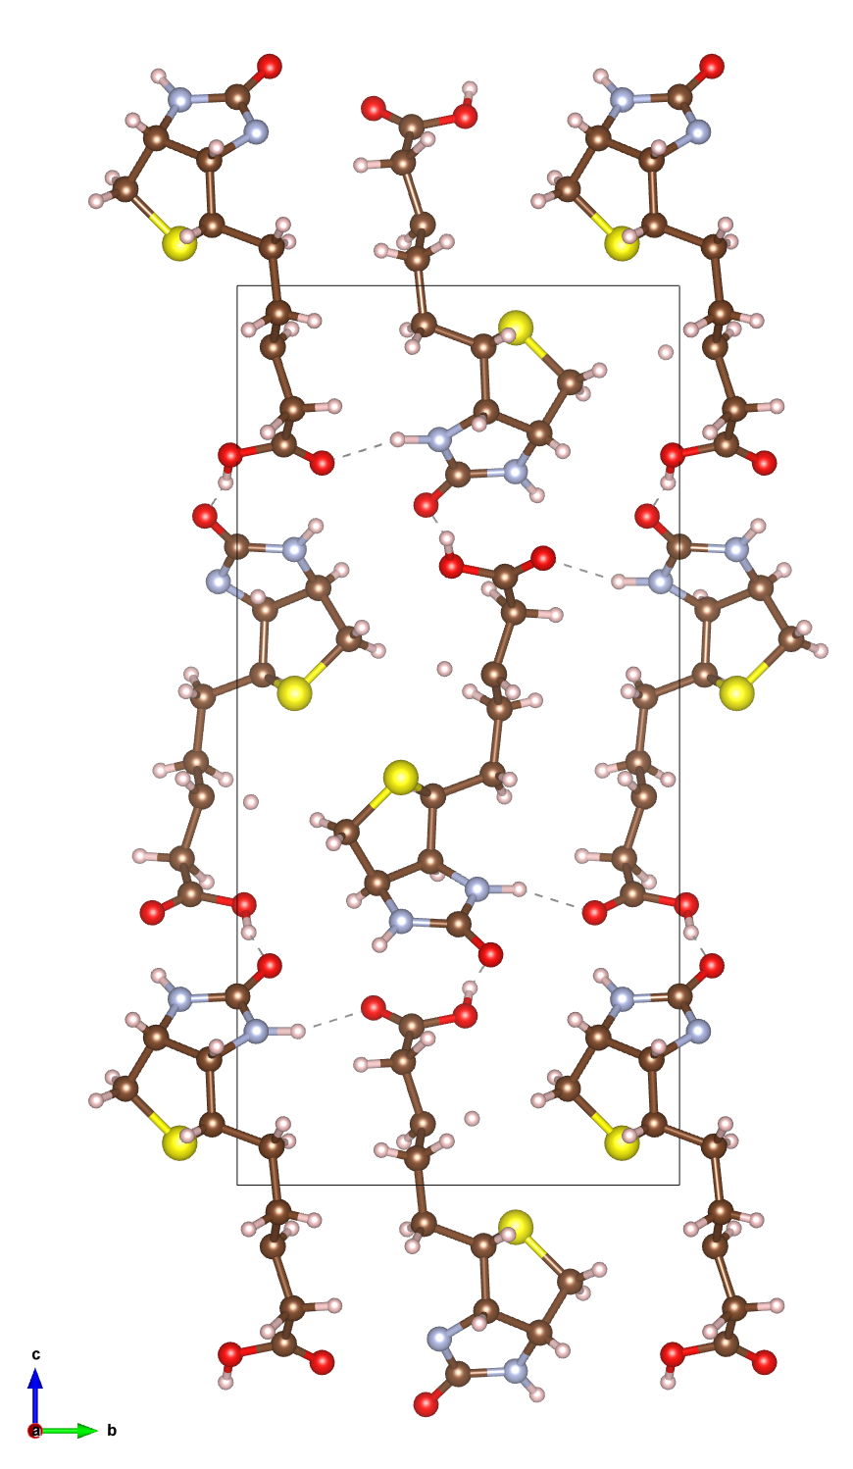
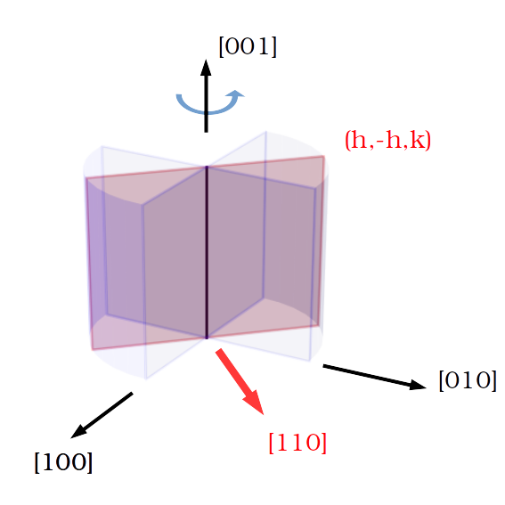
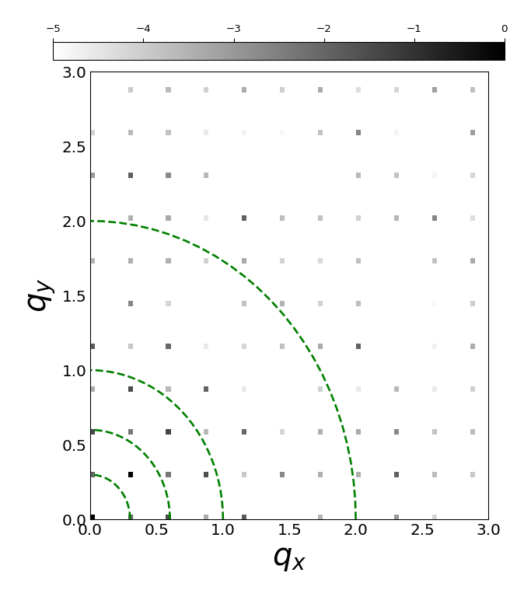

Simulation of Dynamical Scattering Effect in Electron Diffraction Patterns
Tarik Drevon, David Waterman, Eugene Krissinel
Notes:
I am Tarik Drevon, I work in the Biology and life science department with David Waterman and Eugene Krissinel within the CCP4 group. I started 02/2020.
CCP4 is a software used to solve macromolecular structures from X-ray diffraction data and there is currently an interest in the group to expand those capabilities to handle electron diffraction data. The main reason is that electron diffraction technique shows benefits for handling proteins that only grow to nanocrystal scale.
Ideally, we would like to implement some corrections at different stages of the structure determination process to handle Electron Diffraction data while still using the same overall framework as used for X-ray data.
To identify those correction opportunities, we wanted to simulate electron diffraction patterns.

Slide 2
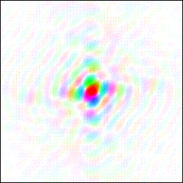
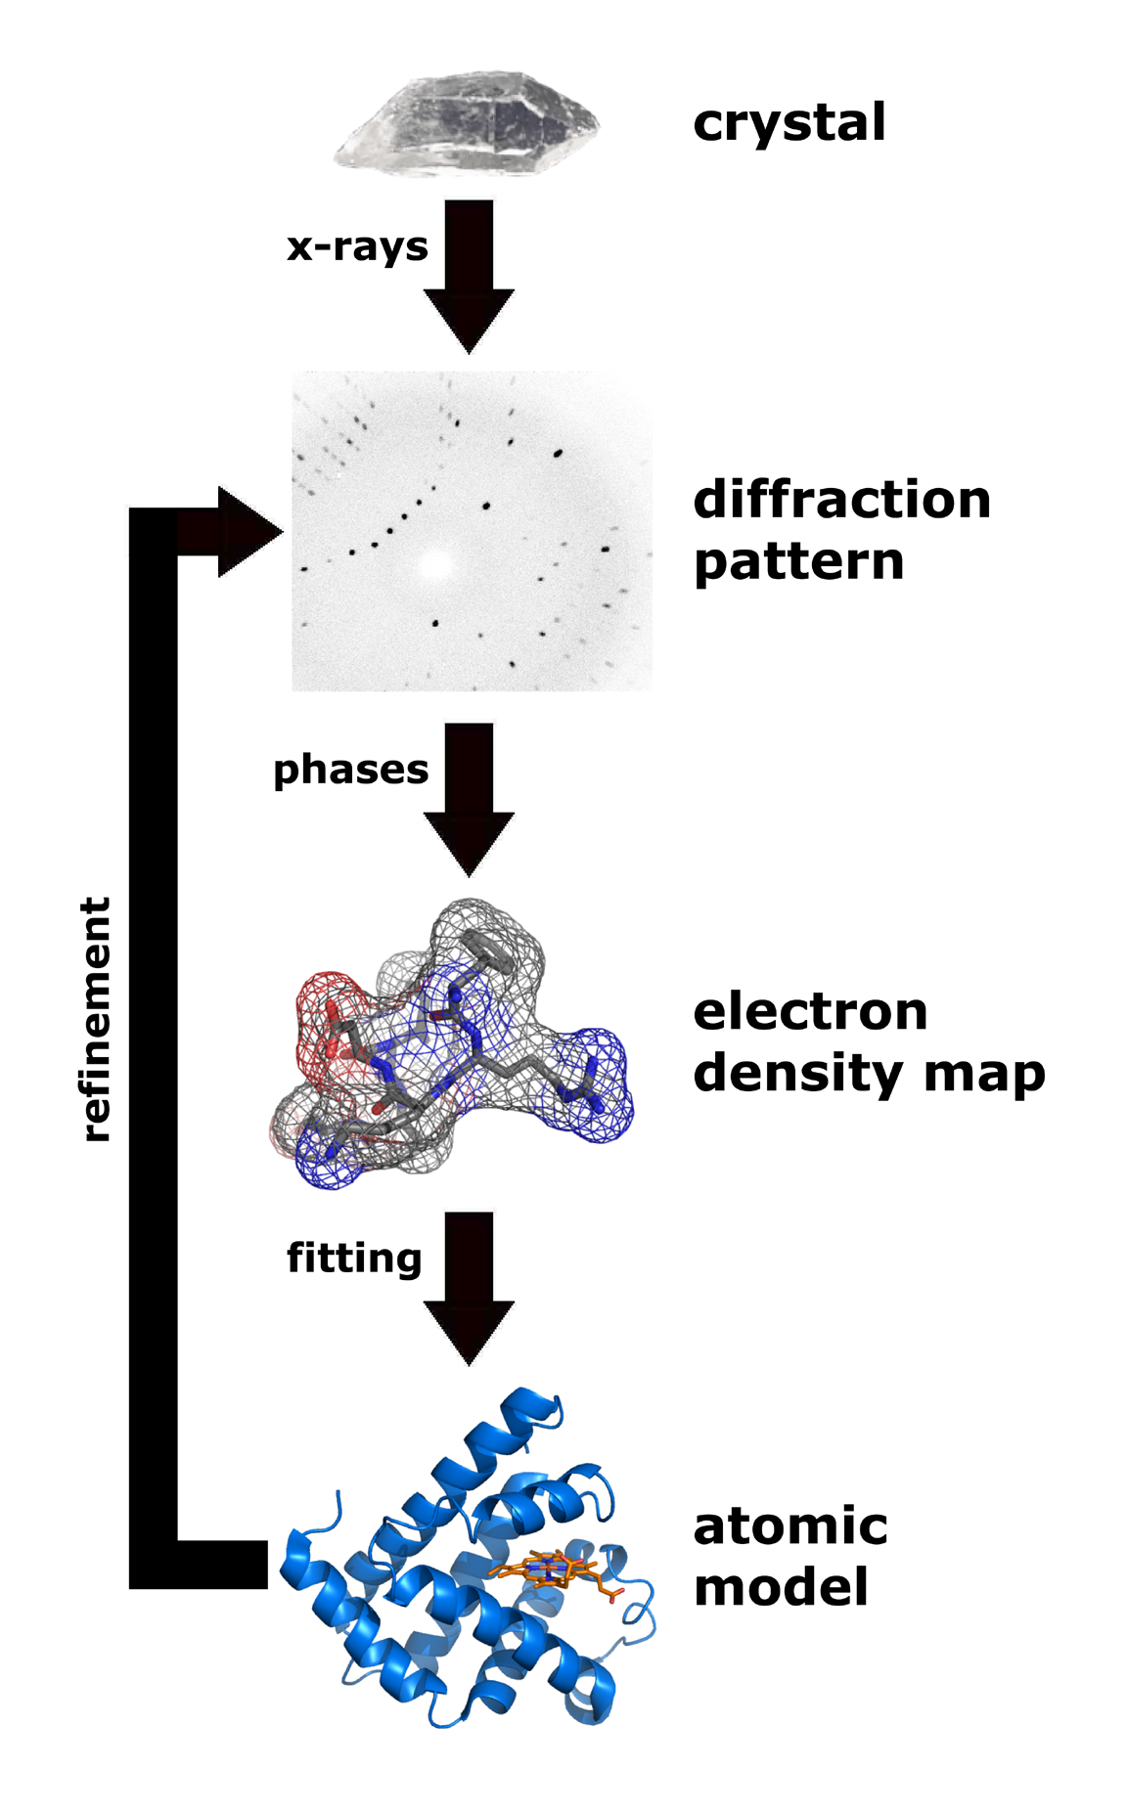
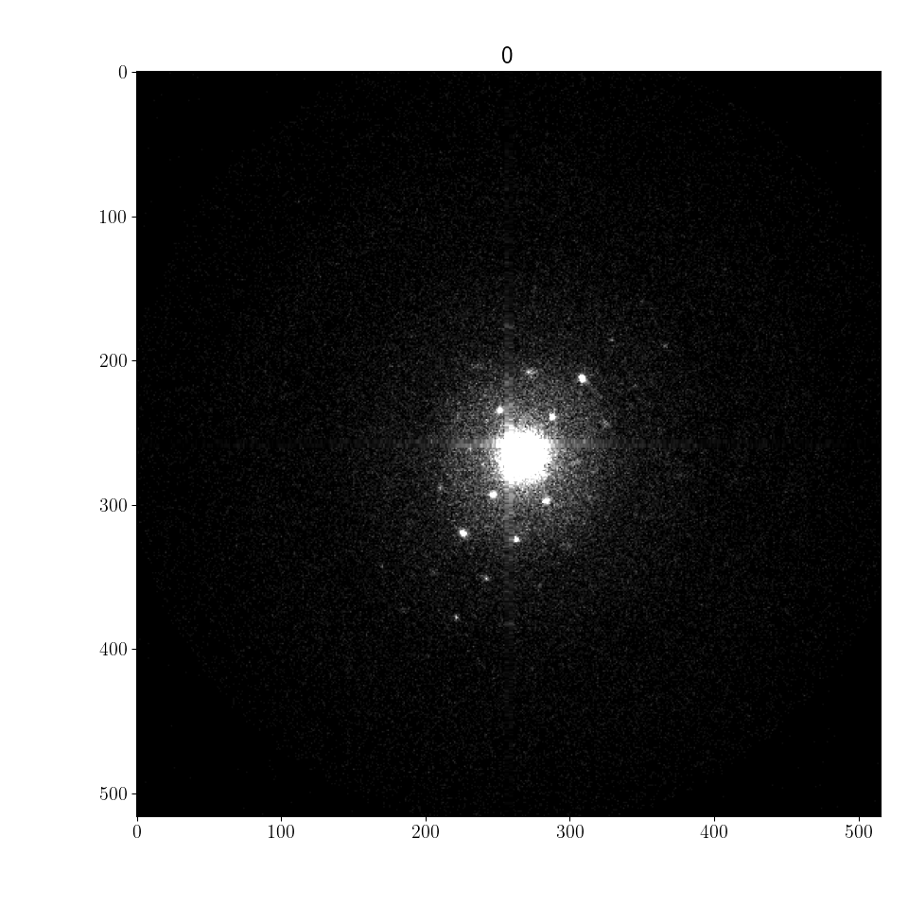
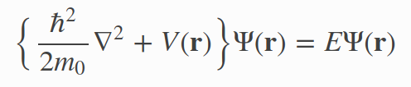
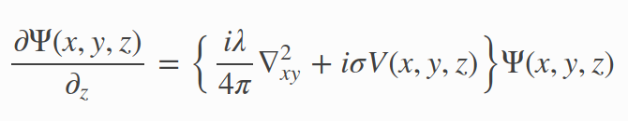

Numerical simulation tools of ED patterns
Crystal
Refinement loop
phasing
Density map
Model
Intensities
FFT⁻¹
Structure Factor F_{hkl}
Schrodinger’s fast electron wave equation
Notes:
Here is the standard MX technique framework.
X-rays are sent through a crystal which is continuously rotated around an axis to produce series of diffraction patterns.
The square root of the diffraction patterns are enriched with the adequate phases known as the structure factor.
An inverse Fourier transform of the structure factor yields the electron density map.
Note that for electron diffraction, the inverse Fourier transform
would yield the electrostatic potential map which provides more direct information about the location of the nucleus.
The problem is that when dynamical diffraction is present as in electron diffraction, this transformation no longer holds as is is based on the single or kinematic scattering assumption.
Instead the diffraction patterns are found from directly solving Schroedinger's equation where V is the electrostatic potential of the crystal, Psi the incident electron beam wave function and E the energy of the electron(typically 100keV). The actual equation solved uses the small scattering angle assumption and is shown below.
To simulate a diffraction pattern, there are a few possible approaches with pros and cons. The most popular is the multislice with various opensource packages. Among them, TEMSIM a very well documented and easy to use that we have chosen.
We are also developing an alternative approach which should have some benefits for macromolecular crystals but I will not cover it here.

Slide 3
Numerical simulation tools of ED patterns
Method | Exact | Speed | Mem (beam per atom) | Periodic structure | Grid based | Parallelization type | Package
Multislice (MS) (physical optics based approach) | no | N_{z}N_{b}logN_{b} | 100 | yes | yes | FFTw one slice after another | TEMSIM (pyMS) PRISM,...
Near bragg (real space path differences) | no | N_{z}N_{b}²N_{p} | 1 | no | no | per pixel | NearBragg (James Holton)

Slide 4
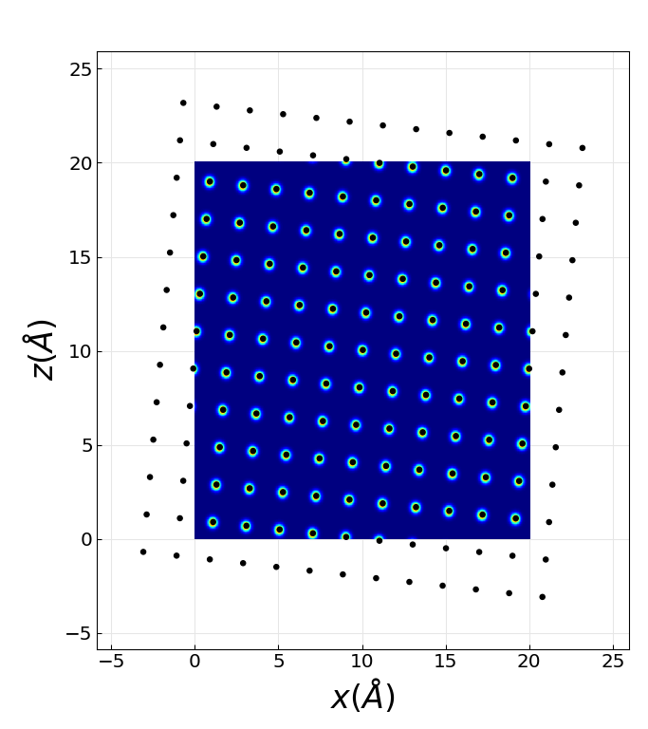
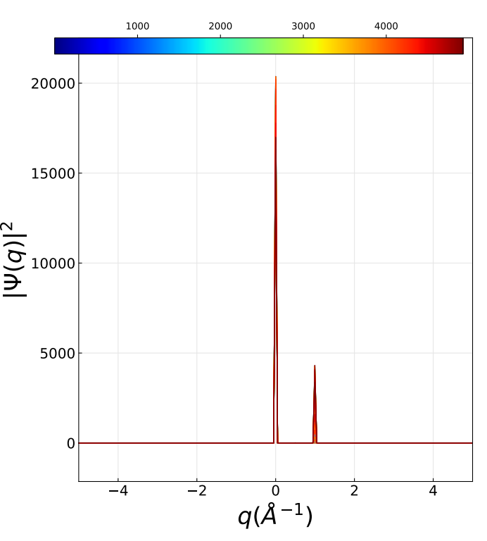
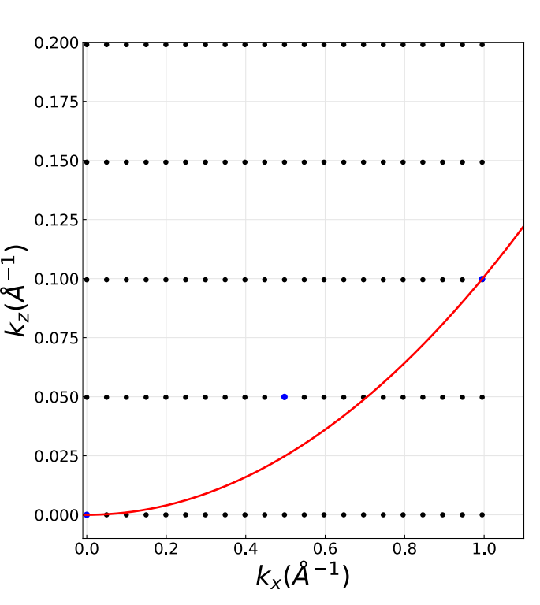
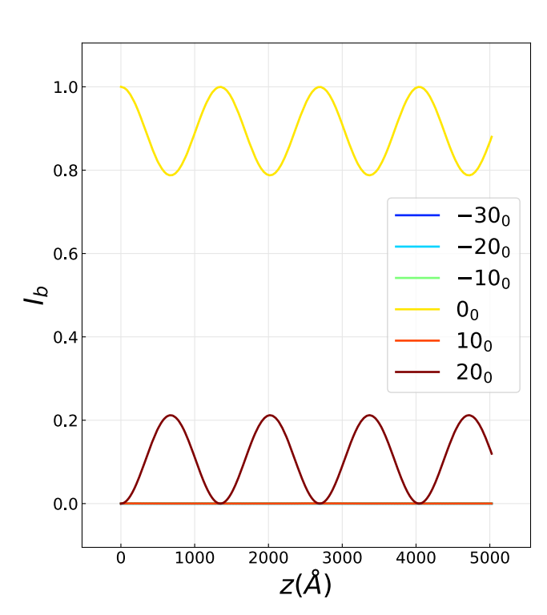
Multislice 2-beam diffraction case
Beams with thickness
2-beam setup

Slide 5
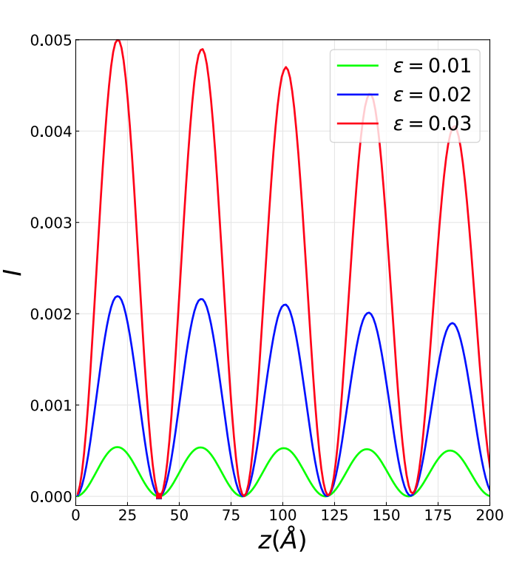
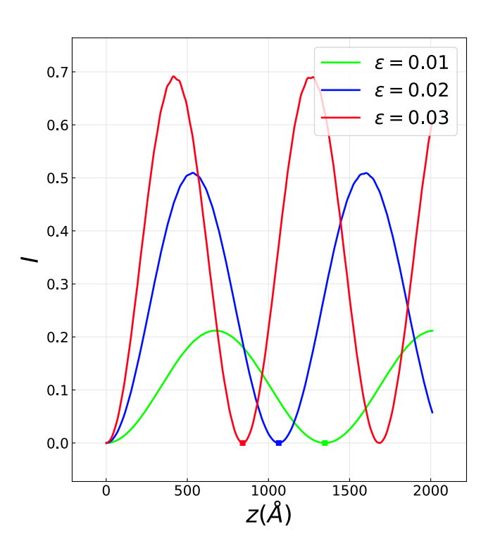
Dynamical diffraction extinction distance
Kinematic Ewald sphere
curvature effect weakly diffracted beam
Potential dependent extinction distance for strongly diffracting beam

Slide 6

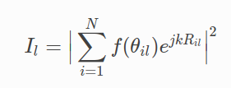
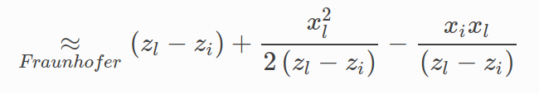
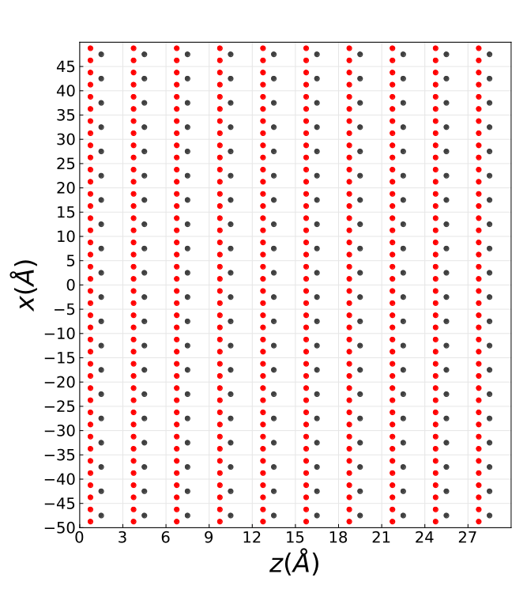
Near Bragg
θ_{il}
θ
Atom i
θ_{B}
Pixel detector
l
Plane wave

Slide 7
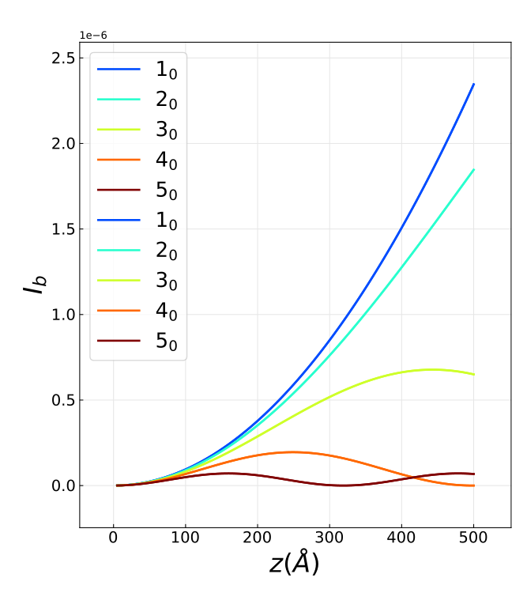
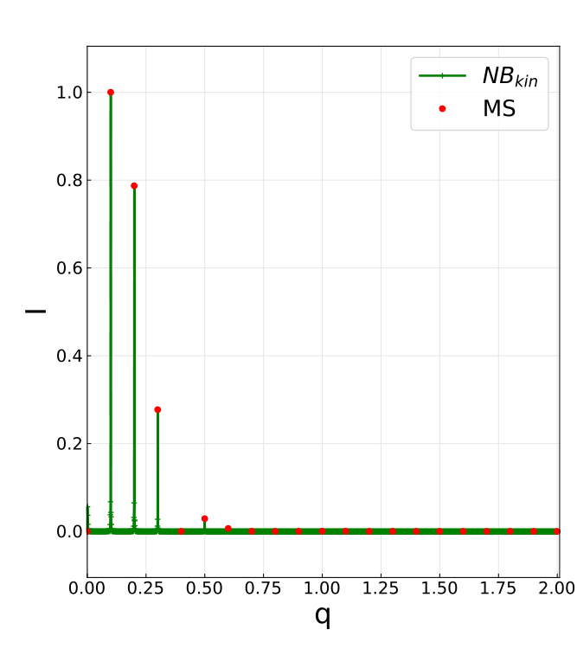
Weak potential kinematic approximation

Slide 8
Extension to multiple scattering
θ_{ij}⁽¹⁾
θ_{i}
θ_{ij}⁽¹⁾
Plane wave

Slide 9
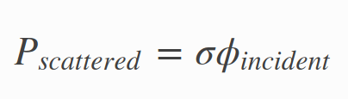
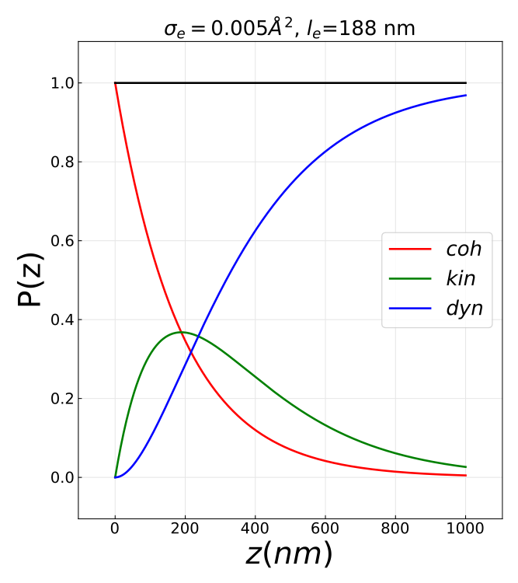
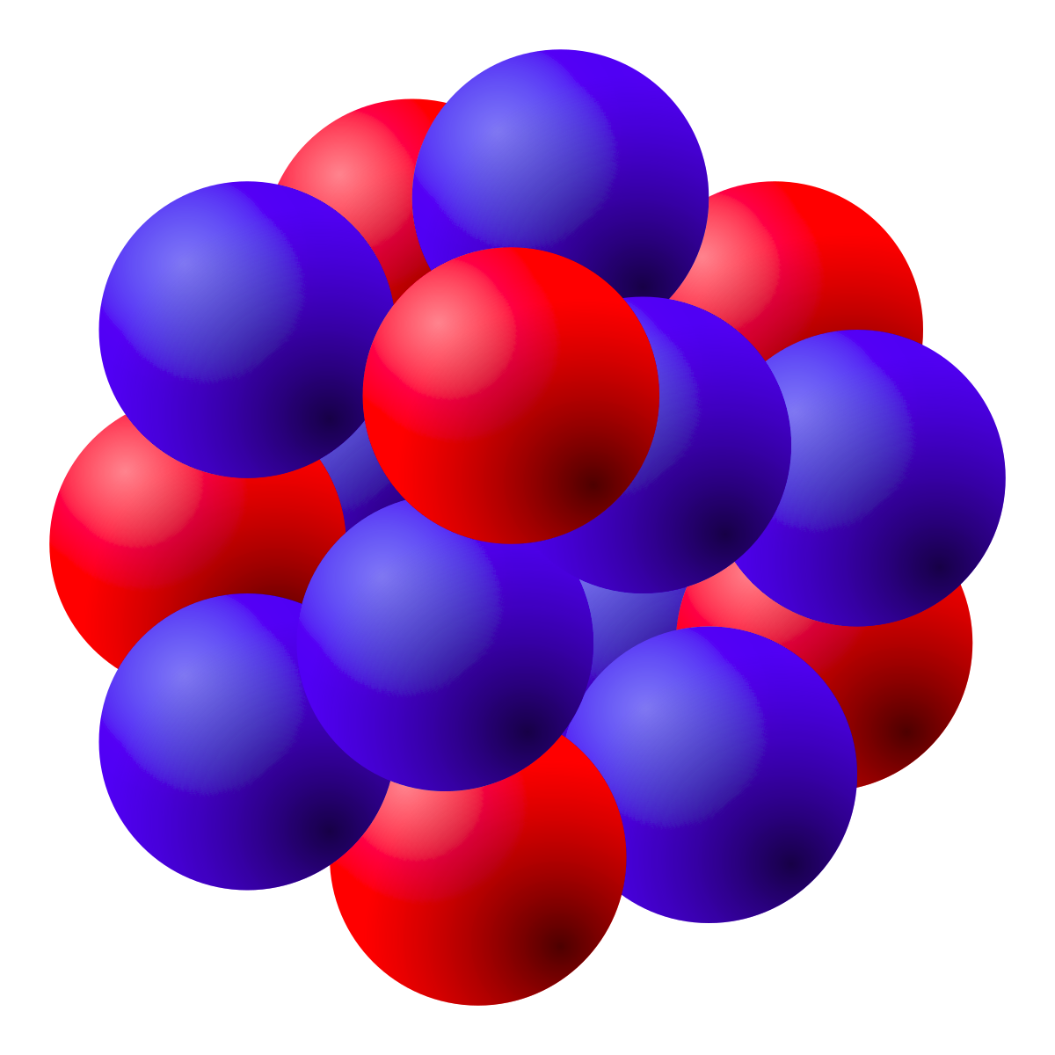
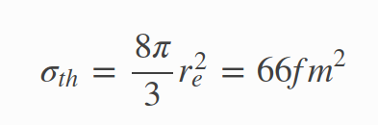

Multiple Scattering in Electron Diffraction
Atomic interation cross section
Mean free path, l_{e} = 200nm
σ
X-rays (Thomson scattering)
Electrons (Coulomb scattering)
Notes:
The core difference between X-ray and ED exp lies in the strength of the interaction between the specimen and the probing source : ED involves Coulomb scattering which is orders of magnitude stronger than Thomson scattering involved in X-ray.
We measure the strength of an interaction with the interaction cross section which can be determined from first principles as you can see below.
The cross section is an area with a simple meaning.
If you take a beam of particles(X-rays or electrons) with a given flux(part/s/m^2) incident onto a scatterer(atom), the interaction cross section gives you the number of particles that will be scattered per second. So large cross section means strong interaction.
For X-rays, the cross section is proportional to the square of the classical radius of the electron which is tiny.
<!-- For Thomson scattering the cross section from X-ray with a atomic electron is basically the square of the classical radius of the electron which results in a tiny cross section. Scattering from the atom then somehow linearly increases with its number of electrons. -->
For electron scattering, the typical cross section is orders of magnitude stronger. In fact, combining the cross section and typical material density gives a mean free path less than 200nm.
On the figure, you can see the probability of electron scattering events as a function of specimen thickness. In red, no scattering, in green scattered only once(so kinematic) and blue more than once (so dynamical)
As you can see for samples larger than 200nm, which is below typical crystal sizes, dynamical diffraction starts to dominate.
<!--Can we grow crystals smaller than 200nm ? exp ED crystal sizes ?-->

Slide 10
Extension to multiple scattering
0.1% subsequently scattered electrons
Scattered Intensity at distance r
Pdual_scat = σϕ_{e}(r)
r
1% electrons in this scattered beam
Plane wave

Slide 11
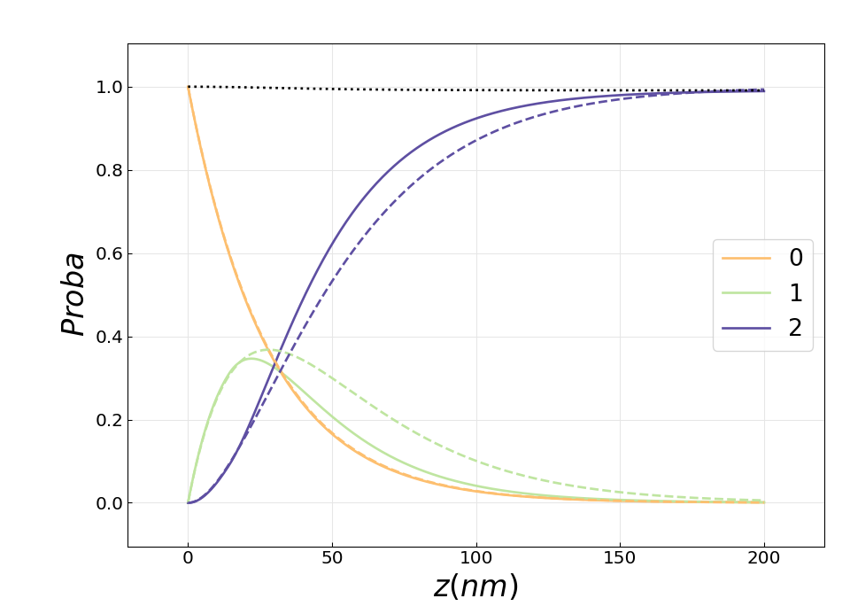
Extension to multiple scattering
Dashed : near bragg solid : Theory
0 no scattering
1 single scattering
2 multiple scattering

Slide 12
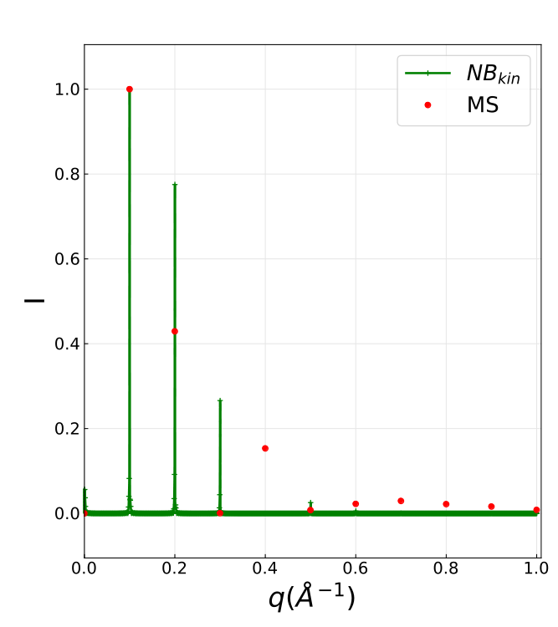
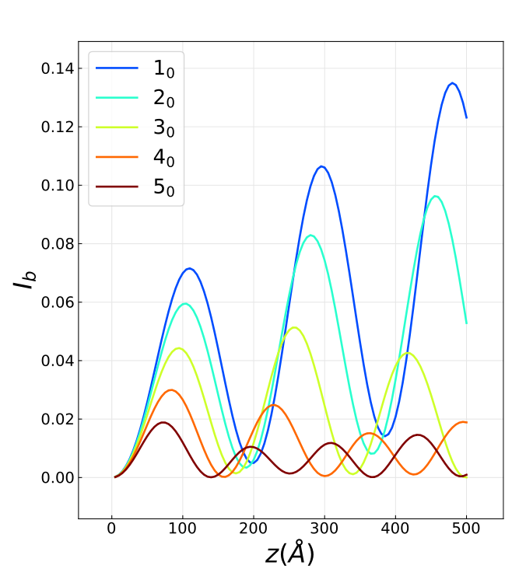
Near Bragg vs multislice

Slide 13
Current challenges
- adapt nearBragg approach to multiple scattering events
- Compare simluation to experimental dataset
- Simulate defects (modelling and computationnal), Thermal difffuse scattering, inelastic scattering
- model partially coherent beam as produced by LaB₆ guns

