Slide 1


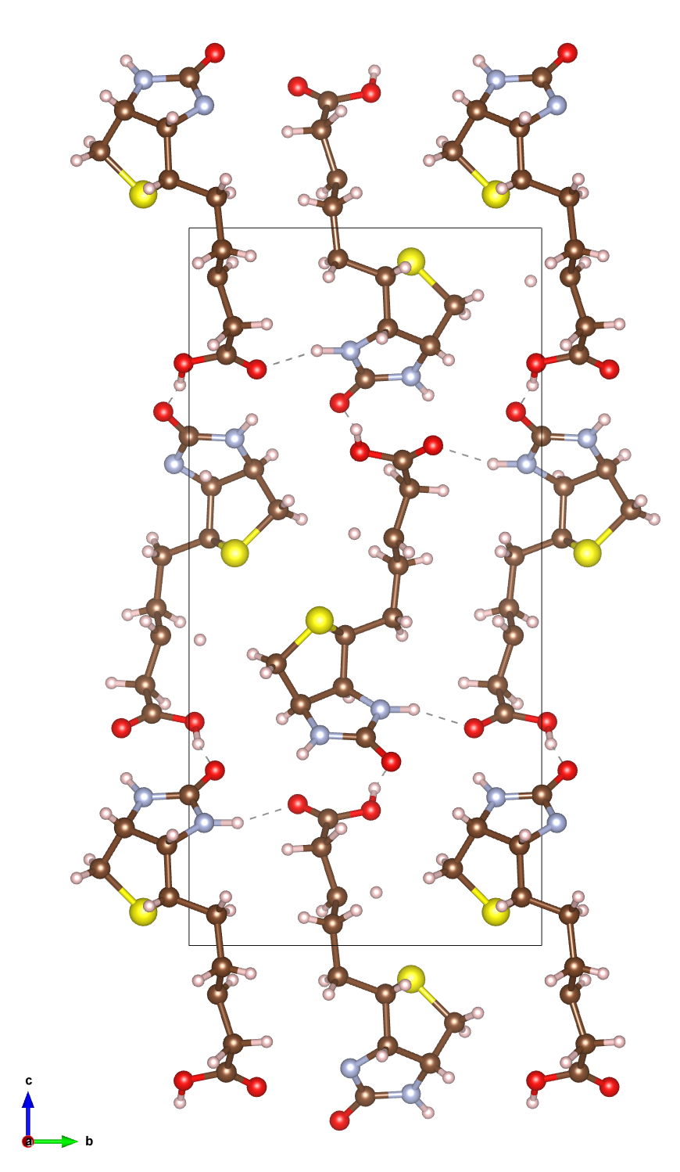
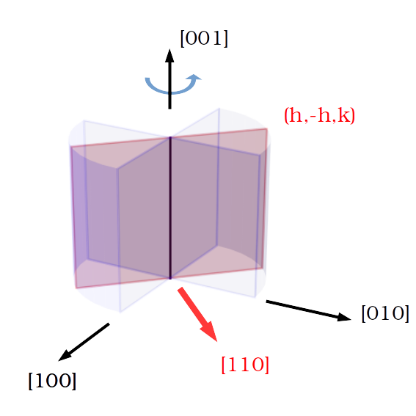
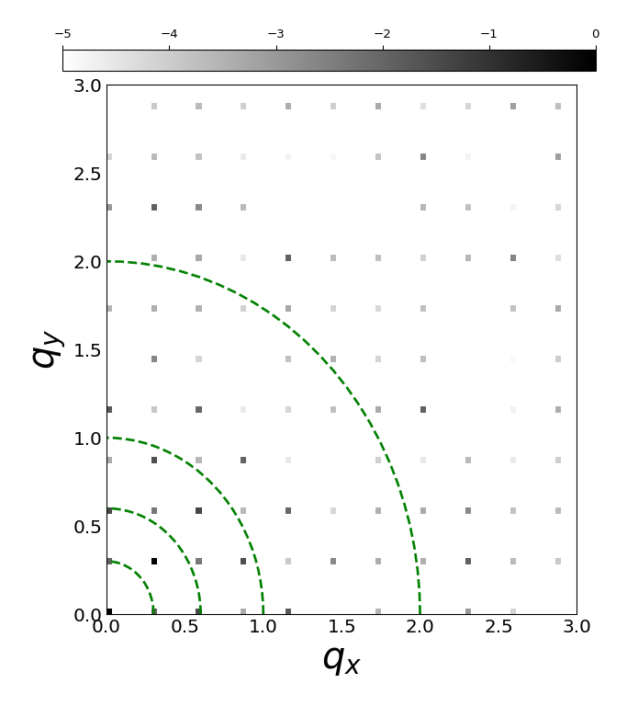
Electron diffraction project WP4
Tarik Drevon, David Waterman, Eugene Krissinel
Simulating electron diffraction patterns of macromolecular crystals
Identifying correction opportunities at the scaling stage in DIALS

Slide 2
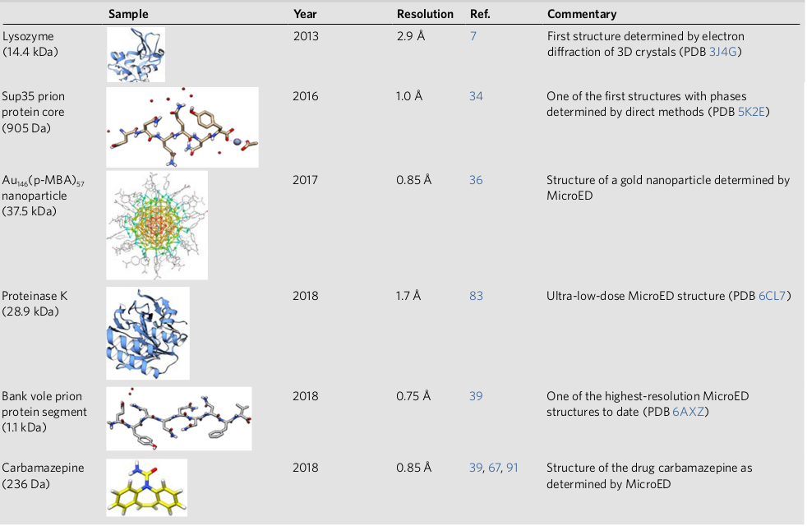
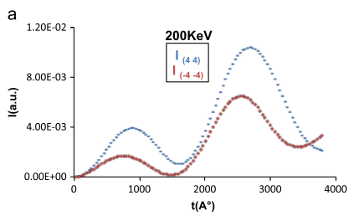
Discrepancy between theory and experiments
Macromolecules solved from experimental Electron Diffraction (ED) data
Multiple scattering should prevent use of standard X-ray kinematic technique
B. L. Nannenga and T. Gonen, “The cryo-EM method microcrystal electron diffraction (MicroED),” Nat. Methods, vol. 16, no. May, pp. 369–379, 2019
G. Subramanian, S. Basu, H. Liu, J. Zuo, and J. C. H. Spence, “Solving protein nanocrystals by cryo-EM diffraction : Multiple scattering artifacts,” Ultramicroscopy, vol. 148, pp. 87–93, 2015

Slide 3
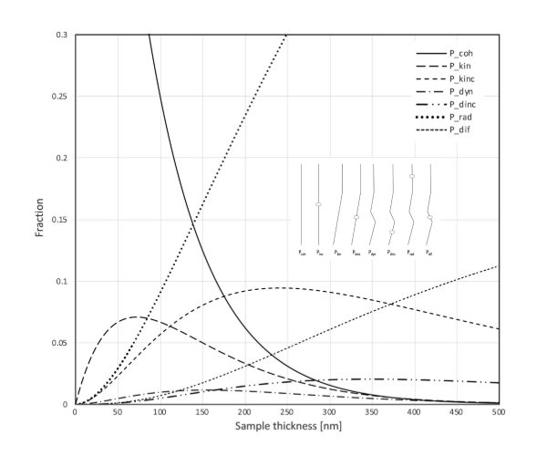
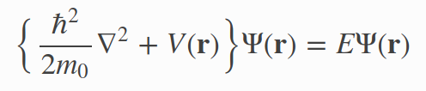
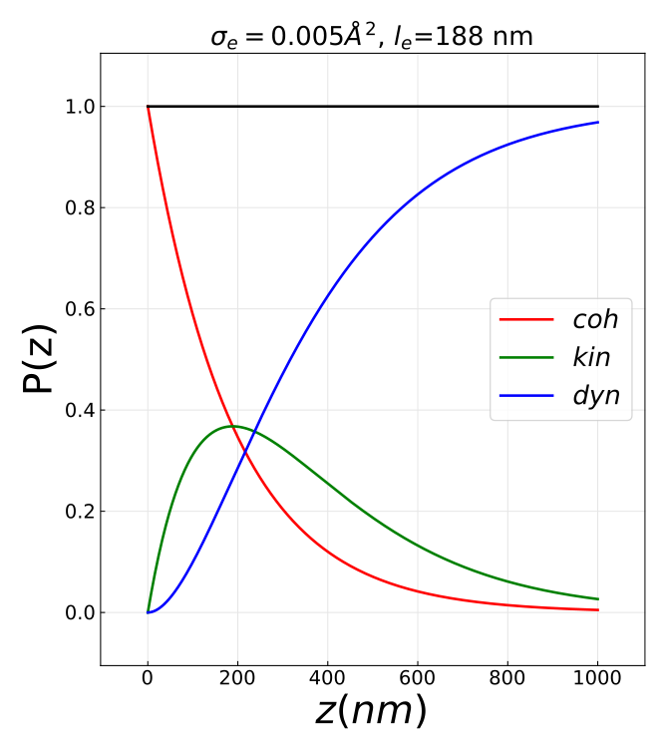
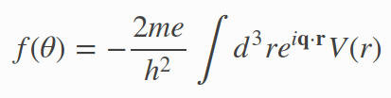


Electron diffraction and dynamical scattering
Atomic scattering factors and cross section
Born approximation
Atomic cross section
Mean free path
T. Latychevskaia and J. P. Abrahams, “Inelastic scattering and solvent scattering reduce dynamical diffraction in biological crystals,” Acta Crystallogr. Sect. B Struct. Sci. Cryst. Eng. Mater., vol. 75, pp. 523–531, 2019

Slide 4

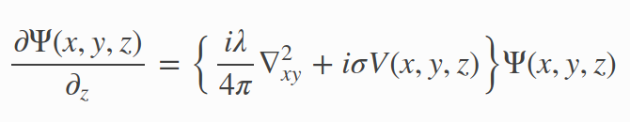
Numerical simulation tools of ED patterns
Fast electron wave equation
Method | Exact/consistent | Speed | Memory (per atoms) | Periodic structure | Grid based | Package
Multislice (MS) | no | fast | 10 points | yes | yes | TEMSIM PRISM
Bloch wave (diagonalization in reciprocal space) | yes | slow | 10 points | yes | no | EDM muSTEM PyQt
Near bragg (real space path difference integral ) | no | ?? | 1 point | no | no | NearBragg (James Holton)

Slide 5

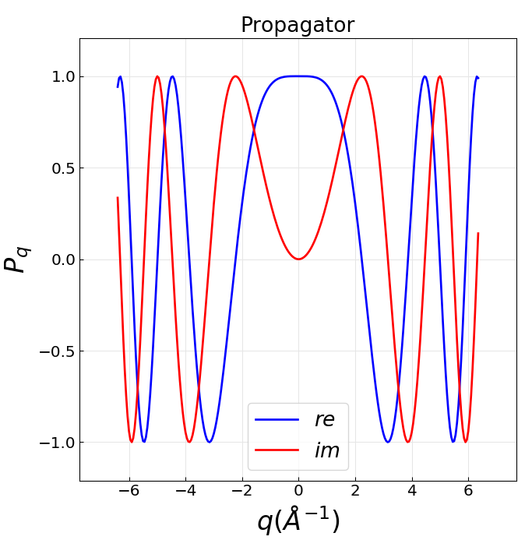
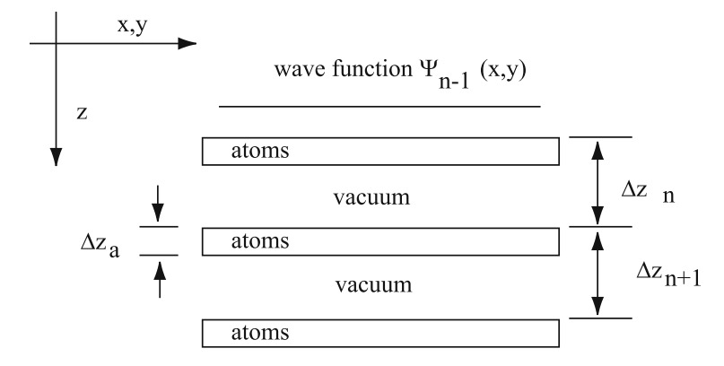

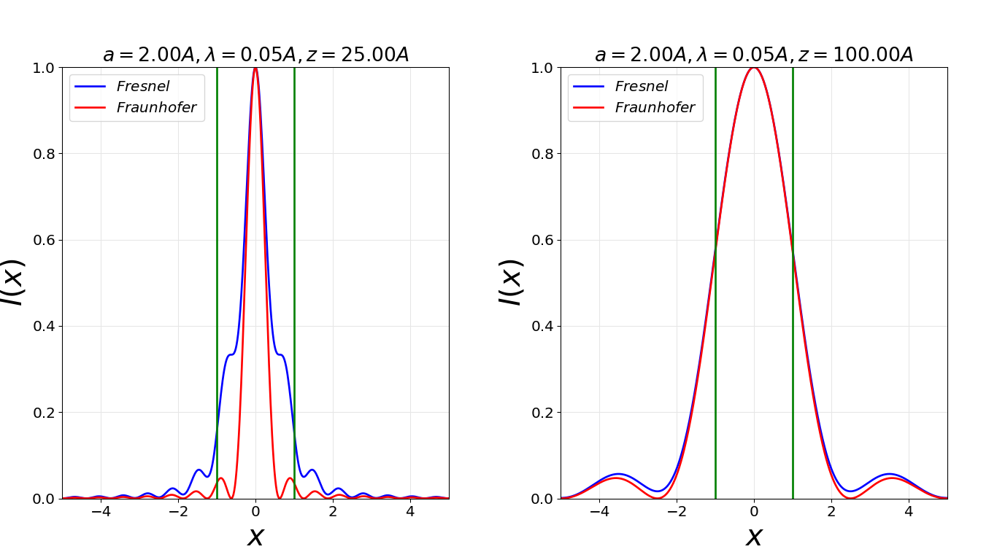

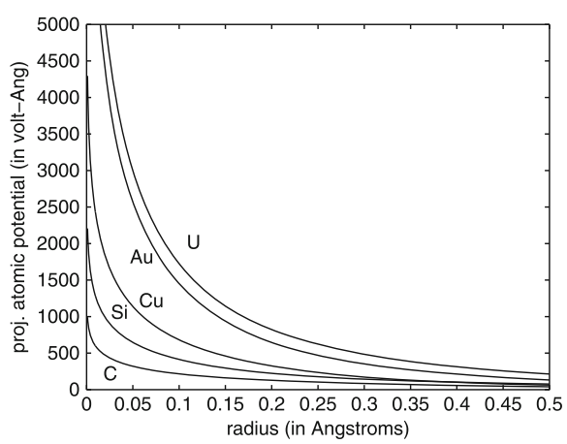


Multislice (MS) algorithm
FFT
Fresnel propagator
Specimen is cut in slices
~ 1 Angstrom thick each
Transmission function
Weak potential
Projected potential

Slide 6
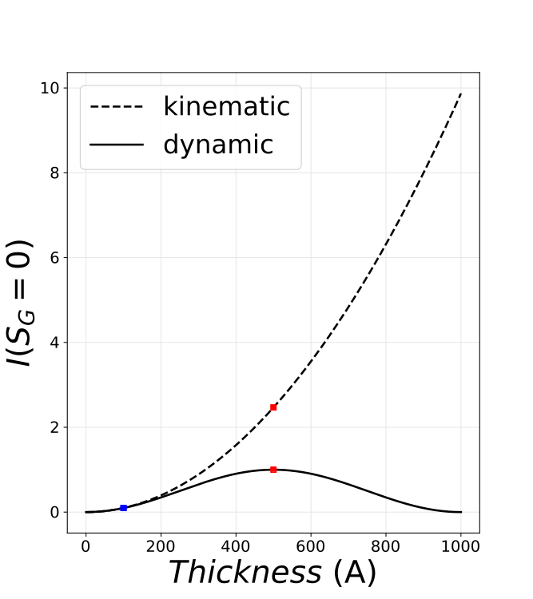
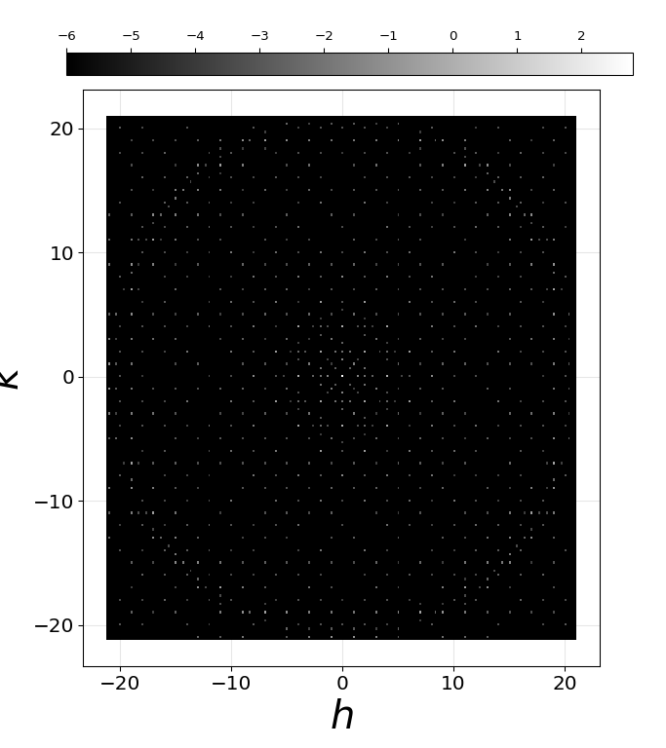
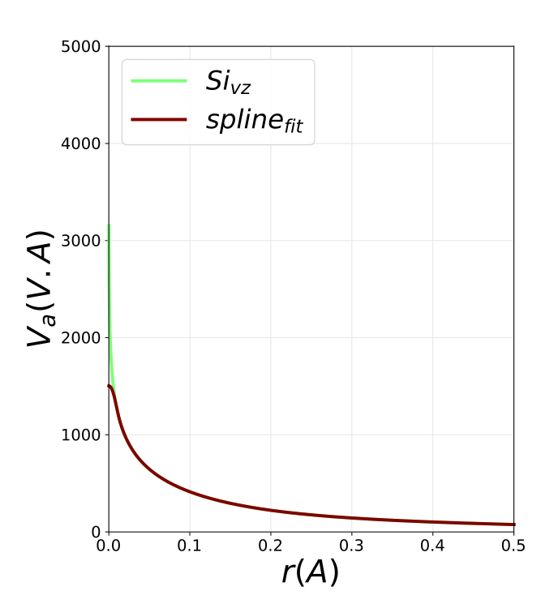
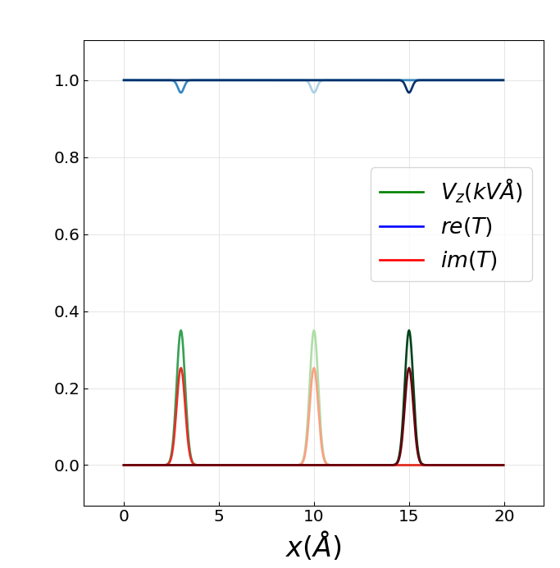
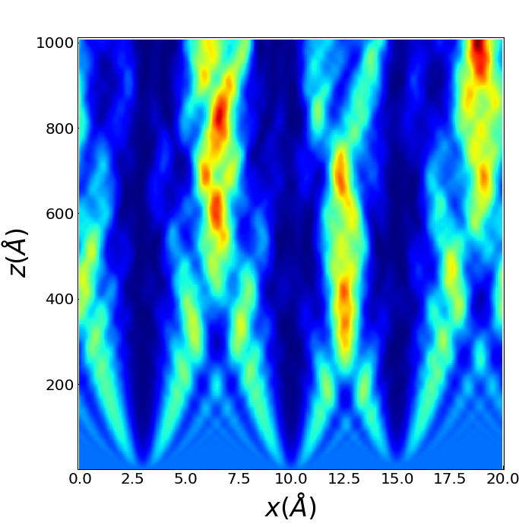
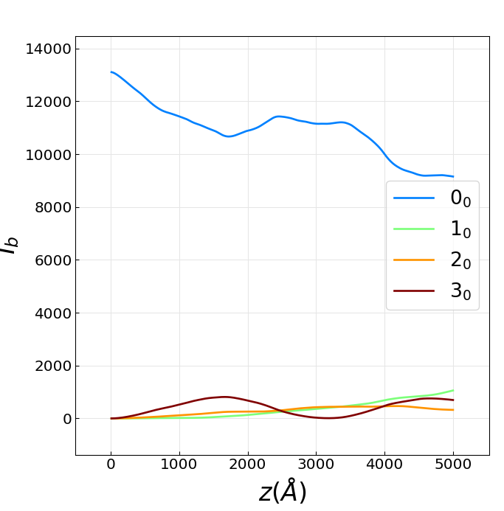
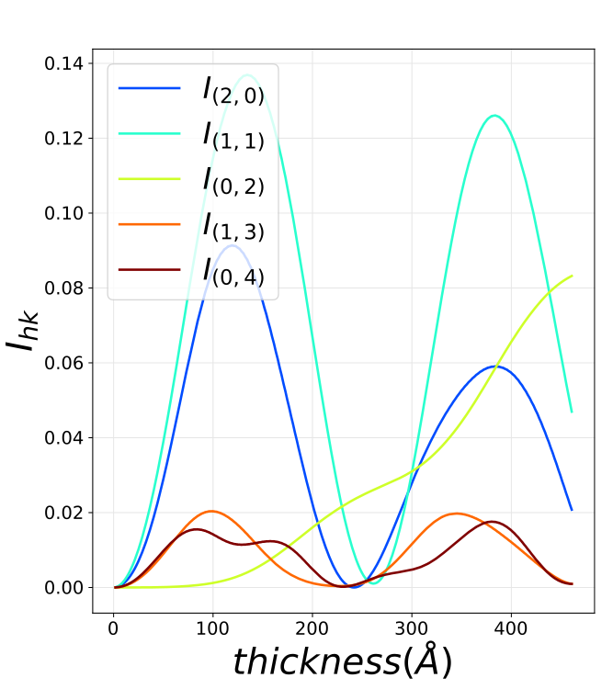
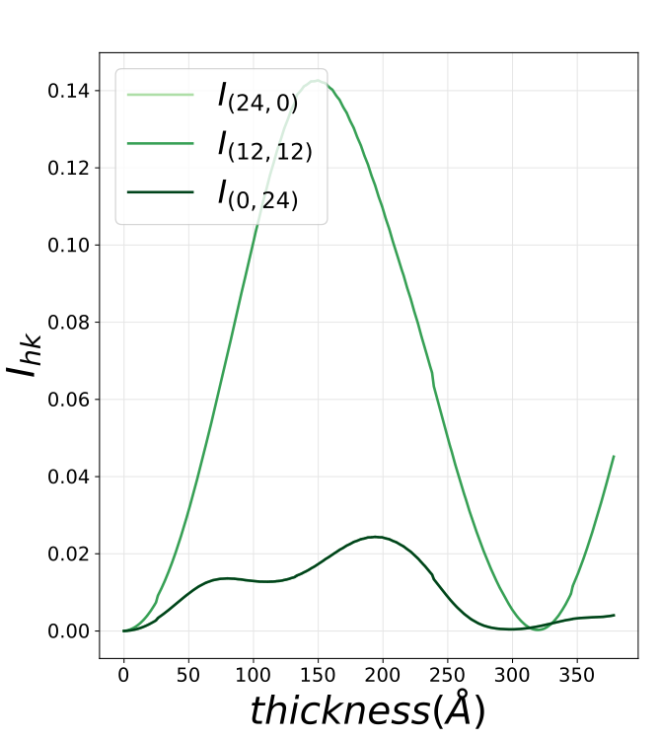
Multislice (MS)
3D Silicon
Diamond structure
Basic 2D example
[110]
[100]

Slide 7


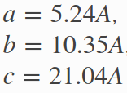
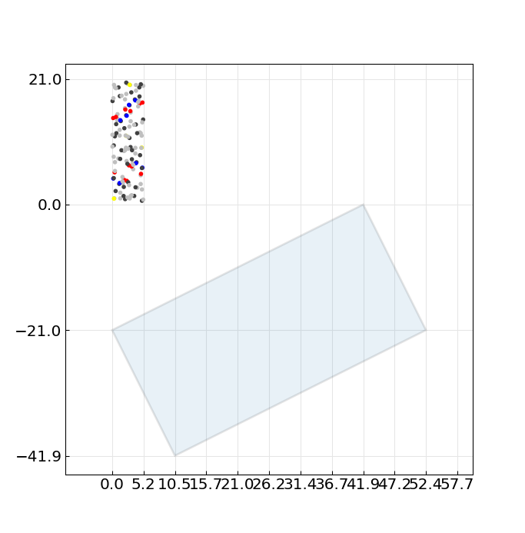
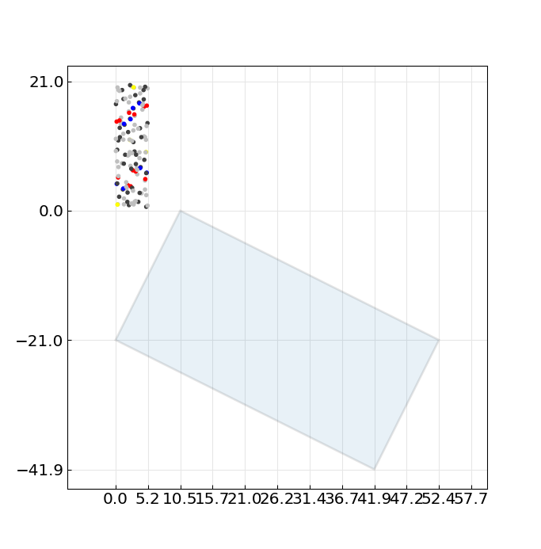
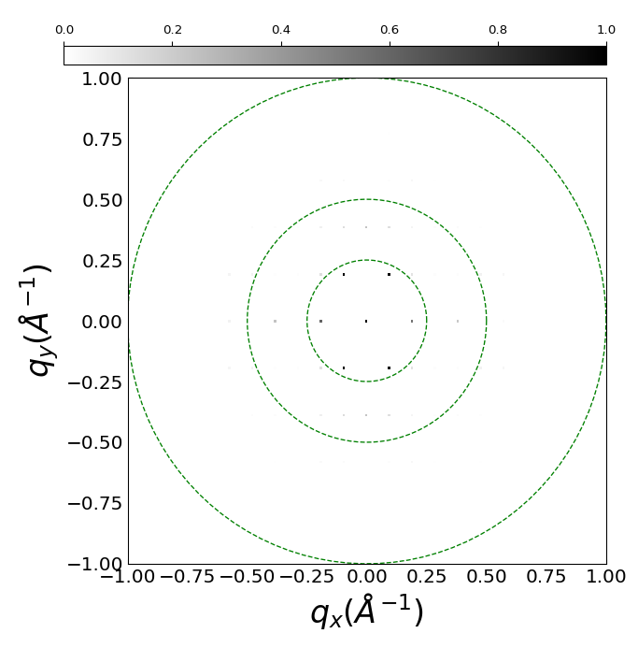
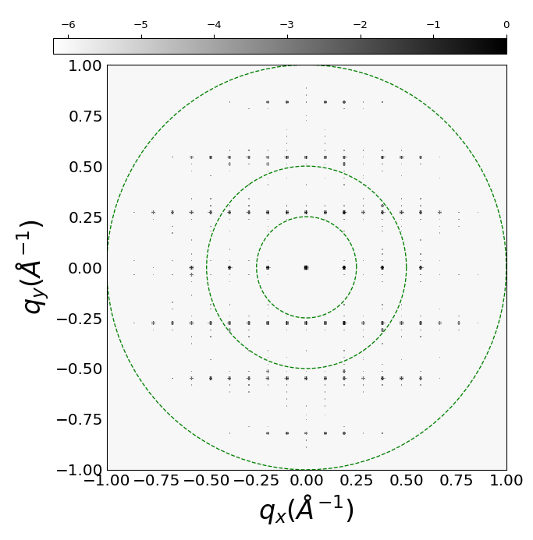

Simulation of biotin
Structure
[102]=7deg
[201]=25deg
[001]=0deg

Slide 8
What‘s next?
- Explore opportunities with nearBragg simulator
- Perform simulations under continuous rotation
- Investigate the effect of defects and mosaicity
- Use CCP4 with the simulated data
http://brno.rc-harwell.ac.uk:8000/

