Slide 1
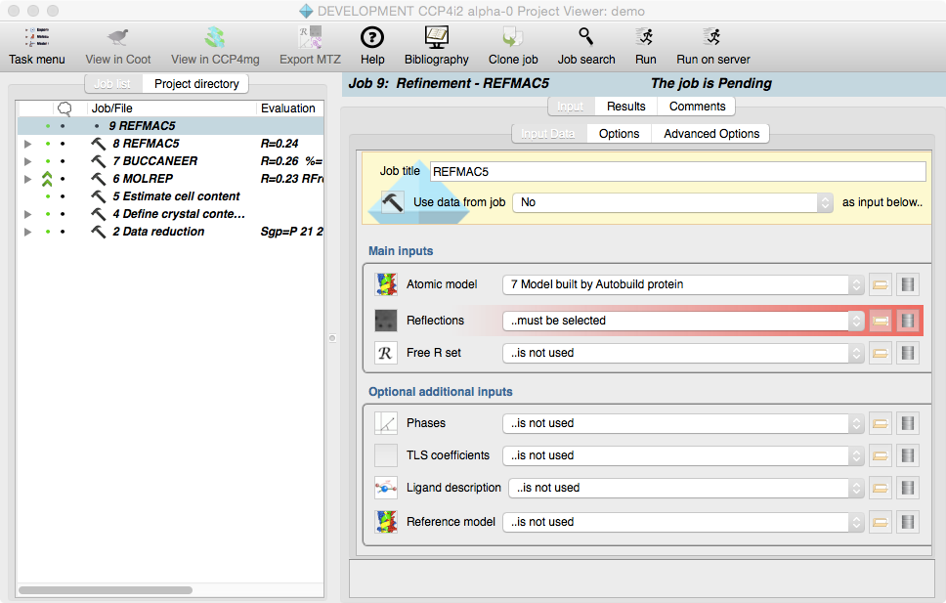
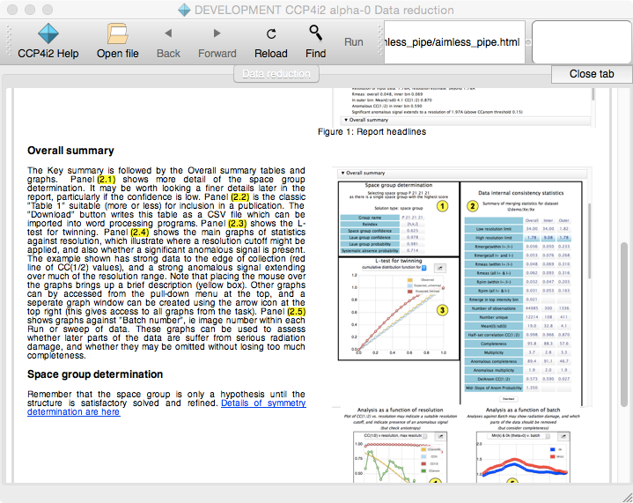
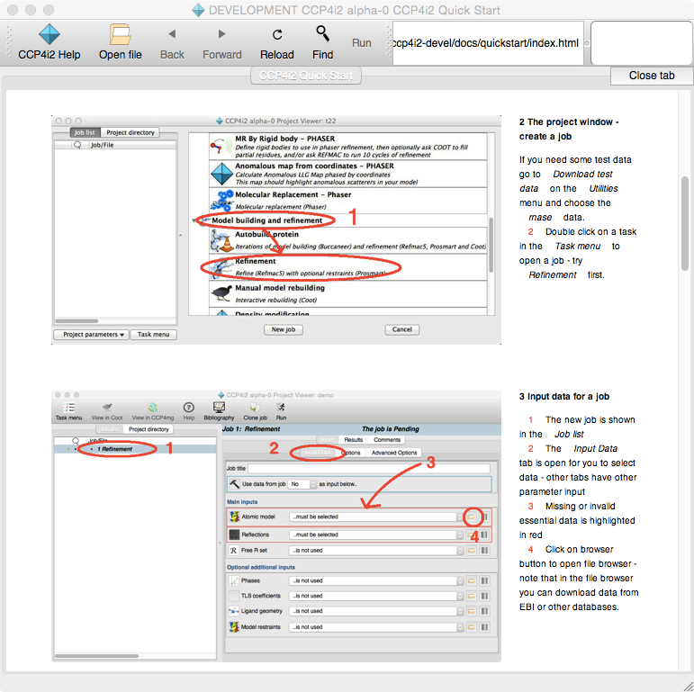
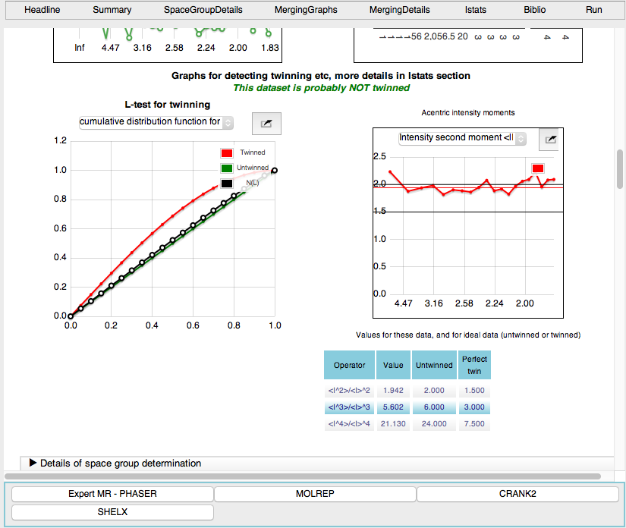
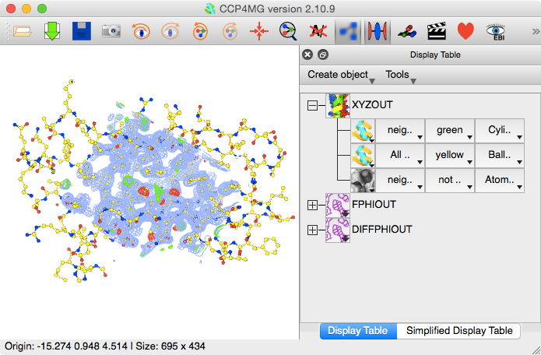
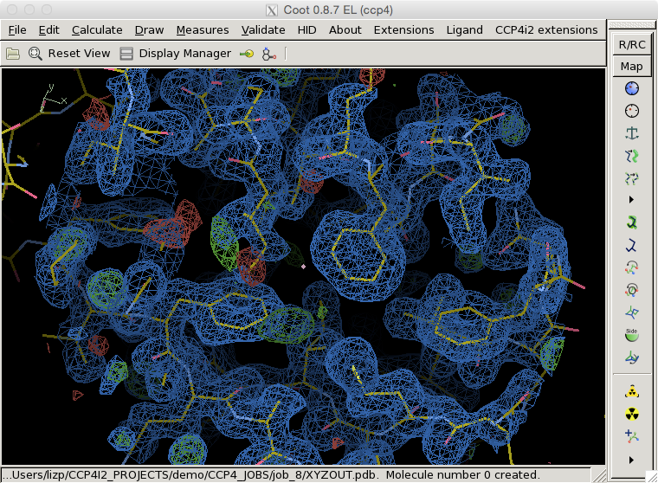
CCP4i2 - the New CCP4 User Interface
Liz Potterton - University of York
CCP4 Study Weekend 2017

Slide 2
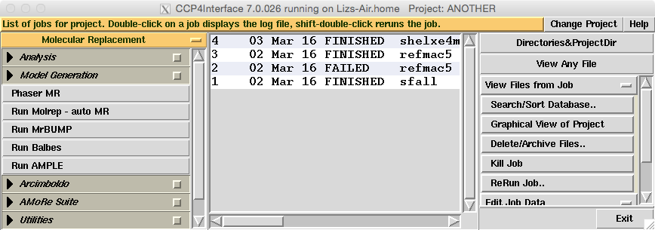
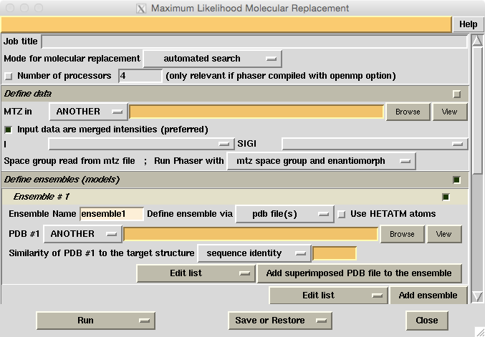
‘i1’ - the old user interface
Outdated gui style
Difficult for beginners
Many tasks could now be more automated
BUT does everything & refined by long use

Slide 3
Programming
Python - the ‘standard’ MX scripting language
Qt - graphics tools and much more
A ‘proper’ SQL database - sqlite chosen mostly for its liberal licence

Slide 4

Where To Start?
1) THE DATA MODEL!
Choosing input to job user has list of outputs from previous jobs. For this to work..
task must be specific about type of data input and output - and all most use the same formats etc.
database must keep track of each tasks input and output data
there is a graphical widget for each type of data

Slide 5

ExperiMENTAL DATA - THE MTZ FILE
Old-style ‘monster’ MTZ files contained all experimental data - user must select columns
New ‘mini’ MTZ files contain either reflections, phases, FreeR sets or map coefficients

Slide 6
2) THe database
The Job list is a view onto the database for one project
The database records projects, jobs, sub-jobs, input and output data to each job & quite a lot more.

Slide 7
3) The graphics
Project window
Task
Data widget

Slide 8
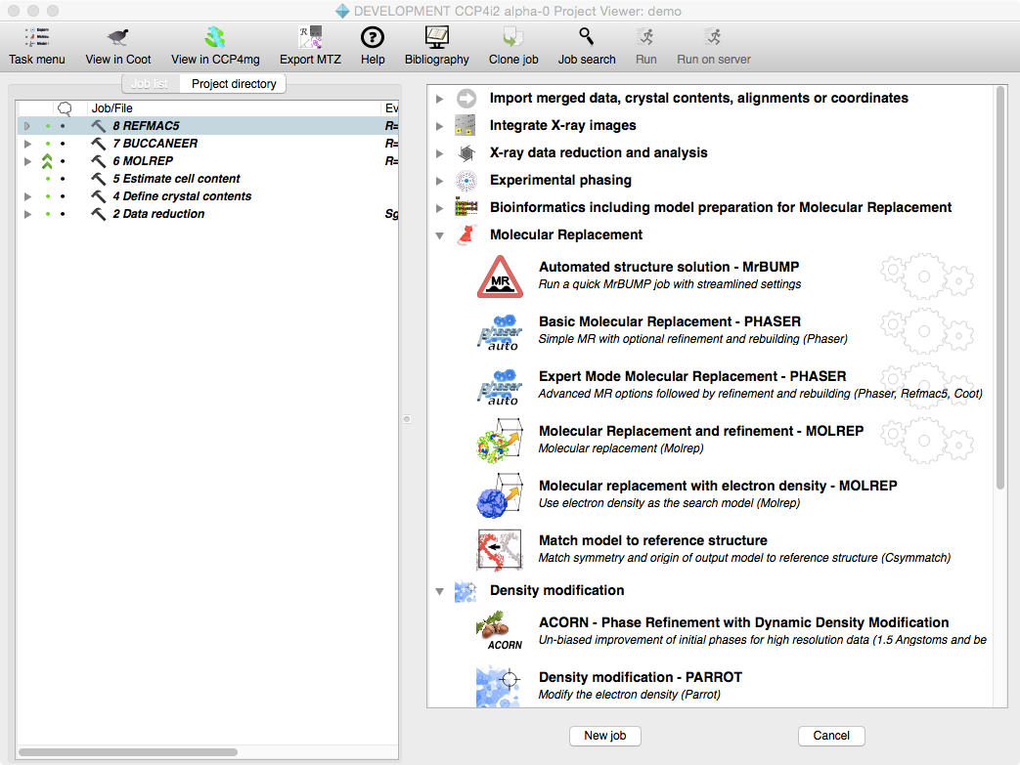
The TASKS
50-60 tasks
Integraton to deposition
interface Coot, ccp4mg
one task per program
pipeline can use other tasks
written by dozen experts

Slide 9
4)WRITING TASKS
<content id=“F_SIGF”>
<className>CObsDataFile</className>
<qualifiers>
<mustExist>True</mustExist>
<allowUndefined>False</allowUndefined>
<fromPreviousJob>True</fromPreviousJob>
<requiredContentFlag>4</requiredContentFlag>
</qualifiers>
</content>
<content id="XYZIN">
<className>CPdbDataFile</className>
<qualifiers>
<mustExist>True</mustExist>
<allowUndefined>False</allowUndefined>
<fromPreviousJob>True</fromPreviousJob>
<saveToDb>True</saveToDb>
<ifAtomSelection>True</ifAtomSelection>
<requiredSubType>2,1,0</requiredSubType>
<default><subType>2</subType></default>
</qualifiers>
</content>
..etc… etc..
self.createLine( [ 'subtitle', 'Main inputs' ])
self.createLine( [ 'widget', '-browseDb', True, 'XYZIN' ] )
self.createLine( [ 'widget', '-browseDb', True, 'F_SIGF' ])
self.createLine( [ 'label','Use anomalous data for ', 'widget', 'USEANOMALOUSFOR',
'label', 'Wavelength', 'widget', 'WAVELENGTH'],
def file - list of data and parameters
gui file - the task window
alboardman.tumblr.com
program.xml
script file - the real work - runs program
report file - how to show results

Slide 10
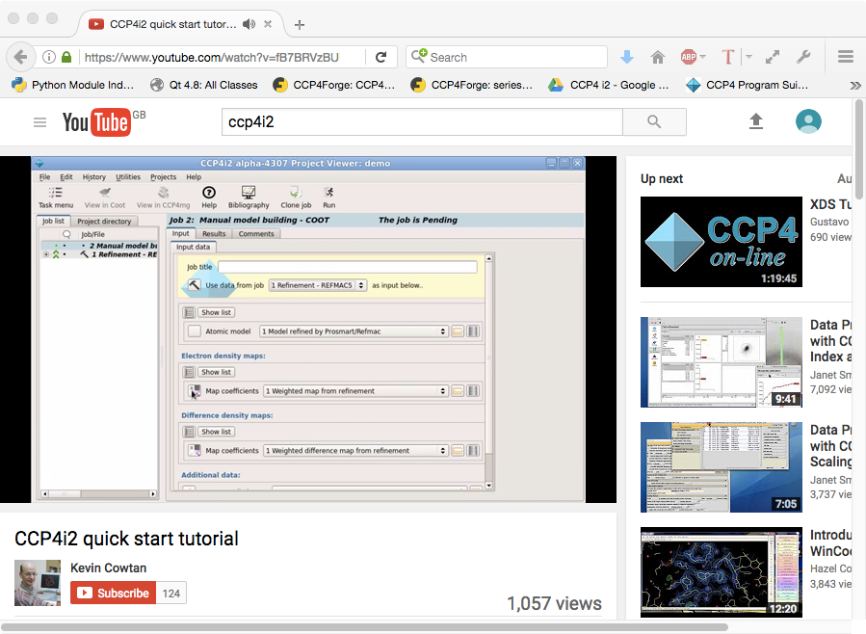
FOR NEW USERS..
I hope you did not miss the Lunchtime Bytes!
Try the Quickstart tutorial
Look at Kevin Cowtan’s YouTube tutorial

Slide 11
RECENT FEATURES..

Slide 12
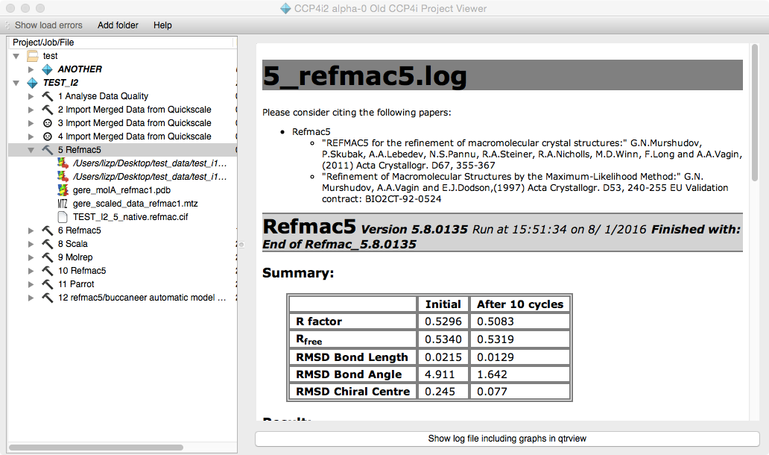
VIEWING OLD i1 PROJECTS
Projects menu > View old CCP4i projects

Slide 13
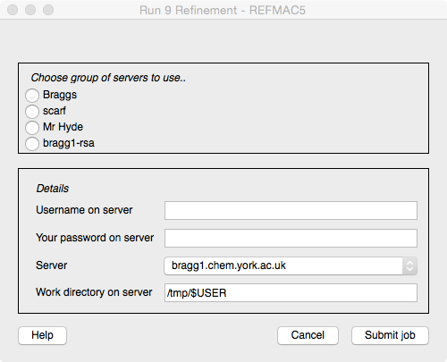
Running JOBS ON A SERVER
To run on server user must usually just enter username and password once per session.
‘Running’ reports usually work but maybe some delay.

Slide 14
RUNNING JOBS ON A SERVER
CCP4 must be installed on the server.
Can be set up by computer manager for everyone’s use.
Three mechanisms:
Unix SSH
qsub job queue
customised - probably web-based

Slide 15
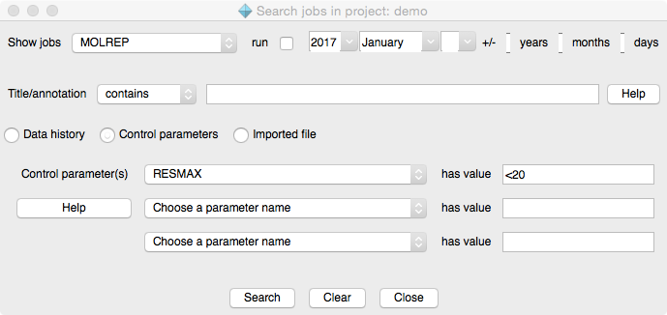
job SEARCH
Task
Date/time run
Title text
Control parameters
Imported file

Slide 16
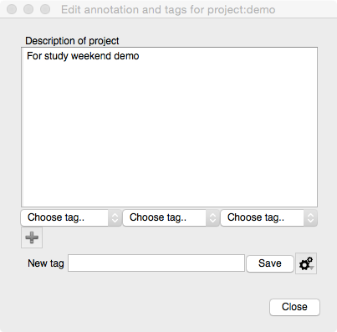
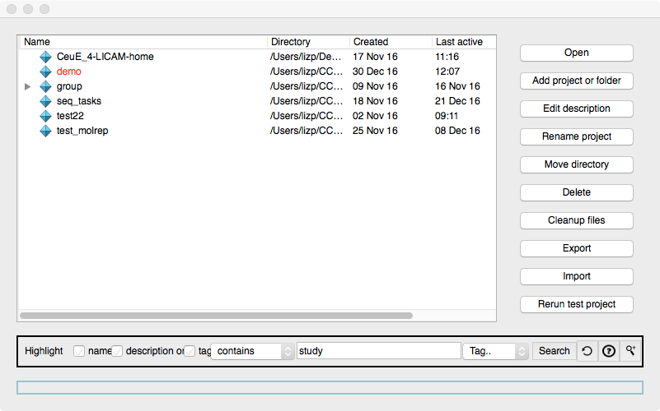
SEARCH ProjectS
Enter description and tags for a project
Search projects for text or tags

Slide 17
SEARCH ProjectS
‘Hit’ projects highlighted in red

Slide 18
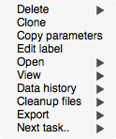

VIEWING DATA HISTORY
For any job select ‘Data history’ and the type of data
Highlighted in red are all jobs that use the data
Tracks the parents and children of coordinate files

Slide 19
THE FUTURE
More science - for software developers:
an ‘easy’ way to make software available to users
interfacing smoothly with other software
The individual tasks and control of running tasks can become more automated but will not be a black box
user can see what was done and intervene
i2 maintains good record of structure solution but
currently ‘single user’ - intend to support ‘lab-wide’ database system

Slide 20
ACKNOWLEDGEMENTS
Project leaders: Martin Noble, Keith Wilson
Core i2 contributors: Martin, Stuart McNicholas, Phil Evans, Kevin Cowtan, Jon Agirre, Kyle Stevenson
CCP4 Core team: Eugene Krissenel, Andrey Lebedev, Charles Ballard, Ronan Keegan, Villi Uski, Marcin Wojdyr, David Waterman
Task developers: Martin, Phil, Stuart, Kevin, Jon, Kyle, Ronan, Andrey, David, Martyn Winn, Rob Nicholls, Pavel Skubek & Navraj Pannu
Tireless testing & advice: Keith, Eleanor Dodson, Phil, Frank von Delft, Johan Turkenburg, Christian Roth, Huw Jenkins, George Sheldrick

