Slide 1
CCP4i2 the New User Interface
Liz Potterton

Slide 2
..just like the old interface..
Organise work into projects - not strictly defined – can be organised into hierarchy*
Tasks – one program or a pipeline of programs
Jobs – one run of a task
*New feature

Slide 3
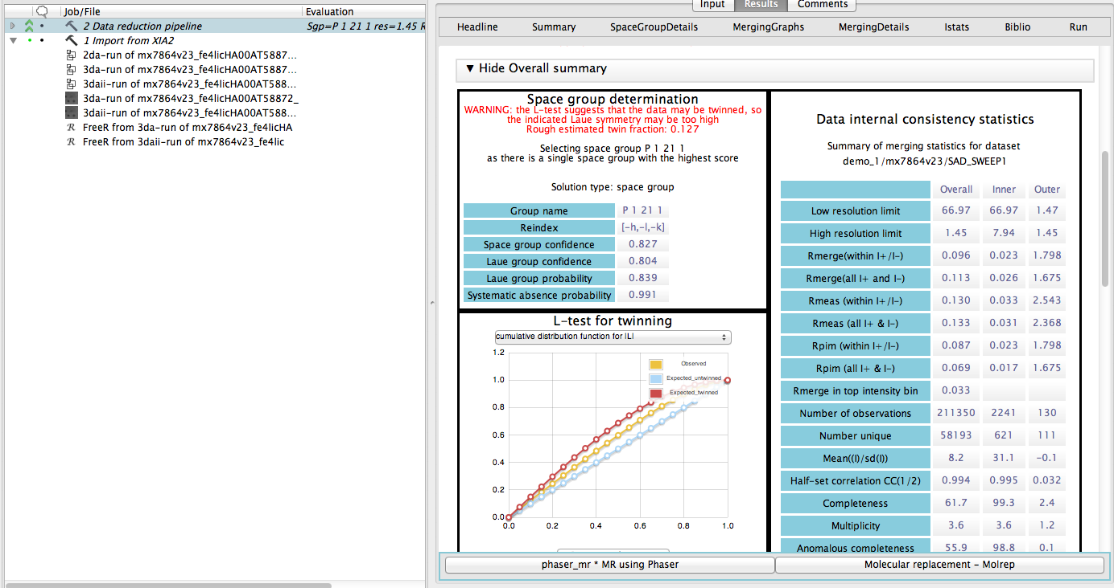
Project window

Slide 4
‘Mini’ MTZs – data types
Observed data (I+/- , Imean, F+/- or Fmean)
Phases (HL coeffs or Phi/FOM)
Map coefficients
Free _x0018_R sets

Slide 5
The database
One database per user (not per project) but ..
Each project has a directory containing all files
Uses SQLlite (upgradable)
Can be accessed by multiple users

Slide 6
New features
Easy to export/import a project to copy work between machines/users
Mechanism to explicitly export a file
Works with Coot to save changes to database

Slide 7
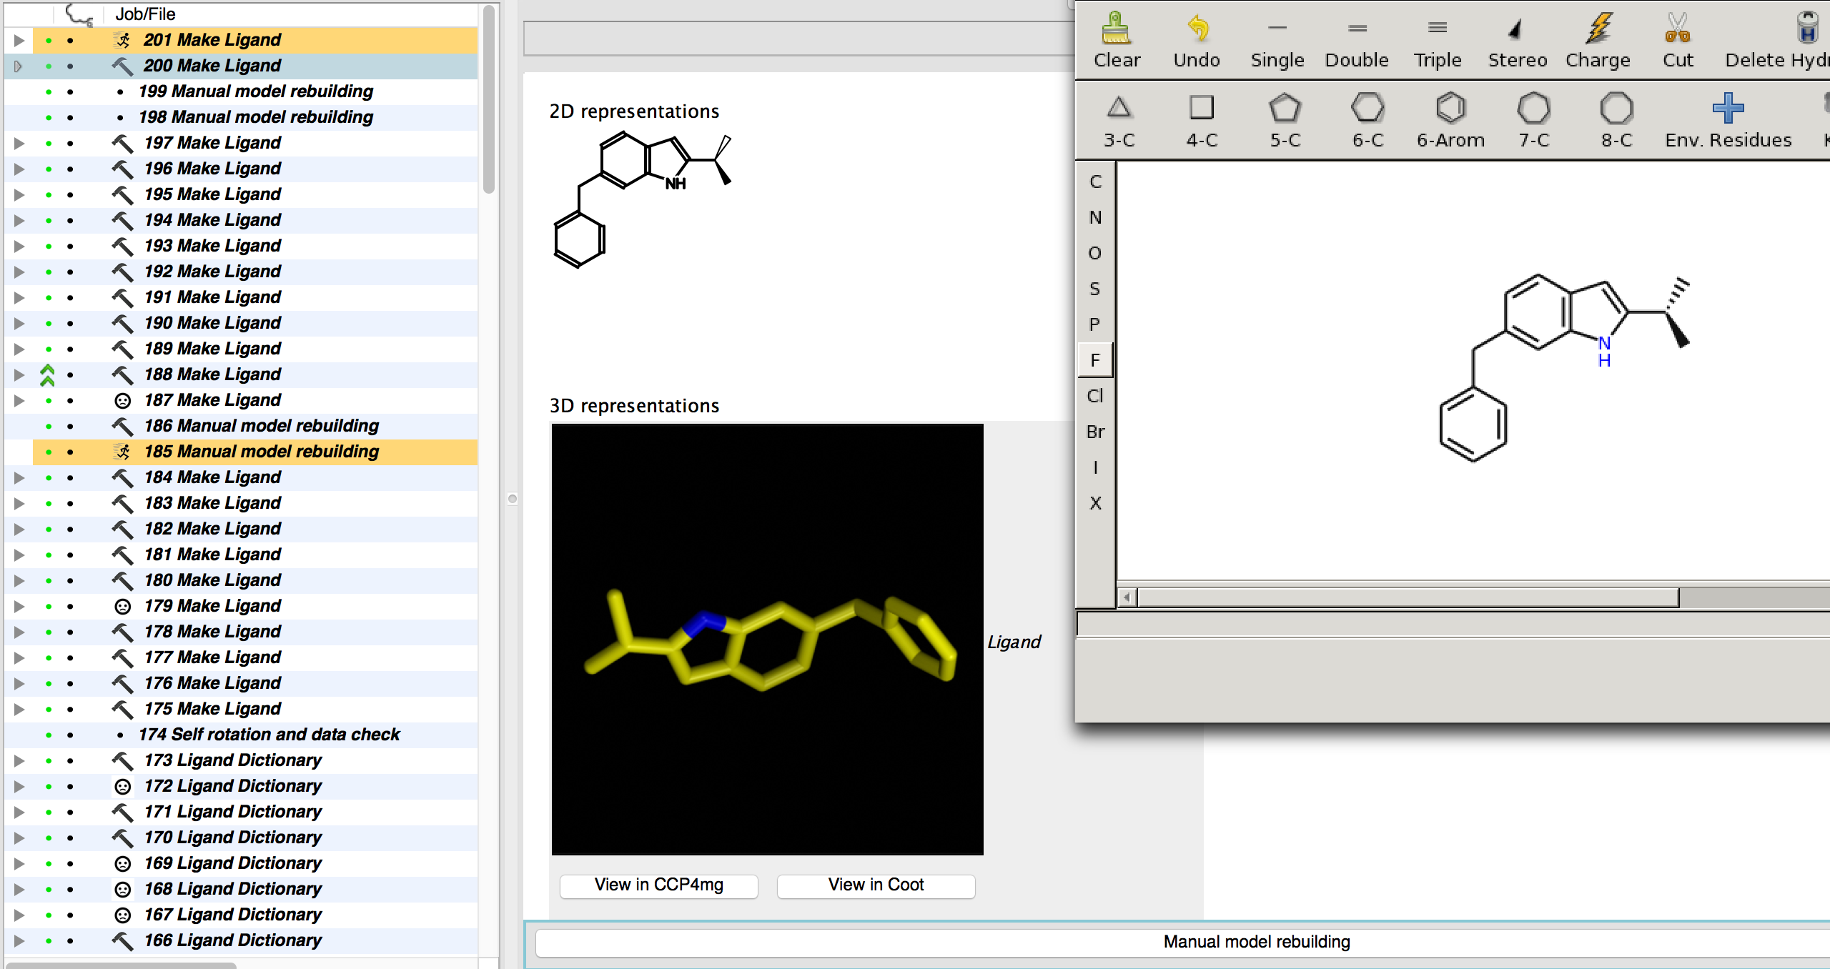
Interface to Lidia-Acedrg

Slide 8
Programming a new task
Is easy (especially if you know Python)
Documentation and examples
Requires programmer to write..
  ‘Def’ file list of parameters
Script to run the program(s)
Definition of the GUI
Definition of the report

Slide 9
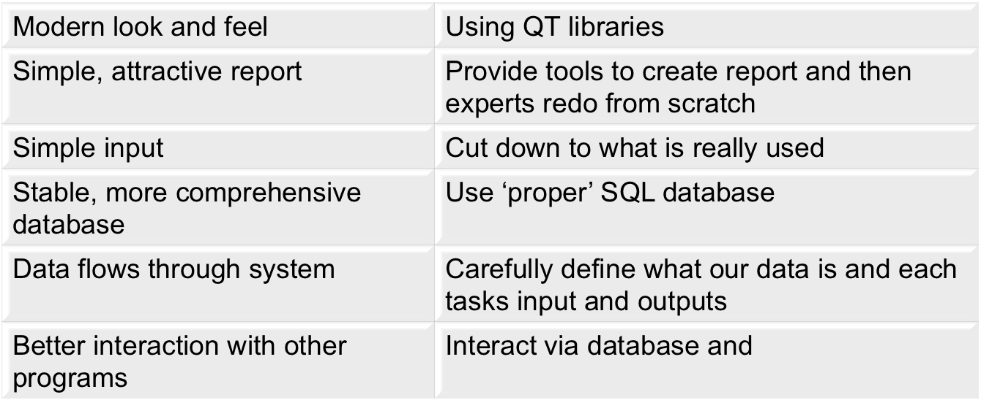
Some improvements over i1

Slide 10

Acknowledgments
Martin Noble
Kevin Cowtan, Phil Evans, Stuart McNicholas
Jon Agirre
Rob Nichols, Raj Pannu, Pavol Skubak, Andrey Lebedev, Martin Winn
The CCP4 team at Rutherford
Keith Wilson, Eleanor Dodson, Johan Turkenburg

Slide 11
Interested in testing..
liz.potterton@york.ac.uk

Slide 12
Customisation
User can implement new functionality in CCP4i2
Workflows – repeat a series of jobs
Task parameters and patches – customise individual jobs
Custom tasks – run a non-supported program
Import job – import results from a non-supported program(in progress)

Slide 13
Customisations - Further Features?
Import job – to be done
Workflows – enable some variable parameters
Task parameters – applying to one or more jobs in a pipeline or workflow
Workflows and Custom tasks – auto-generate basic code

Slide 14
Uses for import/export project
Creates XML version of the SQL database and compresses necessary data files. On import recreates same directory structure.
Support syncing work on different machines
Enable sending specific job(s) to colleague
A necessary component for running jobs remotely
Upload to a laboratory database

