Slide 1
CcpNmr Screening Report
19F_Pipeline (Project: ScreenIntroTutorial_completed)
Operator: Vicky Higman
Pipeline Settings: • Peak Picking Thresholds: - Mode: Auto - ManualThresholdLimits: [-1.0, 1.0] • Propagate Peaks From References: - Propagate To: SG:Control - PeakList: Last - Snap Peaks: True - Max snap distance (ppm): 0.1 • Copy PeakLists: - Origin SpectrumGroup: SG:Control - Control SpectrumGroup: N/A - Target SpectrumGroup: SG:Target - Displacer SpectrumGroup: SG:Displacer - Destination PeakList: Last - Peak Properties: Snap_To_Extremum - Refit Peaks: False - Skip Below Merit: 0.5 - rereferenceSpectra: Optimise With Local Alignments - Optimise With Local Alignments: True • Setup Screening dataset: - Run Name: 19F_Pipeline - Origin SpectrumGroup: SG:Control - Control SpectrumGroup: SG:Control - Target SpectrumGroup: SG:Target - Displacer SpectrumGroup: SG:Displacer - Matching Engine: Annotation Match - Experiment Type: 19F - Use Substance referenceSpectra: True - AutoScale Control-Target Spectra: False
Date/Time: 14/03/25 14-04-11
CcpNmr Version: 3.3.1
Hit Analysis Calculation Settings: • Calculation Mode: Height • Calculation Engine: Absolute Relative Change • Displacement Engine: Displacement Fraction • Total Score Engine: Sum • Relative S/N Engine: Mean • Scale Delta Score: No
Data Paths: - Control: /Users/vad5/Documents/Tutorials/data/3.1onwards/Screening/CcpnScreeningIntroTutorial/data - Target: /Users/vad5/Documents/Tutorials/data/3.1onwards/Screening/CcpnScreeningIntroTutorial/data - Displacer: /Users/vad5/Documents/Tutorials/data/3.1onwards/Screening/CcpnScreeningIntroTutorial/data

Slide 2
Substances Summary
Index | Sample Name | Substance Name | Binding Score | Displacement Score | Matching Score | Control S/N | Flag
1 | Target_7 | C705 | 0.3 | 0.88 | 5 | 14.44 | None
2 | Target_7 | C701 | 0.3 | 0.68 | 5 | 12.16 | None
3 | Target_8 | C8015 | 0.3 | 0.66 | 5 | 14.33 | None
4 | Target_10 | C10011 | 0.29 | 0.98 | 5 | 12.66 | None
5 | Target_6 | C6020 | 0.29 | 0.9 | 5 | 13.12 | None
6 | Target_5 | C5012 | 0.29 | 0.72 | 5 | 12.78 | None
7 | Target_10 | C10010 | 0.29 | 0.91 | 5 | 11.52 | None
8 | Target_4 | C405 | 0.29 | 0.68 | 5 | 12.47 | None
9 | Target_9 | C902 | 0.29 | 0.7 | 5 | 15.77 | None
10 | Target_9 | C906 | 0.29 | 0.68 | 5 | 16.3 | None

Slide 3
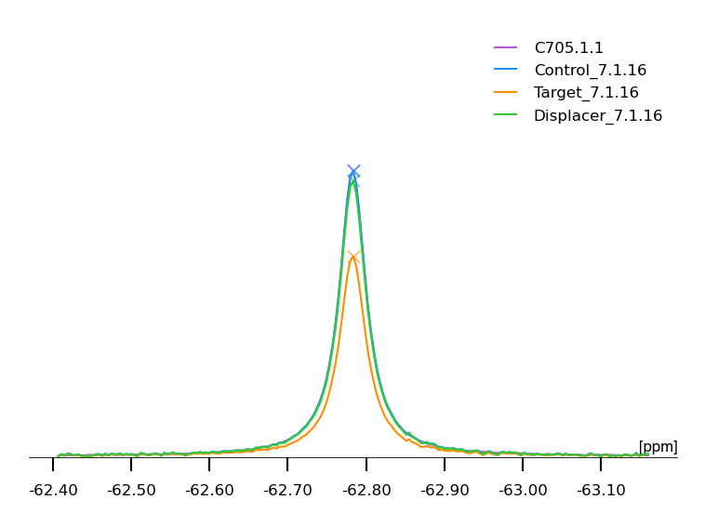
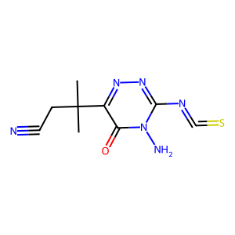
C705 (Target_7)
1) Binding Score: 0.3 -- Displacement Score: 0.88 -- Matching Score: 5
Reference Peak Pid | PK:C705.1.1
Binding Score | 0.3
Matching Score | 5
Displacement Score | 0.88
Control S/N | 14.44
Reference Position (ppm) | -62.783
Label
Comment
1

Slide 4
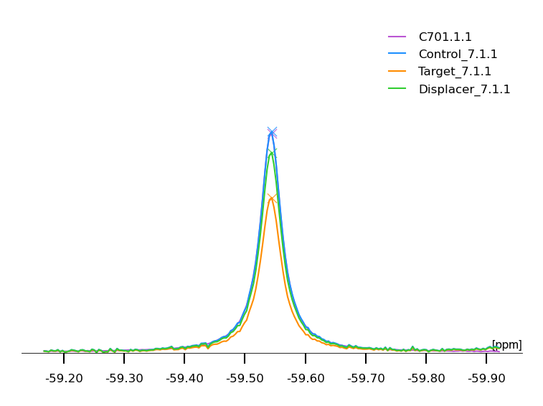
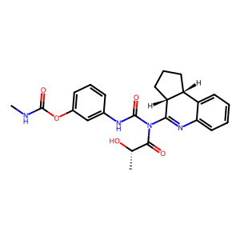
C701 (Target_7)
2) Binding Score: 0.3 -- Displacement Score: 0.68 -- Matching Score: 5
Reference Peak Pid | PK:C701.1.1
Binding Score | 0.3
Matching Score | 5
Displacement Score | 0.68
Control S/N | 12.16
Reference Position (ppm) | -59.544
Label
Comment
2

Slide 5
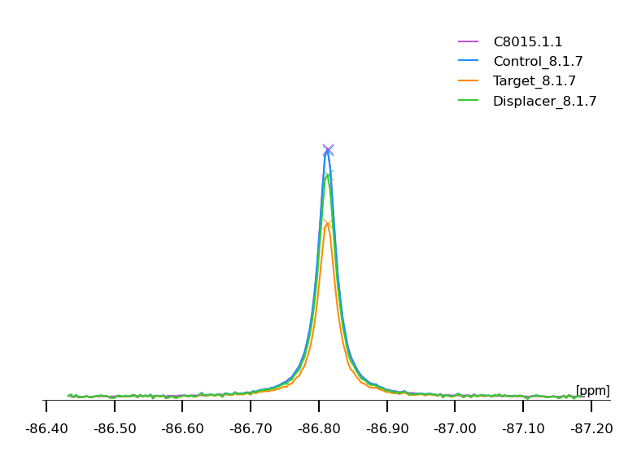
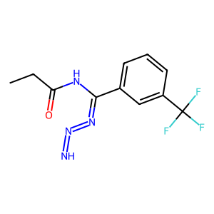
C8015 (Target_8)
3) Binding Score: 0.3 -- Displacement Score: 0.66 -- Matching Score: 5
Reference Peak Pid | PK:C8015.1.1
Binding Score | 0.3
Matching Score | 5
Displacement Score | 0.66
Control S/N | 14.33
Reference Position (ppm) | -86.813
Label
Comment
3

Slide 6
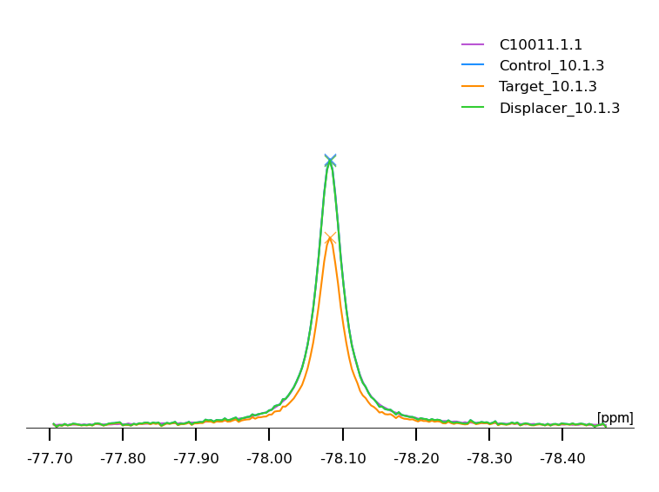
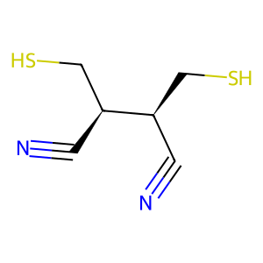
C10011 (Target_10)
4) Binding Score: 0.29 -- Displacement Score: 0.98 -- Matching Score: 5
Reference Peak Pid | PK:C10011.1.1
Binding Score | 0.29
Matching Score | 5
Displacement Score | 0.98
Control S/N | 12.66
Reference Position (ppm) | -78.082
Label
Comment
4

Slide 7
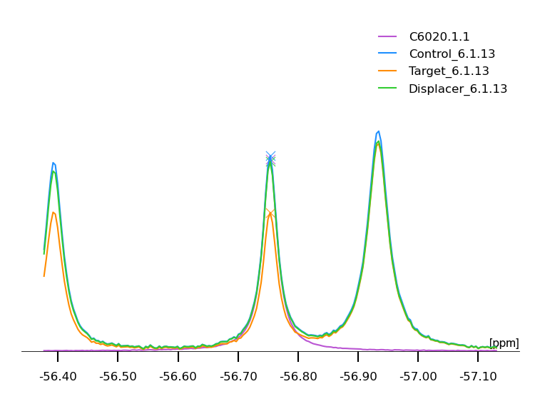
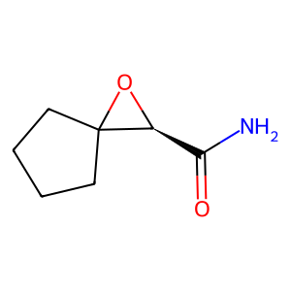
C6020 (Target_6)
5) Binding Score: 0.29 -- Displacement Score: 0.9 -- Matching Score: 5
Reference Peak Pid | PK:C6020.1.1
Binding Score | 0.29
Matching Score | 5
Displacement Score | 0.9
Control S/N | 13.12
Reference Position (ppm) | -56.753
Label
Comment
5

Slide 8
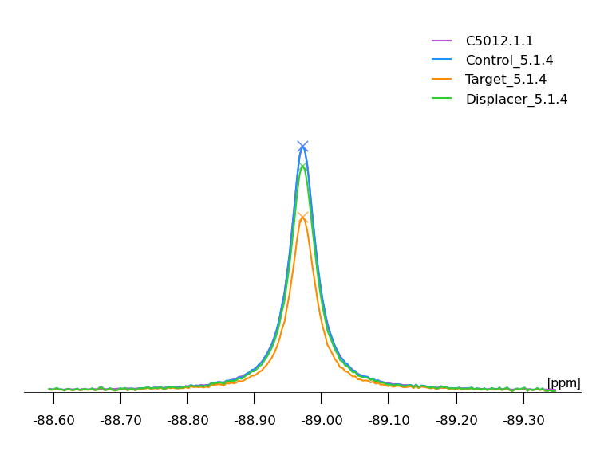
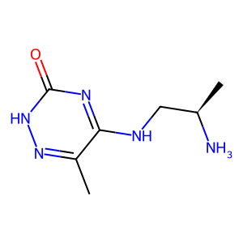
C5012 (Target_5)
6) Binding Score: 0.29 -- Displacement Score: 0.72 -- Matching Score: 5
Reference Peak Pid | PK:C5012.1.1
Binding Score | 0.29
Matching Score | 5
Displacement Score | 0.72
Control S/N | 12.78
Reference Position (ppm) | -88.971
Label
Comment
6

Slide 9
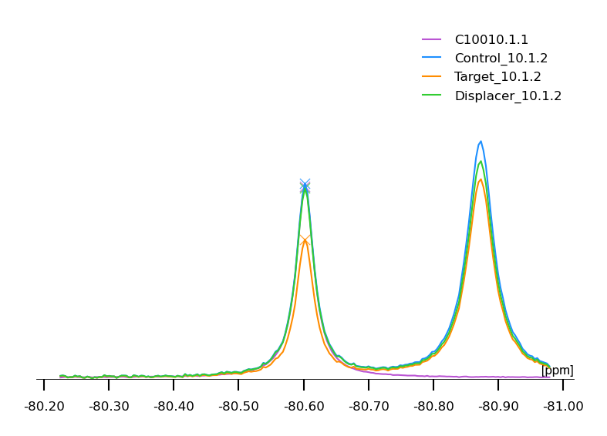
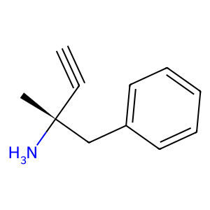
C10010 (Target_10)
7) Binding Score: 0.29 -- Displacement Score: 0.91 -- Matching Score: 5
Reference Peak Pid | PK:C10010.1.1
Binding Score | 0.29
Matching Score | 5
Displacement Score | 0.91
Control S/N | 11.52
Reference Position (ppm) | -80.602
Label
Comment
7

Slide 10
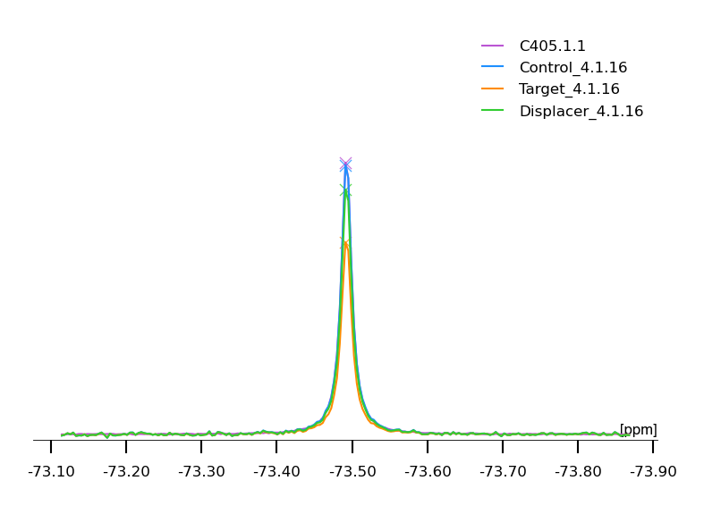
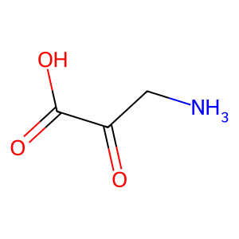
C405 (Target_4)
8) Binding Score: 0.29 -- Displacement Score: 0.68 -- Matching Score: 5
Reference Peak Pid | PK:C405.1.1
Binding Score | 0.29
Matching Score | 5
Displacement Score | 0.68
Control S/N | 12.47
Reference Position (ppm) | -73.491
Label
Comment
8

Slide 11
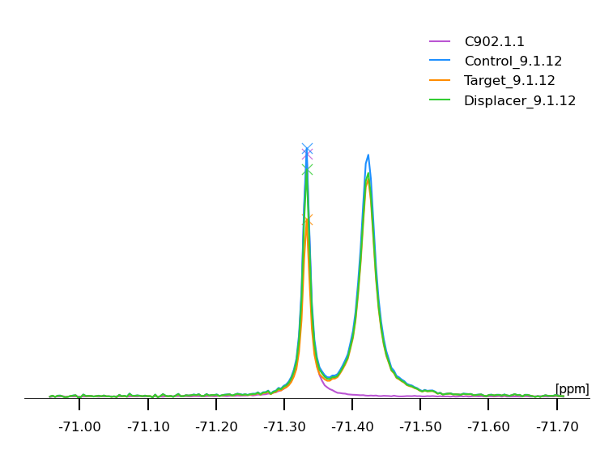
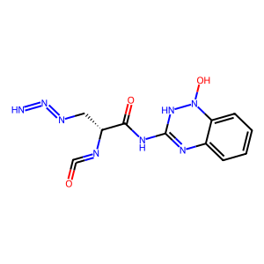
C902 (Target_9)
9) Binding Score: 0.29 -- Displacement Score: 0.7 -- Matching Score: 5
Reference Peak Pid | PK:C902.1.1
Binding Score | 0.29
Matching Score | 5
Displacement Score | 0.7
Control S/N | 15.77
Reference Position (ppm) | -71.333
Label
Comment
9

Slide 12
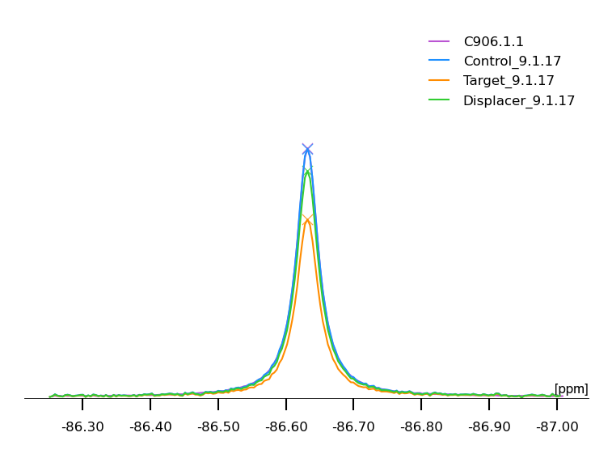
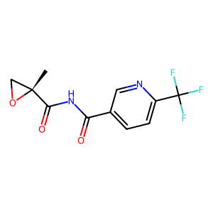
C906 (Target_9)
10) Binding Score: 0.29 -- Displacement Score: 0.68 -- Matching Score: 5
Reference Peak Pid | PK:C906.1.1
Binding Score | 0.29
Matching Score | 5
Displacement Score | 0.68
Control S/N | 16.3
Reference Position (ppm) | -86.632
Label
Comment
10

