Slide 1
Profiling com Perf, GCC e Valgrind
Gianni Rossi
Feat. Rodrigo Strauss

Slide 2
Agenda
O que vamos medir?
Perf
GCC / PGO
Valgrind
Kcahcegrind

Slide 3
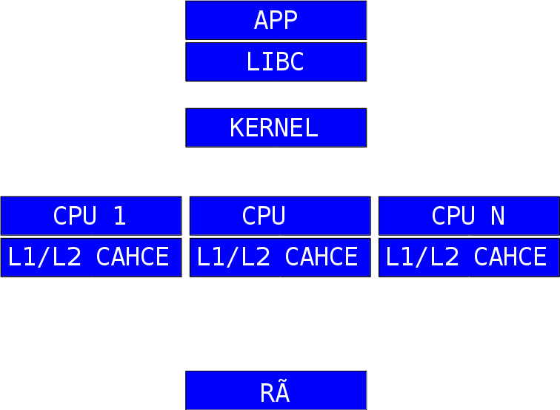



O que vamos medir?
1 Contadores de
Software
2 Contadores de
Software
3 Contadores de
Hardware
4 Cache Miss
5 Page Fault

Slide 4
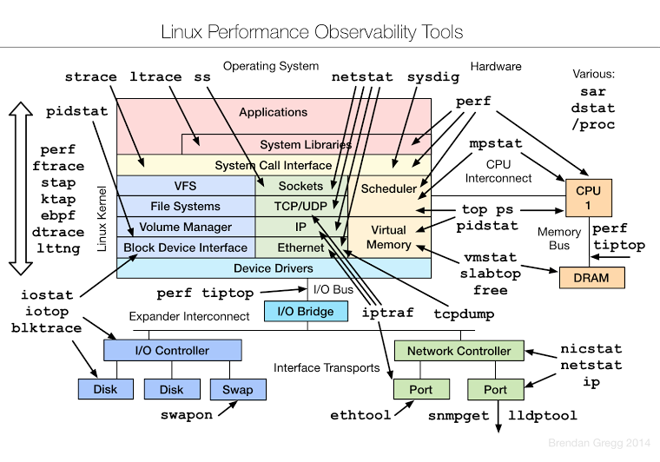

Slide 5
Google Test
class Config : public TPM {};
TEST_F(Config, SetConfig_Invalid) {
ASSERT_EQ(Set_Config("file_that_doesnt_exists.tpm"), rsError);
}
TEST_F(Config, SetConfig_Valid) {
createConfigFile();
ASSERT_EQ(Set_Config(configFileName), rsOK);
}

Slide 6
Google Test
Running main() from gtest_main.cc
[==========] Running 3 tests from 1 test case.
[----------] Global test environment set-up.
[----------] 3 tests from Config
[ RUN ] Config.SetConfig_Invalid
[ OK ] Config.SetConfig_Invalid (1 ms)
[ RUN ] Config.SetConfig_Valid
../service/tpm-p2-link/tests/config.cpp:19: Failure
Value of: rsOK
Actual: 0
Expected: Set_Config(configFileName)
Which is: 101
[ FAILED ] Config.SetConfig_Valid (1 ms)

Slide 7
[ RUN ] Config.ConnectDB
unknown file: Failure
C++ exception with description "FATAL: database "logprod_p2" does not exist
" thrown in the test body.
[ FAILED ] Config.ConnectDB (2 ms)
[----------] 3 tests from Config (4 ms total)
[----------] Global test environment tear-down
[==========] 3 tests from 1 test case ran. (4 ms total)
[ PASSED ] 1 test.
[ FAILED ] 2 tests, listed below:
[ FAILED ] Config.SetConfig_Valid
[ FAILED ] Config.ConnectDB
2 FAILED TESTS

Slide 8
test_detail.xml
<testsuites tests="3" failures="2" disabled="0" errors="0" timestamp="2015-03-27T17:40:31" time="0.004" name="AllTests">
<testsuite name="Config" tests="3" failures="2" disabled="0" errors="0" time="0.004">
<testcase name="SetConfig_Invalid" status="run" time="0.001" classname="Config" Get_Last_Error="No such file or directory" />
<testcase name="SetConfig_Valid" status="run" time="0.001" classname="Config" Get_Last_Error="FATAL: database &quot;logprod_p2&quot; does not exist&#x0A;">
<failure message="../service/tpm-p2-link/tests/config.cpp:19&#x0A;Value of: rsOK&#x0A; Actual: 0&#x0A;Expected: Set_Config(configFileName)&#x0A;Which is: 101" type=""><![CDATA[../service/tpm-p2-link/tests/config.cpp:19
Value of: rsOK
Actual: 0
Expected: Set_Config(configFileName)
Which is: 101]]></failure>
</testcase>
<testcase name="ConnectDB" status="run" time="0.002" classname="Config" ConnectDB="host=localhost dbname=logprod_p2 user=postgres password=&apos;&apos; client_encoding=UTF-8 application_name=tpmtests" Get_Last_Error="FATAL: database &quot;logprod_p2&quot; does not exist&#x0A;">
<failure message="unknown file&#x0A;C++ exception with description &quot;FATAL: database &quot;logprod_p2&quot; does not exist&#x0A;&quot; thrown in the test body." type=""><![CDATA[unknown file
C++ exception with description "FATAL: database "logprod_p2" does not exist
" thrown in the test body.]]></failure>
</testcase>
</testsuite>
</testsuites>

Slide 9
Perf
Profiler para o Kernel do Linux >2.6
Abstraí o CPU (x86, ARM, etc.), em “Events”
Interface similar ao git:
  Todo linha de comando
  Sempre começa com 'perf' <comando>
  Cada comando tem suas opções e interface
  perf record ls /proc
  perf report

Slide 10
$ perf stat -B dd if=/dev/zero of=/dev/null count=1000000
1000000+0 records in
1000000+0 records out
512000000 bytes (512 MB) copied, 0.336377 s, 1.5 GB/s

Slide 11
336.151748 task-clock (msec) # 0.998 CPUs utilized
4 context-switches # 0.012 K/sec
2 cpu-migrations # 0.006 K/sec
60 page-faults # 0.178 K/sec
1,107,658,331 cycles # 3.295 GHz
279,896,073 stalled-cycles-frontend # 25.27%
102,366,275 stalled-cycles-backend # 9.24%
1,680,971,485 instructions # 1.52 insns/cycle
# 0.17 stalled cycles per insn
357,234,573 branches # 1062.718 M/sec 1,604,911 branch-misses # 0.45% of all branches
0.336902173 seconds time elapsed

Slide 12
$ perf record ls /proc
[ perf record: Woken up 1 times to write data ]
[ perf record: Captured and wrote 0.002 MB perf.data (~99 samples) ]
$ ls
total 1
4448 Mar 27 11:33 perf.data
$ perf report

Slide 13
# Samples: 8 of event 'cycles'
# Event count (approx.): 6141644
#
# Overhead Command Shared Object Symbol
55.06% ls libc-2.20.so [.] __strcoll_l
41.28% ls ld-2.20.so [.] _dl_new_object
3.54% ls [kernel.kallsyms] [k] flush_signal_handlers
0.12% ls [kernel.kallsyms] [k] intel_pmu_enable_all

Slide 14
“Events”
Perf, usando a instrumentação do Kernel, mede eventos de várias fontes.
Contadores dentro do kernel, como erros ou trocas de contexto, são [Software event]
PMU – Performance Monitoring Unit são [Hardware event]

Slide 15
cpu-cycles [Hardware event]
instructions [Hardware event]
cache-references [Hardware event]
cache-misses [Hardware event]
branch-instructions [Hardware event]
branch-misses [Hardware event]
stalled-cycles-frontend [Hardware event]
stalled-cycles-backend [Hardware event]
ref-cycles [Hardware event]

Slide 16
cpu-clock [Software event]
task-clock [Software event]
page-faults [Software event]
context-switches [Software event]
cpu-migrations [Software event]
Minor-faults [Software event]
major-faults [Software event]
alignment-faults [Software event]
emulation-faults [Software event]
dummy [Software event]

Slide 17
L1-dcache-loads [Hardware cache event]
L1-dcache-load-misses [Hardware cache event]
L1-dcache-stores [Hardware cache event]
L1-dcache-store-misses [Hardware cache event]
L1-dcache-prefetches [Hardware cache event]
L1-dcache-prefetch-misses [Hardware cache event]
L1-icache-loads [Hardware cache event]
L1-icache-load-misses [Hardware cache event]
LLC-loads [Hardware cache event]
LLC-load-misses [Hardware cache event]
LLC-stores [Hardware cache event]
LLC-store-misses [Hardware cache event]
LLC-prefetches [Hardware cache event]
LLC-prefetch-misses [Hardware cache event]

Slide 18
dTLB-loads [Hardware cache event]
dTLB-load-misses [Hardware cache event]
dTLB-stores [Hardware cache event]
dTLB-store-misses [Hardware cache event]
iTLB-loads [Hardware cache event]
iTLB-load-misses [Hardware cache event]
branch-loads [Hardware cache event]
branch-load-misses [Hardware cache event]
node-loads [Hardware cache event]
node-load-misses [Hardware cache event]
node-stores [Hardware cache event]
node-store-misses [Hardware cache event]
node-prefetches [Hardware cache event]
node-prefetch-misses [Hardware cache event]

Slide 19
branch-instructions [Kernel PMU event]
branch-misses [Kernel PMU event]
cache-misses [Kernel PMU event]
cache-references [Kernel PMU event]
cpu-cycles [Kernel PMU event]
instructions [Kernel PMU event]
mem-loads [Kernel PMU event]
uncore/clockticks/ [Kernel PMU event]
uncore/qhl_request_ioh_reads/ [Kernel PMU event]
uncore/qhl_request_ioh_writes/ [Kernel PMU event]
uncore/qhl_request_local_reads/ [Kernel PMU event]
uncore/qhl_request_local_writes/ [Kernel PMU event]
uncore/qhl_request_remote_reads/ [Kernel PMU event]
uncore/qhl_request_remote_writes/ [Kernel PMU event]
uncore/qmc_normal_reads_any/ [Kernel PMU event]
uncore/qmc_writes_full_any/ [Kernel PMU event]

Slide 20
GCC / PGO
gprof – Profiler – Gera relatório de performance com contador e custo de chamadas.
PGO – Profile Guided Optimization – Gera informações para re-compilar os fontes com melhor de branch-prediction e hot/cold functions

Slide 21
GCC / gprof
$ gcc -pg fontes.c classes.cpp -o prog
$ ./prog
$ ls
classes.cpp fontes.c gmon.out prog
$ gprof prog gmon.out

Slide 22
GCC / gprof
Each sample counts as 0.01 seconds.
% cumulative self calls self total
33.86 15.52 15.52 1 15.52 15.52 func2
33.82 31.02 15.50 1 15.50 15.50 new_f
33.29 46.27 15.26 1 15.26 30.75 func1
0.07 46.30 0.03 main

Slide 23
GCC/ PGO
int calcula() __attribute__ ((hot));
int paga() __attribute__ ((cold));
#define likely(x) __builtin_expect(!!(x), 1)
#define unlikely(x) __builtin_expect(!!(x), 0)
if (likely(cond))
...

Slide 24
GCC / PGO
$ g++ -O3 -pg -fprofile-generate ...
//run my program's benchmark
$ g++ -O3 -fprofile-use ...

Slide 25
GCC / PGO
Firefox | Startup | Memory-mapped (KB)
stock | 2515ms | 49452
icegrind | 1919ms | 45344
static | 2321ms | 49616
static.icegrind | 1577ms | 37072
static.pgo | 1619ms | 38436

Slide 26
Valgrind
Memtool
Cachegrind
Callgrind
Icegrind
Outros...?
$ valgrind --tool=callgrind
./intelihub --data-path /tmp

Slide 27
Memtool
Mismatched free() / delete / delete []
at 0x4808290: operator delete(void*) (vg_replace_malloc.c:507)
by 0x58A603: std::_Sp_counted_ptr<char*, (__gnu_cxx::_Lock_policy)2>::_M_dispose() (shared_ptr_base.h:373)
by 0x520389: std::_Sp_counted_base<(__gnu_cxx::_Lock_policy)2>::_M_release() (shared_ptr_base.h:149)
by 0x51F9DC: std::__shared_count<(__gnu_cxx::_Lock_policy)2>::~__shared_count() (shared_ptr_base.h:666)

Slide 28
Memtool
HEAP SUMMARY:
in use at exit: 3,978,026 bytes in 80,867 blocks
total heap usage: 766,079 allocs, 685,212 frees, 370,733,748 bytes allocated
LEAK SUMMARY:
definitely lost: 0 bytes in 0 blocks
indirectly lost: 0 bytes in 0 blocks
possibly lost: 4,237 bytes in 102 blocks
still reachable: 3,973,789 bytes in 80,765 blocks
suppressed: 0 bytes in 0 blocks

Slide 29
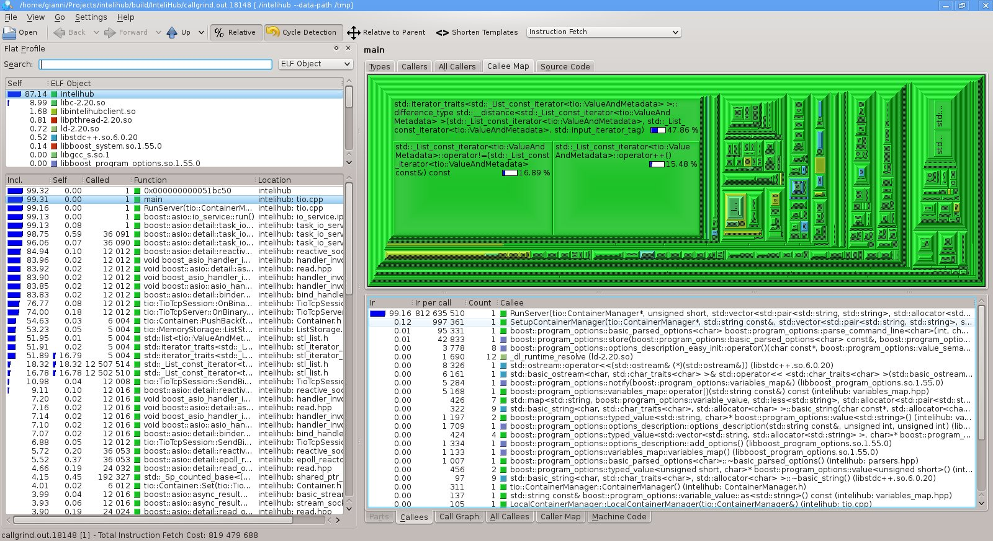
KCachegrind

Slide 30
Valgrind / KCachegrind em Ação
Com TIO Rodrigo Strauss
http://intelitrader.com.br

Slide 31
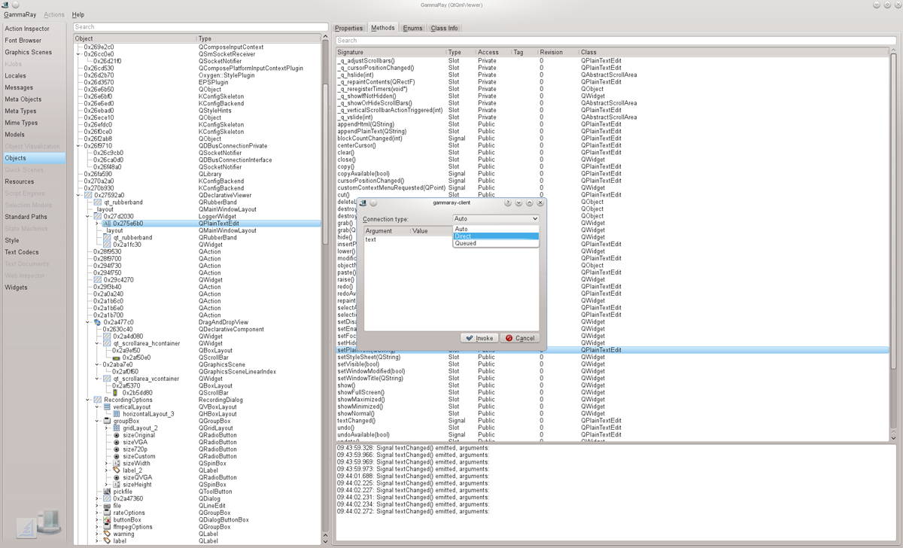
Gamma Ray

Slide 32
Vale pesquisar
http://code.google.com/p/gperftools/
http://hubicka.blogspot.com.br/
http://www.kdab.com/kdab-products/gammaray/

